Slide 1
Modification of GFS Land Surface Model Parameters to Mitigate the Near-Surface Cold and Wet Bias in the Midwest CONUS: Analysis of Parallel Test Results
04 September 2012
Fanglin Yang, Shrinivas Moorthi, Helin Wei, Glenn White, Geoff Manikin,, Mike Ek, John Derber and Bill Lapenta
NOAA/NWS/NCEP Environmental Modeling Center

Slide 2
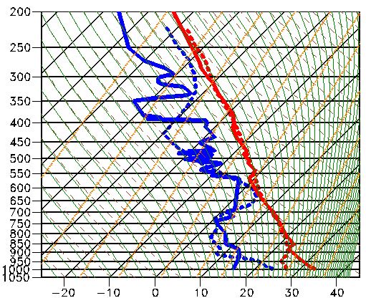
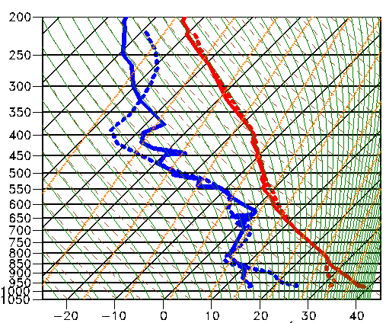
Problem: Customers Noted the GFS PBL was too Cold and Wet
Observed and simulated soundings valid 00 UTC 23 July 2012
Observed: Solid; GFS 24h Fcst: Dashed
Lincoln, Illinois (ILX)
Omaha, Nebraska (OAX)
∆T_{d}=+9°C
∆T=-7°C
∆T_{d}=+10°C
∆T=-8°C
The GFS 2m temperature and dew point forecasts valid in the late afternoon were too low and high, respectively

Slide 3
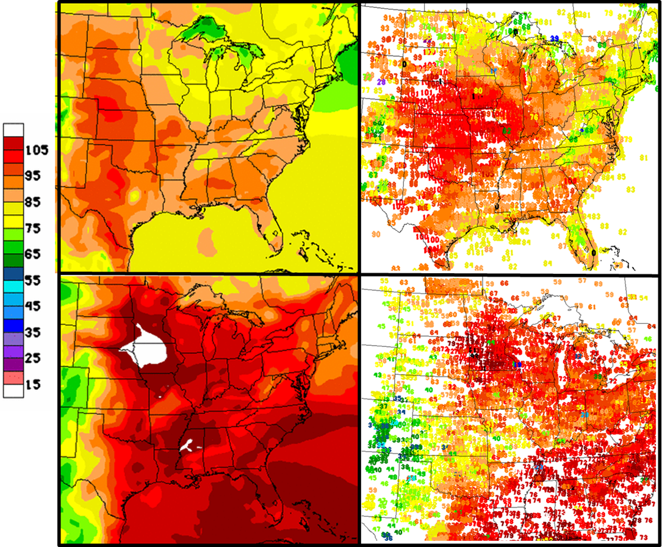
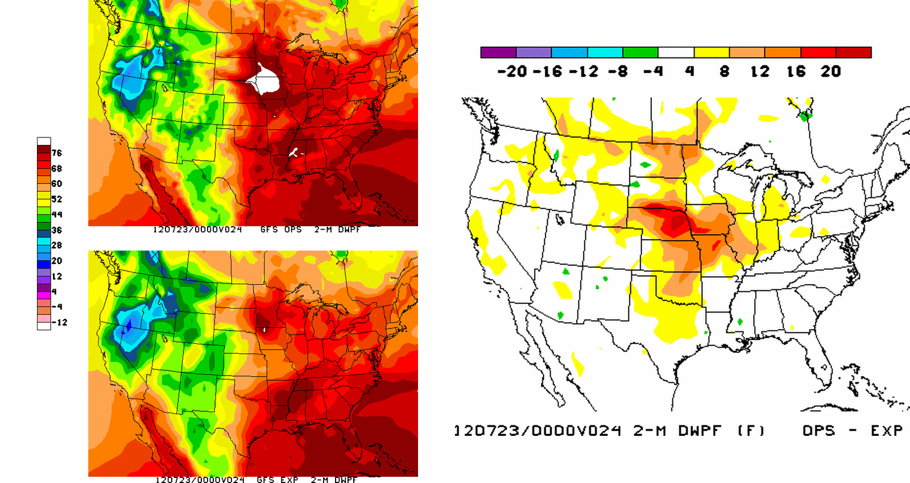
Spatial Distribution of Biases in 2-Meter
Temperature and Dew Point
2 Meter Temperature
GFS approximately 10-15 °F too cool in the late afternoon for the mid-west
GFS 24h Fcst
OBS
2 Meter Dew Point
GFS dewpoint approximately 15-20 °F too high in the late afternoon for the mid-west
GFS 24h Fcst
OBS

Slide 4
Sequence of Events, Actions and Results
24 May: EMC Model Evaluation Group (MEG) identified potential cold/wet bias in GFS over the Central US
14 June: MDL and EMC received complaints from field that the GFS 2m temperature and dew point forecasts valid in the late afternoon were too low and high, respectively
19 June: EMC verified field observations and disassociated problem from the hybrid GDAS upgrade implemented 22 May
21 June: EMC isolated the problem to land surface model:
Look up table for vegetation canopy resistance and root zone depth used in GFS was the culprit
Implemented erroneously in the May 2011 upgrade
Change allowed too much evaporation through vegetation types in central CONUS
24 June: EMC conducted limited tests using original LSM look up table and found positive impact in poor performing areas
29 June: EMC notified users of suspect cause and plans to correct through MDL
June-August: EMC Conducted a retrospective parallels:
June-August 2012 (CONUS warm season)
Jan-Feb 2012 (CONUS cold season)
CCS Availability limited due to SREF testing and service interruptions in August
Change of LSM table has expected impacts on improving warm season PBL structure and precipitation
No impact on CONUS PBL structure and precipitation during cold season
August 25: NCEP Director approves fix to be implemented 5 Sept.

Slide 5
RSMTBL =(/300.0, 175.0, 175.0, 300.0, 300.0, 70.0, & 45.0, 225.0, 225.0, 225.0, 400.0, 45.0, & 150.0, 0.0, 0.0, 0.0, 0.0, 0.0, & 0.0, 0.0, 0.0, 0.0, 0.0, 0.0, & 0.0, 0.0, 0.0, 0.0, 0.0, 0.0/) NROOT_DATA =(/4,4,4,4,4,4,3,3,3,2,3,3,2,0,0, & 0,0,0,0,0,0,0,0,0,0,0,0,0,0,0/)
Land Surface Model Look-up Table
Minimum Canopy Resistance (RSMIN) and Root Depth Number (NROOT) were changed in May-2011 Implementation leading to increased evapotranspiration over some regions depending on vegetation type
Operational GFS
Prior to May 2011 implementation
RSMTBL =(/300.0, 175.0, 175.0, 300.0, 70.0, 70.0,
& 20.0, 70.0, 70.0, 70.0, 70.0, 20.0,
& 70.0, 0.0, 0.0, 0.0, 0.0, 0.0,
& 0.0, 0.0, 0.0, 0.0, 0.0, 0.0,
& 0.0, 0.0, 0.0, 0.0, 0.0, 0.0/)
NROOT_DATA =(/4,4,4,4,4,4,4,4,4,4,4,4,4,0,0,
& 0,0,0,0,0,0,0,0,0,0,0,0,0,0,0/)
Parameter differences in table highlighted in RED
Lower canopy resistance (i.e. lower values in table) and deeper root zone depth (i.e., larger values in table) will allow more evapotranspiration to occur for those vegetation types
Modified table is used in CFS

Slide 6
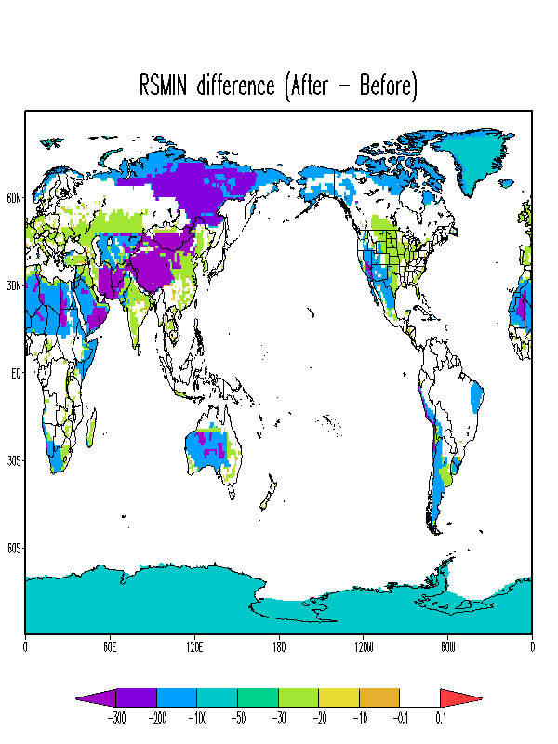
Changes in Canopy Resistance
Mixed forest: Reduced from 300 to 70 units
Canopy Resistance (Operational – Corrected)
Cropland: Resistance Reduced from 45 to 20 units
Bare soil: Reduced from 400 to 70 units

Slide 7
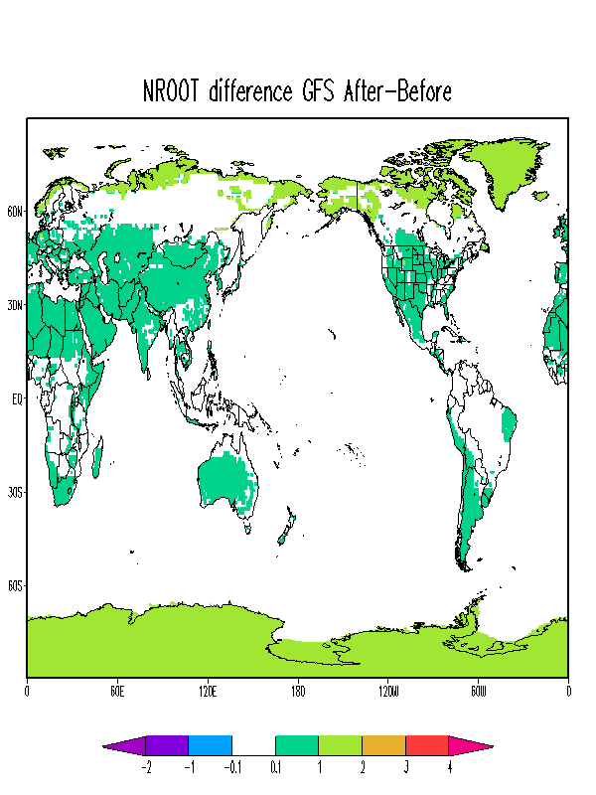
Changes in Root Zone Depth
Root Zone Depth Layer (Operational – Corrected)
Positive values indicate shallower rooting depth

Slide 8
Numerical Experiments
Use the LSM table employed in the operational GFS before May 2011 implementation
Warm season experiment prt2mexp:
Started from the operational GFS 20120531 18Z initial conditions
Results presented for the period of Jun 14 – Aug 22, 2012
Cool season experiment prt2mwin:
Started from the prd12q3s hybrid-enkf parallel 20120101 06Z initial conditions
Results presented for the period of Jan 15 – March 01, 2012

Slide 9
Summary of Results
Warm Season Experiment (prt2mexp)
Reduced late-afternoon surface cold bias and moisture bias over the Northern and Southern Great Plains found in the operational GFS
Significantly improved CONUS precipitation skill scores especially for light amounts
No significant change to:
Hurricane track and intensity
Standard forecast skill scores such as 500-hPa height AC and tropical wind RMSE
Slightly worsened the mid-day warm bias over the SE US
Cool Season Experiment (prt2mexp)
No significant change in:
CONUS meteorological fields
Standard global forecast skill metrics
Detailed verification at Fanglin’s websites
http://www.emc.ncep.noaa.gov/gmb/wx24fy/para/t2mbias/exp2012/
http://www.emc.ncep.noaa.gov/gmb/wx24fy/para/t2mbias/exp2012w/

Slide 10
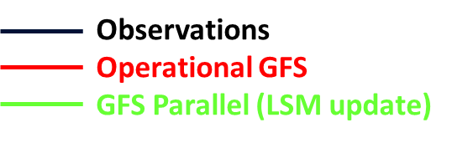
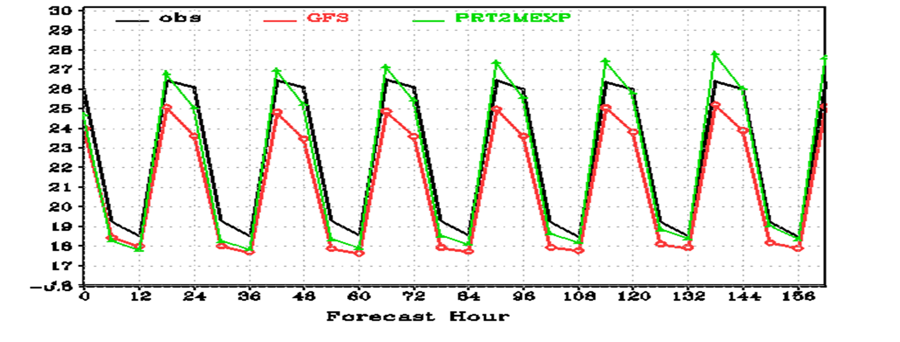
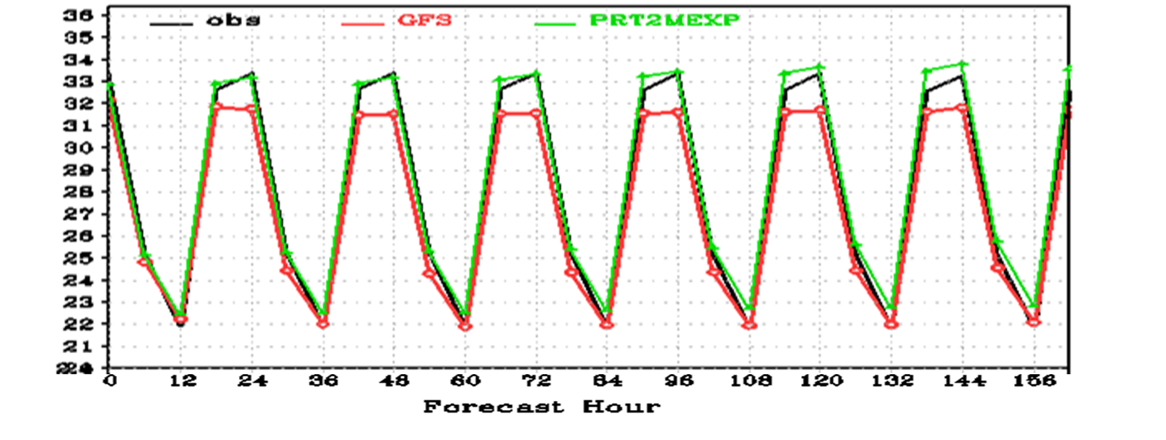
14 June to 22 August 2012 (00Z Cycles Only) CONUS Northern and Southern Great Plains regions
Time Averaged 2 Meter Temperature (°C)
Northern Great Plains
CONUS East
CONUS West
Southern Great Plains
10

Slide 11
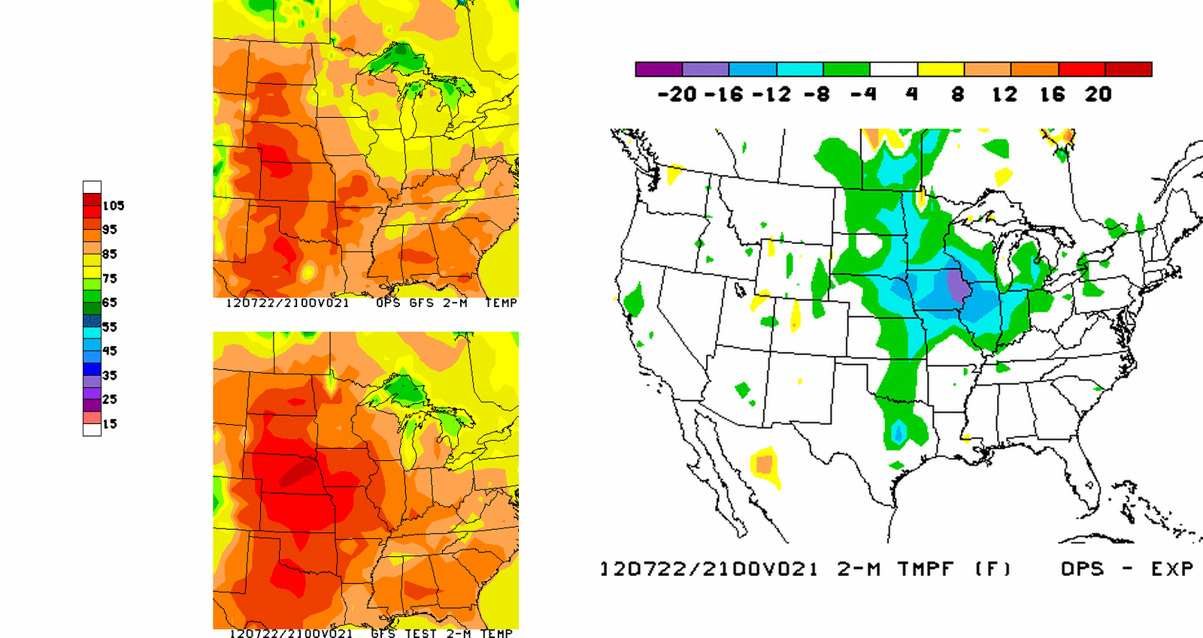
Example of Correction Obtained in GFS Parallel
21h GFS 2-m Temperature Forecasts (°F) Valid 21UTC 22 July 2012
Operational GFS
LSM GFS Parallel
GFS approximately 10-15 °F too cool in the late afternoon for the mid-west (see slide #3 for OBS)
Correction to LSM alleviates cold bias (see slide #3 for OBS)
Corrected LSM in GFS found to mitigate 4 to 16 °F cold bias in operations and compares favorably with observations
Difference
Ops – Para

Slide 12
Example of Correction Obtained in GFS Parallel
24h GFS 2-m Dewpoint (°F) Forecasts Valid 00 UTC 23 July 2012
Operational GFS
LSM GFS Parallel
GFS dewpoint approximately 15 °F too high in the late afternoon for the mid-west (see slide #3 for OBS)
Correction to LSM alleviates moist bias (see slide #3 for OBS)
Corrected LSM in the GFS found to reduce dewpoint by 8 to 16 °F and compares more favorably with observations
Difference
Ops – Para

Slide 13
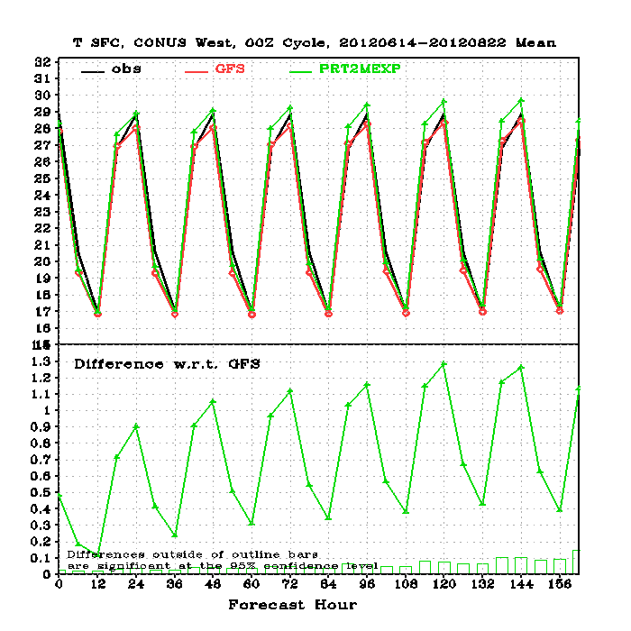
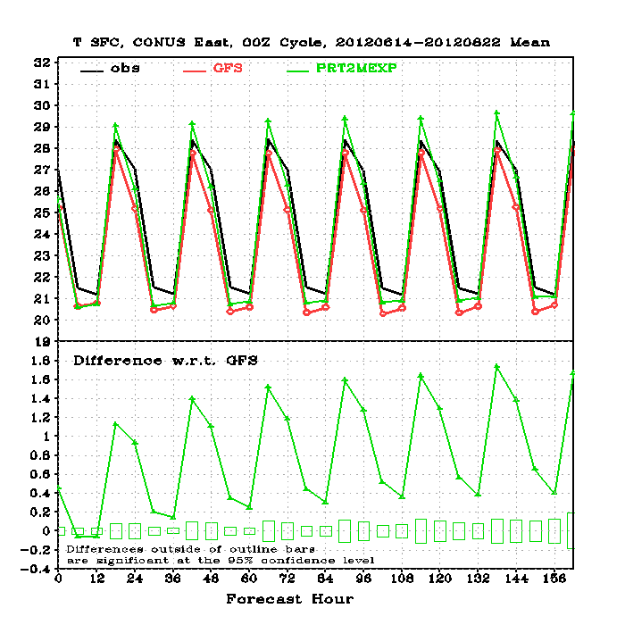
14 June to 22 August 2012 (00Z Cycles Only) CONUS East and West regions
Time Averaged 2 Meter Temperature (°C)
CONUS East
CONUS West
13

Slide 14
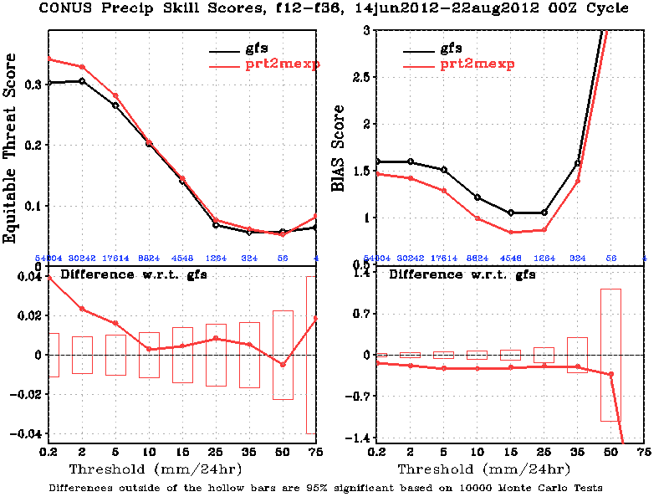
14 June to 22 August 2012 (00Z Cycles Only)
Quantitative Precipitation Forecasts (CONUS)
Day 1: 24h Period ending at 36h forecast
14

Slide 15
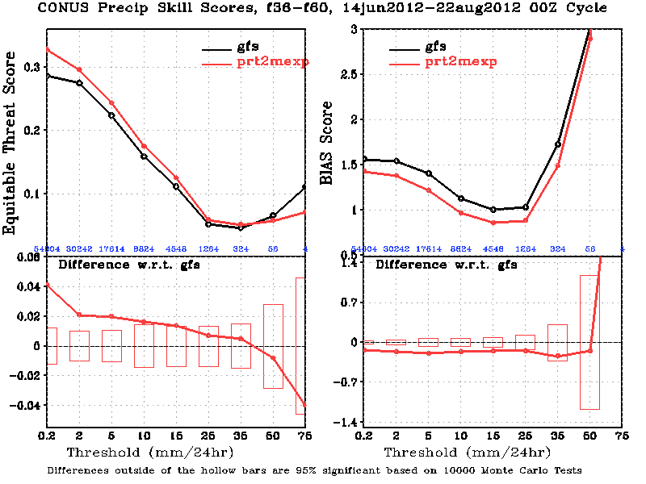
14 June to 22 August 2012 (00Z Cycles Only)
Quantitative Precipitation Forecasts (CONUS)
Day-2: 24h Period ending at 60h forecast
15

Slide 16
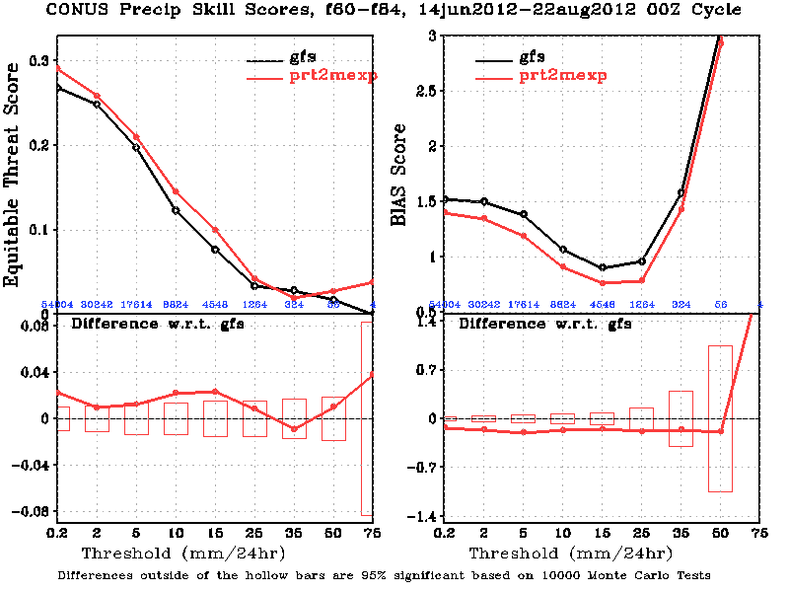
14 June to 22 August 2012 (00Z Cycles Only)
Quantitative Precipitation Forecasts (CONUS)
Day-3: 24h Period ending at 84h forecast
16

Slide 17
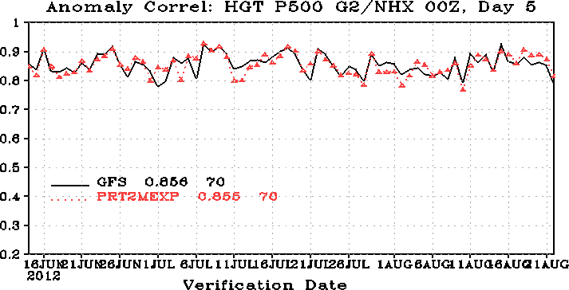
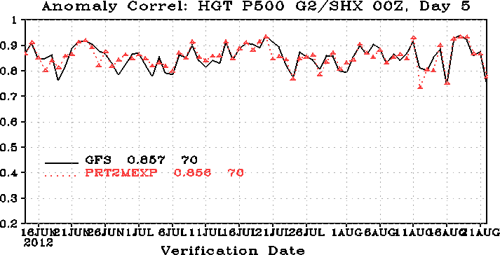


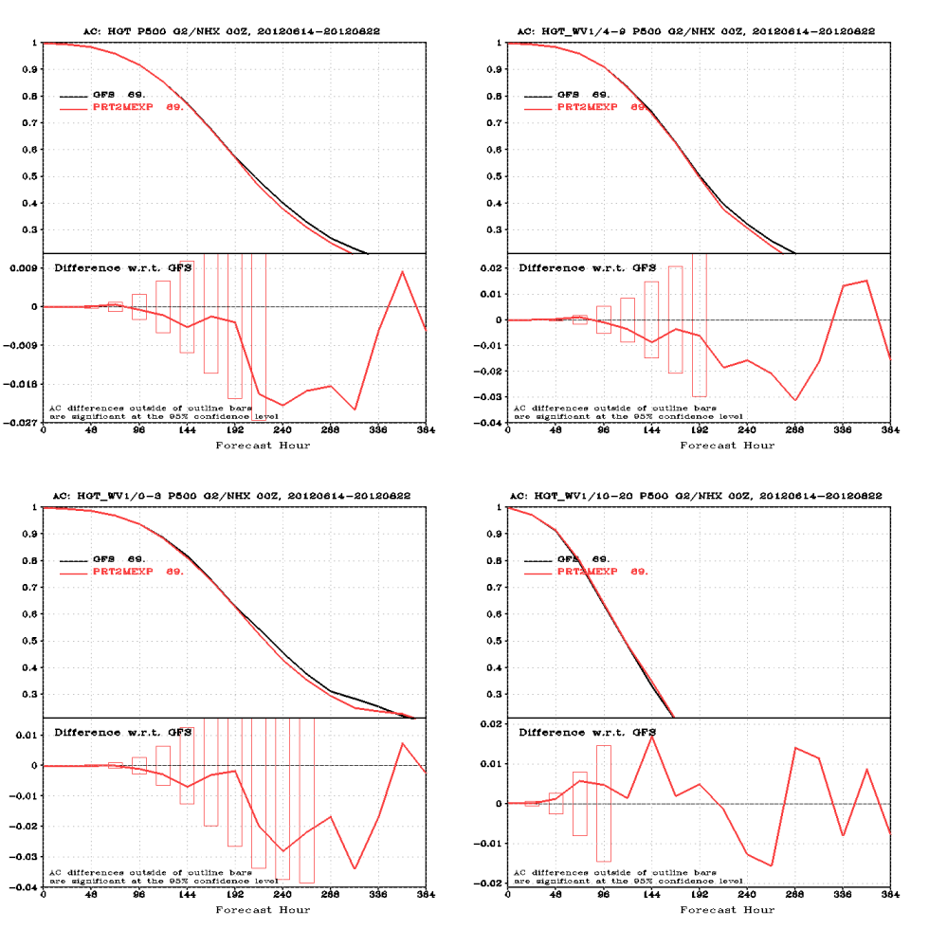
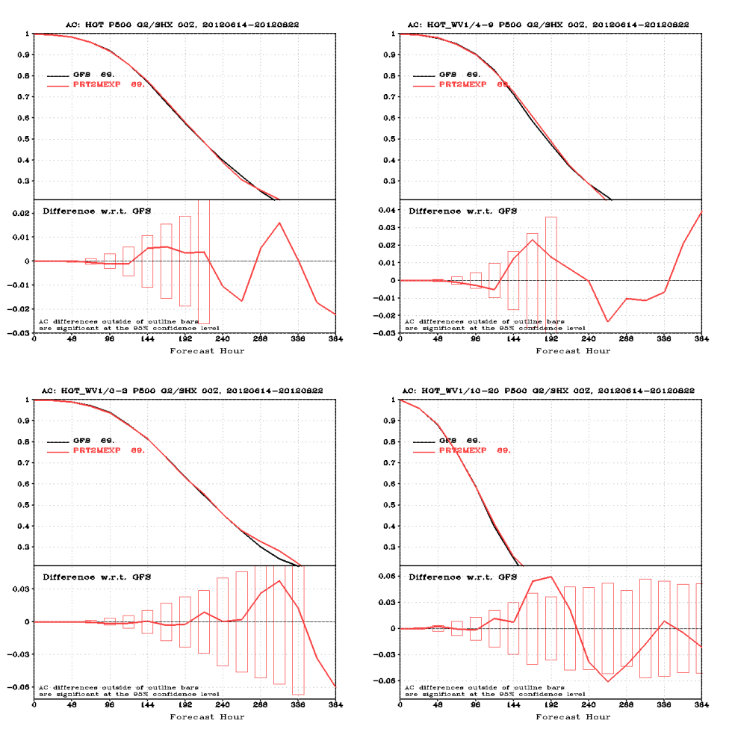

500 hPa Anomaly Correlation
14 June to 22 August 2012 (00Z Cycles Only)
Northern Hemisphere
Southern Hemisphere
Operational
LSM Para
17

Slide 18
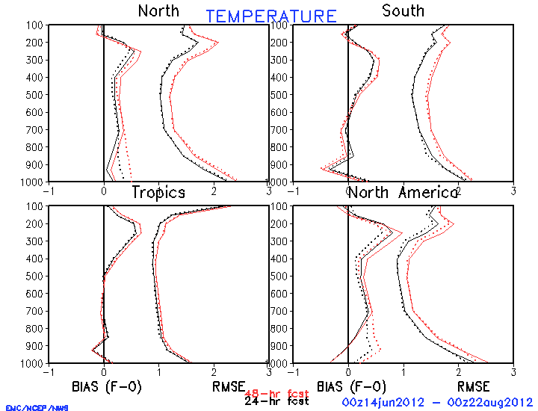
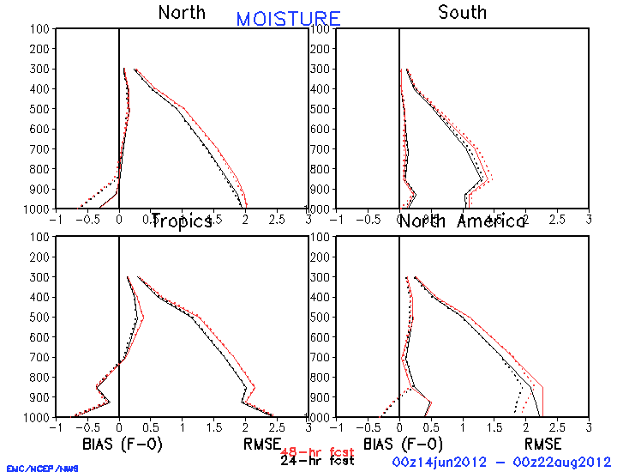
Large ScaleTemperature and Moisture Verification 14 June to 22 August 2012 (00Z Cycles Only) 24 and 48h Forecasts for the Northern Hemisphere and North America
Northern Hemisphere Temperature (°C)
North America Temperature (°C)
Pressure (hPa)
Bias
RMSE
Pressure (hPa)
Bias
RMSE
Northern Hemisphere Mixing Ratio (g/kg)
North America Mixing Ratio(g/kg)
Pressure (hPa)
Bias
RMSE
Pressure (hPa)
Bias
RMSE
Operational GFS= Solid
LSM Parallel = Dotted
24h Fcst = Black
48h Fcst = Red

Slide 19
Large ScaleTemperature and Moisture Verification 14 June to 22 August 2012 (00Z Cycles Only) 24 and 48h Forecasts for the Southern Hemisphere and Tropics
Southern Hemisphere Temperature (°C)
TropicsTemperature (°C)
Pressure (hPa)
Bias
RMSE
Pressure (hPa)
Bias
RMSE
Southern Hemisphere Mixing Ratio (g/kg)
Tropics Mixing Ratio(g/kg)
Pressure (hPa)
Bias
RMSE
Pressure (hPa)
Bias
RMSE
Operational GFS= Solid
LSM Parallel = Dotted
24h Fcst = Black
48h Fcst = Red

Slide 20
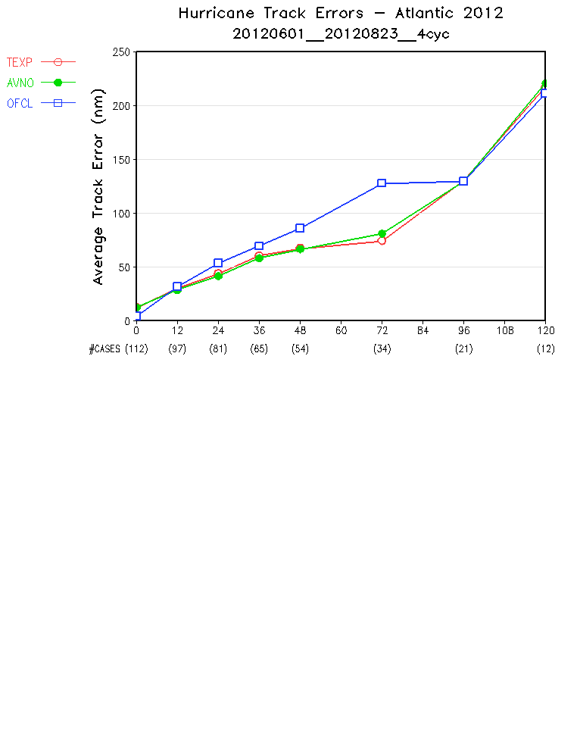

Atlantic Hurricane Track Errors
01 June to 23 August 2012
All 4 GFS cycles

Slide 21
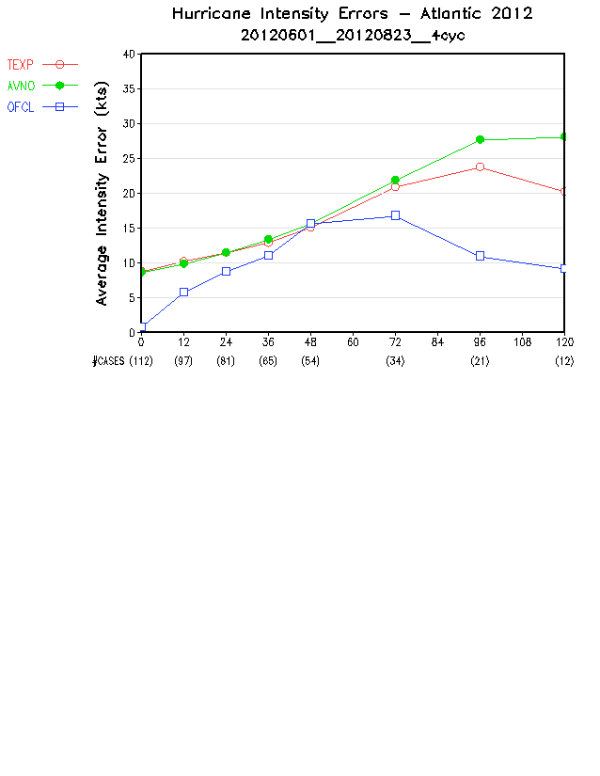
Atlantic Hurricane Intensity Errors
01 June to 23 August 2012
All 4 GFS cycles

Slide 22
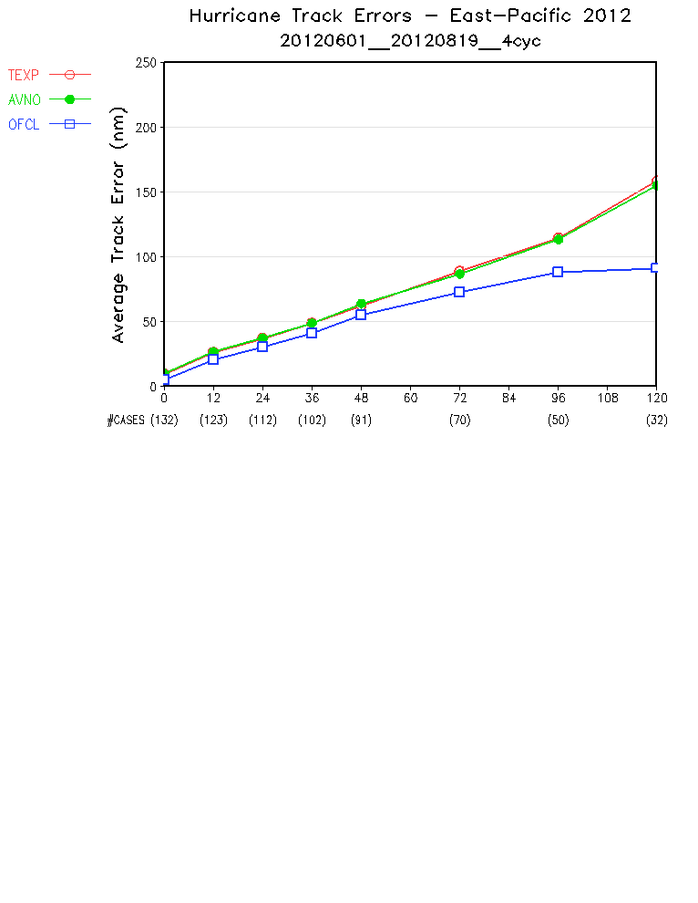
East-Pacific Hurricane Track Errors
01 June to 19 August 2012
All 4 GFS cycles

Slide 23
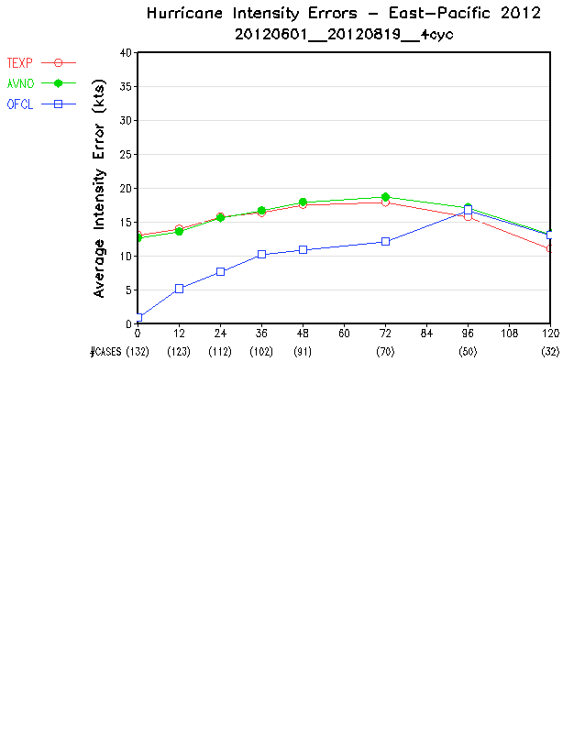
East-Pacific Hurricane Intensity Errors
01 June to 23 August 2012
All 4 GFS cycles

Slide 24
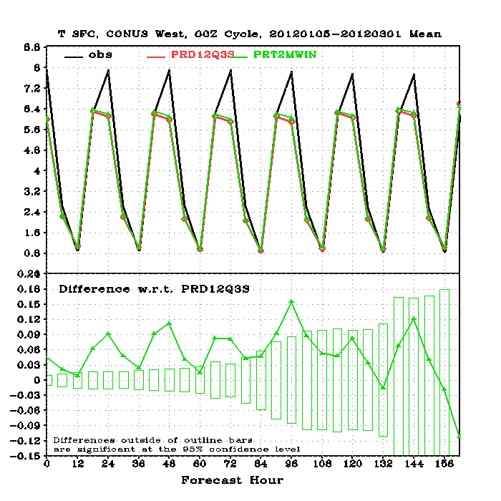
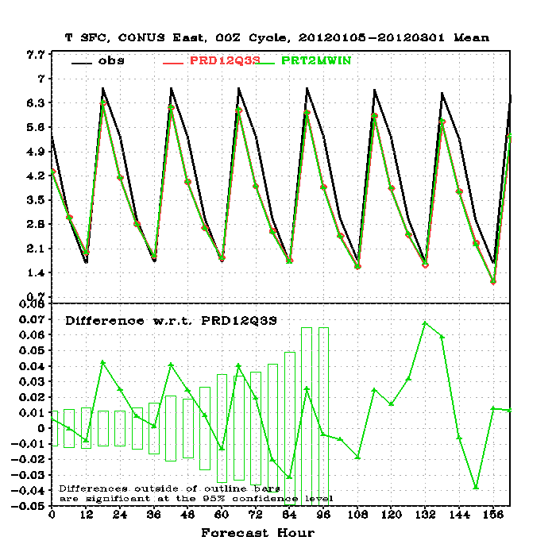
15 January to 01 March 2012 (00Z Cycles Only) CONUS West and East regions
Time Averaged 2 Meter Temperature (°C)
CONUS West
CONUS East
24

Slide 25
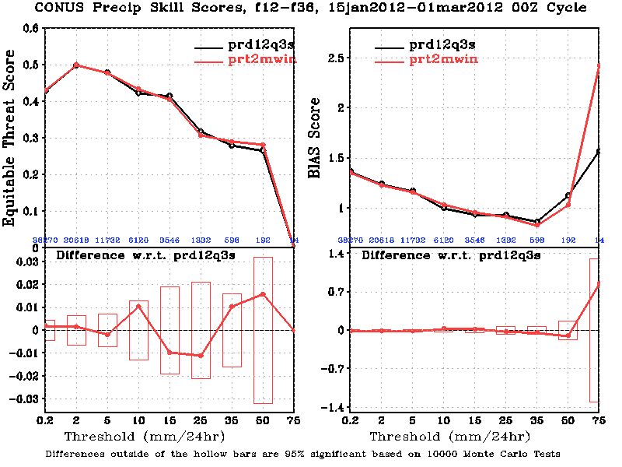
15 January to 01 March 2012 (00Z Cycles Only)
Quantitative Precipitation Forecasts (CONUS)
Day 1: 24h Period ending at 36h forecast
25

Slide 26
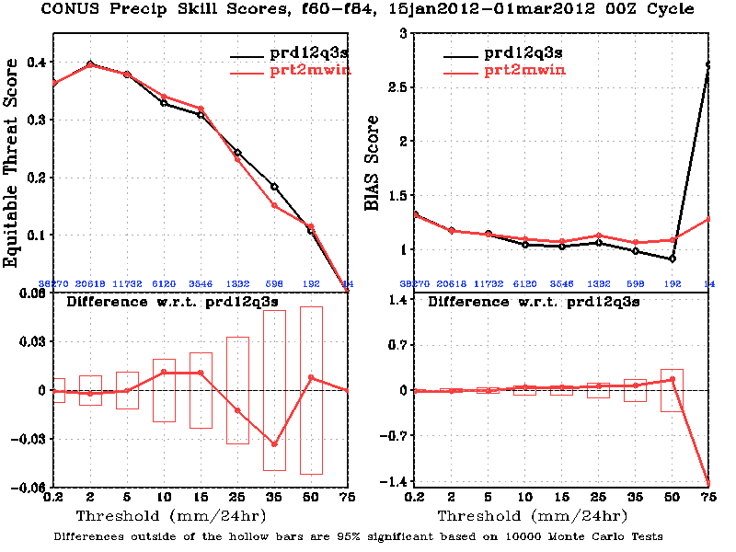
15 January to 01 March 2012 (00Z Cycles Only)
Quantitative Precipitation Forecasts (CONUS)
Day 3: 24h Period ending at 84h forecast
26

Slide 27
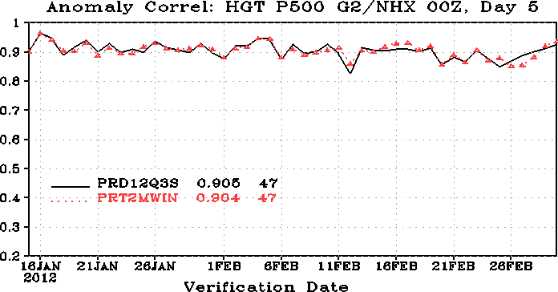
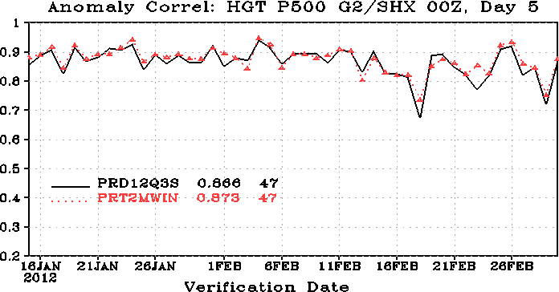


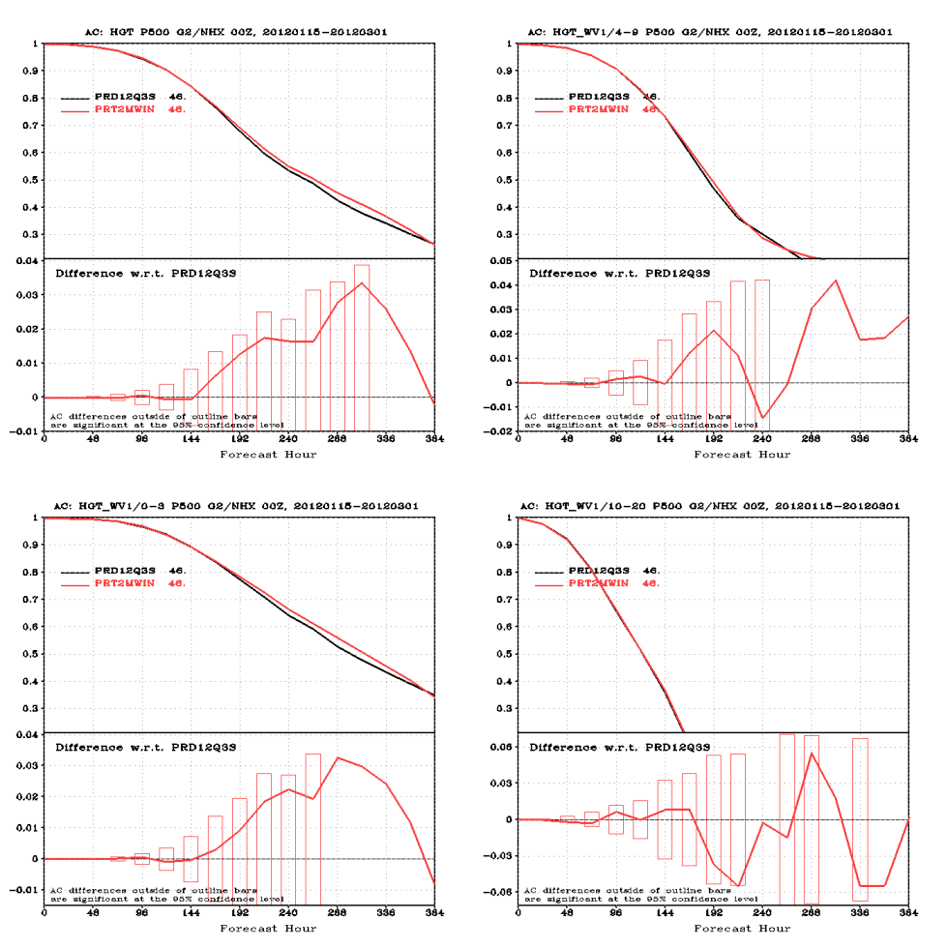
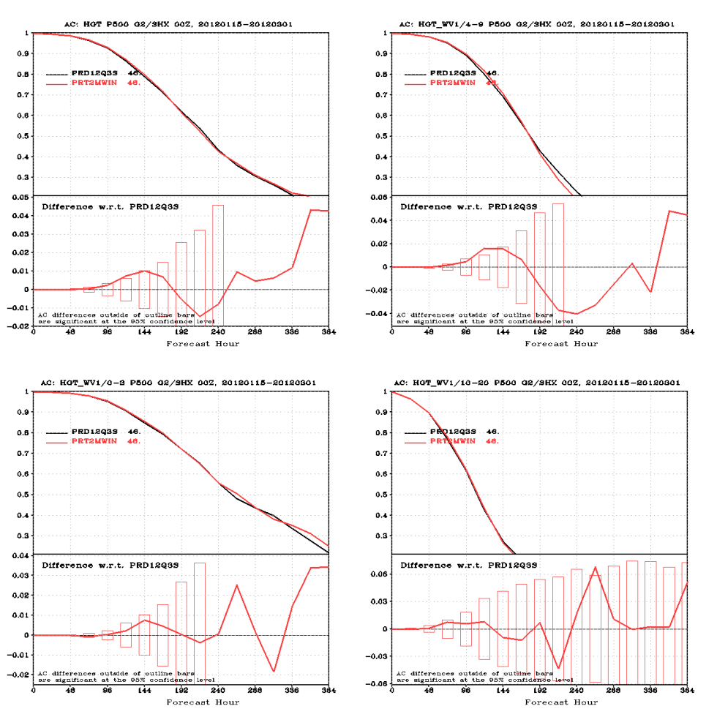
500 hPa Anomaly Correlation
15 January to 01 March 2012 (00Z Cycles Only)
Northern Hemisphere
Southern Hemisphere
27

Slide 28
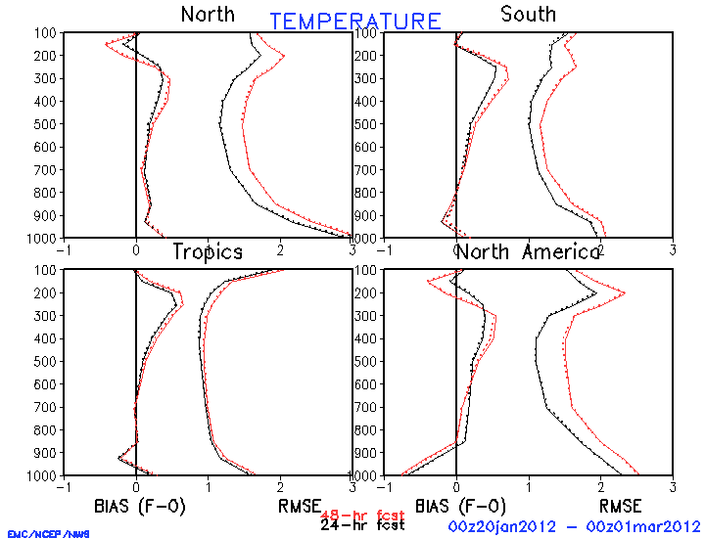
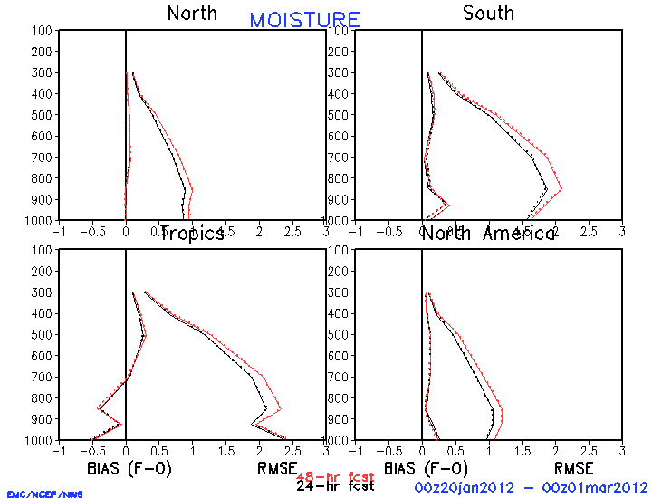
Large ScaleTemperature and Moisture Verification 15 January to 01 March 2012 (00Z Cycles Only) 24 and 48h Forecasts for the Northern Hemisphere and North America
Northern Hemisphere Temperature (°C)
North America Temperature (°C)
Pressure (hPa)
Bias
RMSE
Pressure (hPa)
Bias
RMSE
Northern Hemisphere Mixing Ratio (g/kg)
Northern America Mixing Ratio (g/kg)
Pressure (hPa)
Pressure (hPa)
Bias
RMSE
Bias
RMSE
Hybrid Parallel= Solid
LSM Parallel = Dotted
24h Fcst = Black
48h Fcst = Red

Slide 29
Large ScaleTemperature and Moisture Verification 15 January to 01 March 2012 (00Z Cycles Only) 24 and 48h Forecasts for the Southern Hemisphere and Tropics
Southern Hemisphere Temperature (°C)
TropicsTemperature (°C)
Pressure (hPa)
Bias
RMSE
Pressure (hPa)
Bias
RMSE
Southern Hemisphere Mixing Ratio (g/kg)
Tropics Mixing Ratio (g/kg)
Pressure (hPa)
Bias
RMSE
Pressure (hPa)
Bias
RMSE
Hybrid Parallel= Solid
LSM Parallel = Dotted
24h Fcst = Black
48h Fcst = Red

Slide 30
Summary of Results
Warm Season Experiment (prt2mexp)
Reduced late-afternoon surface cold bias and moisture bias over the Northern and Southern Great Plains found in the operational GFS
Significantly improved CONUS precipitation skill scores especially for light amounts
No significant change to:
Hurricane track and intensity
Standard forecast skill scores such as 500-hPa height AC and tropical wind RMSE
Slightly worsened the mid-day warm bias over the SE US
Cool Season Experiment (prt2mexp)
No significant change in:
CONUS meteorological fields
Standard global forecast skill metrics
Detailed verification at Fanglin’s websites
http://www.emc.ncep.noaa.gov/gmb/wx24fy/para/t2mbias/exp2012/
http://www.emc.ncep.noaa.gov/gmb/wx24fy/para/t2mbias/exp2012w/

