Slide 1
CBRFC WATER YEAR OUTLOOKS
CRFS
November 8, 2011

Slide 2
August 2, 2011
WY2012 MONTHLY OUTLOOKS
FLAMING GORGE
2011 2012
OCT NOV DEC JAN FEB MAR
50% 73 62 56 48 47 80
2012
APR MAY JUN JUL AUG SEP WY2012
10% 2460
50% 129 260 385 184 84 62 1470
90% 815
BLUE MESA
2011 2012
OCT NOV DEC JAN FEB MAR
50% 46 35 30 29 25 35
2012
APR MAY JUN JUL AUG SEP WY2012
10% 1520
50% 81 240 285 105 55 44 1010
90% 555
NAVAJO
2011 2012
OCT NOV DEC JAN FEB MAR
50% 35 33 23 21 28 83
2012
APR MAY JUN JUL AUG SEP WY2012
10% 1660
50% 161 285 245 56 35 35 1040
90% 450
LAKE POWELL
2011 2012
OCT NOV DEC JAN FEB MAR
50% 700 650 550 500 450 700
2012
APR MAY JUN JUL AUG SEP WY2012
10% 19500
50% 1100 2600 3050 1250 550 500 12600
90% 7000
October 3, 2011
WY2012 MONTHLY OUTLOOKS
FLAMING GORGE
2011 2012
OCT NOV DEC JAN FEB MAR
50% 62 57 50 45 45 75
2012
APR MAY JUN JUL AUG SEP WY2012
10% 2340
50% 117 240 380 183 84 62 1400
90% 790
BLUE MESA
2011 2012
OCT NOV DEC JAN FEB MAR
50% 41 35 32 29 25 34
2012
APR MAY JUN JUL AUG SEP WY2012
10% 1490
50% 78 206 255 105 52 43 935
90% 555
NAVAJO
2011 2012
OCT NOV DEC JAN FEB MAR
50% 26 28 20 19 25 71
2012
APR MAY JUN JUL AUG SEP WY2012
10% 1530
50% 136 260 230 54 29 32 930
90% 410
LAKE POWELL
2011 2012
OCT NOV DEC JAN FEB MAR
50% 650 625 525 475 450 675
2012
APR MAY JUN JUL AUG SEP WY2012
10% 18500
50% 1050 2250 2750 1150 525 475 11600
90% 7000

Slide 3
ESP starting point is current model snow and soil states.
Since there is generally no snow Aug 1 and Oct 1, the main difference between the two runs, besides lead time, is the starting soil moisture conditions.

Slide 4
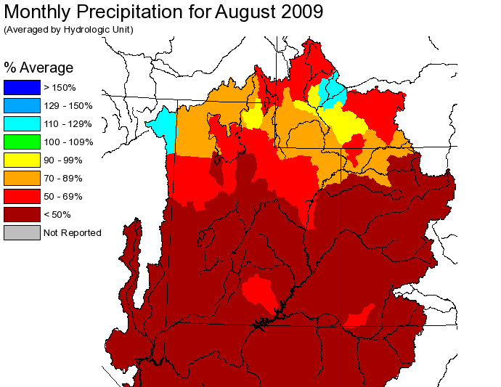
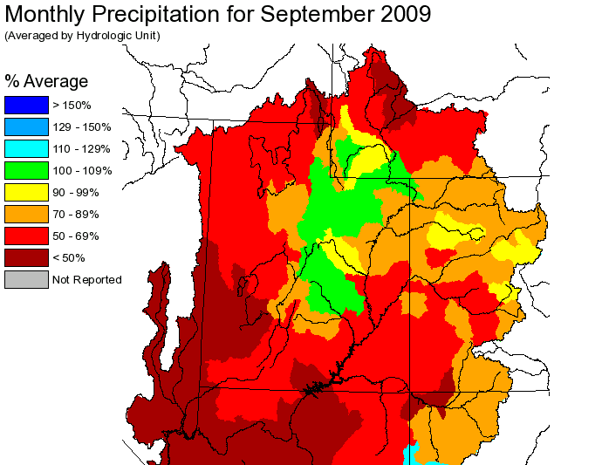
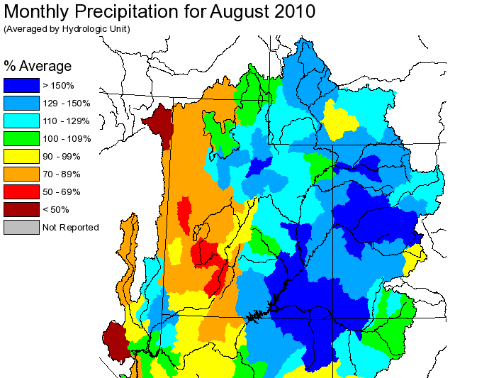
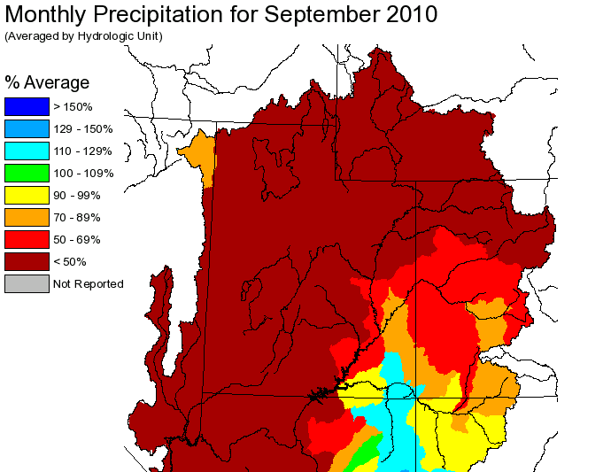
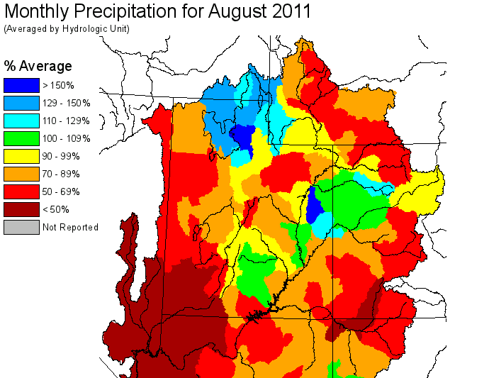
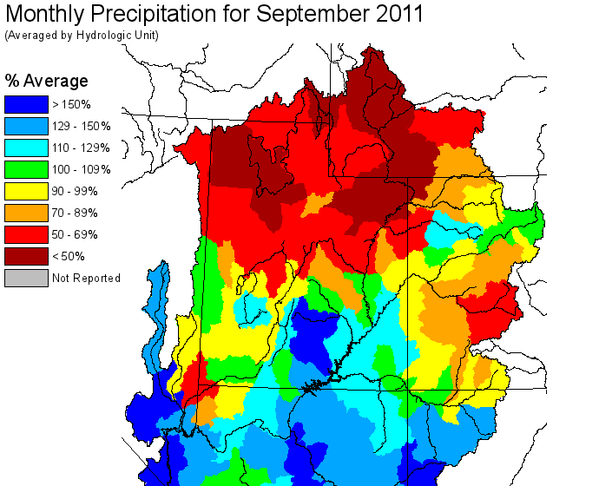
45%
75%
140%
55%
75%
85%

Slide 6
Contributing Factors
Late run-off
Model soil moisture states very wet.
Dry Aug-Sep
Model assuming ‘normal’ precipitation.
Consumptive Use/Diversions
More irrigation occurring than model assumes?
Consumptive Use operation is fixed in how much and when water will be taken.

