Slide 1

“Talking Freight”
Presented by the Federal Highway Administration
United States Department of Transportation
July 27, 2011

Slide 2

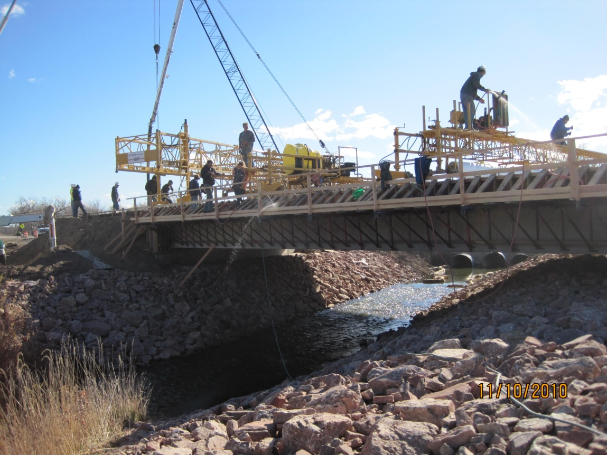
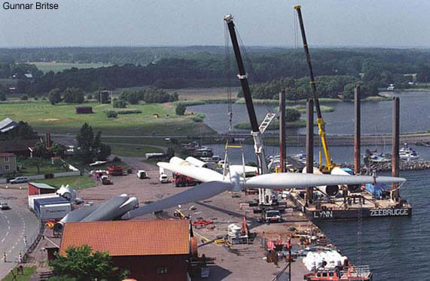
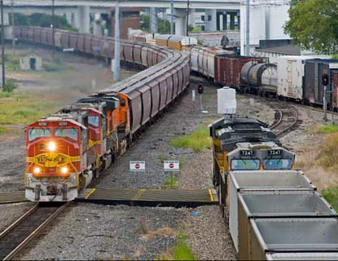
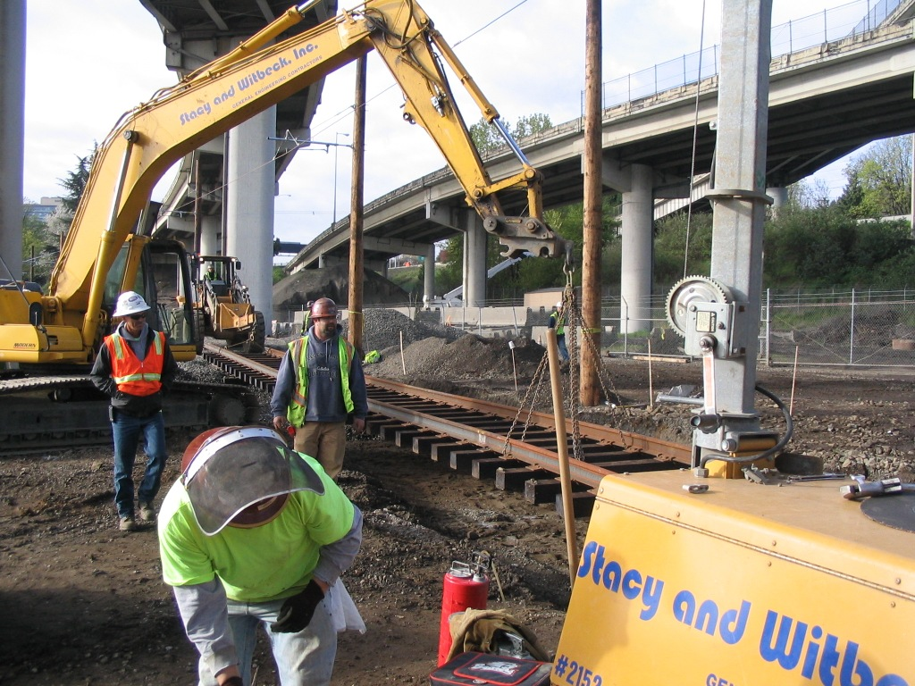
Pine Ridge, SD
North Kingston, RI
Fort Worth, TX
Portland, OR

Slide 3

$527 million multimodal, merit-based discretionary grant program
$140 million for rural areas
Up to $150 million for TIFIA payments
Last round the average award was $13.25 million
Geographic diversity requirement

Slide 4
2011 Application Process
Sept. 9th - Pre-Application Registration
October 3rd - Pre-Applications Due
October 4th - Final Applications Open
October 31st - Final Applications Due

Slide 5
Changes from TIGER 2
No Planning Funds this round
3 Application Limit (per sponsor)
TIFIA Letter of Interest

Slide 6
Keys to Competitive Applications
Eligibility
Address Criteria and Outcomes
Clarity
Leveraging Investment
Project Segmentation
Project Readiness/NEPA
Highly Competitive Projects
Application Pitfalls
Planned Technical Assistance

Slide 7
Eligibility
Surface transportation capital projects only
Open to state, tribal, and local entities, and other subdivisions
Private entities, including non-profits, must partner with a public lead
Rural grants: $1 million minimum (no match req)
Urbanized area grants: $10 million minimum (20% match)
Eligible ≠ Competitive

Slide 8
Address Criteria and Outcomes
Application outline in the NOFA
Describe how project addresses challenge
Detail how federal funds will be used
Address the selection criteria
Primary Criteria
State of Good Repair
Economic Competitiveness
Livability
Environmental Sustainability
Safety
Job Creation/Near-Term Economic
Secondary Criteria
Innovation
Partnership

Slide 9
Clarity
Ensure project descriptions are clear and concise
Pictures and maps are helpful
Focus on why project is compelling
Staff and experts may review 100-200 applications within a short period of time

Slide 10
Leveraging Investment
Matching state and local funds with private funds helps demonstrate commitment = more competitive
First round: TIGER grantees delivered $4.5 billion in matching funding for TIGER’s $1.5 billion
Public-private projects must demonstrate significant public benefits
Up to $150 million in TIFIA payments available

Slide 11
Project Segmentation
Clearly identify multiple project elements if the project is segmentable
Segments must have “independent utility”
Provides transportation benefits
Will be ready for use when complete
Phases must complete operable segment

Slide 12
Project Readiness/NEPA
Projects that are ready to move to construction quickly are given priority
Document where the project is in the NEPA process
Initiate NEPA in advance of the application process, if possible
If the project expects a CE determination, demonstrate why this is justified

Slide 13
Talking Freight
Freight projects are competitive in TIGER
$669.5 million (32% of total) for freight projects
$454.2 million for rail (22% of total)
$215.3 million for ports (10% of total)
Eligibility: surface transportation, including
Port infrastructure (dredging ineligible)
Freight rail
Roads and highways
Opportunity for rural freight
$140 million set-aside

Slide 14
Talking Freight
Key criteria:
economic competitiveness
state of good repair
environmental sustainability
Net national benefits
Identify public and private beneficiaries and contributors
National Export Initiative

Slide 15
Highly Competitive Projects
Multimodal projects, coordinated investment from other sources and programs
Demonstrate project benefits across selection criteria
New partnerships, multi-jurisdictional cooperation
Public-private partnerships
Support key national priorities
Non-traditional or hard to fund projects

Slide 16
Application Pitfalls
Ineligibility: applicants and projects
Priorities/outcomes not aligned with selection criteria
Project readiness
Insufficient matching funds, lack of demonstration
Non-construction requests: O/M assistance, ROW
Grouping unrelated projects

Slide 17
Technical Assistance
USDOT offers technical assistance to help applicants through the TIGER process
Preparation of benefit cost analysis
Previous TIGER application debriefs
Special Topics Webinars

Slide 18
Additional Application Help
TIGER Website: www.dot.gov/tiger/
Special Topics Webinars
August 17th - Benefit Cost Analysis
August 22nd - Project Readiness/NEPA
August 24th - Public Private Partnerships & TIFIA
August 24th - Rural and Tribal Applications
August 30th - MARAD Port Outreach

Slide 19

Question and Answer Session

