Slide 1

USBR Updates:
Forecast and Modeling Changes
CRFS Meeting Nov 8, 2011

Slide 2
Forecasting and Modeling Updates
Lake Powell Mass Balance
30-Year Historic Record Implementation
Lake Mead Area Capacity Table Update and Implementation
Mid-Term (Probabilistic) Operations Model (MTOM)

Slide 3
Lake Powell Mass Balance
Jan 2012: move to Mass Balance approach to computing Lake Powell “observed” inflows
Inflow at Lake Powell will be computed based on reservoir delta storage and releases instead of routed 3-gages upstream
Corrects inconsistencies between modeling (future) and database (historic), bank storage issues, and is consistent with other reservoirs
Historic Data in HDB
Recomputed inflow and bank storage back to 1964
Forecast
use new inflow data
Notes:
Starting on January 1, 2012, all Powell forecast products should reflect (be calibrated to) the MB calculation method. CBRFC currently has the MB inflow and unreg record for Powell in their database. When was this record last updated in the CBRFC database? (i.e. when did CBRFC last received a full copy of the current data in HDB for these parameters for the period of record). Reclamation has re-computed this record in the past 6 months to reflect some minor changes in the methodology. It will be important for CBRFC to get a fresh copy of these data records from Reclamation prior to shifting to the MB method to make sure the data is in sync between the two database systems.
Currently Reclamation has 6 experimental parameters in our database (HDB) for the MB based data for Powell. These are:
average mass balance inflow (cfs)
mass balance inflow volume (af)
average mass balance unregulated inflow (cfs)
mass balance unregulated inflow volume (af)
mass balance delta bank storage (af)
mass balance bank storage (af)
Reclamation has daily records for all of these for the period of record back to 1963. Which ones are maintained in the CBRFC database system? These are experimental but since the method is becoming Reclamation’s official method we will be making sure the official parameters in HDB will be updated to reflect the mass balance method. This will like be completed by December 15th. The following official parameters for Lake Powell will be re-computed with the Mass Balance method and these official parameters will no longer reflect the Three Gage method.
average inflow (cfs)
inflow volume (af)
average unregulated inflow (cfs)
unregulated inflow volume (af)
delta bank storage (af)
bank storage (af)
The forecast models should be calibrated to these official parameters (directly above) after December 15th. The official inflow statistics (i.e. official 30 year average for 1981 through 2010) for Powell should be based on these official parameters after December 15th.

Slide 4
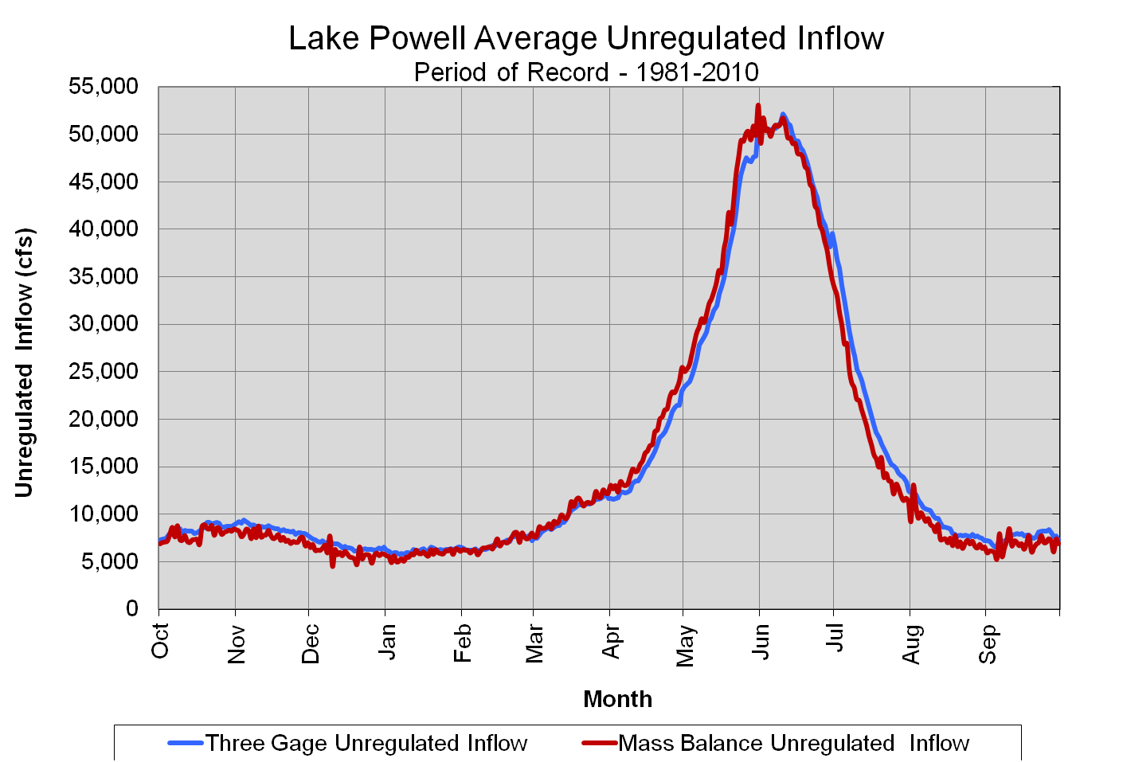
Lake Powell Mass Balance
Notes:
Daily average comparison of MB v. TG. They look very similar when summarized to daily averages.

Slide 5
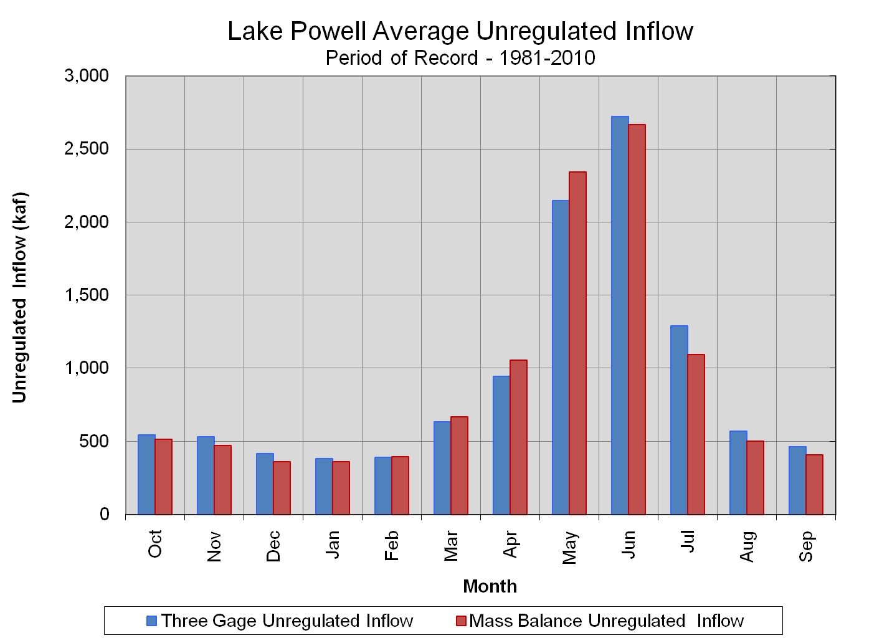
Lake Powell Mass Balance
Notes:
Monthly differences between the 81-10 averages of the Three Gage Inflow record as compared to the Mass Balance Inflow record (UNREG IN BOTH CASES). Mass Balance Inflow typically comes earlier in the Apr-Jul period than Three Gage. Base flows under MB are lower than TG.

Slide 6
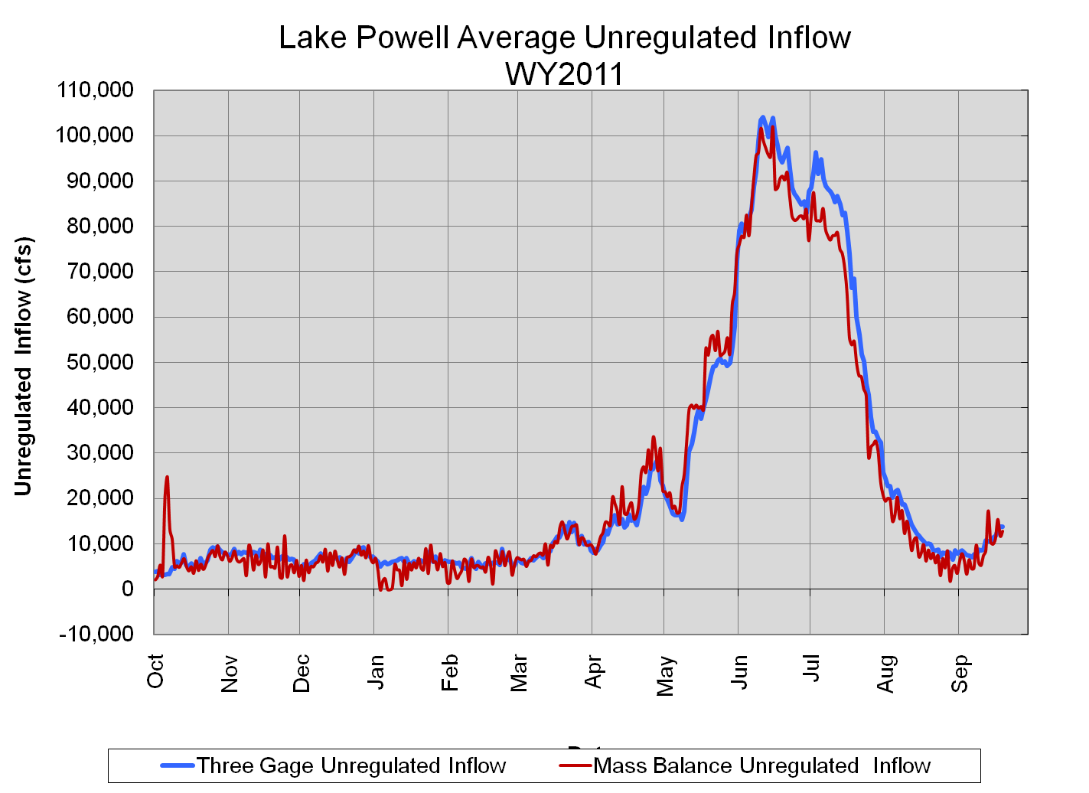
Lake Powell Mass Balance
Localized rain events show up in the Mass Balance Inflow Record
Notes:
Mass Balance catches local rain events such as the one that occurred in Oct of 2010. The Three Gage method can miss these events because they occur below the gages but above the reservoir. By moving to MB, this is one of several improvements we will see in the inflow record for Lake Powell. On issue you can see in the MB record is that it is more noisy than the Three Gage record. This is due to the sensitivity this record has to the the measured elevaiton of Lake Powell. We measure the elevation to the nearest 0.01 feet and we can see errors in this measurement due to wind and equipment issues. We will actively correct for observed errors to minimize noise but we can’t make all of the noise go away. Hopefully the noise will not be too big of an issue for CBRFC for forecasting.

Slide 7
30-Year Historic Record
Jan 2012: move to 1981-2010 average
Forecasts from RFC
RFC models calibrated to ‘81-’10 inflow data
Reclamation will use updated forecasts
Percent of Average reporting
Will use ‘81-’10 statistics (previously ‘71-’00)
“Out-year” inflows in 24-Month Study
Will use 81-’10 statistics (previously ‘76-’05)

Slide 8
30-Year Historic Record - Powell

Slide 9
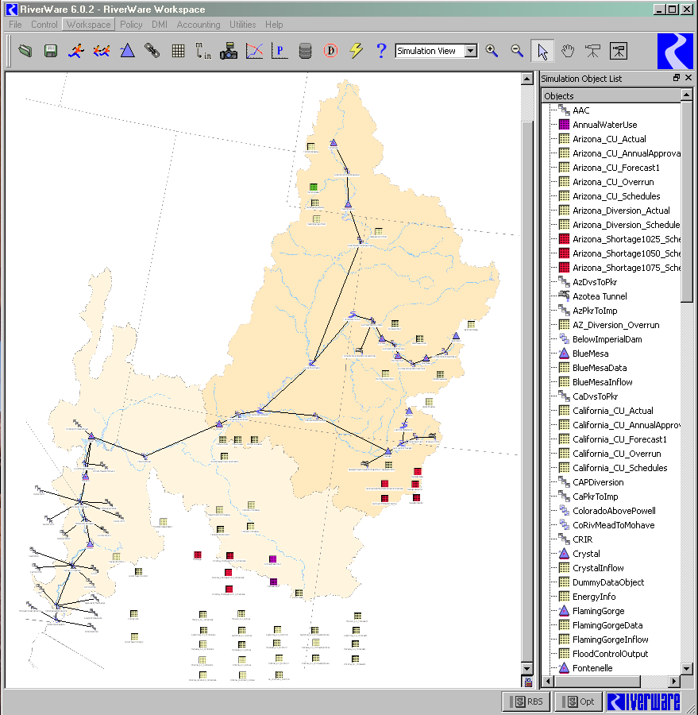
MTOM- Overview
Based on 24-Month Study, but able to simulate multiple traces for a probabilistic output and analysis
MTOM is additional tool to evaluate risk and uncertainty in Colorado River Basin
24-Month Study is still official model for operational tier determinations

Slide 10
MTOM- Current Status
Completed:
UC/LC reservoir operation / surplus rules
Multiple run management configured
Input / Output data management interfaces built
Automated output visualization
RiverWare software development
Current work:
Training UC/LC operators
Installing RiverWare 6.1 when released
Documentation
Future plans:
Begin parallel runs with 24MS in Jan 2012
(Delayed from June 2012 due to contracting problems and need for RiverWare 6.1 release to run in operational mode)

Slide 11
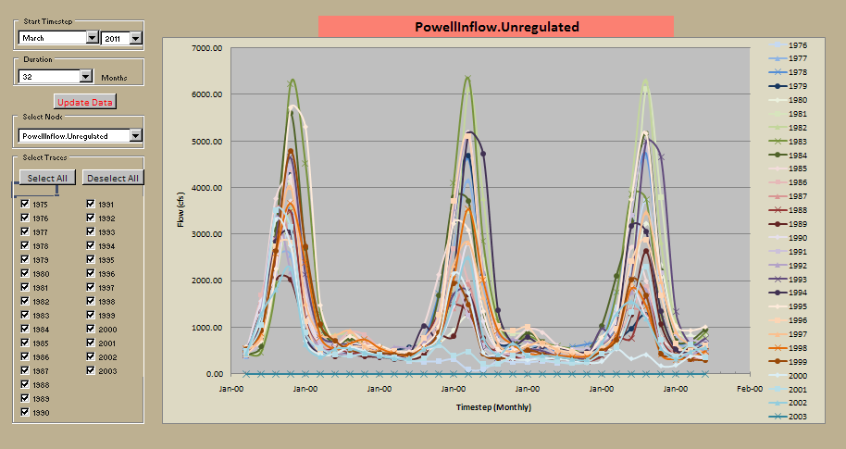
MTOM Inflows
Model input is range of probable inflows
CBRFC’s ESP forecasts (27 traces) will drive first and second years of model
Ongoing research to develop forecasting techniques for beyond 2 years (2-10 yrs)

Slide 12
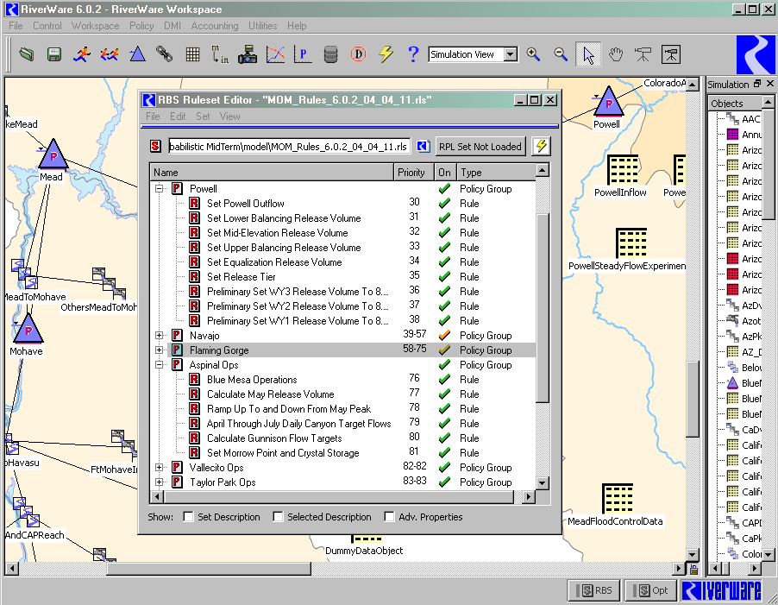
MTOM – Reservoir Operations
Uses “rules” (prioritized logic) to set UC reservoir releases rather than manual input

Slide 13
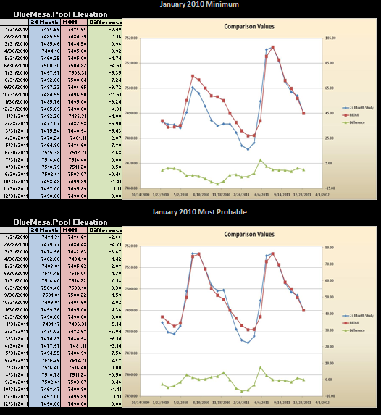
MTOM – Reservoir Ops Validation
Parallel runs begin in Jan
Compare 24-MS official results against MTOM (using official forecast) to verify reservoir rules
Evaluate elevations and releases
Validation already completed for all 2010 runs (including Min and Max probable)

Slide 14
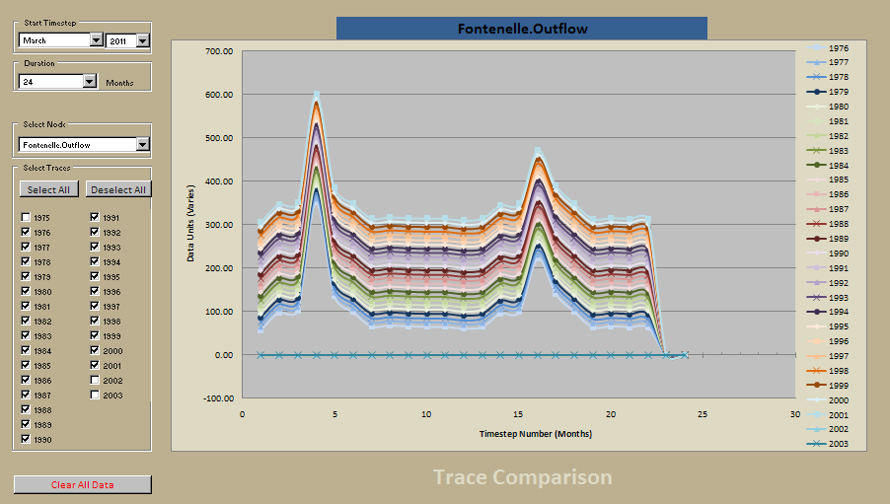
MTOM: Output
All data in 24Month Study Report
Automated visualization/plots
Reservoir releases, elevations,prob of equalizaiton
Prob of shortage
Prob of surplus

Slide 15
MTOM: Next Steps
Parallel runs with 24MS beginning Jan 2012
Run two models in parallel with official forecast and further validate and “tweak” rules as necessary
Overlay official (MOST, MIN, MAX) with 27 ESP traces to visualize where official forecast fits within ESP spread
Expect to be ready to share *preliminary* multiple trace results with stakeholders beginning in early Spring 2012
Need a couple months to ensure model is working operationally as we expect it to
Expect to share *draft* model, ruleset and documentation with interested technical stakeholders in early Spring 2012

Slide 16
Extra Slides

Slide 17
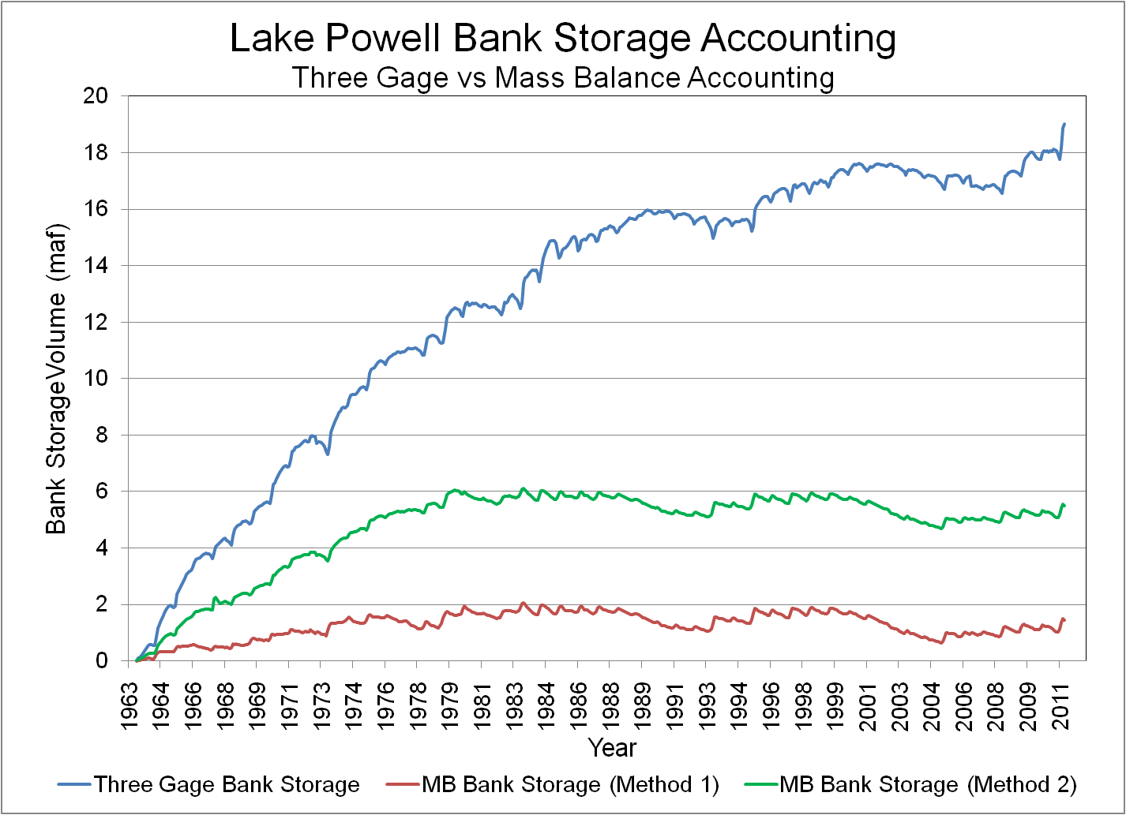
Filling Period
Normal Operation
Notes:
In order to merge the conclusions of the studies performed in 1969 (and 1971) with the assumptions used in the 24-month study and CRSS, a bank storage record was generated in 2 parts. The first part (1963 to June 22, 1980 (first date when Lake Powell exceeded 3700 feet of elevation)) of this record is based on a scaling of the three gage bank storage record to 48% of its original value and results in a bank storage on June 22, 1980 of 6 maf. From that point onward, the bank storage record is based on 8% of the delta storage.
This merged methodology results in a bank storage record that has a capacity of 6 maf and fluctuates up or down at 8% of the delta storage each day.
It is important to note that by implementing the merged methodology for bank storage, this will not change the 1981-2010 period of record for mass balance inflow to Lake Powell. Inflows during this period will not change and so forecasts based on this period of record will also not change. The mass balance inflow record for the period from 1963-1980 will change and this change will be an increase over the period of approximately 4 maf. During the period the overall mass balance inflow volume was 184.7 maf so percentage wise it is about a 2% increase in the inflow record for the period.

