Slide 1
VT CORS (VECTOR) Benefits
Daniel J. Martin
National Geodetic Survey
VT Geodetic Advisor
VTrans Monthly Survey Meeting
February 02, 2009

Slide 2
What is VECTOR??
Network of Continuously Operating GNSS Reference Stations.
Provides access to the National Spatial Reference System (NSRS)
Access available for post processing (Static) and Real-time.

Slide 3
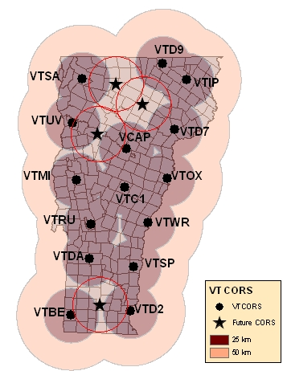
VECTOR Expansion
1996 - VCAP
2004 - VTUV
2006 – VTD2, VTSP, VTWR, VTOX, VTD7, VTD9, VTC1, VTSA, VTRU, (VCAP Upgrade)
2008 – VTBE, VTDA, VTMI, VTIP
Four Stations will be added in 2010 to complete the network - Dover, Bolton, Craftsbury, and Eden

Slide 4
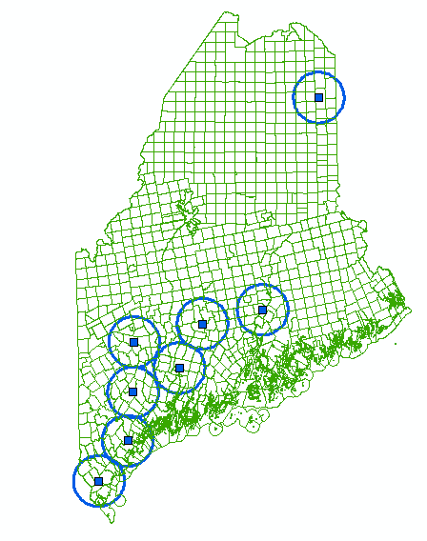
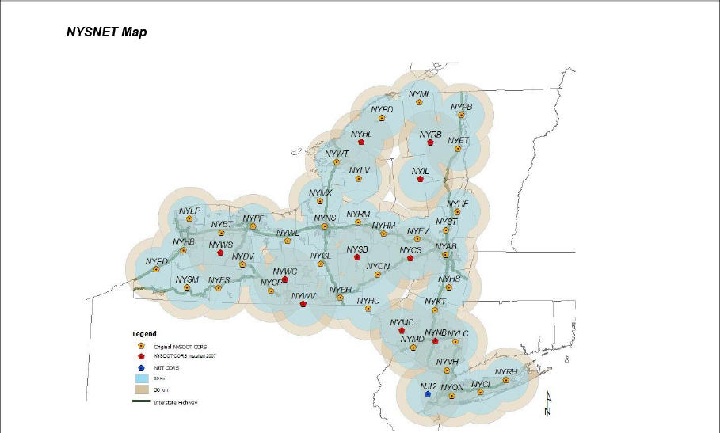
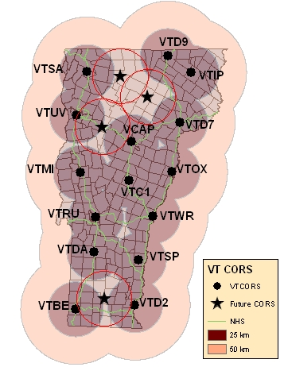
Real Time Networks

Slide 5
So What??
What is the benefit to having these station out there?
Are they being used?
How are they being used?
Who is using them?
How are they being accessed?
How much are they being accessed?

Slide 6
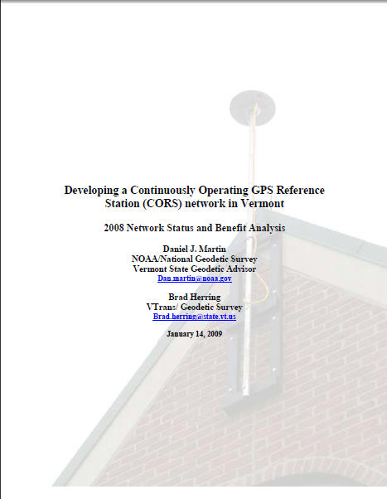

Slide 7
How are they being used?
Highway Surveys
Collection of inventory and resource data
Culvert inventory, Rest Area re-design, and ITS elements such as RWIS, PCMS/VMS, and WIMS location and planning
Control surveys for photography and LiDAR
Topo
Boundary
Flood Plane mapping
Wetland Surveys
Construction stakeout
Geodetic and Geophysical applications
Ionospheric modeling
Plate tectonics
Precipitable Water Vapor modeling (weather forecasting

Slide 8
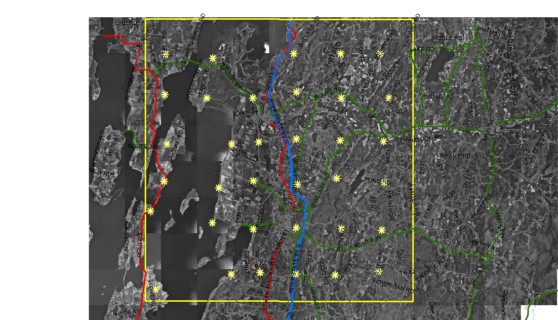
QA/QC for LiDAR (Real-time)

Slide 9
Interstate Small Culvert Inventory 2007-2008
I89
≈4000 Culverts
≈2800 DI’s
≈10,800 Total Shots
I91 (first 95 miles)
≈2700 Culverts
???? DI’s
≈5400 Total Shots+DI’s
59 crew weeks
≈ $60k savings

Slide 10
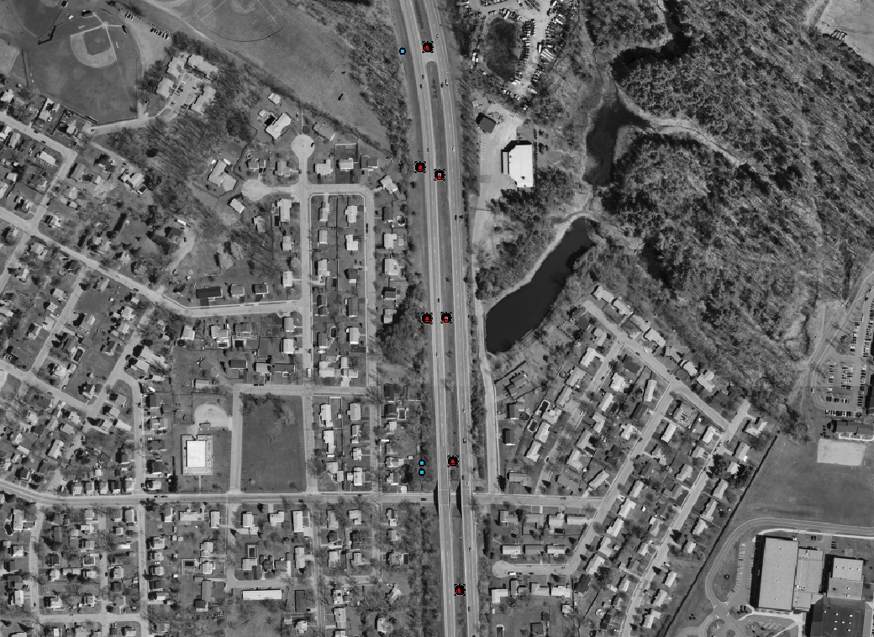
I89 Small Culvert Inventory

Slide 11
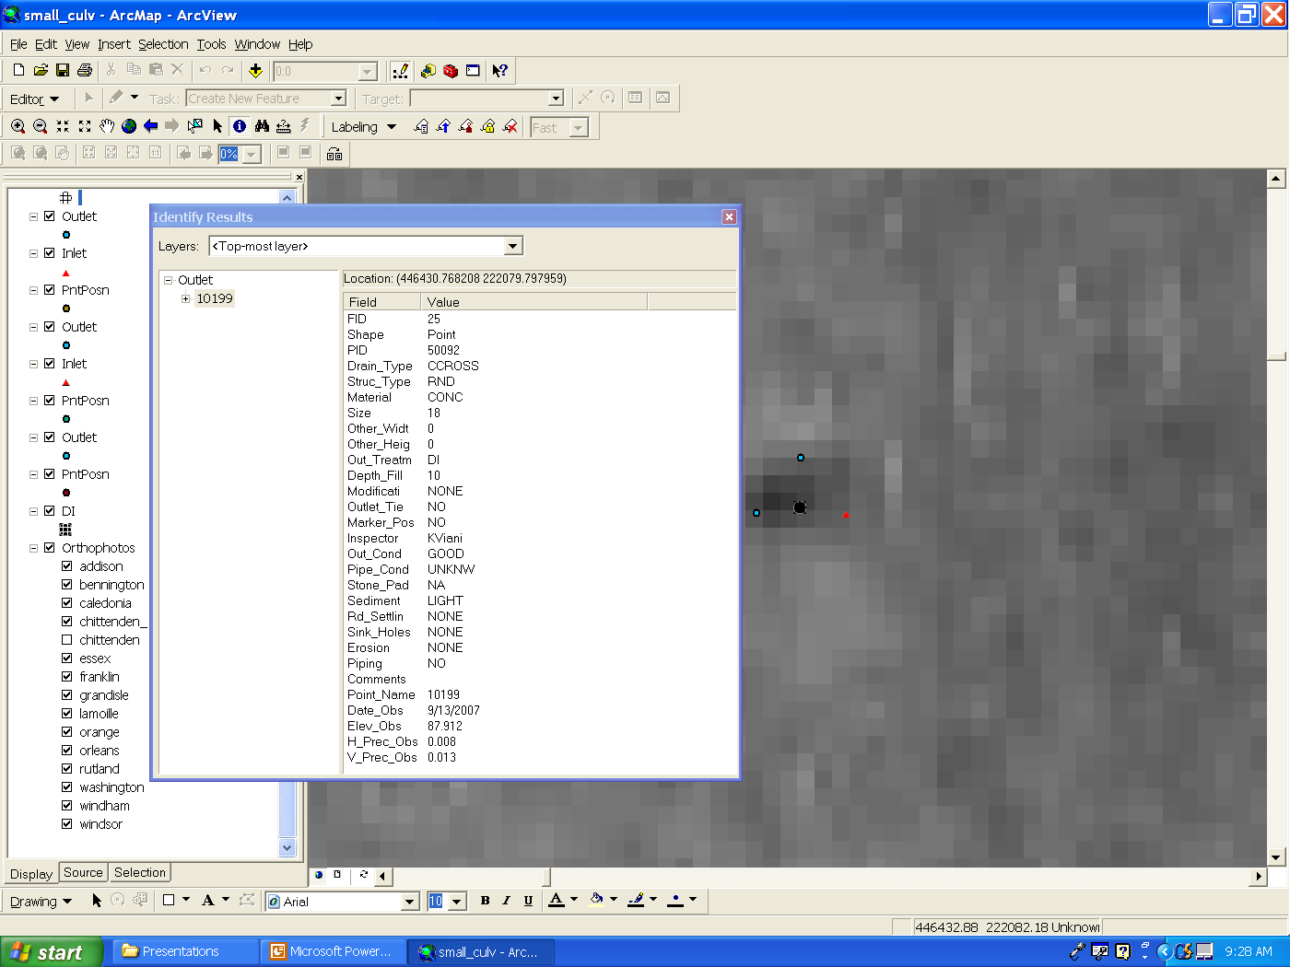

Slide 12
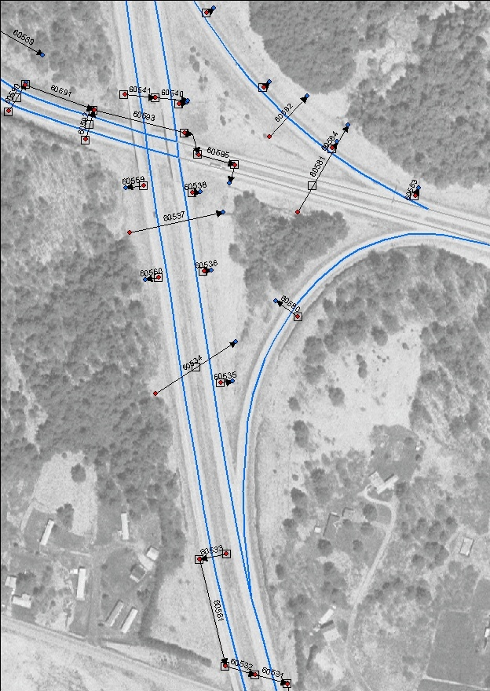

Slide 13
Who is using them
VTrans
Land Surveyors
Engineering firms
GIS Professionals
Foresters
Other State Agencies Such as Agency of Natural Resources and Department of Agriculture
Other non-VT State Agencies
Federal and International Agencies and educational institutions
National Weather Service
National Geodetic Survey
US Geological Survey
Geodetic Survey Canada
International GNSS Service
UVM, UNH, UMaine, Lyndon and Johnson State, Norwich University

Slide 14
How are the VT CORS being Accessed?
Raw Data (post processing)
VTGS Web
VTGS FTP
NGS Web (UFCORS)
Derived Products
OPUS_S
OPUS_RS
OPUS_DB
RTK Corrections
Incorporated into other networks (NY, Keynet, MTS)

Slide 20
COST/Benefit of VT CORS (Initial Investment)
Initial system investment into the VT CORS Network which was made to support the fiber optic project on the VT Interstates ≈ $340,000
9 receivers and antennas
system software,
Installation
required field equipment needed to make use of the system (4 rovers)

Slide 21
Benefit
Easy to quantify (included in report)
Reduction in person hours to accomplish a task
Reduction in purchased equipment to accomplish a task
Reduction in purchased software
Difficult to quantify (not included in report)
Reduced training (multiple types of equipment)
Reduced maintenance (multiple types of equipment)
Consistency and reliability of a system

Slide 22
Some generalities need to be made
One CORS replaces one receiver and operator
Without CORS network, one receiver and observer would need to spend an average of 2 hours to collect and download one hour of data (including travel)
Average UFCORS download consists of 2 hours of data
Cost of one observer and receiver is $50/hour
Most VT FTP users are “Resource Grade” users who require less accuracy. Could operate without VT CORS but would be subjected to even lower accuracy. FTP data has half the $$ benefit of data retrieved from the web page

Slide 23
Benefit for VT CORS Products
Product | User Benefit
UFCORS | $200/download
VT Web Download (VTDL) | $100/1-hour file
VT FTP Download | $50/1-hour file
OPUS_S | $600/solution
OPUS_RS | $600/solution
OPUS_DB | $400/submission
RTK | $100/hour

Slide 24
Direct Benefit to VTrans (work on Interstate)
RTK
2007 use = 576 hours
2008 use = 970 hours
OPUS_S
60 solutions in 2008
OPUS-DB
60 submissions in 2008

Slide 25
Direct Benefit to VTRANS

Slide 26
Direct Benefit to VTrans
2 year benefit (2007-2008) ≈ 63% of initial system investment
If 2009 benefit is equal to 2008 then the three year benefit ≈ 99% of initial system investment (three year return on investment)

Slide 27
Cost/Benefit (Current level of investment)
Current level of investment ≈ $481,400 which includes the initial investment ($340,000) plus $141,400 after year 1
4 new CORS
Extended Warranty on firmware and software

Slide 28
Total Usage in 2008
Product | 2008 Usage
UFCORS Downloads | 1798 2-hr files (ave)
VT Web Download (VTDL) | 6051 1-hr files
VT FTP Download | 8329 1-hr files
OPUS_S | 686 Solutions
OPUS_RS | 467 Solutions
OPUS_DB | 60 Submissions
RTK | 1771 Hours

Slide 29
2008 Benefit to VT Taxpayers

Slide 30
Taxpayer Benefits
Total system benefit ≈ 472% of current investment
2008 CORS not available until October of 2008, so it is fair to say that most of the 2008 benefit was derived from the initial level of system investment
2008 prorated benefit ≈ $1,900,000 = 559% of initial system investment.

Slide 31
Summary
The VT CORS Network has provided significant benefit to VTrans and the taxpayers of VT
It supports a wide variety of different applications from a diverse user community
Anticipated three-year cost recovery based on VTrans usage only
2008 benefit realized by entire user community exceeds total investment by almost 500%

Slide 32
Recommendations
Continue with expansion of network to provide state-wide coverage
Work to get as many stations into the National Network as possible
Work to increase the use of the network inside VTrans
Continue to promote the network outside of VTrans

