Slide 1
Characterization of Aerosol Data Quality from MODIS for Coastal Regions
Jacob Anderson
Mentor: Gregory Leptoukh

Slide 2
Research Objectives
Based on previous research determine the variables that most affect MODIS bias
Find which MODIS aerosol algorithm works better over coastal regions
Determine if there is a relationship between MODIS aerosol retrieval accuracy and distance to the coastline

Slide 3
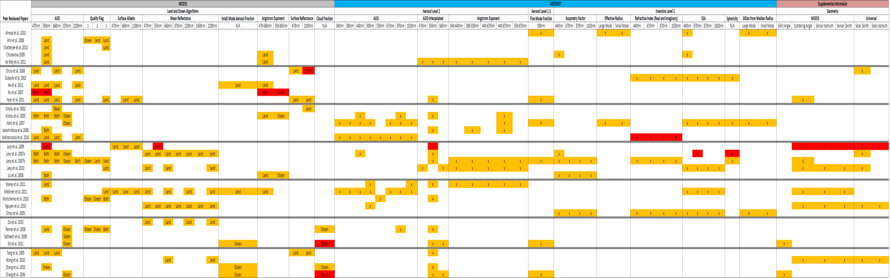
MODIS-Aeronet Intercomparison
Review previous research with an emphasis on which conditions affect the bias the most
Prepare a table on various measurement environmental conditions addressed in these papers
Notes:
AOD 550 is used most commonly for intercomparison
Many factors are important with emphasis on regional variation
surface characterization
aerosol type

Slide 4
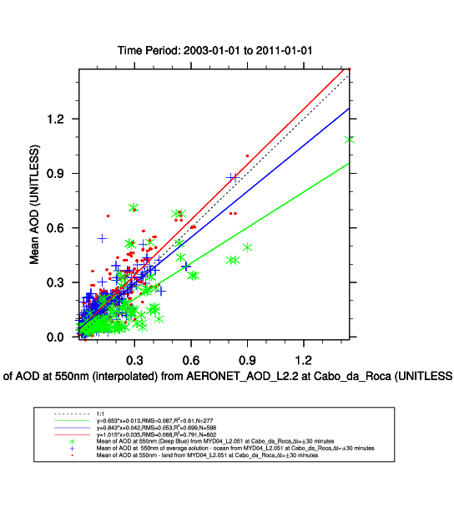
AeroStat Giovanni for Exploration
The initial assessment shows that the algorithms do not agree
MODIS Over-Ocean algorithm shows lower AOD compared to the Dark Target Land algorithm and AERONET
Leads to primary research questions
Are the differences in the algorithms similar for other coastal locations?
How do these results compare to global, and non-coastal analysis?
Does distance to the coast affect retrievals?
Cabo_da_Roca AERONET Site
Notes:
Along the Portuguese coast

Slide 5
MODIS Aerosol Algorithms
MODIS calibrated reflectances are binned into 10x10km boxes consisting of 400 pixels
MODIS uses three algorithms for aerosol retrievals
Over-Ocean algorithm is used if all pixels are ocean
Land algorithms are used if any pixels are land
Dark Target – Dark land surfaces
Deep Blue – Bright land surfaces
AeroStat Giovanni has revealed a disagreement between the algorithms

Slide 6
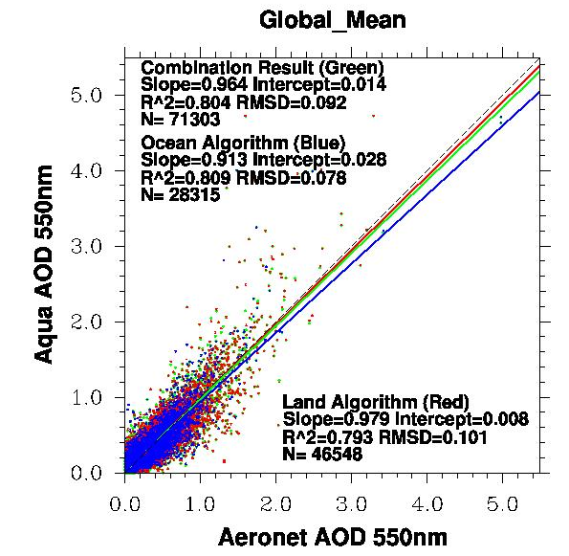
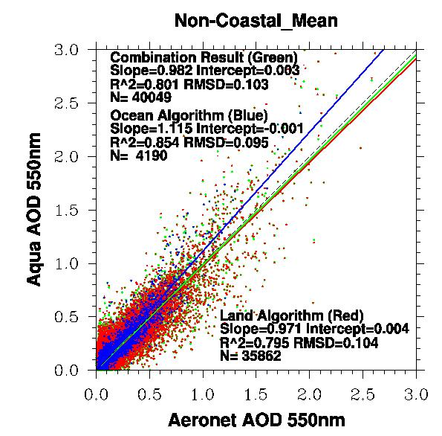
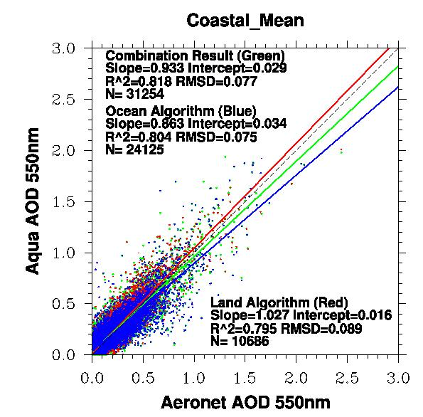
Global Results Aqua-MODIS
For coastal sites the MODIS Over-Ocean algorithm generally has a slope<1, overestimating AOD for low aerosol loading events and underestimating for higher aerosol loading. The opposite is true for non-coastal sites.
In general the MODIS Dark Target Land algorithm performs better than the Over-Ocean algorithm for coastal sites.
Notes:
Slop less than 1 and a positive y offset, overestimating…

Slide 7
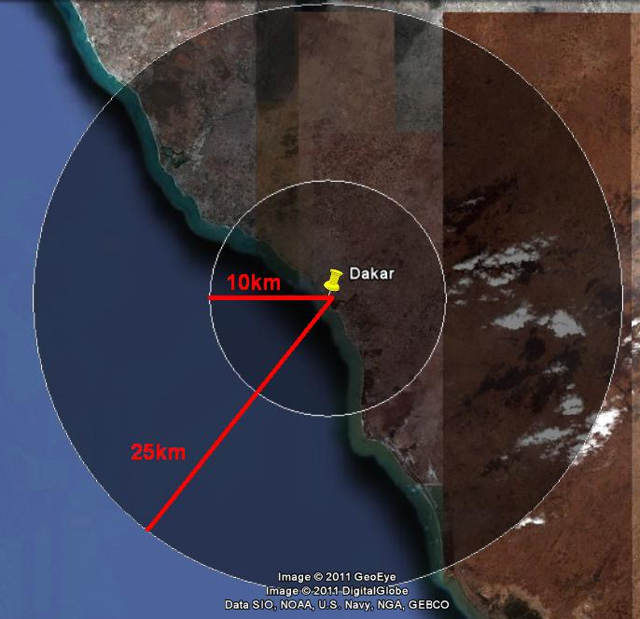
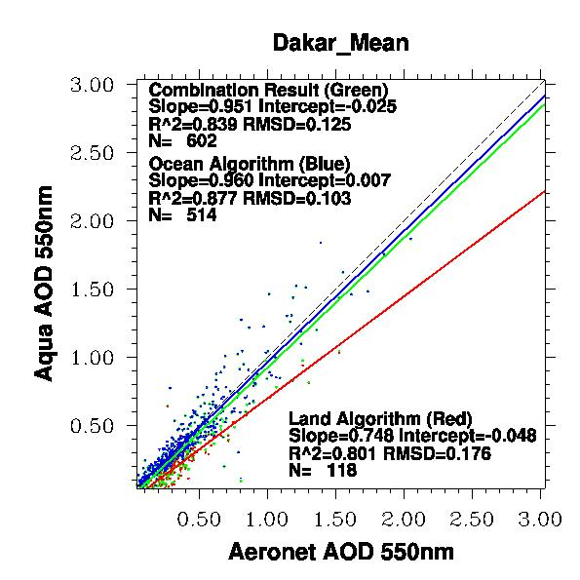
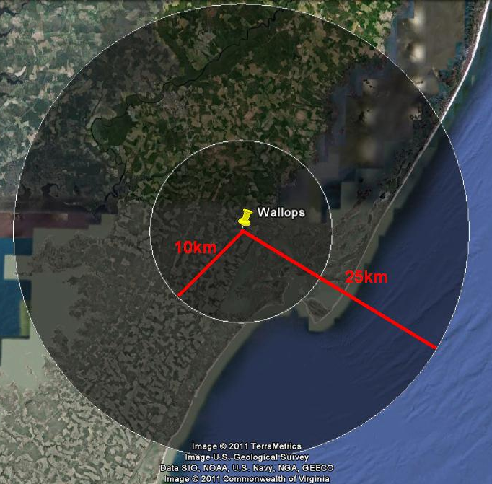
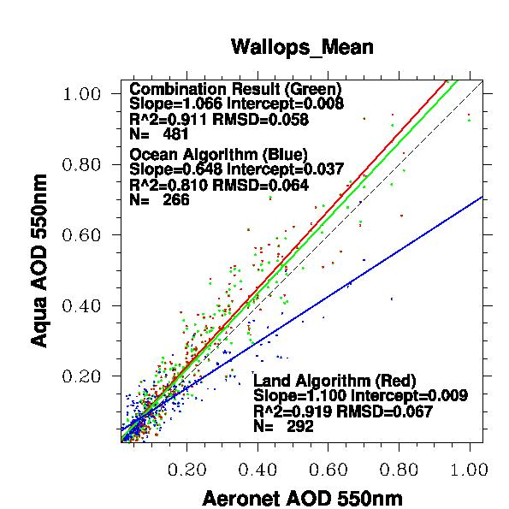
Individual AERONET Station Results
The MODIS Over-Ocean algorithm performs worse as the location moves inland
The MODIS Dark Target Land algorithm correlation improves as the location moves inland
Notes:
The Ocean algorithm performs worse as the location moves inland.
The Land algorithm correlation improves as the location moves inland but is less affected than the Ocean algorithm.

Slide 8
Conclusions
For coastal sites the MODIS Over-Ocean algorithm generally has a slope<1, signifying that it overestimates AOD for low aerosol loading events and underestimates for higher aerosol loading. The opposite is true for non-coastal sites.
In general the MODIS Dark Target Land algorithm performs better than the Over-Ocean algorithm for coastal sites.
The MODIS Over-Ocean algorithm performs worse as the location moves inland
The MODIS Dark Target Land algorithm correlation improves as location moves inland

Slide 9
Thank You
Any Questions?

