Slide 1
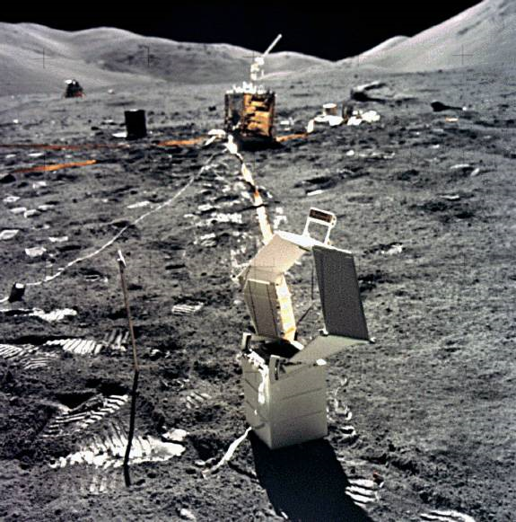
Terrestrial Gravity
Plans at NGS
Dru Smith
Mark Eckl
Vicki Childers

Slide 2
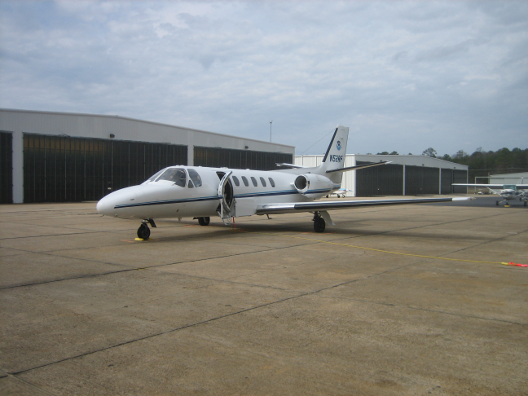
Airborne Survey Control
Currently with FG-5 near tarmac
Relative meters to connect to tarmac
A-10 soon
About 2-3 / year

Slide 3
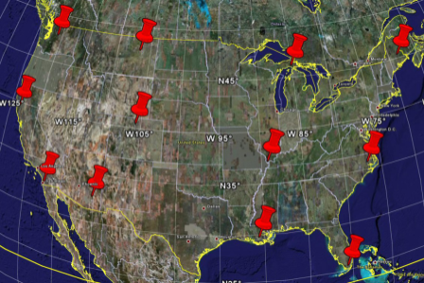
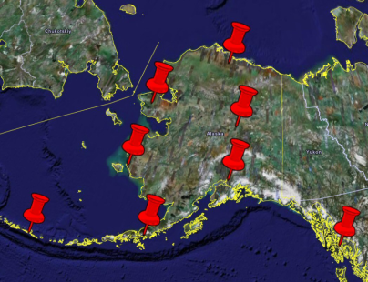
Geoid Change Validation
Original GRAV-D plan called for modeling geoid change through gravity change,
mostly via absolute gravimetry
More recent plan is to use absolute gravity to validate geophysically-driven gravity/geoid change models
Requires local hydrological modeling

Slide 4
TMGO Experimentation
Table Mountain Geophysical Observatory
NGS will conduct its own research at TMGO
Hydrologic, Gravimetric, Etc
An open invitation exists for any researchers to temporarily house gravity and other geophysical experiments at TMGO

Slide 5
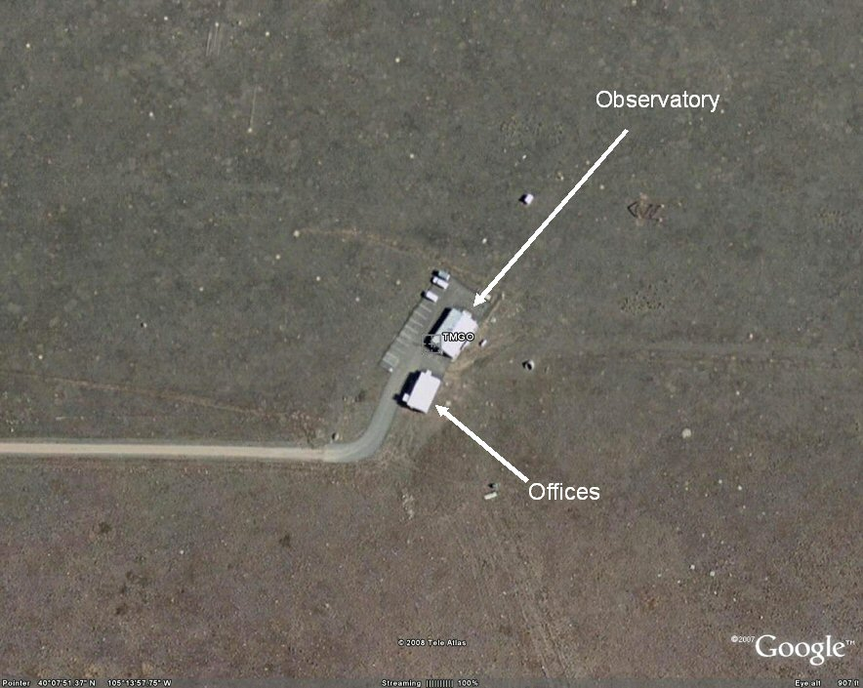
= Existing Superconducting Gravimeter
= Existing Digital Bucket Rain Gage
= Existing TMGO CORS
= Existing loaned TRIMBLE antenna
on pillar
= Existing 2 monitor wells (defunct)
= New Met Sensor (proposed location)
= New CORS (proposed location)
= New Soil Moisture Probe
(proposed location)
30 m radius
(limit of wires
that came with
probes)
100 meters

Slide 6
TMGO Meter-checks
NGS welcomes brief visits by those whose FG-5’s or A-10’s have recently been at Micro-G for service
Provides a safe, nearby environment for checking meter after servicing, prior to shipping home

Slide 7
Absolute Gravimeter Comparisons
Periodic comparisons (4 years?)
N.Amer. in 2010. More open next time.
Critical now that BIPM is no longer hosting them
Reports to IAG, and consolidated metadata website
Contribution to the A.G. Database at BKG

Slide 8
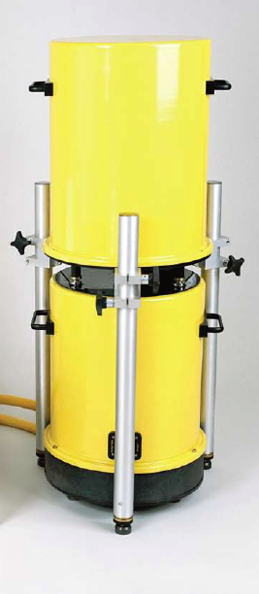

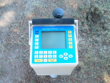
New Instruments
A-10
Delivery early 2011
Under consideration (out years)
gPhone
Portable temporary gravity studies
CG-5
Augment aging L/R spring meters

Slide 9
Field Research
Geoid Slope Validation Survey (Fall 2011)
375 km / 270 geodetic control marks
GPS, Leveling, gravity, DoVs
FG-5 at endpoints and midpoint
A-10 on each 7th pt
Relative gravity between

Slide 10
Standards and Specifications
Standards of Accuracy
Working Group Definition: A statistical assessment of the final calculated value of set(s) of measurements into categories that represent the known accuracy of control relative to an accepted reference (e.g., 1st order, 1st class = 20 µGals (@ 2σ level) with < 20µGal change over 5 years)
Purpose: To report to potential users the accuracy or quality categories of measurements and computations that were made to compute the published value of survey control. By knowing the quality of the published value, a user is enabled to ascertain the usefulness of the control for their purpose.

Slide 11


Standards (FGCC 1984)
Gravity Accuracy Standards
Classification | Gravity Accuracy (µGal)
First-order, class I | 20 (subject to stability verification)
First-order, class II | 20
Second-order | 50
Third-order | 100

Slide 12
Standards and Specifications
Specifications of Measurement Systems
Working Group Definition: Those elements of a survey that are considered essential for the survey to meet the standards of accuracy for a particular order/class.
Purpose: To identify and minimize errors propagated through the individual components of a measurement system and appropriately constraining the error budget to ensure that the reported final standard of accuracy is statistically valid.

Slide 13
Specifications (FGCC 1984)
Absolute Measurements
Order Class | 1st I | 1st II | 2nd | 3rd
Standard deviation of each excepted measurement set not to exceed (µGal) | 20 | 20 | 50 | 100
Minimum number of sets/observation | 5 | 5 | 5 | 5
Maximum Difference of measurements set from mean of all measurements (µGal) | 12 | 12 | 37 | 48
Barometric pressure standard error (mbar) | 4 | 4 | - | -
Gradient Measurements
Standard deviation of measurement of vertical gradient at time of observations (µGal/m) | 5 | 5 | 5 | 5
Standard deviation of ht. of instrument above point (mm) | 1 | 1 | 5 | 10

Slide 14
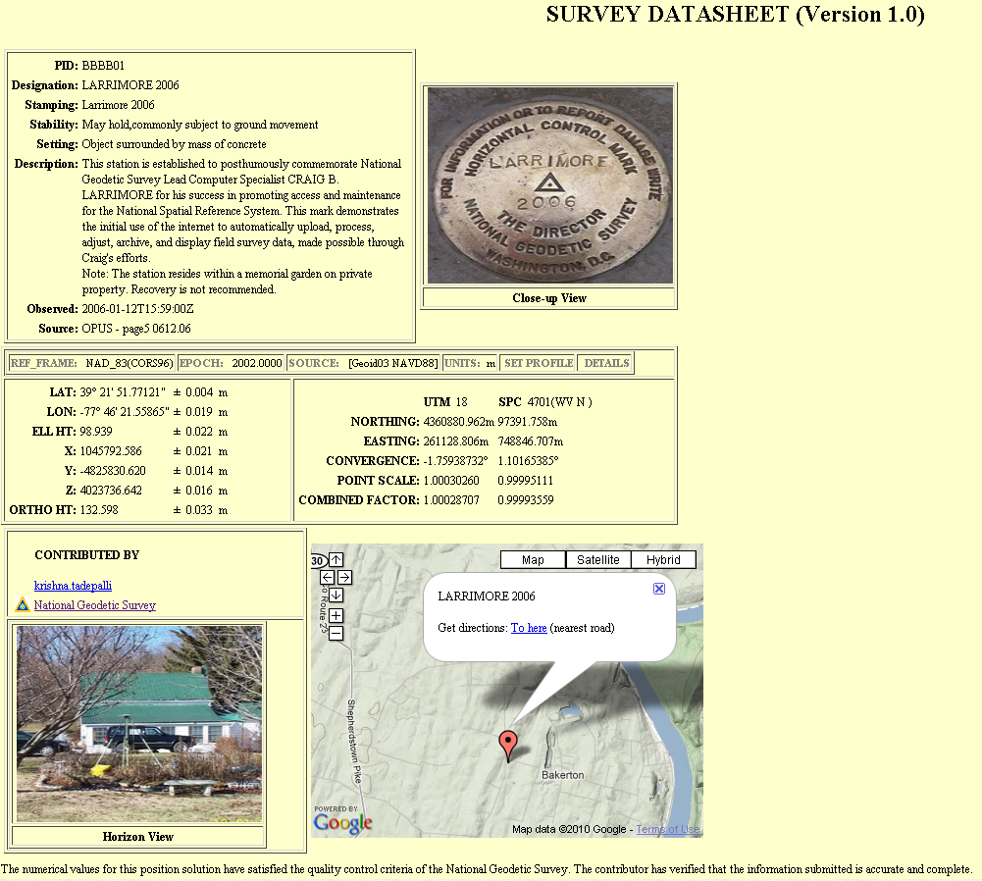
AG Database(s)
Collecting/Organizing our historic data
Plan to contribute to BKG’s DB
Also working on
synchronizing A.G.
collection with
“OPUS-DB”

