Slide 1
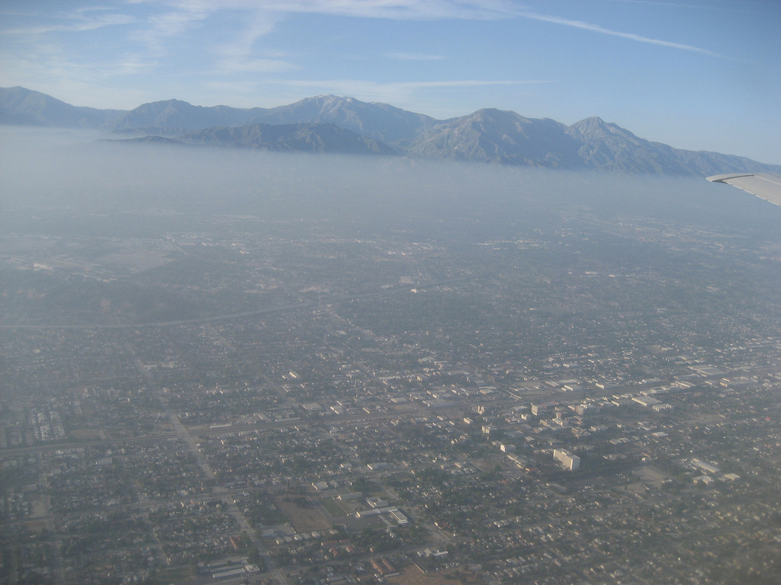
Airborne Measurements of Nitryl Chloride and Implications for Chlorine Activation in the South Coast Air Basin of California
J.M. Roberts; S.S. Brown; W.P. Dubé; J. Neuman; J.B. Nowak;
C.A. Brock; A.M. Middlebrook; R. Bahreini; T.B. Ryerson;
I.B. Pollack; P.R. Veres; A.K. Cochran; C. Warneke; J.A. de Gouw
Introduction to ClNO₂ chemistry: what do we know about it so far
Measurements aboard the NOAA WP-3 During CalNex 2010
What does this tell us about ClNO₂ formation chemistry
Photo: Sarah Lance

Slide 2
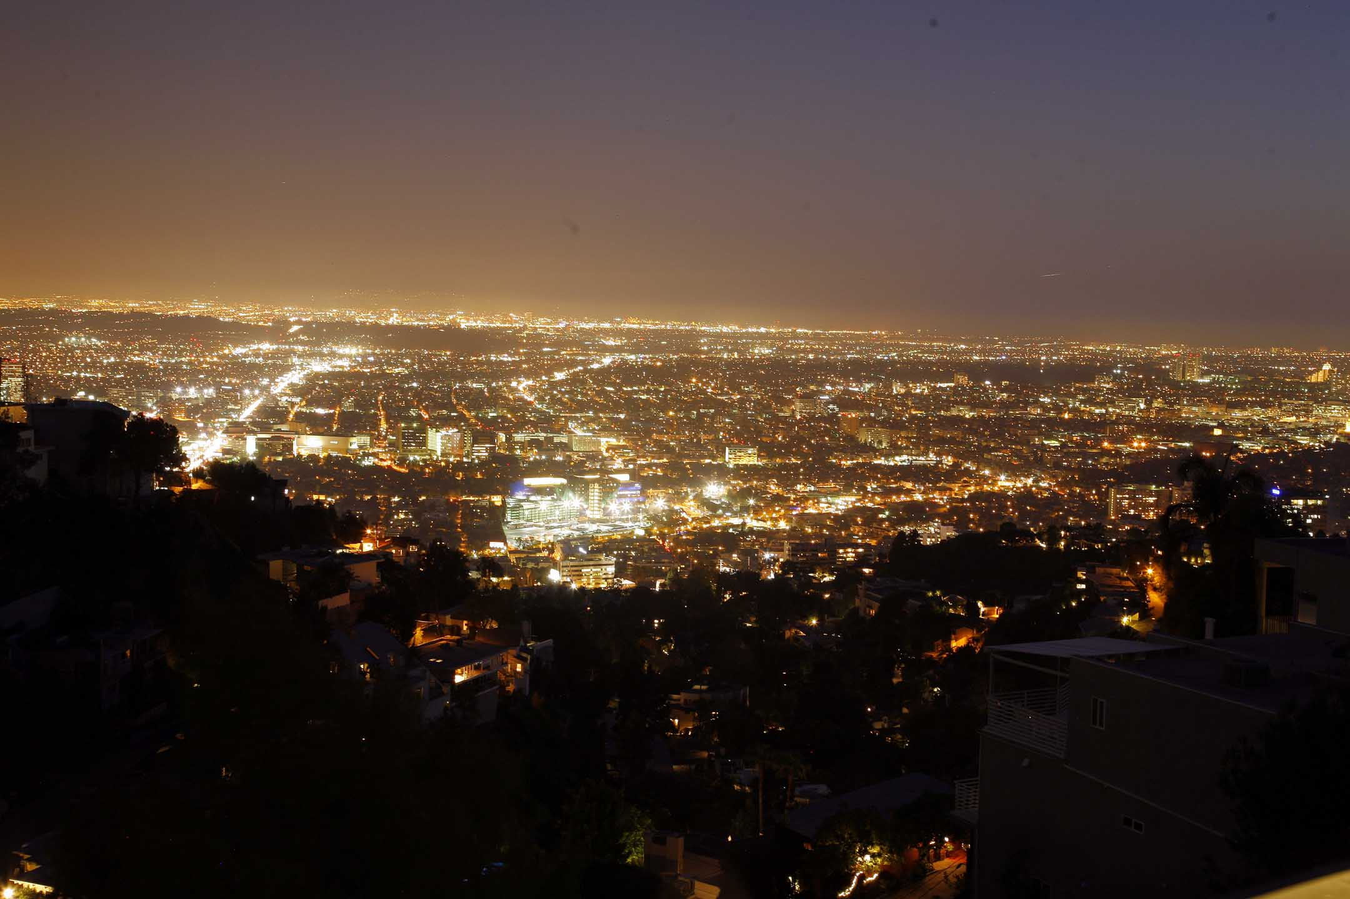

Slide 3
sea salt
N₂O_{5(g)} + Cl⁻_{(aq)} => ClNO_{2(g)} + NO₃⁻_{(aq)}
ClNO₂ + hν => Cl + NO₂
The Chemistry Requires
N₂O₅ (NO₂, O₃, Time,)
Efficient N₂O₅ uptake
Aerosol Surface Area
Aerosol Chloride
Source of Soluble Chloride to Aerosol
NH₄NO₃
NH₃
Finlayson-Pitts, et al., 1989
HNO₃
NH₄⁺
+
N₂O₅ NO₃⁻ + NO₂⁺
HCl H⁺ + Cl⁻
+
NH₄⁺
ClNO₂
NH₃
NH₄Cl

Slide 4

NOAA 43RF
ClNO₂ Iodide ion CIMS Jim Roberts, Andy Neuman, John Nowak
NO₃, N₂O₅ CaRDS Steve Brown, Bill Dube, Nick Wagner
NO_{y}, NO₂, NO, O₃ Chemiluminescence Tom Ryerson, Ilana Pollack
NH₃ CIMS; John Nowak
HNO₃ CIMS; Andy Neuman
Aerosol Chemistry C-ToF AMS; Ann Middlebrook, Roya Bahreini
Aerosol Surface Area NMASS/UHSAS Chuck Brock

Slide 5
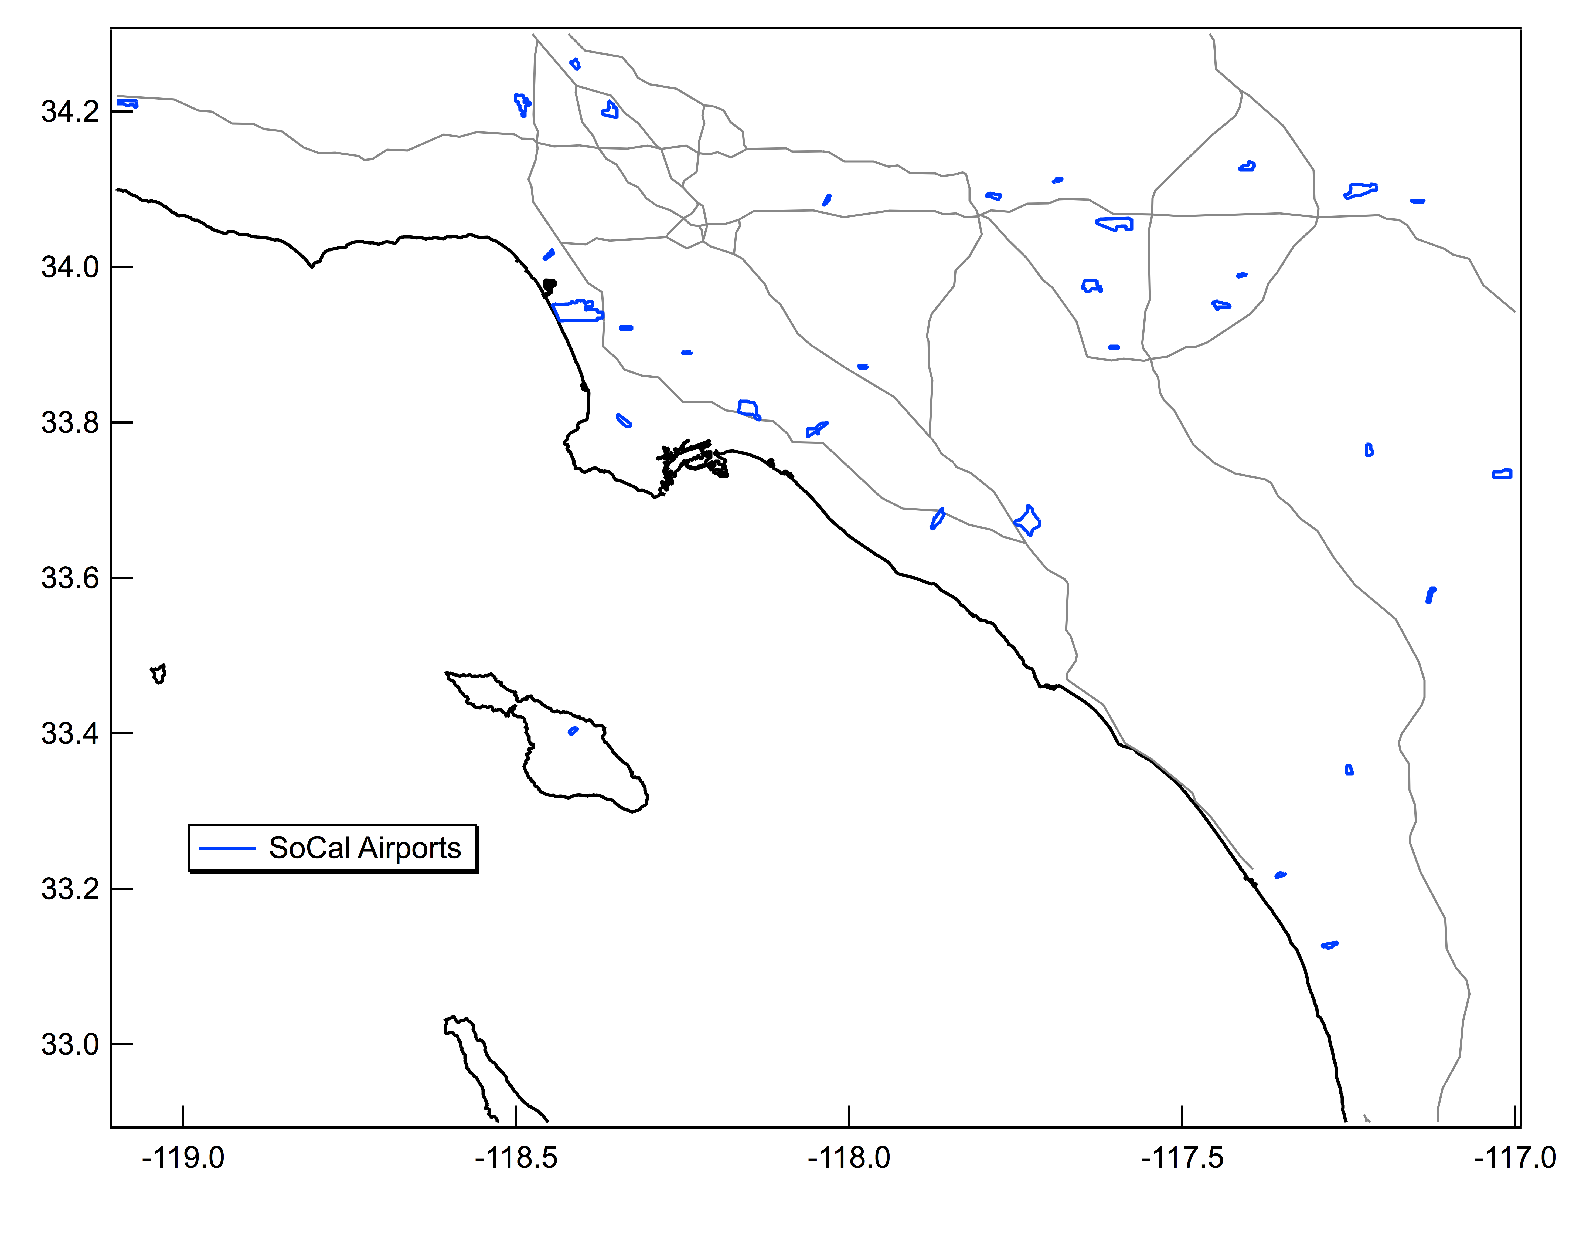
NOAA P3 Flight patterns for May 24, 30, 31 and June 2, 3, 2010 Night Flights

Slide 6
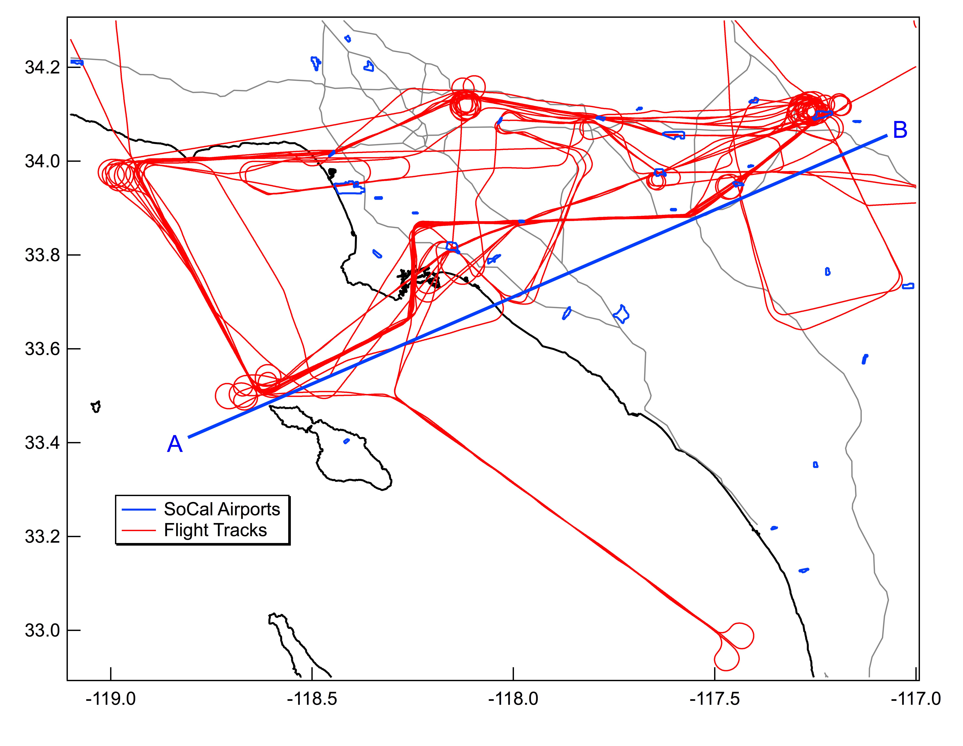
NOAA P3 Flight patterns for May 24, 30, 31 and June 2, 3, 2010 Night Flights
Pasadena Site Mielke et al.,

Slide 7
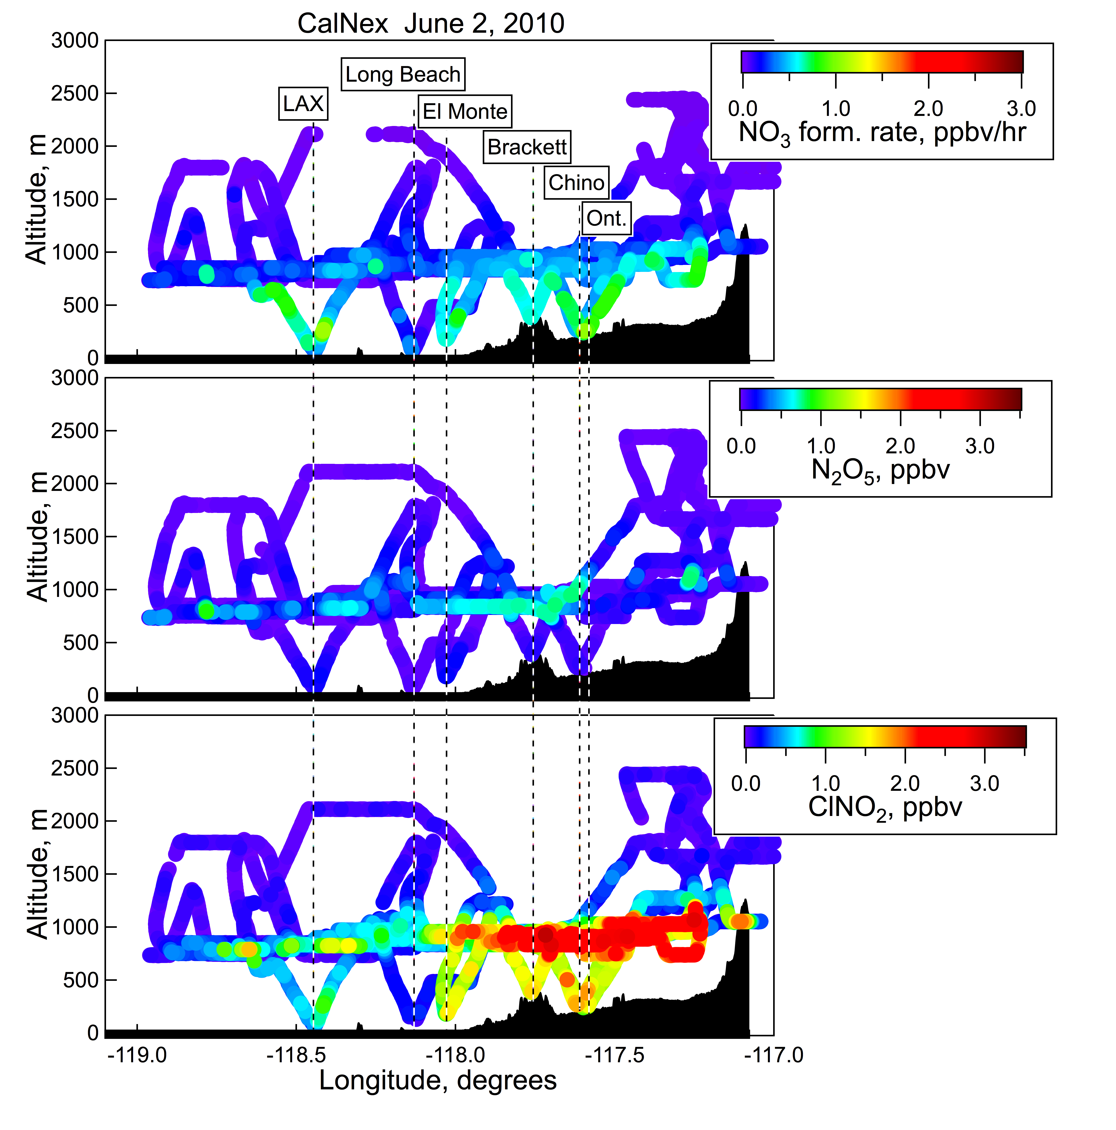
dNO₃/dt = k[NO₂][O₃]
N₂O₅ almost absent
Residual of the Daytime
Boundary Layer
Gradient within the RL

Slide 8
dNO₃/dt = k[NO₂][O₃]
Ozone Production
ClNO₂ + hν => Cl + NO₂
Cl + RH => RO₂
RO₂+ NO => RO+NO₂
RO + O₂=> HO₂+ OVOC
HO₂ + NO => NO₂ + OH
N₂O₅ almost absent
Residual of the Daytime
Boundary Layer
Gradient within the RL

Slide 9
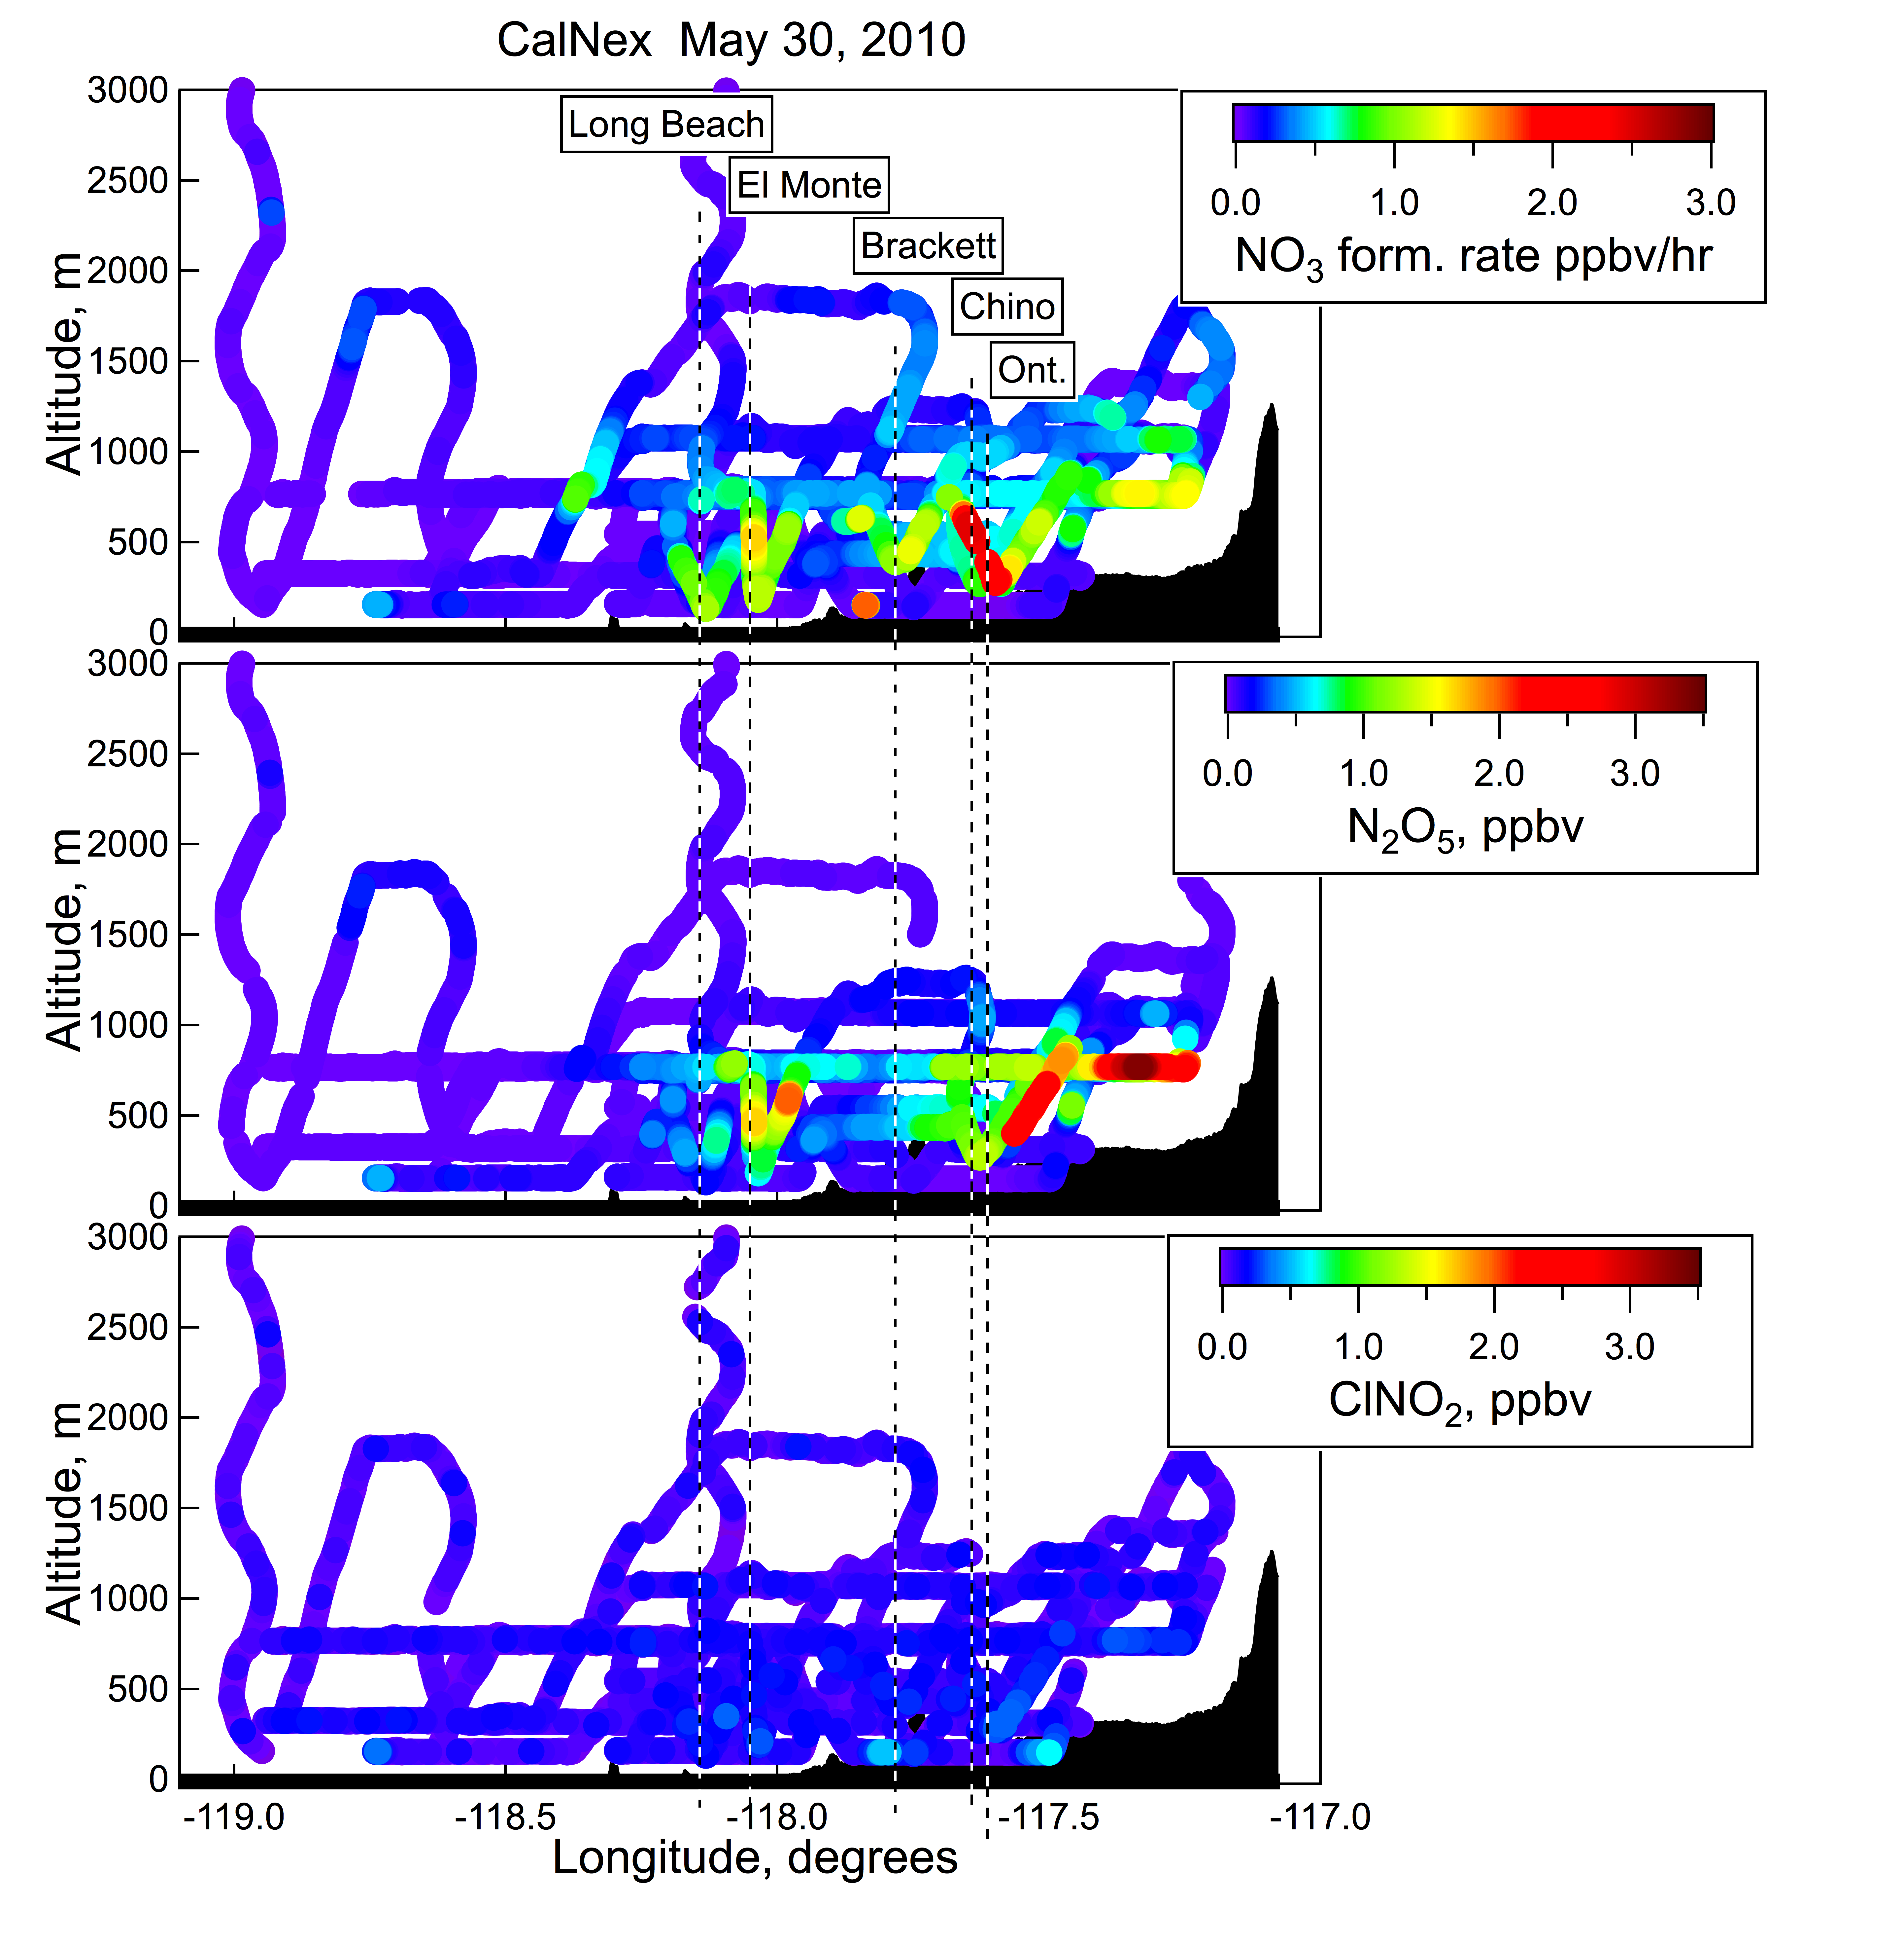
N₂O₅, but not much ClNO₂
Low level leg over the Ocean

Slide 10
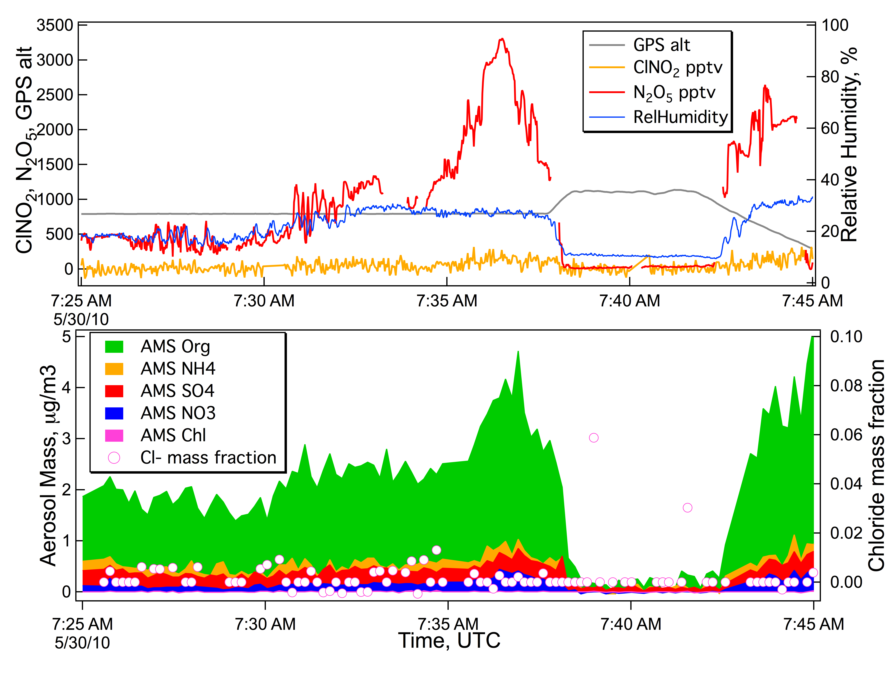
May 30, 2010 Flight –N₂O₅ High, almost no ClNO₂
San Bernadino Valley Ontario
Mostly Org C
Low RH
Slow N₂O₅ uptake

Slide 11
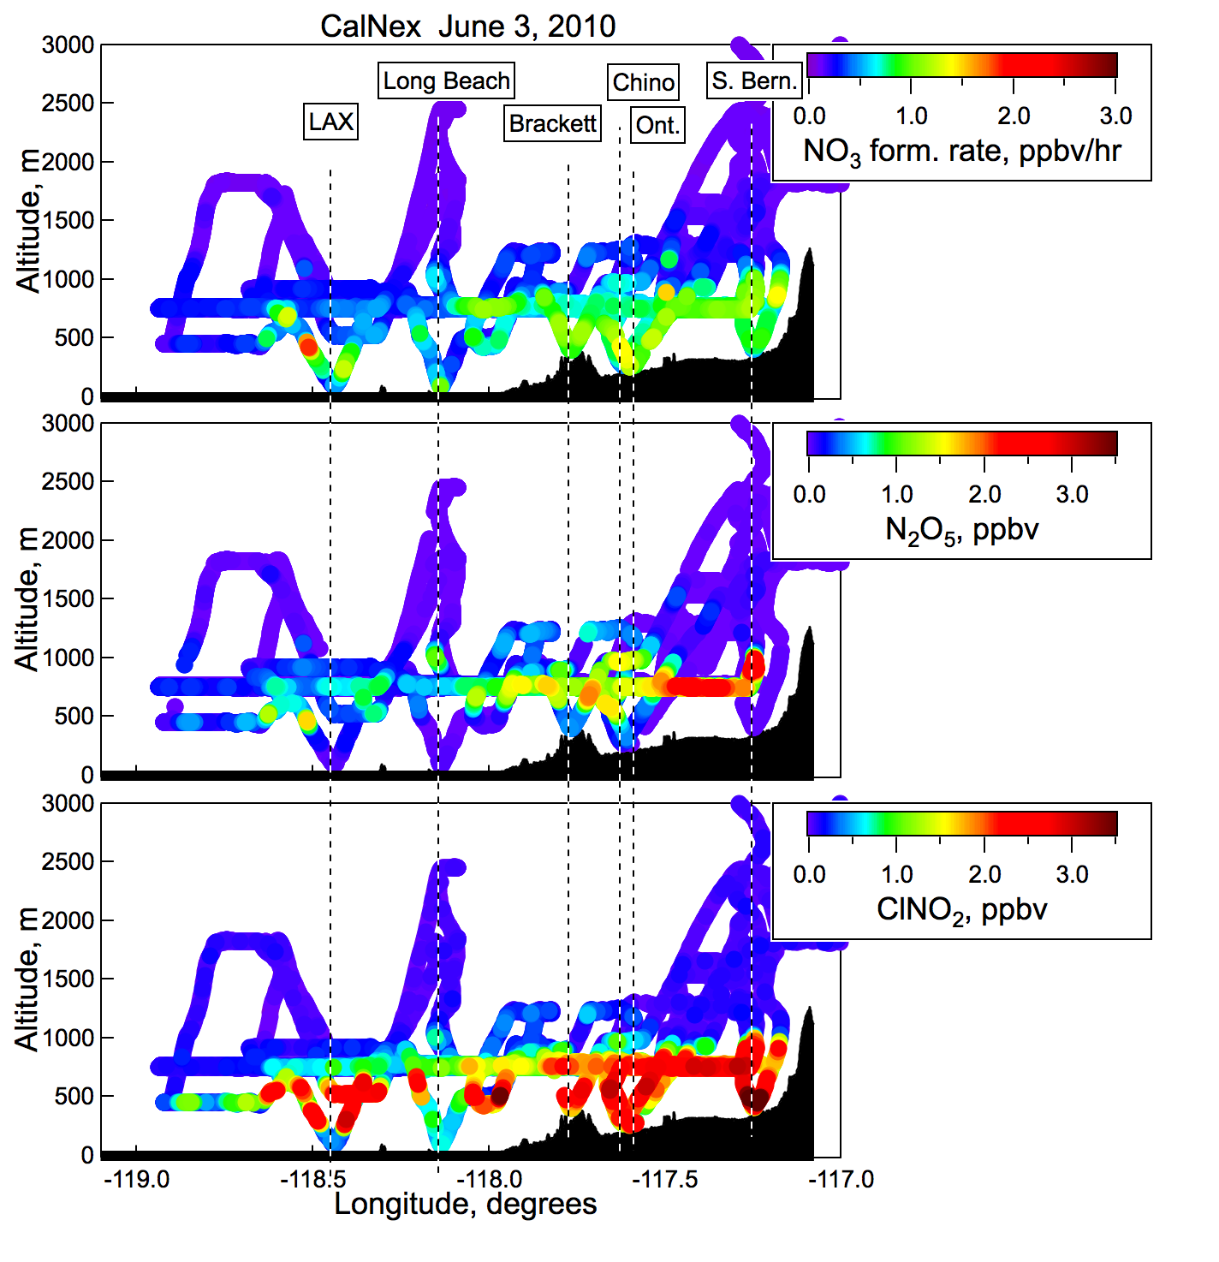
High ClNO₂ close to ground

Slide 12
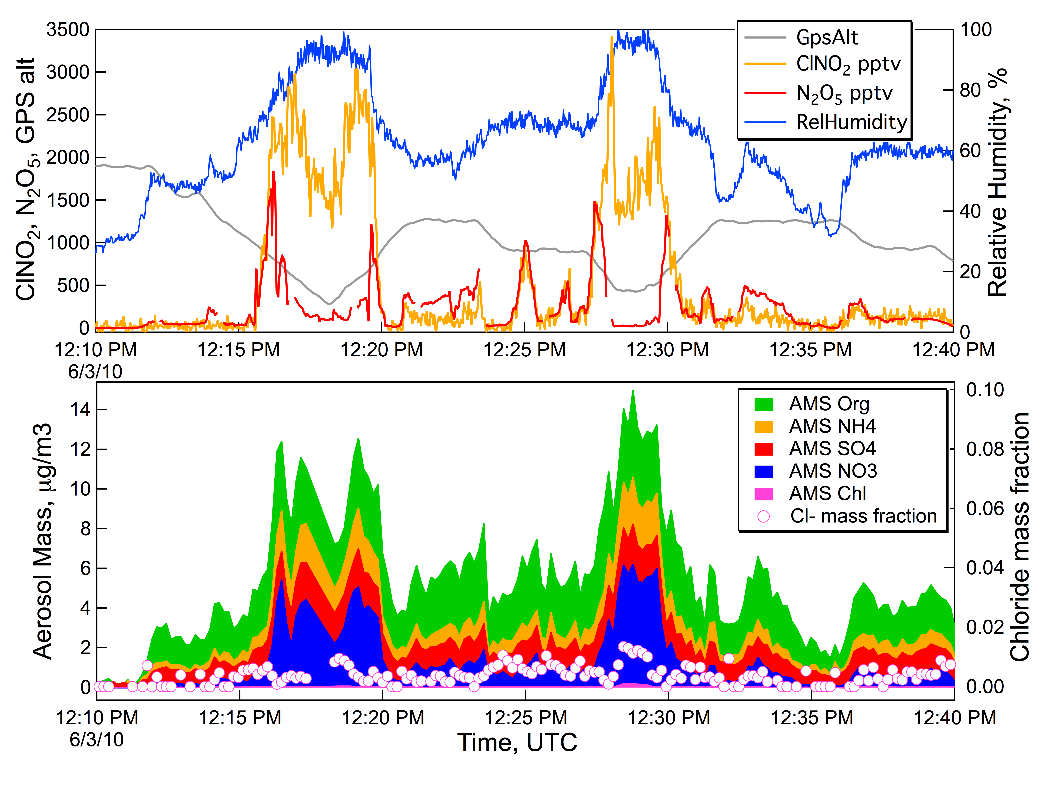
June 3, 2010 Flight – High ClNO₂ close to the ground
Chino El Monte
High RH, Efficient Uptake

Slide 13
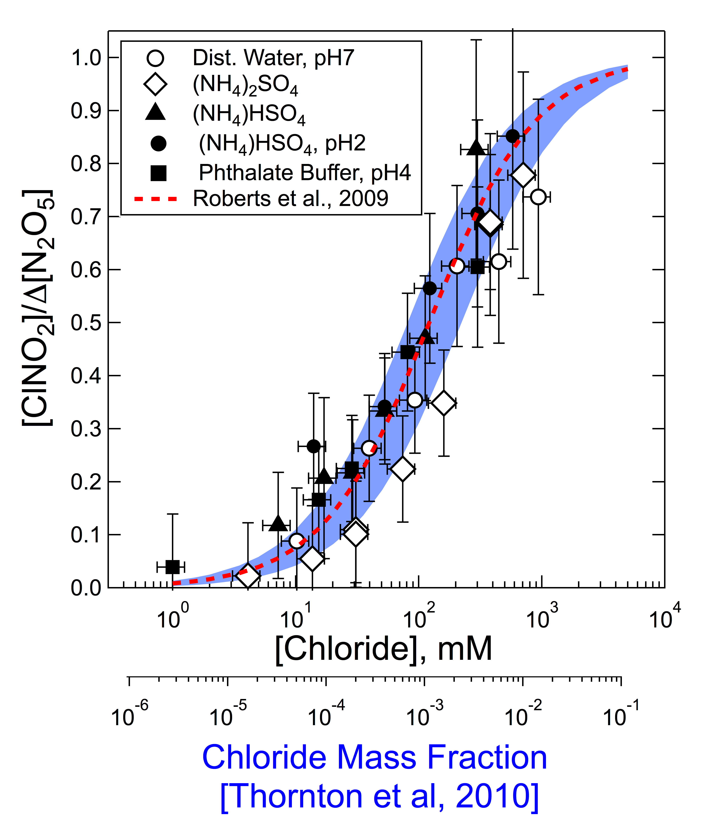
Reaction efficiency vs. particle chloride
N₂O₅ ⬄ NO₂⁺ + NO₃⁻
NO₂⁺ + Cl⁻ => ClNO₂
NO₂⁺ + H₂O => HNO₃ + H⁺
in the particle
Bertram and Thornton, 2009
The chemistry is efficient
even at modest [Cl-]
Low [Cl⁻] difficult to measure
by AMS

Slide 14
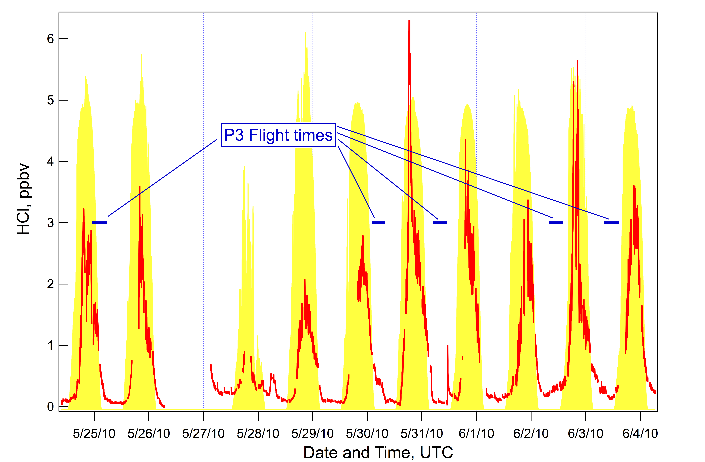
Mass balance requires a gas phase source of soluble chloride
HCl measurements at the Pasadena ground site
J_{NO2} from the
Lefer group
If mid-day HCl is somewhat characteristic of the Daytime PBL then the Residual Layer
has 2-6 ppbv HCl (see also Eldering, et al., Atmos. Environ., 25A, 2091, 1991)
Trevor VandenBoer et al., P21 - Thursday

Slide 15
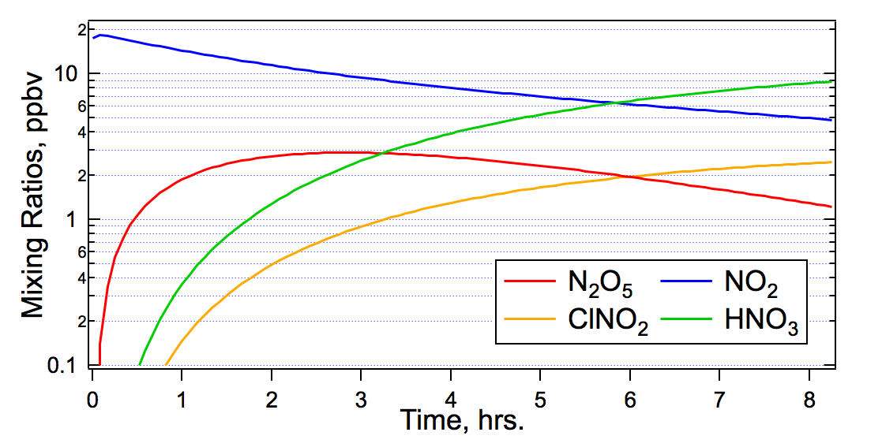
Box model of N₂O₅ to ClNO₂ conversion
R1 NO + O₃ => NO₂ + O₂
R2 NO₂ + O₃ => NO₃
R3 NO₃ + NO₂ <=> N₂O₅
R4 N₂O₅ + Cl⁻_{(aerosol)} => ClNO₂ + HNO₃
R5 N₂O₅ + H₂O_{(aerosol)} => 2HNO₃
R6 NO₃ + NO => 2NO₂
N₂O₅ + H₂O ⬄ NO₂⁺(H₂O) + NO₃⁻
}
Sum: Total uptake rate
Ratio: Reaction efficiency
Initialize with ambient measurements
Adjust R4 and R5 to match N₂O₅ and ClNO₂ at end time
Calculate N₂O₅ uptake and ClNO₂ formation efficiency
Example
Output

Slide 16
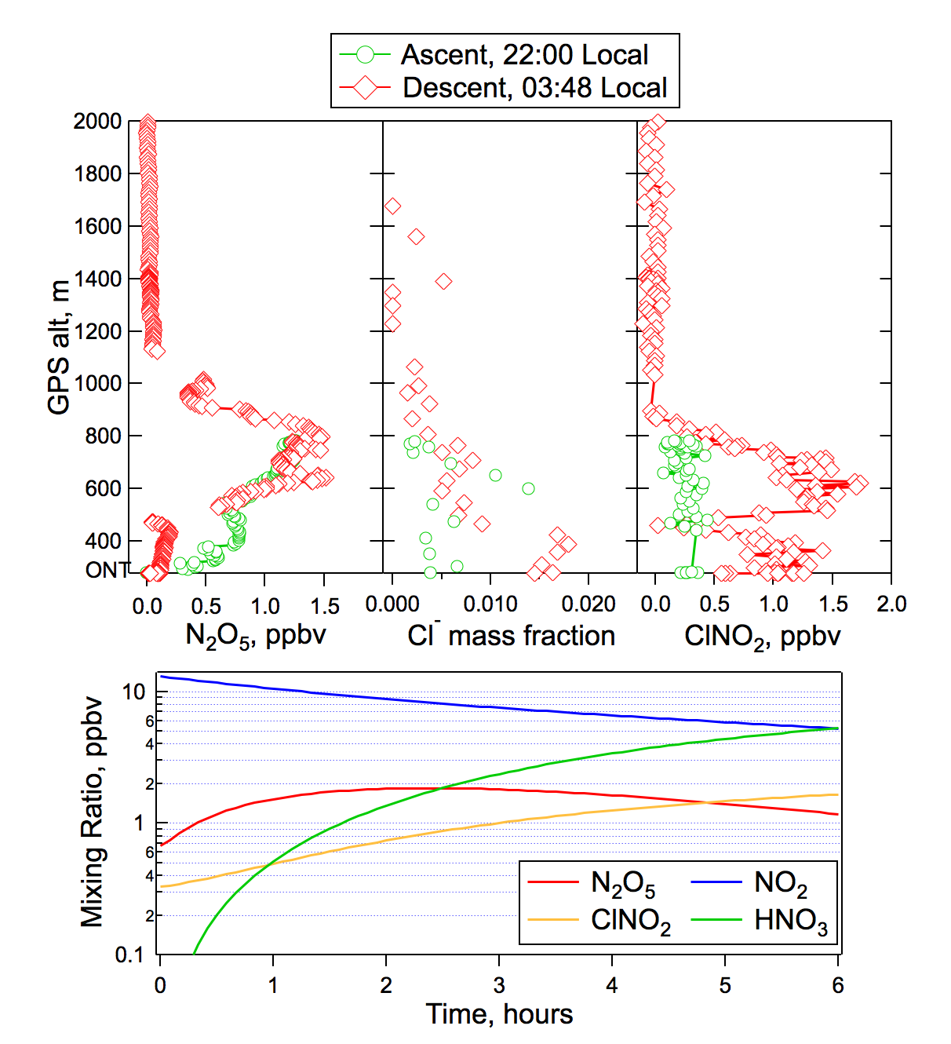
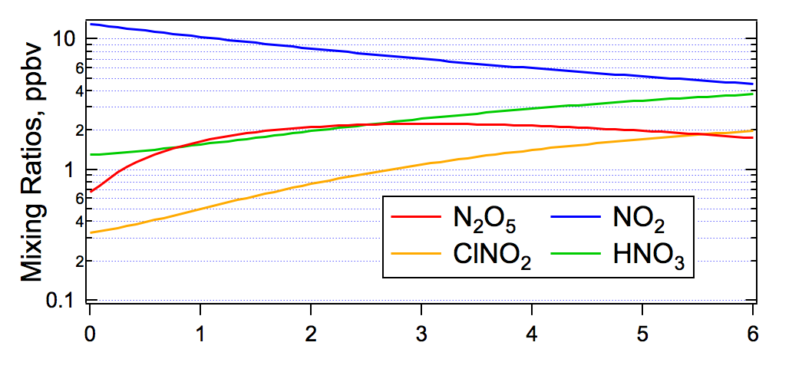
May 31, 2010 Flight
Ascent
vs
Descent
= 3.3 x10⁻³
80% efficiency

Slide 17
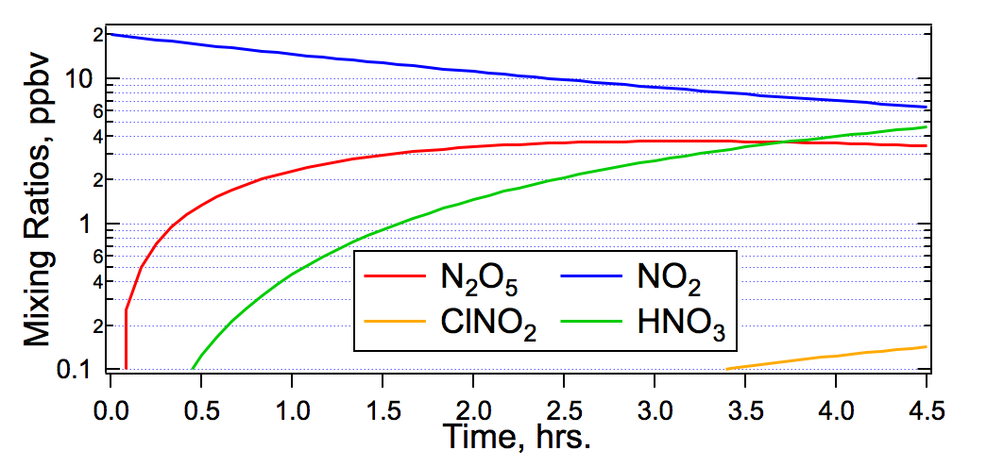
Some more results – maybe a summary
May 30, 2010 Flight
4:05
4:10
4:15
4:20
4:25 Hours since sunset
4:05
4:10
4:15
4:20
4:25
γ= 4.4 x10⁻³
6% efficiency

Slide 18
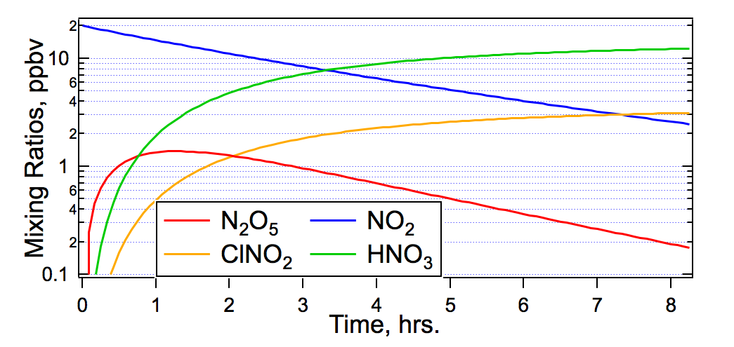
June 3, 2010 Flight
8:20
8:25
8:30
8:35
8:40
8:45
8:50 Hours since sunset
8:20
8:25
8:30
8:35
8:40
8:45
8:50
γ= 2.8 x10⁻²
44% efficiency

Slide 19
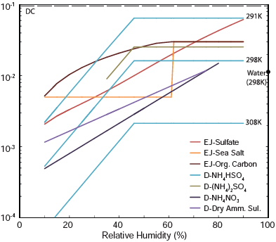
What does this tell us about uptake coefficients.
N₂O₅ uptake coeff.
Figure 15. Chang et al., Aer. Sci. Technol., 45, 655-685, 2011.

Slide 20
Conclusions
ClNO₂ is often abundant in the nighttime residual layer, measured
mixing ratios were up to 3.7 ppbv.
There is often enough aerosol surface area and chloride in the LA Basin to make
the chemistry reasonably efficient.
Low ClNO₂ production seems to be related to low N₂O₅ uptake due to low RH
and low aerosol chloride.
Box model runs make much more HNO₃/NO₃⁻ than is measured
Further Work/Problems/Unknowns
Nitrogen and Odd-Oxygen Balances
O₃ production from Cl atom Chemistry
Soluble Chloride Inventory

