Slide 1


Measurements of light absorption spectra of fine particle aqueous extracts during CalNex at the Pasadena ground site
X. Zhang and R. J. Weber
Georgia Institute of Technology
CalNex Data Analysis Workshop
May 16-19, 2011
Sacramento, CA

Slide 2
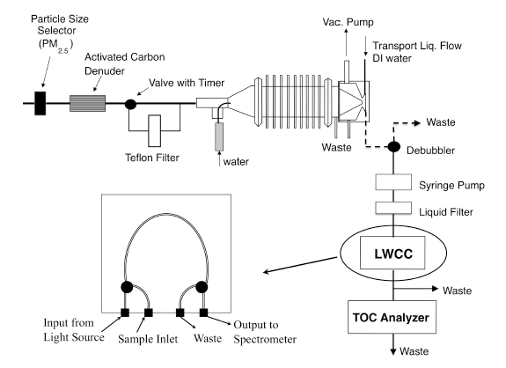
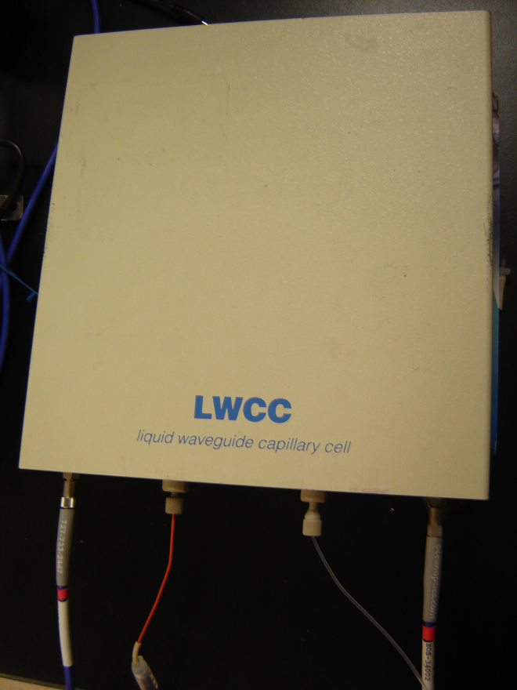
Real-time light absorption spectral measurement
Simultaneous measurements of soluble particle absorption spectra and carbon mass
Long Optical Path Spectrometry
With Liquid Wave guides (LWCC)
1 meter Waveguide
Capillary Cell
(Hecobian et al., 2010)
Complete absorption spectra (200 – 800nm) was saved every 15 min
Absorption coefficients at selected wavelengths (365nm, 700nm) were saved
every 60 sec

Slide 3
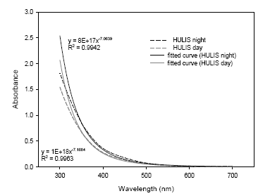
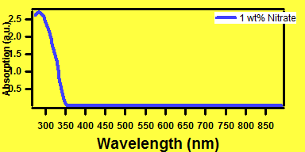
Choice of wavelength: λ = 365nm
λ = 365nm : Absorption averaged between 360 and 370nm
Soluble Brown Carbon, specifically associated with HULIS (Lukacs et al., 2007);
Avoid interferes from other species: e.g. Nitrate;
Nitrate
HULIS
λ = 700nm: Reference wavelength
(Hoffer et al., 2006)
Blank
measurement
Absorption coefficient at 365nm (Abs₃₆₅)
λ = 365
V_{l}
Abs_{λ} = (A _{λ} – A₇₀₀)
· ln(10)
V_{a} · l
λ = 700
Unit: m⁻¹

Slide 4
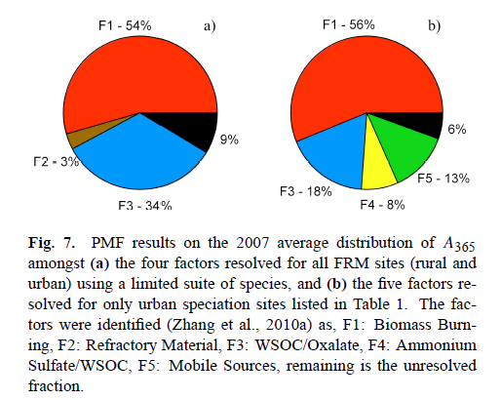
Sources of brown carbon: PMF result on FRM filters
PMF analysis on 900 FRM filters collected at 15 sites in SE US
Major sources of Brown Carbon (Abs₃₆₅) in the southeast:
Biomass Burning
Ammonium Sulfate/WSOC
Biomass burning;
Primary emissions from vehicle;
SOA formation (WSOC/Oxalate);
Refractory Material
Mobile Sources
WSOC/Oxalate
Residual
Possibly related to aqueous SOA formation/chemical aging – oxalate and brown carbon peak hours after WSOC peak on diurnal average from online dataset in Atlanta.
(Hecobian et al., 2010)

Slide 5
WSOC and brown carbon during CalNex
Caltech site: Jun. 01 – Jun. 15
Abs₃₆₅
WSOC
Riverside campus: May. 17 – Jun. 14

Slide 6
CalNex: mass absorption efficiency
“primary”
secondary
Abs₃₆₅
WSOC
EC
Mass absorption efficiency (α_{abs})
ΔAbs₃₆₅/ ΔWSOC
at 360-370nm
α_{abs} = 0.71 m²/g
Small compared to α_{abs} for soot ~ 7.5m²/g (Bond and Bergstrom, 2006)

Slide 7
Mass absorption efficiency: LA compared with Atlanta
primary
secondary
Abs₃₆₅
WSOC
EC
Gatech campus
in Atlanta, Aug. 2010
ΔAbs
Mass absorption efficiency
LA: α_{abs} = 0.71 m²/g
LA 4 x higher
ATL: α_{abs} = 0.18 m²/g
LA fresh secondary WSOC is much more light-absorbing than Atlanta

Slide 8
Angström exponent
Wavelength dependence of the absorption coefficient
Plot on Ln-Ln scale
α_{ab} = K · λ^{-Å}
Slope = -Å
For ambient aerosol
Å ~1: black carbon (absorbs at all wavelength)
Å ~2: ambient biomass burning aerosol (Kirchstetter et al., 2004)
Å ~3.5: polluted region in China (Yang et al., 2009)
For liquid extracts (this study)
Å ~7: water-soluble HULIS (Hoffer et al., 2006)
Å ~7-16: smoldering smoke (Chen and Bond, 2010)
Å ~7: fresh limonene SOA (Bones et al., 2010)
Å ~4.7: aged limonene SOA (Bones et al., 2010)
Å ~6-8: FRM filters in SE US (Hecobian et al., 2010)

Slide 9
Variation of Angström exponent
Example: 6.3.2010 – high concentration of Abs₃₆₅
Å varies between 2 and 5.5, lower during daytime and higher at night; Å increased from “fresh” to “aged” SOA?
Å derived from online measurement significantly lower than Å from filter-based measurement (discussed in the next slide);

Slide 10
Filter-based vs. online absorption measurements
Comparing Absorption coefficient (Abs₃₆₅) and Angström exponent
CalNex Online
CalNex
Hivol Filter
Some underestimation of Abs₃₆₅ by high-vol filter;
Online and filter Å quite different; For filter less absorption at higher wavelengths;
Possible artifacts of filter-based brown carbon measurement:
Storage: 1-yr in the freezer leading to changes?
Extraction: extraction/sonication leading to degradation of larger chromophores
which absorb light at higher wavelengths? (Sun et al., 2007)
Time resolution: filter liquid extracts sit for 1-2 days before analysis

Slide 11
Why care about Brown Carbon?
Summary and Implications
Summary
Major sources of brown carbon during CalNex is SOA formation and mobile emission ;
Fresh LA WSOC is ~4 times more light-absorbing than fresh ATL WSOC, possibly due to a larger fraction of anthropogenic aerosol in LA;
Angström exponents lower during daytime and higher morning and night (evidence for anthropogenic SOA evolution?);
Filter-based measurement not consistent with online measurement (more experiments)
Generally not thought to have effect on radiative forcing due to small mass absorption efficiency (Andreae & Gelencser, 2006), BUT
SOA properties, source and evolution:
- Component of fresh anthropogenic SOA (related to aromaticity?) (Sun et al., 2007),
useful for contrasting SOA in different urban settings (e.g. LA vs ATL);
- Dissolve in liquid droplets, affect cloud absorption (Mayol-Bracero et al., 2002) &
useful to study heterogeneous processing;
Future work/collaboration
Try to find correlation between brown carbon and specific SOA component?

