Slide 1
Integrating Resources for World History
Mark Jarrett, Ph.D. Amy Thibaut Montra Rogers
Jarrett Publishing Thibaut Consulting Houston ISD

Slide 2

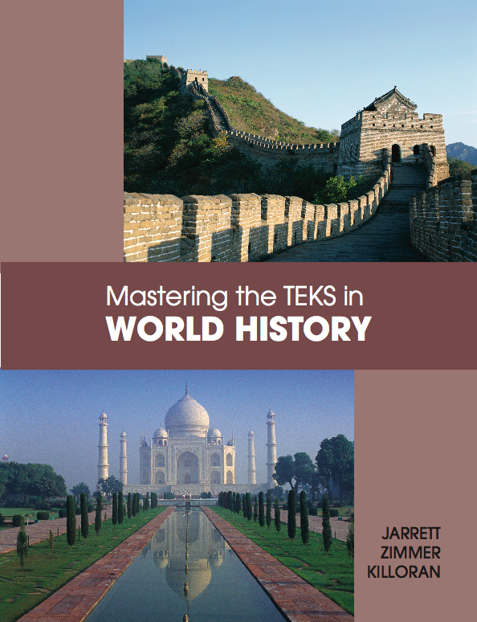
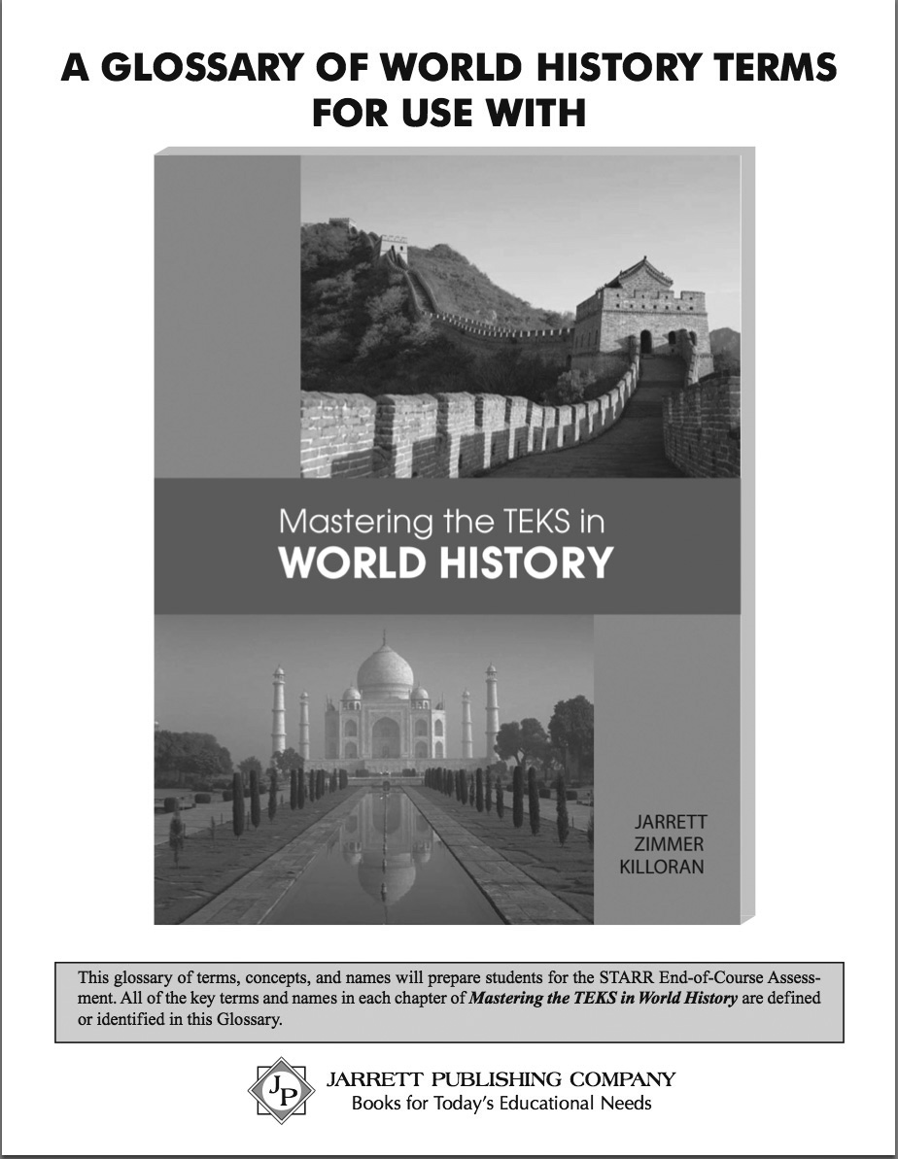
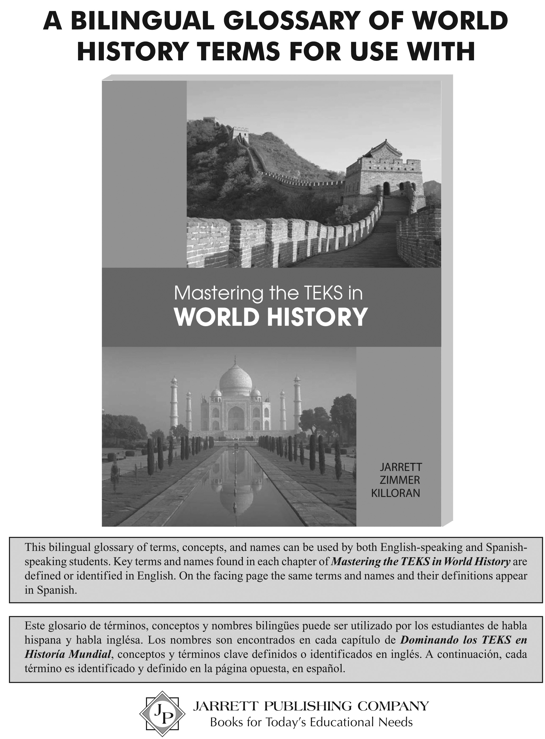
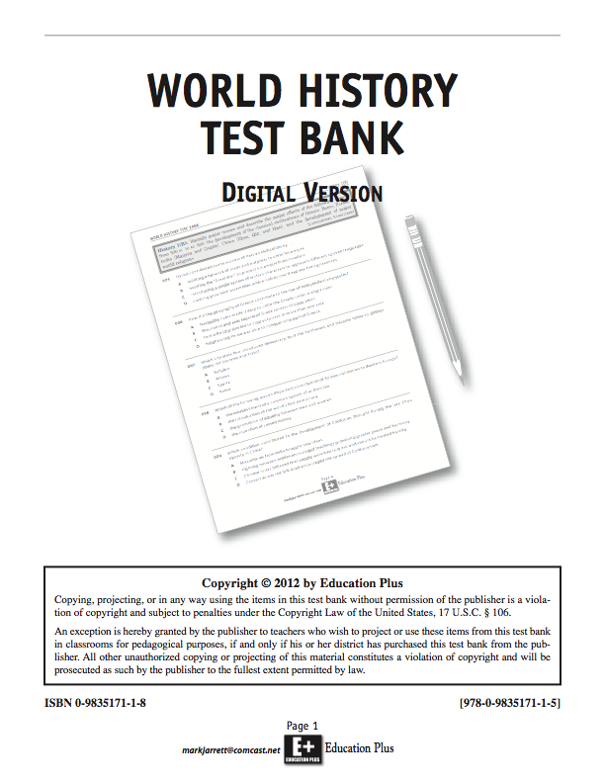
World History Resources
Mastering the TEKS in World History
Video Overview
World History Test Bank
Teacher’s Guide
A Glossary of World History Terms

Slide 3
Rocky slowly got up from the mat, planning his escape. He hesitated a moment and thought. Things were not going well. What bothered him most was being held, especially since the charge against him had been weak. He considered his present situation. The lock that held him was strong but he thought he could break it. He knew, however, that his timing would have to be perfect. Rocky was aware that it was because of his early roughness that he had been penalized so severely--much too severely from his point of view. The situation was becoming frustrating; the pressure had been grinding on him for too long. He was being ridden unmercifully. Rocky was getting angry now. He felt he was ready to make his move. He knew that his success or failure would depend on what he did in the next few seconds.

Slide 4
Critical Questions
What was this reading about?
What is the importance of prior knowledge in providing a context, or frame of reference, for the reading?
Notes:
contextus:
con = with
texere = to weave

Slide 5
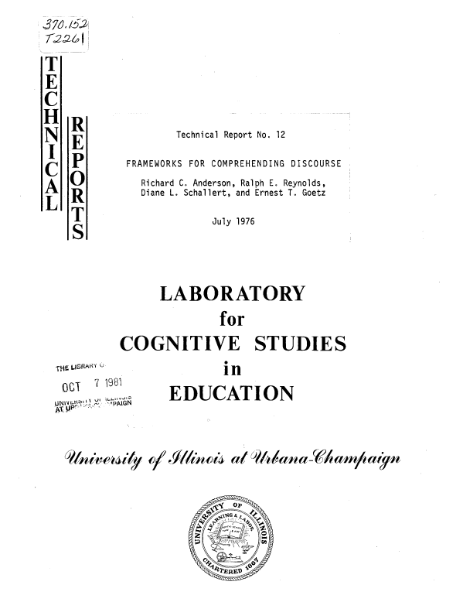

Slide 6
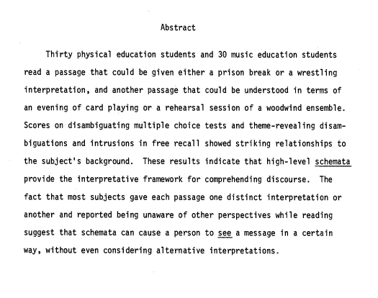

Slide 7
The Critical Importance of Possessing a Larger Framework
How can students learn all of the myriad names, events, dates and facts of World History if they have no framework in which to place them?
How can students understand and relate all these facts if they are simply random events, and students don’t see any bigger picture? These events simply appear to them, absent any larger context.

Slide 8
Our new World History video includes a “Survey of World History” that provides a very basic framework for your students—i.e., an “advance organizer” for the entire course, based on the TEKS, which students can access at any time on the Internet. This overview provides the contextual framework into which educated adults instinctively fit the specific periods, achievements and events of world history.

Slide 9
Video: A Guide to Mastering the TEKS in World History
Introduction
STAAR Test
World History Survey
Special Features of the Book
Glossary – World History Terms
World History Test Bank
Copyright/Copying Policies
IMA Funding
Contact Information

Slide 10
What is the World History Test Bank?

Slide 11
World History Test Bank
The World History Test Bank contains 684 test questions based on STAAR and includes an additional 21 questions based on the Social Studies Skills TEKS.
There are enough questions to be used for teacher quizzes, unit tests, a district-wide midterm and a final practice test.

Slide 12
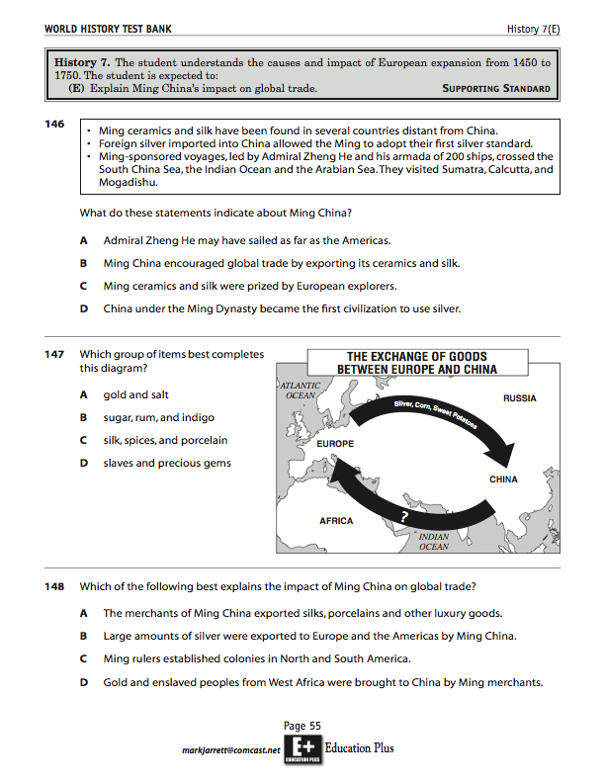
World History Test Bank
Each TEKS starts a separate section.
Three or more questions follow each TEKS.

Slide 13
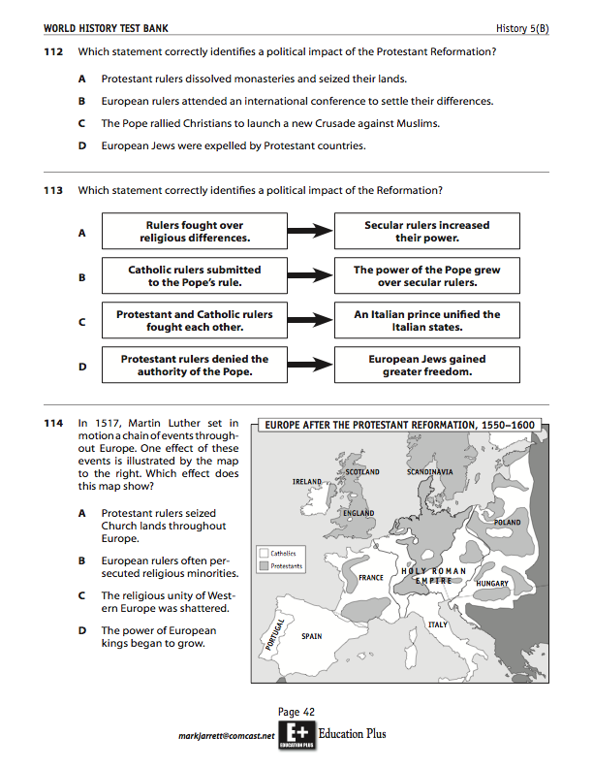
World History Test Bank
Special emphasis is placed on the “action word” of the TEKS.
A large number of items include maps, quotations and diagrams

Slide 14
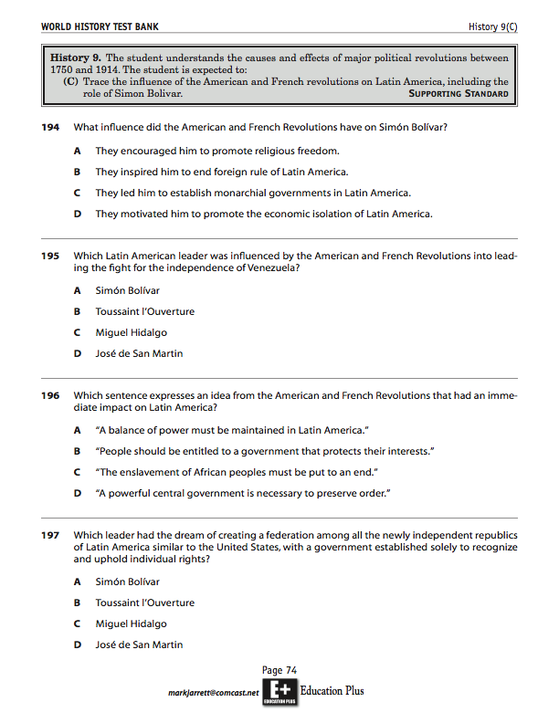
World History Test Bank
Answer choices are in parallel format.
Wrong answers (“distractors”) are plausible but incorrect.
Questions are of varying difficulty.

Slide 15
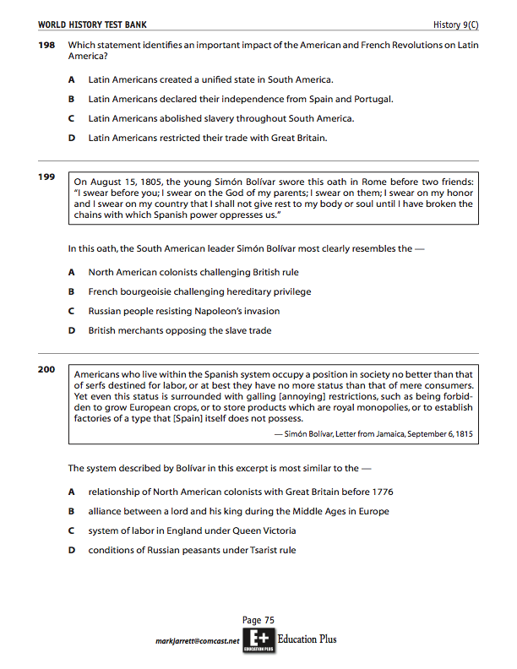
World History Test Bank
Answer choices are in parallel format.
Wrong answers (“distractors”) are plausible but incorrect.

Slide 16
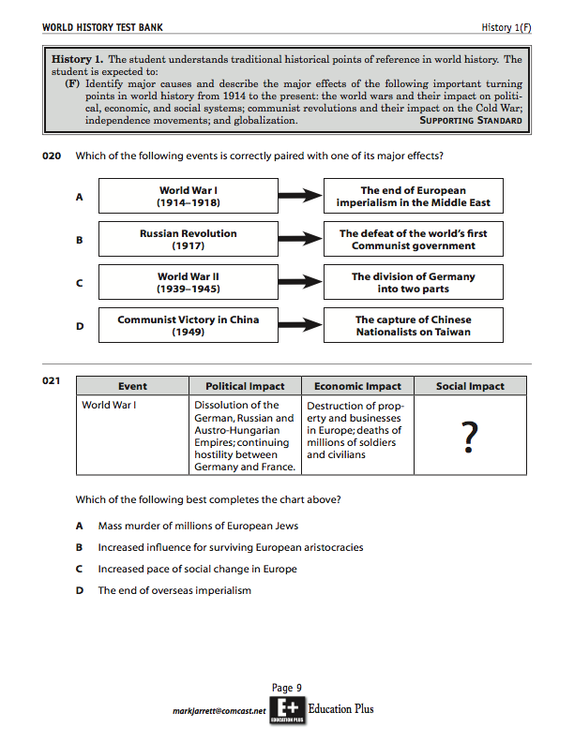
World History Test Bank
Many items are modeled directly after questions released by the Texas Education Agency.

Slide 17
World History Test Bank
A large number of items include one or more illustrations, maps, quotations, cartoons, or diagrams.

Slide 18
World History Test Bank
There are sequence questions.

Slide 19
World History Test Bank
There are timelines.

Slide 20
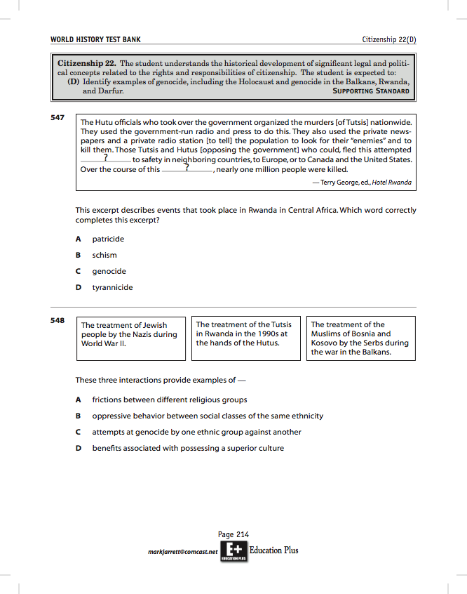
World History Test Bank
There cloze-type questions.

Slide 21
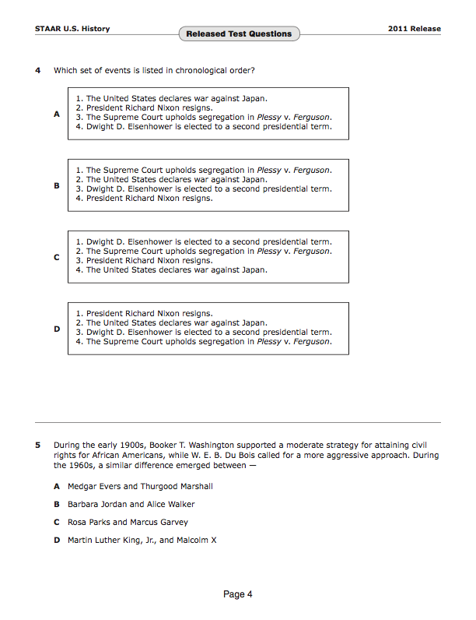
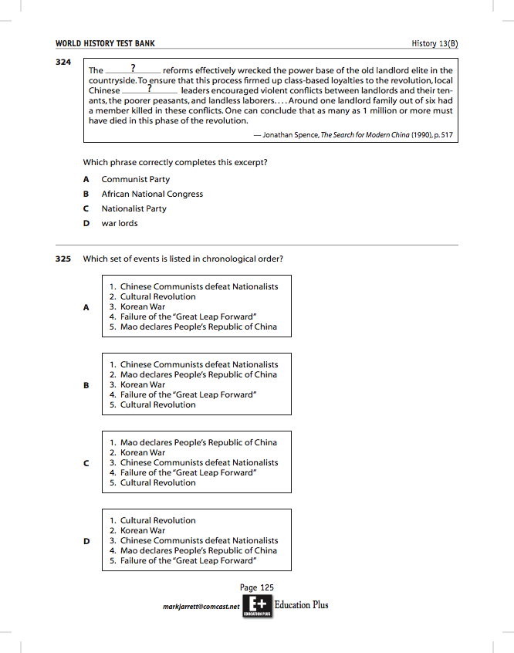
World History Test Bank
There are chronology questions, based on one of the released questions for US History.

Slide 22
World History Test Bank
Cluster questions can be used together or separately.

Slide 23
World History Test Bank
In addition to questions for the History TEKS, there are a host of questions on the other reporting categories — government and citizenship, geography and culture, and economics and science and technology.
For example, there are 12 questions on Culture 23(A) on the origins, central ideas, and spread of major world religions and philosophical traditions.

Slide 24
World History Test Bank
For “Science, Technology & Society,” for example, the Test Bank focuses on those scientists and inventors expressly identified in the TEKS.

Slide 25
World History Test Bank
However, we keep in mind that the TEKS states that students should identify the contributions of significant scientists and inventors “such as” Marie Curie, Thomas Edison, Albert Einstein, etc. In other words, these are only examples, and (as the TEA reminds us from time to time) there could be others.

Slide 26
World History Test Bank
There are 21 additional Social Studies Skills questions.

Slide 27
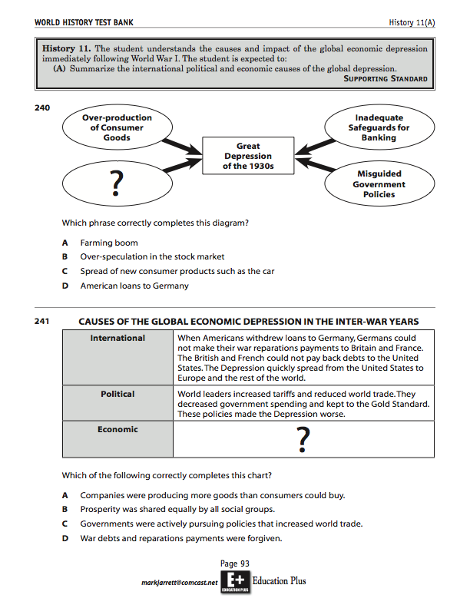
World History Test Bank
Questions are of varying difficulty and cognitive complexity.
Some questions are especially challenging.
Teachers should choose questions within the test bank to moderately challenge their students and gradually introduce more difficult questions.

Slide 28
TSSSA World History Challenge
How do you design a question about a documentary excerpt, graph, photograph, painting, cartoon, table or map that:
(1) assesses a student’s ability to interpret information from that source;
and at the same time:
(2) assesses the student’s content knowledge of that topic
This question has two parts. How should one do this? How does Pearson do this in designing STAAR questions?

Slide 29
Question: How can a test-writer embed a document in an assessment item and ask students a question about it that goes beyond assessing data-interpretation skills?
The Problem: The test-writer must navigate between Scylla and Charybdis: on the one hand, the student should not be able to respond correctly to the question just by a skilled reading of the document alone. On the other hand, the student should not be able to answer the question correctly just based on his or her content knowledge without ever reading the document (e.g. most TAKS questions).

Slide 30
The mystery unraveled!
One might conclude that the reading should be one that requires prior background knowledge to be understood correctly; or that the student should be challenged to draw conclusions from the reading that require additional outside content knowledge to make.
In fact, Pearson has eschewed this approach for the STAAR test. Rather, based at least on their released sample items for all social studies subjects, they have adopted the approach of using the information in the document to ask about something that goes outside of it—such as asking for a cause, an effect, or an analogy to the information described in the source quotation. The most common of these are questions asking for an effect of whatever is displayed in the question.

Slide 31
Typology of Released Questions on Documents:
EFFECT
Identify an effect (either of the document itself, or of the situation described in the document, including government responses to problems described in the document)
CAUSE
Identify a cause, (either of the document itself, including the purpose for the document, or of the situation described in the document)
CLOZE
Identify a missing term or text from the document (cloze format)

Slide 32
Typology of Released Questions on Documents
SEQUENCE
Identify the next step in the same process as that described in the document
ANALOGY
Identify an equivalent based on an analogy with the information in the document
PROCESS
Identify the general process described or exemplified in the document

Slide 33
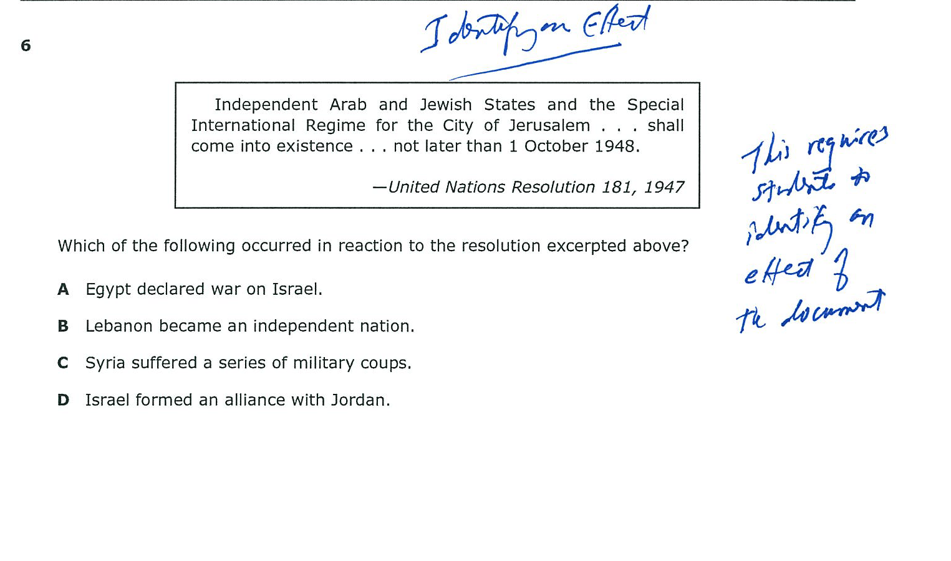

Slide 34
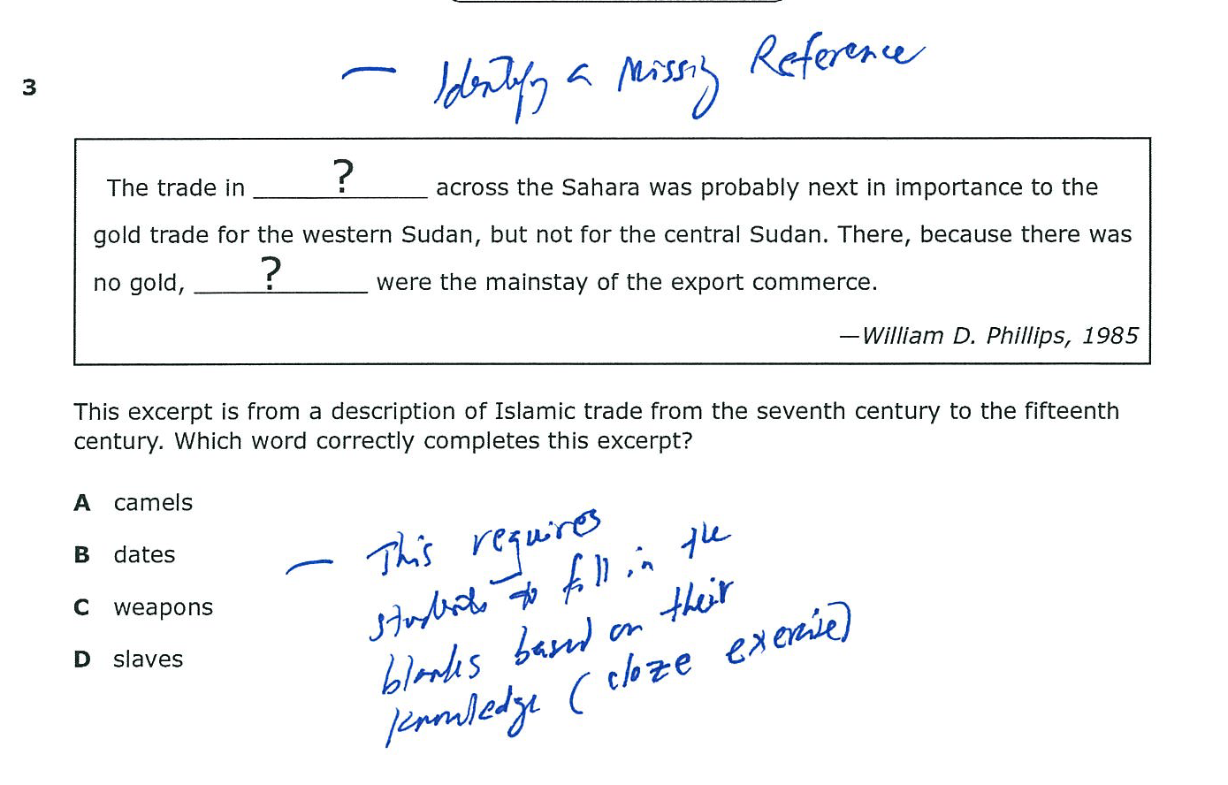

Slide 35
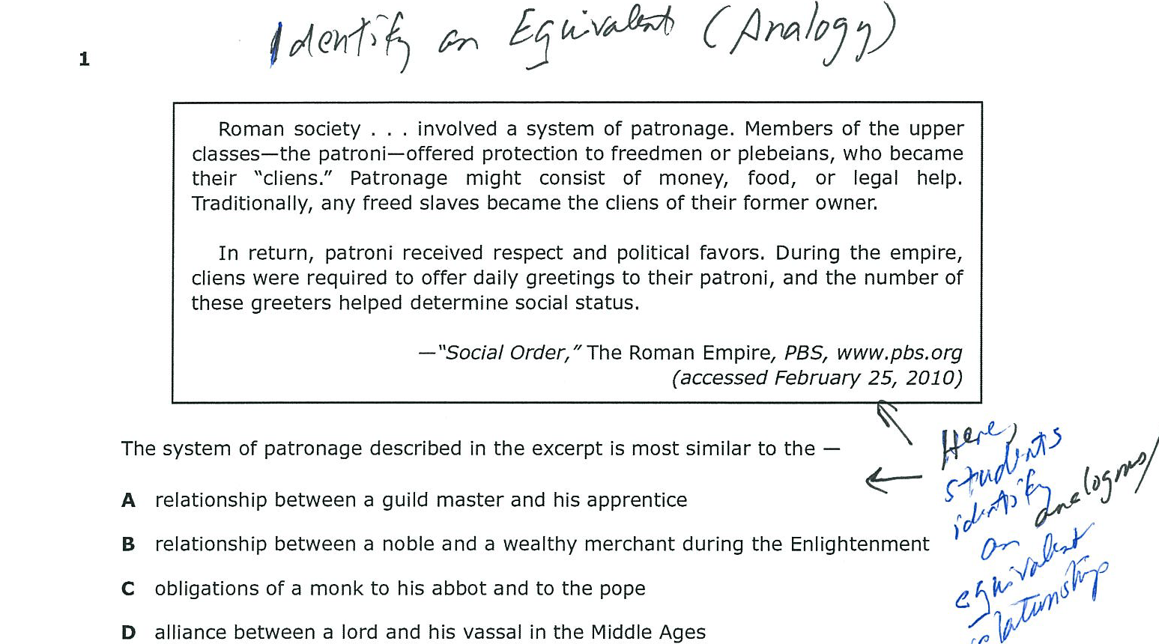

Slide 36
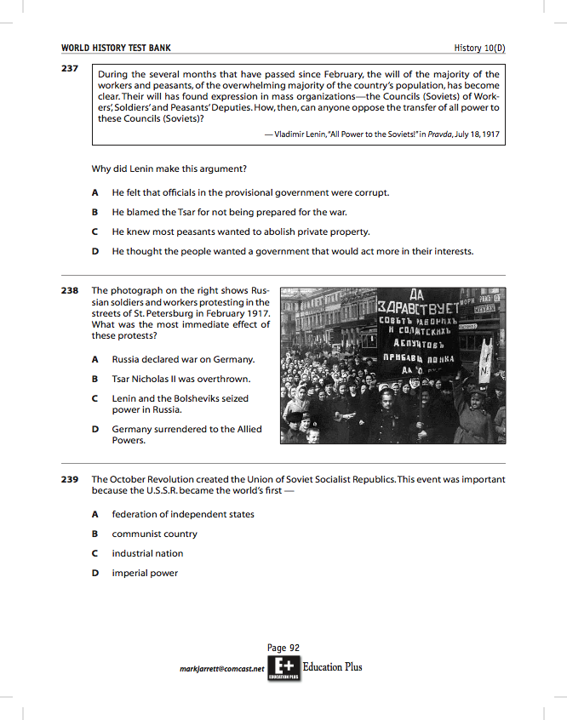
World History Test Bank
Questions on documents ask students both (A) to interpret the document and (B) to apply outside content knowledge.

Slide 37
World History Test Bank
Let’s revisit this page!
Question 199 asks for an analogy based on the quotation
Question 200 also asks for an analogy

Slide 38
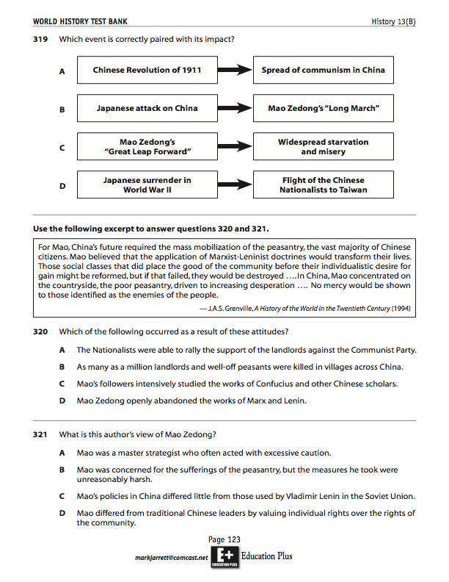
World History Test Bank
And let’s look again at Question 320. It asks students to read a secondary source and then to identify an effect of what is described in the document:
“Which of the following occurred as a result of these attitudes?”

Slide 39
In Question 219, students examine a photograph and then apply their own content knowledge of “the major characteristics of World War I, including . . . trench warfare” (History 10 B) to identify the conflict in the photograph.

Slide 40
World History Test Bank
Every World History TEKS is covered by items in the World History Test Bank.
Students have not seen any of these questions before—they are not in our book and they are not available to students.
They are only available to districts purchasing the test bank.

Slide 41
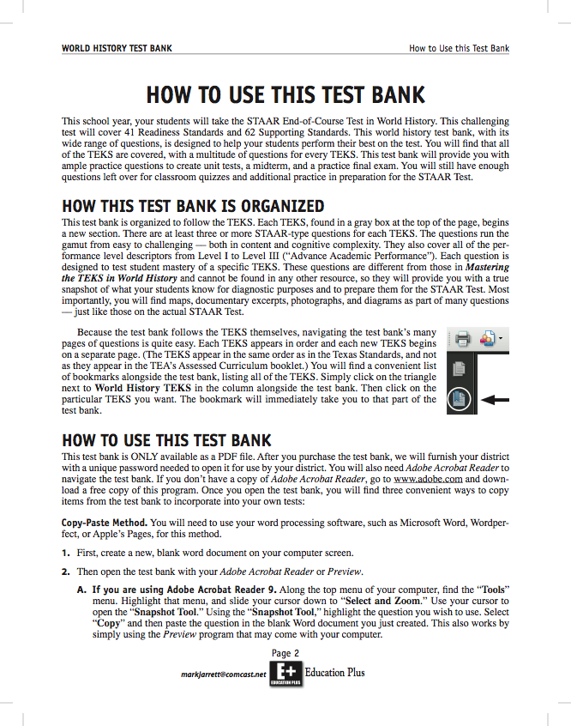
World History Test Bank
All the TEKS are bookmarked.
You can copy and paste, use the snapshot tool, physically cut out items, or retype the items.
We also include the questions themselves, without visuals, in an accompanying MS Word document to facilitate copying of items or incorporation into your district's own test bank.

Slide 42
World History Test Bank
We are licensing intellectual property, not a book.
No replacements will ever be needed.
The terms of the license are generous—about as generous as they can be—in perpetuity within your district!
When you purchase the test bank, think not only in terms of this year but all future years.
Please order from our affiliate for digital products, Education Plus. (We can provide your purchasing department with a sole source affidavit, W-9, conflict-of-interest form, etc.)

Slide 43
What to Remember about the World History Test Bank:
684 questions on the assessed TEKS and an additional 21 on the Social Studies Skills TEKS.
At least three and sometimes more than ten items per TEKS.
A special focus on the History TEKS.
Every tested TEKS is covered.
Test items directly focus on what each TEKS asks.
Many items have images, documentary excerpts or maps.
Enough questions to be used for teacher quizzes, unit tests, a district-wide midterm and a practice final.
Students have not seen these questions before.

Slide 44
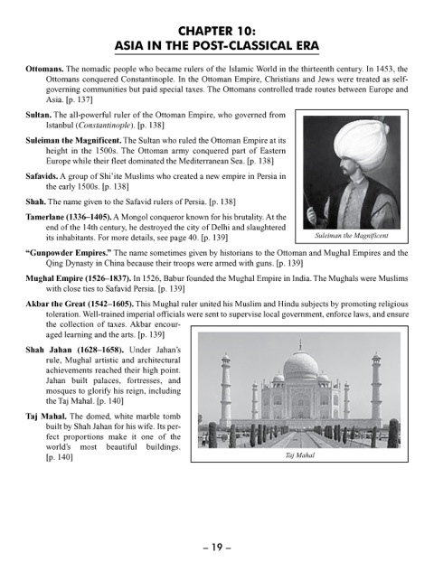
Wor
Glossary of World History Terms
Bilingual edition has 111 pages.
People, places, events and concepts are fully defined, identified or described.

Slide 45
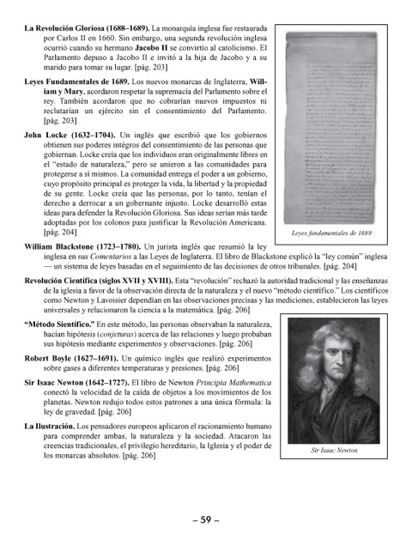
Glossary of World History Terms The glossary is organized to follow the chapters of the book

Slide 46
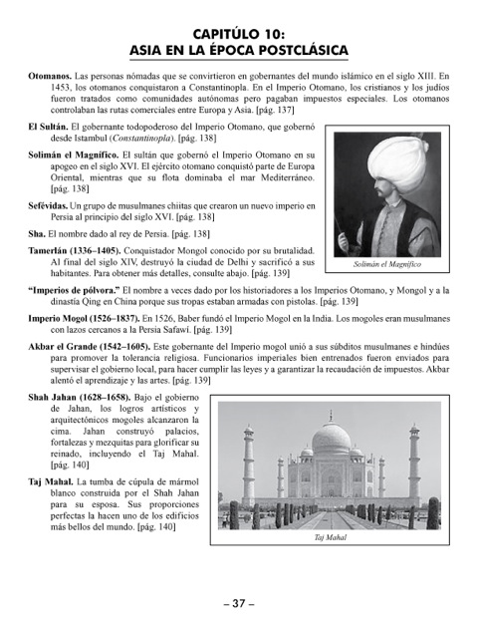
Glossary of World History Terms
The same text
appears on
facing pages
in Spanish

Slide 47
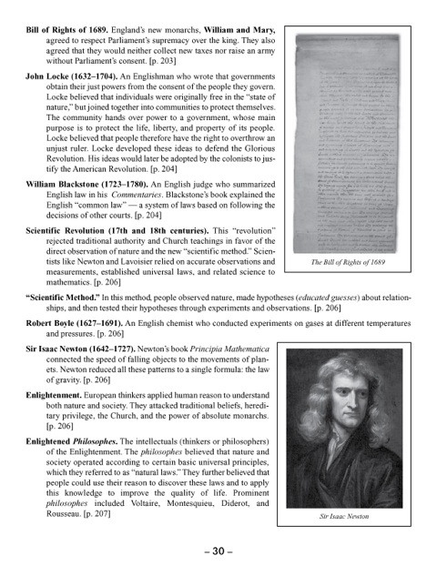
A Glossary of World History Terms Also available in an English- only edition (57 pp.)

