Slide 1
Encumbering Payroll
Winter Conference
2012

Slide 2
Why Encumber?
Helps project salaries and fixed costs based on live data when you encumber.
Reports and account balance lookups will reflect a true balance after payroll expenses and projected payroll expenses are subtracted.
If you post in detail, you will see each person listed in the Account Balance and Transaction Detail Lookup.
State will be requiring for some counties this year and probably all next year.

Slide 3
How does the process work?
Run a program that will project remaining salaries and fixed costs.
Review the reports. When satisfied, post the encumbrances.
As you run payrolls, the system will disencumber based on the expenses.
At year end, you will run a program that will clear any remaining balances.
Balances can be viewed in the Employee Encumbrance Balance program, in the Beginning Account Balance and Transaction Detail Lookup program and also on financial reports.
Changes to assignments or deduction amounts will not change the encumbrance balance. Manual changes can be done in the Employee Encumbrance Balance program or you can clear your encumbrance balances and re-encumber.

Slide 4
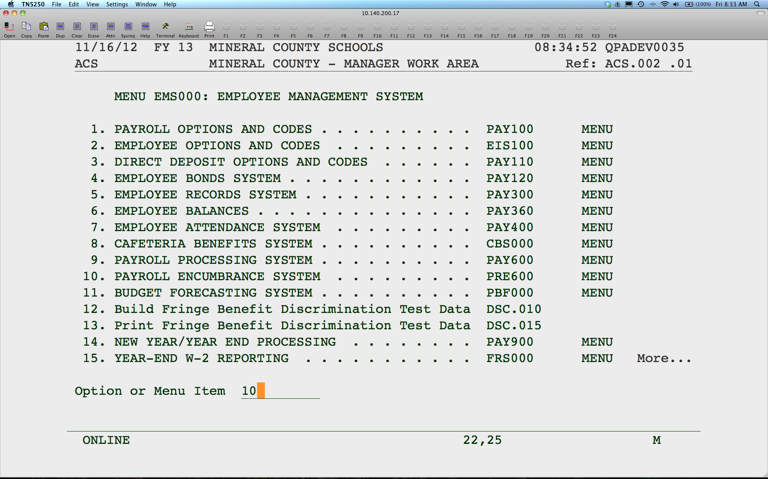
Notes:
Select Payroll Encumbrance System.

Slide 5
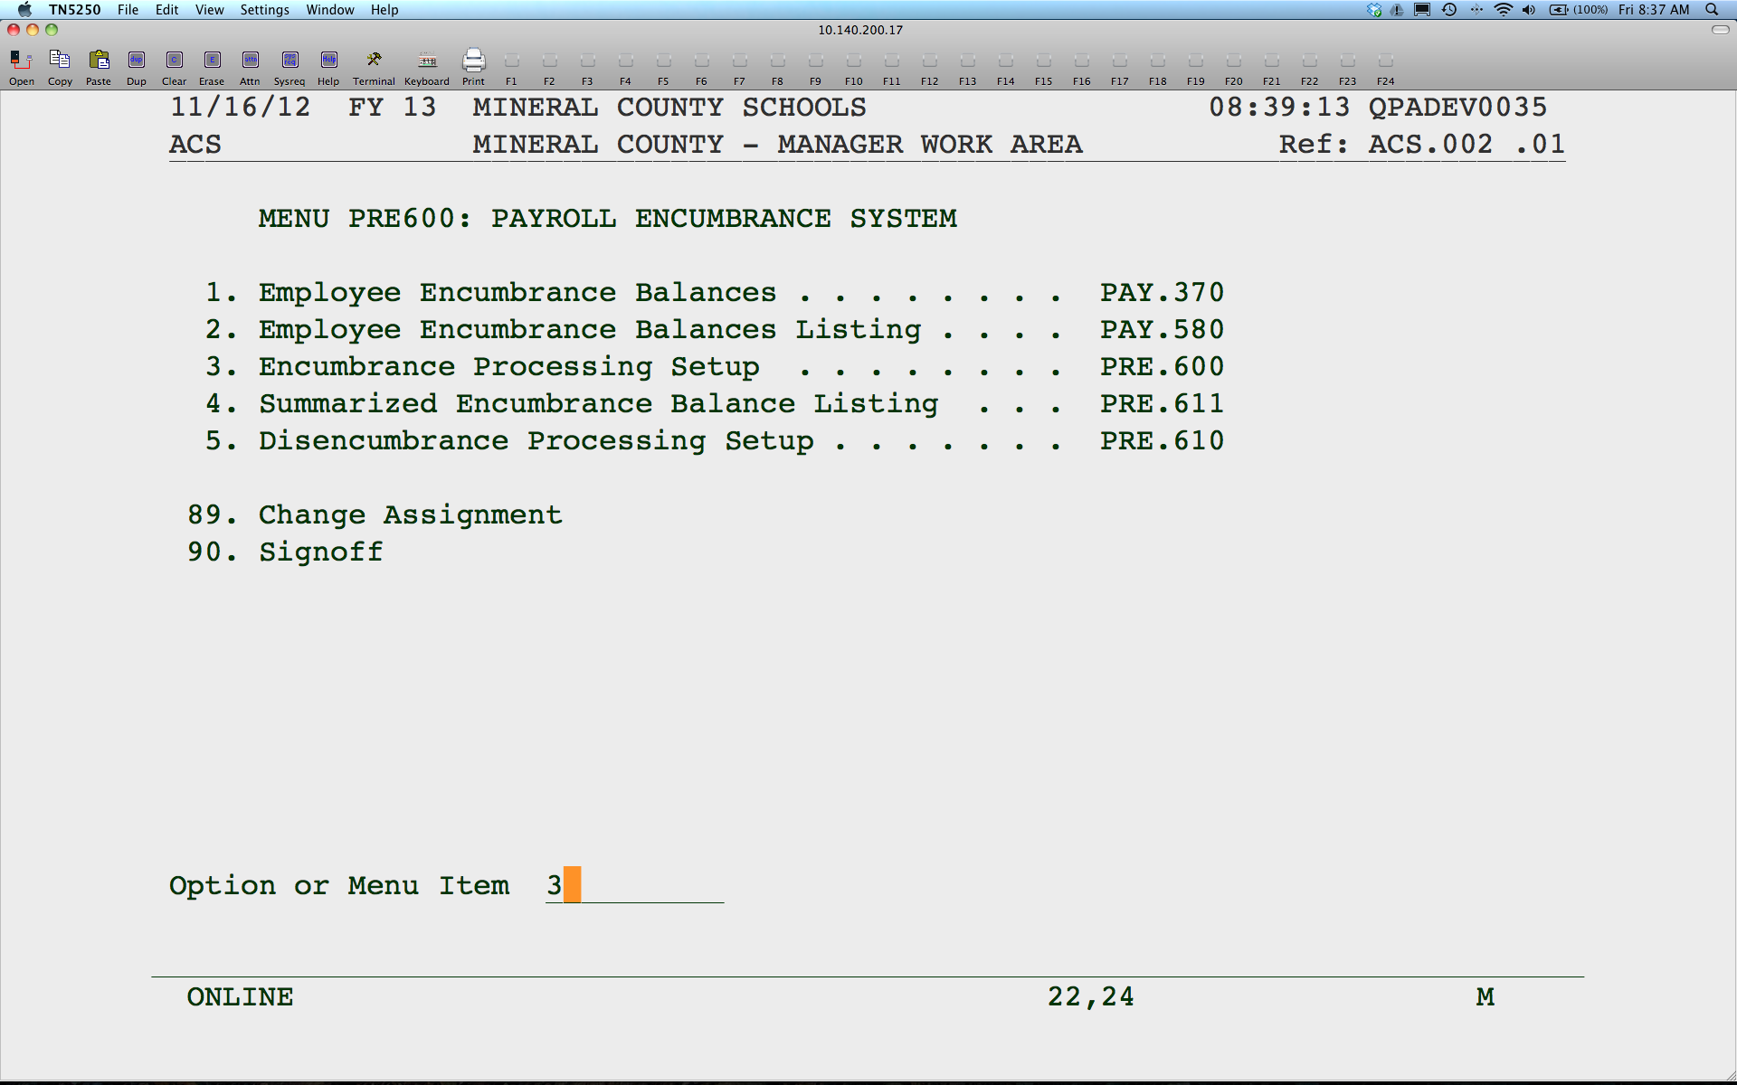
Notes:
Run the Encumbrance Processing Setup program to calculate and encumber salaries and fixed costs.

Slide 6
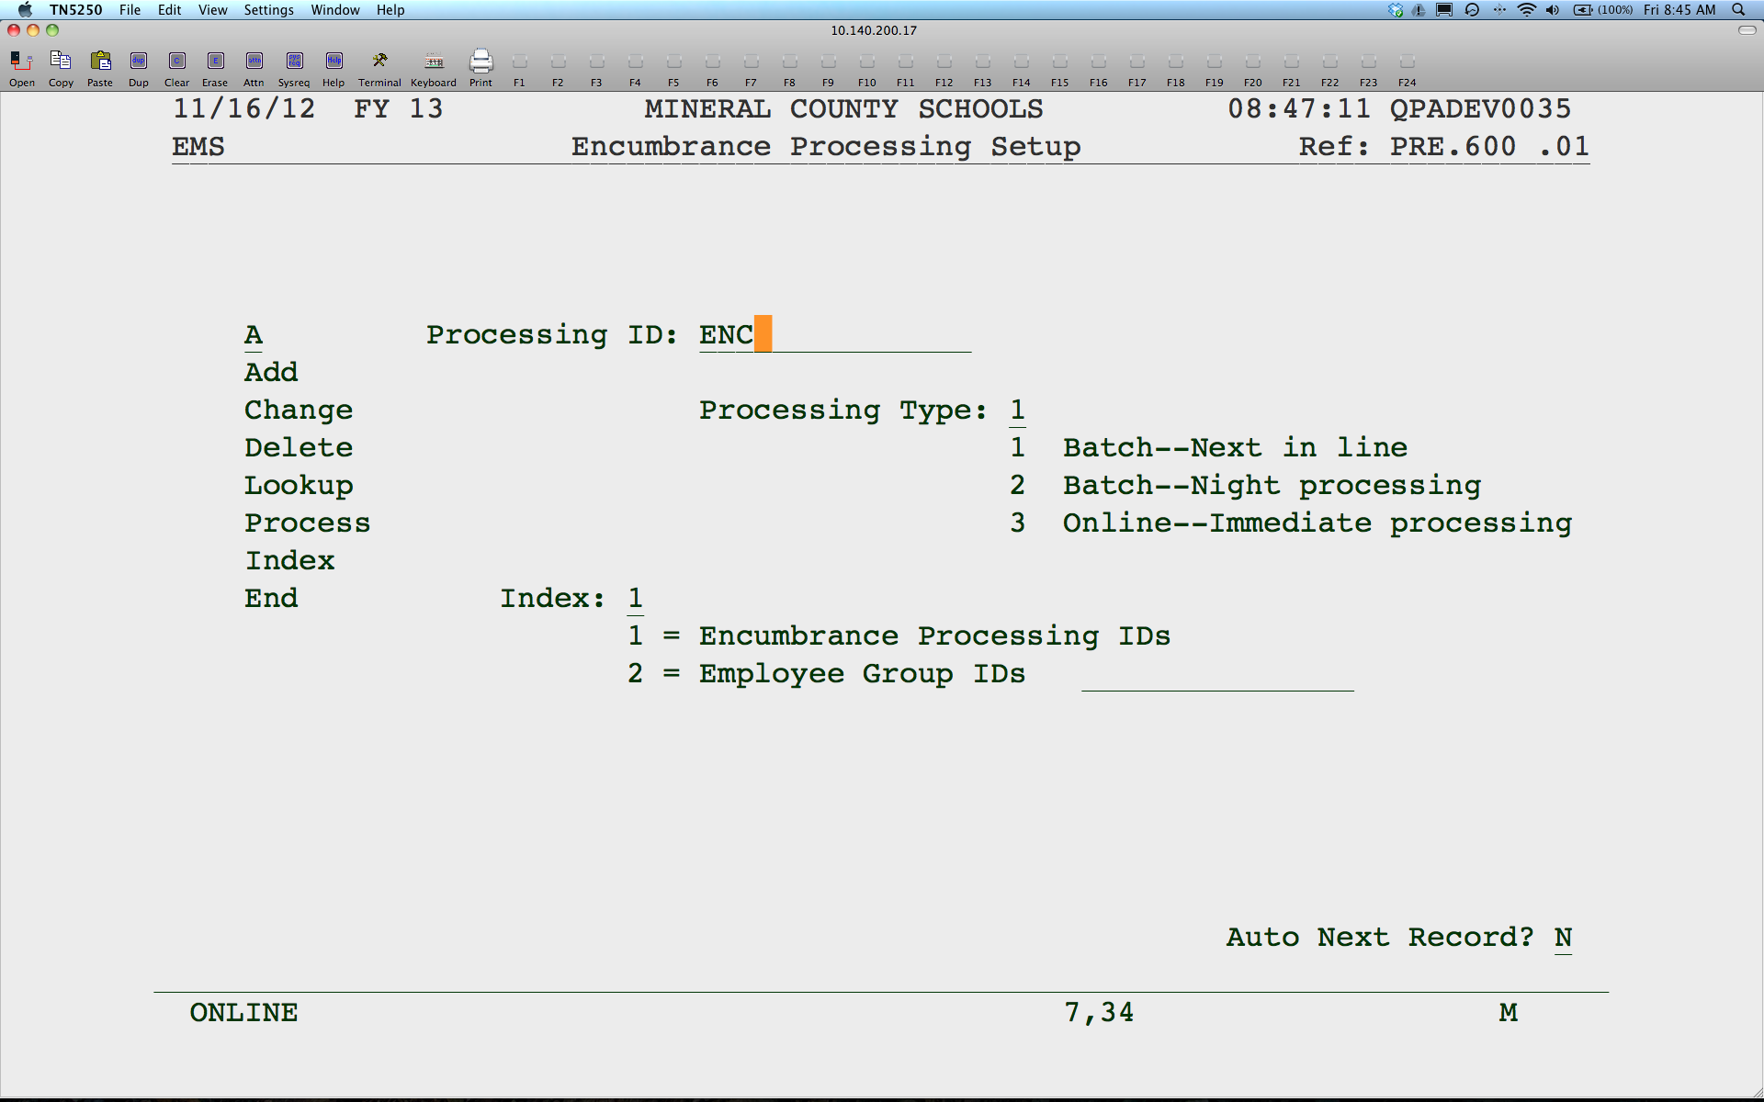
Notes:
Add or change a Processing ID.

Slide 7
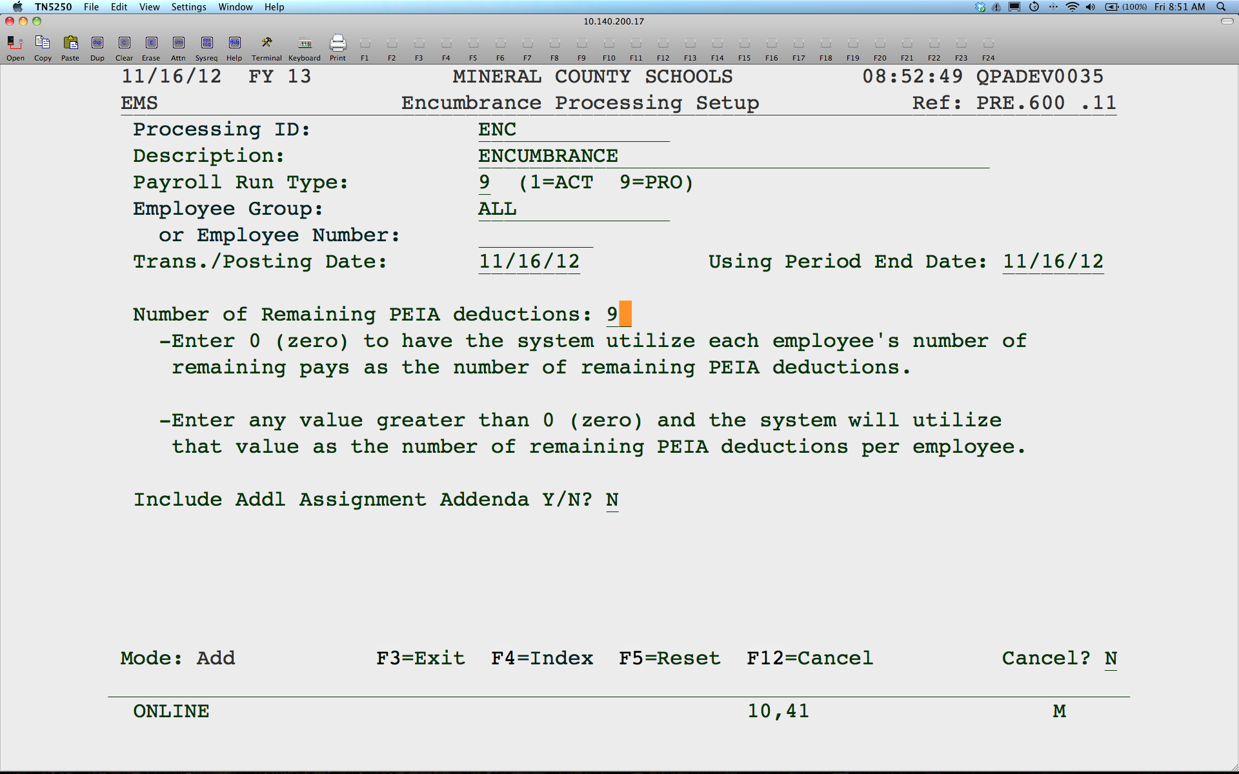
Notes:
Enter a description.
Enter a 9 for Payroll Run Type for a proforma or report only. Enter a 1 for Actual or to post encumbrances.
Leave today’s today or enter a posting date for the encumbrances. The Period End Date will determine what assignments will get processed based on whether or not the assignment is active for that date.
Enter the number of remaining PEIA deductions you have left. If you leave at zero, the system will use the remaining number of checks for an employee to calculate the PEIA costs.
If you use Additional Assignment Addenda and you want the system to calculate and post an encumbrance for those, enter “Y”.
The encumbrances are calculated based on remaining salaries and fixed costs. The Employee Encumbrance Balance is updated as well as the General Ledger.

Slide 8
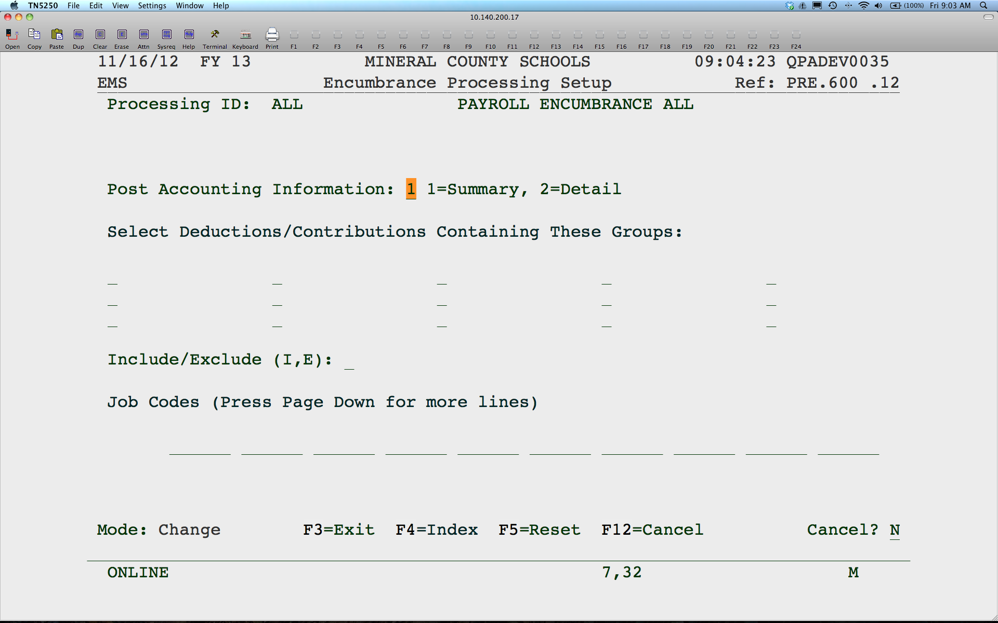
Notes:
Posting in detail will list Employee names and amounts in the General Ledger.
You can select what groups of deductions are to be calculated or leave blank for all.
Include or Exclude job codes, if you wish. Only contracted job codes will be included.

Slide 9
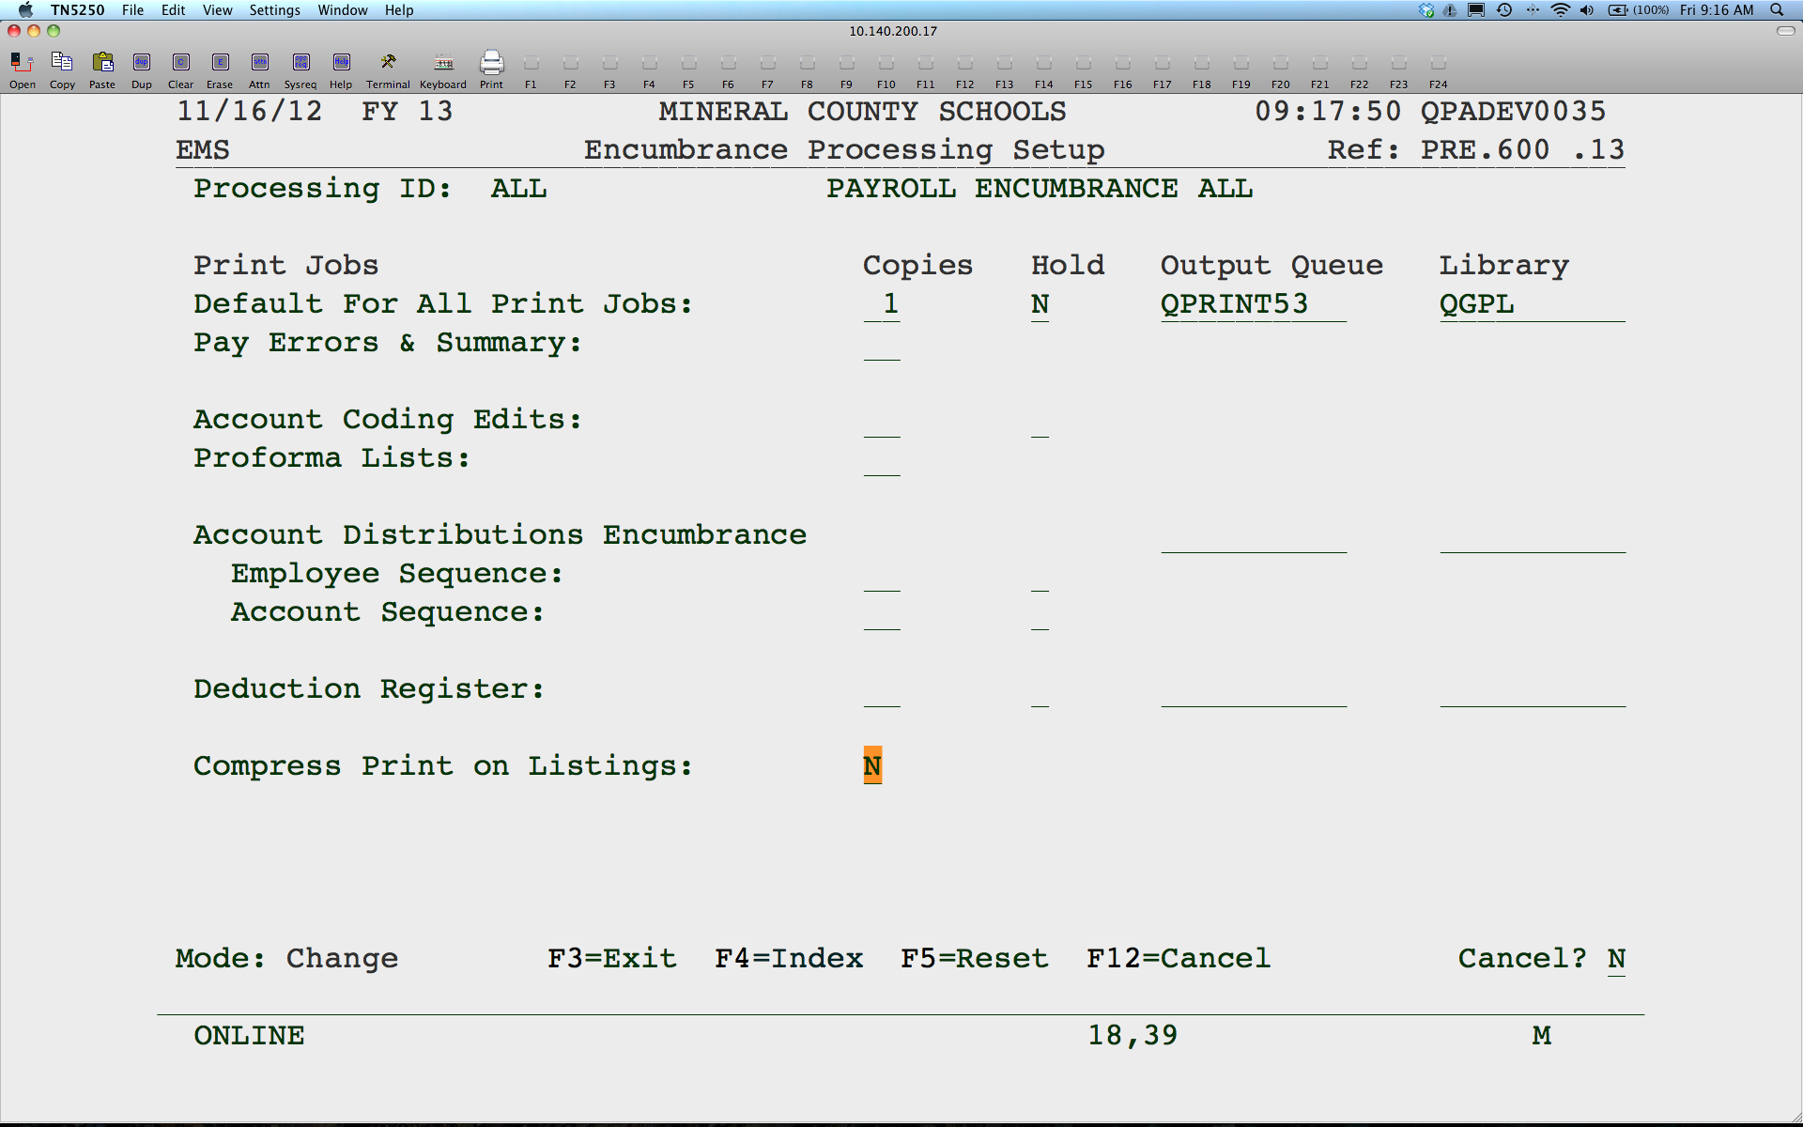
Notes:
Enter the printer you want the reports to go to. When you hit enter, you will be back to the Processing ID menu
A couple of notes…Be sure the keyword ENCUMBRANCE_EMS is defined in FMS, under Define Account Code Keywords, Chart of Accounts Maintenance, General Ledger System. Make sure your Processing ID’s have Encumbrance Active as “Y” and if you want the disencumbering reports to print when running a payroll, make sure those are set to print. They can always be re-created, if needed.

Slide 10
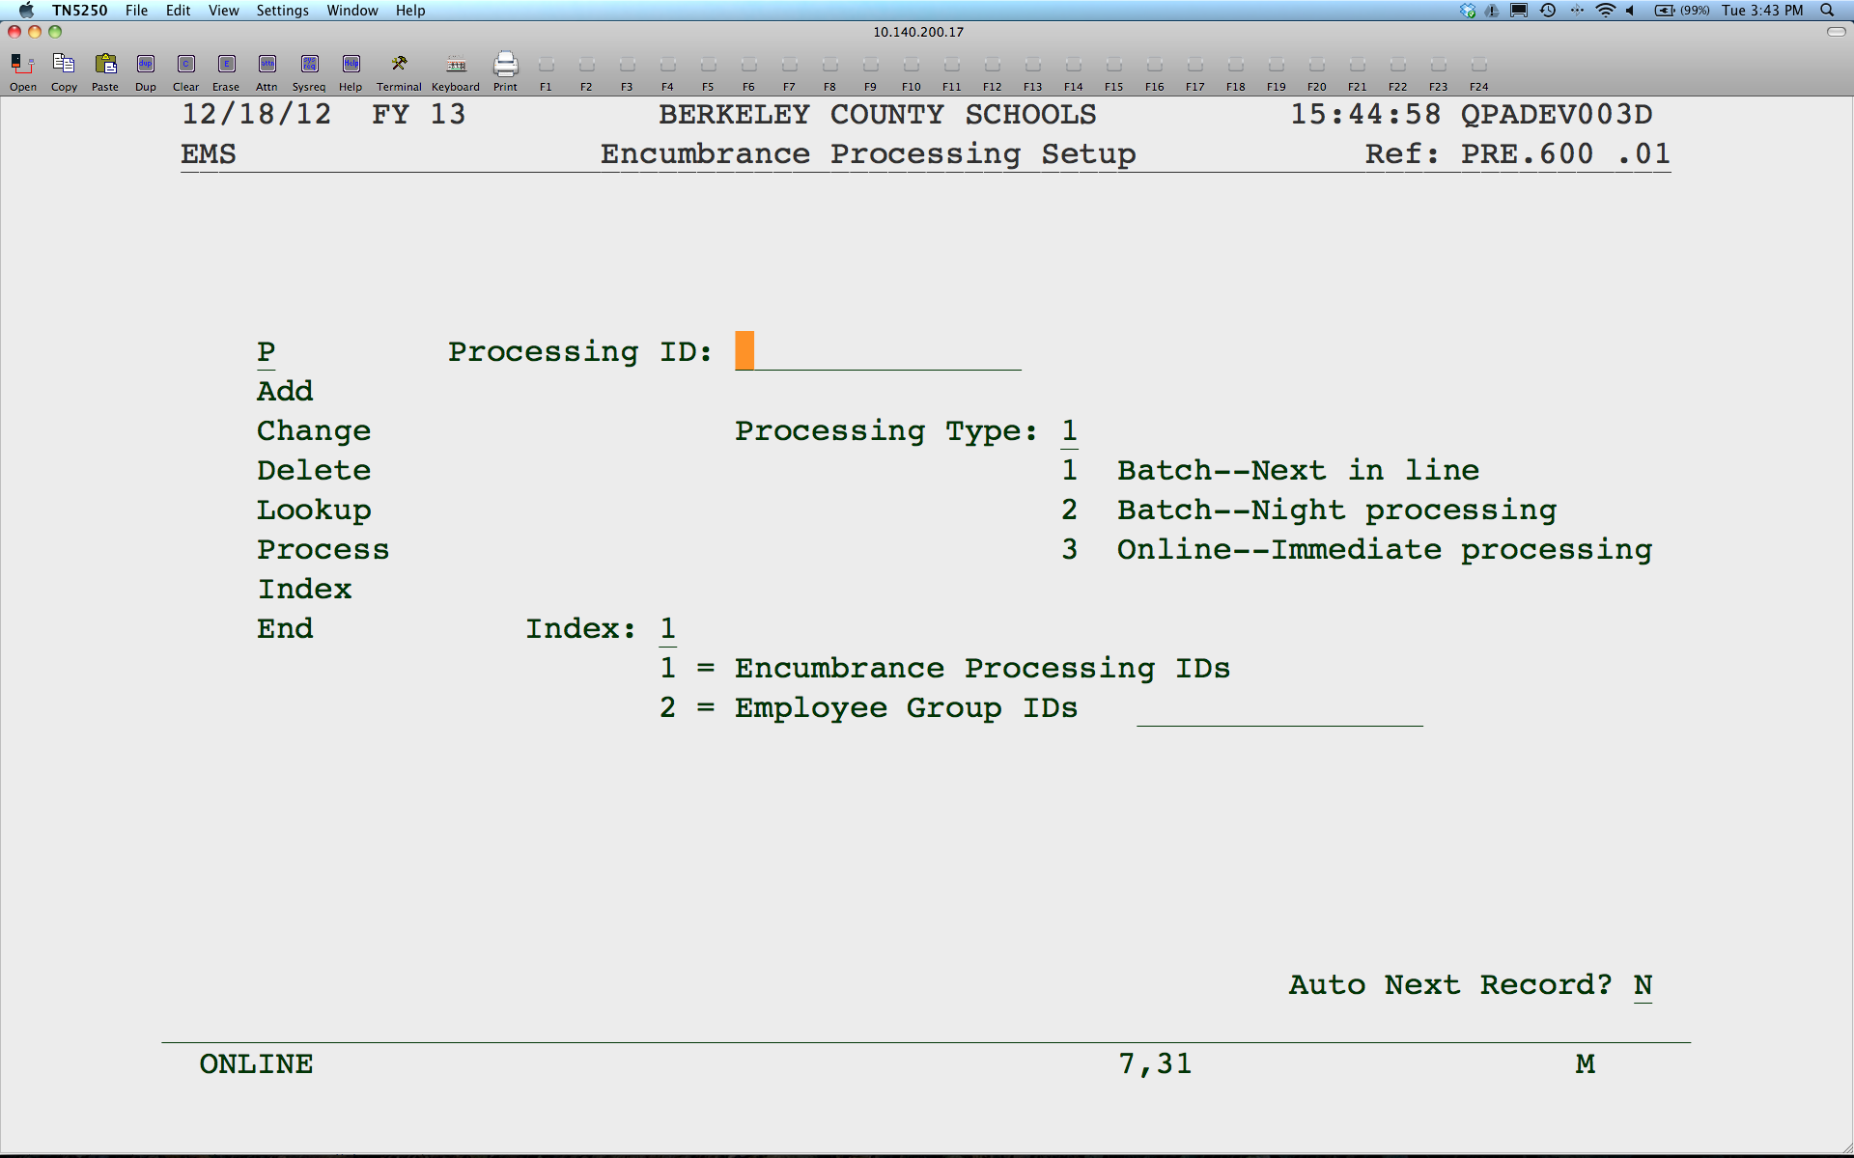
Notes:
Enter a P to process. If running a proforma, you will only get reports. If running an actual, you will get reports and the balances will be updated.

Slide 11
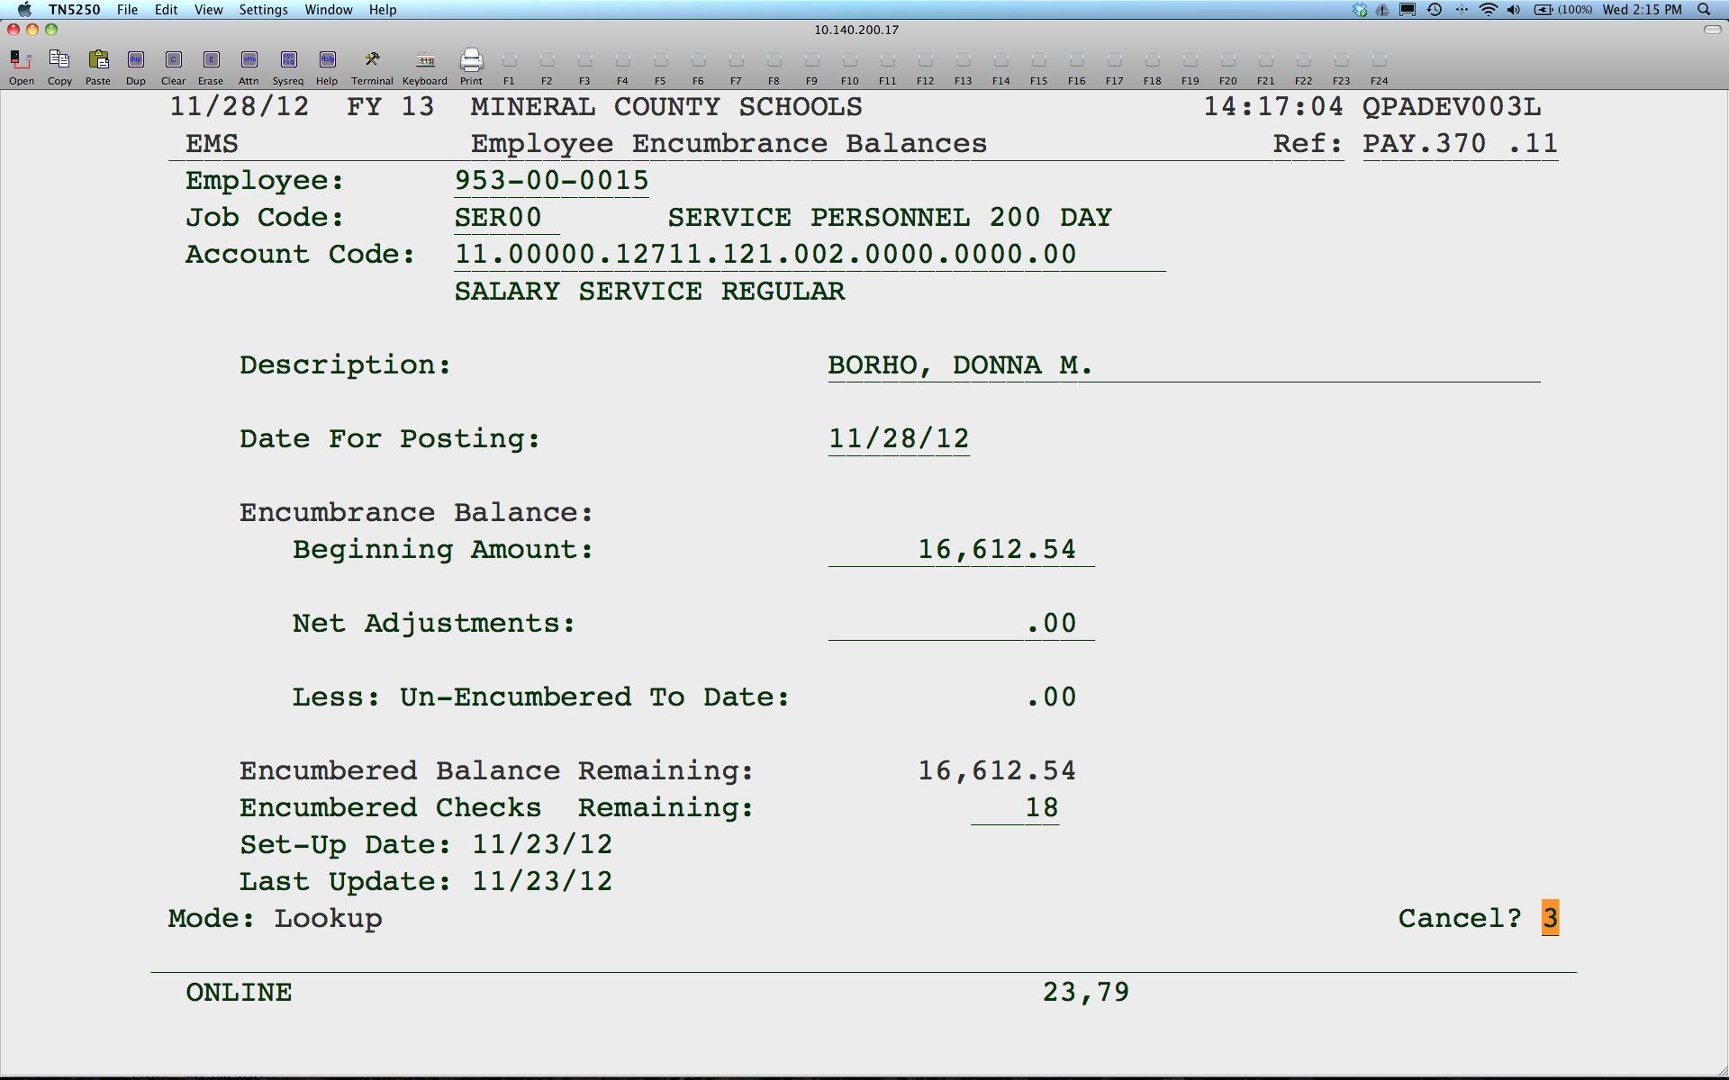
Notes:
Sample Encumbrance Balance.

Slide 12
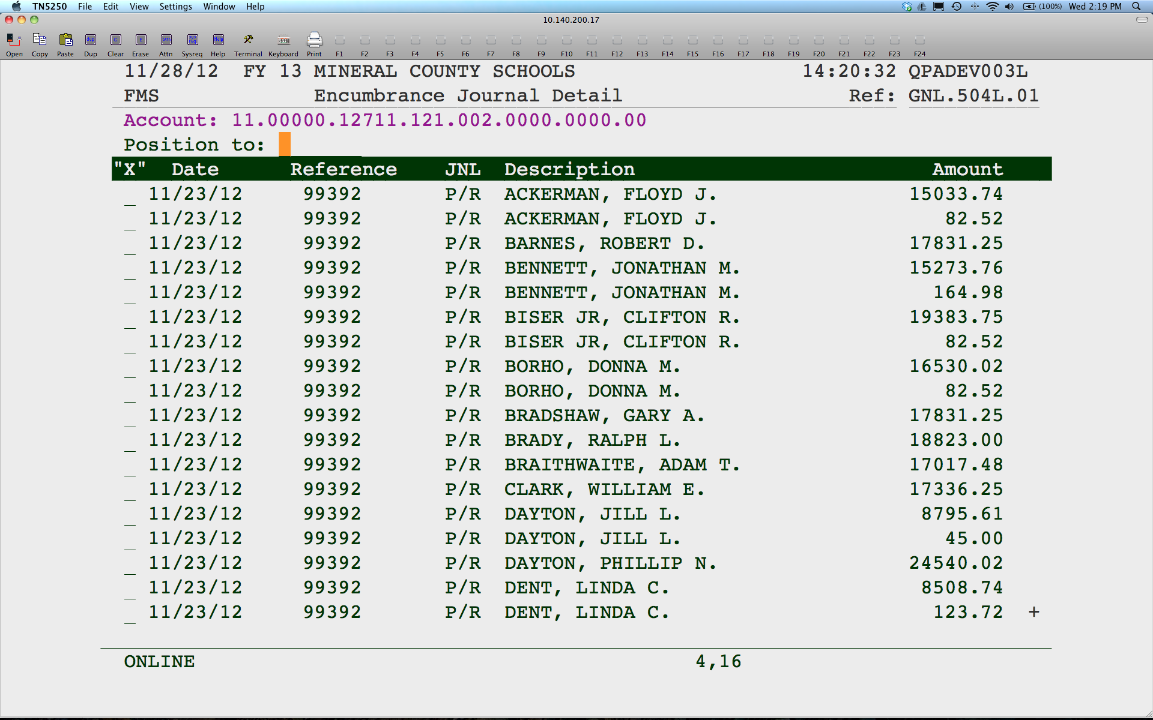
Notes:
General Ledger Payroll Encumbrances posted in detail.

Slide 13

Notes:
Option 5 will disencumber all remaining encumbrance balances. Option 4 will print a summarized report of the disencumbrances.

Slide 14
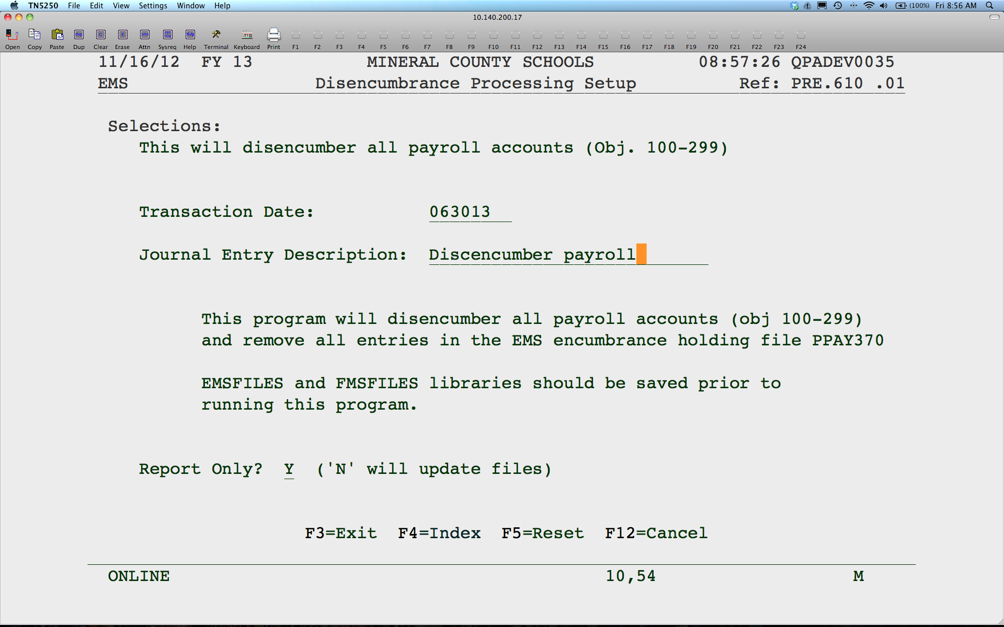
Notes:
Enter a date you want the JE to post and a description. This program will create an EJE to disencumber what is remaining in the General Ledger. The Employee Encumbrance Balances are also cleared.
Leave “Y” for Report Only if only wanting to see a report with the remaining balances. Enter a “N” to post and disencumber.

