Slide 1
Minnesota DNR GIS Service Delivery and Governance
Tim Loesch
GIS Section Manager

Slide 2
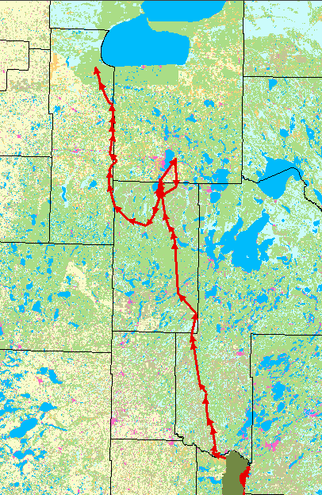
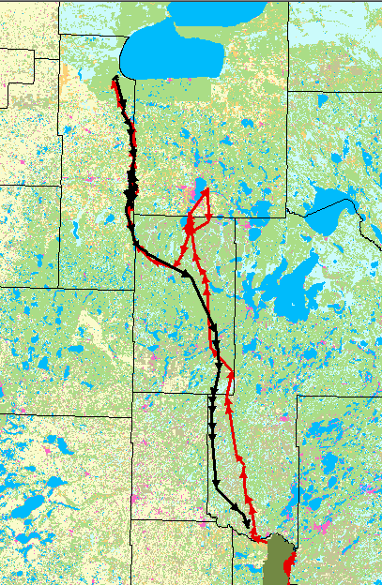
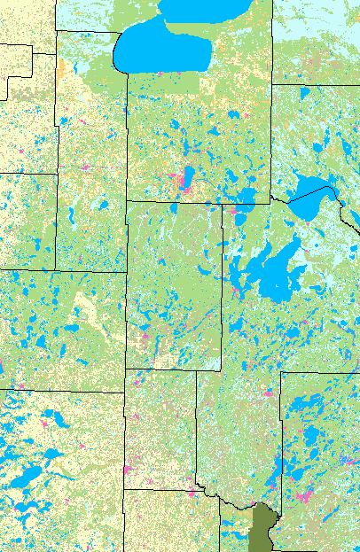
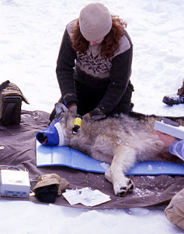
Wildlife Tracking - Wolves
191 miles (red)
157 miles (black)
Camp Ripley

Slide 3
GIS Service Delivery and Governance
Background
Long established GIS program in DNR
High number of users (200+ArcGIS, 900+LandView)
All reaches of the State
100+ Offices throughout the state
Good connectivity (generally)
Mobile work-force
Spectrum of applications
Forestry, Fisheries, Wildlife, Land Records, Invasive species, Law Enforcement, Emergency Response, Land Restoration, Flood prevention, Dam Safety, Protected waters, recreation

Slide 4
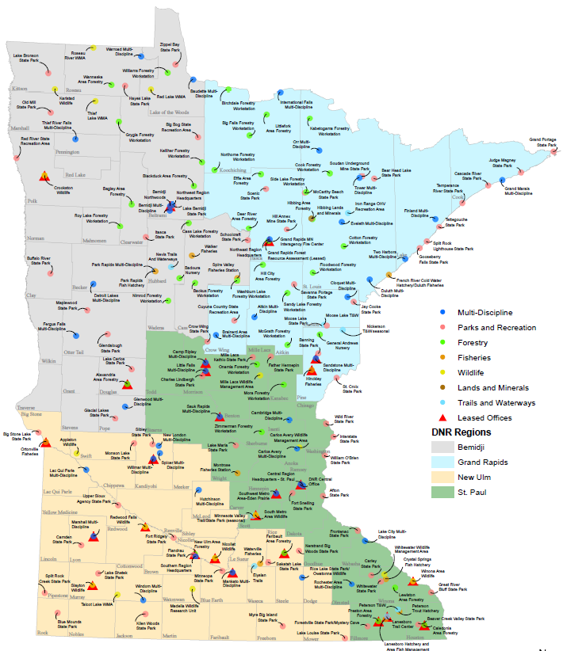
GIS Service Delivery and Governance
DNR in Minnesota
Central Office (St. Paul)
Administrative Regions
Northwest, Northeast, Central, South
120 Offices
High Speed WAN

Slide 5
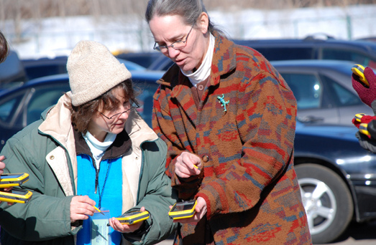
GIS Service Delivery and Governance
GIS Section
Support Natural, Cultural and Recreation resource management
Provide infrastructure, training and support to DNR Business units
Technology Integration
GIS integrates business units
Support the DNR Website

Slide 6
GIS Service Delivery and Governance
DNR GIS Team
Part of DNR Management Resources
Common Service Delivery Unit
MIS, Fleet, Facilities Management, Safety, Purchasing
Unit within DNR MIS Program
Three GIS Service Areas
Operations
User Support
Professional Services

Slide 7
GIS Service Delivery and Governance
Organization
Management Resources
Fleet
Safety
MIS
Mtrls Mgmt
Prof. Services
Networks
GIS
Data/Apps
GIS Project Management
GIS User Support
GIS Operations

Slide 8
GIS Service Delivery and Governance
Funding
Shared Services Governance Board
DNR Senior Managers and Commissioners Office
IT Governance Sub-Group
DNR Operations Managers
MIS Service Level Agreement
Defines Services Provided and Associated Costs
Costs are assessed to business units yearly based on established indexes
Recommendations forwarded to Shared Services Board
IT Service Level Agreement

Slide 9
GIS Service Delivery and Governance
Governance
Shared Services Governance Board
HR
IT
OMBS
OCO
Facilites
Fleet
$
GIS Indices Include:
Installed ArcGIS Software
LandView overhead fee
Existing Business Application resource requirements
GIS

Slide 10
GIS Service Delivery and Governance
Day-to-Day Interaction
DNR IT Liaisons
DNR Business Unit IT specialists
Advise Business Unit Managers on IT issues
Meet quarterly with MIS Program Managers
Share information
Develop Department Standard Practices
Identify areas of common interest
People appreciate knowing what’s going on

Slide 11
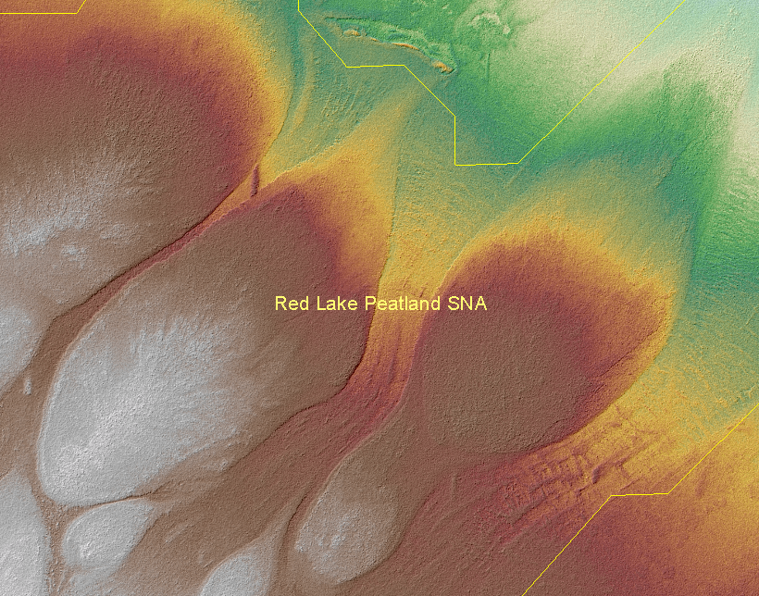
GIS Service Delivery and Governance
GIS Operations
Develop and maintain GIS Infrastructure
Server hardware and software
Data Resource Sites (DRS)
DNR Data Deli
Technical Assistance
Data Modeling
Programming
Data services
Software and Data Licensing
Staffing
Section Manager – IT PM
Spatial Data Administrator - ITS4
GIS Application Programmer – ITS4, ITS3
Spatial Data Technician – OASI
Student Worker

Slide 12

GIS Service Delivery and Governance
GIS User Support
Provide User and Site Support
DNR Field Staff, Regional Directors, Commissioner’s Office
Software installation and setup
Develop, Maintain and Deliver GIS Training and Information
Tip Sheets and user guides
Annual GIS User Group Meetings
“What’s New in GIS” Newsletter
GIS Web site
Fee-based Training classes
Small Project Work
Non-fee based
< 40 hours
Maps and reports
Staffing
Regional GIS Coordinator (4 – ITS3)

Slide 13
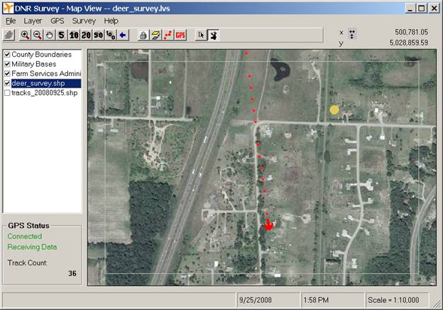
GIS Service Delivery and Governance
Professional Services
Fee for service work for DNR Business units
Governance Funding does not cover all costs
Approximately 25% of annual budget
Have done work for other State Agencies
Project requirements > 40 hrs
Programming
Database Design
Cartography
Data Development QA/QC
Rates
$80, $55, $38 / hour
Staffing:
Project Manager – (1 - ITS3)
All GIS staff contribute in some way

Slide 14
GIS Service Delivery and Governance
Recent Projects
Forest Inventory Module – Field Data Recorder
DNR Land Records Upgrade
State LiDAR Mapping Project
Furbearer Data Entry
Parks and Trails Data QA/QC
Hydrology data maintenance

Slide 15
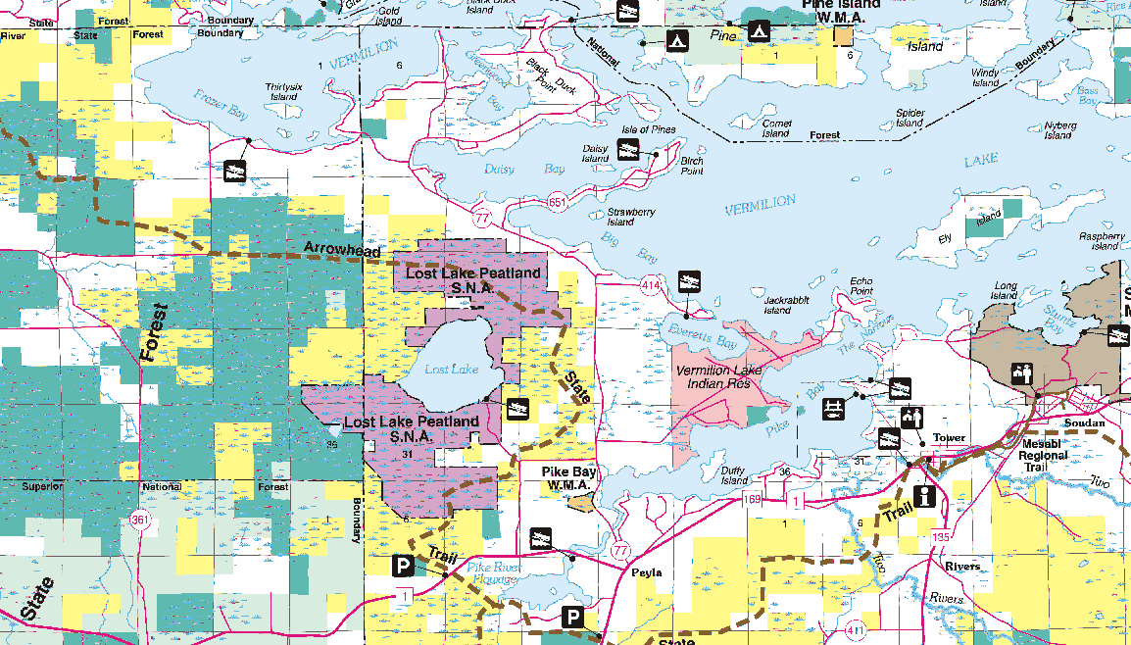
GIS Service Delivery and Governance
Future Work Efforts
Service oriented map and data delivery
Shared Common GIS Infrastructure (DRS2)
Mobile and Smartphone Applications
Enhanced Public access to High Quality Cartographic Services
Print-on-Demand

