Slide 1




Partnership Program for Spring Leaf-Off Imagery
April 3, 2012

Slide 2
Agenda for Today’s Meeting
Introductions and Overview
Project Specifications
Acquisition Region(s)
Control Targets
Project Status
Partnership Opportunities & Schedule

Slide 3
Steering Committee
Steve Kloiber – MnDNR
Primary funding partner; technical guidance
Chris Cialek – MnGeo
Project management, coordination, contracting
Pete Jenkins – MnDOT
Control target coordination; technical guidance

Slide 4
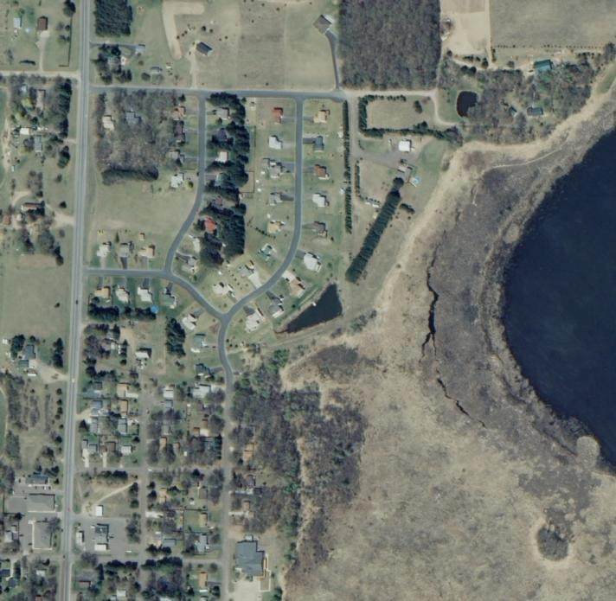
Overview
Statewide project to collect leaf-off color imagery over 5 years
Spurred on by DNR efforts to update wetlands mapping
0.5-meter (20-inch) nominal GSD
Offer local partnership options to buy-up at improved 1-foot GSD

Slide 5
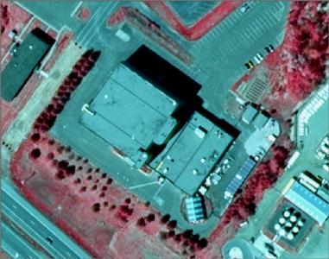
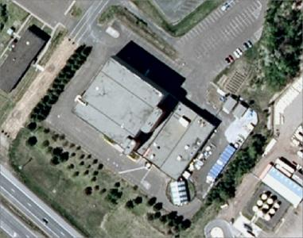
Project Specifications Four Spectral Bands
Near IR
Red
Color Infrared
Green
Blue
Natural Color

Slide 6
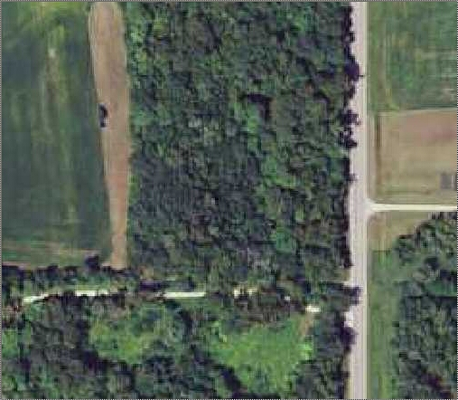
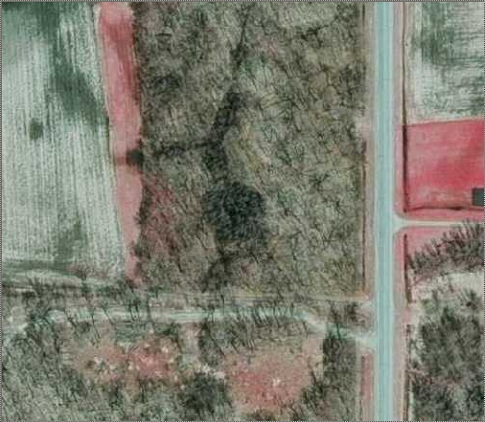
Project Specifications – Leaf-Off

Slide 7

Project Specifications - Format
Ortho-rectified quarter quad (tif)
Compressed county mosaic (jp2)
Digital stereo pairs (tif)

Slide 8
What Ground Sample Distance?
Cost vs. benefit
Managing risk
Tight time window
Large, complex project
Manage the number of variables/requirements
“Don’t pay for higher resolution if you don’t need it.”

Slide 9
Definitions
Image Scale is the ratio between its size on the image and its actual size on the ground, but with most viewers you can zoom-in and zoom-out changing the scale.
Ground Sample Distance is the actual size of the ground that corresponds to an individual picture element (pixel).

Slide 10

What GSD Do You Need?
The ability to accurately resolve, or identify, specific features from an image is a function of many variables
Size of the feature
Ground sample distance
Contrast with background

Slide 11
What GSD Do You Need?
Aronoff (2005) – Assumes user can see a feature as small as 1/300th of an inch
GSD(meters) x 12000 = scale denominator
Kloiber – Assumes user needs at least three pixels for a 1280 x 1024 screen (19-inch diag.)
GSD(meters) x 10000 = scale denominator
Both of these are rather conservative

Slide 12
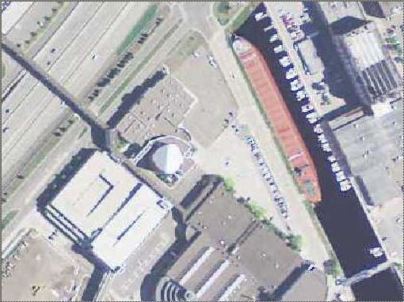
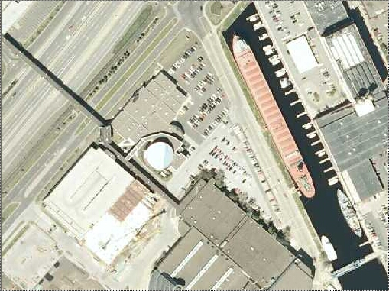
GSD Comparison
1:3000
0.5-meter GSD
1-meter GSD
1-meter vs. 0.5-meter

Slide 13
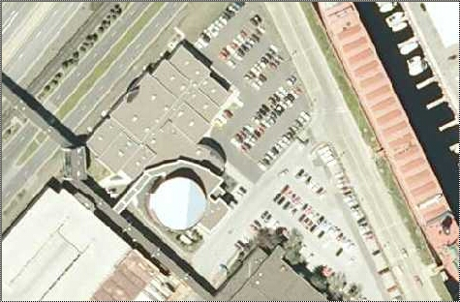
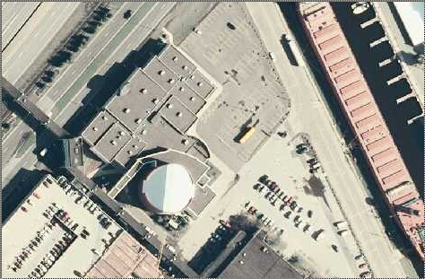
GSD Comparison
1:2000
12-inch GSD
0.5-meter GSD
0.5-meter vs. 1-foot

Slide 14
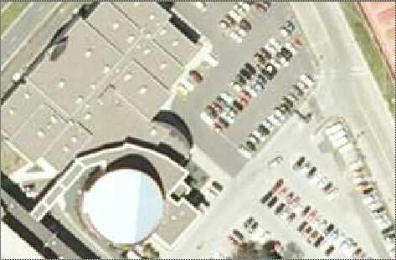
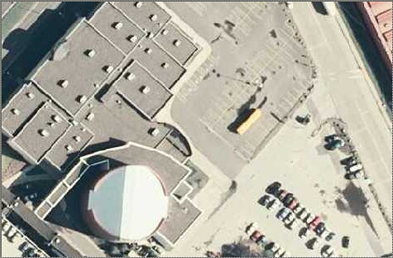
GSD Comparison
1:1200
12-inch GSD
0.5-meter GSD
0.5-meter vs. 1-foot

Slide 15

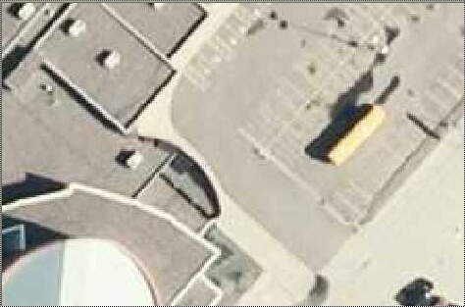
GSD Comparison
1:600
12-inch GSD
0.5-meter GSD
0.5-meter vs. 1-foot

Slide 16
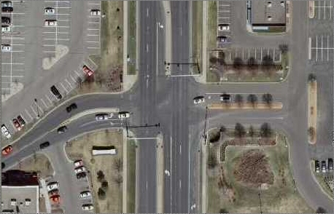
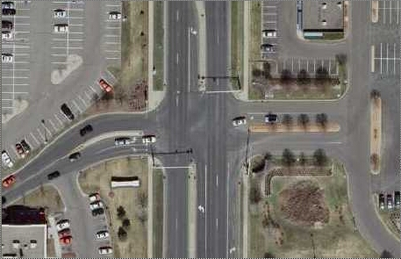
GSD Comparison
1:1200
12-inch GSD
6-inch GSD
1-foot vs. 6-inch

Slide 17
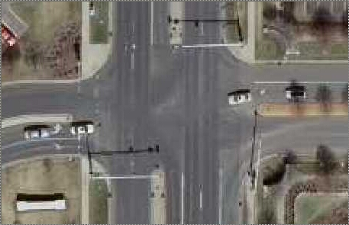
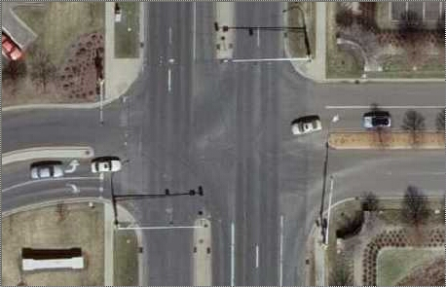
GSD Comparison
1:600
12-inch GSD
6-inch GSD
1-foot vs. 6-inch

Slide 18
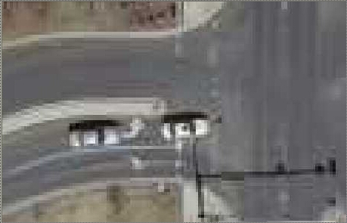
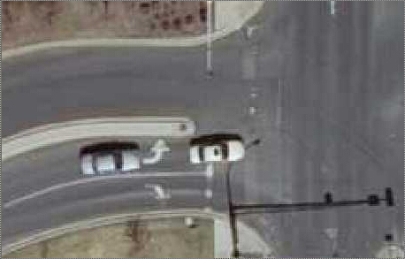
GSD Comparison
1:300
12-inch GSD
6-inch GSD
1-foot vs. 6-inch

Slide 19
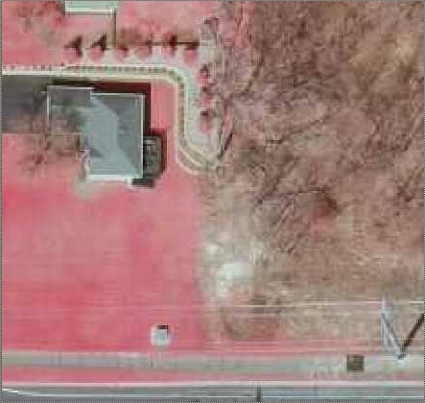
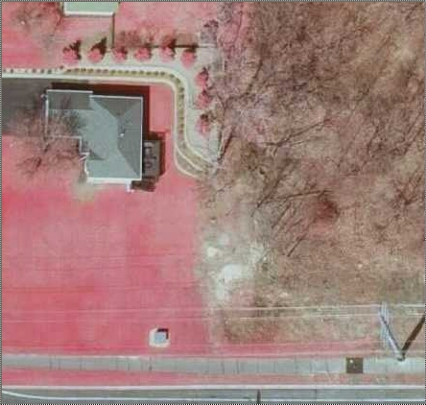
GSD Comparison
1:600
12-inch GSD
6-inch GSD
1-foot vs. 6-inch

Slide 20
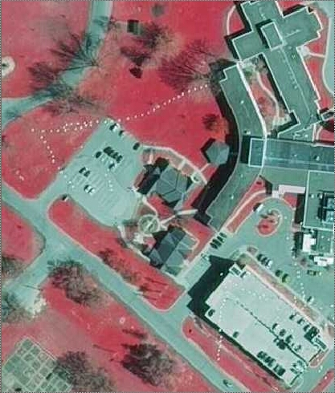
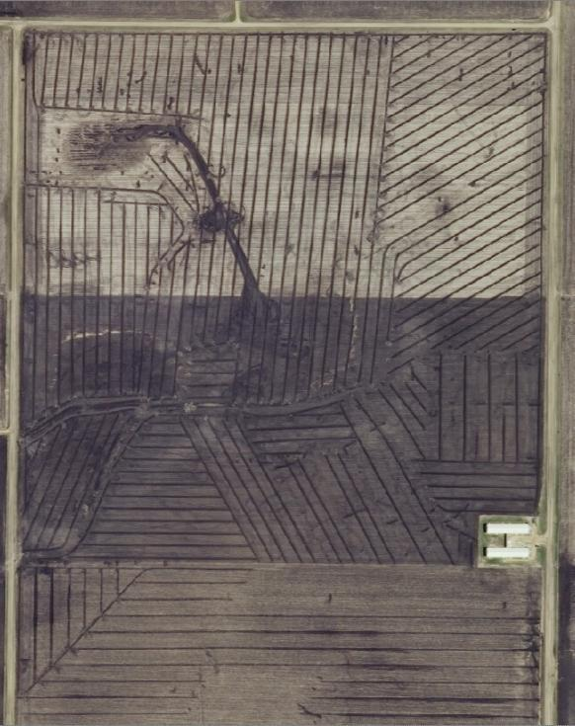
GSD = 0.5-meter What Can You See?

Slide 21
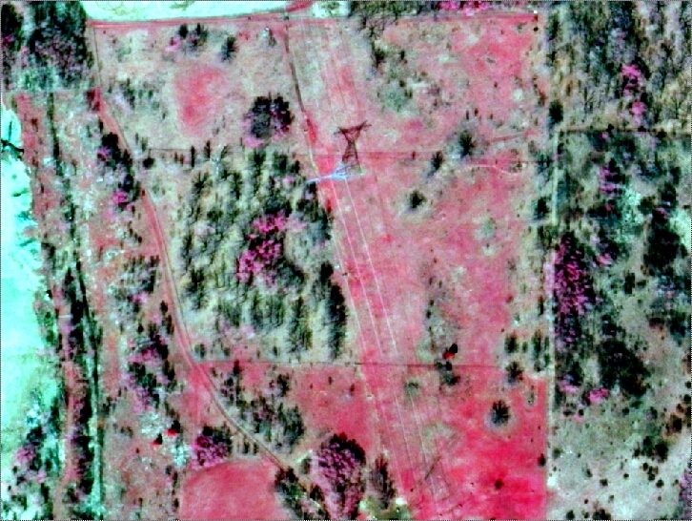
GSD = 0.5-meter What Can You See?

Slide 22
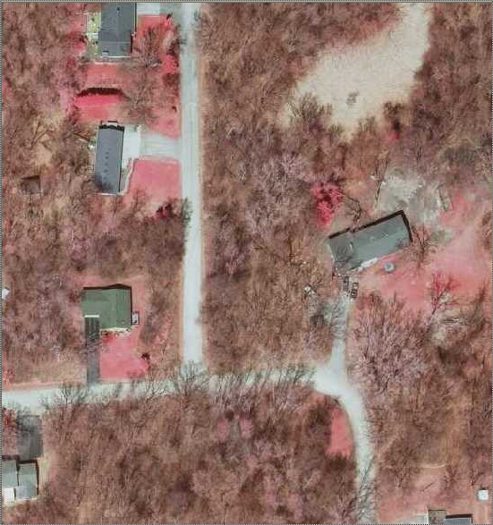
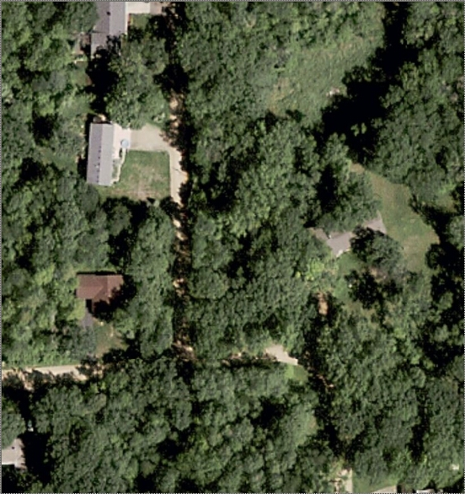
What about Bing?

Slide 23
Project Specifications – Positional Accuracy
Ground Sample Distance | Approx. Map Scale¹ | ASPRS Accuracy 95% (NSSDA) (ft)
0.15 m (6-inch) | 1:1500 | 3.06
0.30 m (1-ft) | 1:3000 | 6.12
0.50 m | 1:5000 | 10. 0
1.00 m | 1:10000 | 20.1
1) Assumes you need at least three pixels to define feature edge
Tested 95% Accuracy
Northeast 2009 = ±11.5 ft
East-Central 2010 = ±4.40 ft
South 2011 = ±4.65 ft

Slide 24
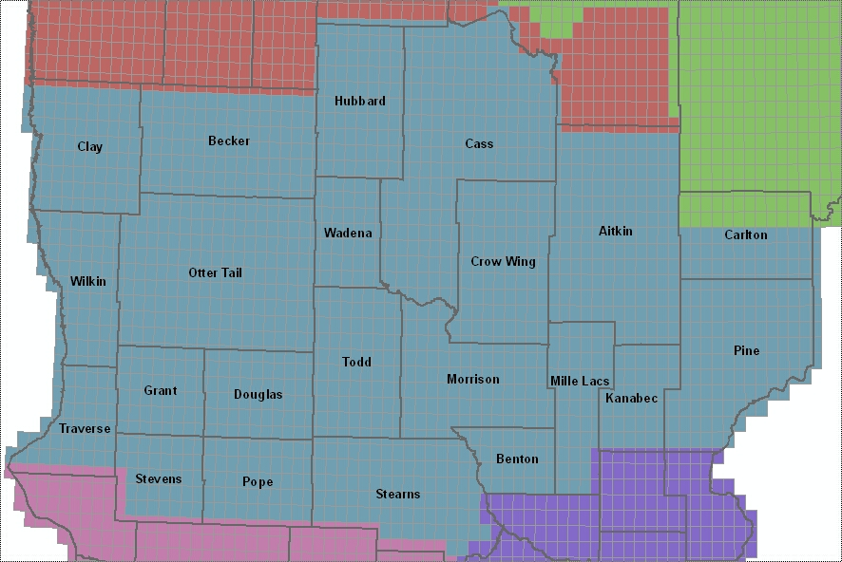
Central Acquisition - 2013
14.2 Million Acres

Slide 25
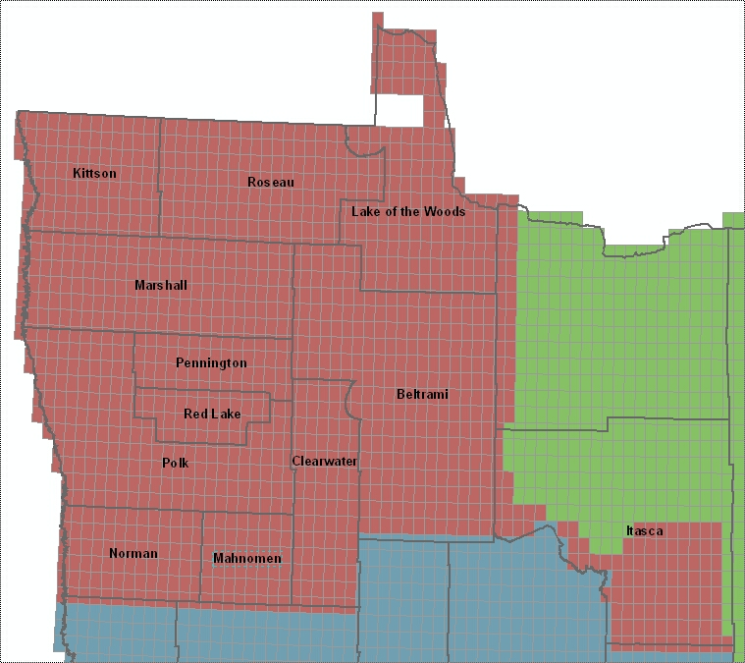
Northwest Acquisition – (2014?)
10.5 Million Acres

Slide 26
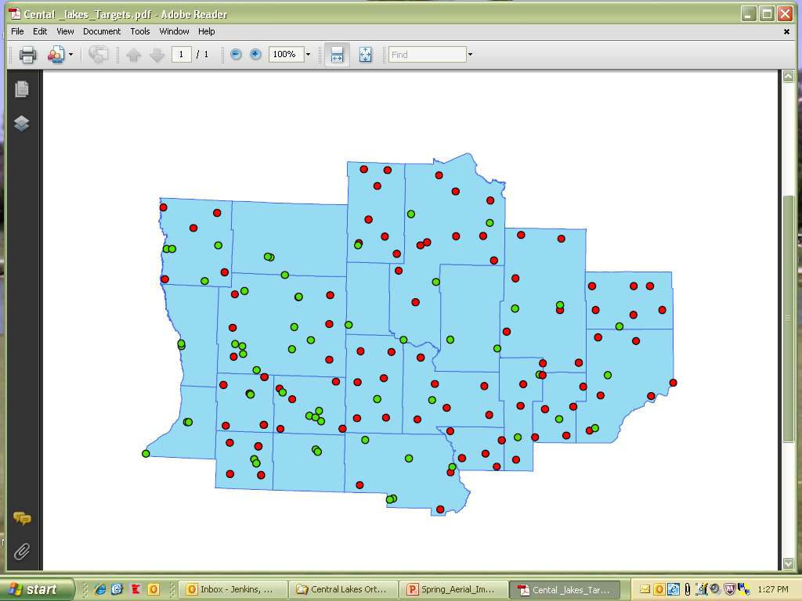
2008 FSA Target Inventory

Slide 27
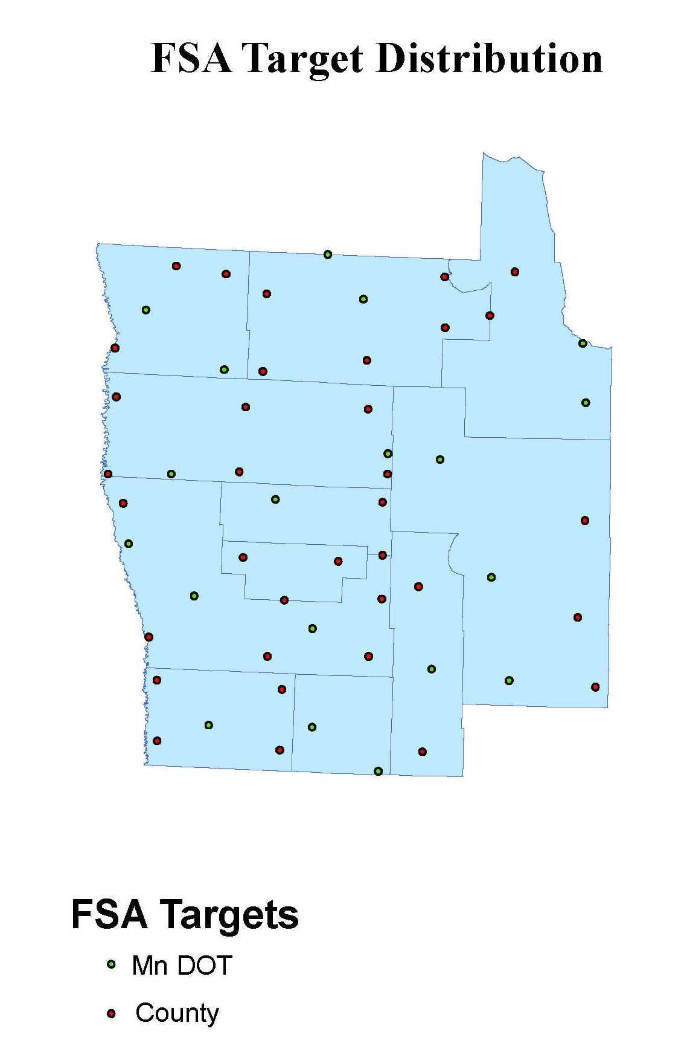

Slide 28
2011 Target Requirements
Two ways to capture target data
Targets (2008)
Physical features

Slide 29
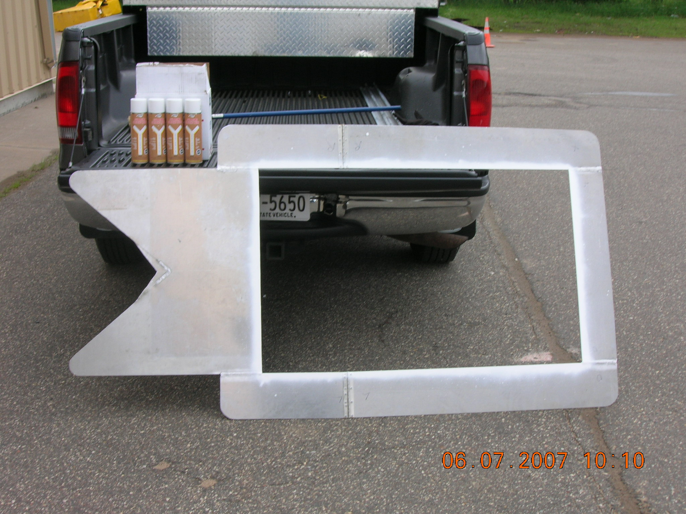
Single Leg Template

Slide 30
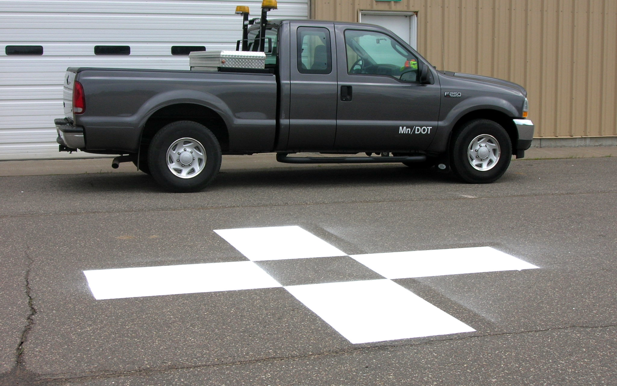
Completed Target

Slide 31
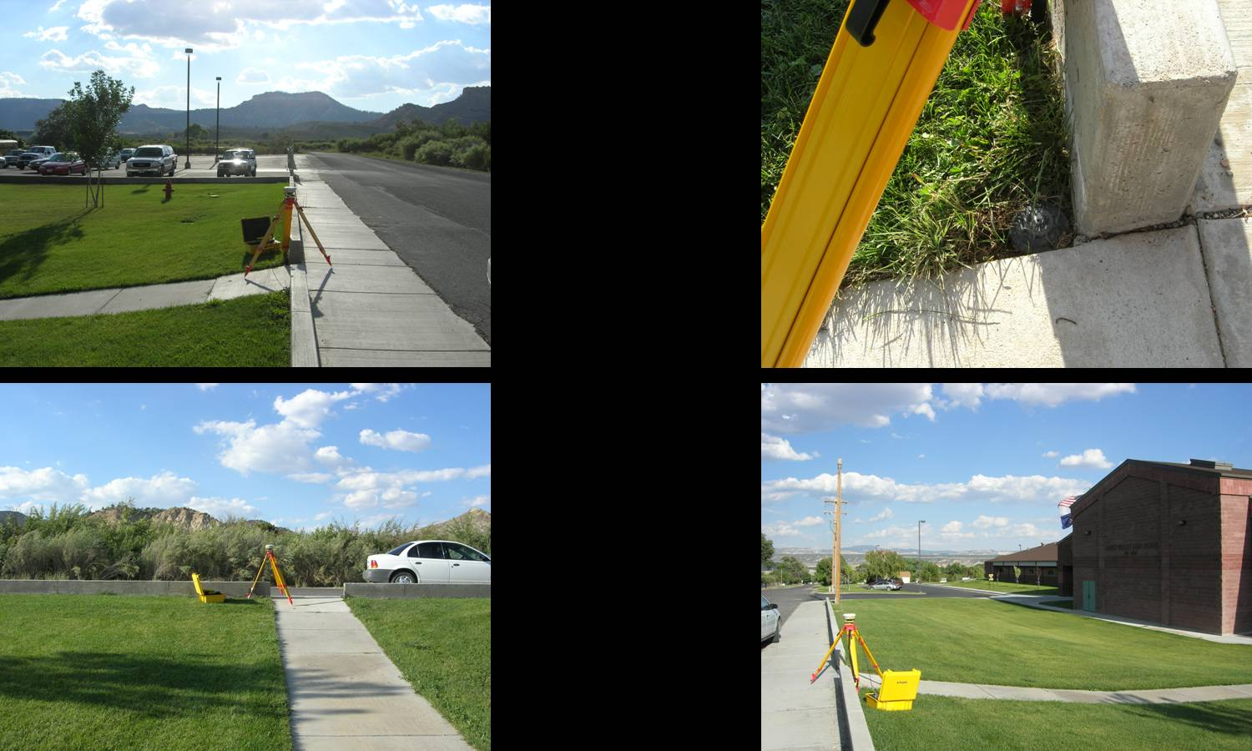
Physical Features

Slide 32
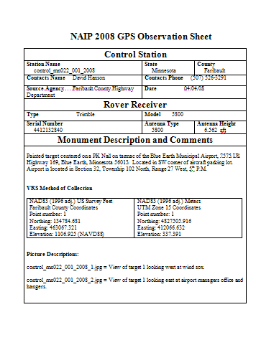
Documentation
2008 FSA Observation Sheet
Use the same form
Pictures are necessary
Will share data with FSA

Slide 33
What is Needed?
Existing targets need to be re-painted
New targets for counties with low numbers
Follow up with documentation

Slide 34
Spring Leaf-Off Imagery for Minnesota
THANK YOU FOR ATTENDING
Q & A
steve.kloiber@state.mn.us
651.259.5164
chris.cialek@state.mn.us
651.201.2481
peter.jenkins@state.mn.us
651.366.3457

Slide 35
SAIP Partnership Opportunities
Standard Statewide coverage:
½ meter (1.6 feet)
Four band; leaf off
Stereo and ortho (no provision for oblique at this time)
Buy-ups offer:
Increased resolution/detail
Improved accuracy
Complete specific area of interest
Volume pricing

Slide 36
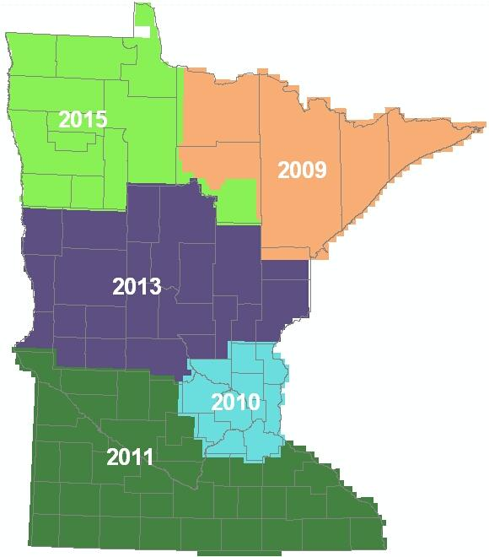
SAIP Partnership Opportunities
How?
Joint Powers Agreement
Interagency Agreement
Purchase Order

Slide 37

2010 Metro Imagery Partnerships
CONTRACT
INTERAGENCY AGREEMENT
PURCHASE ORDER
JOINT POWERS AGREEMENT
DNR
Metropolitan Council
INFORMAL AGREEMENT
Rice County
MnGeo
USGS/NGA
Dakota County
Scott County
MMCD

Slide 38
Estimated Cost at Three Resolutions
 | 1/2-meter | 1-foot | 6-inch
State contribution | $ 17 | $ 17 | $ 0
County contribution | $ 0 | $ 28 | $ 133
Total cost/square mile | $ 17 | $ 45 | $ 133

Slide 39
Comparative Costs
 | 1/2-meter | 1-foot | 6-inch
Wisconsin 2010 (WROC) | $ 34² | $ 75² | $ 300²
Maine 2012 | $24²* | $ 58² | $ 141²
MINNESOTA BUY-UP | $ 0¹ | $ 28¹ | $ 133¹
*2 foot resolution
¹ ASPRS Accuracy Class I
² ASPRS Accuracy Class II

Slide 40
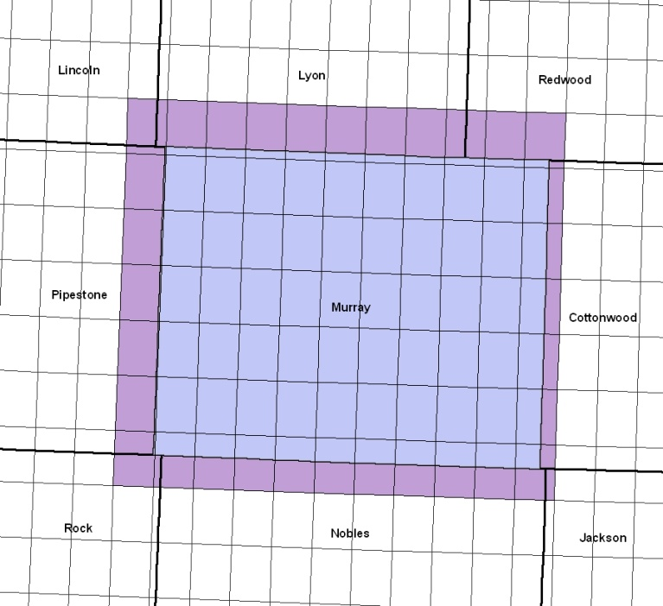
Estimated Cost and Compactness
 | 1-foot Large & Compact | 1-foot Small & Scattered
State contribution | $ 17 | $ 0
County contribution | $ 28 | $ 47
Total cost/square mile | $ 45 | $ 47
 | MURRAY COUNTY
To county line: | 745 sq. mi. X $47 = | $35,000
To quad line: | 1,035 sq. mi X $28 = | $29,000

Slide 41
Spring Aerial Imagery Program Partnerships 2009 – 2011

Slide 42
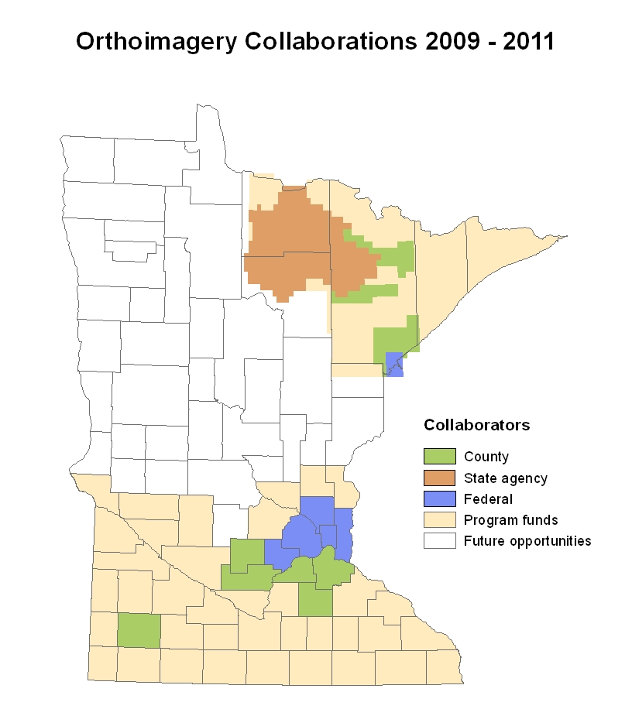

Slide 43
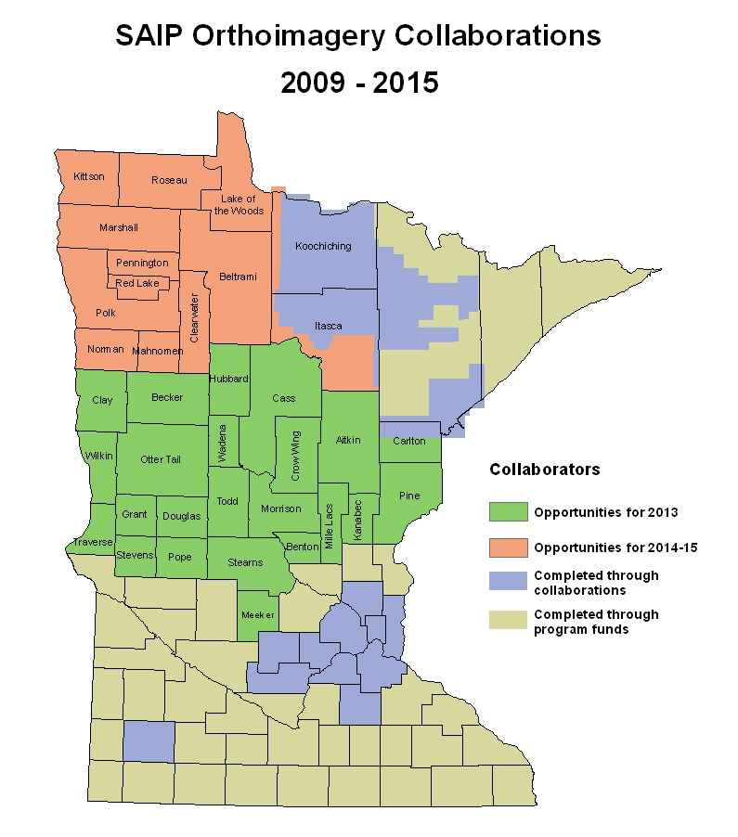

Slide 44
Tentative Schedule
2012
March – May: Partnership information meetings
November: Letters of intent
December: RFP issued
2013
January – March: Proposals due/evaluated, final vendor negotiations, award made, partnership Joint Powers Agreements executed
March – May: Field observations, control point refresh, flights
May – November: Data delivered evaluated; QA/QC
December: Final delivery, acceptance

Slide 45

Request for Proposals (RFP)

Slide 46

Contract

Slide 47


Slide 48
Data Management
Quarter quadrangle GeoTiffs, county mosaics, stereo, metadata
Data storage at DNR, partner organizations, back-up at MnGeo
Publicly available
Accessible through Web Mapping Service

Slide 49
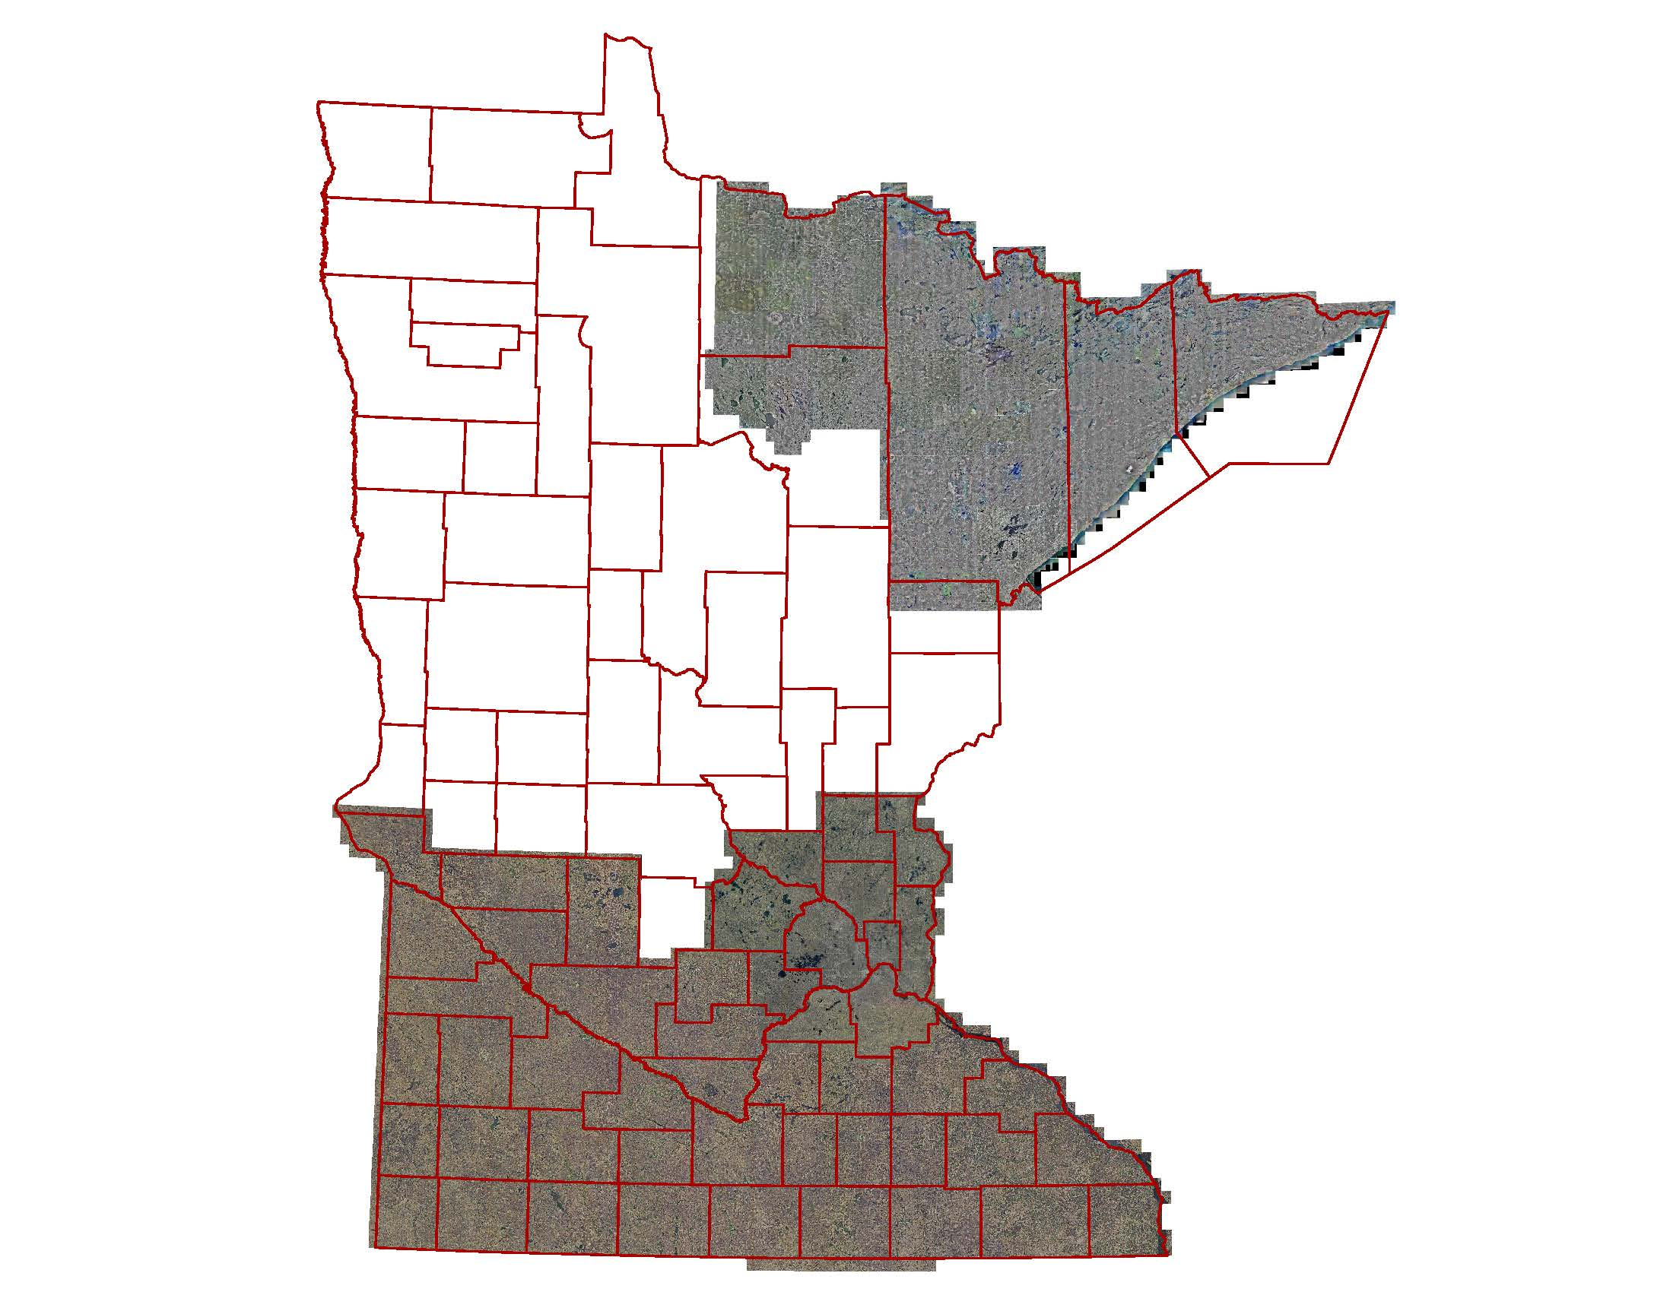
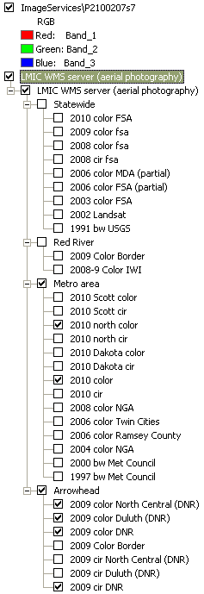
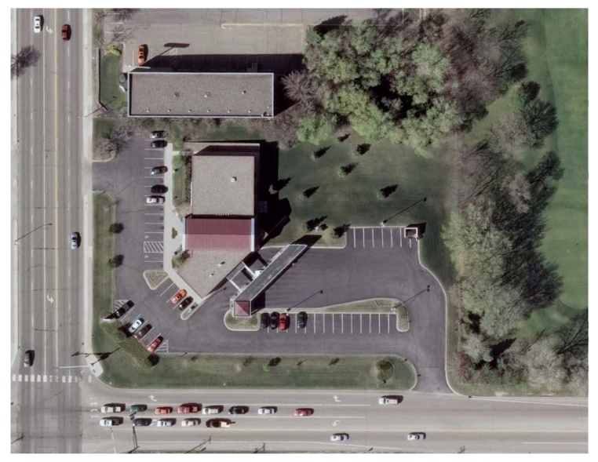

Slide 50
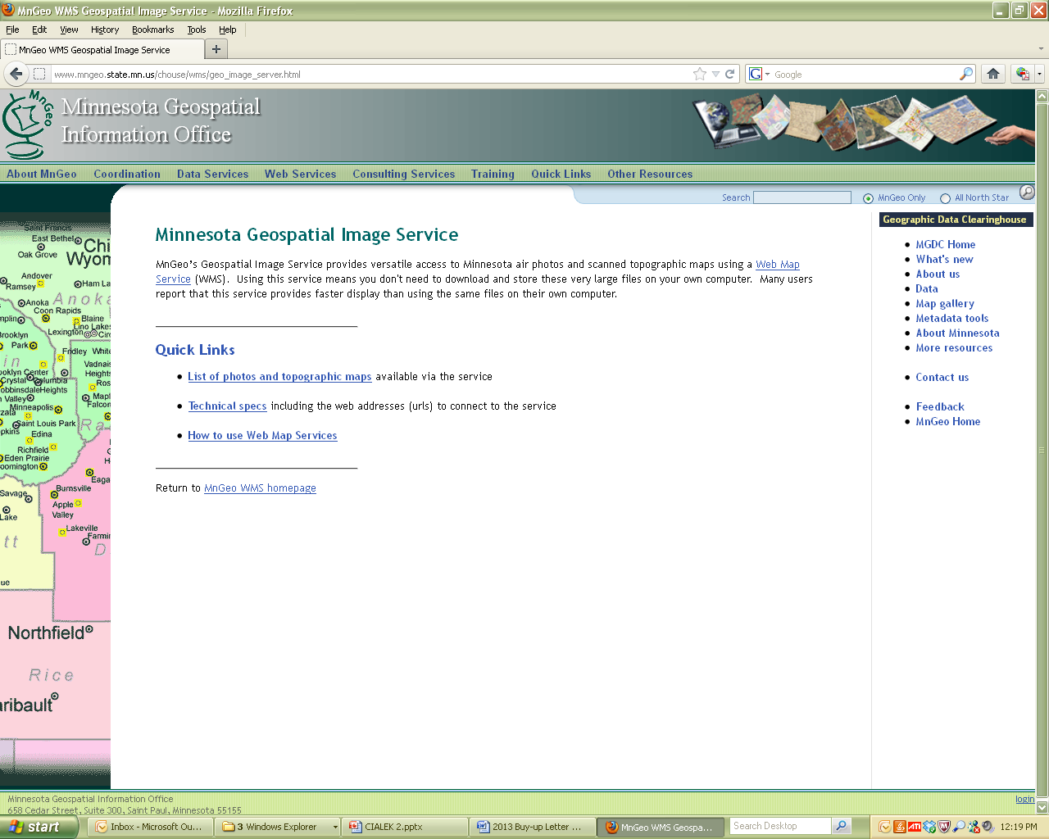
http://www.mngeo.state.mn.us/chouse/wms/geo_image_server.html

Slide 51
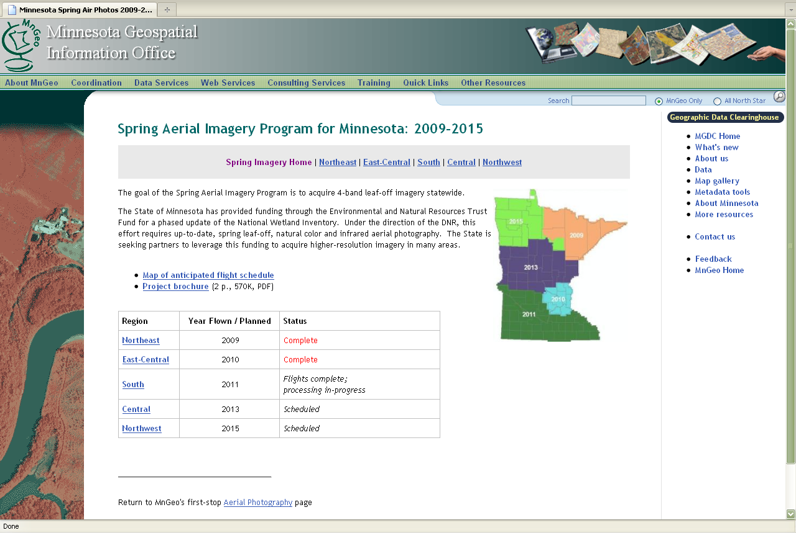
http://www.mngeo.state.mn.us/chouse/airphoto/spring2009-2015.html

Slide 52
Spring Leaf-Off Imagery for Minnesota
THANK YOU FOR ATTENDING
Q & A
steve.kloiber@state.mn.us
651.259.5164
chris.cialek@state.mn.us
651.201.2481
peter.jenkins@state.mn.us
651.366.3457

