Slide 1

Geospatial Data Resource Sites
GDRS and you!
Tim Loesch, MN DNR
Presentation to the Statewide Geospatial Advisory Council
May 30, 2012

Slide 2
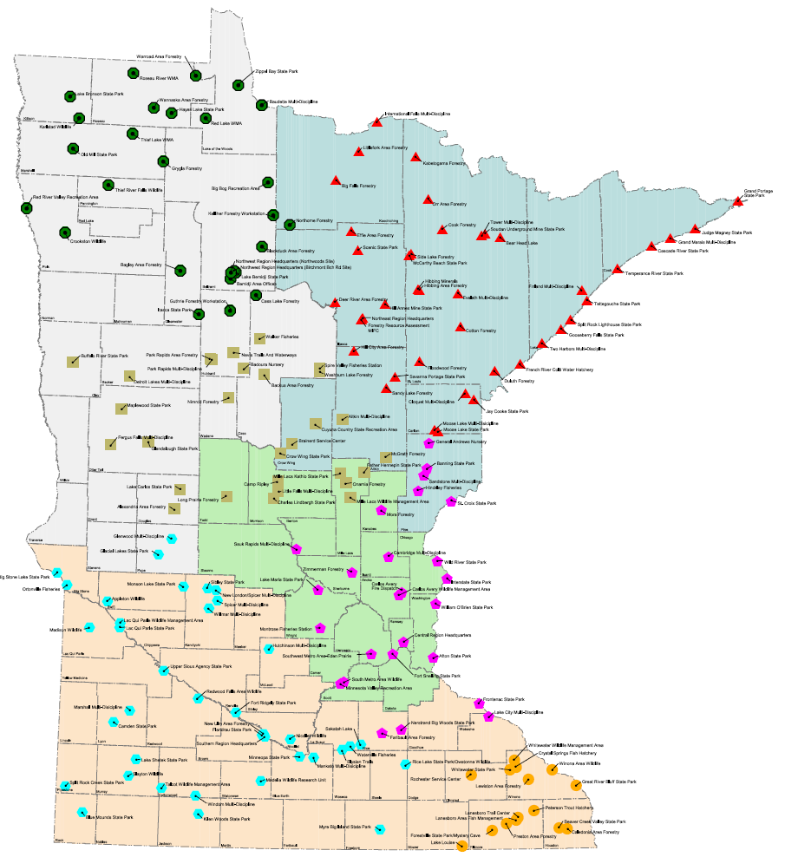
Geospatial Data Resource Sites
At the DNR
2,000 resource professionals
Planners, resource managers, researchers, technicians, conservation officers, hydrologists
Widely dispersed across the state
100+ offices with permanent staff
Diverse set of applications
Asian Carp -> Zebra Mussles
Desktop GIS is a standard tool
Field Use of GIS tools is growing

Slide 3
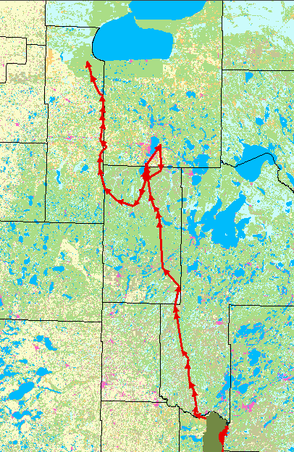
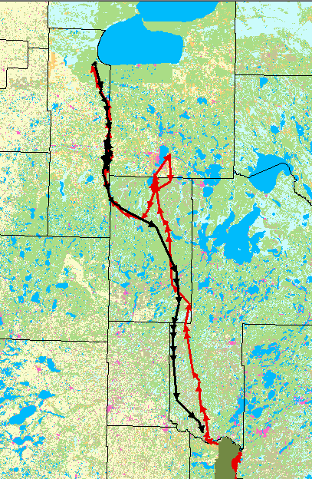
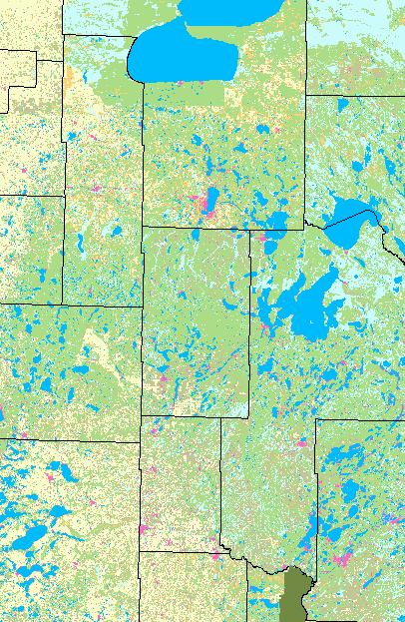
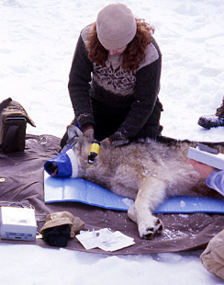
Geospatial Data Resource Sites
Wildlife Tracking - Wolves
191 miles (red)
157 miles (black)
Camp Ripley

Slide 4

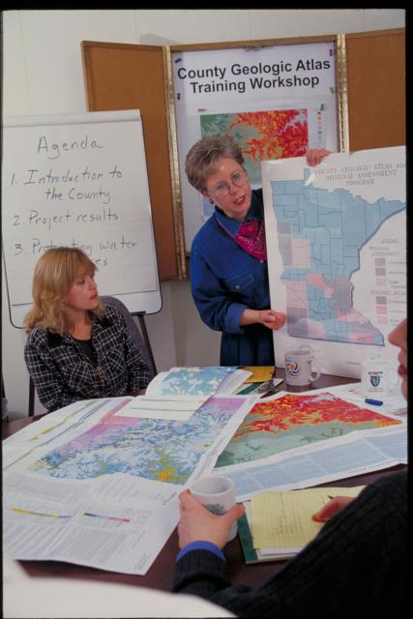
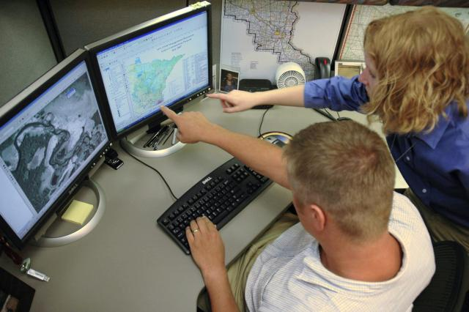

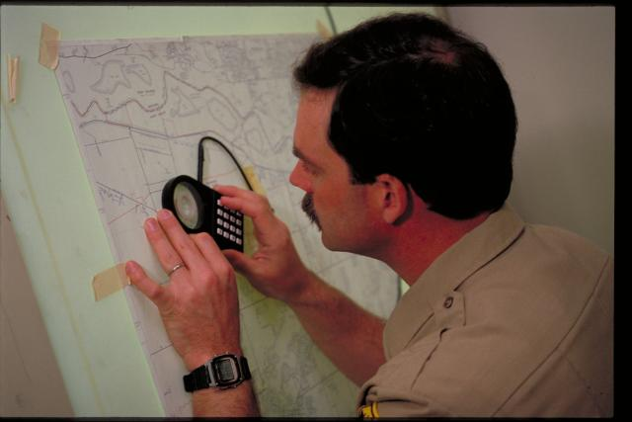
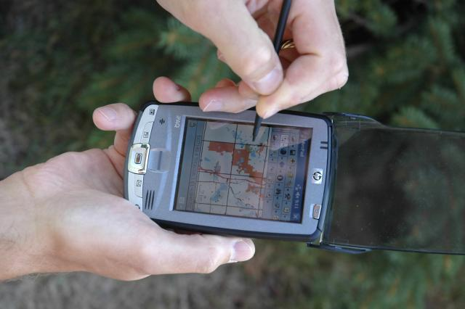
Geospatial Data Resource Sites
The GIS Section provides high-quality tools, products, services, and technical leadership to carry out the mission of the DNR

Slide 5

GEOSPATIAL DATA RESOURCE SITE

Slide 6

Geospatial Data Resource Sites
A GDRS can be independent

Slide 7


Geospatial Data Resource Sites
GDRSs can relate to one another

Slide 8

Geospatial Data Resource Site
The GDRS is a system of components
Geographic Data
Provides consistent and predictable storage and access for file, database and web service data
Software and data format agnostic
Data is maintained and replicated
Enables data sharing across the enterprise

Slide 9
Geospatial Data Resource Site
The GDRS is a system of components
Metadata
XML Based
Documents the contents of the GDRS
Describes the individual data layers
Provides security and authentication
Records data sharing arrangements

Slide 10



Geospatial Data Resource Site
The GDRS is a system of components
Tools
GDRS Manager
User Productivity
Facilitates sharing of applications
System tools
Automated maintenance and monitoring
Replication and updating of data and applications

Slide 11
Geospatial Data Resource Sites
What does this mean for you?
Depends on your role….
Data Managers – Publish, document and disseminate
Data User – Ready access to data and tools
Developer – Data provides grist for applications
System Admin – Upkeep, maintenance and monitoring
System Managers – Enterprise sharing and monitoring

Slide 12

Geospatial Data Resource Sites
Implementations…
DNR-wide implementation
U of M Duluth Geography
Department of Agriculture
Department of Human Services
Board of Water and Soil Resources
Department of Transportation
Geospatial Information Office
Pollution Control Agency

Slide 13
Geospatial Data Resource Sites
Demo
QuickLayers and ArcMAP
LandView and ArcMAP
GDRS Manager

Slide 14
Geospatial Data Resource Sites
What’s next?
Minnesota Spatial Data Infrastructure (MSDI)
Geo-Broker database to catalog data and applications
Web Based Portal for discovery and access
Minnesota Geocommons
2012 GIS/LIS Hands on Workshop

