Slide 1
Explore Minnesota Tourism
House State Government Finance Committee
February 28, 2011

Slide 2

Agenda
Industry overview
Agency profile
Goals and measurements
Current budget
Governor’s proposed budget
Marketing programs
What can change
2020 tourism vision

Slide 3
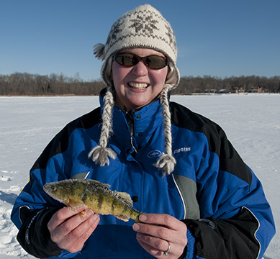
Tourism in Minnesota
$11 billion in leisure and hospitality gross sales annually
$699 million in state sales tax revenue
Over 238,000 jobs
$3.9 billion wages

Slide 4

Leisure and Hospitality Jobs and Revenue
11% of all private jobs
5th highest job growth among all states in 2010 (projected)
17% of all state sales tax revenue in 2009 (up from 15% in 2006)
Impacts all Minnesota

Slide 5

Seasonally Adjusted December 2010 Unemployment Rates By Educational Attainment
Less than a high school diploma = 15.3%
High school graduates, no college = 9.8%
Some college or associate degree = 8.1%
Bachelor’s degree and higher = 4.8%
Source: Bureau of Labor Statistics

Slide 6
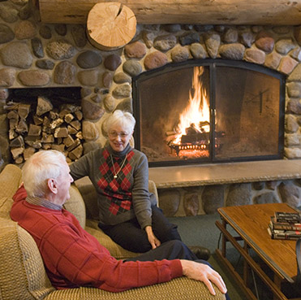
Leisure and Hospitality Industry Gross Sales 2009
67.9% Minneapolis-Saint Paul Area
9.2% Central Minnesota
4.2% Northwest Minnesota
12.2% Southern Minnesota
6.5% Northeast Minnesota

Slide 7
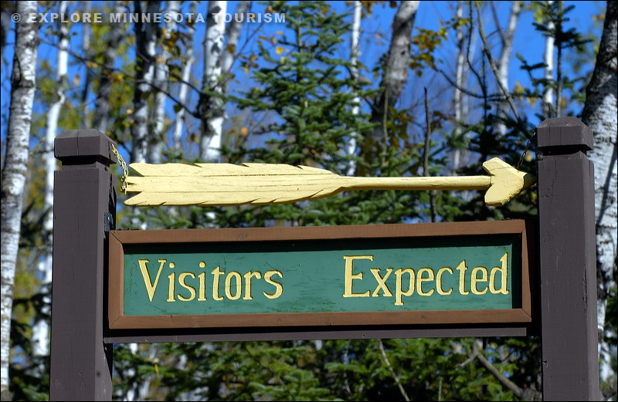
Minnesota Rank
28th in US in state tourism office budget
22nd in traveler spending
18th in travel-generated employment
9th in travel-generated taxes

Slide 8
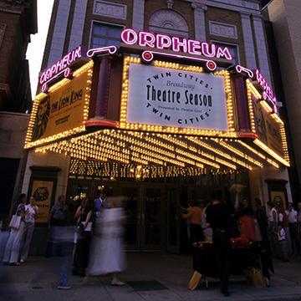
Mission
Promote travel to and within MN
Over 6,000 accommodations, attractions, events and communities
Public and private sector resources
Parks, trails, zoos, historic, and arts
EMT promotes all of Minnesota’s travel assets
public or private
urban or rural
state, local or federal management

Slide 9
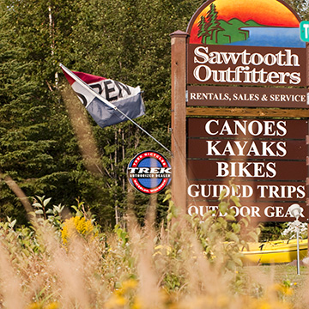
Goals
Leisure and hospitality sales
State sales tax generated
Employment in leisure and hospitality
Resident and non-resident travelers

Slide 10
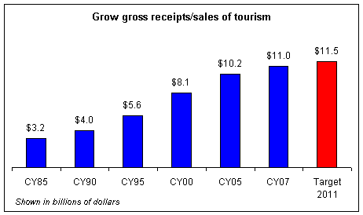

Slide 11
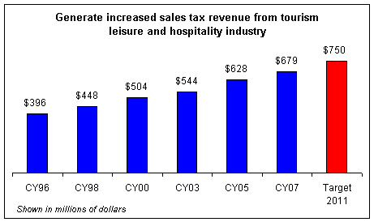

Slide 12
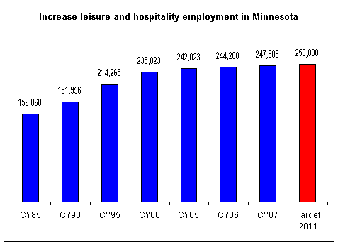

Slide 13

Tourism Council
28 person industry council
Tourism businesses and organizations
Four legislators
Statewide representation
Advisory role

Slide 14
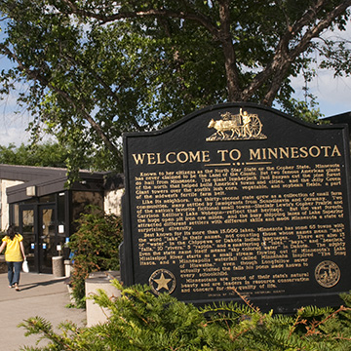
Structure
Approximately 60 full and part-time staff
48 full-time equivalents
Offices in Brainerd, Duluth, Thief River Falls, Mankato and Saint Paul
Six staffed travel information centers

Slide 15

Core Functions

Slide 16
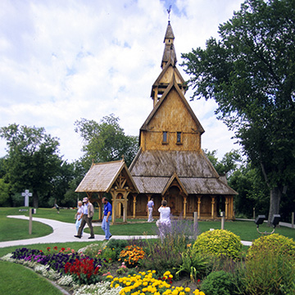
Marketing, Public Relations and Research
Advertising and promotions
U.S. North Central Region – International
Group tour
Research
Partnerships
Media relations and publications

Slide 17
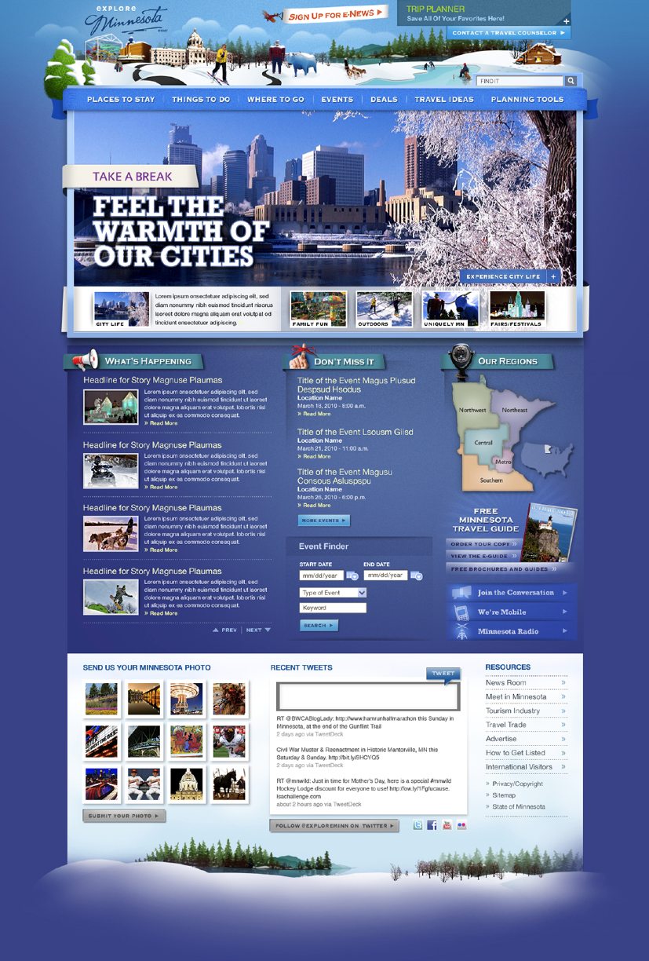
Operations and Technology
Administration, financial, and personnel
EMT extranet – database
Explore Minnesota web site
Distribution and contact center
Mobile website

Slide 18
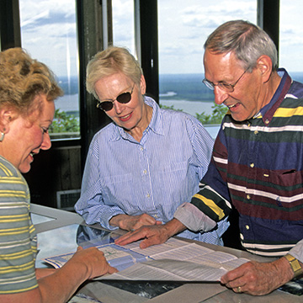
Industry Relations and TICs
Regional offices and outreach
Grant programs to extend marketing
State staffed information centers
Partnership centers and affiliates

Slide 19
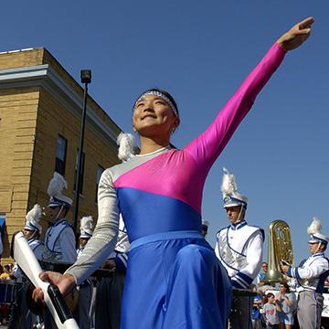
FY11 Budget
$8.353 million operating budget
$500,000 public private incentive funding
$325,000 MN Film and TV
Total $9.19 million*
*Note: $1.2 million Snowbate appropriation in FY10

Slide 20
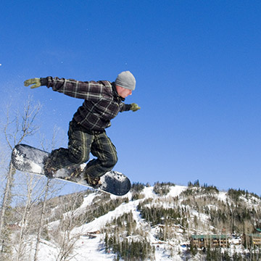
Public/Private Partnerships
FY 2010 Generated
$2.18 million cash match
$4.50 million in-kind
Total $6.68 million in tourism marketing partnerships

Slide 22
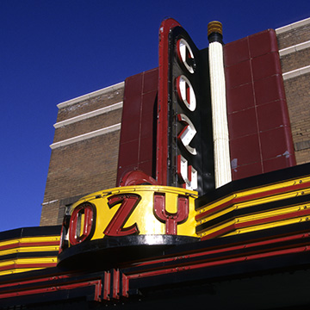
MN Film and TV Board FY 2010-2011
$325,000 operating budget per year
$1 private to $3 state match
$1.225 Million Snowbate (Biennial)
Up to 20% reimbursement

Slide 23
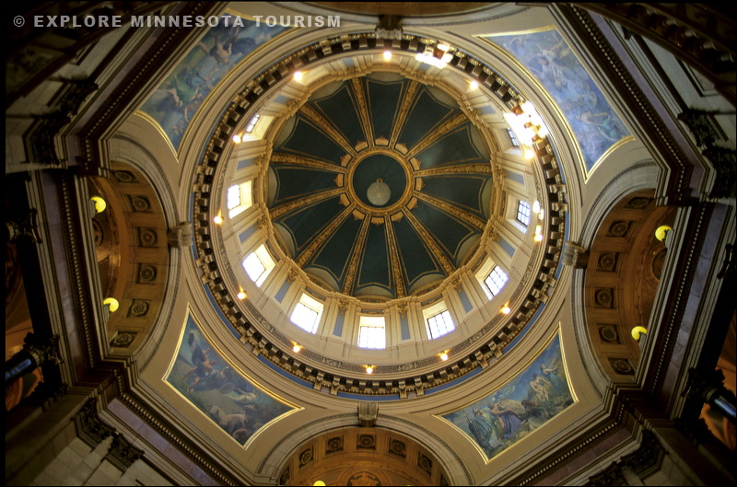
Governor’s Recommendation FY 12/13
$8.091 million annual operating budget
$500,000 public private incentive funding
$325,000 annual MN Film and TV appropriation
$1,000,000 one-time appropriation to MN Film & TV Board Jobs program
Total $9.928 million (FY2012)

Slide 24
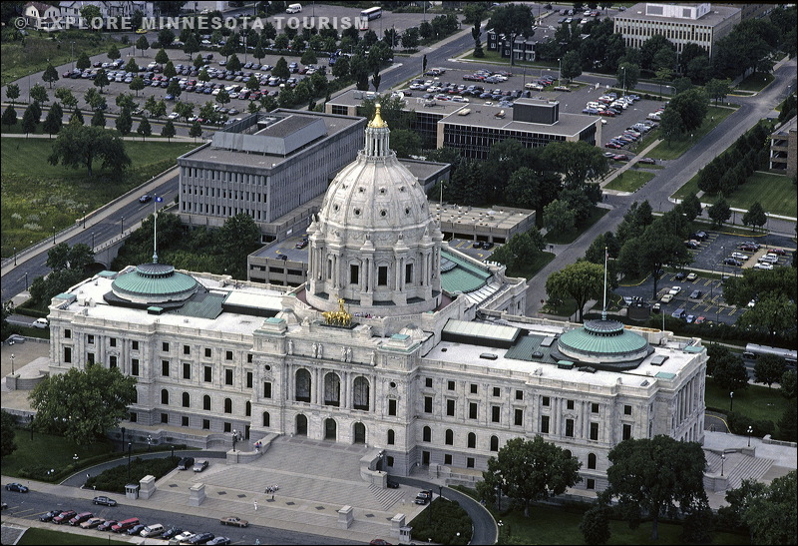
Proposed Operating Budget Reduction
$260,000 reduction
each fiscal year
Focus on high priority programs
Salary and benefits savings through early retirement (2.4 FTE’s)
Other retirements and vacancies (2.0 FTE’s)
Additional professional and IT savings

Slide 25
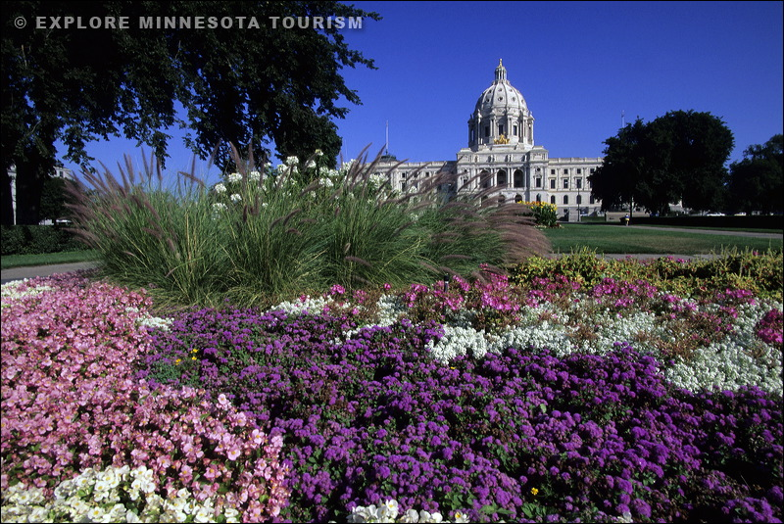
Maintain High Priority Programs
Marketing and sales that provide the greatest return for the state
Programs that leverage public and private sector partnerships
Programs that bring revenue and jobs to Minnesota

Slide 26
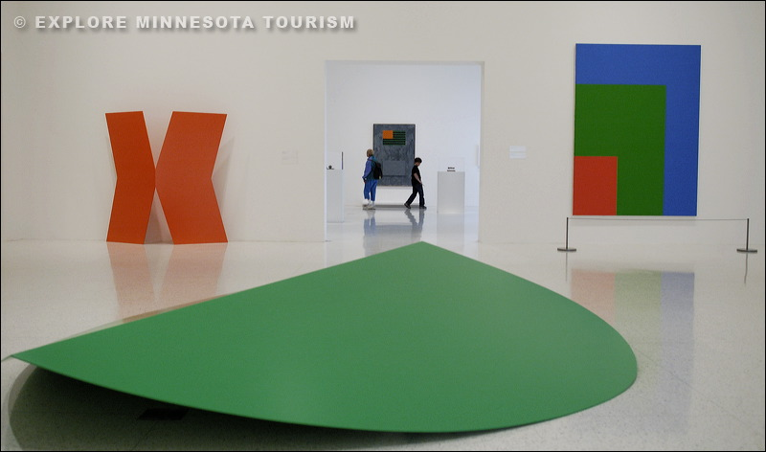
MN Film and TV Board Recommendation
$325,000 each fiscal year for operations
$1 million to fund Snowbate program
in FY 12
Attract production through reimbursement of 15 – 20% of eligible expenditures

Slide 27
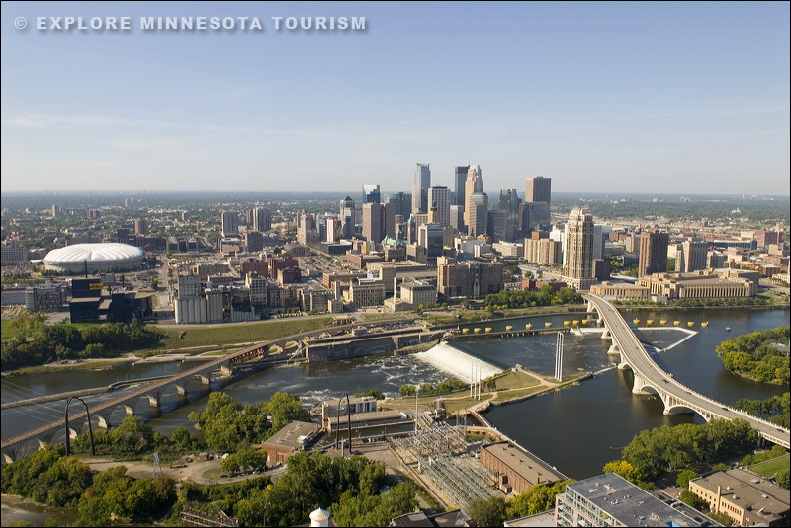
Car Rental Tax Proposal
1% increase in car rental taxes dedicated to tourism
This would generate $2.6 million or more
Majority of revenues captured from MSP
Most additional collections are within the metro area
Most revenue would come from travelers and be used to promote tourism

Slide 28

Alternative Funding Sources Needed
Being outspent by regional competitors
Rank 28th U.S. in total tourism spending
Need to diversify source of revenues to remain competitive
Car rental tax recommended by Tourism Council

Slide 29
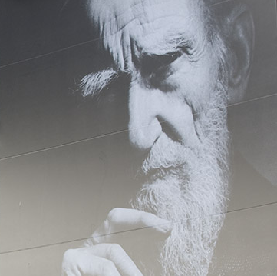
Car Rental Cost Minimal
Cost would be minimal
$1 for a $100 two-day rental
Minneapolis ranks 24th among airports
Even with tax, car rental tax would on par with other states
Allows MN to compete with other states

Slide 30

Industry Trends
Coming off difficult year
Gradual improvement forecast
Close to home and last minute
Search for value
Concern about gas prices

Slide 31
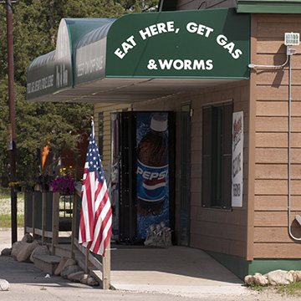
Marketing Changes
Encourage travel
Discover and explore
Marketing partnerships
Traditional and digital

Slide 32



New Approach
Rebuilt database
New website
Social and web sharing
New approach
New tactics

Slide 33

Integrated Marketing
Statewide Integrated Marketing (SWIM)
Results of strategic planning
Avoid duplication
Extend promotion and reach
Consistent narrative and brand

Slide 34

Partnership for MN
Natural resource promotion
Historical sites partnerships
Private sector partnerships
Promotion of active lifestyles

Slide 35
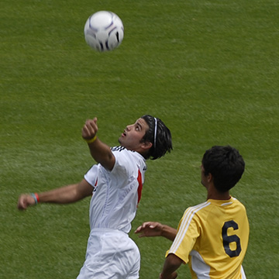
Statewide Industry Cooperation
Meetings and conventions
Sports marketing
Sustainable tourism
Multi-state marketing

Slide 36
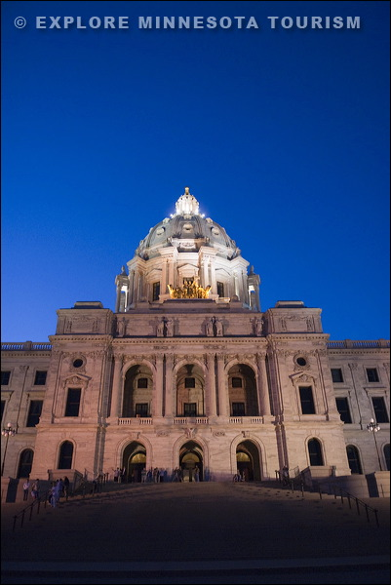
Return on Investment
For every dollar invested in tourism marketing:
$4.60 in state taxes
$20.40 in wages
$53.00 in gross sales

Slide 37

Tourism and Growth
Tourism means jobs and revenue for MN
Cannot rely on general fund alone
Must look for new public and private sector partnerships
Tourism can mean growth for Minnesota

Slide 38

Tourism 2020
Our goal:
$20 billion industry
271,500 jobs
$1.3 billion sales tax

Slide 39
Proposed Budget
Allows us to grow revenue and jobs
Diversify funding sources
Stay competitive with other states
Develop new public and private sector partnerships
Enhance recovery through tourism

Slide 40
Thank You

