Slide 1
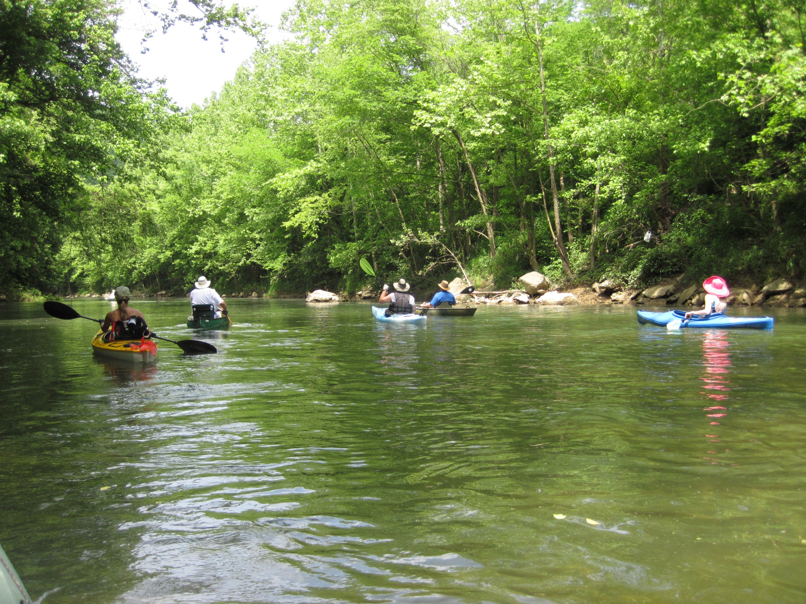
WATER TRAILS
AND THE
WEST VIRGINIA RECREATIONAL TRAILS ADVISORY BOARD (WVRTAB) PROCESS FOR DESIGNATION

Slide 2
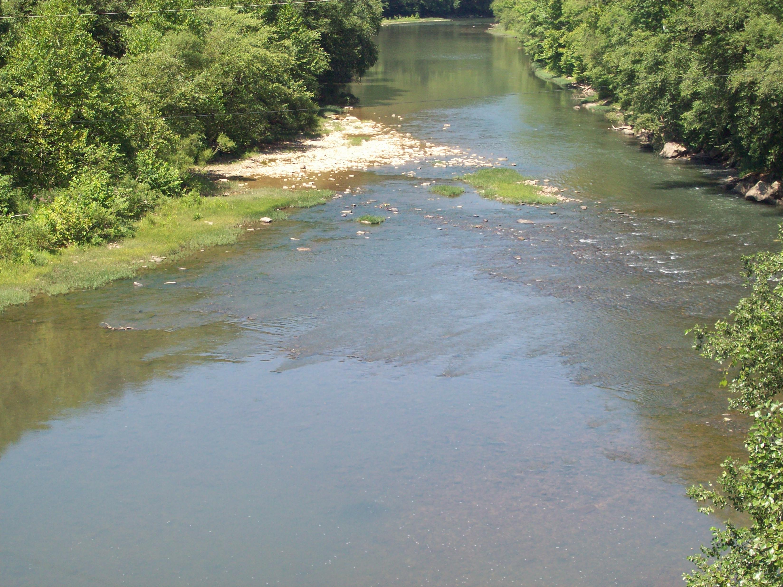
WHAT ARE THE BENEFITS OF A WATER TRAIL?
Increase Tourism.
Improved access and infrastructure for recreational boating.
Improved access and infrastructure for fishing.
Notes:
Same applies to fishing.

Slide 3
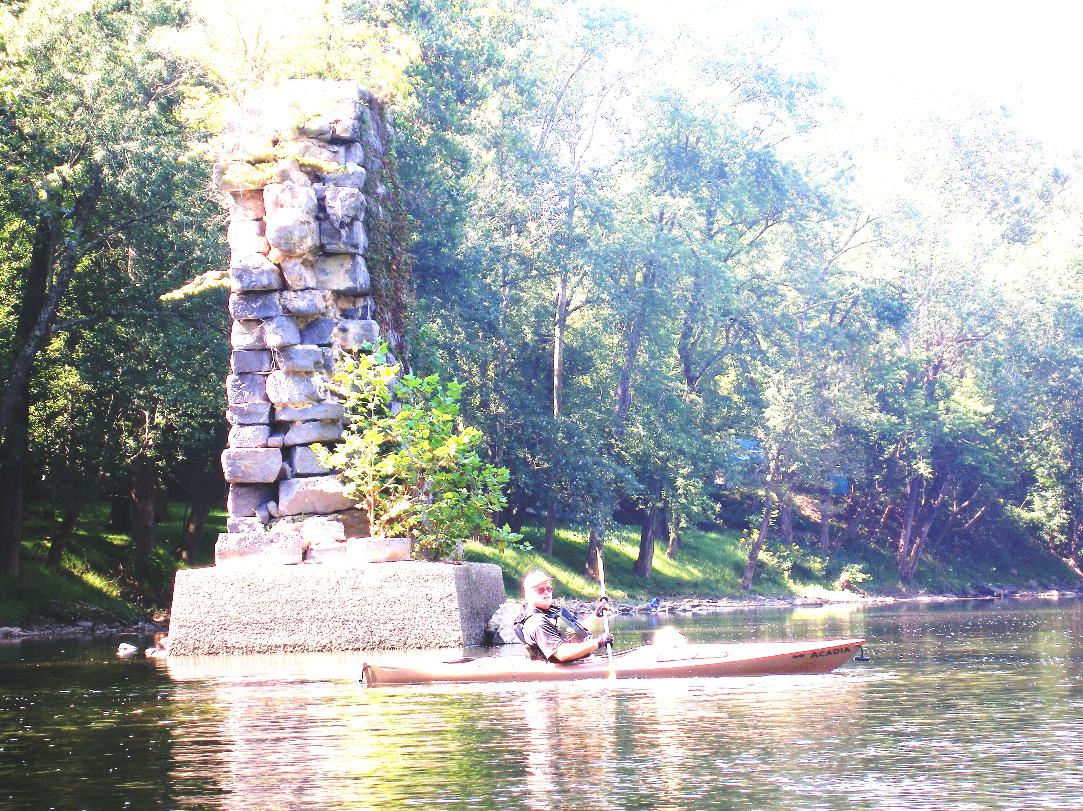
WHAT IS A WATER TRAIL?
A water trail is a route on a stream, river or lake that provides boaters with a recreational, scenic, historical or educational opportunity.
Notes:
RECREATIONAL
SCENIC
HISTORIC
EDUCATIONAL

Slide 4
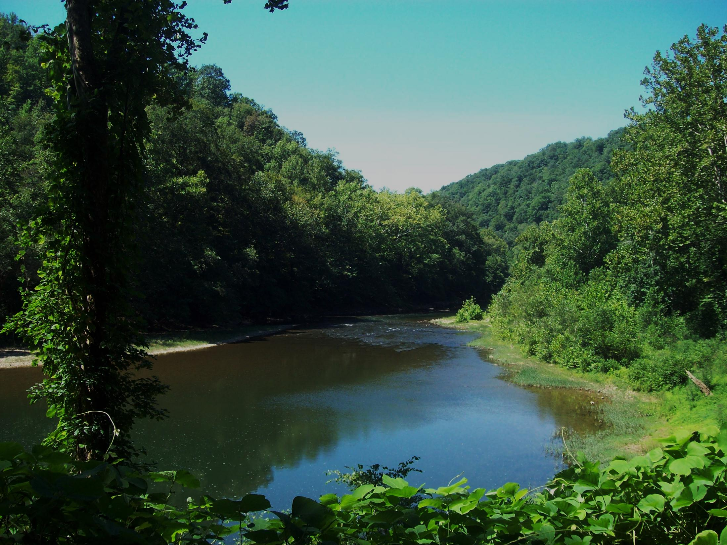
A water trail is not just a stream. For designation, a water trail must be:
A nearly contiguous waterway or series of waterways open to paddlers or other boaters.
At least deep enough and wide enough for a modern John boat, canoe, kayak or similar small boat to maneuver.
Primarily flat water.
Accessible to the public.
Notes:
Not every stream can be a water trail. It must be:
Continuous
Big enough to float a boat
Primarily flat water
Accessible

Slide 5
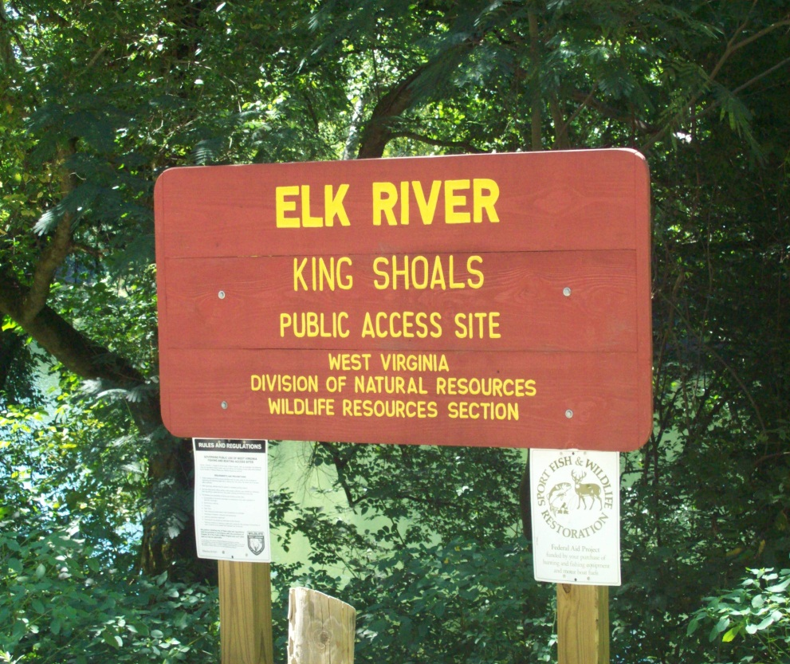
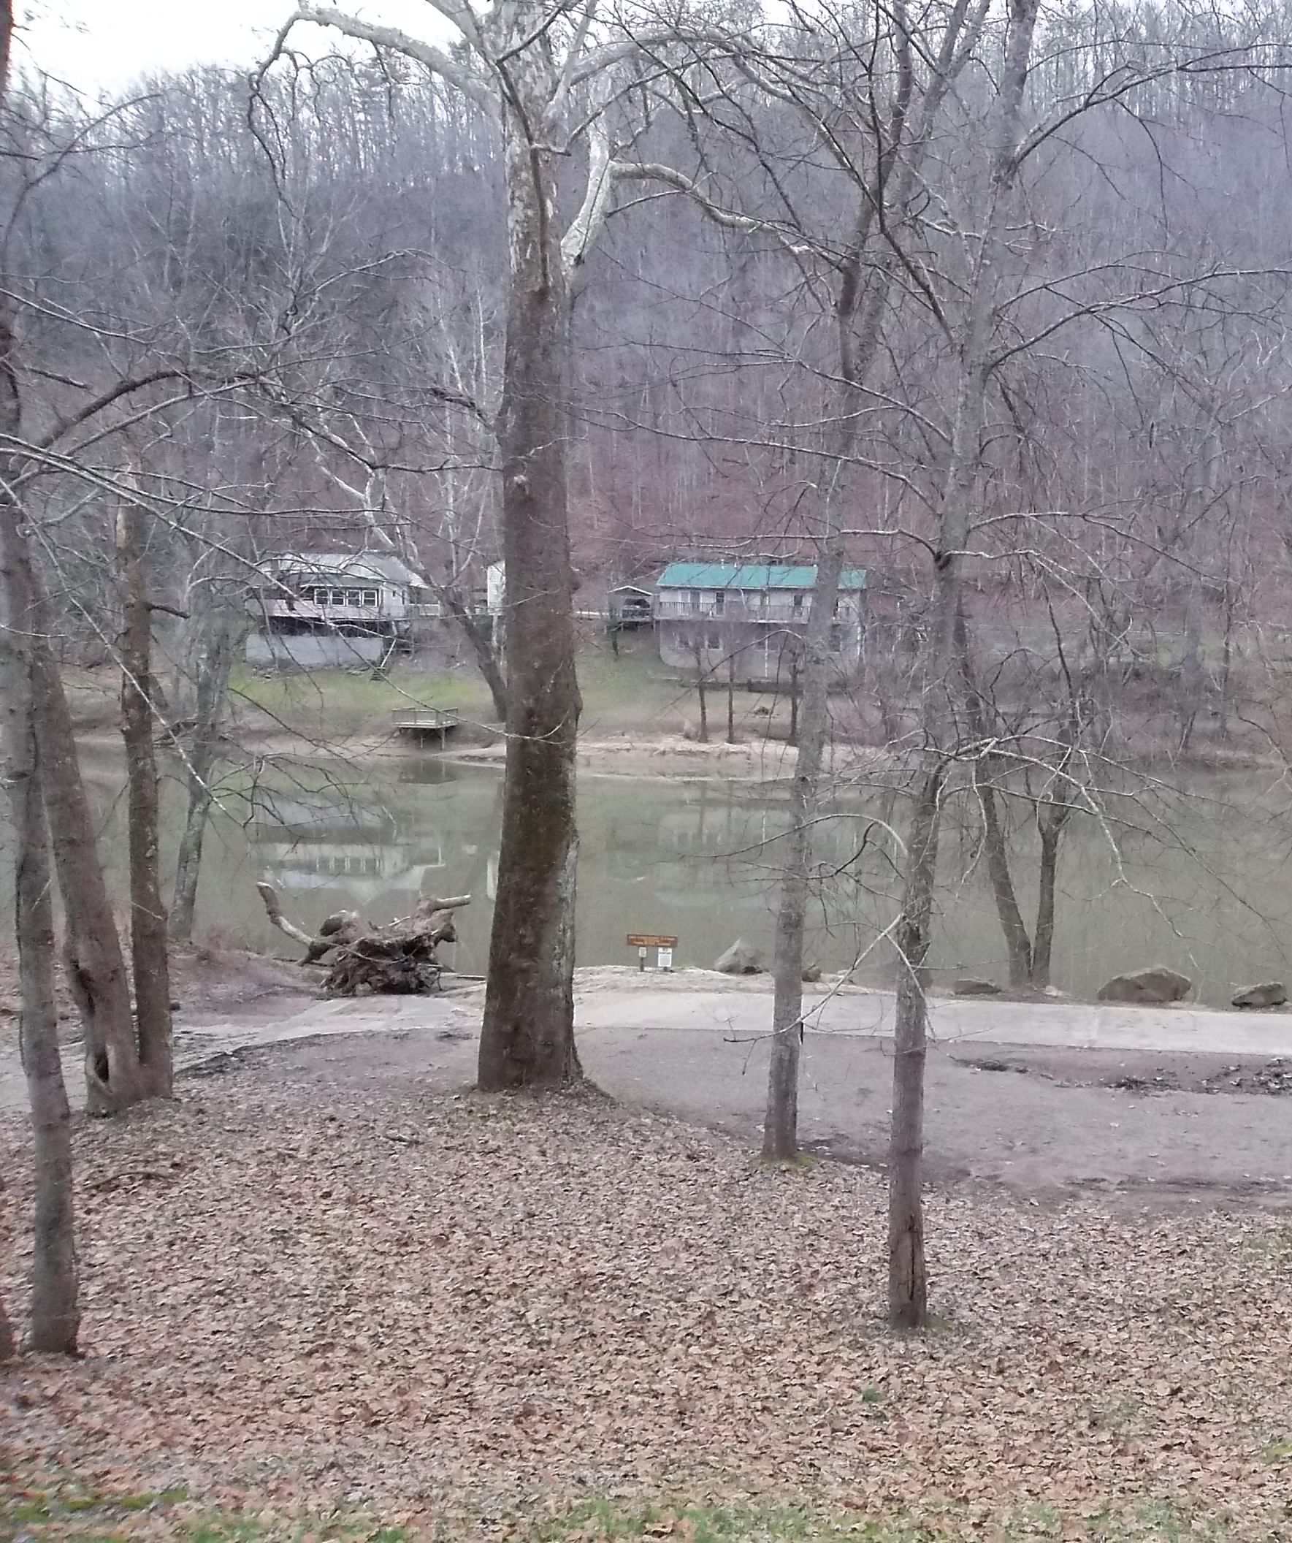
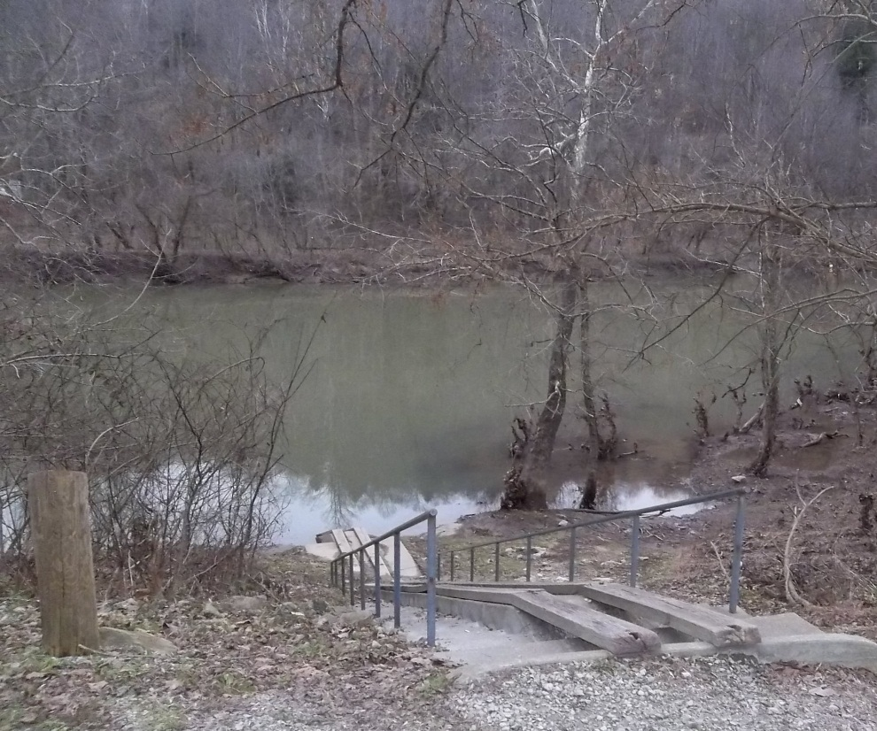
Public Access
Public access points should be available every five to ten miles along water trail.
Parking and a ramp or path to water are minimum requirements for access.
May include any other trailside amenity.
Portage trails should be short and easy to use.
Some organization must agree to maintain public access points and trailside amenities.
Construction must meet WV DNR design criteria.
Access points must be adequate for the size of boat appropriate for the water trail.
Notes:
Bigger water allows bigger boats and usually bigger trailers, and more of them. So you need bigger public access areas. Both for the increased numbers of boats and the increased size of them.

Slide 6


WHO CAN REQUEST WATER TRAIL DESIGNATION?
Any city, county or non-profit group can apply, or any combination of the above.

Slide 7
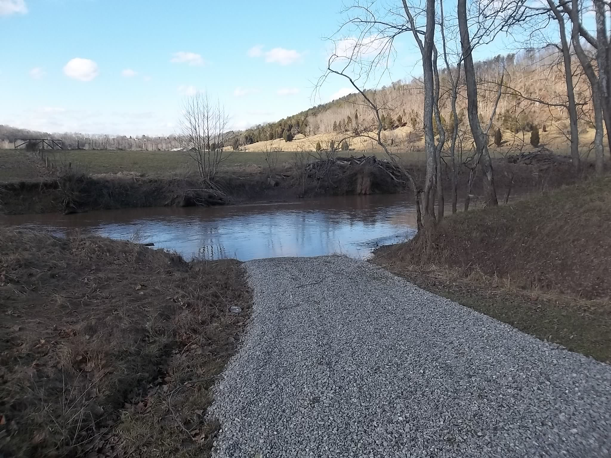
Primary Sponsor:
A local government organization responsible for developing the proposal for designating and managing the trail.
Any number of organizations or individuals may partner with the primary sponsor.
An application for a grant with the WVRTAB must be submitted by primary sponsor.
Primary sponsor is responsible for coordinating maintenance and upkeep of public access to trail, trailside amenities, signage, maps, guides or website developed with funds awarded by WVRTAB.
Notes:
The primary sponsor is the group we will hold responsible. In the past, local government sponsors and established non-profit groups have been given more credibility than a newly organized non-profit.

Slide 8
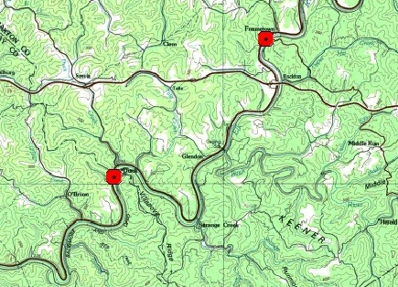
HOW TO GET YOUR WATER TRAIL DESIGNATED.
Prepare a ROUGH map showing
Proposed Route,
Roads,
Parks
Cities and towns
County boundaries…
Notes:
Now lets talk about how you can get your stream or lake designated as a water trail.
To begin you need to submit a draft application for designation to the Chairman of the WVRTAB. We don’t have a particular form for this. Instead you just send a letter identifying the stream along with certain information. First, include a map, topo maps or county highways are fine. Make sure the maps include all the information needed.

Slide 9
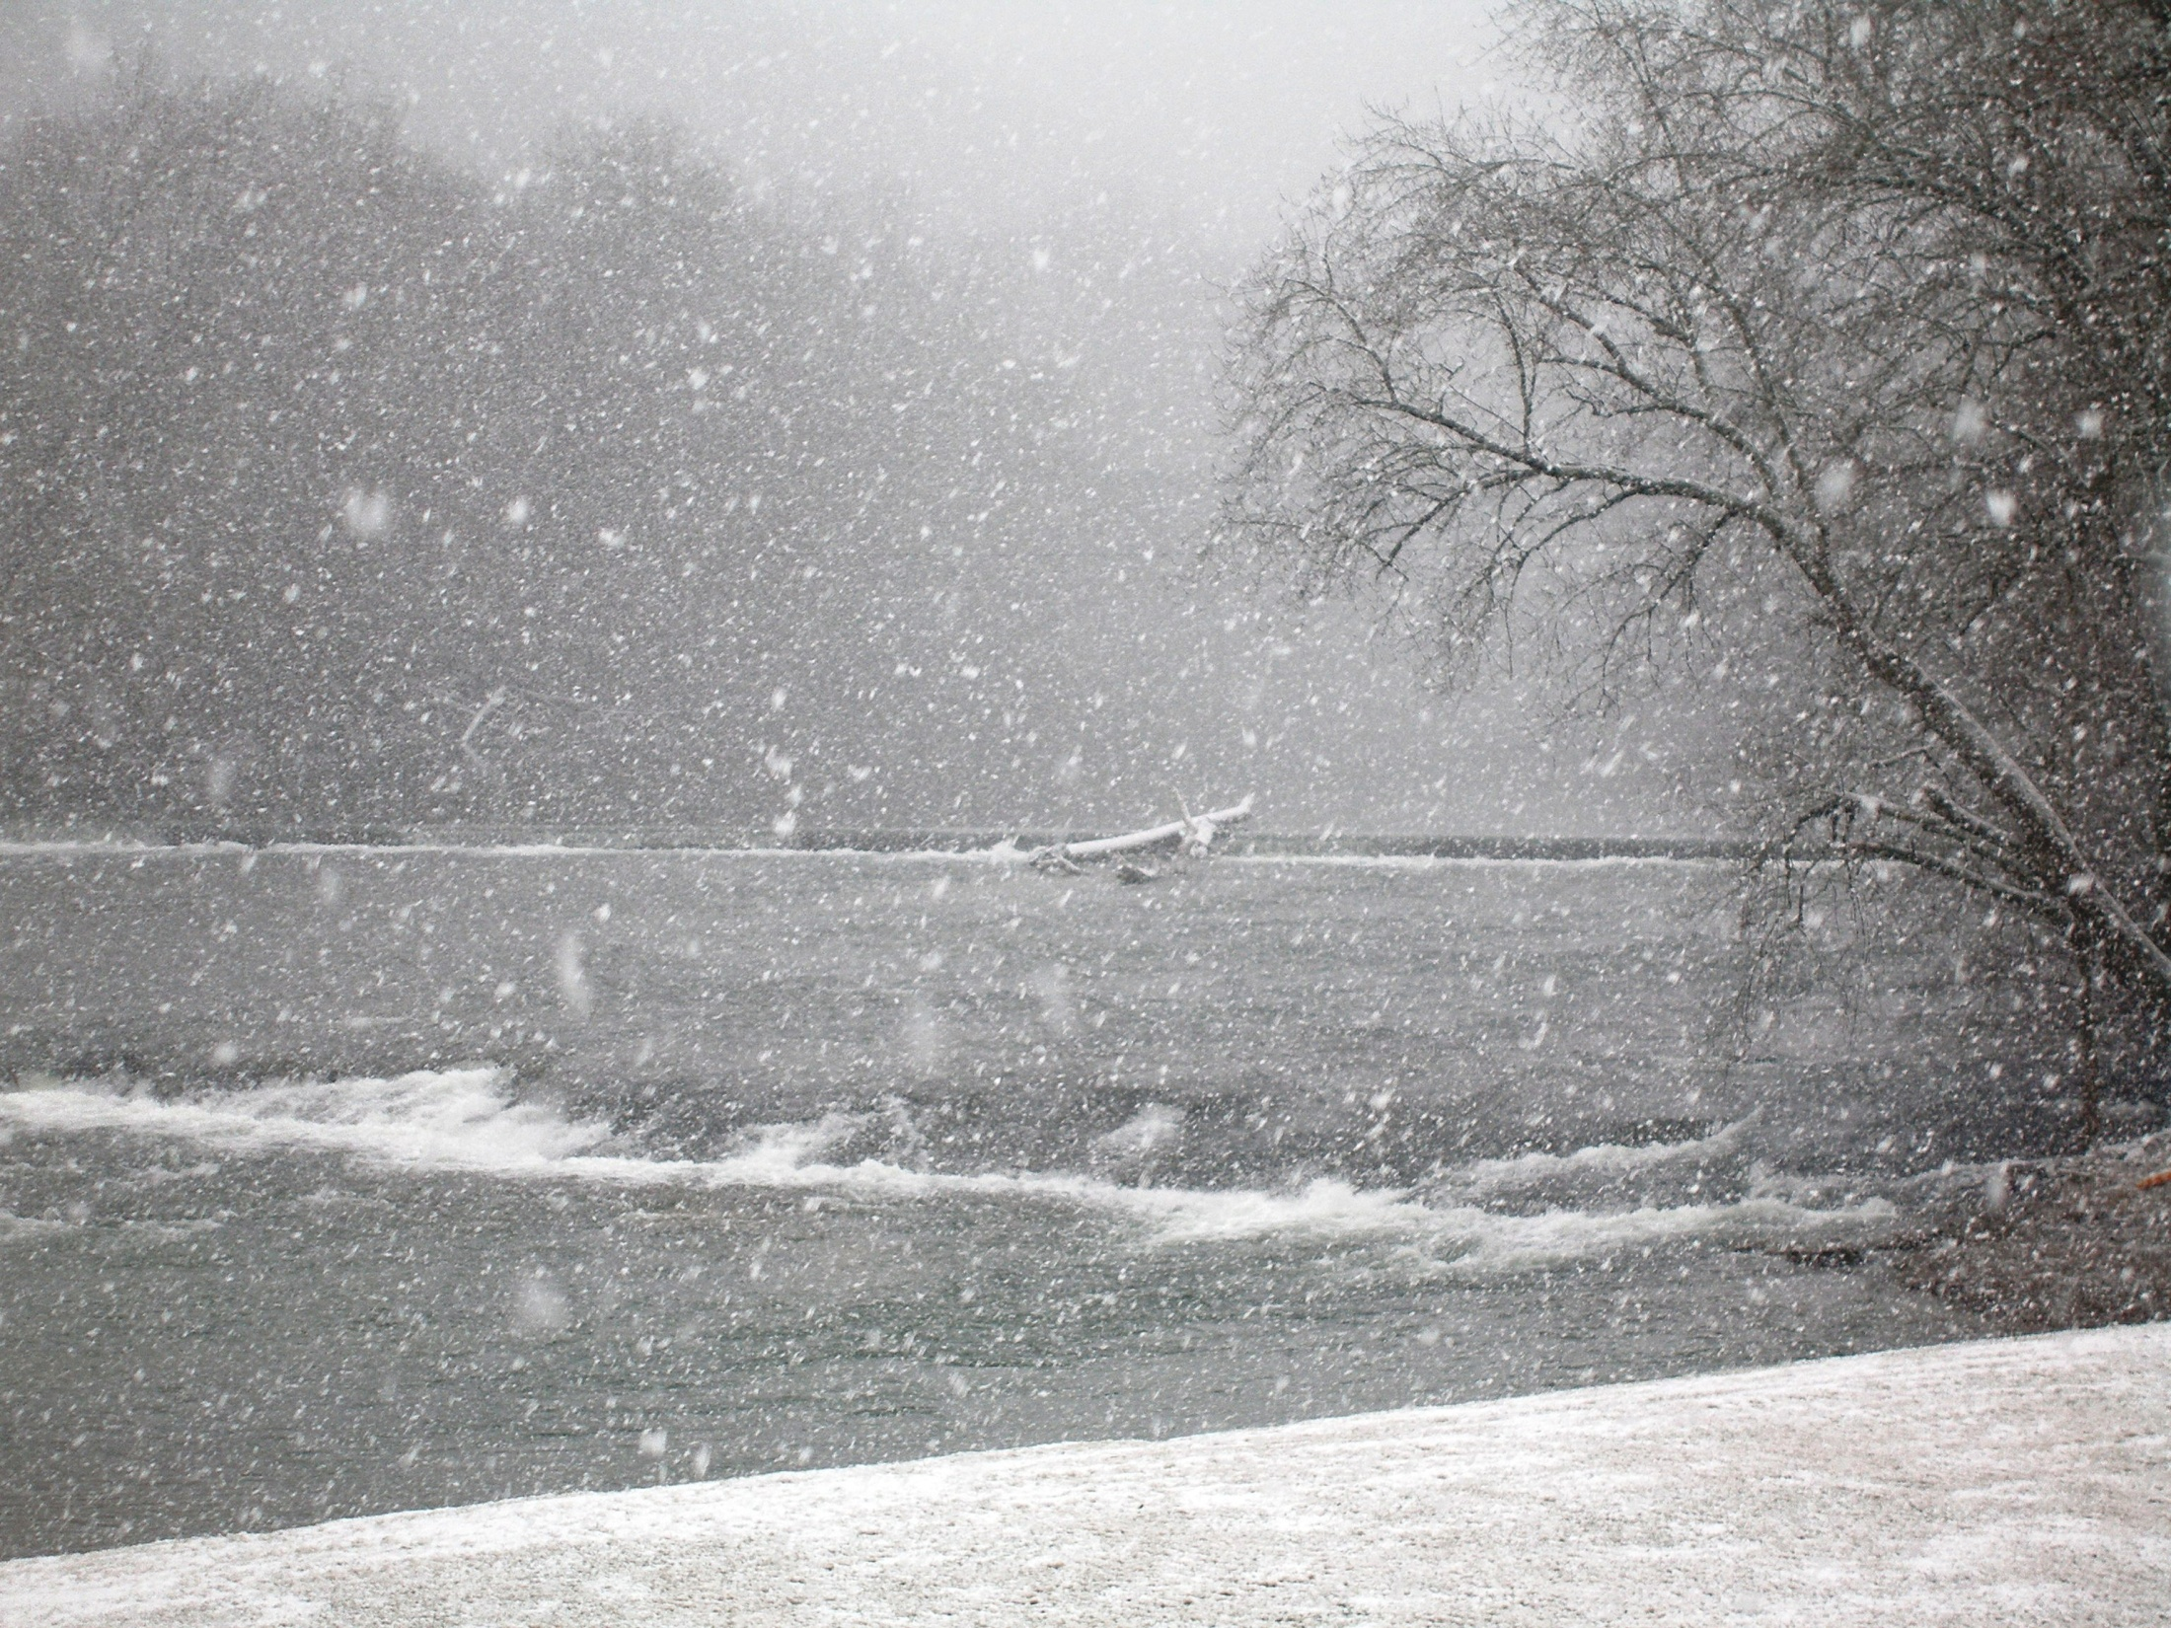
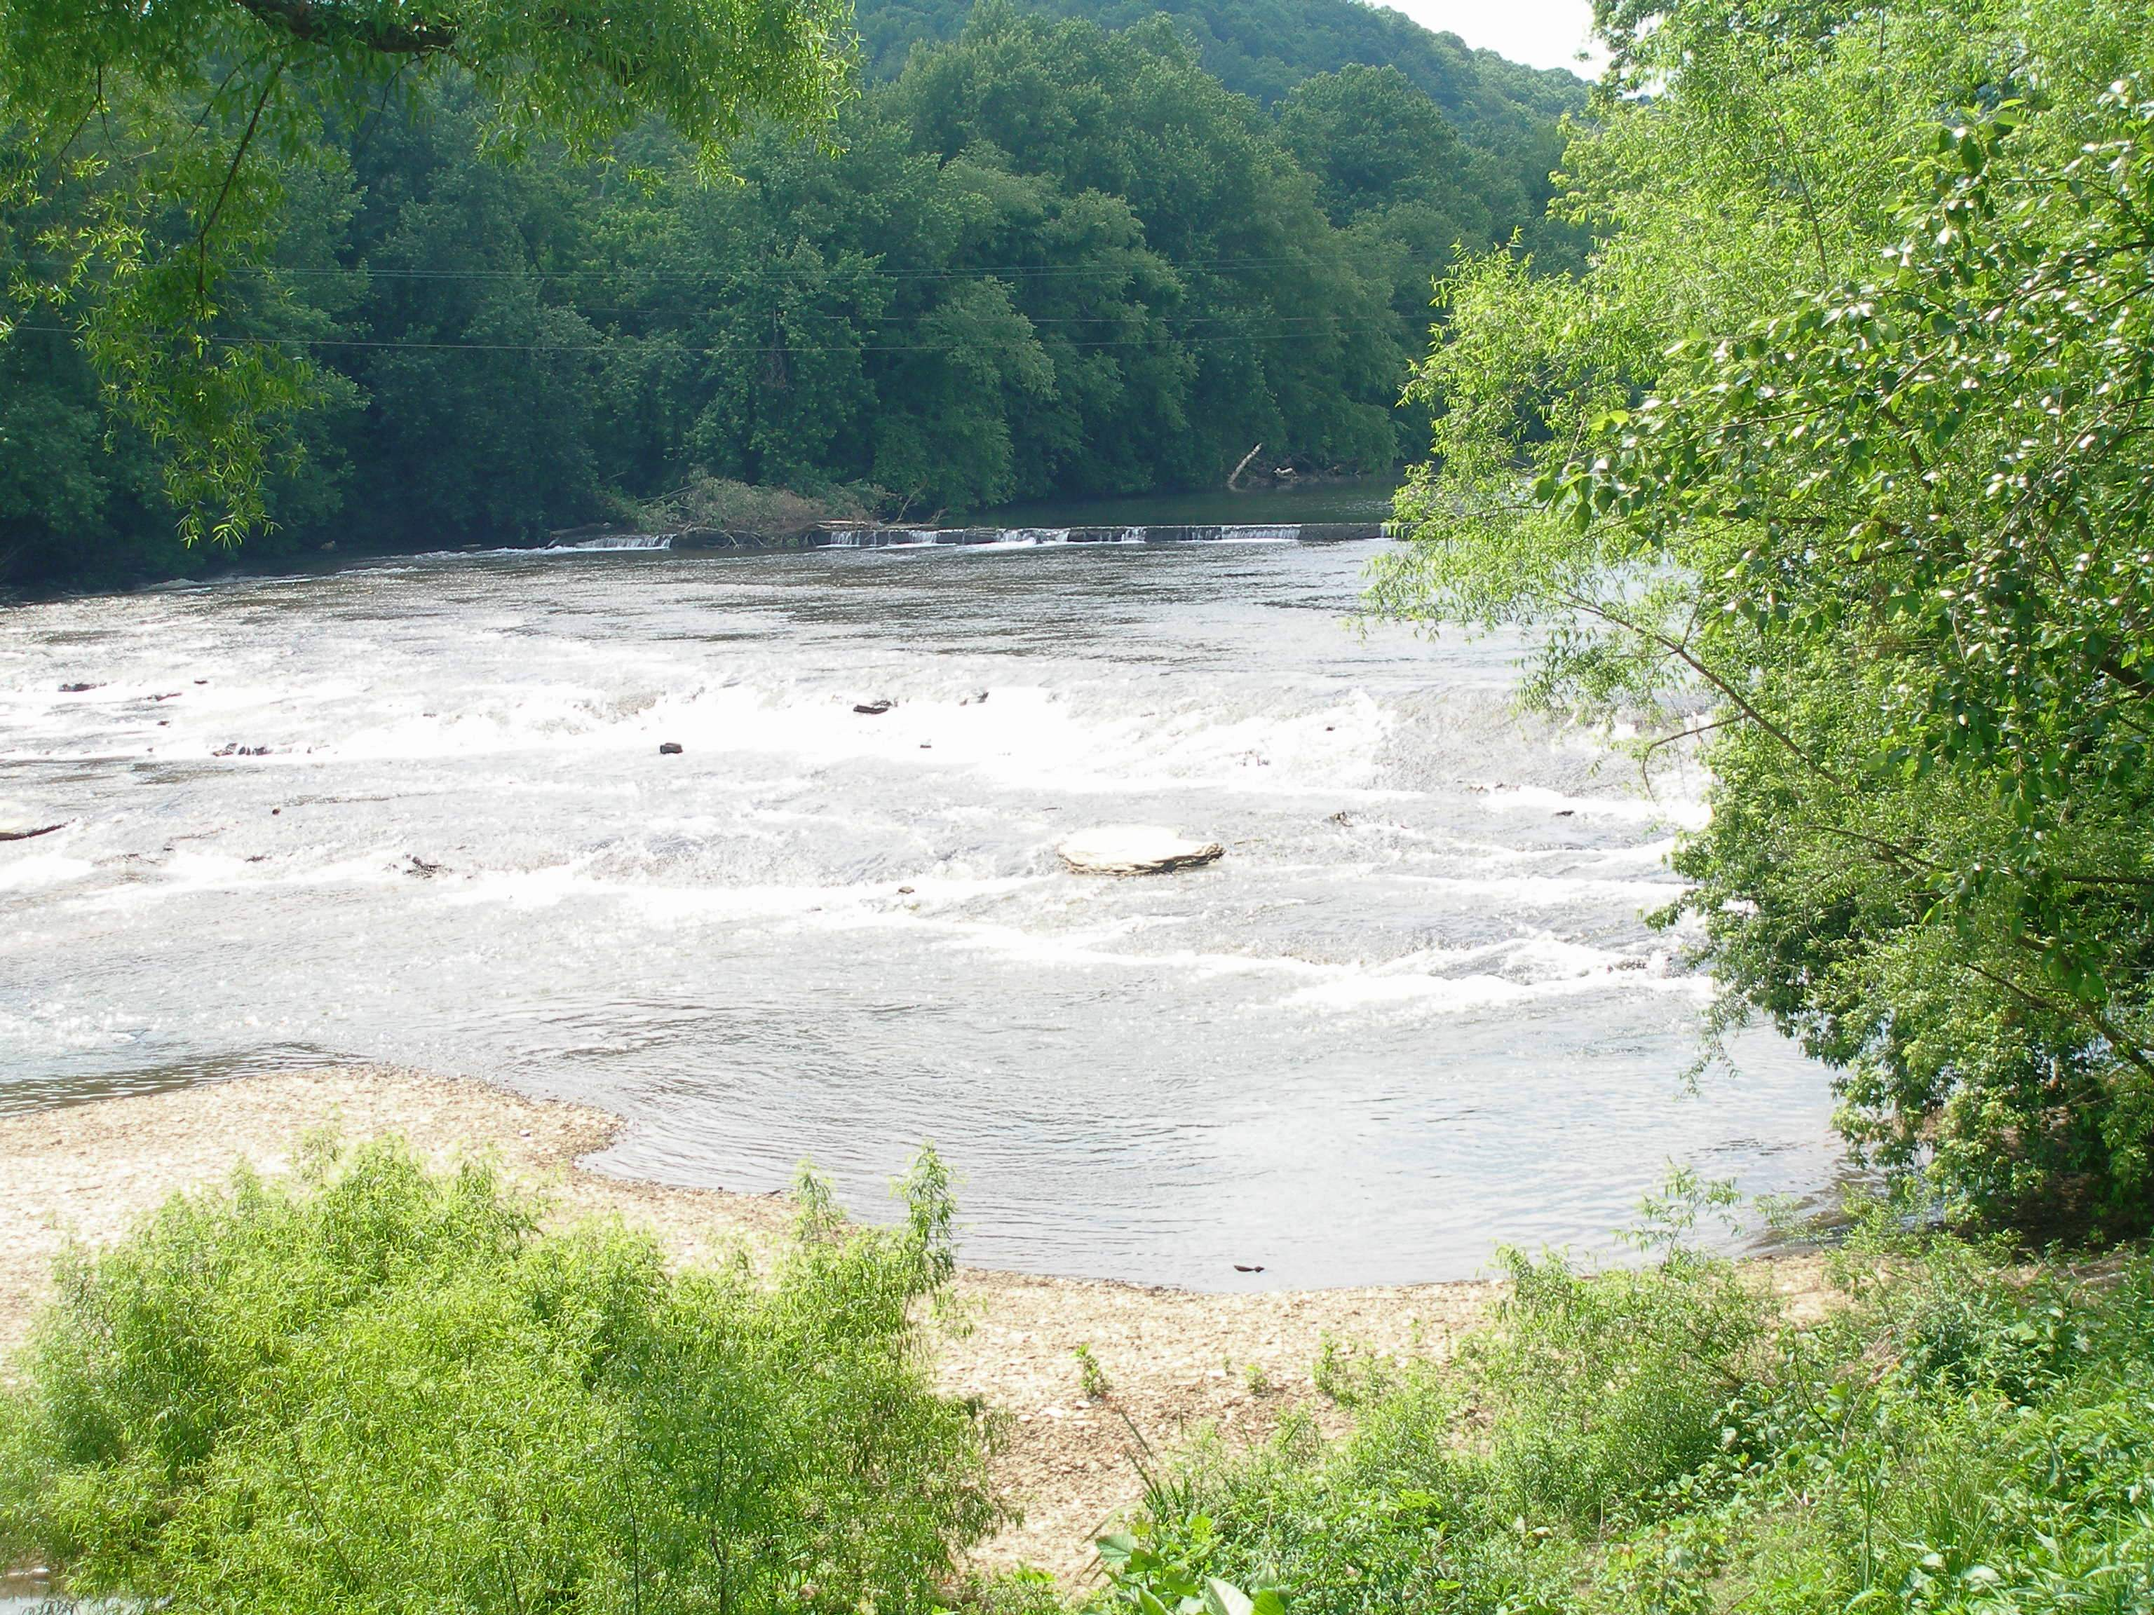
Water trail obstacles (dams, falls, etc.)…
Notes:
Most maps won’t have water trail obstacles marked. These could be old locks and dams no longer in use. Low water dams used to provide water for a community, natural water falls, or shoals where the water is usually too low for easy navigation.

Slide 10
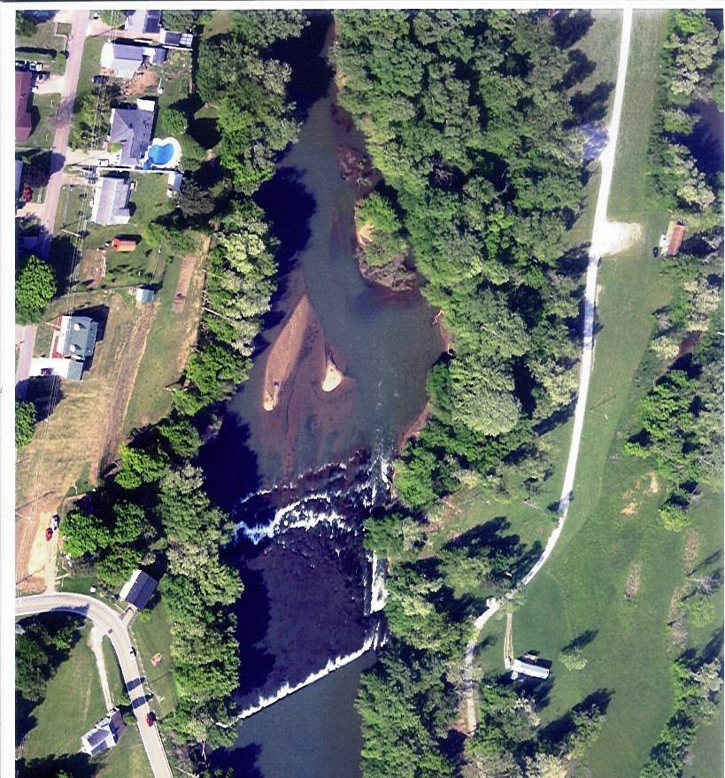
Existing and proposed access points and portage trails…
Notes:
Mark where the existing access points are and any proposed access points and portage trails. Here the heavy black lines are two proposed access points. The red line is the proposed portage trail connecting them. I have watched kayakers ride over the falls shown in this picture. In fact I have done it. But I won’t do it again and I don’t think my wife could do it.

Slide 11
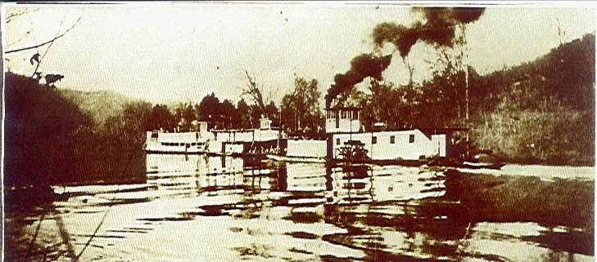
A brief description of the recreational, scenic, historic or educational opportunities offered by this water trail.
Notes:
Include in your draft application a narrative about the recreational, scenic, historic or educational aspects of your proposed water trail. Some water trails will include all four. All of them will include at least two of the four.

Slide 12
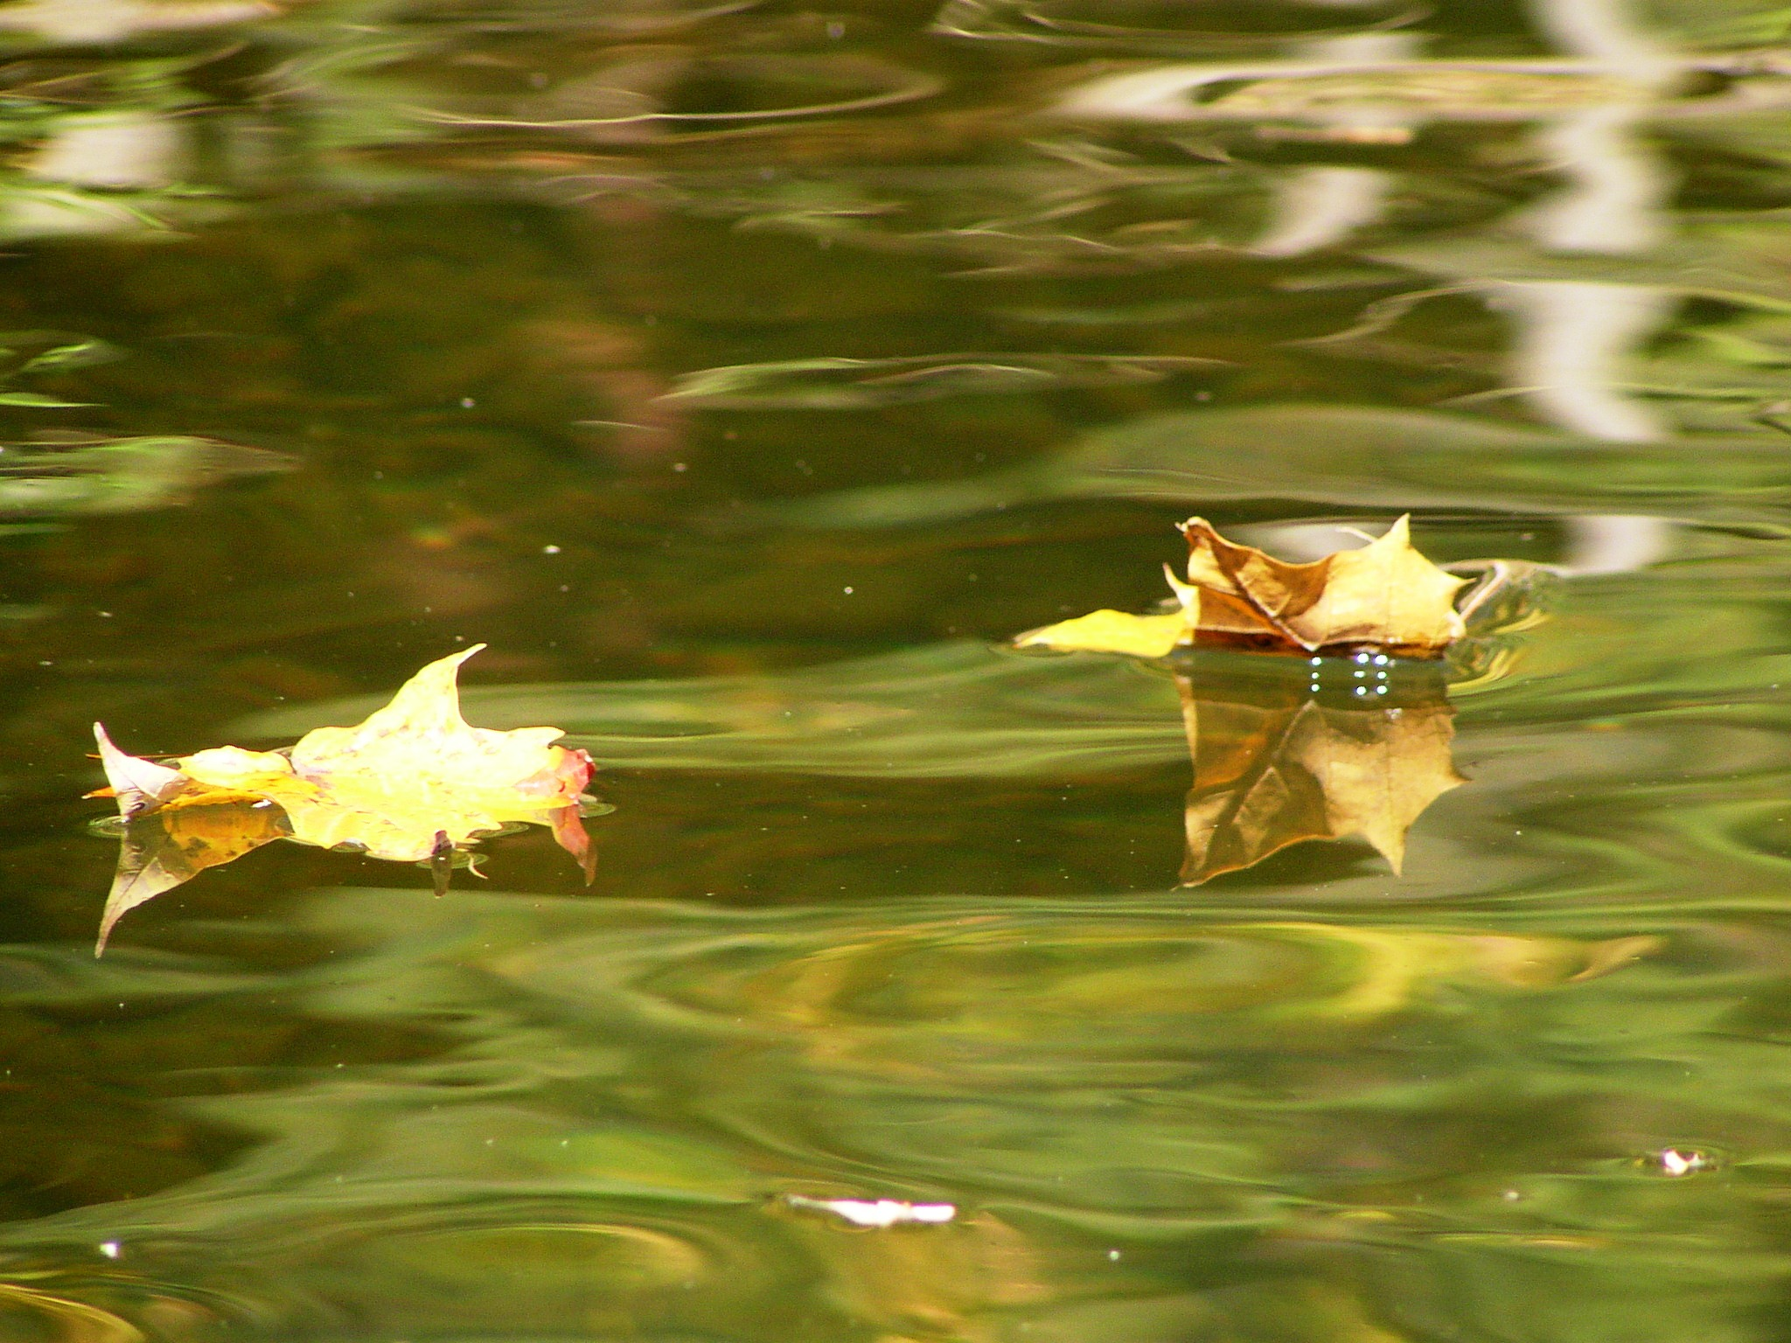
Submit all this to the WVRTAB via the WVDOH and someone will get in touch with you to help with the rest of the process.
Notes:
Submit your draft request for designation to Bill Robinson. After he reads it, I’ll get it. After I read it, Bill and I will discuss your application, do some research on the data provided and contact you to set up a meeting to discuss refining your request to sure it meets all the criteria. Up to this point we can deal with crayon on butcher paper quality in the submission. The final version that goes to the full RTAB needs to be a quality document. We’ll help you do that.

Slide 13
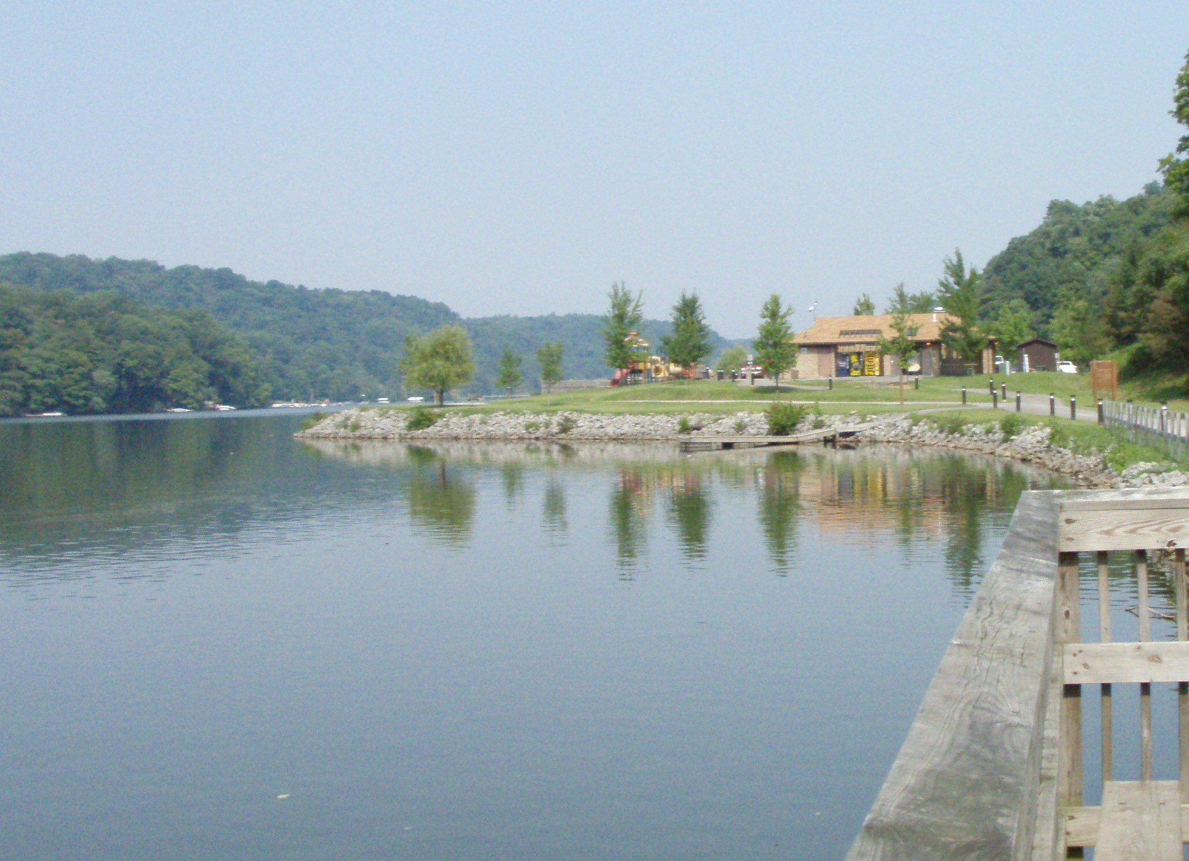
You will have to:
Hold at least one public meeting in each county.
Have the most recent version of the draft request on hand for review.
Notify all local governments and property owners near the proposed trail of the meeting.
Notify the WV DOH/WVRTAB and the WV DNR District Wildlife Biologist.
Notes:
In preparing your final submission you need to address some things that were not covered in the initial draft. One big thing is a series of public meetins.
Most recent draft
Invite all local gov
Invite RTAB and local WV District Wildlife Biologist

Slide 14
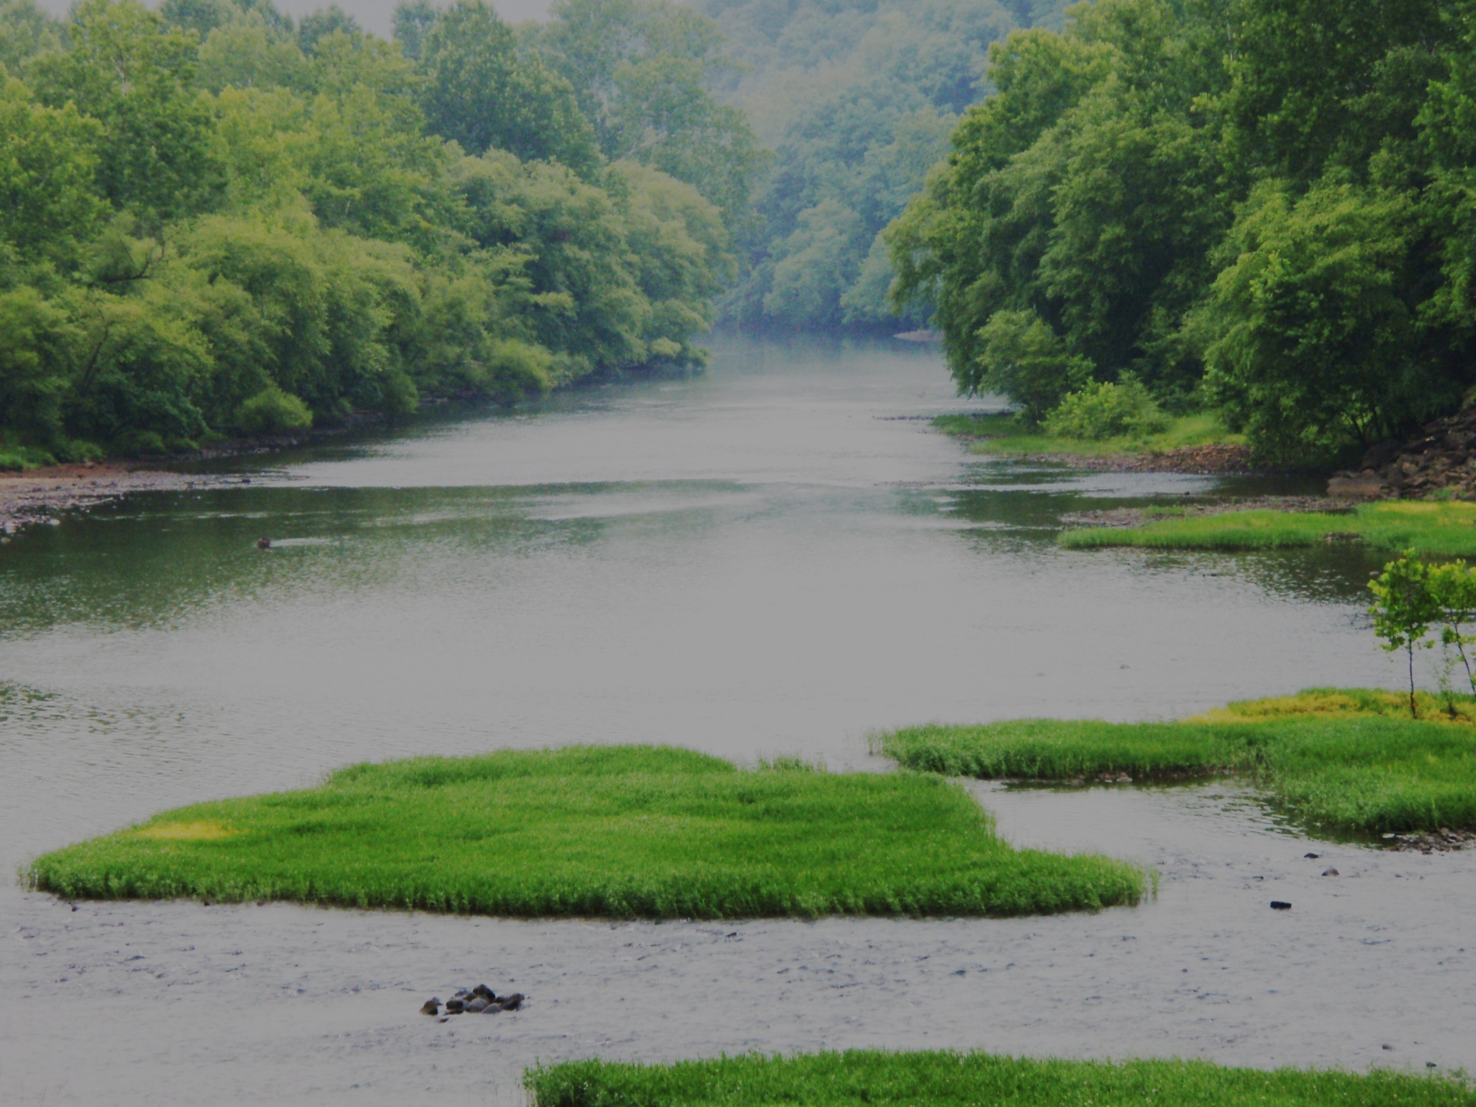
REVISE THE DRAFT REQUEST! The final draft request must include:
Name and contact information of the primary sponsor.
List of all participating sponsors.
Reproducible map showing details required in draft request.
Draft copy or detailed description of a map, guide, web site, signage or other process to advertise trail.
Description of the planning process.
Description of how local government and the public will be kept informed.
Description of the recreational, scenic, historic or educational opportunities of the trail.
Information about where the public meetings were held, comments received and how any comments were addressed.
Notes:
This list should not be considered a table of contents for your application. Every stream is different and every application for a water trail will probably be different. But these are the items you have to address in your application. We don’t care what order they are addressed but the must be covered.

Slide 15
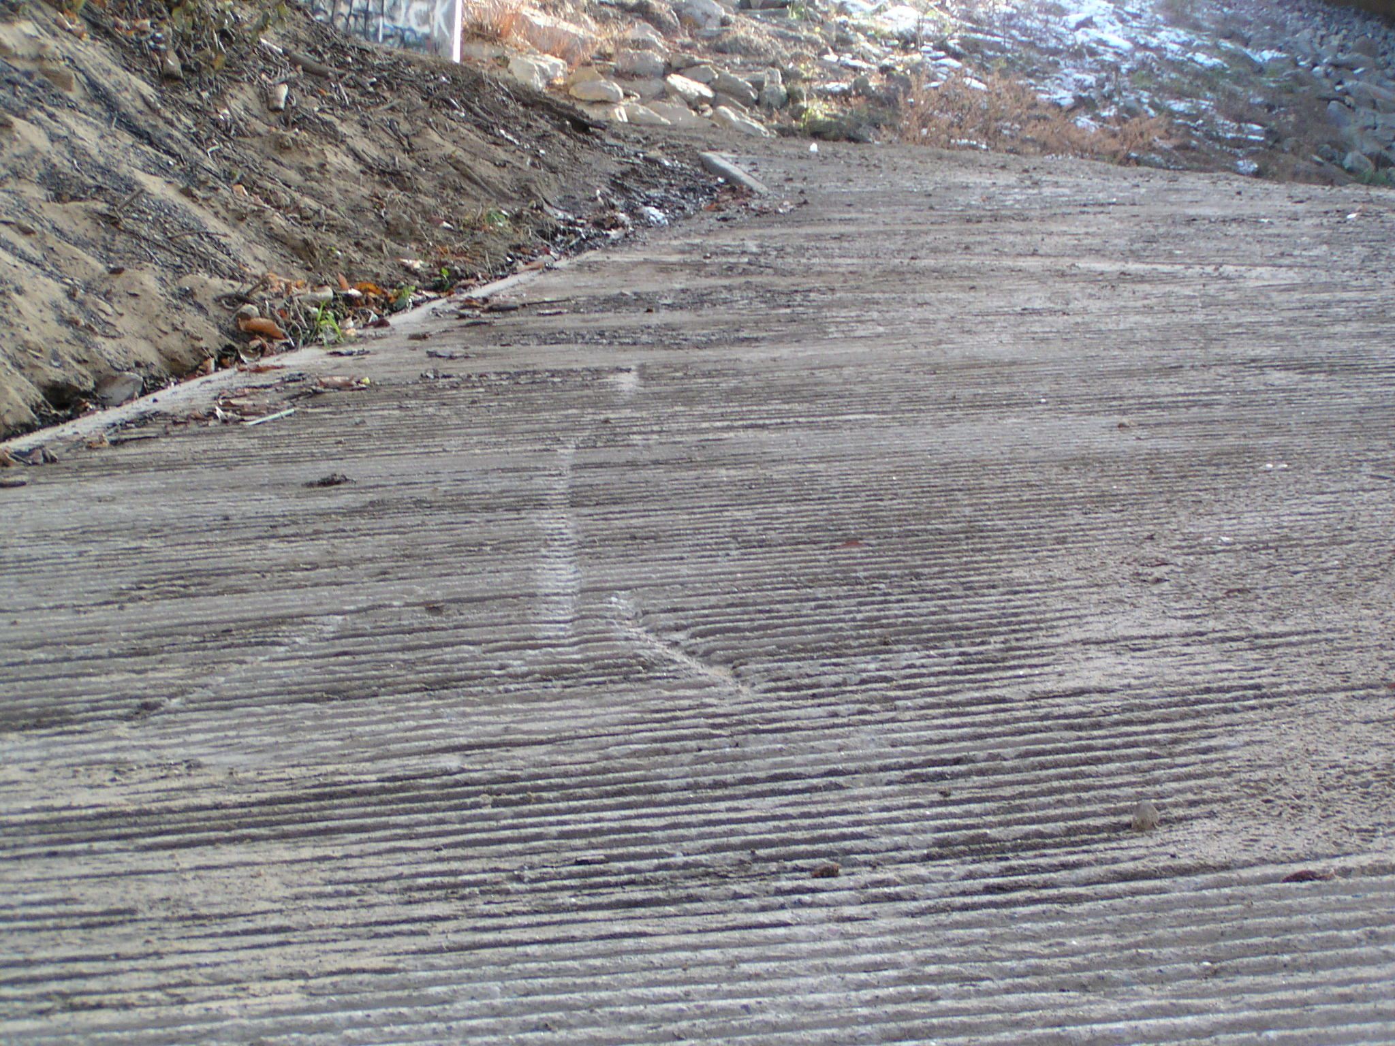
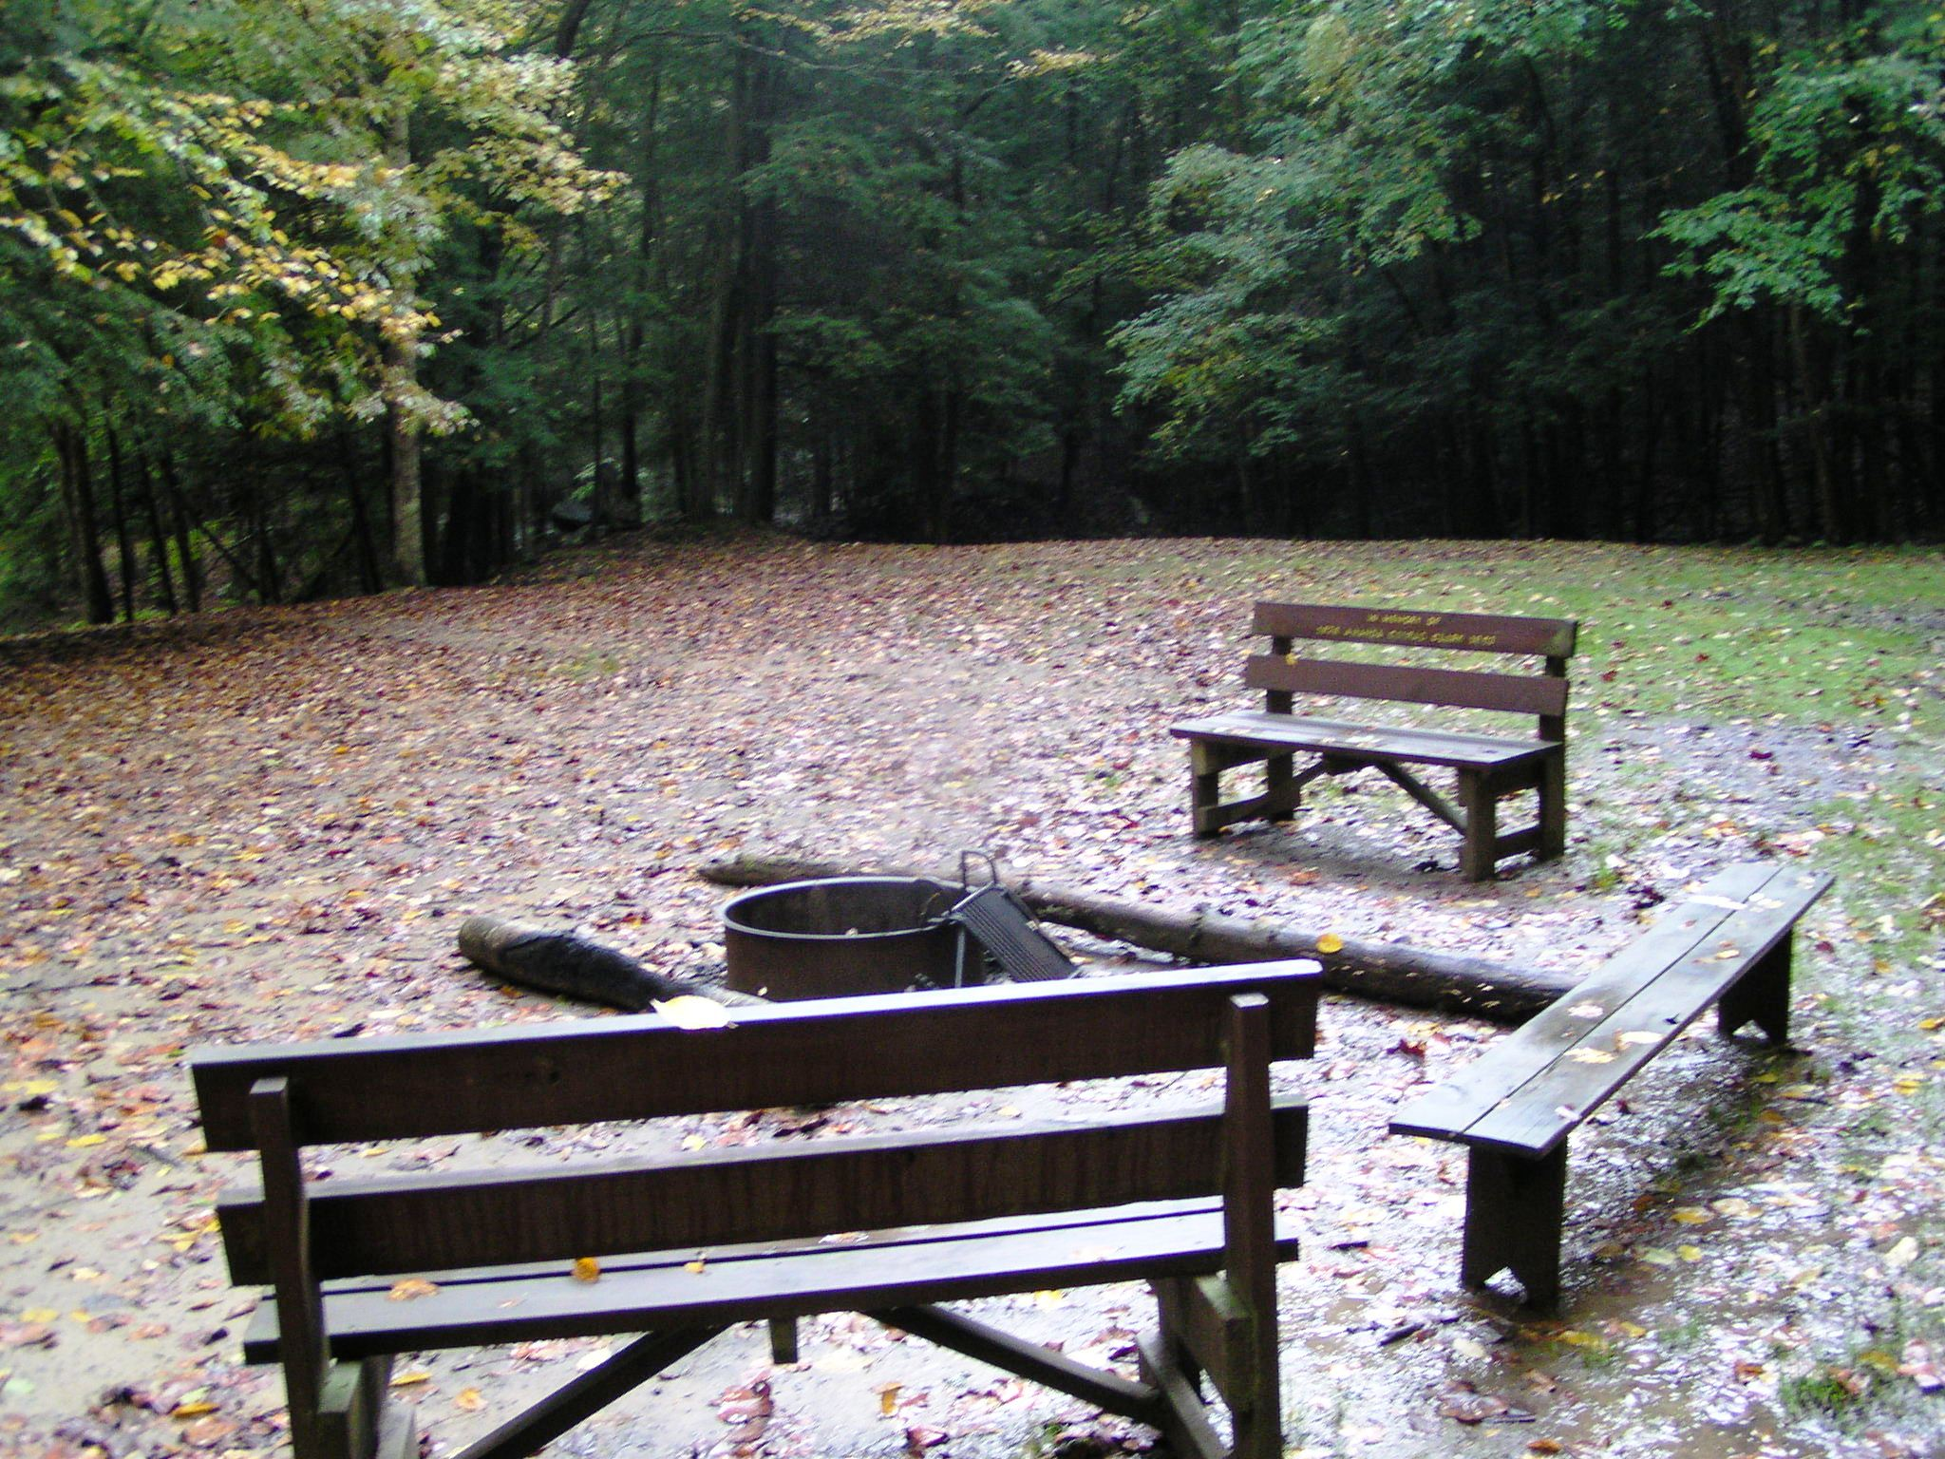
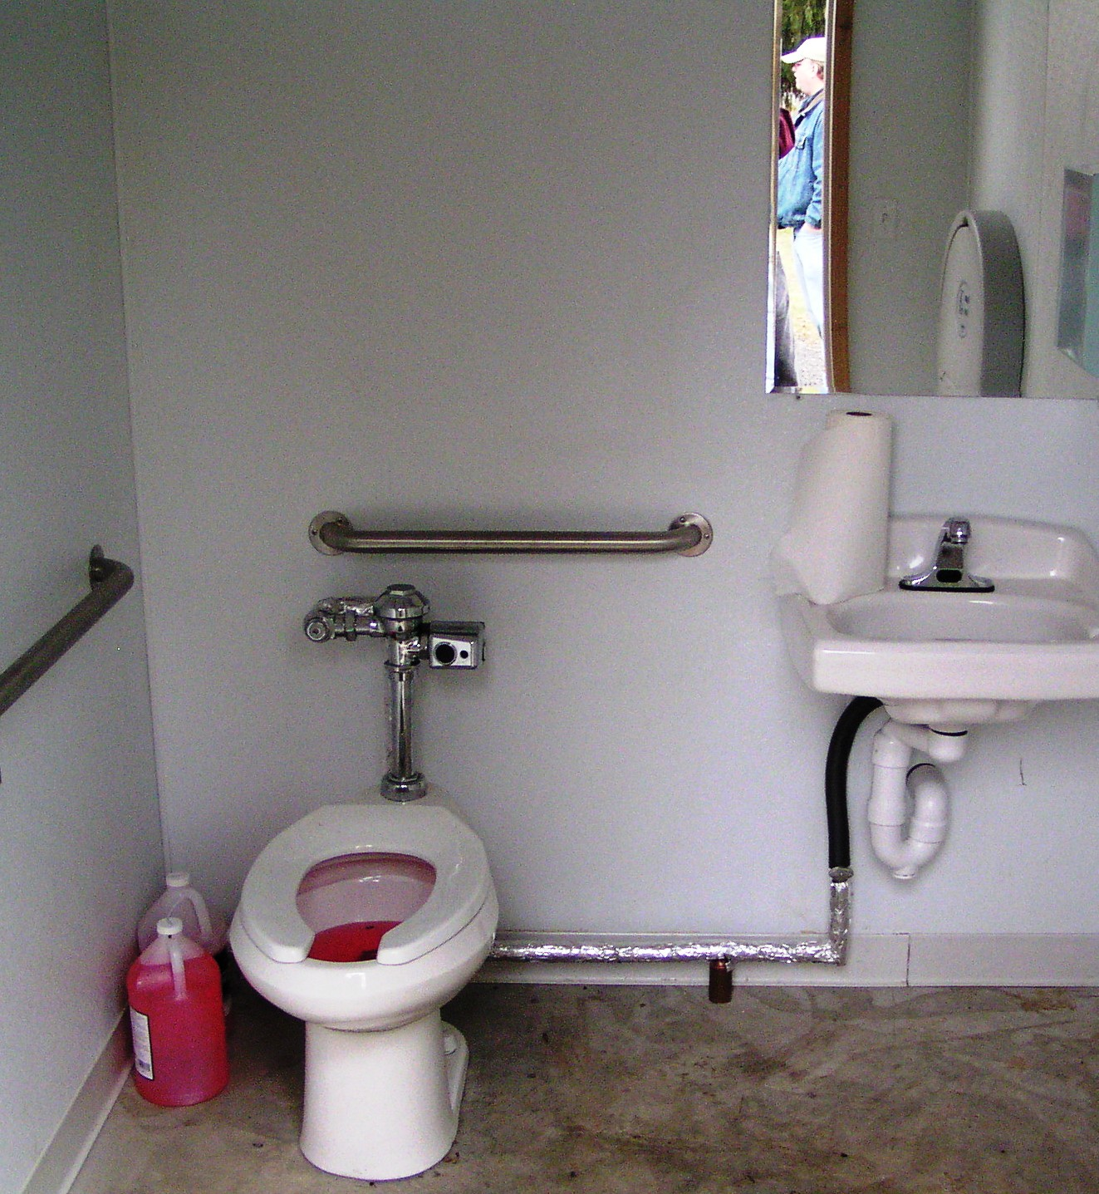
RECREATIONAL TRAILS PROGRAM ELIGIBLE ITEMS
Parking for trail users Trash Cans
Informational Kiosks Restrooms
Guidebooks and maps Benches
Notes:
If you choose to apply for an 80/20 grant from the WV RTAB for your water trail certain things are eligible:
Public access areas including parking for trail users, informational kiosks, benches, trash cans, potable water, restrooms and similar things at the public access sites for users of the trail, camp sites for the trail users, and GUIDE BOOKS AND MAPS THAT INCLUDE A SAFTETY MESSAGE.

Slide 16
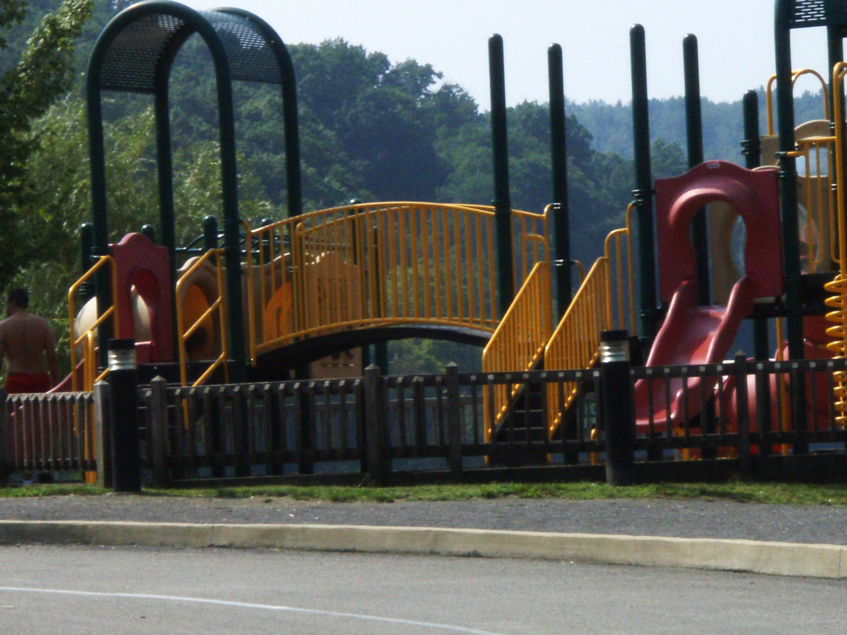
RECREATIONAL TRAILS PROGRAM INELIGIBLE ITEMS
Park development.
Fishing piers or docks.
Purchase of boats.
Excessive infrastructure.
Notes:
What the RTAB won’t fund are play grounds, road signs, and things that aren’t intended for use by those on the trail itself. Like overlooks so motorists can photograph people on the water trail as they go by. If you aren’t sure if what you want to do is eligible, call Bill or I and we’ll tell you. We may have to do some research if it is something we haven’t run into before, but we’ll find out.

Slide 17
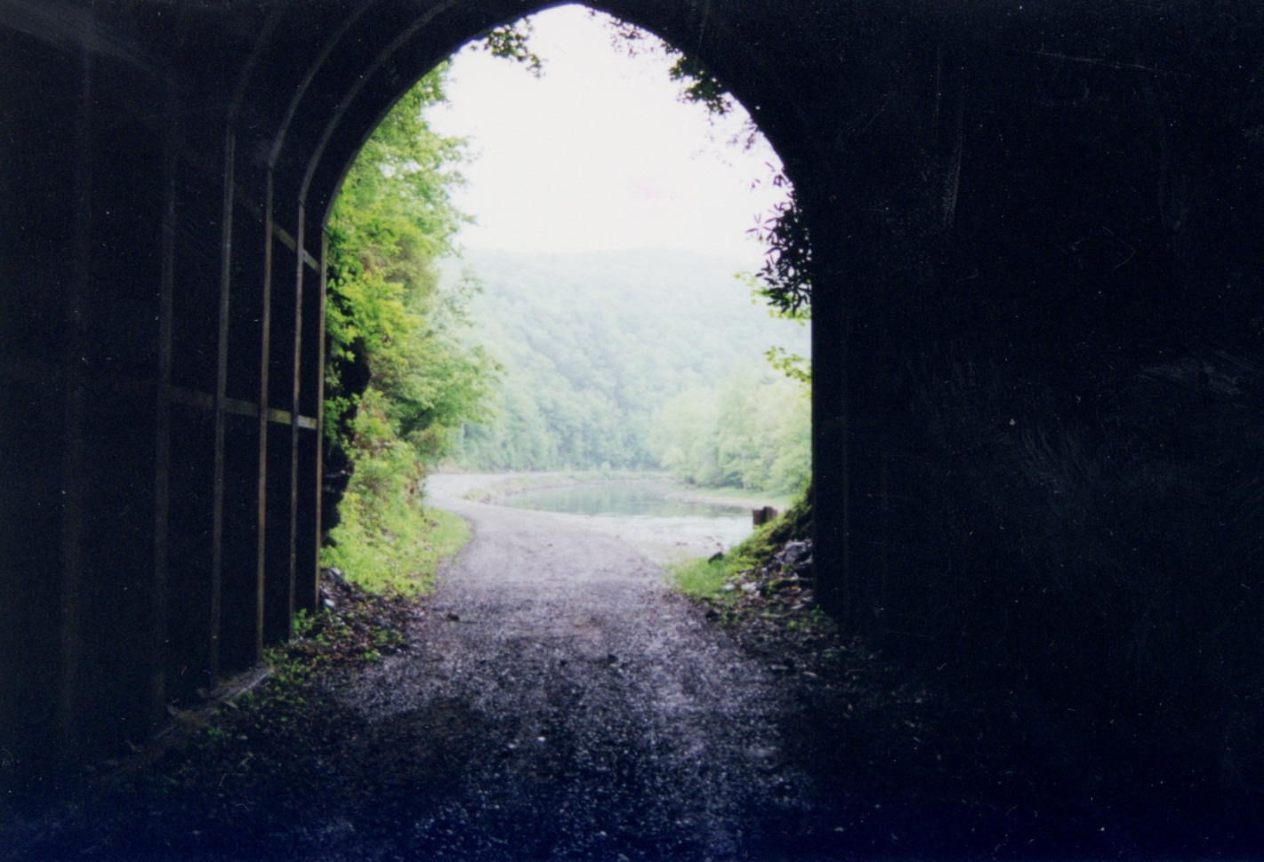
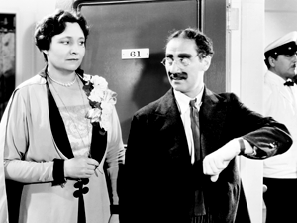
My time is about up…

Slide 18
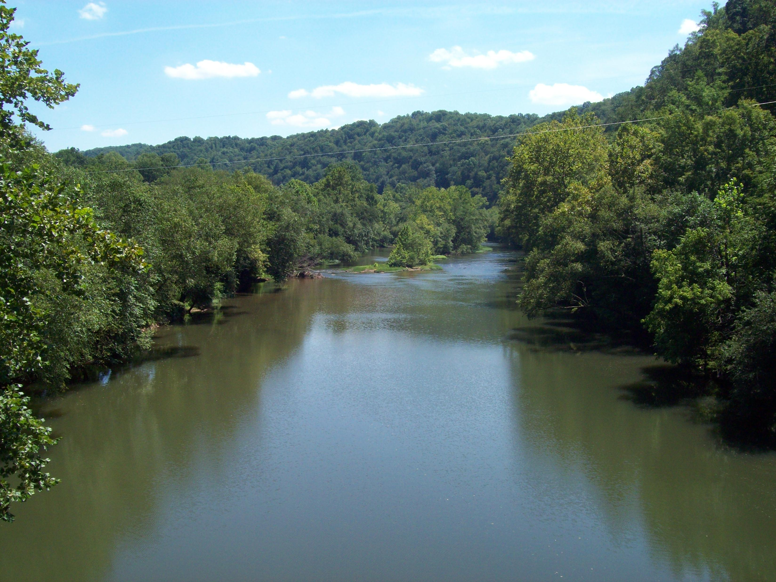
However, should you have any questions regarding the water trail designation process, please contact the WV DOH Grant Administration Unit at (304) 558-9621.

