Slide 1

Elevating Postsecondary Enrollment
in West Virginia
Presented during the
2012 State Superintendents Leadership Institute
Wednesday, June 27, 2012

Slide 2
What is P-20?
P-20 refers to a seamless system of education that follows student progress from Pre-K though postgraduate study and into the workforce.
Supports mutually beneficial partnerships related to education and training at all levels from preschool (P) through graduate studies (20+) in schools, workplaces and community settings
Is a coordinated set of policies designed to ease student transitions between grades and schools by providing student information, support services, and coordinated policies among all sectors of the educational system
Aims to enhance student access to postsecondary education, especially for disadvantaged and minority students, by aligning high school expectations with college admission requirements
Strengthens communication and collaborative decision-making
Often includes focus on improving the quantity and quality of teacher candidates (and current teachers) so that every classroom has a highly qualified teacher

Slide 3

Enrollment of Recent High School Graduates
Digest of Education Statistics 2010
Notes:
3
Pbc 1/10/11
College going rates of recent HS grads are from digest of ed statistics 2010 http://nces.ed.gov/programs/digest/d10/tables/dt10_203.asp
They are 2007-08 student numbers.
Freshman classes are first-time freshman, full-time and part-time, based on October headcount (from Jeannie).

Slide 4
Using the Facts to Create Reasonable Expectations
We need to enroll 738 more students across the state to meet the SREB average of 62.52
That equates to approximately 6 more students from every public high school
We need to enroll 1,098 more students across the state to meet the U.S. average of 63.82
That equates to approximately 9 more students from every public high school

Slide 5
Using the Facts to Create Reasonable Expectations
The #1 predictor of whether or not a student will enroll in postsecondary education is the completion of the FAFSA.
As of May 13 – Less than 50% of West Virginia’s High School Seniors had successfully completed a FAFSA.
FAFSA completion by High School is updated every two weeks on the U.S. Department of Education's website at this link: http://federalstudentaid.ed.gov/datacenter/fafsahs.html

Slide 6
Postsecondary Educational Attainment - SREB States
Notes:
Updated 1/11/11, pbc
2009 data is from the ACS 2005-2009 data set. 2010 full census data not yet available.

Slide 7
College Foundation of West Virginia
Build public awareness of the college- and career-planning processes;
Inform the public of postsecondary opportunities;
Encourage utilization of the state’s free college- and career-planning web portal, www.cfwv.com;
Provide professional development to assist educators and counselors in improving the college-readiness of students; and
Build a college-going culture in West Virginia.
West Virginia GEAR UP
Deliver direct, intensive college readiness and rigorous academic preparation services to students in 10 high-need counties; and
Evaluate the impact of intensive college readiness interventions.
Helping You Through Statewide P-20 Initiatives

Slide 8
P-20 Initiatives
College Exploration and Application Week—October 1-5, 2012
Provide schools with implementation kits to create a college going culture within high schools.
Schools must pre-register before September 14
College Goal Sunday—February 10, 2013
Provide students and families with personalized assistance in applying for state and federal financial aid; and
Increase public awareness of financial aid opportunities and the need to complete the Free Application for Federal Student Aid (FAFSA).
P-20 Collaboration and Support
Support the work of the Commission’s adult-learner degree completion programs, including the “Degree Now” grant program and the “RBA Today” initiative. Support the work of the Commission’s Division of Financial Aid in informing students, families, and counselors of the availability of financial aid and the application process.

Slide 9

Partnering to Provide You with the Tools to Elevate Postsecondary Enrollment
West Virginia’s
“One-Stop Shop” for College and Career Planning
www.cfwv.com

Slide 10

“One-Stop Shop” for College and Career Planning

Slide 11



Building the College-Going Culture & Focusing on Student Support

Slide 12
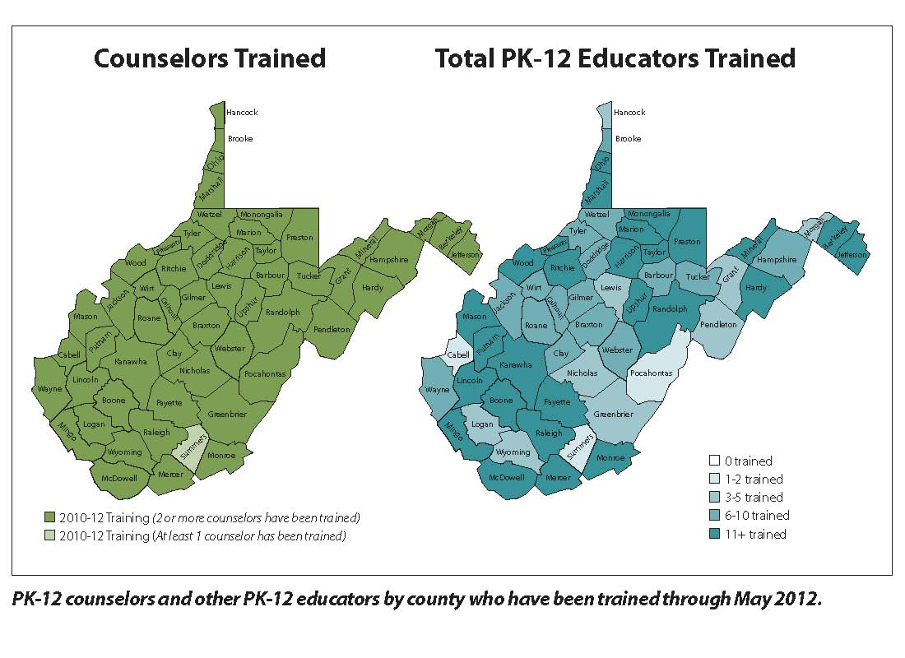
Building the College-Going Culture & Focusing on Student Support
Source: College Foundation of West Virginia Training Records (May 2012)
Notes:
Training Map

Slide 13
Building Momentum: Early Results
Increased participation-levels among target audiences
Since fall 2009, nearly 115,000 individuals have created accounts on cfwv.com. (CFWV System Utilization Reports)
In 2011, nearly 195,000 individuals visited the CFWV web portal. The average visitor viewed more than 11 pages on the site. (Google Analytics Unique Visitor and Average Page View Statistics)
Participation in College Goal Sunday 2012 (year three) has grown by 444 percent as compared to College Goal Sunday 2010 (year one). (College Goal Sunday Participation Summaries, 2010, 2011, 2012)
62 percent of those participating in College Goal Sunday 2012 were from low-income families. (College Goal Sunday West Virginia Participant Survey, 2012)
The number of adult learners creating accounts on cfwv.com has increased steadily during the 2011-12 academic year as compared to 2010-11 and 2009-10.
ACT test-preparation tool use has continued to grow substantially.

Slide 14
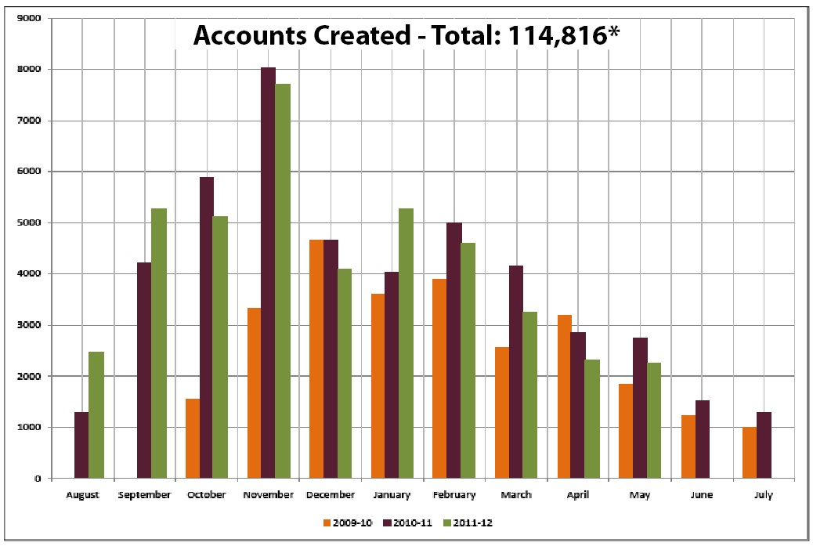
Early Results
Source: College Foundation of West Virginia Utilization Statistics (May 2012)
Notes:
Accounts created

Slide 15
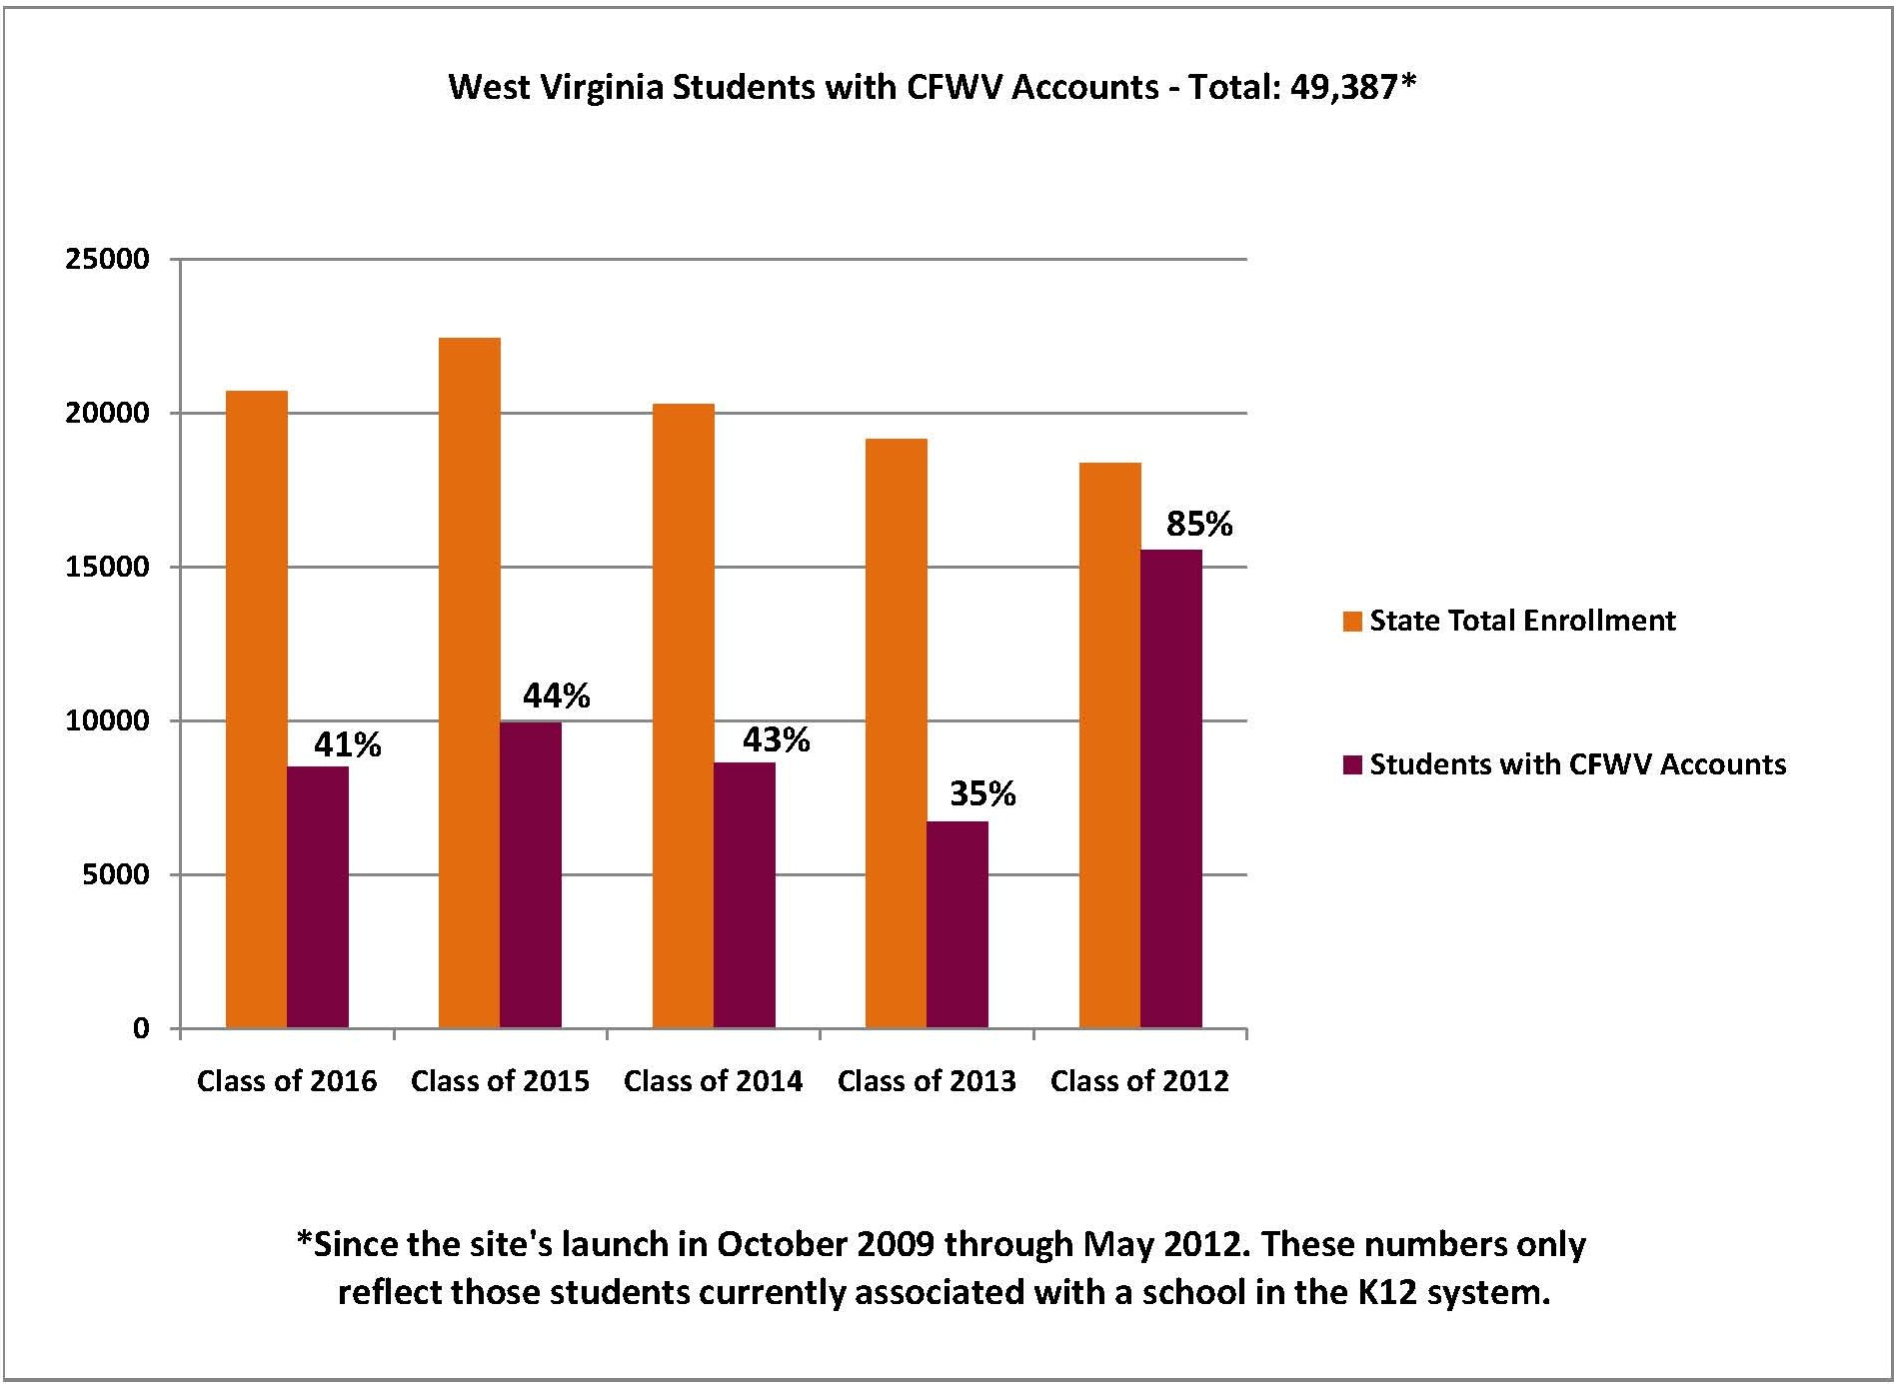
Early Results
Source: College Foundation of West Virginia Utilization Statistics (May 2011)
Notes:
Accounts created

Slide 16
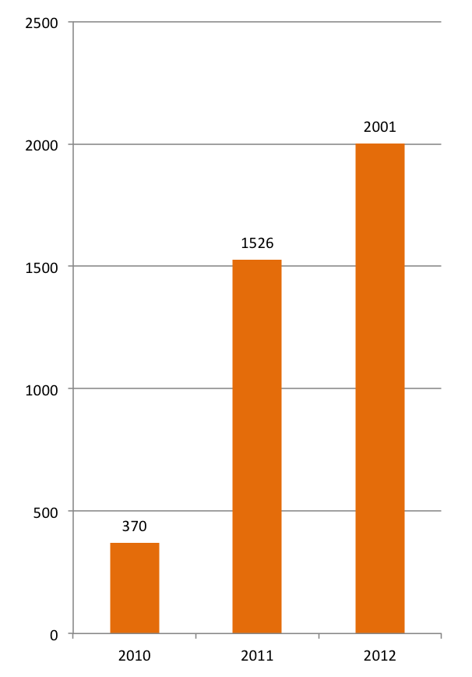
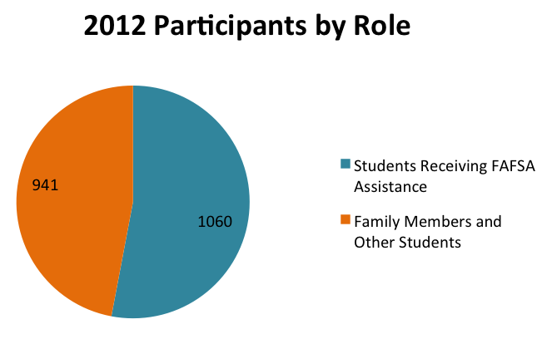
Statewide Results
College Goal Sunday Participation
Participation by Role
Source: College Goal Sunday Participation Records (2010-2012)
Notes:
CGS Chart

Slide 17
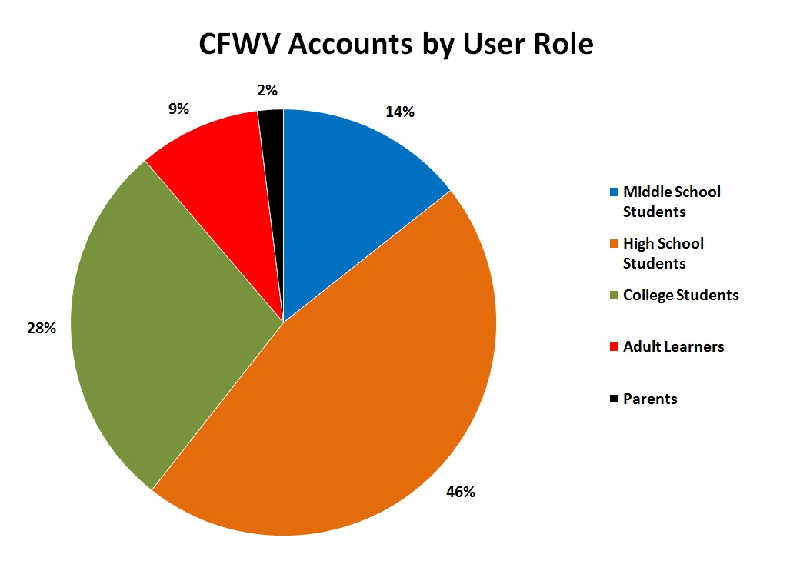
Statewide Results
Source: College Foundation of West Virginia Utilization Statistics (May 2012)
Notes:
Accounts created

Slide 18
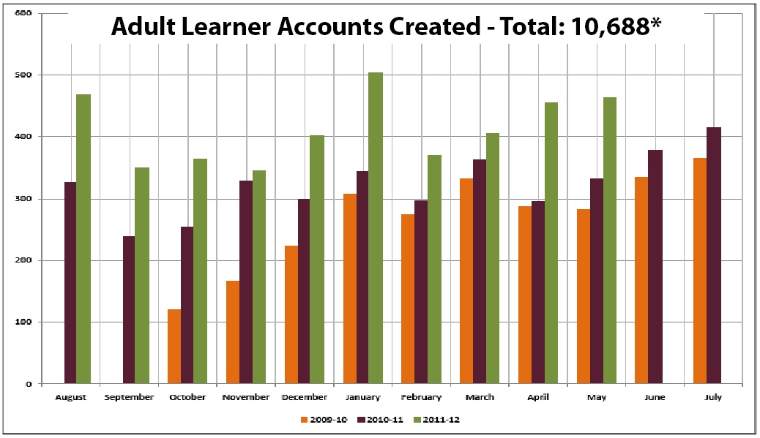
Statewide Results
Source: College Foundation of West Virginia Utilization Statistics (May 2012)
Notes:
Accounts created by user role

Slide 19
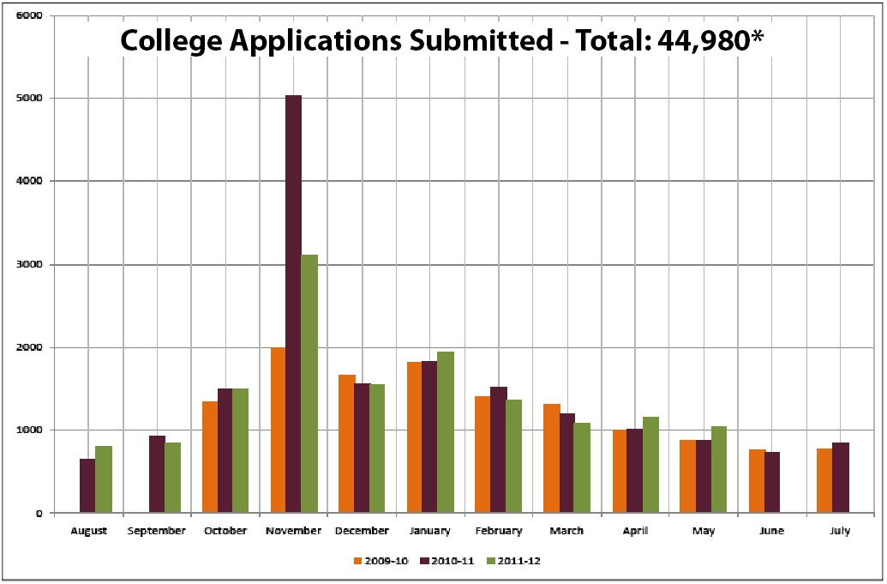
Statewide Results
Source: College Foundation of West Virginia Utilization Statistics (May 2012)
Notes:
College applications submitted

Slide 20
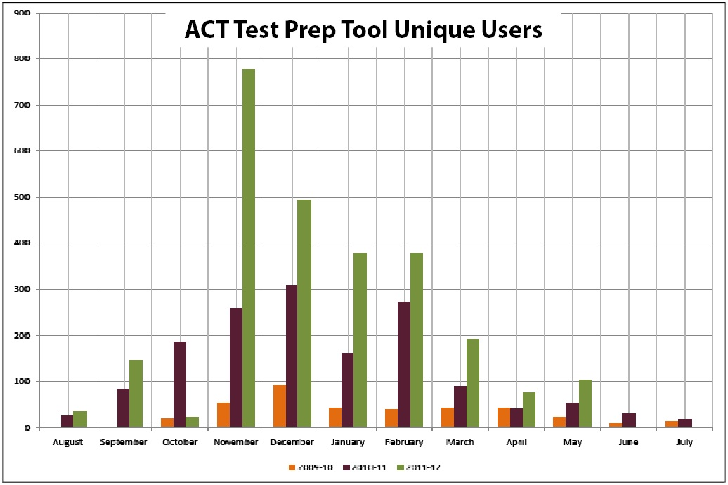
Statewide Results
Source: College Foundation of West Virginia Utilization Statistics (May 2012)
Notes:
College applications submitted

Slide 21
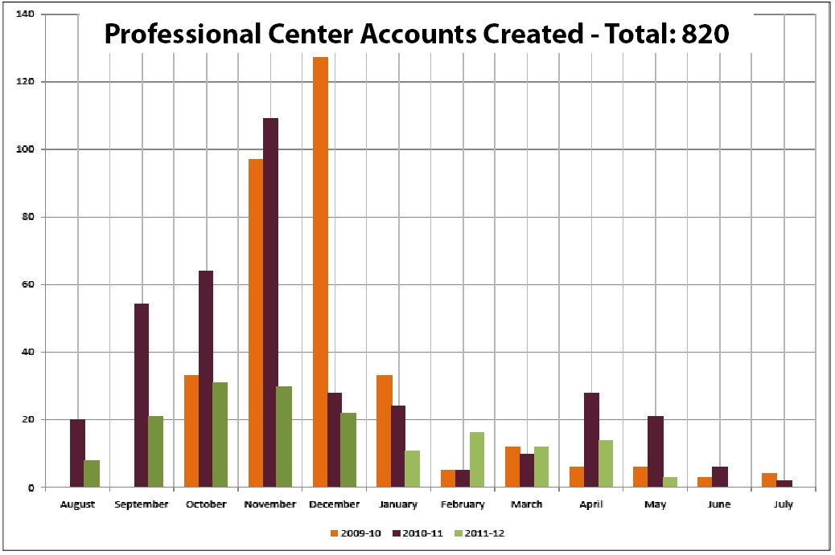
Statewide Results
Source: College Foundation of West Virginia Utilization Statistics (May 2012)
Notes:
Procenter accounts

Slide 22
Adam S. Green, Ed.D.
Senior Director
Division of Student Success and P-20 Initiatives
WV Higher Education Policy Commission
(304) 558-0655 | green@hepc.wvnet.edu

