Slide 1
Statewide Geospatial Advisory council
November 28, 2012

Slide 2
AGENDA
Welcome and Call to Order
Introductions
Approval of the September 5, 2012 Meeting Minutes
Esri MPA Update
Committees and Workgroups Reports
Review and discussion of draft Committee/Workgroup document (formation, governance, support, operation, expectations, charter, and work plan)
Break
MnGeo Project Priorities Survey Results – 10 min
Hot Topic: Location Privacy
Other Business
Proposed Future 2013 Meetings: February 27th and May 29
Adjourn

Slide 3
Esri Master Purchase Agreement Update
Chris Cialek

Slide 4
MPA for Esri Software, Support and Professional Services
Who’s Eligible:
MN State and Local Government
State agencies, Counties, Cities, Townships, School Districts
Institutions of Higher Education
Including MnSCU
For their internal use only
Must be registered Certified Purchasing Venture (CPV) member
Agreement began in mid-1990s

Slide 5
ESRI MPA
Over past three years:
State Agencies purchases: <$100,000
Local, County, Regional govt: >$4.25-million
Features:
Reduced prices on Esri software licenses
Standard prices on maintenance
Premium Support Services (enhanced maintenance)
Enterprise Advantage Program (certain enhanced consulting services, training & support associated with new sw buys)
Training
Contracted Services (custom software and technical data)

Slide 6
ESRI MPA
Current contract
Expires December 1
Being extended for two years (through November 30, 2014)
Status
New OET data security language is currently under negotiation
All other terms and conditions have been accepted
For more information:
Cooperative Purchasing Opportunities webpage: http://www.mmd.admin.state.mn.us/coop.htm

Slide 7
Committees & Workgroups – How do we optimize their efforts?

Slide 8
Committees
Committees and Subcommittees
Digital Cadastral Data
Digital Elevation
LiDAR Research and Education
Emergency Preparedness
Hydrography
Outreach
Standards

Slide 9
Workgroups
Workgroups
Geocoding
Geospatial Commons
Metadata

Slide 10
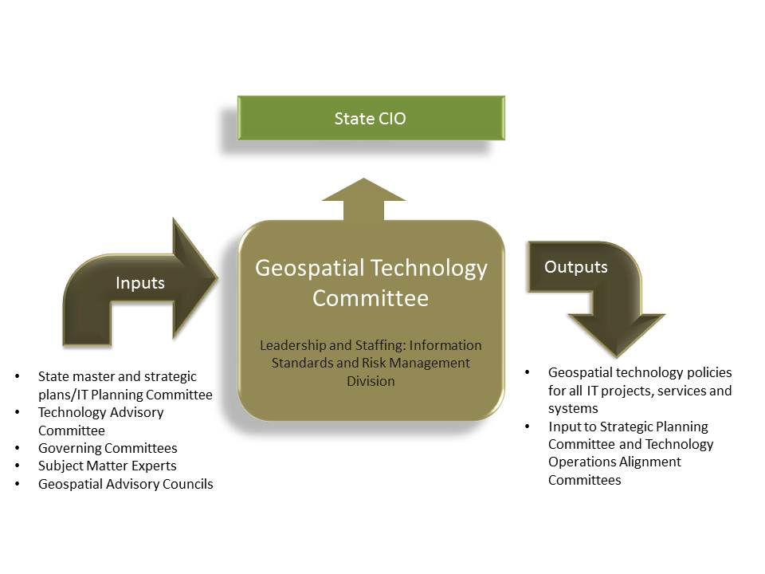
Why are they important?
Geospatial Committees and Workgroups
Standards and guidelines

Slide 11
Updates ….
Committees and Subcommittees
Digital Cadastral Data
Digital Elevation
LiDAR Research and Education
Emergency Preparedness
Hydrography
Outreach
Standards
Workgroups
Geocoding
Geospatial Commons
Metadata

Slide 12
Discussion: Committees and Workgroups
Discussion: Committees and Workgroups – 30 min
You asked for guidelines…
What is needed?
Need to be active?
Need regular attendance and output?
Facilitated by MnGeo – resource impact?
New that are needed
Are there committees that need to sunset?
New ones needed?
Projects versus workgroups?

Slide 13
MnGeo Services

Slide 14
Project Priorities Survey Results

Slide 15
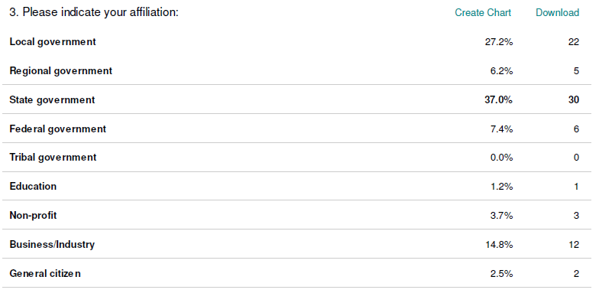
Broader Stakeholder Community Who responded….

Slide 16
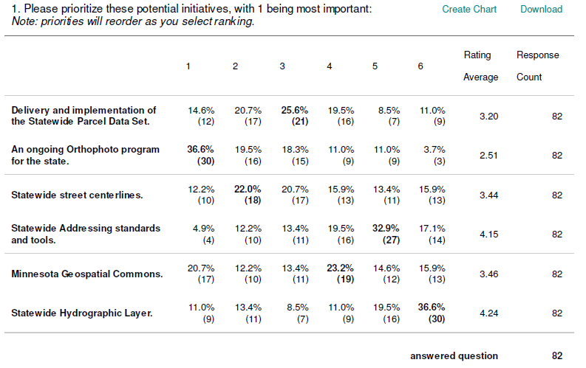
Broader Stakeholder Community

Slide 17
Statewide Advisory Council
LiDAR/Elevation Data Delivery (already underway)
Minnesota Geospatial Commons
Sustainable Program for Orthophotos
Statewide Parcel Integration
Street Centerlines (already underway)
Statewide Addresses (many tied to Centerlines)
Statewide Hydrography

Slide 18
Stakeholder identified priorities from meetings
LiDAR/Elevation Data Delivery (already underway) BSC SAC
Minnesota Geospatial Commons (4) (1)
Sustainable Program for Orthophotos (1) (2)
Statewide Parcel Integration (2) (3)
Street Centerlines (already underway) (3) (4)
Statewide Addresses (many tied to Centerlines) (5) (5)
Statewide Hydrography (6) (6)
We will likely have some activity on the first 5?
Need to figure out how to resource
Will be limited by optimization
Notes:
Stakeholders have identified 7 important effort
Provide a short sentence on each….

Slide 19
Service offerings will change a bit….
Reduce/Refocus?
Geospatial Coordination
More?
About the same?
1
Coordination, Outreach, Communication Intra-government (agencies) Inter-government (Counties, Feds) Extra-government
25%
Data Coordination Data gaps Data Standards Data stewardship Aggregation of 3rd party data Enterprise licensing
Technology Coordination Project & procurement review Agency-based enterprise resources New enterprise technologies
3
2
28%
2%
6
Guidance Mentoring Best practices
Training Formal, technical
7
Data Services Deployment of an Enterprise Data Library
5
4
Web Services Map services (OGC) Capability services (geocode)
0%
Consulting & Project Support In-source vs. outsource
1%
5%
3%
36%
8
Technical Infrastructure
Technical Support

Slide 20
Hot Topic Location Privacy
Steve Swazee

Slide 21
Other Business?
An Update of Geospatial Happenings in State Government
Phase 4 - Optimization

Slide 22
Executive Branch IT Consolidation
Required transfer of authority October 3, 2011
Phase 1
7/25/11 –
9/30/11
Phase 2
10/1/11 –
12/31/11
Phase 3
11/15/11 – 6/30/12
Phase 4
7/1/12 – 7/1/14
Finance/
HR Foundation
Agency Centralization Planning
Enterprise Strategic Planning, Governance
Service Optimization
Through 2014 and beyond
Required Service Level Agreements June 30, 2012
Legislative mandate to consolidate July 25, 2011
Notes:
This is the same slide that we’ve been showing for the past year – it represents a great deal of work from people in every corner of the new organization.

Slide 23
What does this mean for Geospatial in State Government?
We too need to look at opportunities to optimize
Five areas have been identified
Infrastructure
Data Management
Application Development and Management
Guidance, Governance, and Support
Innovation
Timeframe is two years
Discussions taking place with agencies
Could affect how geospatial is organized
Our organization and priorities will become business driven

Slide 24
Proposed Future 2013 Meetings: Feb 27th and May 29th
Adjourn

Slide 26
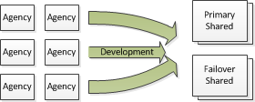
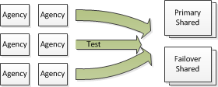
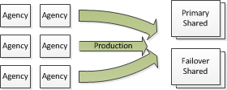
Infrastructure
Today each agency manages their own infrastructure and the resources required to manage it.
Would it make sense to move toward shared infrastructure for all agencies needing geospatial infrastructure?
What efficiencies can we gain?
Notes:
How might it help in application development and management?
Data Sharing?
License sharing?

Slide 27
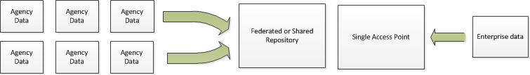
Data Coordination and Management
Today each agency manages the geospatial data needed for their specific agency.
Redundant data exists in each agency (e.g. boundaries).
Would it make sense to move toward a shared model for managing spatial data (create and store once, use many times)?
Many data sets serve many stakeholders and have statewide benefits. Should these be prioritized, coordinated, created and managed centrally?

Slide 28
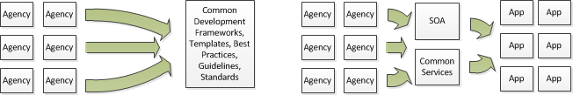
Enterprise Application Development and Management
Today each agency follows their own path
Does it make sense to:
Share ideas and code so we do not create apps that do the same thing?
Move to common development and delivery platforms?
Move to common standards and best practices
Move toward SOA and common services?
Build it once and use it many times
Have a common code repository

Slide 29
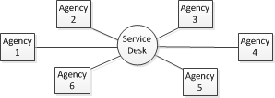
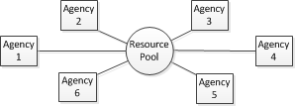
Guidance, Governance and Support
Today we have the “Haves” and the “Have Nots”
Would it make sense to put together a guidance and support structure and culture where each agency has access to geospatial guidance, support, and resources when their priorities dictate they need them?
Would you support resource pooling and sharing resources?

Slide 30



Innovation and Technology Improvement
Today agencies are only somewhat aligned with the geospatial technology they use.
In order to be effective, some resources need to be applied to innovation, technology improvement, research and development.
Working on this together would help us to align around specific technologies where needed and pursue new technologies to help us meet business needs and improve service delivery.
This should involve a diverse group of individuals and ideas.
Do you believe it important to keep up with technology and expend resources to be creative and innovative?

