Slide 1
MnGeo Statewide Geospatial Advisory Council Meeting Wednesday, September 5, 2012

Slide 2
AGENDA
Call to Order, Welcome & Introductions 5 Min - 1:00
May 30, 2012 Meeting Minutes 5 Min - 1:05
October GIS/LIS Consortium Conference
(Governor’s Commendation, sessions) 5 Min - 1:10
Legislation (Data Practices, other) 20 Min - 1:20
Discussion and Advice: MnGeo’s Services,
Projects and Priorities 60 Min - 1:35
Break 15 Min - 2:35
Committees & Workgroups –
How do we optimize their efforts? 20 Min – 2:50
State Geospatial Governance 20 Min – 3:10
Hot topics: Open Source Conference
Blaine Hackett 15 Min - 3:30
Other Business 15 Min - 3:45
Next Meeting: November 28, 2012
Adjourn 4:00

Slide 3
Discussion and Advice: MnGeo’s Services, Projects and Priorities

Slide 4
Coordination, Outreach, and Communication
MnGeo should be the primary sales force and advocate for GIS in the state.
Similarly, MnGeo should summarize state agency GIS capacities, expertise, software and on-going activities. The summary should be kept up-to-date and written for three audience types: executive, user and technical.
MnGeo should lead or coordinate the effort to provide a single place to obtain geospatial data for the state.
MnGeo should take the lead on coordinating efforts where many partners are involved.
Examples provided: Image web service, National Hydrographic Data/DNR Waters data migrated into a single hydrographic data set for the state

Slide 5
Data Coordination
Identify enterprise layers needed for the state to function more effectively
Identify the steward for each and empower and give them the authority to establish, create, manage and maintain the data, data model, and standards related to providing that data to the statewide geospatial community.
All stakeholders (so far) identified parcels as a very important GIS data layer
It should be available statewide in a format that is consistent, uniform and current.
Identify, activate, and facilitate a group for each of the important geospatial data layers or groups of data

Slide 6
Technology Coordination
There should be a technology plan for the state that could meet multi-agency needs
Should be led by a technology steering group
Should set direction but be flexible and nimble
Should have the ability to set standards but should provide a process for exceptions to occur
Consider sponsoring a workgroup related to geospatial innovation
It is important that the GIS and the CAD environments work well and integrate together
We need more mobile applications that increase efficiencies and comply with standards

Slide 7
Data Services
Staff spend too much time hunting for common data sets only to find that what they track down may not be the most up-to-date version or even correct. By extension, this would make the case for the Geospatial Commons where the best-of-the-best resides with proper metadata.
MnGeo should be responsible for insuring that data are available, in the proper form, to fuel applications that will be developed as technology allows and as technology changes.

Slide 8
Web services
It would be nice to see additional web map services available especially as it relates to emergency response
Example provided: the MnGeo image service is very useful

Slide 9
Training
Geospatial applications and tools should be so simple and easy to use that they do not require training. This includes public-facing applications.
“As a manager, I don’t know what’s out there. How can I use GIS; what should I be asking for? Is there a Clearinghouse?” MnGeo should serve as the focal point for educating and sharing information to the broader community about data, activities, and answers to common geospatial questions.
Consider training on simple use of geospatial tools on mobile devices.

Slide 10
Guidance, mentoring and best practices
MnGeo should be the missionary for geospatial
Awaken and lead the effort to get the technology into business and the systems they use
Lead the charge to educate executives and other management about GIS, the data applications, and resources available to create business work better
There is a desire for GIS governance but there needs to be flexibility with the governance that allows the business to move forward effectively
MnGeo should lead the effort to create geospatial standards and policy and where possible ensure alignment with Federal and local counterparts

Slide 11
Advice on priorities
What is important to the Community

Slide 12
Minnesota Geospatial Commons
Multiple agencies share geospatial data with their customers using their own tools and technology. Several agencies have identified their current geospatial data delivery mechanisms are at the end of their lifecycle and need to be replaced. This effort will implement a statewide system (technology, data and human resources) that will make geospatial data, services and applications easier to publish, share, discover and access using a web-based shared services approach that will reduce redundancy, enhance decision-making capacity and improve operational efficiency of state agencies and their partners.

Slide 13
Delivery of LiDAR/Elevation products to the greater geospatial community:
With Clean Water Legacy Grant funding, MnGeo is working with the Minnesota DNR to develop a data distribution capacity for the statewide LiDAR/elevation data being acquired and generated by DNR. This will provide the ability to select an area (county, city, township, watershed, PLS or specified polygon) and select the data desired (DEM, contours, hillshade, building footprints, break-lines, or raw LAS data) and then pull it from an FTP site upon notification. This is in addition to providing a backup FTP site of the data organized by county.

Slide 14
Delivery and implementation of the Statewide Parcel Integration Business Plan:
For years, multiple agencies have sought a statewide parcel data layer. This project is generating a business plan to help guide us in developing and sustaining an authoritative statewide parcel data layer. The plan will include multiple tactics that will tell us how, when, how much and who needs to do what for us to achieve our vision. The plan recognizes the varied county situations and suggests ways to meet needs and address obstacles.

Slide 15
An ongoing Orthophoto program for the state:
Statewide aerial imagery projects have been occasionally implemented since 1991. But, a single, enterprise-wide and sustainable program meeting the imagery needs of state agencies and local governments does not exist in Minnesota. The goal of this program is to cooperatively develop a dependable aerial imagery collection regime that is persistently funded, based on the business needs of its partners and efficiently managed.

Slide 16
Statewide street centerlines:
Today multiple agencies and jurisdictions create and maintain street centerline data. This requires significant redundant investment, there is not a state standard and sharing is difficult. Street centerlines have been identified as an NSDI and an MSDI foundational data set. This effort will collaboratively develop an authoritative, public domain street centerline dataset maintenance model that meets the needs of a diverse set of users in the State of Minnesota. The model includes not only the centerline data itself, but also the governing data standards, process and workflow interactions for data collection and data distribution, data stewardship conditions and protocols, disputes resolution, and related technology and policy developments.

Slide 17
Statewide Addressing standards and tools:
Most agencies need addresses for some aspect of their business, yet currently for Minnesota there is no common address standard or data sharing practices occurring on a broad basis in the state. There are efforts going on that this effort can build upon. A national data standard does exist, as does a very manageable set of data specifications for the MetroGIS Address Points Dataset. In addition, MetroGIS is developing a web-editing application (North Point Geographics is building it) that will be available for free to be hosted by any government in MN (e.g., counties or state).

Slide 18
Statewide Hydrographic Layer:
Today multiple agencies and jurisdictions create and maintain hydrographic data. This requires significant redundant investment, there is not a state standard, and sharing is difficult. Hydrographic data have been identified as an NSDI and an MSDI foundational data set. This effort will collaboratively develop an authoritative, public domain hydrographic dataset maintenance model that meets the needs of a diverse set of users in the State of Minnesota. The model includes not only the data itself, but also the governing data standards, process and workflow interactions for data collection and data distribution, data stewardship conditions and protocols, disputes resolution, and related technology and policy developments.

Slide 19
Committees & Workgroups – How do we optimize their efforts?

Slide 20
Committees
Committees and Subcommittees
Digital Cadastral Data
Digital Elevation
LiDAR Research and Education
Emergency Preparedness
Hydrography
Outreach
Standards

Slide 21
Workgroups
Workgroups
Geocoding
Geospatial Commons
Metadata

Slide 22
State Geospatial Governance

Slide 23
Committee Roles
Minnesota law gives the Chief Geospatial Information Officer authority to identify, coordinate, and guide strategic investments in geospatial information technology systems, data, and services. Enabling legislation also establishes two advisory bodies to improve management of geospatial technology:
A State Government Geospatial Advisory Council to advise the Chief Geospatial Information Officer about issues pertaining to state government
A Statewide Geospatial Advisory Council to advise the Chief Geospatial Information Officer about issues of importance to the entire state

Slide 24
3rd Group
The Minnesota IT Governance Framework has created a third group, the Geospatial Technology Committee, to be the primary governing body for decisions and policies that impact the use of geospatial technology in the executive branch.
Relationship to Other Governing Bodies
Input: Like all Technology Operations Alignment governing bodies, the Geospatial Technology Committee will work closely with subject matter experts in state government to facilitate the development of policies and standards. However, the Geospatial Technology Committee will also solicit input from the two existing advisory councils that foster collaboration between state government and other stakeholders.
Output: Adherence to the policies recommended by the Geospatial Technology Committee will be required of all executive branch geospatial activity.

Slide 25
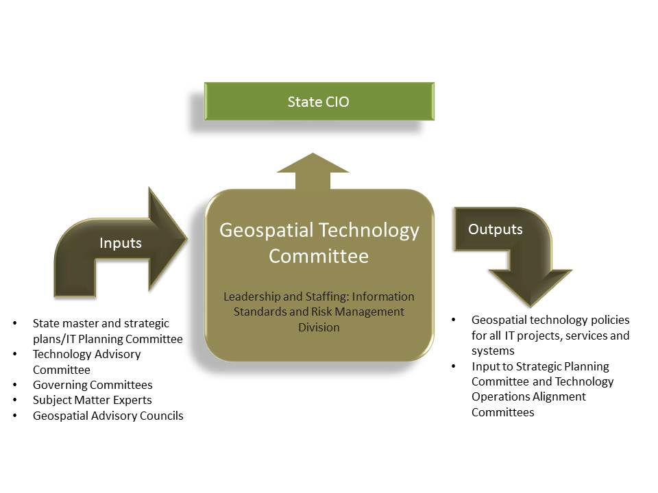

Slide 26
Attribute Description
Purpose: Approve geospatial policies, standards, and planning initiatives
Chair: Chief Geospatial Information Officer Co-Chair: Agency CIO
Governance Category: Vision Planning ☑Technology Operations Alignment
Decision Authority: ☑ Responsible Accountable Consulted Informed
Decisions:
• Approve geospatial policies and standards and enterprise planning initiatives
• Approve exceptions to geospatial policies and standards
Membership: The committee has eleven members, as follows:
• Chief Geospatial Information Officer
• Information Standards and Risk Management Executive
• State Enterprise Architect
• GIS Architect
• Service Delivery Executive
• One agency-based CIO
• One member from a state agency that is involved in business planning, such as deputy commissioner, assistant commissioners, or program director
• Three members with advanced geospatial expertise who serve on existing advisory councils
• Assistant Commissioner of Agency Support
Meetings : Monthly

Slide 27
Hot topics: Open Source Conference
Blaine Hackett

Slide 28
Other Business

Slide 29
Next Meeting: November 28, 2012

Slide 30
Thank you!
The MnGeo Team

