Slide 1

Louisiana Young Readers’ Choice Award
2012 Nominees
Grades 6 - 8

Slide 2
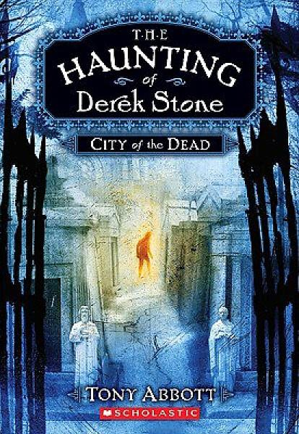
The Haunting of Derek Stone City of the Dead
Derek Stone just turned fourteen. He's lived in the heart of New Orleans with his dad and older brother, Ronny, his whole life. He's a little overweight. He can't hear well out of his left ear and he's on the run from the dead. Derek never imagined that the dead could be anything but dead. But there's no denying it. They're back -- and they're after him. He just doesn't know why. And he doesn't have long to figure it out.
By Tony Abbott

Slide 3

Young Samurai The Way of the Warrior
Jack’s ship is attacked by Ninja warriors off the coast of Japan in 1611. His father and crew lie slaughtered. Rescued by a legendary master swordsman and brought under his wing, Jack begins the grueling physical and psychological training needed to become a samurai. At Samurai school Jack is bullied and treated as an outcast. It takes all the courage he can muster to prove himself, face deadly rivals and challenges that will test him to his very limits.
By Chris Bradford

Slide 4
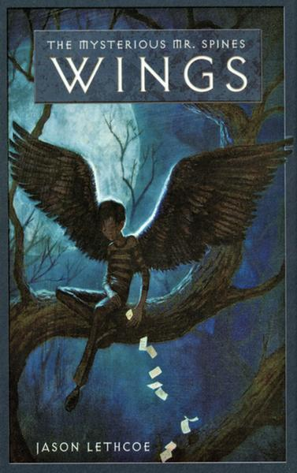
Wings The Mysterious Mr. Spines
When Edward’s mother dies, his aunt sends him to a school for troubled youths. There, Edward develops an itch in his back that he can’t scratch, and when he gets angry it seems like he can move things with his mind. When the itch erupts into a set of wings, an evil teacher tries to cut them off but he is rescued by Mr. Spines, who tells Edward that he is a Guardian. Suddenly thrown into a battle for his life Edward joins the army of Guardians battling the Jackal, the most evil fallen Guardian of all.
By Jason Lethcoe

Slide 5
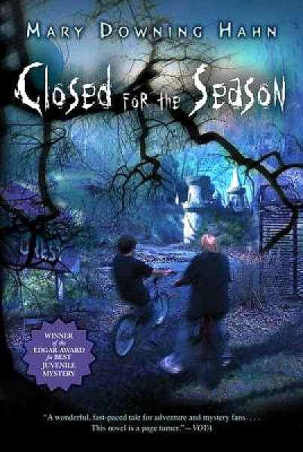
Closed for the Season
Logan Forbes and his family have recently moved into a run-down old house. Arthur, the next door neighbor tells him that a woman accused of embezzling money from the local amusement park was murdered in their new home. Arthur believes the murdered woman may have been innocent of the crime she was accused of. The boys’ attempt to solve the mystery leads them on a dangerous investigation.
By Mary Downing Hahn

Slide 6
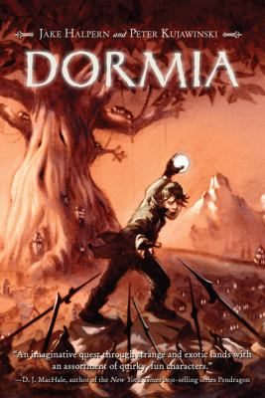
Dormia
Alfonso is an unusual sleeper. He climbs trees, raises falcons, even shoots deadly accurate arrows, all in his sleep. Then a man claiming to be Alfonso’s long-lost Uncle shows up and tells him that his ancestors come from Dormia, a hidden kingdom whose inhabitants possess the ancient power of “wakeful sleeping.” Alfonso sets out on a mission to save the kingdom from destruction, discovering secrets that lurk in his own sleep.
By Jake Halpern

Slide 7
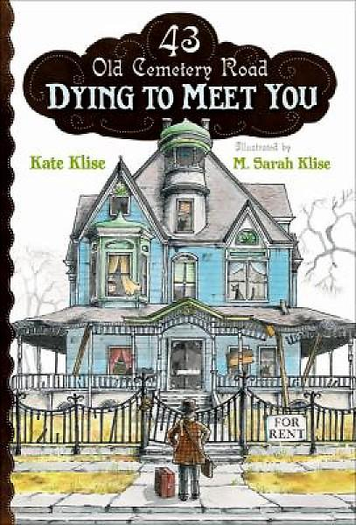
Dying to Meet You
Ignatius B. Grumply, a writer, moves into the Victorian mansion at 43 Old Cemetery Road hoping to find some peace and quiet so he can crack a wicked case of writer's block. But 43 Old Cemetery Road is already occupied by eleven-year-old Seymour, his cat Shadow, and an irritable ghost named Olive. It's hard to say who is more outraged. But a grumpy old ghost just might inspire this grumpy old man--and the abandoned kid? Well, let's just say his last name's Hope.
By Kate Klise

Slide 8

invisible I / The Amanda Project Book 1
Three very different students from the same high school are selected to be guides for new student, Amanda Valentino. When she graffitis the vice principal’s car and disappears, Callie, Nia, and Hal are blamed. Following a course that they suspect Amanda deliberately plotted, they piece together some cryptic clues. Finding more questions than answers they quickly realize that before they can figure out what happened to Amanda—the girl who changed their lives—they'll need to solve the most important mystery of all: Who is Amanda Valentino?
By Stella Lennon

Slide 9

11 Birthdays
It's Amanda's 11th birthday and she is super excited. But from the start, everything goes wrong. The worst part of it all is that she and her best friend, Leo, with whom she's shared every birthday, are on the outs and this will be the first birthday they haven't shared together. When Amanda turns in for the night, glad to have her birthday behind her, she wakes up happy for a new day. Or is it? Her birthday seems to be repeating itself. What is going on?! And how can she fix it?
By Wendy Mass

Slide 10

Brand-New Emily
New-girl Emily Wood is in big trouble: she’s accidentally crossed the alpha-clique she calls “The Daisies,” and now no one at school is talking to her. But when Emily stumbles onto some top-secret celebrity gossip, she finds herself in a position to hire New York’s most powerful public relations firm—and have a shot at a whole new image! Make way for Brand Em: she’s got style, she’s got attitude, and she doesn’t take flak from The Daisies. But no product can stay hot forever.
By
Ginger Rue

Slide 11
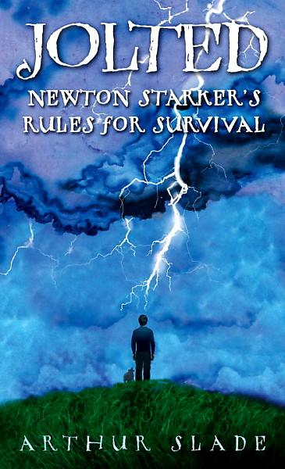
Jolted Newton Starker’s Rules for Survival
Nearly everyone in Newton Starker’s family has been killed by lightning. It seems to be some kind of family curse. To hopefully escape this fate, Newton enrolls in Jerry Potts Academy for Survival in Moose Jaw, Canada. Newton's ready to learn, and to be remembered in the school's Hall of Heroes. What Newton hasn't counted on is the other students. For a boy who's spent most of his life in a protective dome, making friends is sometimes as challenging as surviving.
By Arthur Slade

Slide 12

a truth worth tellin’
It is 1962, and Maggie and her family have just moved to Pearl, Louisiana. Maggie has become quite an accomplished liar over the years by fabricating stories to cover for her schizophrenic mother. The first friend Maggie makes in her new town is a wild little girl named Sam. Sam has a secret and swears Maggie to secrecy about it. When Sam’s situation takes a turn for the worse, Maggie has to decide if telling the truth is important enough for her to break her promise to Sam.
By Toni Teepell

Slide 13
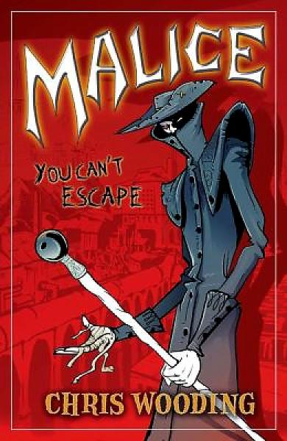
Malice
Everyone's heard of it...but nobody's read it. Luke, Seth, and Kady have heard all the stories about Malice--a secret comic about a strange, awful world full of tricks and traps, and overseen by a sinister master of ceremonies, Tall Jake. But if the rumors are to be believed, the children in this comic are real... Luke is the first to fall into this trap--and Seth and Kady are the next to follow. They have left our world and entered the sinister comic book. The question is--can they make it out alive?
By Chris Wooding

