Slide 1

Louisiana Young Readers’ Choice Award
Grades 6 - 8

Slide 2

The Call
Mack MacAvoy, a seriously average twelve-year-old boy, is faced with a difficult decision when a three-thousand-year-old man appears in the boys' bathroom and informs him that he is one of the Magnificent Twelve and he needs to find his eleven teammates and save the world.
By Michael Grant

Slide 3

The Dead Boys
After moving to a small, remote desert town near a nuclear research facility, Teddy quickly realizes that something weird is happening. His investigation reveals that all of his new friends actually disappeared from the town decades ago and that a giant sycamore tree is somehow responsible. Teddy fights to save himself and the others from the tree's grasp.
By Royce Buckingham

Slide 4

Heist Society
Fifteen-year-old Kat schemes her way into the best boarding school, hoping to leave the thieving antics of her family behind her, but Hal, a former co-conspirator, appears on campus to tell Kat that a powerful mobster believes her father stole art from a priceless collection, and in order to save him, Kat will have to recover the paintings.
By Ally Carter

Slide 5

Hide and Seek
In the remote mountains of Arizona where he lives with his mother, stepfather, and two sisters, fourteen-year-old Chase discovers two kidnapped boys and gets caught up in a dangerous adventure when he comes up with a plan to get them to safety.
By Katy Grant

Slide 6

How to Survive Middle School
When eleven-year-old David Greenberg's best friend makes the start of middle school even worse than he feared it could be, David becomes friends with Penny, who shares his love of television shows and posts one of their skits on YouTube, making them wildly popular--online, at least.
By Donna Gephart

Slide 7

The Limit
When his family exceeds its legal debt limit, thirteen-year-old Matt is sent to the Federal Debt Rehabilitation Agency workhouse, where he discovers illicit activities are being carried out using the children who have been placed there.
By
Kristen Landon

Slide 8
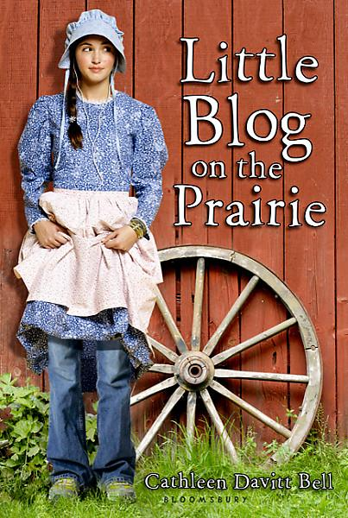
Little Blog on the Prairie
Thirteen-year-old Genevieve's summer at a frontier family history camp in Laramie, Wyoming, with her parents and brother is filled with surprises, which she reports to friends back home on the cell phone she sneaked in, and which they turn into a blog.
By Cathleen Davitt Bell

Slide 9

Max Cassidy : Escape from Shadow Island
British fourteen-year-old Max Cassidy calls on his skills and training as a professional escape artist when he attempts to clear his mother of murdering his father, who disappeared two years earlier in the Central American country of Santo Domingo.
By Paul Adam

Slide 10

Ninth Ward
In New Orleans' Ninth Ward, twelve-year-old Lanesha, who can see spirits, and her adopted grandmother have no choice but to stay and weather the storm as Hurricane Katrina bears down upon them.
By
Jewell Parker Rhodes

Slide 11

Smile
Raina just wants to be a normal sixth grader but one night she trips and falls, severely injuring her two front teeth. What follows is a long and frustrating journey with on-again, off-again braces, surgery, embarrassing headgear, and even a retainer with fake teeth attached. And on top of all that, there's still more to deal with.
By Raina Telgemeir

Slide 12

The Strange Case of Origami Yoda
Dwight, talks to his classmates thru an origami finger puppet of Yoda. Origami Yoda predicts the date of a pop quiz, guesses who stole the classroom Shakespeare bust, and saves a classmate from popularity-crushing embarrassment with some well-timed advice. Dwight’s classmate Tommy wonders how Yoda can be so smart when Dwight himself is so clueless.
By Tom Angleberger

Slide 13
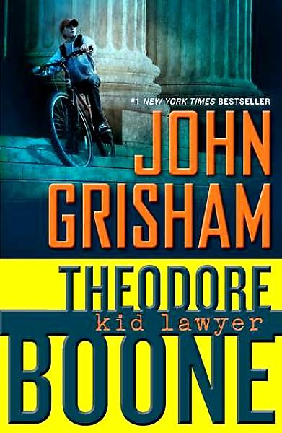
Theodore Boone : Kid Lawyer
Thirteen-year-old Theodore Boone, who knows every judge, police officer, and court clerk in the small town of Strattenburg, finds himself involved in a murder trial because of knowledge he might have about a cold-blooded killer.
By John Grisham

