Slide 1

Louisiana Young Readers’ Choice Award
Grades 3 - 5

Slide 2
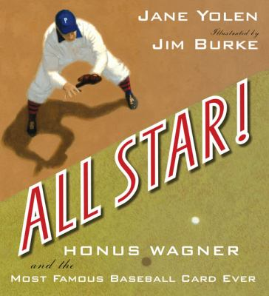
All Star! : Honus Wagner and the Most Famous Baseball Card Ever
The Honus Wagner baseball card is the most valuable baseball card of all time! Honus Wagner was born poor, ugly, bow-legged, and more suited to shoveling coal in his Pennsylvania mining town than becoming the greatest shortstop of all time. This is a biography of the personal and professional life of American Major League Baseball shortstop Honus Wagner, who played mostly for the Pittsburgh Pirates from 1897 to 1917.
By Jane Yolen

Slide 3

The Case of the Lost Boy: The Buddy Files Book 1
King the dog has a very big mystery to solve. His family is missing, and he's been put in the P-O-U-N-D. Why doesn't his beloved human come to get him? When King is adopted by Connor and his mom, things get more confusing. The new family calls him Buddy! And just as Connor and Buddy start to get acquainted, Connor disappears! Buddy (aka King) has big problems to solve, but with some help from his friends he shows what a smart, brave dog can do.
By Dori Hillestad Butler

Slide 4
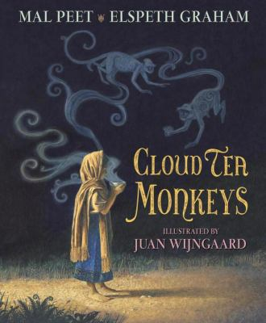
Cloud Tea Monkeys
Tashi lives in a tiny village at the foot of the mountains, below the tea plantations where her mother works. When her mother falls ill, Tashi goes alone to the plantation, hoping to earn money for the doctor but she is far too small to harvest the tender shoots, and her clumsy efforts anger the cruel Overseer. Then she tells the monkeys she has befriended why she is sad.
By Mal Peet

Slide 5
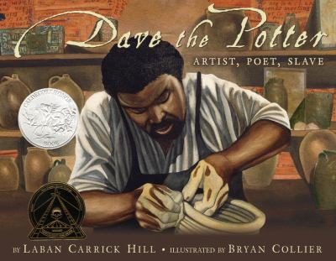
Dave the Potter : Artist, Poet, Slave
To us it is just dirt, the ground we walk on... But to Dave it was clay, the plain and basic stuff upon which he formed a life as a slave nearly 200 years ago. Dave was an extraordinary artist, poet, and potter living in South Carolina in the 1800s. He combined his superb artistry with deeply observant poetry, carved onto his pots, transcending the limitations he faced as a slave.
By Laban Carrick Hill

Slide 6

The Fantastic Secret of Owen Jester
An amazing secret has tumbled off a freight train into Carter, Georgia, and Owen Jester is the only person who knows about it. If he can simply manage to evade his grandfather’s snappish housekeeper, organize his two best friends, and keep his nosy neighbor, Viola, at bay, he just might be in for a summer of a lifetime.
By Barbara O’Connor

Slide 7

The Junkyard Wonders
When young Trisha finds out her class at the new school is known as “The Junkyard,” she is devastated. She moved from her old town so she wouldn’t be in a special class anymore! But then she meets her teacher, the quirky and invincible Mrs. Peterson, and her classmates, an oddly brilliant group of students each with his or her own unique talent. And it is here in The Junkyard that Trisha learns the true meaning of genius, and that this group of misfits are, in fact, wonders, all of them.
By Patricia Polacco

Slide 8

Mirror Mirror : A Book of Reversible Verse
This ingenious book of reversos, or poems which have one meaning when read down the page and perhaps an altogether different meaning when read up the page. It toys with and reinvents oh-so-familiar stories and characters, from Cinderella to the Ugly Duckling.
By Marilyn Singer

Slide 9

Of Thee I Sing : A Letter To My Daughters
In this tender, beautiful letter to his daughters, President Barack Obama has written a moving tribute to thirteen groundbreaking Americans and the ideals that have shaped our nation. From the artistry of Georgia O'Keeffe, to the courage of Jackie Robinson, to the patriotism of George Washington, President Obama sees the traits of these heroes within his own children, and within all of America's children.
By Barack Obama

Slide 10
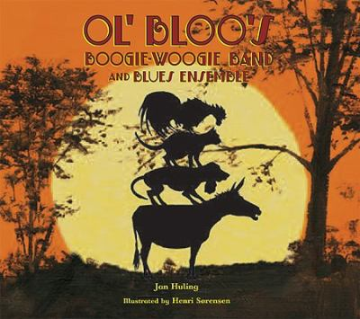
Ol' Bloo's Boogie-Woogie Band and Blues Ensemble
Ol Bloo Donkey has spent year after year hauling cotton dreaming of the day he could enjoy retirement. Then he overhears the Farmer’s plan to retire him permanently and he realizes it’s time to move on. Off he goes to New Orleans to become a honky-tonk singer. Along the way he meets up with a dog, a cat, and a rooster and when they stumble upon a tumbledown shack filled with piles of food and a mountain of money, their plans take a turn.
By Jan Huling

Slide 11
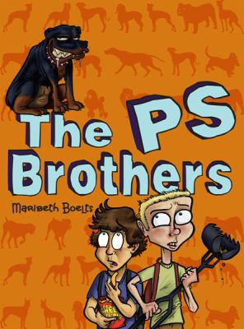
The PS Brothers
Sixth-graders Russell and Shawn, poor and picked on, work together scooping dog droppings to earn money to buy a Rottweiler puppy to protect them from bullies, but when they learn the puppies' owner is running an illegal dog-fighting ring, they are torn about what to do. Doing the right thing might still get them what they want—and maybe even more.
By Maribeth Boelts

Slide 12
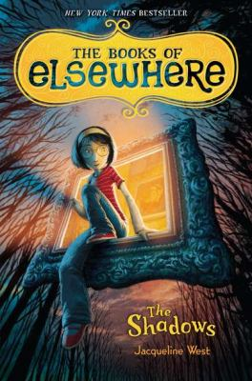
The Shadows The Books of Elsewhere
When eleven-year-old Olive moves into a crumbling old mansion she finds a pair of old-fashioned glasses in a dusty drawer and with them she discovers that she can travel inside the creepy antique paintings on the wall to Elsewhere, a world that's strangely quiet . . . and eerily sinister. Olive soon finds that Elsewhere has secrets to hide and she finds herself caught in a plan darker and more dangerous than she could have imagined, confronting a power that wants to be rid of her by any means necessary.
By Jacqueline West

Slide 13
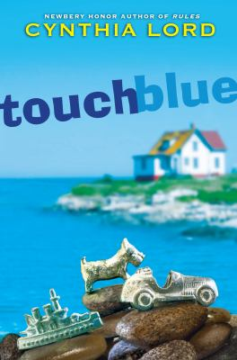
Touch Blue
The state of Maine plans to shut down her island's schoolhouse, which would force Tess's family to move to the mainland--and Tess to leave the only home she has ever known. Fortunately, the islanders have a plan to increase the numbers of students by having several families take in foster children. So now Tess and her family are taking a chance on Aaron, a thirteen-year-old trumpet player who has been bounced from home to home. And Tess needs a plan of her own--and all the luck she can muster. Will Tess's wish come true or will her luck run out?
By Cynthia Lord

Slide 14
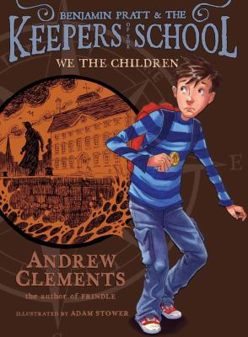
We the Children: Benjamin Pratt and the Keepers of the School
Sixth-grader Benjamin Pratt is about to embark on a mystery. After receiving a peculiar gold coin from the school janitor, who unexpectedly dies, Ben finds himself on a quest to save his elementary school from destruction by developers who want to build an amusement park. When things don't feel quite right, and the new janitor appears to be a spy, Ben and his classmate Jill start digging for answers, hoping that secrets hidden in the building itself will help them to save the school.
By Andrew Clements

Slide 15

Wildfire Run
The president's retreat, Camp David, is one of the safest places in the United States. So why can't the President's son, Luke, and his friends Theo and Callie stay there without Secret Service agents constantly hovering over them, watching their every move? And yet, when an earthquake sets off a raging wildfire, causing a chain reaction that wreaks havoc at Camp David, they are suddenly on their own. Now Luke needs a plan.
By Dee Garretson

Slide 16
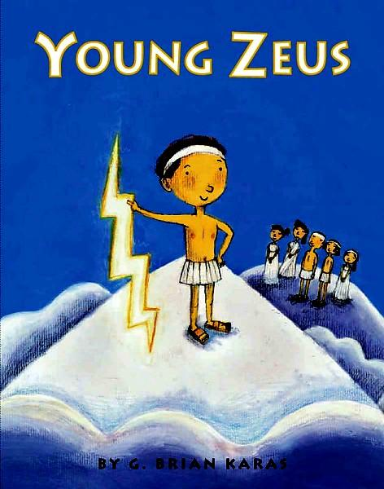
Young Zeus
This is the story of how young Zeus, with a little help from six monsters, five Greek gods, an enchanted she-goat, and his mother, became god of gods, master of lightning and thunder, and ruler over all and in doing so, he learned a lot about family. Who knew that having relatives could be so complicated, even for a god?
By Brian G. Karas

