Slide 1
MnGeo Activity Portfolio
Dan Ross
Chris Cialek
Fred Logman
John Hoshal
State Government Geospatial Advisory Council, May 22, 2012

Slide 2
Getting to know MnGeo
New leadership, new ideas, new approach
Want folks to know understand who we are and what we have been up to
Want to work with the community to develop a service model that meets your needs
Want your help
What geospatial services do you need
Advising – projects, priorities, program and service development

Slide 3
wHo we are

Slide 4
Our funding Model

Slide 5
MnGeo Focus Areas
Geospatial Coordination
1
Coordination, Outreach, Communication Intra-government (agencies) Inter-government (Counties, Feds) Extra-government
Data Coordination Data gaps Data Standards Data stewardship Aggregation of 3rd party data Enterprise licensing
Technology Coordination Project & procurement review Agency-based enterprise resources New enterprise technologies
3
2
6
Guidance Mentoring Best practices
Training Formal, technical
7
Data Services Deployment of an Enterprise Data Library
5
4
Web Services Map services (OGC) Capability services (geocode)
Consulting & Project Support In-source vs. outsource
8
Technical Infrastructure
Technical Support

Slide 6
Focus of our time FY 2011

Slide 7
Focus of our time FY 2012

Slide 8

MnGeo Activity over past couple years

Slide 9
Minnesota’s Foundational data Layers
Cadastral
Elevation
Geodetic Control
Governmental Boundaries
Hydrography
Orthoimagery
Transportation
Soils
Foundations June 2004

Slide 10
MnGeo activity
1. Coordination, Outreach & Communications

Slide 11
Coordination, outreach, communications
Two councils provide policy advice to MnGeo and address geospatial issues
State Government Geospatial Advisory Council focuses on state agency issues – 15 Members
Statewide Geospatial Advisory Council addresses issues of concern to the wider GIS community - 23 Members
Meeting support – agendas, scheduling, minutes, materials
Coordination
Communications
Facilitation
Clients: Entire geospatial community

Slide 12
Coordination, outreach, communications
5 Committees + Subcommittees Digital Elevation Emergency Preparedness Hydrography Digital Cadastral Data Outreach Standards Active participation Websites Communications Member/distribution lists | Workgroups Geocoding Geospatial Commons Metadata Clients: Entire geospatial community

Slide 13
Coordination, outreach, communications

Slide 14
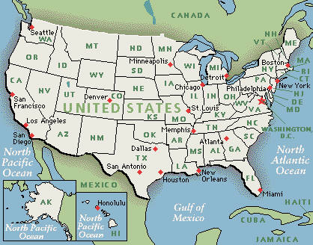
Coordination, outreach, communications
National States Geographic Information Council
Shared Initiatives
Conferences
Congressional “Lobbying”
Experience Sharing – Networking
Clients: Entire geospatial community

Slide 15

Coordination, outreach, communications
GIS/LIS Consortium
Board Member
Newsletter Editor
Announcements
Conferences
Clients: MN Geospatial Community

Slide 16
MnGeo activity
2. Data Coordination

Slide 17
Data Coordination
As LMIC: Significant focus on data
Today: data coordination remains a vital goal
Governmental Boundaries
Hydrography
Structures
Parcels
Imagery
Elevation
Hybrid funding model helps gets work done
Notes:
MSDI – Minnesota Spatial Data Infrastructure
Red: grants
Blue: interagency agreements

Slide 18
Boundaries
PROJECT | CLIENT | FTE | HOURS | BUDGET | DESCRIPTION
Federal Grant | USGS; State; Local Government | 0.10 | 217.0 | $ 13,000 | In-kind effort spent developing and launching project plan for $75,000 grant to integrate and publish updated statewide municipal boundary geospatial data. Coordinate with appropriate state agencies. Engage local governments.
Federal Grant | USGS; State; Local Government | 0.33 | 682 | $ 59,700 | Integrate base boundary data with annexations in as highly accurate process as source data will allow. Design and populate Geodatabase. Provide access.
Minnesota Township Area Calculations | Department of Administration | 0.06 | 130 | $ 10,000 | Legislative mandate to provide these data annually to Revenue, OSOS
Municipal Boundary Updates for Sales Tax Analysis | Department of Revenue Tax Research Division | 0.02 | 51.5 | $ 4,000 | Update boundaries for cities with local sales tax options on a quarterly basis for DOR
Municipal Boundaries Adjustment Web Support | Office of Administrative Hearings - MBAU | 0.02 | 47 | $ 5,700 | Host MBA’s web site hosting annexation docket management system and current related information
Municipal Boundaries Adjustment Web Support | Office of Administrative Hearings - MBAU | 0.03 | 57.5 | $ 5,436 | Enhance MBA’s web site with new tools and data.
 | GENERAL FUND | 0.10 | 217.0 | $ 13,000
 | GRANT | 0.33 | 682.0 | $ 59,700
 | CONTRACT WORK | 0.14 | 286.0 | $ 25,136
 | TOTAL | 0.57 | 1185.0 | $ 97,836
Notes:
FY2011 Governmental Boundaries began with contract work:
Legislative mandate
Office of Administrative Hearings – Municipal Boundary Adjustment Unit
Department of Revenue
Created City, Township and Unorganized Territories Identifying Standard (GNIS)
The applied for FGDC Cooperative Agreements Program grant to try and invest resources to help coordinate,
Required a 50% in-kind contribution
Final project report published in March on FGDC website.
Publishing data increases transparency – this year 3 cities have identified errors, which have been inspected by MnDOT (Federal Aid) and are being researched by MBAU

Slide 19
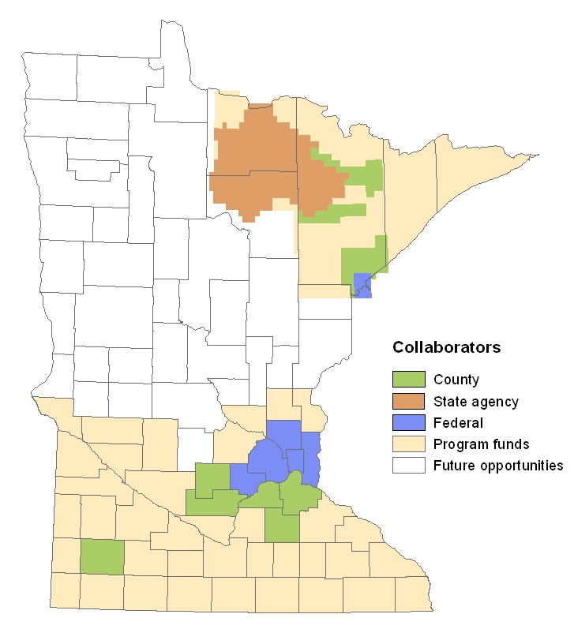
AERIAL IMAGERY
CLIENTS
U.S. Geological Survey
Nat Geospatial Intelligence Agency
MPCA
Metropolitan Council
Dakota County
McLeod County
Murray County
Rice County
St. Louis County
Sibley County
Metropolitan Mosquito Control District
GENERAL
FUND
65%
$18,645
* Pass through: $496,450
Notes:
Imagery FY12
About a $34K spend, managing $500,000 in Legacy funds
GF primarily for outreach and mgmt of partnerships
For every $100 of state money investing in this program, $67 are added by non-State partners

Slide 20
water
GENERAL FUND
18%
$45,833
CONTRACT
47%
$120,000
GRANTS/
COOPERATIVE AGREEMENTS
35%
$87,601
CLIENTS:
U.S.G.S. - National Hydrography Dataset
U.S. EPA - National Environmental Info Exchange Network (NEIEN) implements National Info Exchange Model (NIEM)
endorsed by NASCIO
MN PCA - Altered Watercourse
Notes:
Water
Water-related programs:
National Hydrography Database (NHD) -- USGS
NEIEN (National Environmental Information Exchange Network) -- EPA
Altered Watercourse – PCA
In 2004: $4-million in support from USGS & EPA

Slide 21
MnGeo activity
3. Technical Coordination

Slide 22
Technical coordination
ESRI Enterprise License Agreement
MnGeo’s Role:
Primary business contact with vendor
Lead contract negotiation preparation
Determine partner requirements
Execute interagency agreements
Collect funds; assure payments & other obligations
Manage software license deployment
Assist new agencies

Slide 23

ESRI ela
Began in May ‘09; current contract expires July ’12
Over the ELA’s timespan:
Number of participating agencies doubled (8 to 16)
Number of software licenses roughly doubled
Positive ROI
Negotiations are currently underway to continue ELA for three more years
MnGeo dedicates ~260 hrs/yr; compensated ~3.5%

Slide 24
MnGeo activity
4. Data Services

Slide 25
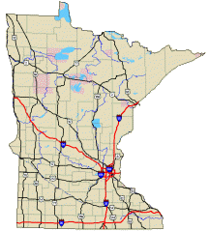
Data services
Minnesota Geographic Data Clearinghouse
The Minnesota Geographic Data Clearinghouse (MGDC) serves as a convenient source for geographic data, ranging from simple state maps to complex geospatial data needed to power Geographic Information Systems.
Coordinated by MnGeo, the MGDC provides access to a wide variety of sources making it your "First Stop" for geographic data for Minnesota. MGDC partners include the USGS, Bureau of the Census, Minnesota's DNR, DOT and PCA, the MetroGIS program and many others.
Information Requests
Website Maintenance
Outreach and Promotion
Metadata
Web Map Services
Clients: Entire Geospatial Community

Slide 26
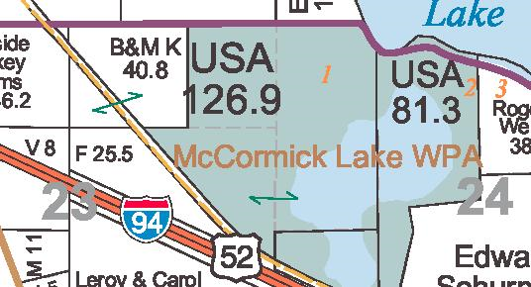
Data services
Parcel Business Plan
Collaborative Effort
Multiple Funding Sources
Building on Strategic Plan – Foundations
Create Statewide Data Layer
Clients: State Agencies
Counties
Public

Slide 27
Data services
MetroGIS Data License
Point of Contact
Single Attorney Review
Coordinated Distribution
Discussion – Single State License
Clients: State Agencies & Met Council

Slide 28
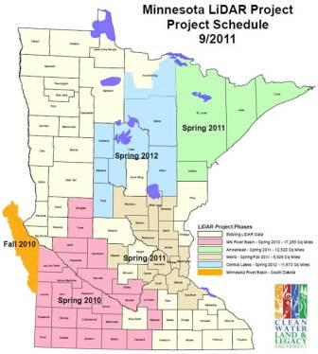
Data services
LiDAR/Elevation Data Distribution
Replicate DNR FTP Site
Data Download Portal
Clients: Geospatial Community

Slide 29
MnGeo activity
5. Web Services

Slide 30
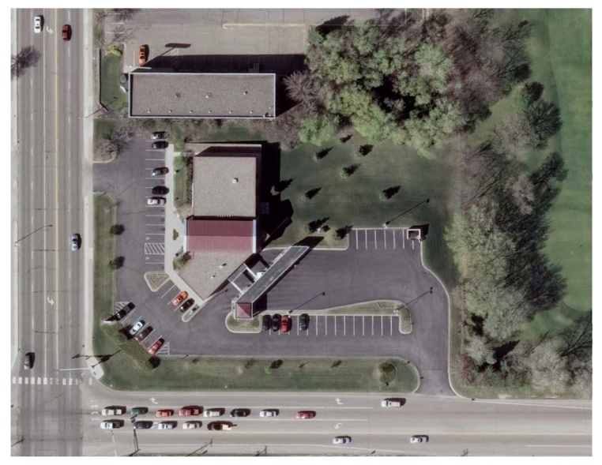
Web services
“First and foremost we use the aerial Web Map Services. They have been by far the most reliable online services I have ever used in GIS…”
Senior GIS Analyst
Engineering Consulting Firm
Minneapolis
May 18, 2012

Slide 31
Geospatial image service
2012 Top Ten of 31 offerings
1 | 2010 FSA Statewide leaf-on color
2 | 2010 DNR Metro MN leaf-off color
3 | 2011 DNR Southern MN leaf-off color
4 | 2008 FSA Statewide leaf-on color
5 | 2009 FSA Statewide leaf-on color
6 | 2010 Dakota County 6 inch leaf-off color
7 | USGS 1:24,000-scale Digital Raster Graphics
8 | Composite Image Service
9 | 1991 USGS Statewide leaf-off B/W
10 | 2008 FSA Statewide leaf-on color infrared
Notes:
Top Ten represent 94% of all map requests for the period between Jan thru April 2012.
Priorities seem to be:
new data
statewide coverage – FSA and best available
golden oldies: quad maps, 1991 DOQ
Best estimate as to level of effort: ~.1 FTE ($10K?)

Slide 32
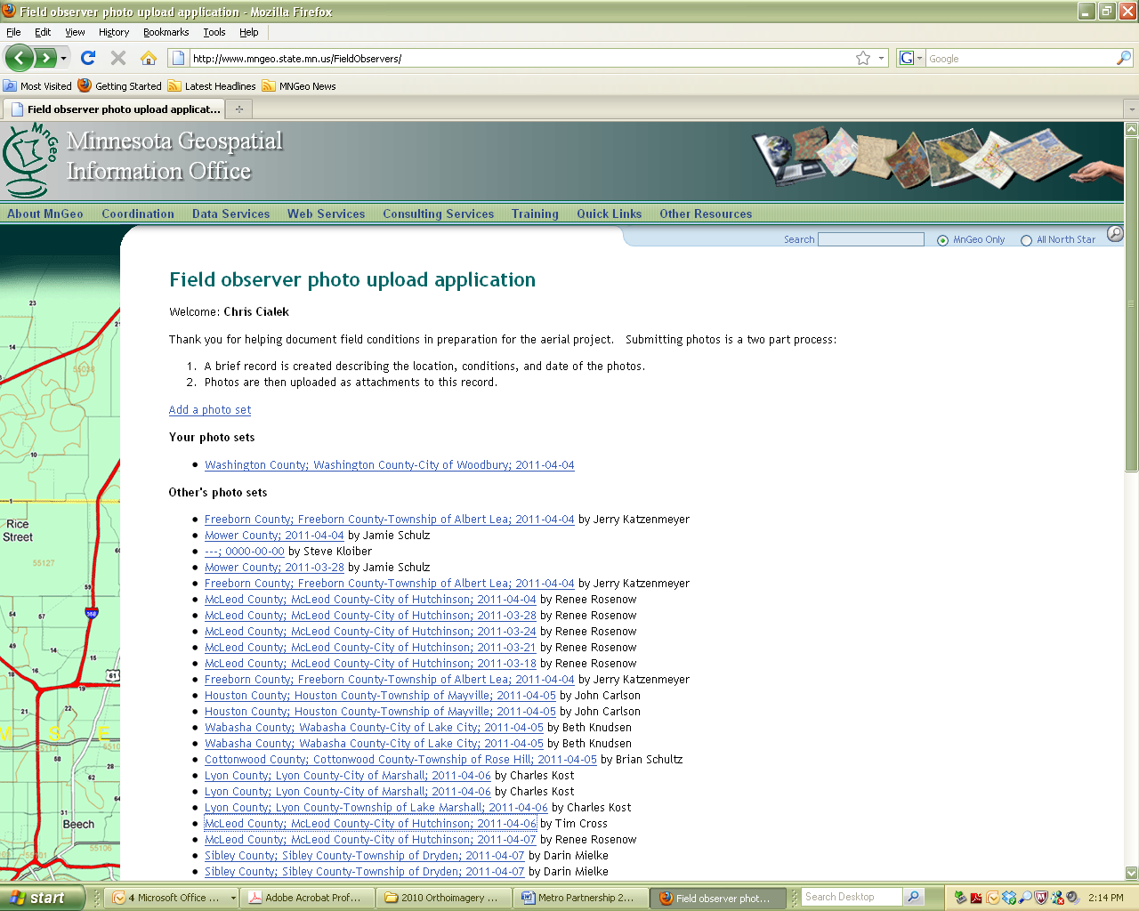
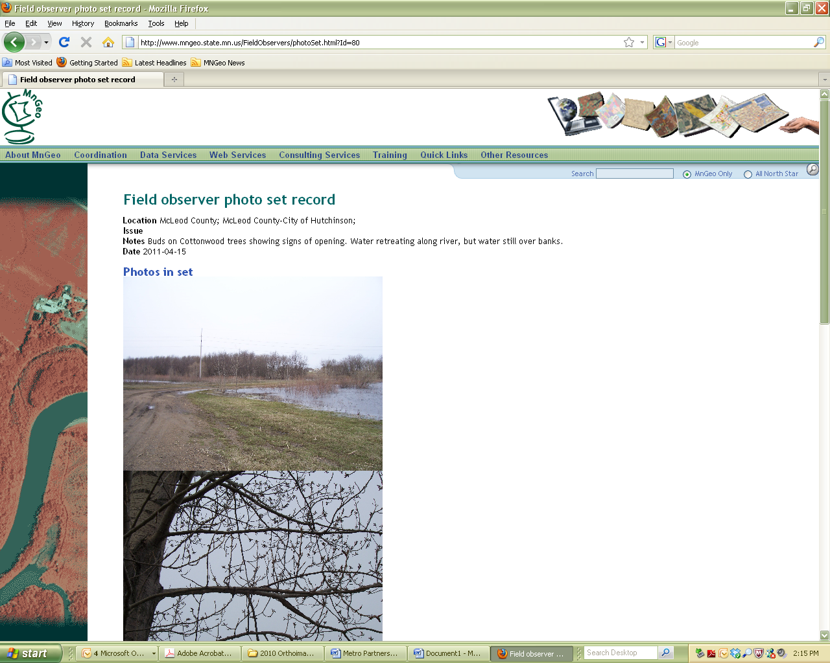
Web services
Crowdsourcing Web Application
Developed in Spring ’11
Allowing field observers from all over Southern Minnesota to post:
current vegetation, flooding, ice and snow conditions
together with daily photos
Optimizing aerial imagery flights to assure they meet contract specifications.
Notes:
Other web services
Field observers web site [Facebook for orthoimagery]

Slide 33
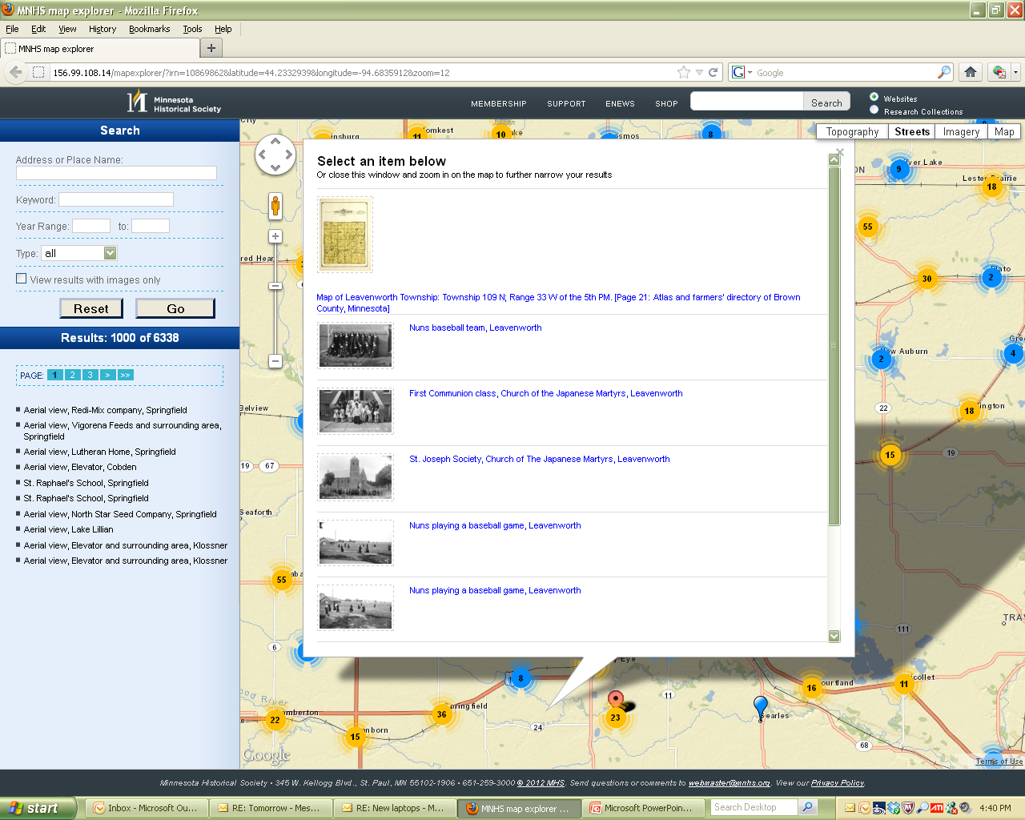
Web Services
MHS: MapExplorer
General Land Office Map Retrieval
Annexation Docket Management
Notes:
Many applications have been built to consume web services that MnGeo publishes for specific project. Minnesota Historical Society: MapExplorer is one example that John will describe later.
Other examples of web services created for client projects:
General Land Office (GLO) Historical Plat maps (georectified and linked to survey notes)
U.S. National Grid mapping for emergency response
Critical Structures
Wind Turbine Locations (Public Utilities Commission – PUC)
Electrical Utility Service Areas (PUC)
Boundary Annexations
search, discover, access
scanned historical photographs, maps, documents,

Slide 34
MnGeo activity
6. Training
Notes:
No measurable time dedicated to this Program Element during FY 11 and 12.

Slide 35
MnGeo activity
7. Guidance

Slide 36
MNGEO GUIDANCE
MnGeo provides advice and support to the GIS community; directing stakeholders to resources, assisting agencies starting with GIS, performing basic needs analysis, identifying grant opportunities and developing strategic partnerships.

Slide 37
MnGeo activity
Consulting & Project Support

Slide 38
MNGEO's Service Bureau
LMIC, now MnGeo, has offered GIS consulting services, customized data compilations, GIS web-mapping and hosting services, and map products on a cost-recovery basis since 1978.
The Service Bureau provides GIS support primarily to federal, state and local governmental units; occasionally to the private sector.

Slide 39
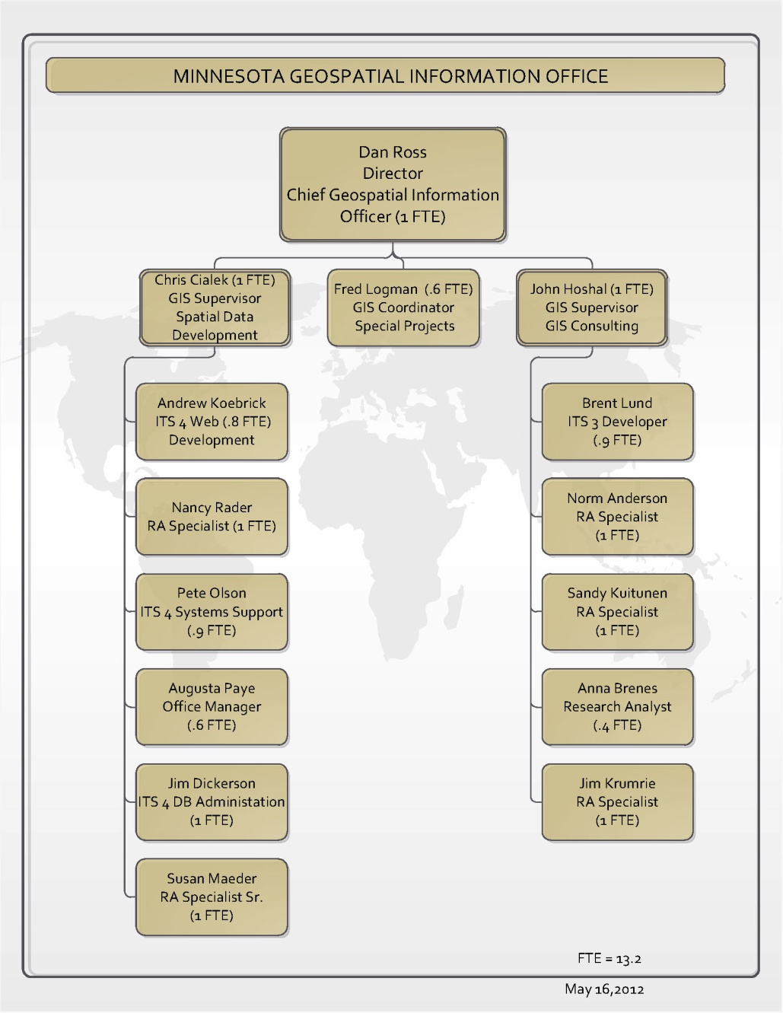
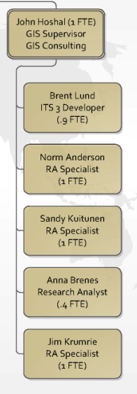
MNGEO's Service Bureau staff
Five Core GIS Staff

Slide 40

MNGEO's Service Bureau staff
Student Workers!!

Slide 41
MNGEO CLIENTS: FY2011
Notes:
Is everyone familiar with GIS or geographic information systems?
Please stop me if you hear any term you are not familiar.
We coordinate with federal, state and local government partners
<- If necessary ->
GIS data is a point, line or area with a database.
Example: a city point located on a representation of the earth with details such as population.

Slide 42
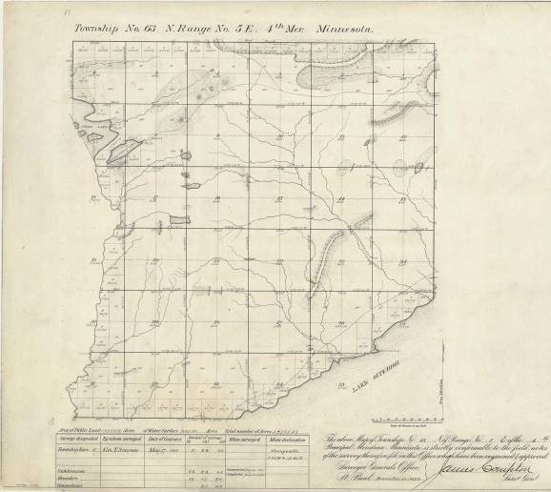
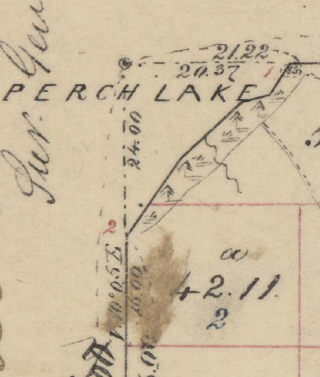
Fy2011 projects: GLO Plats (2004)
Client: MN Dept. of Transportation
Funding: MN Dept. of Transportation
Budget: $45,000
Deliverables: 3,600 high-resolution, color images
Who Benefits: Surveyors, Title Companies, Historians, BLM, MnDOT, DNR – Anyone who owns or manages land in Minnesota!

Slide 43
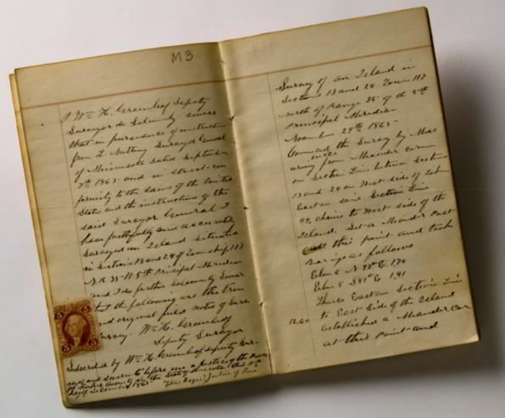
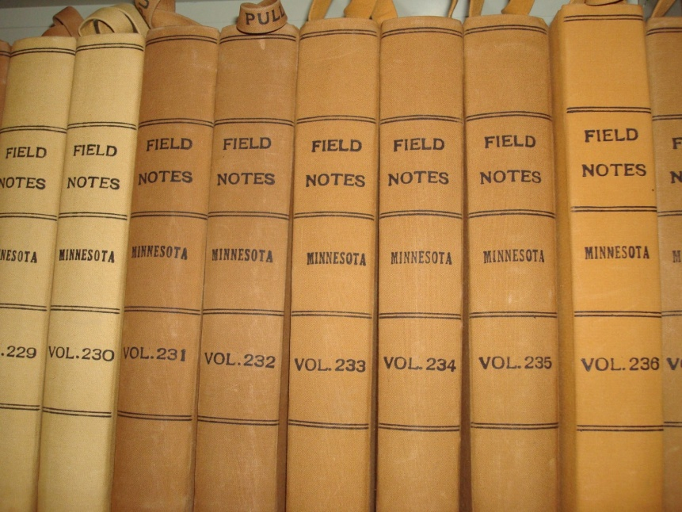
Fy2011 projects: Field Notes
Contained in 1,410 volumes totaling over 300,000 pages, the notes serve as the legal foundation for all land ownership in the state.

Slide 44
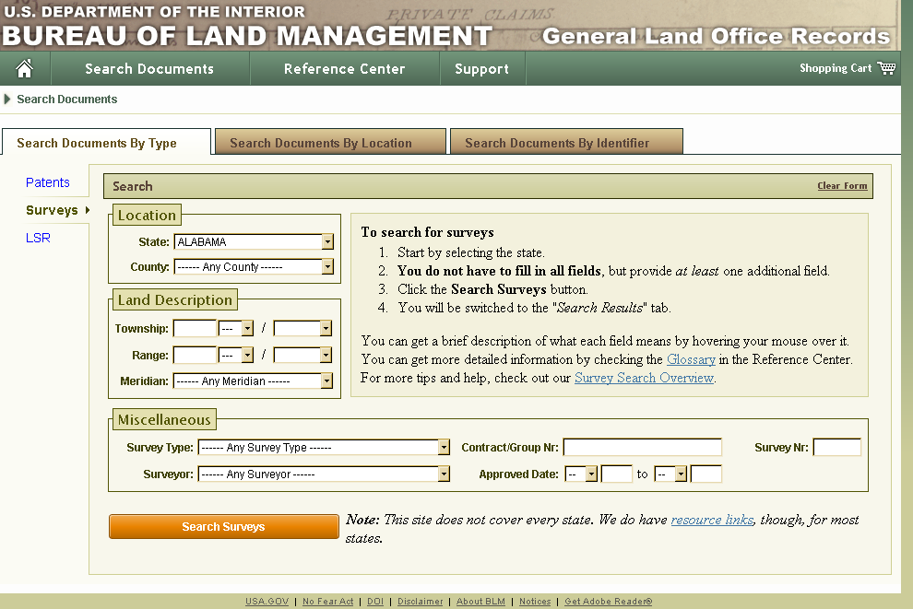
Fy2011 projects: Field Notes
Client: MN Historical Society (in collaboration with the U.S. Bureau of Land Management - BLM)
Funding: Historical and Cultural Heritage Grant Initiative Funded By The Clean Water, Land and Legacy Amendment
Budget: $650,000
Deliverables: 308,000 high-resolution, color images, carefully indexed for efficient distribution on BLM’s Land Records web site, spatially referenced GLO plats
Who Benefits: Surveyors, Title Companies, Historians, BLM, MnDOT, DNR – Anyone who owns or manages land in Minnesota!

Slide 45
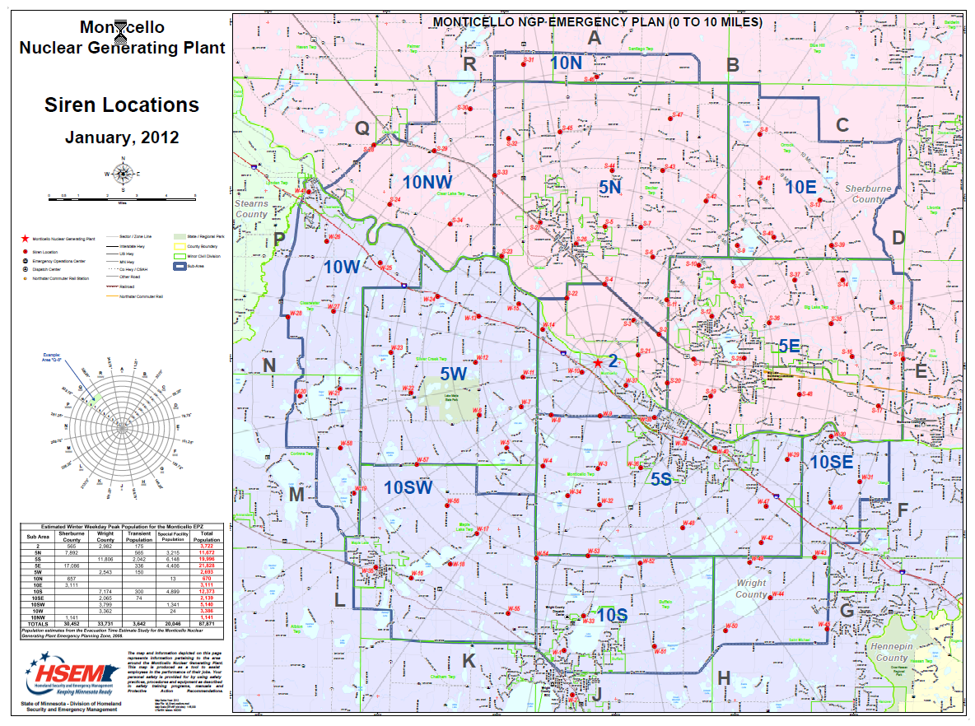
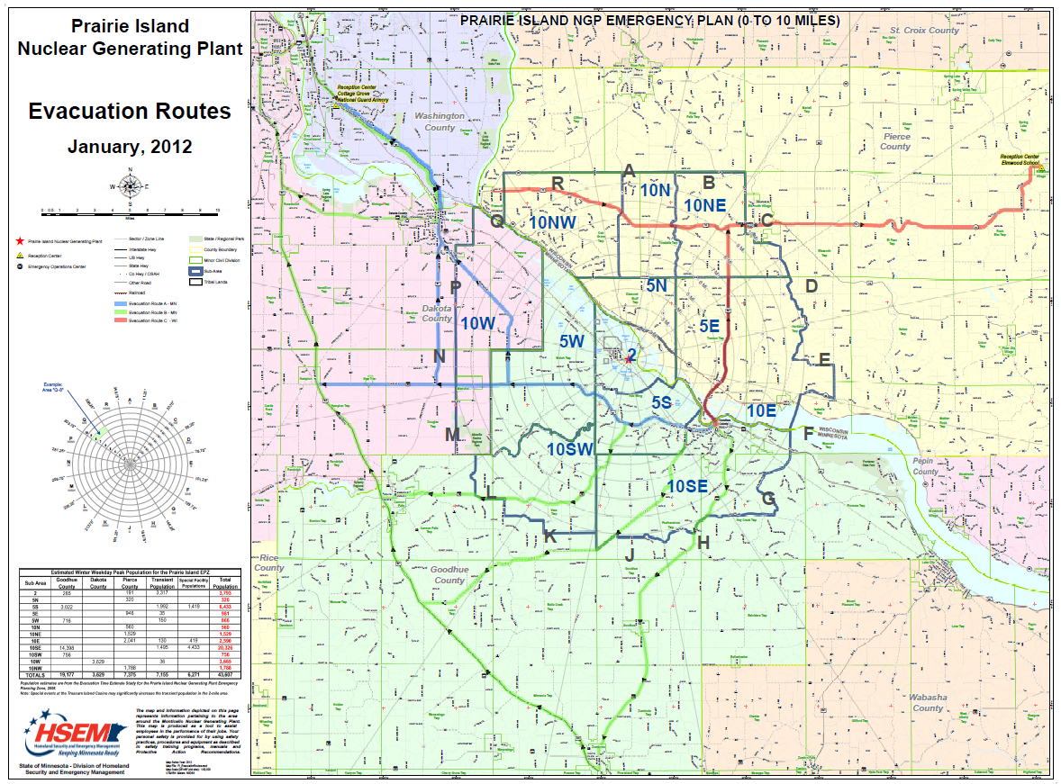
Fy2011 projects: Radiological Events
Client: MN Department of Public Safety - HSEM
Funding: HSEM / Utilities
Budget: $51,400
Deliverables: Custom maps and data required to support drills and exercises, on-site staffing at the SEOC
Who Benefits: – HSEM, Electric Utilities, FEMA, General Public
Notes:
45

Slide 46
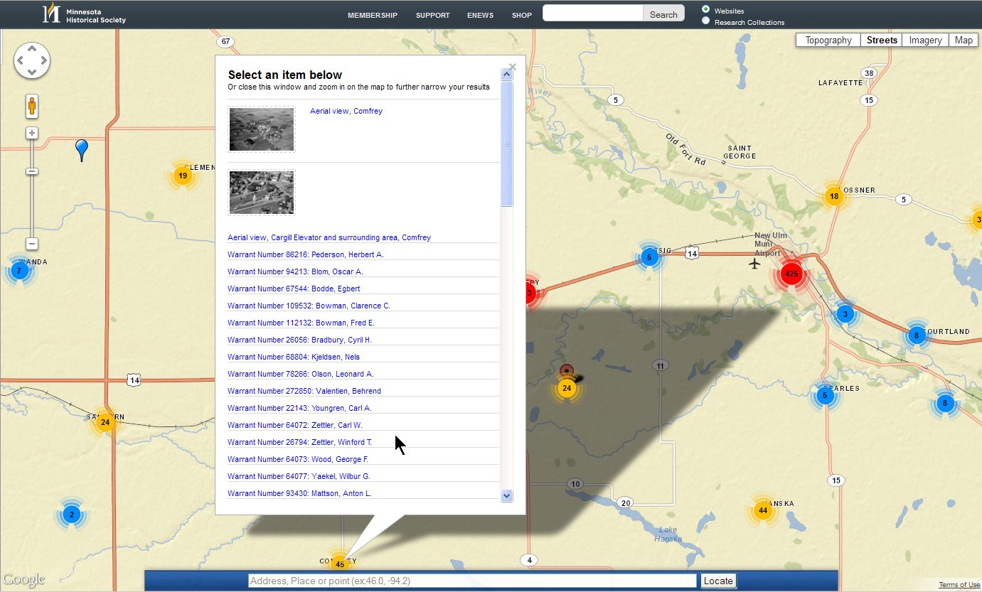
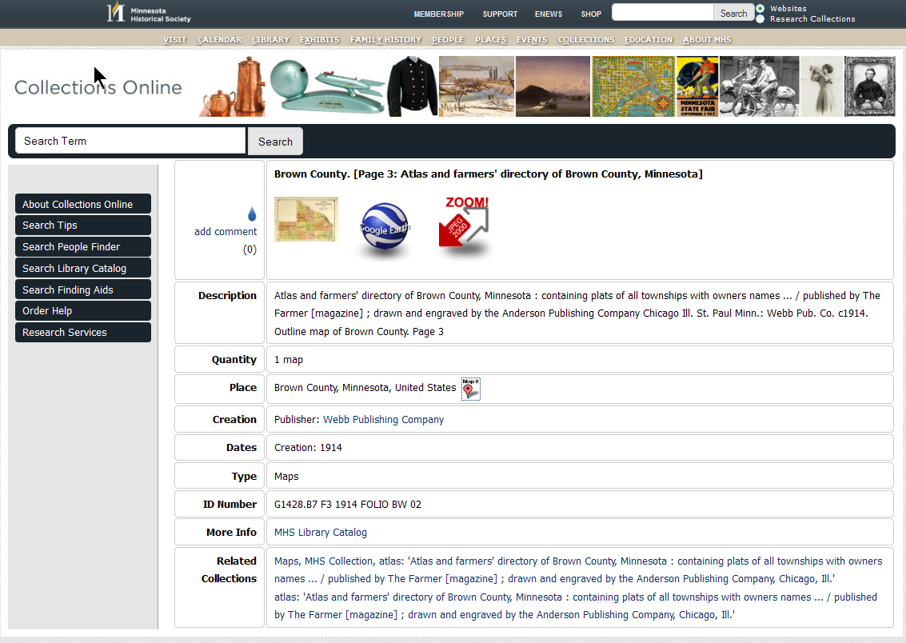
FY2011 projects: GIS & historical photos
Client: MN Historical Society
Funding: Clean Water, Land and Legacy Amendment
Budget: $76,000
Deliverables: Geo-tagged 66,000+ historical photos, constructed web-mapping application
Who Benefits: Historians, Genealogists, General Public

Slide 47
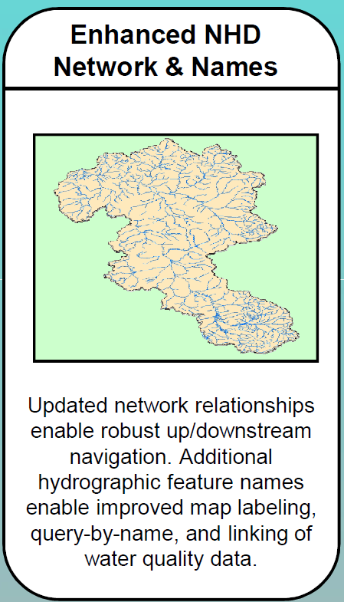
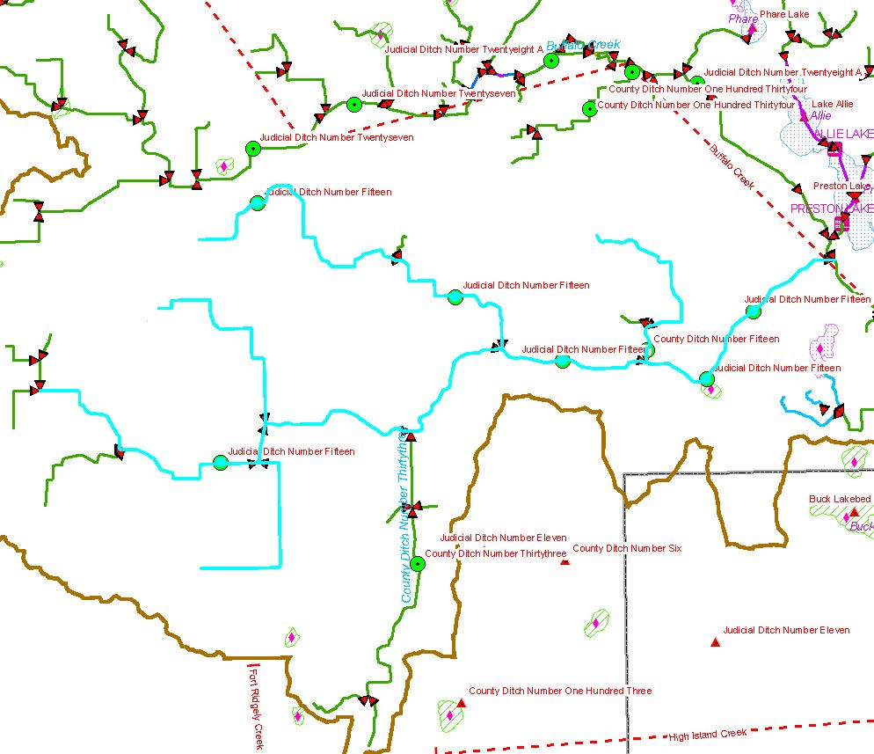
Fy2011 projects: High-Res nhd Updates
Client: U.S. Geological Survey (USGS)
Funding: 2011 USGS
Budget: $65,000
Deliverables: Enhanced NHD GIS Data
Who Benefits: – USGS, EPA, U.S. Forest Service, MN Pollution Control Agency, MN DNR
Notes:
47

Slide 48
MNGEO CLIENTS: FY2012
Notes:
Is everyone familiar with GIS or geographic information systems?
Please stop me if you hear any term you are not familiar.
We coordinate with federal, state and local government partners
<- If necessary ->
GIS data is a point, line or area with a database.
Example: a city point located on a representation of the earth with details such as population.

Slide 49
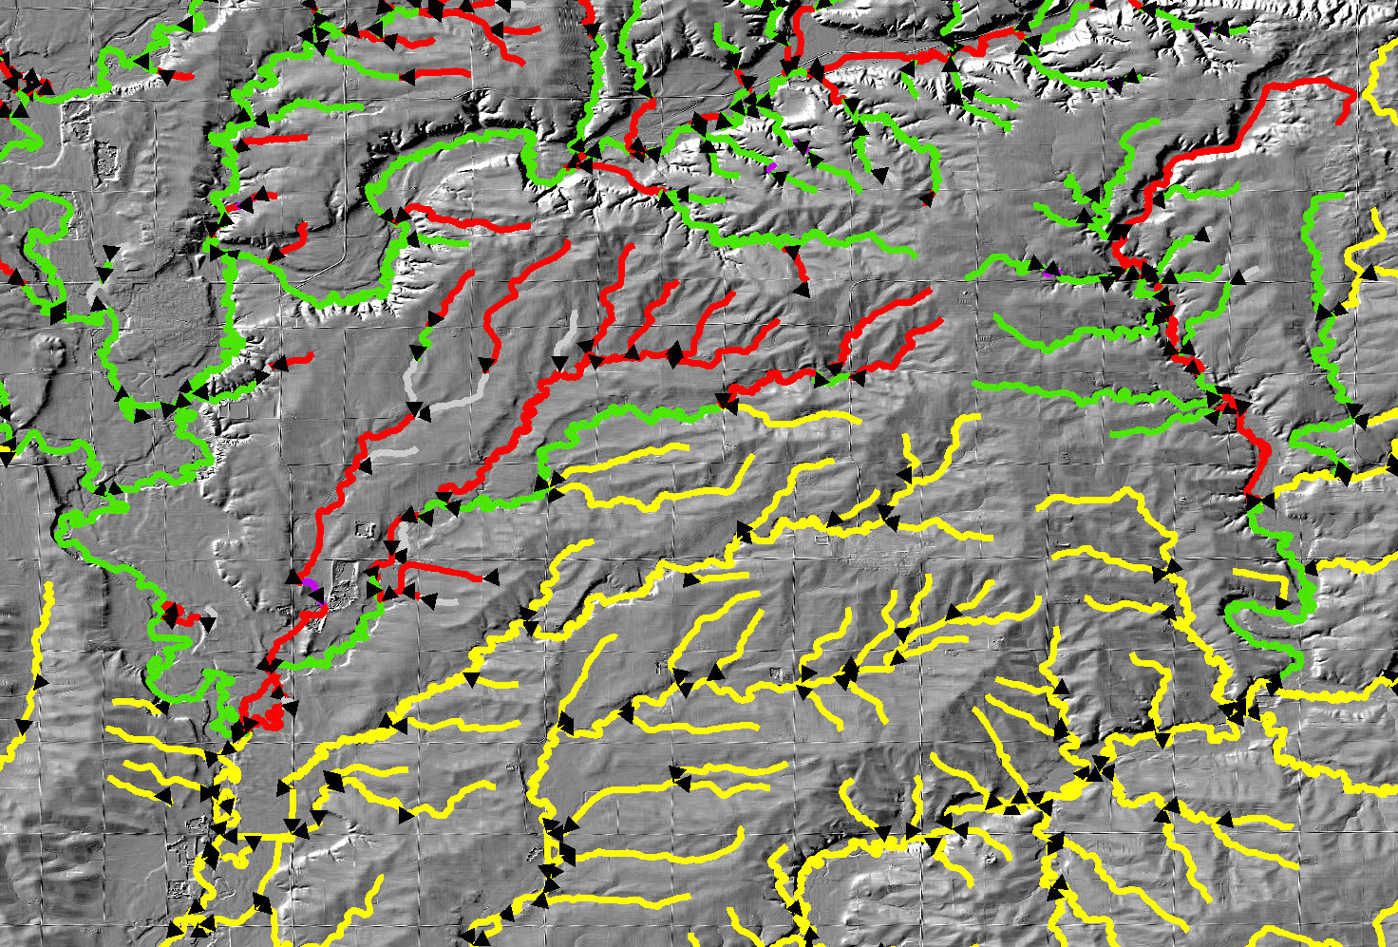
Fy2012 projects: Altered Water Courses
Client: MN Pollution Control Agency
Funding: Clean Water, Land and Legacy Amendment
Budget: $120,000 (FY2012)
Deliverables: Highly detailed, enhanced NHD GIS data
Who Benefits: State Agencies – PCA, DNR, BWSR; Federal Agencies – EPA, U.S. Forest Service, Soil Conservation Service

Slide 50
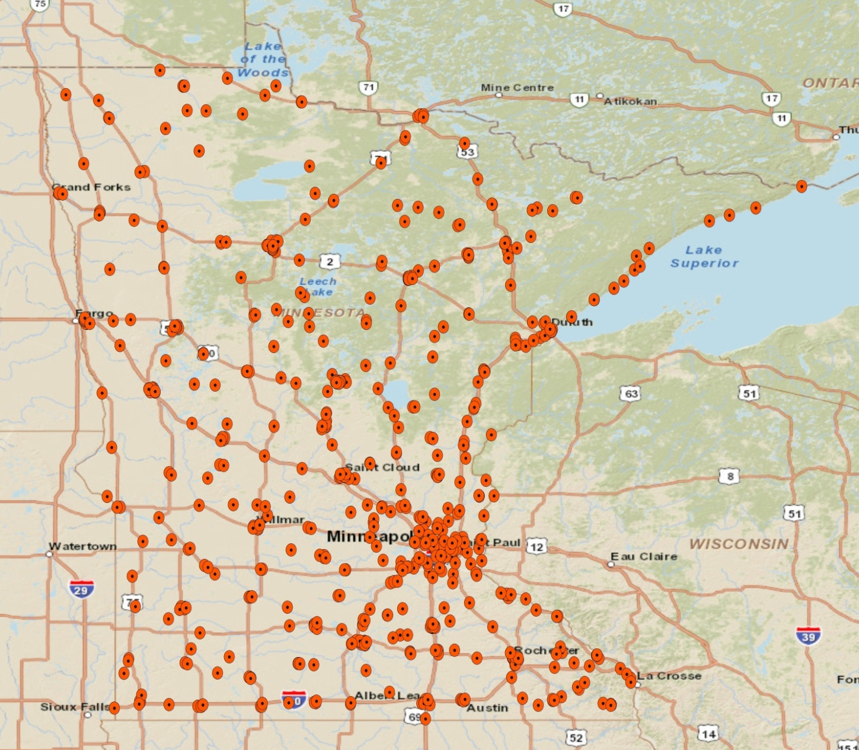
Fy2012 projects: Minnesota Structures
State Structures Housing Employees
Client: U.S. Geological Survey
Funding: 2011 USGS – Minnesota Structures Collaborative
Budget: $25,000
Deliverables: Enhanced structures data for The National Map – improved fire station locations, nursing homes, correctional institutes, public health facilities, State of MN owned or leased structures (that house State employees), updated USNG-based 10K maps for the entire state
Who Benefits: – USGS, MN Management and Budget, MN Dept. of Administration, HSEM, Federal, State and Local Emergency Managers
Notes:
50

Slide 51
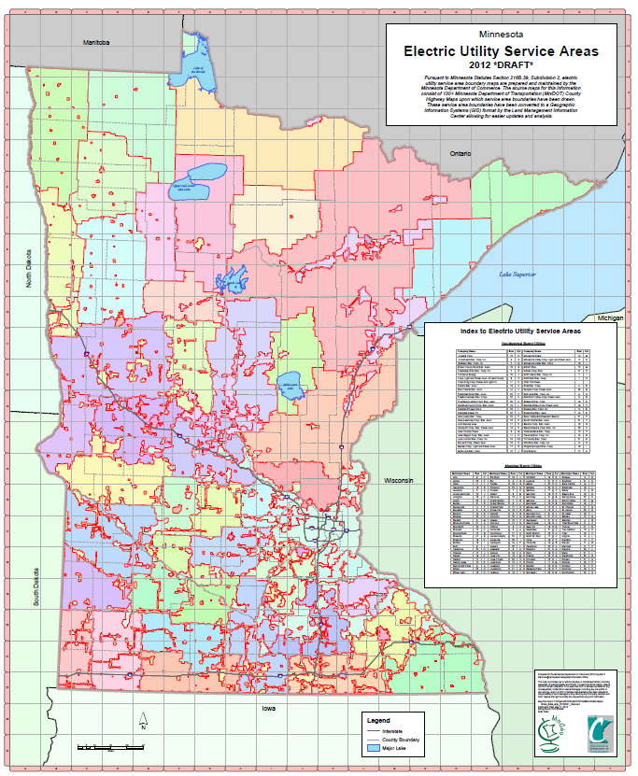
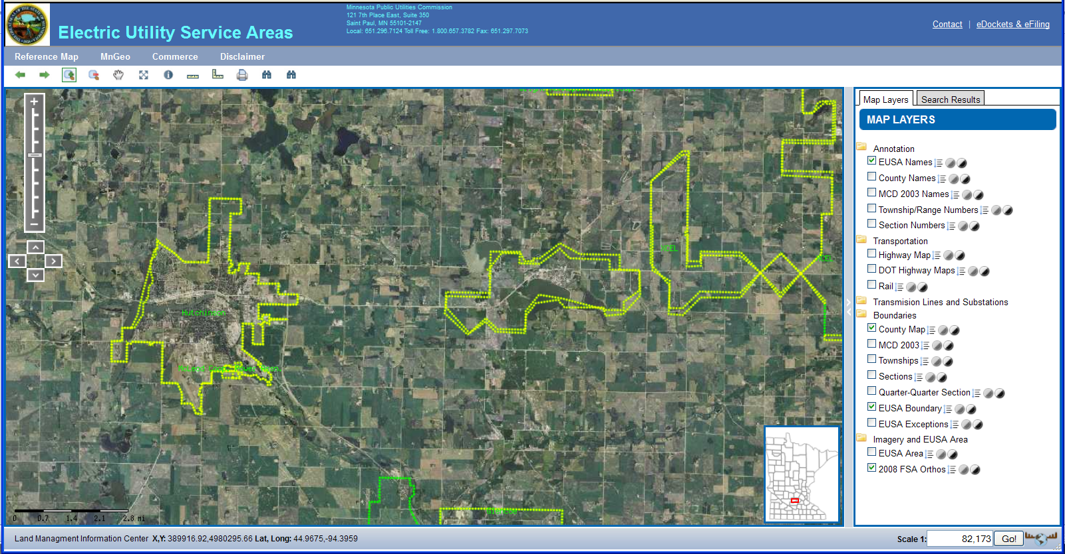
Fy2012 projects: utility Service areas
Client: MN Public Utilities Commission (PUC)
Funding: PUC
Budget: $66,000
Deliverables: Updated Electric Utilities Service Area (EUSA) boundaries, EUSA web-based mapping services
Who Benefits: – PUC, Electric Utilities, HSEM, Business, General Public

Slide 52
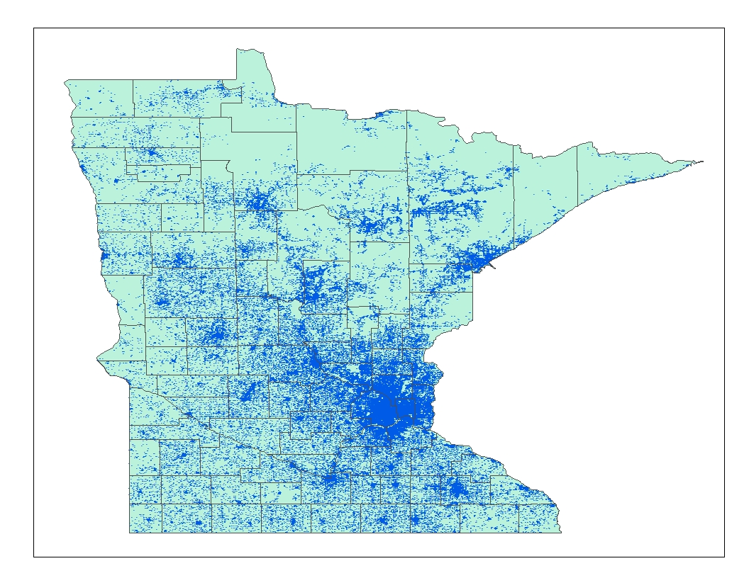
Fy2012 projects: MnSCU Geocoding
Client: Minnesota State Colleges and Universities (MnSCU)
Funding: MnSCU
Budget: $14,000
Deliverables: Geocode SY2011 & SY2012 student home locations (~600,000 records); identify U.S. and Minnesota legislative districts
Who Benefits: MnSCU Research
Notes:
52

Slide 53
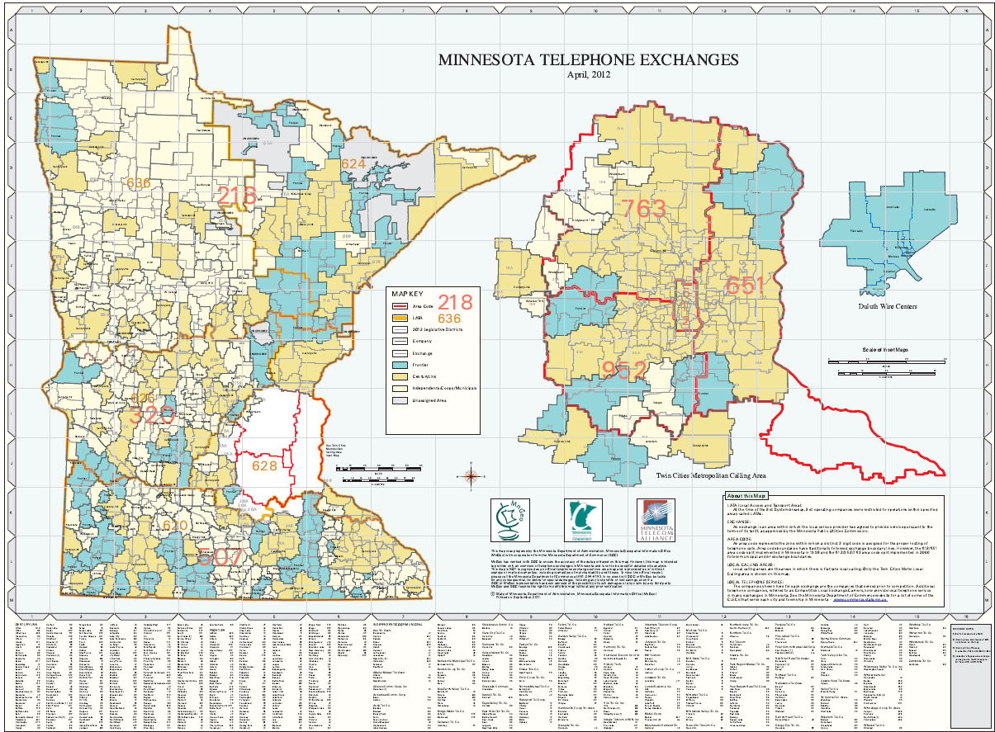
Fy2012 projects: Telephone Exchanges
Client: MN Telephone Exchange Association / MN Dept. of Commerce
Funding: MN Telephone Exchange Association
Budget: $5,000
Deliverables: Updated telephone exchange areas, updated state map of exchanges
Who Benefits: – Telephone industry, MN Dept. of Commerce, Connect Minnesota, Business, General Public
Notes:
53

Slide 54
MnGeo Activities
February 2009
Geospatial Coordination
1
Coordination, Outreach, Communication Intra-government (agencies) Inter-government (Counties, Feds) Extra-government
Data Coordination Data gaps Data Standards Data stewardship Aggregation of 3rd party data Enterprise licensing
Technology Coordination Project & procurement review Agency-based enterprise resources New enterprise technologies
3
2
6
Guidance Mentoring Best practices
Training Formal, technical
7
Data Services Deployment of an Enterprise Data Library
5
4
Web Services Map services (OGC) Capability services (geocode)
Consulting & Project Support In-source vs. outsource
8
Technical Infrastructure
Technical Support

Slide 55
Mngeo priorities

Slide 56
Discussion
Are we working on the right stuff?
Should the service model be different than it is today?
Are the unique needs agencies have?
Future
Governance and Advisory body roles
Priorities based on service model
What is the correct resource model for the state and community?
Resource Pooling?
One state Team?

Slide 57
Whats coming next
30 days
Transition to MN.IT Central
Begin agency/community visits
60 days
Complete Transition to MN.IT Central and continue visits
90 days
Service model definition
Governance model definition for 2014 (1 or 2 advisory bodies)
Needed legislation defined (data practices, stewards for MSDI layers)

Slide 58
Finally
How often do we meet?
Propose cancelling July meeting and meet for regular September?

