Slide 1
Geocoding Workgroup Brief
Mike Dolbow
Workgroup Co-Chair
MnGeo Statewide Advisory Council
December 29, 2010

Slide 2
Reason for Being
Applied Geographics identified as a strategic investment for MnGeo:
“the need for accurate and current statewide addressing, and an attendant geocoding web service, was identified by virtually all state agencies”
-- Final Program Design Report, section 5.2.3 http://www.gis.state.mn.us/committee/MSDI/dte/Pr ogramDesign_FinalFeb09_V21.pdf

Slide 3
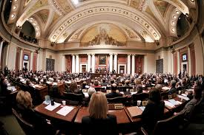
Also…
The 2010 Legislature increased standards for transparency, partly by ensuring that:
“all geospatial data conform to an approved state geocode model.”
-- 2010 Minnesota Statutes 16E.05, Subd. 4 (3)
https://www.revisor.mn.gov/statutes/?id=16E.05

Slide 4

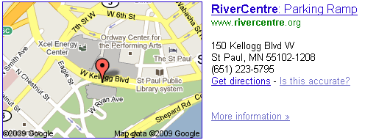
Define Geocoding
The process of finding geographic coordinates from other geographic data, such as street addresses or zip codes.

Slide 5
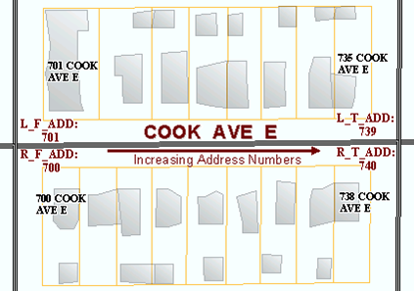
Data vs. Geocoding Support Data
Data: 707 Cook Ave E, St. Paul, MN
Support Data: Parcels, Centerlines, etc.
Result: 44.973158,-93.070529

Slide 6
Existing Options
Google Maps – limitations on numbers, must be on a public site
ESRI – not developed with local data
MetroGIS – not statewide, no batch

Slide 7

Who is Geocoding?
State Agencies
Local Governments
Non Profits
Research Groups
Federal Governments
…Who isn’t geocoding?

Slide 8
Geocoding Workgroup
Mike Dolbow, MDA
Kent Treichel, Revenue
Mary Arvesen, DHS
Bob Basques, St. Paul
Brad Anderson, Moorhead
Brad Neuhauser, SOS
Jessica Fendos, DEED
Jessica Deegan, MN Housing
Jennifer Johnson, DOC
Sandi Kuitunen, MnGeo
Paula Lindgren, MDH
Lee Meilleur, LCC
Fred Logman, MnGeo
Tim Zimmerman, Hennepin County
John Wiersma, DHS
Will Craig, U of M

Slide 9

Efforts to Date
Workgroup Charter created
Work plan / milestones created from charter
“Ideal” service requirements document created
Potential benefits drafted

Slide 10
Next Steps
Identify potential solutions with an RFI
Any innovative solutions out there?
What would they cost?
What data would they require (and what would that cost)?
Would it be a product (software code) or a service (hosted solution)?

Slide 11

Next Steps cont.
Assess costs of potential solutions
Initial
Ongoing
Compare to current
Brief Cost/Benefit analysis

Slide 12

Next Steps cont.
Assess and acquire potential support data sets
Recommend a solution to be developed or acquired
Report and present findings to MnGeo Advisory Councils

Slide 13
Timeline
Best case scenario:
RFI Posted by 1/31/2011
RFI Results by 3/31/2011
Support data assessment in interim
Recommendations by 6/30/2011

Slide 14
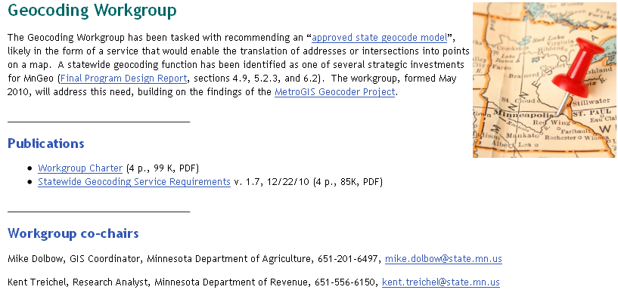
More Information
http://www.mngeo.state.mn.us/workgroup/geocoding/

Slide 15
Q&A
Who in the room has a need for geocoding?
Is anyone paying for a solution (or support data)?
Are locals willing to contribute data to a statewide solution?
What kinds of solutions are used?

