Slide 1

Louisiana Young Readers’ Choice Award
Grades 3 - 5

Slide 2
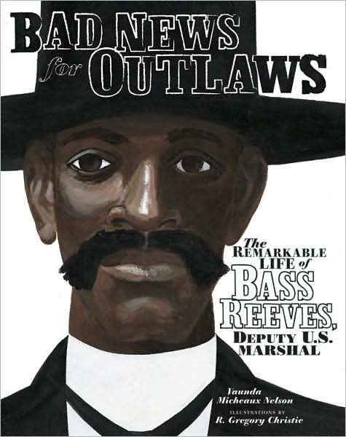
Bad News for Outlaws The Remarkable Life of Bass Reeves, Deputy U.S. Marshall
Bass Reeve was a former slave who escaped to freedom in the Indian Territories. For three decades, Bass was the most feared and respected lawman in the territories. He made more than 3,000 arrests during his 32 years of service as a deputy U.S. Marshal, all without getting injured and although he was a crack shot and a quick draw, he only killed fourteen men in the line of duty.
By Vaunda Micheaux Nelson

Slide 3
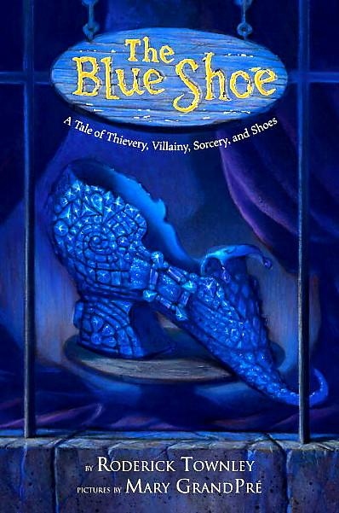
The Blue Shoe
Far away, in a remote mountain village, there is a cobbler's shop. And in the window there sits a shoe. Not just any shoe, but a jewel-encrusted blue shoe. When the shoe's largest jewel goes missing, the cobbler's assistant, Hap, is blamed and banished to the dreaded Mount Xexnax. Legend has it that no one has ever returned from Xexnax, but Hap Barlow isn't just anyone, and legend is about to be rewritten.
By Roderick Townley

Slide 4

Brixton Brothers The Case of the Case of Mistaken Identity
Steve Brixton always wanted to be a detective until he found out he already WAS one. It all starts here with his first case. Our hero has a national treasure to recover, a criminal mastermind to unmask, and a social studies report due Monday — all while on the run from cops, thugs, and secret-agent librarians. Since when can librarians rappel from helicopters? Does Steve have any brothers or sisters? If not, then why is this series called The Brixton Brothers? Solve all these mysteries and many more.
By Mac Barnett

Slide 5

The Dream Stealer
There is a bandit who comes in the night. He does not want pretty silver earrings, dangly gold necklaces, diamonds or rubies. He is supposed to steal only nightmares but makes the mistake of stealing a good dream from Susana. This good dream is about her friend who has moved far away. Susana is very smart and is determined to get her good dream back. She tries to recover her dream from the Dream Stealer who takes her to his castle where countless dreams and even more adventures await.
By Peter Sis

Slide 6

The Dunderheads
Miss Breakbone hates kids. Especially the time-squandering, mind-wandering, doodling, dozing dunderheads in her class. But when she confiscates Junkyard’s crucial find, Wheels, Pencil, Spider, and the rest of the Dunderheads plot to teach her a lesson she won’t soon forget.
By Paul Fleischman

Slide 7
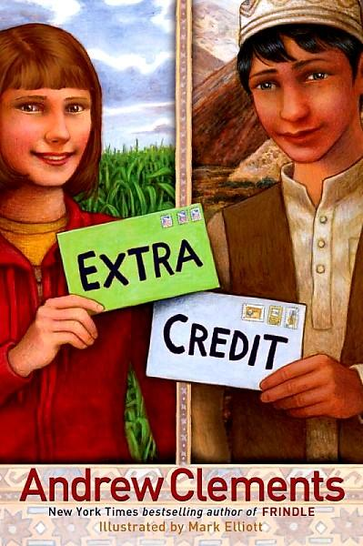
Extra Credit
In order to pass 6th grade, Abby takes on an extra credit project. She develops a pen pal relationship with Sadeed, an English language student in Afghanistan. Corresponding with a girl is not appropriate so Sadeed is told to write as though the letters are from his sister. Eventually their growing friendship becomes a problem for both communities.
By Andrew Clements

Slide 8
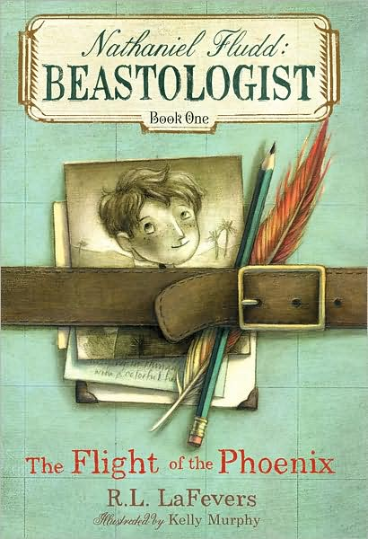
Nathaniel Fludd: Beastologist The Flight of the Phoenix
Nathaniel Fludd’s life has taken a turn for the worst. With his parents lost at sea, he lands on the doorstep of a distant cousin—the world’s last remaining beastologist. Soon Nate is whisked off on his first expedition, to Arabia, where the world’s only phoenix prepares to lay its new egg. When disaster strikes, Nate quickly finds himself all alone. If he fails, nothing will stand between the world’s mythical creatures and extinction.
By R.L. LaFevers

Slide 9
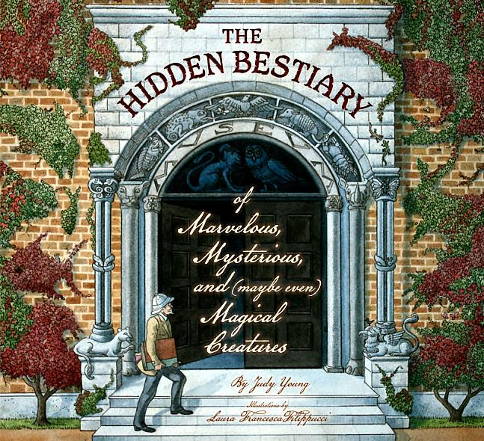
The Hidden Bestiary of Marvelous, Mysterious, and (maybe even) Magical Creatures
Explorer Basil Bernard Barnswhitten (B.B.B.) has a list of creatures he needs to verify for an important report. He travels around the world to track down each creature on his list, all the while asking the same three questions: Is it alive? Is it extinct? Did it ever exist? By deciphering the clues in his journal, young explorers can accompany B.B.B. as he tries to locate each mysterious creature.
By Pam Kaster

Slide 10

Moonshot The Flight of Apollo 11
Simply told, grandly shown, here is the flight of Apollo 11, the first manned mission to land on the moon. Each step of the journey from a quiet moonlit field to splashdown is captured. It is a story of adventure and discovery -- a story of leaving and returning, and a story of home, seen whole, from far away.
By
Brian Floca

Slide 11
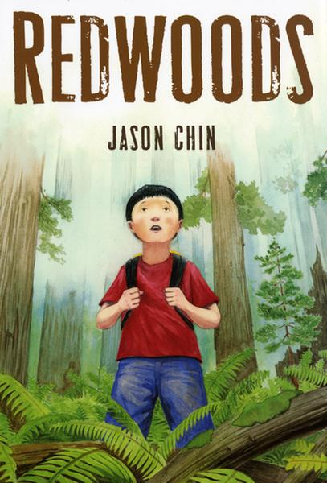
Redwoods
A subway trip is transformed when a young boy happens upon a book about redwood forests. As his eyes read through the pages filled with beautiful illustrations, his imagination travels through what these giant marvels of nature must have experienced and “seen” during their lifetime. Interesting and accurate information about these great natural wonders is given with wonderful illustrations.
By Jason Chin

Slide 12

Sassy Little Sister is NOT My Name!
It’s not easy being nine, especially when you were named for sticking out your tongue on the day you were born and you hate your nickname “Little Sister,” Imagine being the youngest in the family, watching your big brother and sister have all the fun. Sassy finds out though that even if you are the youngest and the smallest you can still do things that bigger people may not be able to do.
By Sharon M. Draper

Slide 13

Tsunami!
Ojiisan, the oldest and wealthiest man in the village, doesn’t join the others at the rice ceremony. Instead he watches from his balcony. He feels something is coming—something he can’t describe. When he sees the monster wave pulling away from the beach, he knows. Tsunami! But the villagers below can’t see the danger. Will Ojiisan risk everything he has to save them? Can he?
By Kimiko Kajikawa

Slide 14
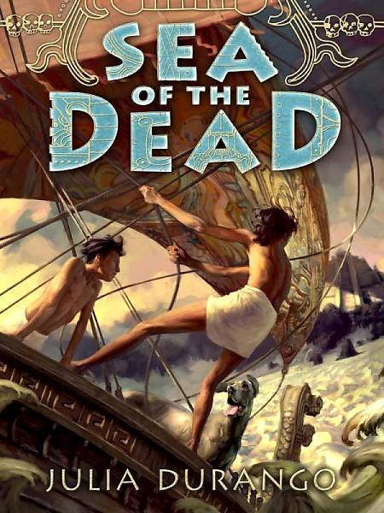
Sea of the Dead
As the fifth son of Prince Amatec, Kehl has known only a small world. He has been fully instructed in the warrior ways and in being obedient to the sun god Teshic, and he has learned that everything beyond the Lands of the Empire is barbaric wilderness or the Sea from which no one ever returns. Then, Kehl is kidnapped by the Fallen King. Finding himself on a ship in the Sea of Carillon, Kelh is forced to rethink the world as he knows it.
By Julia Durango

Slide 15
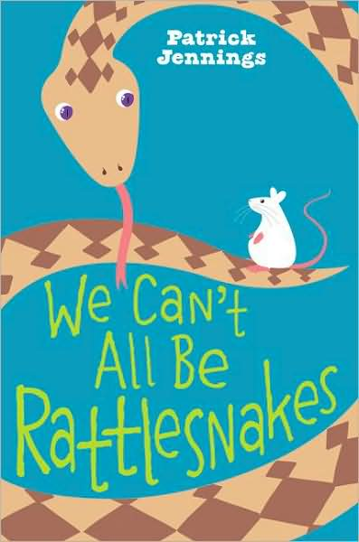
WE Can’t All Be Rattlesnakes
I am a snake. No, not a rattlesnake. I just look like one. I'm a gopher snake. One day an oily, filthy, fleshy human child crossed my path. As luck would have it, he knew the difference between a gopher snake and a rattlesnake. He has imprisoned me in a terrarium. His name is Gunnar. He calls me Crusher. Gunnar thinks I'll be his adoring pet. He's wrong. In fact, I am planning my escape.
By
Patrick Jennings

Slide 16

Wild Girl
Since her mother died long ago, Lidie has lived with relatives. Now she's 12—ready to leave Brazil to live with her father, Pai, and older brother, Rafael, in New York City. Pai runs a stable at a famous race track. Lidie finds that moving to another country is a big challenge. And Pai and Rafael still think of her as the little girl they left behind. But she's determined to befriend, and ride, the spirited filly her father has just bought: Wild Girl.
By Patricia Reilly Giff

