Slide 1


Imagery for the Nation Building a Successful and Effective Program
Minnesota Statewide Advisory Council

Slide 2
Two Programs
One meter, leaf-on (Improvements to existing NAIP Program)
One foot, leaf-off (newly proposed program)
Both programs have buy-up options

Slide 3
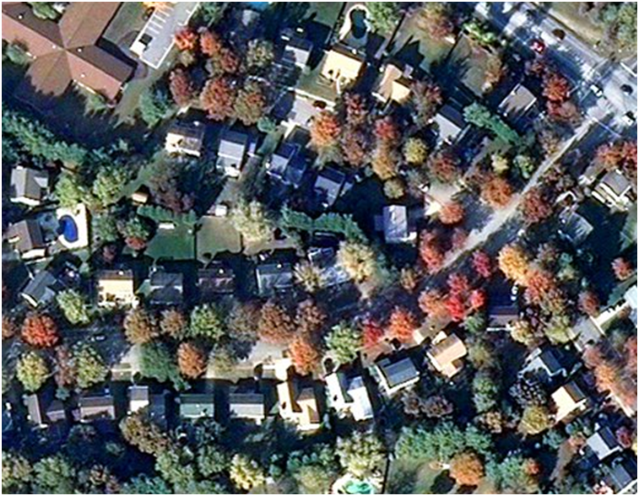
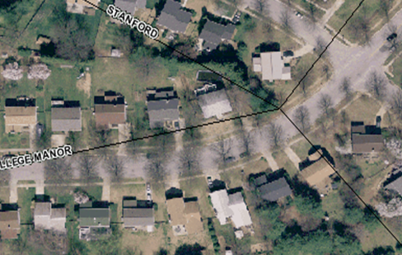
Leaf-Off vs. Leaf-On You can’t map what you can’t see
Detailed information on homes, roads, property boundaries and other features is not easily discernable in the leaf-on Imagery above. Leaf-on imagery is valuable for most agriculture and many natural resources applications. Leaf-off imagery (image below) is required for most mapping applications.

Slide 4
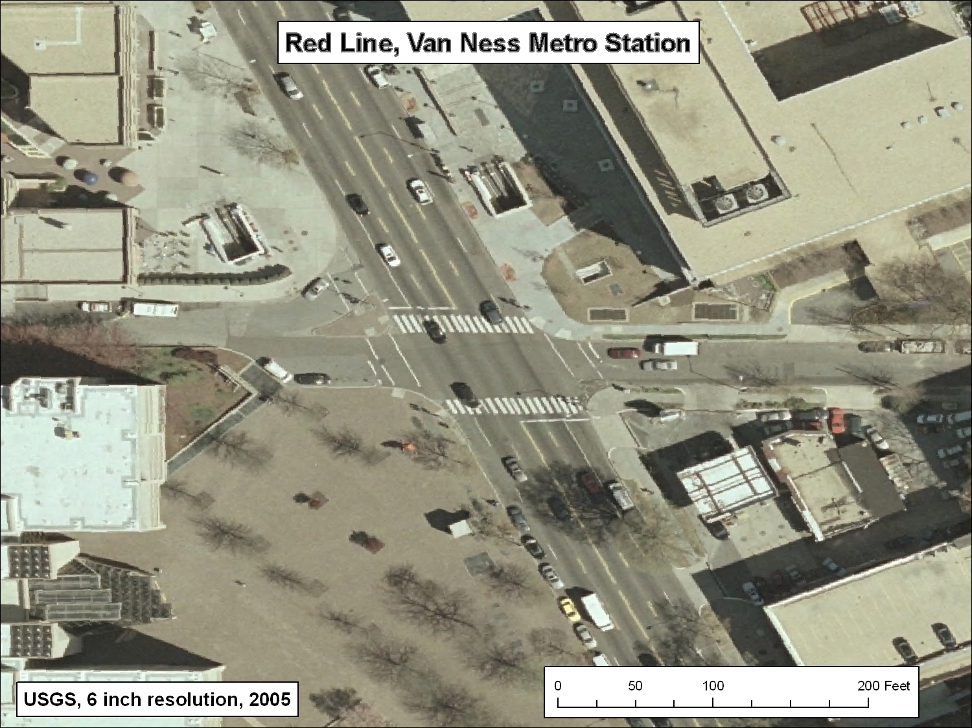
Requirement for Hi-Res Imagery
Local governments are responsible for a great deal of the nation’s infrastructure, and for providing direct citizen services, including emergency response
Mapping at large scales is a required for their business needs
METRO Entrances
METRO Air Vents
Manhole Covers
Light/Utility Poles

Slide 5
National Agriculture Imagery Program (NAIP)
1-meter, leaf-on, natural color imagery
General agreement that it meets most Federal, state and local needs for leaf-on imagery
Well-managed, highly effective program
Issue areas:
Wall-to-wall coverage vs. only agricultural lands (CLU)
Authorization/Appropriation – need “line item”
Need additional new funds to start an annual cycle
Does not address 1-meter need in Alaska (under current concept, DOI has responsibility for AK)

Slide 6
Hi-Resolution Imagery Program
1-foot, leaf-off, natural color imagery (proposed)
General agreement that a higher resolution (>1-meter) leaf-off program is required
Currently Federal/state/local coordination only occurs over some of the identified 133 cities
National Geospatial Intelligence Agency funds acquisitions and works through USGS to partner with state and local governments

Slide 7
Heart of the Program – Buy-ups
Users would pay partner with Feds and pay 100% of the cost for enhancements like the following:
1) CIR or 4-band digital product
2) Increased frequency
3) Increased footprint
4) Increased horizontal accuracy
5) Sampling the products to lower resolutions
6) Increased resolution
7) Better elevation data products
8) Removal of building lean (true ortho)

Slide 8
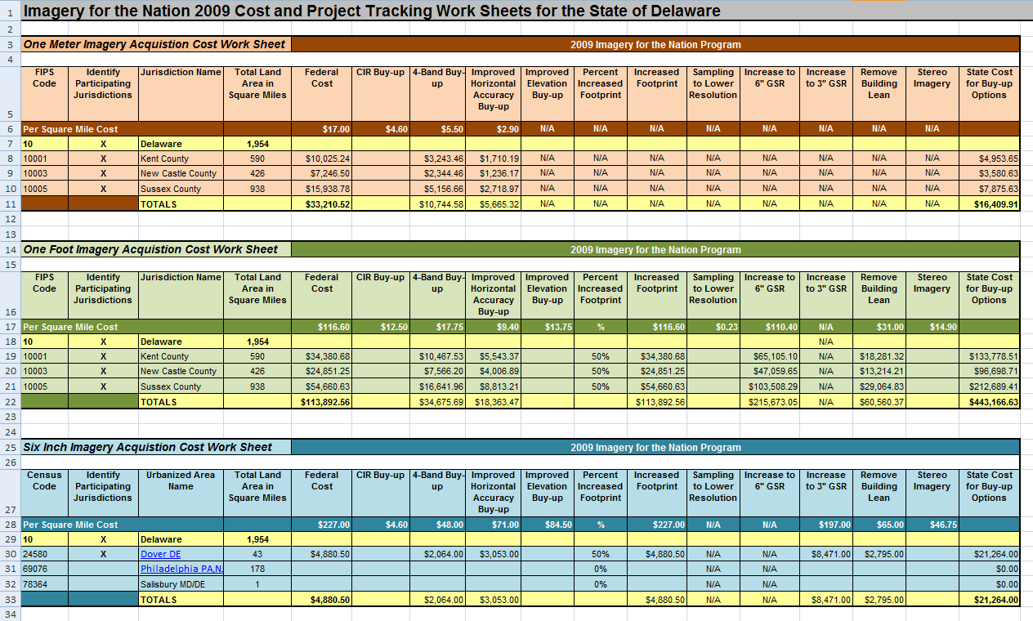
Cost Work Sheet (COST FIGURES ARE FOR ILLUSTRATION PURPOSES ONLY)
DRAFT

Slide 9
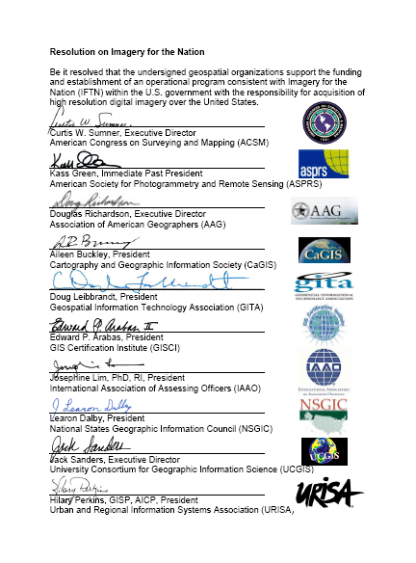
Who has Endorsed IFTN?
Proposal for Reinvigorating the American Economy through Investment in the U.S. National Spatial Data Infrastructure (NSDI)
Autodesk
Microsoft
ORACLE (separate endorsement letter)
Google
Intergraph
A Proposal for National Economic Recovery , An Investment in Geospatial Information Infrastructure, Building a National GIS
ESRI
Booz Allen Hamilton
National Geospatial Advisory Committee - with caveats
National Association of State CIOs - pending
National Emergency Numbers Association (NENA)
National Association of Counties (NACo)
Mid-America GIS Consortium
Association of American Geographers (AAG)
Association of State Wetland Managers (ASWM)
Western Governors Association (WGA)
Association of American State Geographers (AASG)
University Consortium for Geographic Information Science (UCGIS)
Urban/Regional Information Systems Association (URISA)
National States Geographic Information Council (NSGIC)
34 States (most of the remaining states are constrained or prohibited from showing support)

Slide 10
NSGIC’s Plans
NSGIC has asked the FGDC for a briefing on their activities
Considering moving forward with states to develop nationwide contracts through the Western States Contracting Alliance that all states could use (similar to GSA contracts)
Need to identify a state that would be willing to take the lead and adhere to the IFTN concepts

Slide 11

Thank You
We’ve talked and planned for 6 ½ years.
It’s time to move forward.

