Slide 1




Spring Leaf-Off Imagery for Minnesota
July 1, 2010

Slide 2
Agenda for Today’s Meeting
Introductions and Overview
Project Specifications
Acquisition Regions
Control Targets
Partnership Opportunities & Schedule

Slide 3
Steering Committee
Steve Kloiber – MnDNR
Primary funding partner; technical guidance
Chris Cialek – MnGeo
Project management, coordination, contracting
Pete Jenkins – MnDOT
Control target coordination; technical guidance

Slide 4
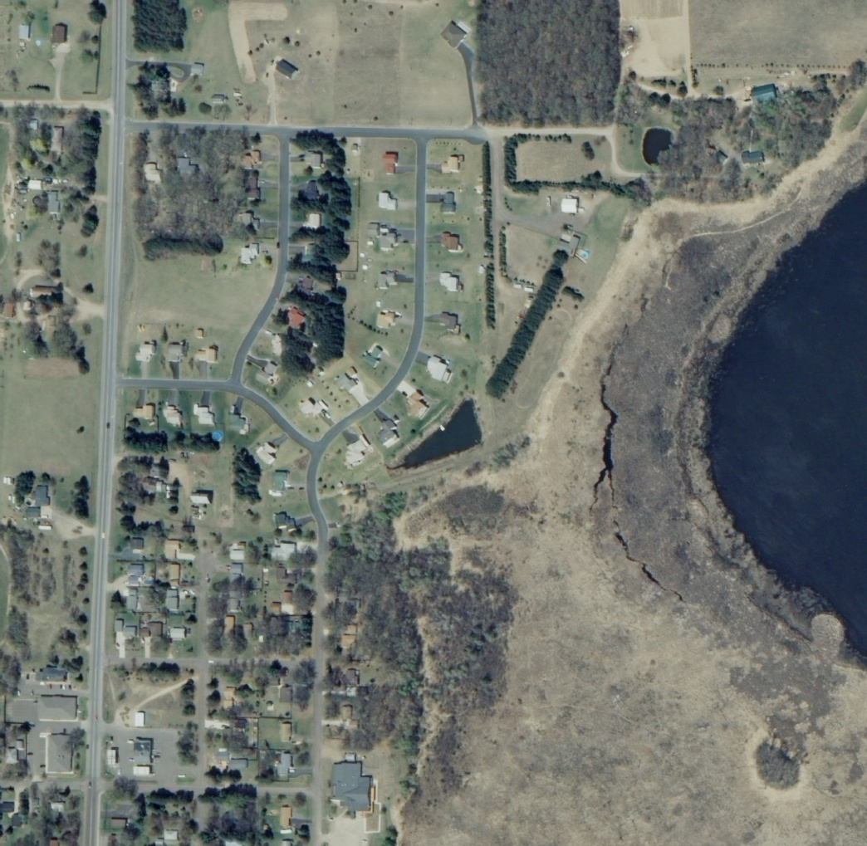
Overview
Statewide project to collect leaf-off color imagery over 5 years
Spurred on by DNR efforts to update wetlands mapping
0.5-meter (20-inch) nominal resolution
Offer local partnership options to buy-up at improved 1-foot res.

Slide 5
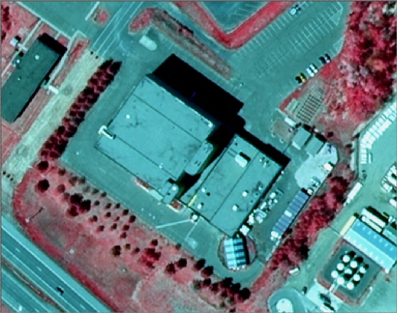
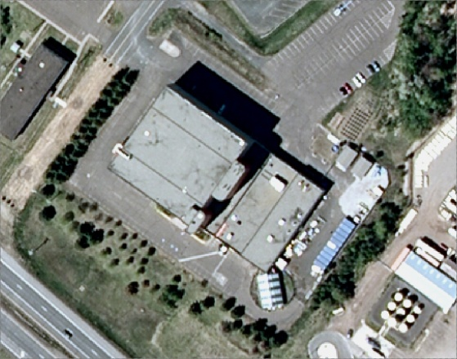
Project Specifications Four Spectral Bands
Near IR
Red
Color Infrared
Green
Blue
Natural Color

Slide 6
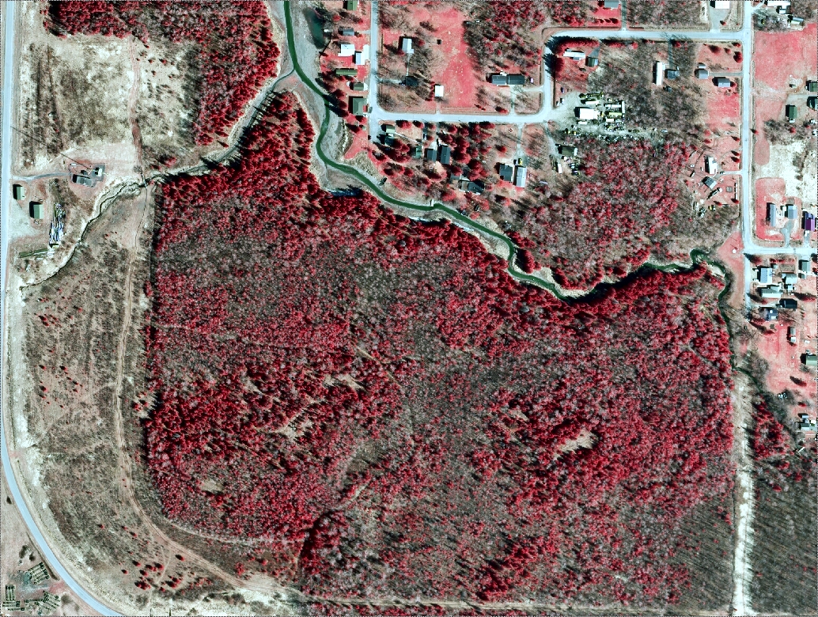
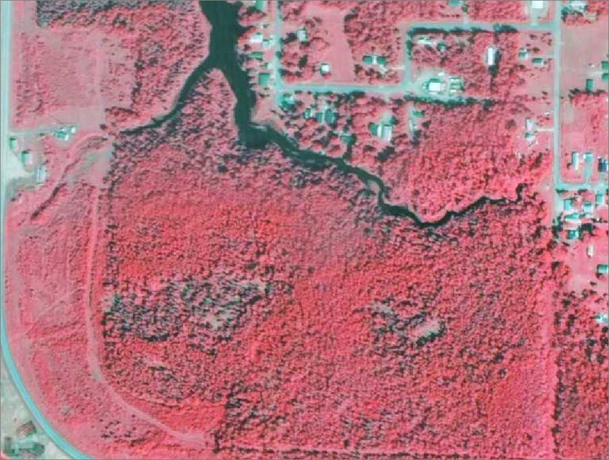
Project Specifications – Leaf-Off

Slide 7
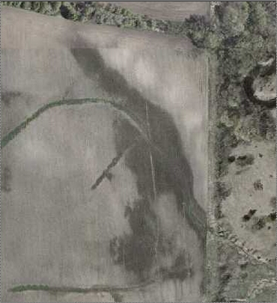
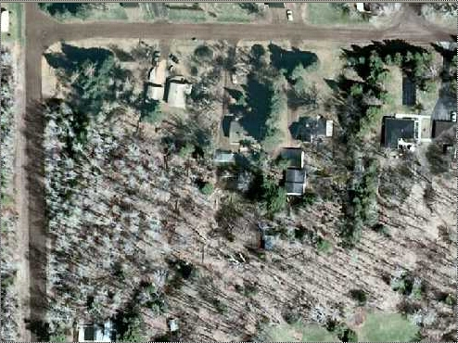
Project Specifications – Leaf-Off
Better view of the land beneath the tree canopy
Seasonally High Water Table

Slide 8

Project Specifications - Format
Digital ortho-rectified quarter quad
*.tif
Compressed county mosaic
*.jp2
Digital stereo pairs

Slide 9
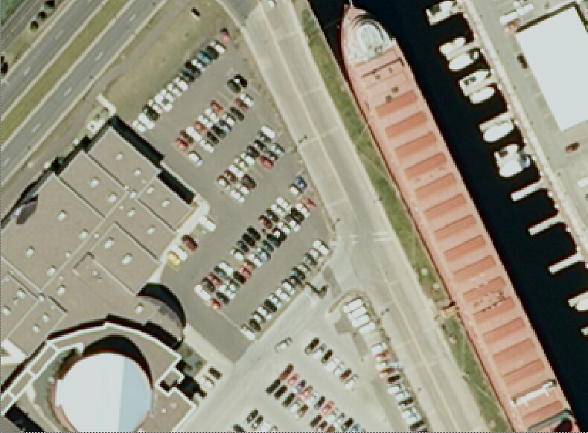
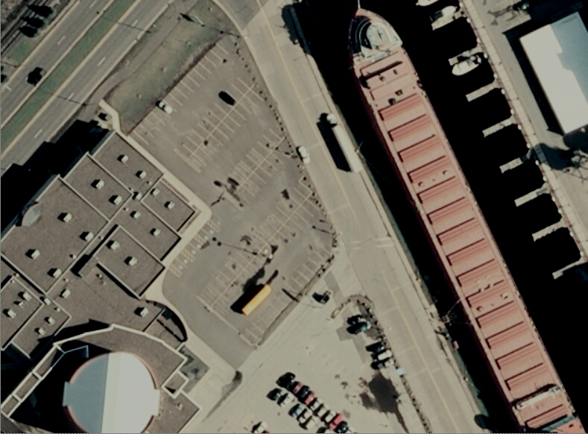
Project Specifications - Resolution
50-cm or 30cm

Slide 10
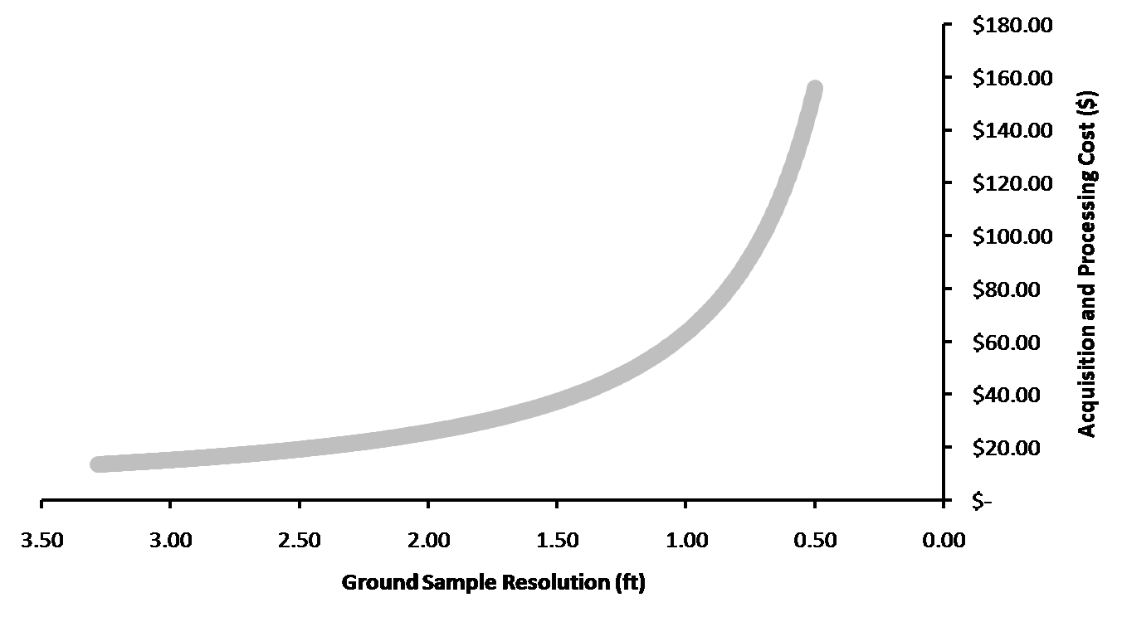
Why Not Six-Inch Resolution?
Tight time window
Large, complex project
Managing risk
Reduce the number of variables
Reduces flying time (limit the scope)
Cost vs. benefit consideration

Slide 11
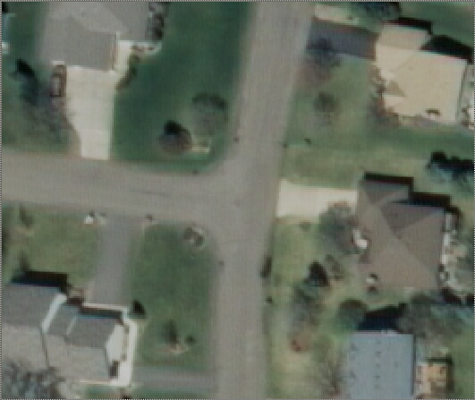
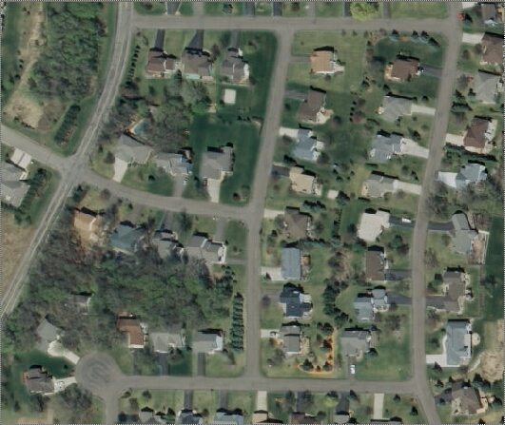
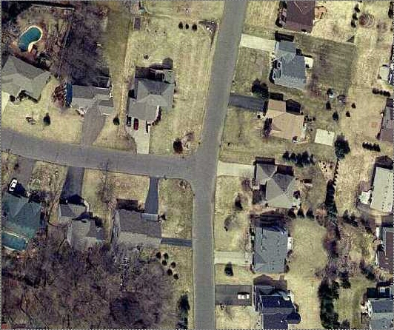
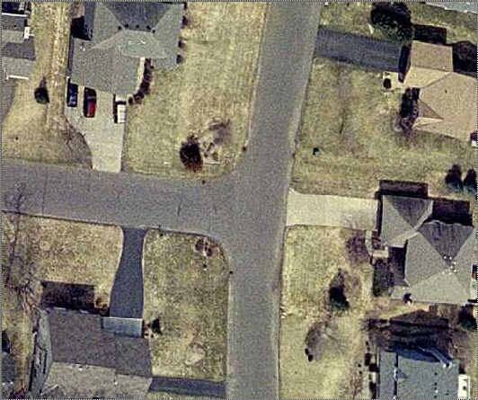
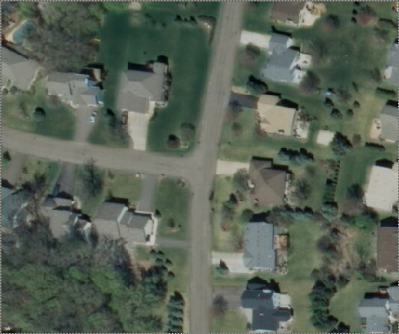
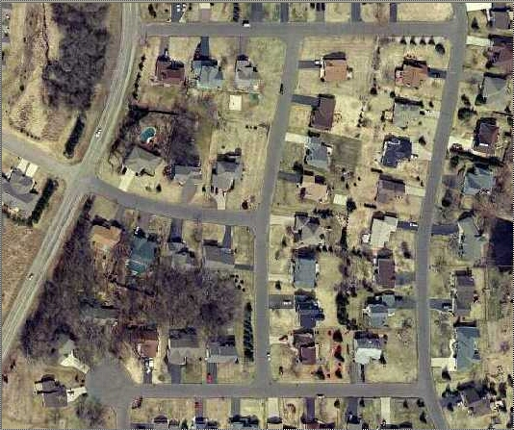
Resolution Comparison
1 inch = 200 feet (1:2400)
1 inch = 100 feet (1:1200)
1 inch = 50 feet (1:600)

Slide 12
Project Specifications – Positional Accuracy
Map Scale | Ground Sample Resolution | NMAS RMSE-c (ft) | NMAS Accuracy 95% (NSSDA) (ft) | ASPRS RMSE-c (ft) | ASPRS Accuracy 95% (NSSDA) (ft)
1:3,000 | 0.30 m / 0.98 ft | 5.49 | 9.50 | 3.54 | 6.12
1:5,000 | 0.50 m / 1.64 ft | 9.15 | 15.8 | 5.80 | 10. 0
1:10,000 | 1.00 m / 3.28 ft | 18.3 | 31.6 | 11.6 | 20.1
Tested 95% Accuracy
Northeast 2009 = ±11.5 ft

Slide 13
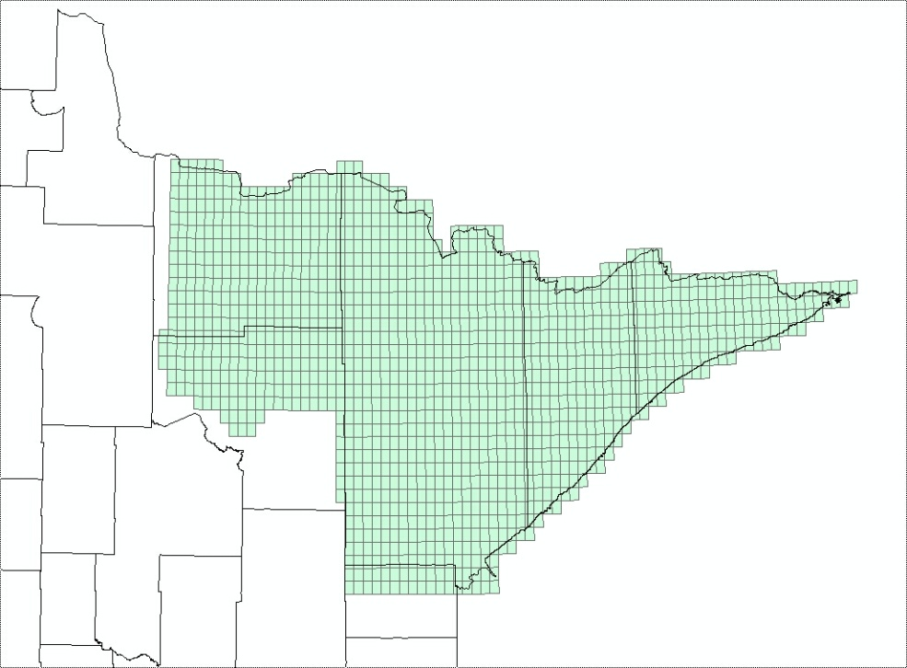
Northeast Acquisition - 2009
Funding Partners
DNR / ENTRF
MPCA
St. Louis County
USGS/NGA
10.5 Million Acres

Slide 14
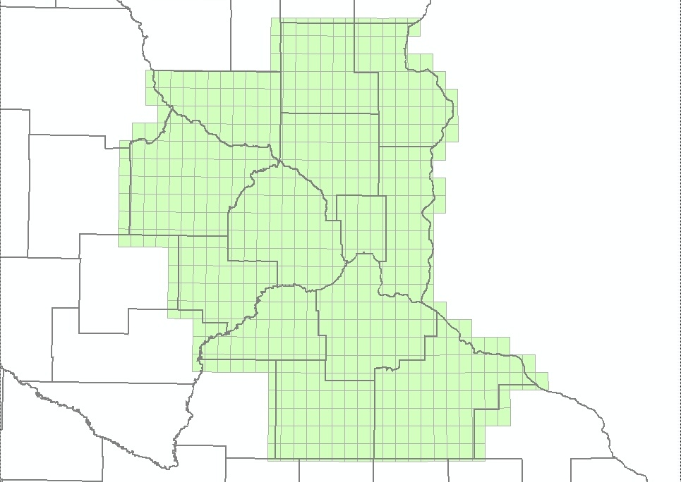
East-Central Acquisition - 2010
Funding Partners
DNR / ENTRF
Metropolitan Council
USGS/NGA
Scott County
Dakota County
MMCD
In-Kind Partners
MnGeo
MnDOT
4.5 Million Acres

Slide 15
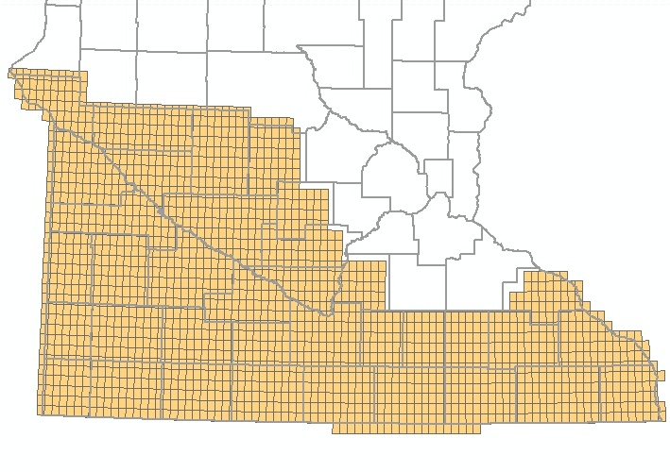
South Acquisition - 2011
Funding Partners
DNR / ENTRF
??
In-Kind Partners
MnGeo
MnDOT
??
4.5 Million Acres
15.3 Million Acres

Slide 16
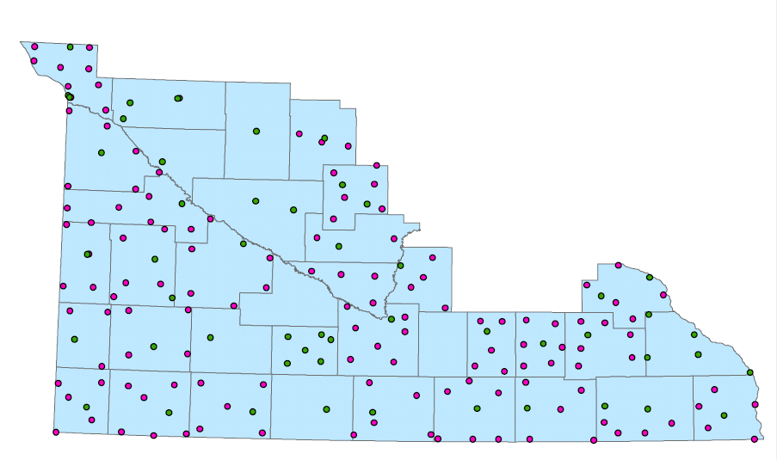
2008 FSA Target Inventory

Slide 17
2011 Target Requirements
Two ways to capture target data
Targets (2008)
Physical features

Slide 18
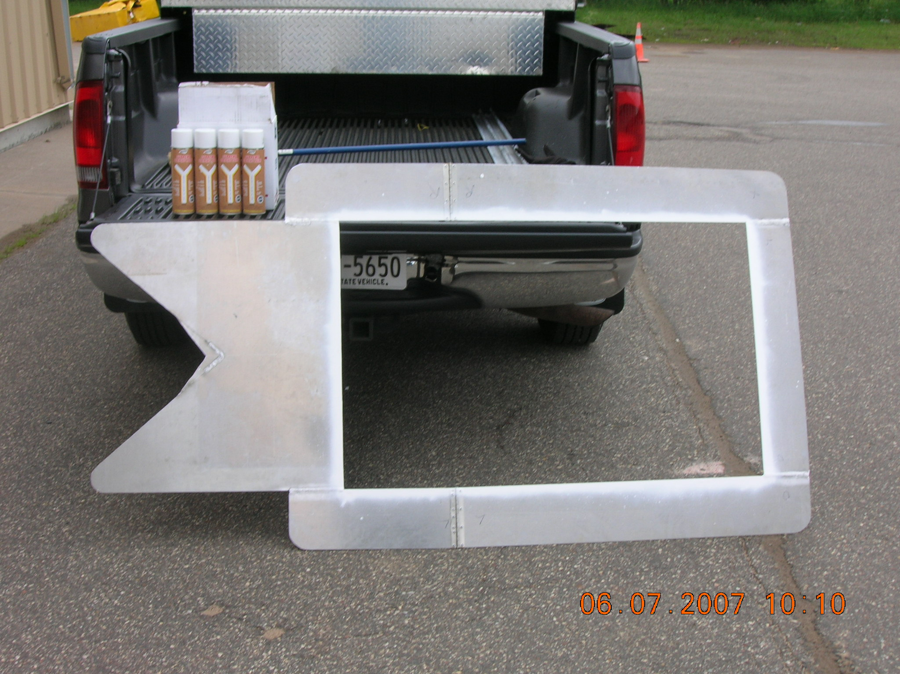
Single Leg Template

Slide 19
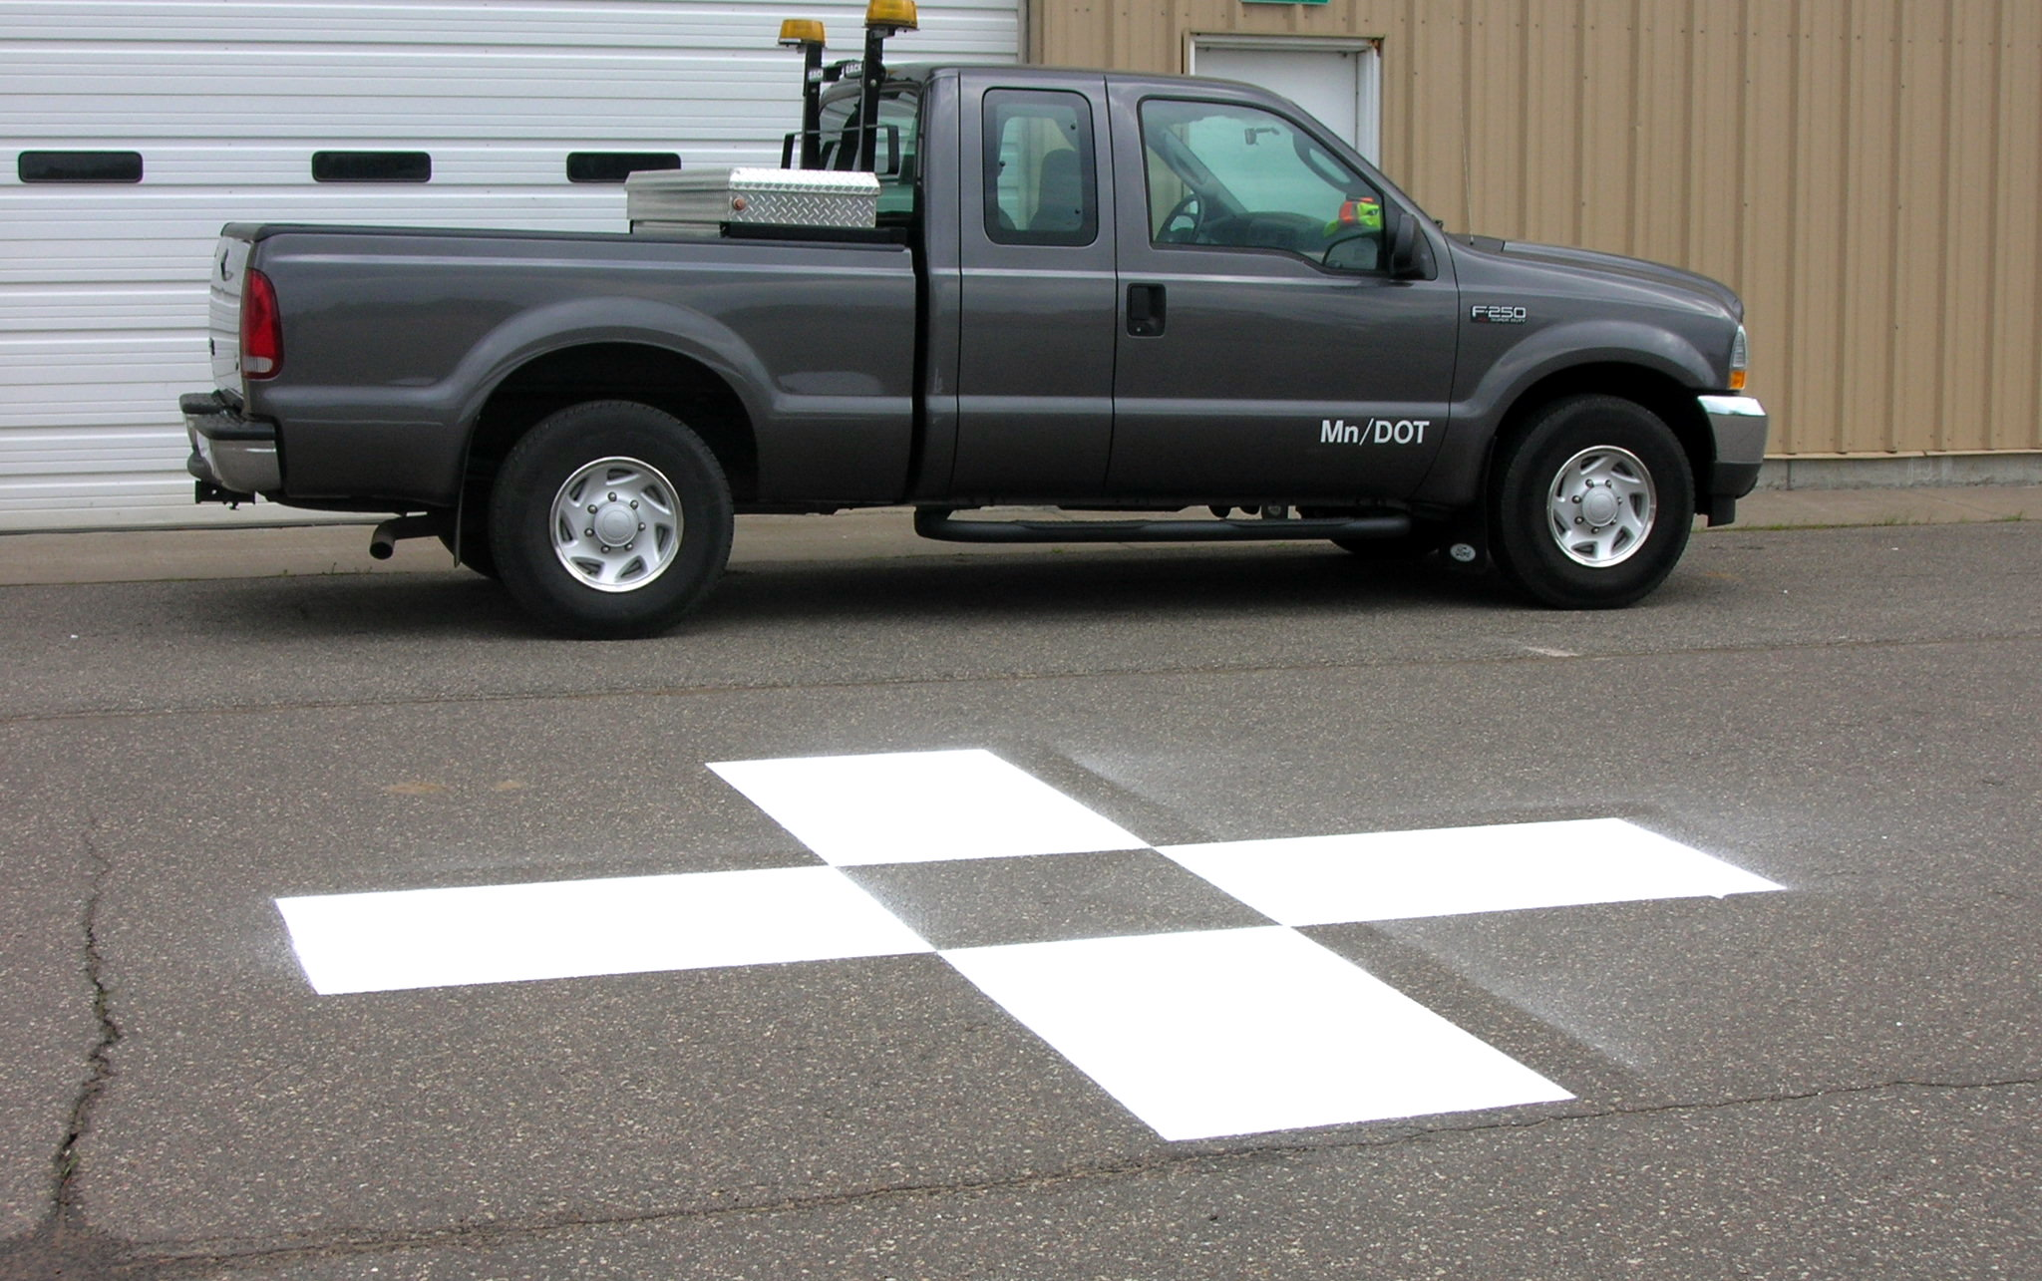
Completed Target

Slide 20
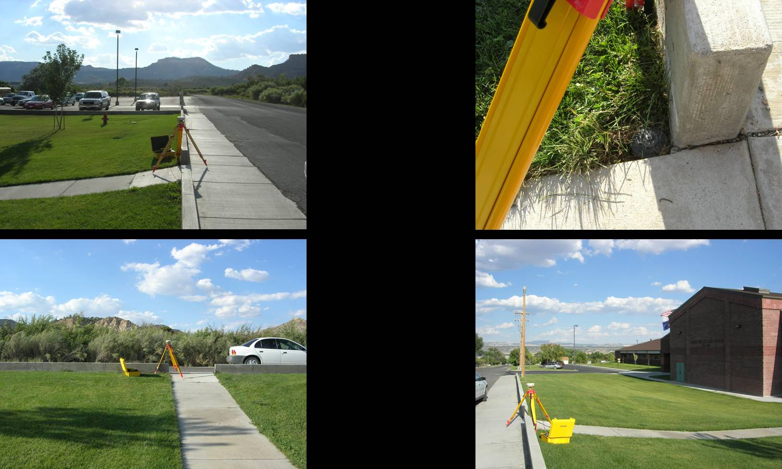
Physical Features

Slide 21
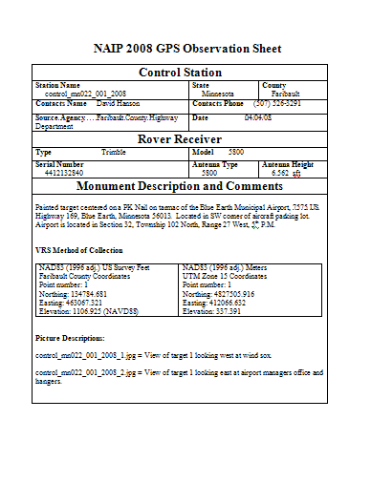
Documentation
2008 FSA Observation Sheet
Use the same form
Pictures are necessary
Will share data with FSA

Slide 22
What is Needed?
Existing targets need to be re-painted
New targets for counties with low numbers
Follow up with documentation

Slide 23
Partnership Opportunities
0.5-meter data provided at no cost
Option to buy-up to 1-foot
Cost estimate (based on previous recent experience) ~ $24/square mile
Assist in target placement or refreshing

Slide 24
Acquisition Schedule
November 2010
Partner agreements drafted
RFP released
December 2010
Vendor selection
Finalized partner agreements
January 2011
Finalize contract
March 2011
Set / refresh targets
April/May 2011
Acquire imagery
September 2011
Data delivery
October 2011
Final QA/QC review

Slide 25
Spring Leaf-Off Imagery for Minnesota
THANK YOU FOR ATTENDING
Q & A
steve.kloiber@state.mn.us
651.259.5164
chris.cialek@state.mn.us
651.201.2481
peter.jenkins@state.mn.us
651.366.3457

