Slide 1
Collaborative Projects Update
Chris Cialek; MnGeo
chris.cialek@state.mn.us
651.201.2481

Slide 2

Projects
STATEWIDE high-resolution elevation data COLLABORATIVE
2010 AERIAL PHOTOGRAPHY COLLABORATIVE
Notes:
Chris Cialek
MnGeo
MN Department of Administration
651.201.2481
chris.cialek@state.mn.us

Slide 3
Statewide Elevation Collaborative
Goal:
Fulfill GCGI Digital Elevation Committee’s vision of statewide high-resolution elevation data for the state (High Res = capable of 2-foot contours)
Technology
Light Detection and Ranging (LiDAR)
Notes:
LiDAR like RADAR (radio detection and ranging)
Laser rangefinder
Reflected by rotating mirror
Laser is scanned around the area being digitized
Gathering distance measurements
At specified angle intervals

Slide 4
Statewide Elevation Collaborative
Goal:
Fulfill GCGI Digital Elevation Committee’s vision of statewide high-resolution elevation data for the state (High Res = capable of 2-foot contours)
Technology
Light Detection and Ranging (LiDAR)
Notes:
LiDAR like RADAR (radio detection and ranging)
Laser rangefinder
Reflected by rotating mirror
Laser is scanned around the area being digitized
Gathering distance measurements
At specified angle intervals

Slide 5
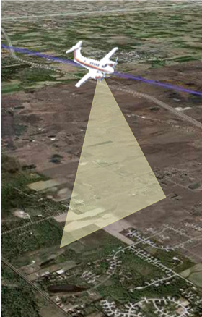
Airborne LiDAR
Laser rangefinder
~75,000 pulses/second
Inertial measuring unit
Motion sensors
Rotation sensors
GPS
On-board computer
Notes:
Inertial measuring unit: a navigation aid that uses, a computer,
motion detector s– Accelerometer
rotation detector s- gyroscope
To continuously calculate the position, orientation and velocity of a moving object without the need for external references.
Initialized using Global Positioning System

Slide 6
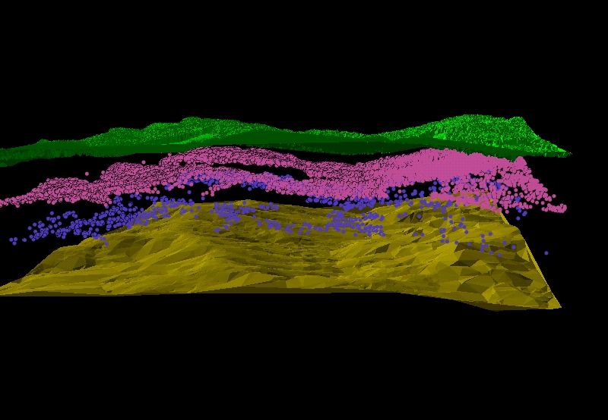
Multiple Returns in 3-D

Slide 7
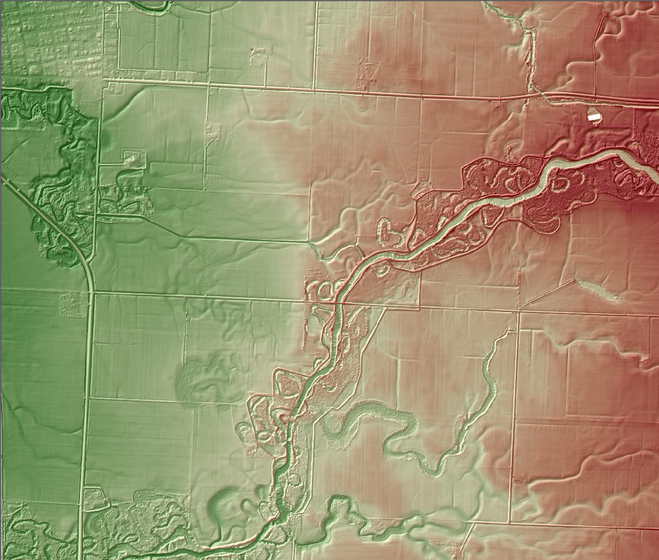
Notes:
First return. Note the detail of this map. The main channel is the Wild Rice River and the city of Ada (Norman County) is in the upper left with the Marsh River
The channel connecting the Wild Rice and the Marsh river was built in the 1800’s for the transportation of timber to the town of Ada.

Slide 8
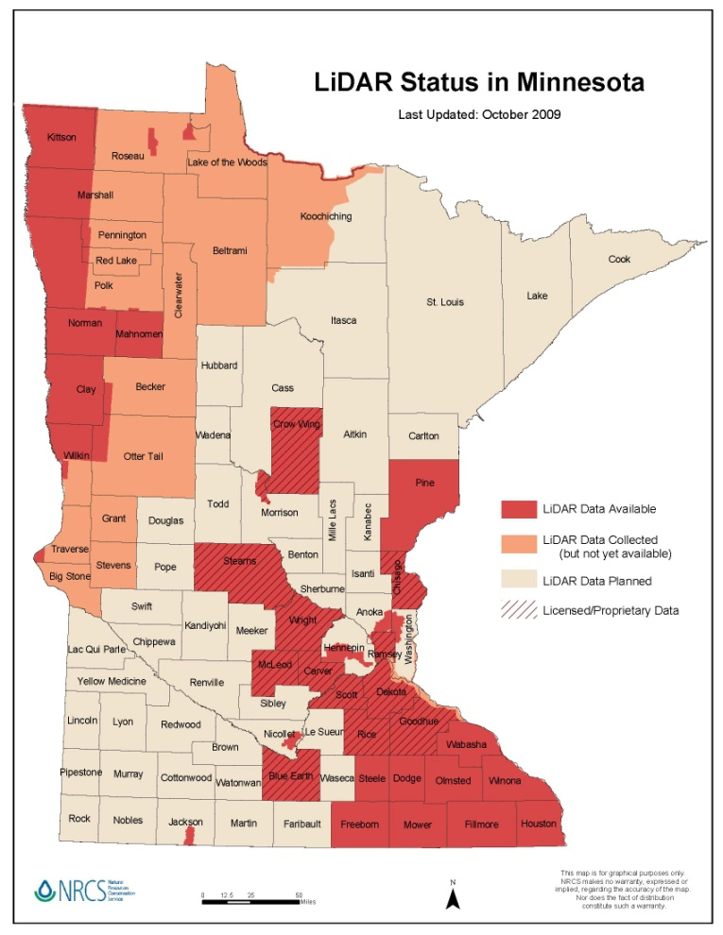
Statewide Elevation Collaborative
Project Areas:
2006 FEMA Grant
2010 Red River Basin Mapping Initiative
2007 Southeast MN Flood Response
12 Counties contracted
Notes:
2006 FEMA Project: $580,000
DNR
Clay County
Mn/DOT
Norman County
White Earth Reservation
Wild Rice Watershed District
Red River Basin Mapping Initiative
Managed by the International Water Institute; NDSU $5.0 million
USGS, ACOE, NRCS
ND Red River Joint Water Resources Bd
MN Red River Watershed Management Bd
MN Buffalo-Red WSD
State of North Dakota
State of Minnesota
MN DOT
Cities of Fargo, Moorhead, Breckenridge, Wahpeton, East Grand Forks, Grand Forks
Begun: spring 2008; Anticipated completion: summer 2010
2007 Flood Response $822,000
$ 625K State Emergency Funds (DNR, DOT)
$ 75K – USGS Grant
$122K – Mower and Freeborn Cos.
County Governments: Surveyors & GIS technicians
12 counties have contracted for their own elevation data

Slide 9
Statewide Elevation Collaborative
Developments:
Last session, Legislature allocated $5.6-million to DNR to continue data collection over 2010 – 2012
Source: 2008 MN Clean Water, Land and Legacy Amendment
2.5% to MnGeo for data coordination and distribution
Steering committee formed to oversee contracting:
Tim Loesch, DNR
Pete Jenkins, MnDOT
Ron Wencl, USGS
Chris Cialek, MnGeo
Data collection to begin in Spring 2010
Notes:
2.5% = $70,000/year

Slide 10
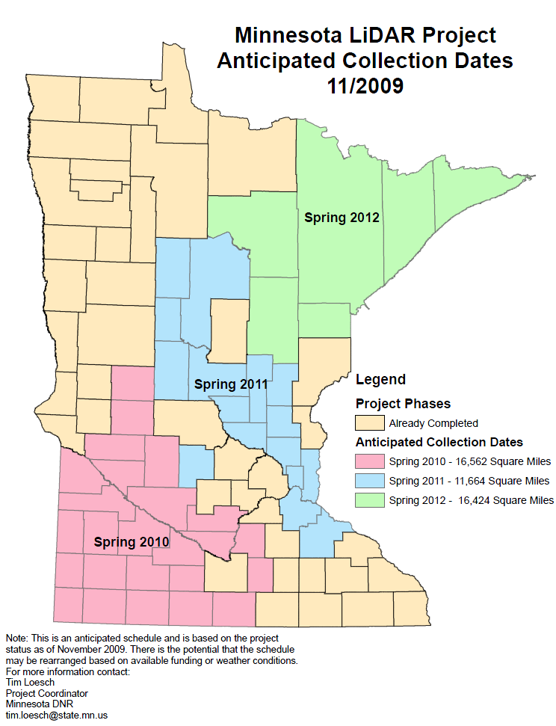
Notes:
Additional funding options for NE:
USGS: LiDAR Partnership Funds
EPA: Great Lakes Restoration Initiative

Slide 11
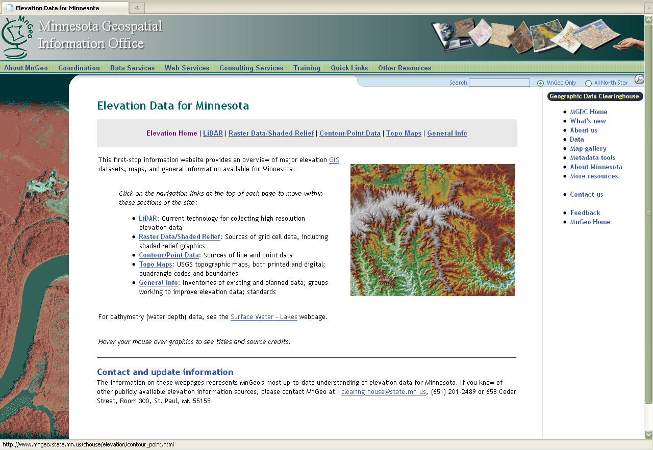
www.mngeo.state.mn.us/chouse/elevation
Notes:
First Stop Web Pages

Slide 12
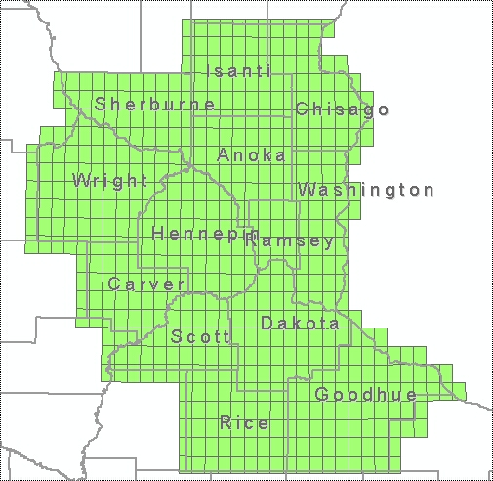
2010 Orthoimagery Collaborative
Goal:
Provide new high resolution aerial photography for the Metro Region
Project Area:
13-counties; 7,000 sq mi
Partners:
Metropolitan Council, DNR, MnGeo, Metropolitan Mosquito Control District, USGS (NGA)
Notes:
NGA: National Geospatial -Intelligence Agency
For 134 Cities Program

Slide 13
2010 Orthoimagery Collaborative
Specifications:
4-band color; leaf-off
0.5 meter resolution
Stereo imagery
Option for 1-foot resolution in 7-county metro
Vendors encouraged to offer 6-inch resolution pricing for selected counties
Status:
RFP closes January 11, 2010
Award expected by end of January
Flights take place spring 2010
Data delivered late summer
Notes:
6-inch counties:
Carver
Dakota
Ramsey
Rice
Scott
Wright
Conclude:
In future, We would like to develop :
more comprehensive agreements with even more options and partners
A program of standard products provided on a regular cycle

