Slide 1

MnGeo Statewide Geospatial Advisory Council
Hot Topics
November 28, 2012
Location Privacy

Slide 2
Four Ideas
“Geographer” Paradigm Shifts - Two
We Want to Be Tracked vs. We Don’t Want to be Tracked
The Big Fat Legal Mess
Takeaways

Slide 3

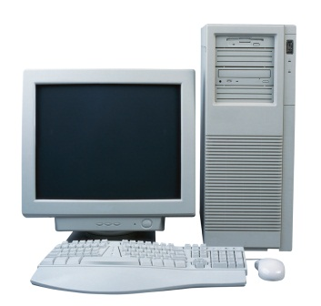
“Geographer” Paradigm Shifts
+
=
GIS
50 years of
A Better Understanding of “Where”

Slide 4
+

Slide 5
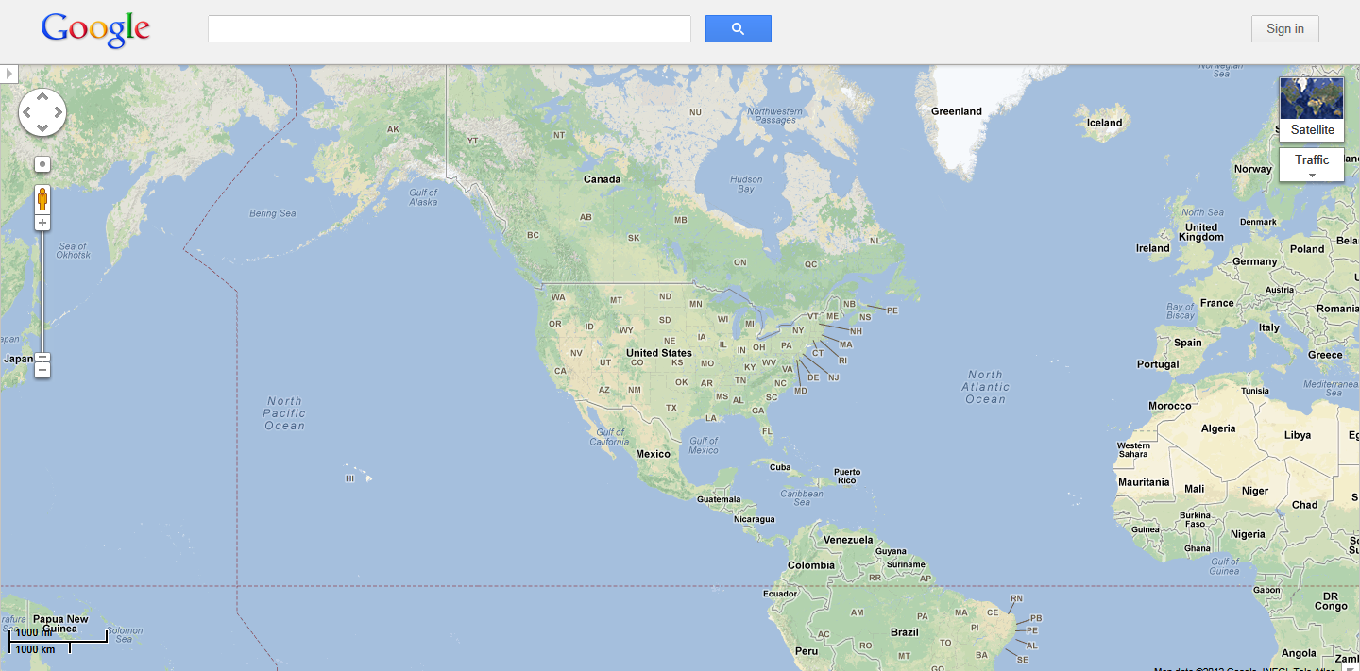
GIS for the Masses
2005!

Slide 6
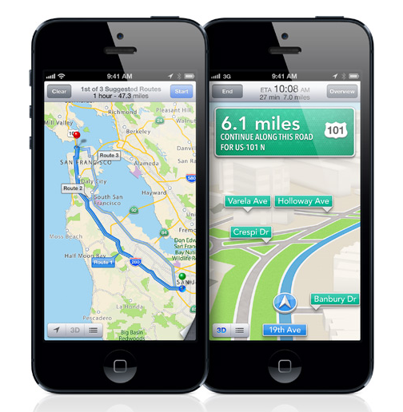
SmartPhone Mapping and Tracking

Slide 7
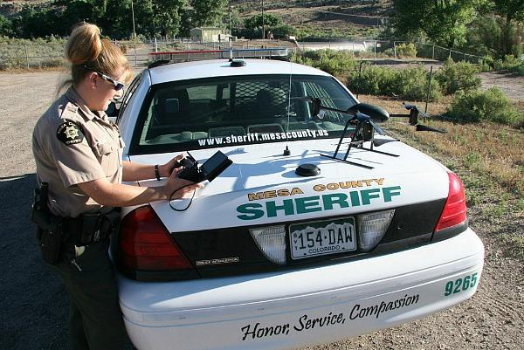
Drones
Credit: csmonitor.com, July 2012

Slide 8
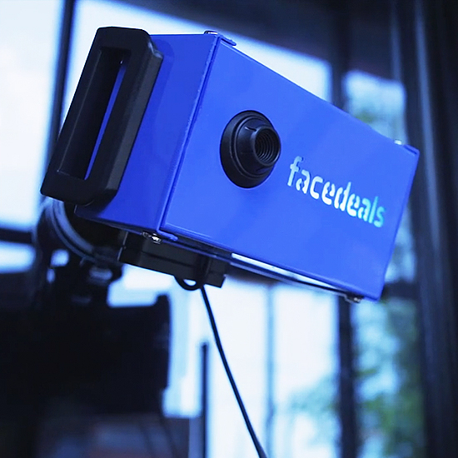
Facebook Based Recognition
Credit: redpepperland.com, August 13, 2012

Slide 9
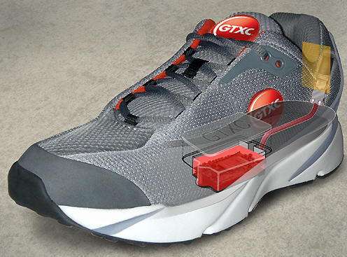
GPS Tracking Devices
Credit: gpsshoe.com, October 16, 2012

Slide 10
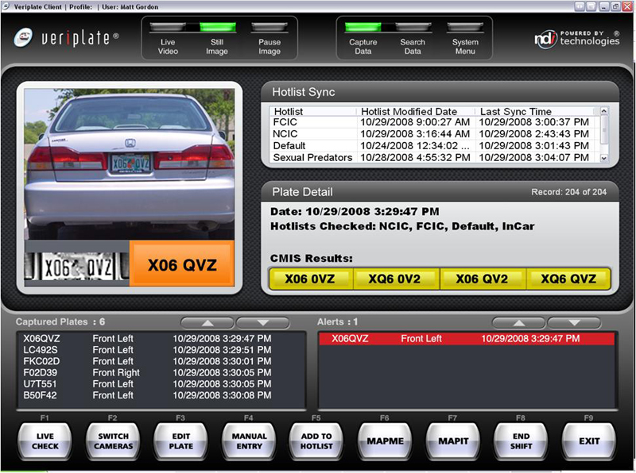
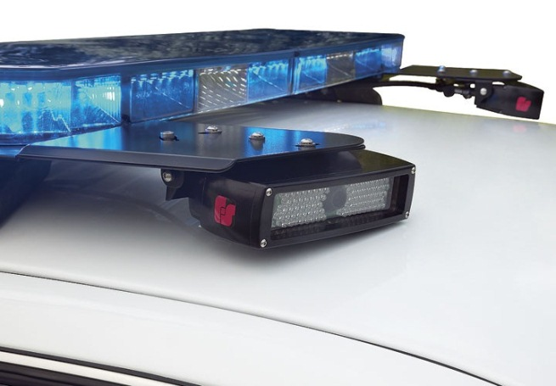
Automated License Plate Recognition (ALPR)
Credit: PIPS Technology, November 8, 2012; NDI Recognition Systems

Slide 11
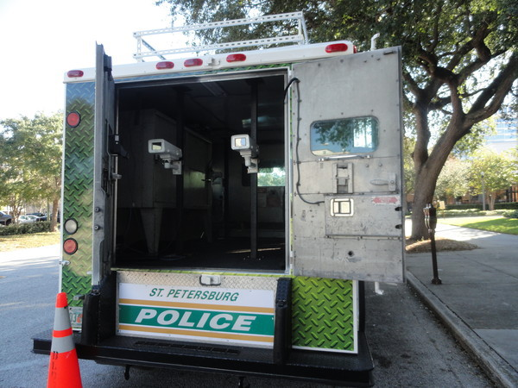
Mobile Surveillance Platforms
Credit: wmnf.org, November 8, 2012

Slide 12

Hand Scanners
Credit: Jack Gruber, USA TODAY, November 25, 2012

Slide 13

RFID School ID’s
Credit: silver tiger via Shutterstock/Salon, November 27, 2012

Slide 14
“Geographer” Paradigm Shifts
7 Years of the “Geospatial Revolution”
(A better understanding of “Where” you are!)
Or
The Big Fat Legal Mess
=

Slide 15
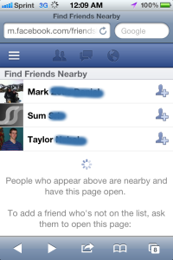
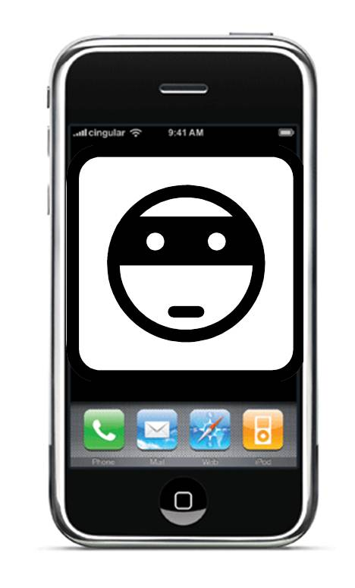

We Want to Be Tracked
vs.
We Don’t Want to be Tracked
‘Find Friends Nearby’ Find My Stolen iPhone We Don’t Want No
Stinking Drones

Slide 16
Legislation
June 14, 2011 - S. 1212/H.R.2168, “Bipartisan Legislation Provides Needed Legal Clarity for Use of Geolocation Information”. Senator Ron Wyden, Oregon; Representative Jason Chaffetz, Utah. Consumer must give consent before tracking.
June 15, 2011 – S. 1223, “The Location Privacy Protection Act of 2011”. Senator Franken, Minnesota. Consumer must give consent before tracking.
June 7, 2012 - S. 3287/H.R. 5925, “Preserving Freedom From Unwarranted Surveillance Act of 2012” Senator Rand Paul, Kentucky, Representative Austin Scott, Georgia. Obtain a warrant before a drone can be used for surveillance activities.
June 29, 2012 - Amendment to H.R. 5972, the Transportation, Housing and Urban Development and Related Agencies Appropriations Act of 2013. Prohibit government of GPS tracking of passenger or commercial vehicles.
October 12, 2012 - GAO Report - Mobile Device Location Data: Additional Federal Actions Could Help Protect Consumer Privacy.

Slide 17
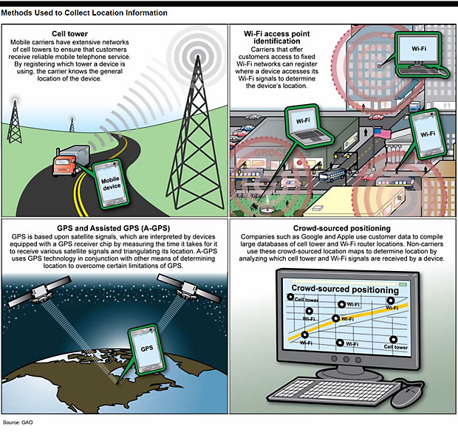
Tracking Technology Examples

Slide 18
Legal Cases
September 10, 2008: U.S. District Court of Western Pennsylvania. Police need a warrant before obtaining a history of location information about a suspect from a cell phone provider.
January 23, 2012: U.S. Supreme Court. U.S. vs. Jones. Police must obtain a warrant before attaching a GPS to a suspect's car.
February 29, 2012: U.S. Court of Appeals for the 7th Circuit. U.S. vs. Abel Flores-Lopez. OK for a police officer to search a suspect's cell phone in the process of making an arrest.
August 14, 2012: United States Court of Appeals for the Sixth Circuit. U.S. vs. Melvin Skinner. Cell phone tower location information of a drug smuggler was admissible in court.
September 4, 2012: U.S. District Court for the District of Columbia. U.S. Vs. Jones. Again…….

Slide 19
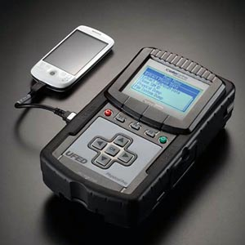
Cell Phone Location Download

Slide 20
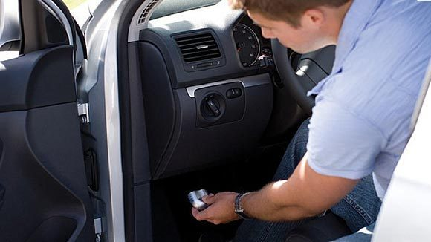
Consumer Deals – No Location Tracking Yet……
Credit: Chicago Tribune: November 12, 2012

Slide 21
Take Aways
A second “Geographer” Paradigm Shift is underway
The technology is miles ahead of the law and accelerating
Attention is going to be needed to straighten this thing out
The “Experts” are in this community
Questions?

