Slide 1


Governance Framework
State is developing a governance framework for IT
The framework will specify how decisions are made for State government
The framework will encompass GIS
A newly created Geospatial Technology Steering Committee will have decision making roles for State IT
State CGIO will lead the GTSC
Advisory Councils will retain important advisory role about State IT/GIS
Governance framework is a work in progress

Slide 2


Attribute | Attribute Description
Purpose: | Advises the State about improving state government services through the coordinated, affordable, reliable, and effective use of geospatial technology. Develops, vets, and assists with the promulgation of IT architectural policies and standards as they apply to geospatial technology and guides planning and development of shared GIS solutions
Chair: | Chief Geospatial Information Officer |  | Co Chair: |  | Agency CIO or GIS Coordinator
Governance Category: | Vision | Planning |  | Technology Operations Alignment
Decision Authority: | Responsible | Accountable |  | Consulted |  | Informed
Decisions: | Decisions about policies and standards concerning investments in geospatial technology and their alignment with state IT policies and enterprise business objectives.
Membership: | Eleven members, including representatives from agencies with active GIS programs, CIOs, and other committees within the IT governance framework. Chief Geospatial Officer Two agency CIOs Three agency GIS Coordinators Representative from IT/Business Alignment Committee Representative from IT Architecture Committee Representative from IT Security Committee Representative from Project/Program Portfolio Committee OET Finance Director Membership for State Government and Statewide Geospatial Advisory Councils are specified in legislation. Standing subcommittees and workgroups include the following: Standards Elevation Data Digital Cadastral Parcel Data Elevation Data Hydrographic Data Emergency Preparedness Outreach Enterprise Licensing
Meetings | Monthly

Slide 3
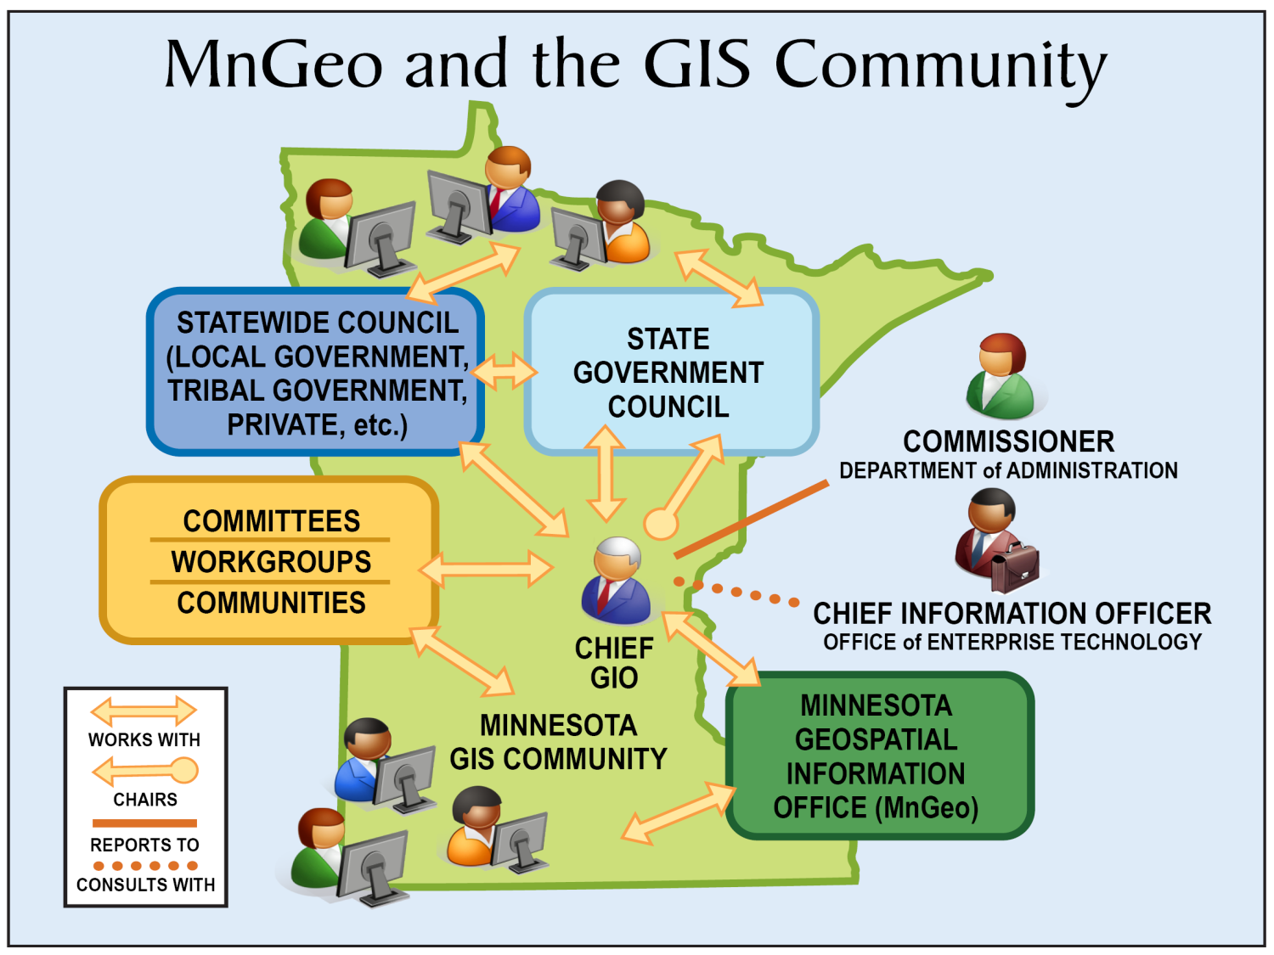
Virtual MnGeo
CHIEF INFORMATION OFFICER OFFICE of ENTERPRISE TECHNOLOGY
COMMISSIONER DEPARTMENT of ADMINISTRATION

Slide 4
GIS Governance: Process Outline
Any
Proposal or
Geospatial
Develop
,
Draft for
Organization or
Review and
Source
Action
Subject Expert
Revise
/
or
Stakeholder
Work Group or
Review and
Committee
Input
External
Impacted
Review and
Stakeholders
Governance
Revise
Committees
Recommend
ation
-
Comments
&
Changes
Comments
&
Changes
State
Statewide
Government
Geospatial
Geospatial
Advisory
Advisory
Council
Council
Recommend
-
Recommend
ation
ation
-
Geospatial
Technology
Decision
CIO
Steering
Committee

