Slide 1
Corps Reservoirs
Brian Johnson and
Elizabeth Nelsen
Hydraulic Engineers
04 Oct, 2012

Slide 2
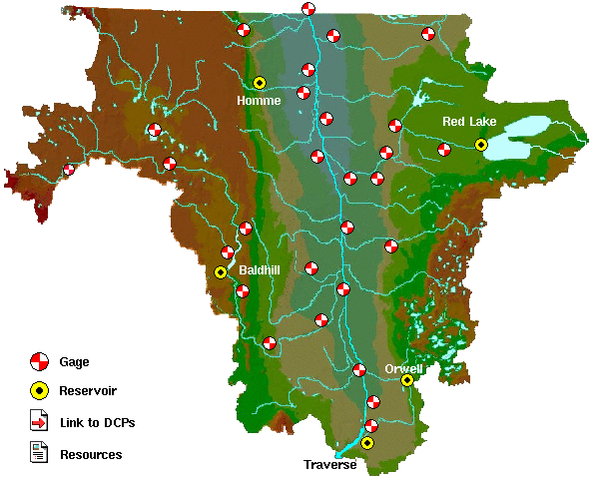
Red River of the North
Orwell and Baldhill are at conservation and outflow = inflow.
Red Lake, Traverse and Homme are below band.
East Grand Forks, MN
 | Current | Minimum | Current Pool | Conservation
Site | Outflow | Outflow | Elevation | Elevation | Δ
Traverse | 0 | 0 | 976.3 | 976.8 | 0.3-0.5
 | Closed since mid-July |  |  | +/- 0.2 feet
Orwell | 110 | 80 | 964.0 | 964.0 | 0
 | Expect to go to min in next week or two. |  |  | +/- 0.5 feet
Baldhill | 440 | 13 | 1265.9 | 1266.0 | 0
 |  |  |  | +/- 0.2 feet
Homme | 0 | 0 | 1079.3 | 1079.8 | 0.5
Red Lake | 35 | 35 | 1172.9 | 1173.5
Moorhead, MN
City
Breckenridge, MN
No needed.

Slide 3
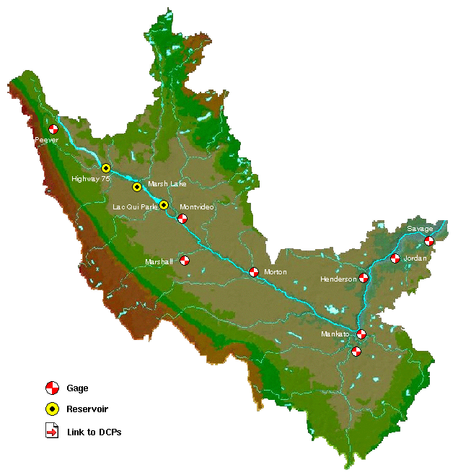
Minnesota River
All reservoirs are below band.
Expect LQP to reach bottom of band in two weeks. Current inflow is around 75 cfs.
 | Current | Minimum | Current Pool | Conservation
Site | Outflow | Outflow | Elevation | Elevation | Δ
Highway 75 | 16 | 2 | 947.1 | 948.0 | 0.7-0.9
 |  |  |  | +/- 0.2 feet
LQP | 20 | 20 | 933.6 | 934.0 | 0.2-.04
 |  |  |  | +/- 0.2 feet

Slide 4
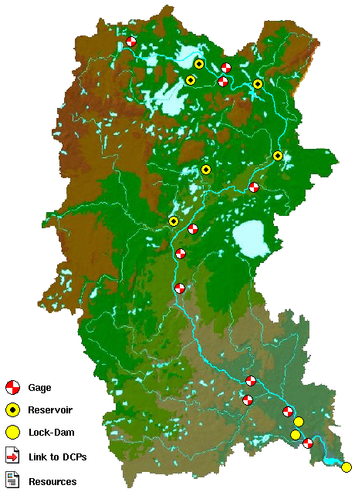
Headwaters of the Mississippi
Bemidji, MN
Winnibigoshish
Leech
Pokegama
 | Current | Reservior | Federal | Running | Min | Lower | Trigger
Site | Outflow | Elevation | Ave Min | Average | Outflow | Outflow | Res Elev
Gull | 20 | 1193.85 | 30 | 66 | 20 | 10 | 1192.75
Cross | 33 | 1229.15 | 90 | 178 | 30 | 15 | 1225.32
Sandy | 23 | 1215.94 | 80 | 66 | 20 | 10 | 1214.31
Pokeg | 395 | 1273.06 | 200 | 658 | 200 | W+L | 1273.17
Leech | 120 | 1294.23 | 70 | 134 | 120 | 60 | 1292.7
Winni | 100 | 1297.64 | 150 | 417 | 100 | 50 | 1294.94
Sandy
Cross/Pine
Aitkin, MN
Gull
Brainerd, MN
City
SAF
Lock 1
No needed.
Lock 2
St. Paul, MN

