Slide 1
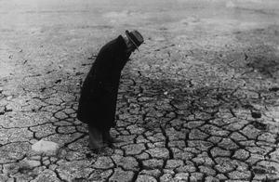

Drought in Minnesota
Greg Spoden
State Climatology Office
Minnesota DNR
Division of Ecological and Water Resources
October 4, 2012

Slide 2
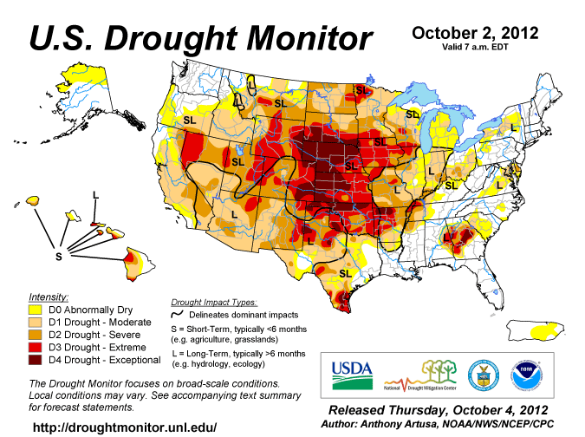

Slide 3
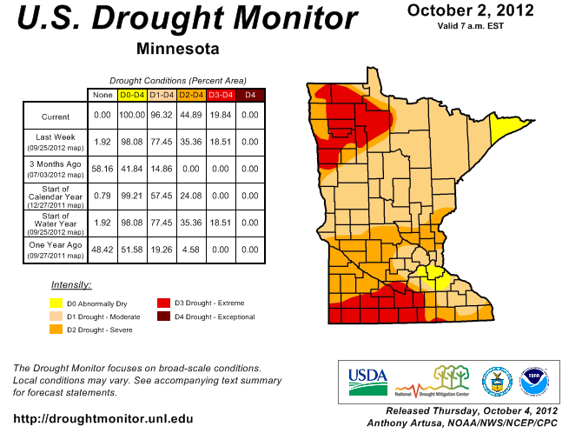

Slide 4
Drought Situation #1 - Autumn 2011 to present
northwest Minnesota and far southeast Minnesota
extraordinarily dry autumn 2011
snow-sparse winter
heavy April and May rains missed these areas

Slide 5
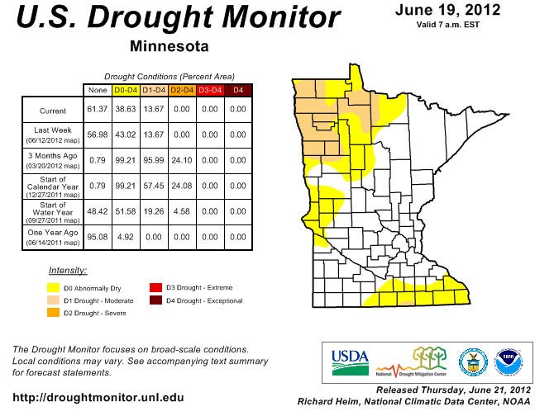

Slide 6
Drought Situation # 2 – late June and July
focus on southern Minnesota
dryness continues northwest Minnesota
very hot July (second warmest ever)
“flash drought”

Slide 7
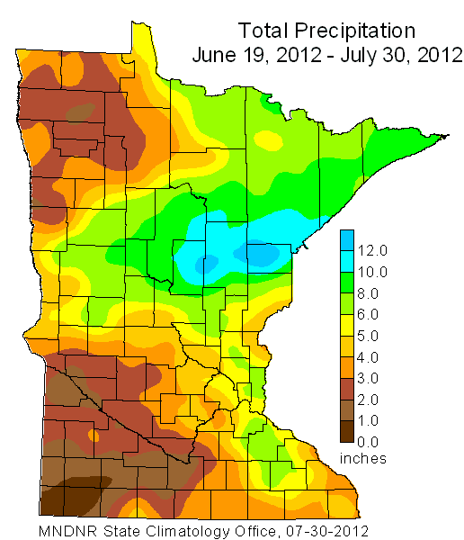
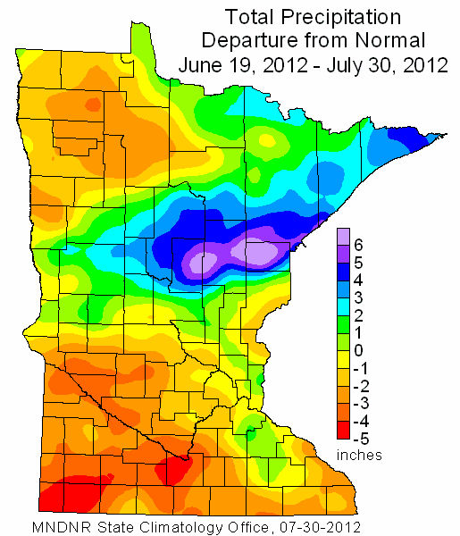

Slide 8
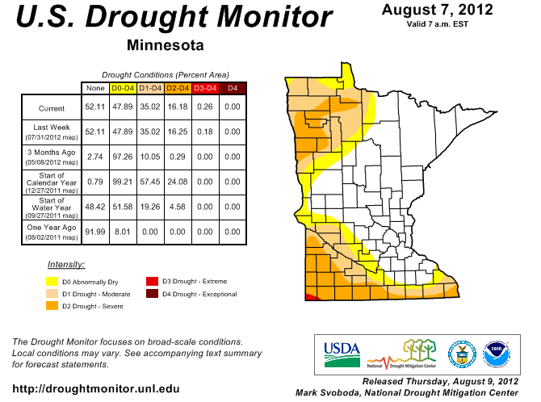

Slide 9
Drought Situation # 3 – August plus September
August plus September rainfall totals lowest ever
drought forms in previously unaffected areas
drought intensifies elsewhere

Slide 10
