Slide 1
Elevating Multimodal Planning
Mark Nelson
Office of Statewide Multimodal Planning

Slide 2
Reorganized to Support Multimodal Planning
A new Office of Statewide Multimodal Planning was created in February 2010
Goals for Mn/DOT:
Be structured to ensure multimodal planning
Use planning to influence investment decisions
Coordinate and integrate modal office plans
Expand district modal planning roles and responsibilities

Slide 3
Office of Statewide Multimodal Planning
Develop and articulate a long-term vision
Coordinate transportation planning efforts among modes and the Districts
Develop planning policies and guidance to advance multimodal planning
Enhance Mn/DOT’s multimodal planning expertise
Notes:
The office of Statewide Multimodal Planning was formed in February of this year. This new office will lead the effort to institutionalize multimodal planning within the Department. Specifically the new offiice will……(read bullets)
Within MPPM, modal offices exist to provide oversight in the areas of Transit (which also oversees intercity bus, bicycle travel, pedestrian accommodations and telework, Aeronautics, Freight and Commercial Vehicle Operations (including rail, ports and motor carriers), Passenger Rail, and Personal Rapid Transit. These modal offices have traditionally been responsible for the development of their modal plans and programs (e.g., the Greater Minnesota Transit Plan). This will not change. The new office is not meant to replace modal planning but rather to facilitate coordination among modes and between the modal offices and the Districts.
The new office will also be responsible for coordination between Mn/DOT and our regional partners in transportation planning- Metropolitan Planning Organizations, and Regional Development Commissions,
As part of this change, the Office of Investment Management has been renamed the office of Capital Programs and Performance Measures. This office will continue to provide program management and support investment analysis and performance measurement for the entire department as well as serve as the highway modal planning office.

Slide 4
Creating a Long-Term Vision
50-year Vision
Form Steering Committee and Advisory Groups in January 2011
Online forum
Workshops

Slide 5
Vision – Balancing Our Priorities
Vision
State of Good Repair
Sustain-ability
Economic Competiti-veness
Livability
Safety
Preservation
Mobility
Economic Competitiveness
Sustainability
Livability
Emerging
Traditional
Safety

Slide 6
Goals and Objectives
Performance Measures
Target Setting
Allocate Resources
Measure and Report Results
Long Term Multimodal Vision
Quality Data

Slide 7
Plan Development Guidance
Effort to systematize statewide planning at Mn/DOT
Consistency across modes
Strengthen public outreach and stakeholder engagement

Slide 8
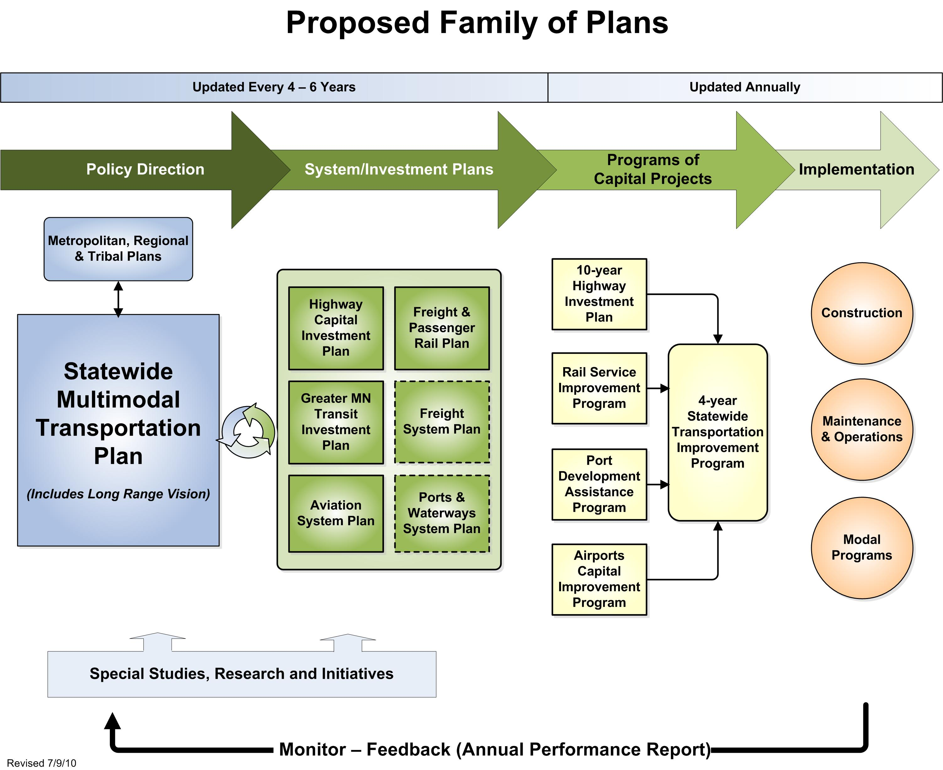

Slide 9
Mark Nelson
651-366-3794

