Slide 1
National Weather Service
North Central River Forecast Center
Mike DeWeese
mike.deweese@noaa.gov

Slide 2
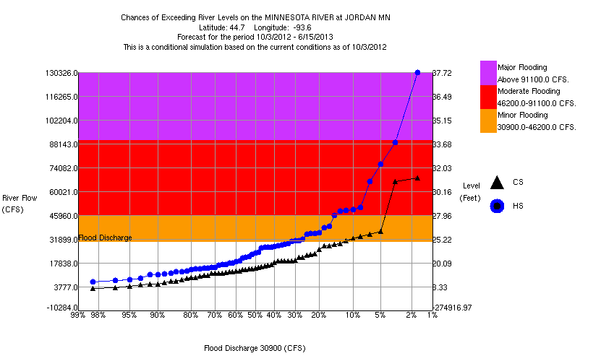
Oct. 2012 to June 2013 Outlook
PRELIMINARY DRAFT
Not an official forecast

Slide 3
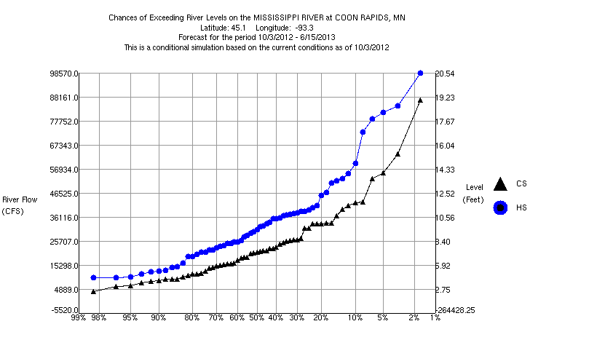
Oct. 2012 to June 2013 Outlook
PRELIMINARY DRAFT
Not an official forecast

Slide 4
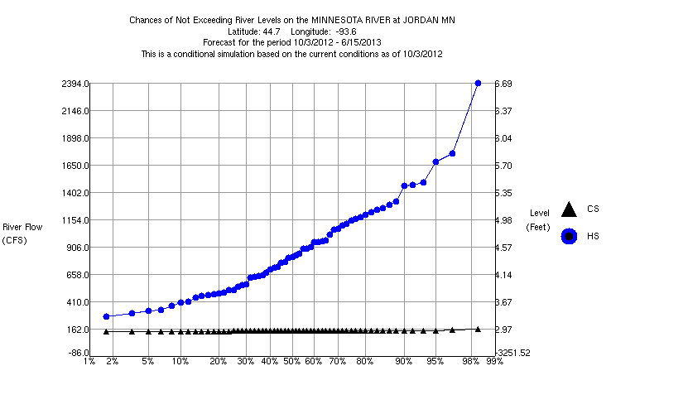
Oct. 2012 to June 2013 Low flow outlook
PRELIMINARY DRAFT
Not an official forecast

