Slide 2
Better Outcomes, Less Taxpayer Cost
An “Evidence-Based” Investment Strategy:
The Washington State Legislative Approach
2010 Legislative Policy Conference
Minnesota State Legislature
February 10, 2010
Steve Aos
Assistant Director
Washington State Institute for Public Policy
Phone: (360) 586-2740
E-mail: saos@wsipp.wa.gov
Institute Publications: www.wsipp.wa.gov
1 of 7

Slide 3

Overview
What Works?
Example
Next Steps?
Washington State Institute for Public Policy
Nature of the Institute
Non-partisan, 27 year history
Projects assigned by legislative bills
Legislative/Executive Board of Dir.
Legislative questions to WSIPP:
What works? What does not?
Cost-benefit, return on investment?
Seattle
Recent Specific Directions to WSIPP from the WA Legislature
What works?
What are the costs & benefits of policies to improve these outcomes?
Crime (1994, 1999, 2003, 2005, 2009),
Education, Early Ed. (2003, 2006, 2009),
Child Abuse & Neglect (2003, 2007, 2009),
Substance Abuse (2003, 2005, 2009),
Mental Health (2005, 2009),
Developmental Disabilities (2008),
Teen Births (1994),
Employment (2009),
Public Assistance (2009),
Public Health (2009), and
Housing (2009)
WSIPP
Capitol
My House
Olympia
2 of 7

Slide 4
Overview
What Works?
Example
Next Steps?
Washington legislature has asked WSIPP this question:
“Are There Evidence-Based Policy Options That Improve Public Outcomes, but at Less Cost?”
Our 3-Step Research Approach
What works, and what doesn’t?
We analyze ALL, RIGOROUS evaluations of REAL WORLD ways to improve key public outcomes.
What are the economics of each option?
We compute benefits and costs (ROI) to the people of Washington for the public policy options.
Statewide, how would alternative “portfolios” affect big picture outcomes ?
3 of 7

Slide 5
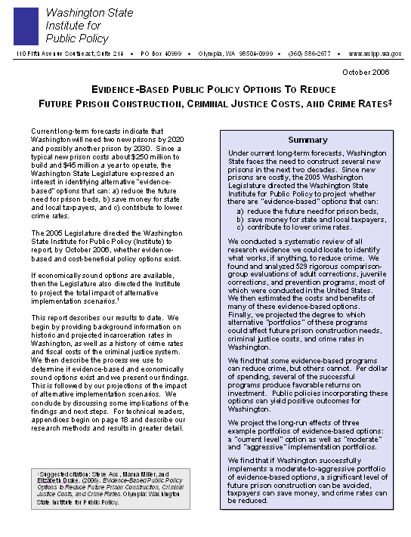



ANNUAL CRIMINAL JUSTICE ISSUE
EXCLUSIVE RATINGS
Over 200 Crime–Related Programs and Policies
Institute
Publications:
www.wsipp.wa.gov
S
Reports Are Available on:
Criminal Justice
Juvenile Justice
Child Welfare
Education
Mental Health
Substance Abuse
Prevention
More on the way
BEST
2010
Crime Policies to Adopt
Programs
programs
taxpayer dollars
programs
that reduce crime and save taxpayers money.
4 of 7

Slide 6
Restorative Justice (low risk) -8.7% (21) $7,067
Overview
What Works?
Example
Next Steps?
What Works to Reduce Crime?
Change In
Crime
(# of EB Studies)
Benefits Minus Costs,
per-person, life cycle (Probability: Costs > Ben)
Adult Offenders
(Draft Update)
Adult Drug Courts -9.3% (67) $3,717 (2%)
Education Prgs., Prison -8.3% (17) $9,449 (3%)
Drug Tx in Prison (TC or out-patient) -5.4% (20) $6,371 (6%)
Cog-Behavioral Treatment -7.1% (27) $8,811 (1%)
ISP: surveillance -1.6% (23) -$2,596 (86%)
ISP: treatment -17.9% (11) $8,531 (22%)
Juvenile Offenders
We located and meta-analyzed 67 rigorous drug court outcome evaluations conducted in the United States.
On average they reduced recidivism rates 9 percent.
Without drug court, an offender has a 58% chance of being reconvicted for a new felony or misdemeanor after 13 years;
With drug court, the odds drop to about 53%.
The reduced recidivism yields a NET gain of $3,717 per participant.
We estimate drug courts cost $4,634 more per person than regular court processing (court costs, treatment); benefits of reduced recidivism total $8,351 to taxpayers (lower criminal justice costs) and crime victims (reduced victimization). A benefit-to-cost ratio of $1.80
Risk: About 2% of the time costs will exceed benefits.
We ran the model 5,000 times testing the expected bottom line for the known or estimated risk and uncertainty in our findings.
Functional Family Thpy. -18.1% (7) $23,671 (<1%)
Multisystemic Therapy -7.7% (10) $6,533 (n/a)
Aggression Repl. Trng. -5.3% (4) $6,714 (n/a)
Family Int. Transitions -15.3% (1) $37,101 (n/a)
MDT Foster Care -17.9% (3) $38,904 (n/a)
Prevention*
Crime Benefits Shown*
Pre-School* (low income) -16.6% (8) $5,707* (n/a)
Nurse Family Partnership* -15.7% (2) $5,225* (n/a)
* Programs have other monetized non-crime benefits; only crime-related benefits reported here.
5 of 7

Slide 7
Overview
What Works?
Example
Next Steps?
Reports available for downloading
www.wsipp.wa.gov
Washington Legislative Actions
Started funding several evidence-based juvenile justice programs in 1990s.
2007 Legislature made a substantial change to evidence-based criminal justice funding in adult and juvenile corrections, and prevention.
WA now ties, explicitly, the official state prison forecast to the expected effects of the funded portfolio.
Encouraging signs of less crime and control of costs.
6 of 7

Slide 8
Overview
What Works?
Example
Next Steps?
Next Steps?
Washington State’s Legislative Approach
Study language from last year’s budget bill
“Sec. 610 (4) $100,000 of the general fund--state appropriation for fiscal year 2010 and $100,000 of the general fund--state appropriation for fiscal year 2011 are provided solely for the Washington state institute for public policy to report to the legislature regarding efficient and effective programs and policies. The report shall calculate the return on investment to taxpayers from evidence-based prevention and intervention programs and policies that influence crime, K-12 education outcomes, child maltreatment, substance abuse, mental health, public health, public assistance, employment, and housing. The institute for public policy shall provide the legislature with a comprehensive list of programs and policies that improve these outcomes for children and adults in Washington and result in more cost-efficient use of public resources. The institute shall submit interim reports by December 15, 2009, and October 1, 2010, and a final report by June 30, 2011. The institute may receive additional funds from a private organization for the purpose of conducting this study.”
1.
Establish an entity, under legislative control, to produce Consumer Reports-like information:
Non-partisan governance
Multi-purpose (topics in many public policy areas).
Work closely with legislative committee staff
Focus: evidence & return on taxpayer investment
2.
Direct the specific studies via legislation:
3.
More Information?
saos@wsipp.wa.gov
7 of 7
2 of 2

Slide 9
Thank You!

Slide 10
Study language from this year’s budget bill
“Sec. 610 (4) $100,000 of the general fund--state appropriation for fiscal year 2010 and $100,000 of the general fund--state appropriation for fiscal year 2011 are provided solely for the Washington state institute for public policy to report to the legislature regarding efficient and effective programs and policies. The report shall calculate the return on investment to taxpayers from evidence-based prevention and intervention programs and policies that influence crime, K-12 education outcomes, child maltreatment, substance abuse, mental health, public health, public assistance, employment, and housing. The institute for public policy shall provide the legislature with a comprehensive list of programs and policies that improve these outcomes for children and adults in Washington and result in more cost-efficient use of public resources. The institute shall submit interim reports by December 15, 2009, and October 1, 2010, and a final report by June 30, 2011. The institute may receive additional funds from a private organization for the purpose of conducting this study.”

