Slide 1
Cross-Jurisdiction Collaboration Break-Out Session
January 25, 2012

Slide 2
Agenda
Introductions
What is Cross-Jurisdiction Collaboration?
What are some examples?
What have other states done legislatively?
What has Minnesota done to-date?
What can Minnesota do going forward?

Slide 3



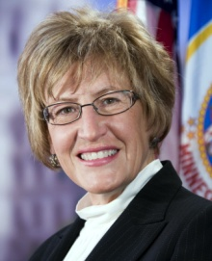

Introductions
Rep. Carol McFarlane
District 53B
rep.carol.mcfarlane@house.mn
Rep. Denise Dittrich
District 47A
rep.denise.dittrich@house.mn
Sen. John Carlson
District 04
sen.john.carlson@senate.mn
Sen. Kathy Sheran
District 23
sen.kathy.sheran@senate.mn
Antonio Oftelie
Executive Director, Leadership for a Networked World
Fellow, Technology & Entrepreneurship Center
Harvard
antonio.oftelie@post.harvard.edu

Slide 4
Minnesota’s Public Service Organizations: The “New Normal”
Unprecedented pressure on the Public Sector: These factors converge to create an imperative to restructure
Falling Revenues
Capacity Imperative
Budget Shortfalls
Reduced Funding
Major Demographic Shifts
…
Rising Citizen Demands
Notes:
Talking points:
Talking points
Today, local and state leaders are facing a mounting problem: They must find ways to deliver the services constituents are asking for with dramatically scarcer resources.
Unprecedented pressures on Public Service
Sustained economic downturn – which leads to fewer resources.
Demand from constituents of all ages for more and newer government services – which leads to increased costs. Meantime, local and state leaders must run government organizations while planning for the future – and many are stuck.
From a region-wide vantage point, there’s a clear argument for a merger. With an array of duplicative back-office functions and a multitude of overlapping citizen-facing services, fiscal savings are at stake, not to mention the potential for more coordinated and effective service delivery.
Not to mention that we have a patchwork of government entities that dates back to the 19th century (Minnesota example)
Across the board, as public service leaders look for solutions, they’re finding that cutting their way out – scaling back programs and services, merging agencies, school systems or counties – is tactically difficult and politically challenging. And raising resources – increasing taxes, fees and borrowing – is economically unsustainable and politically unpalatable.
Growing their way out isn’t a viable option either – most projections show tax receipt and cost curves just don’t add up.
But there is a solution: Cross-jurisdiction collaboration.

Slide 5

The Current Landscape
87 Counties
856 Cities
519 School Districts
$527,100,646 in LGA

Slide 6

Case in Point Memphis & Shelby County, TN
In Memphis, Tennessee and surrounding Shelby County, citizens were faced with a stark vote on the November 2010 ballot:
“For consolidation of City of Memphis and Shelby County,”
or
“Against consolidation of Memphis and Shelby County.”

Slide 7
Why the Vote? What Happened?
For years city and county officials debated the merits of a full-on merger or a consolidation into a regional government.
From a region-wide vantage point, there’s a clear argument for collaboration:
Modernize and meet future demands
Collaborating on economic development
Improving services for citizens and businesses
Reducing overall costs to taxpayers

Slide 8
The Vote Result:
Naturally, a split vote took down the proposed merger:
49 percent against a merger to 51 percent for a merger in Memphis
85 percent against a merger to 15 percent for a merger in Shelby County.
Bridging these chasms was insurmountable.
There is a Better Way Forward…

Slide 9
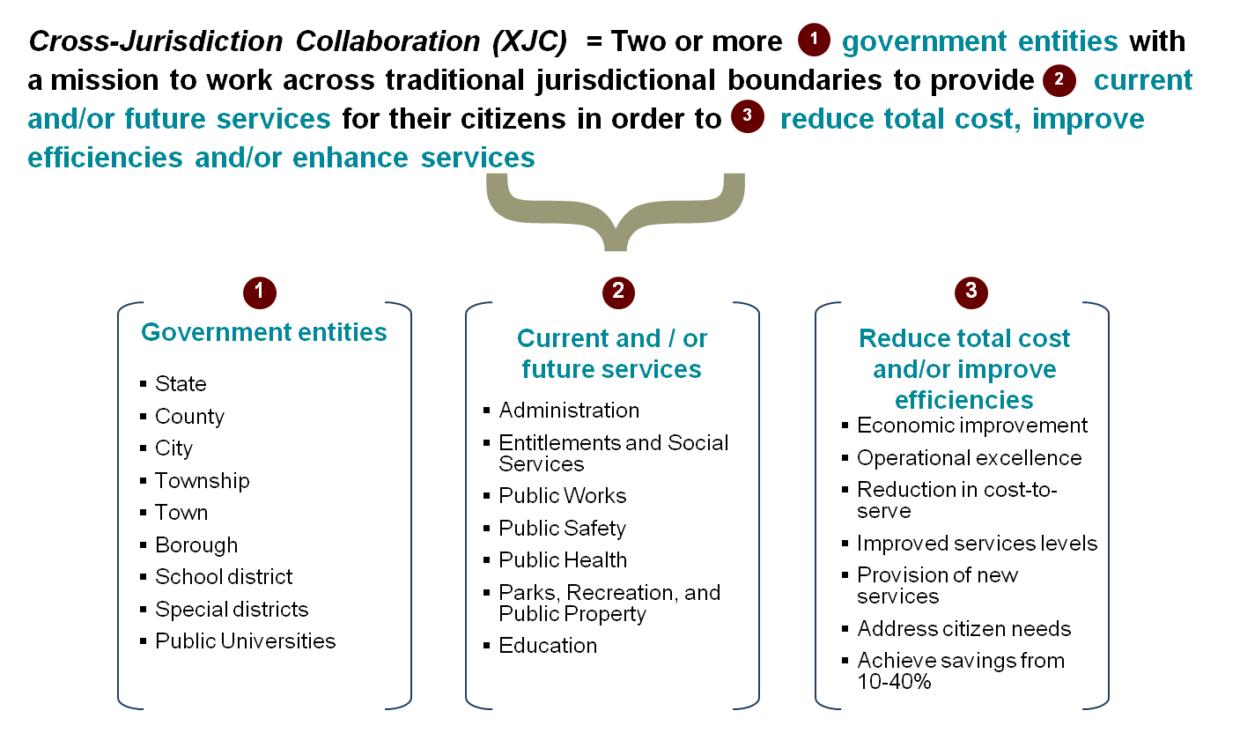
Cross-Jurisdiction Collaboration makes government operations significantly less expensive and more effective

Slide 10
Why Cross-Jurisdiction Collaboration?
Improve Efficiency of Government
Greater output from resources
Savings in administrative and technical costs
Improve Effectiveness of Government
Enhanced quality of citizen services
Enhanced reach of citizen services
Improve Equity and Transparency in Government
Reduce inequity in services across jurisdictions
Enhanced citizen interaction and view
Reduced environmental footprint

Slide 11
Who are the likely partners?
Collaboration between existing public entities and/or…
…public and private entities
Peer-to-Peer
Hierarchical
State/local* and public
State/local* and private
Southeast Consortium common unemployment system
39 counties in CA sign JPA for a new welfare system
MN Child Support delivered by state and counties
St. Paul / Minneapolis Metropolitan Council
Regional planning agency
San Francisco city car share
* Note: In this slide, “Local” is a proxy for a local government entity such as a city, town, township, borough, special district or school district
Notes:
Next we need to determine with whom might we partner with. An XJC may occur across existing public sector entities and at a peer-to-peer relationship (e.g., city to city) or in a more “hierarchical” relationship (e.g., city to county). Also, there are opportunities to partner with third party agencies, which may be public and/or private entities.
Significant examples exist for all these scenarios and choosing the most appropriate model will depend on the individual circumstances of the involved parties.
State of Tennessee
Outcome:
The Tennessee Department of Labor has signed a contract with technology vendor Chicago Systems Group-Government Solutions to assist in the development of functional specifications for an unemployment
insurance system. The focus of the project is to develop a common unemployment insurance benefit system that could be used by multiple states.
Description:
• The U.S. Department of Labor awarded funds to the Southeast Consortium based on proximity and similarity of unemployment programs and laws to aid in the development of a new system.
• The Southeast Consortium (which includes Tennessee, North Carolina, South Carolina and Georgia) is considering improvements to the system that will allow for faster implementation, more efficient use of staff, real-time processing and
access to information, and self service functions so claimants can update their information.
• Multiple states using the system will allow for easier assistance in disaster situations.
• This announcement is part of a $6.8 million infrastructure grant announced October 2009.
• Collectively, the Southeast Consortium of states will contribute $9.9 million toward the redesign project.
• The Southeast Consortium is scheduled to complete the project on September 28, 2011.
C-IV
Outcome:
Thirty-nine counties in the state of California operate under a joint powers authority (JPA) to procure, build, implement and maintain a new welfare and welfare-to-work system with more than 800,000 recipients.
Description:
• C-IV is a consortium of 39 of the 58 California counties managing welfare eligibility and employment services.
• Thirty-five additional “migration” counties using another system known as ISAWS unanimously agreed to migrate to C-IV. The original and migration counties each represent 13 percent of the California caseload, 26 percent total. The overall objective of C-IV is to provide a fair, accurate and effective process by which a planning consultant will be awarded an agreement with the SAWS Consortium JPA to provide the consortium with procurement planning services. These services support the consortium in development of a large-scale, competitive procurement process for maintenance and operations goods and services for the C-IV system.
Ohio Shared Services
Outcome:
Ohio moved to a statewide shared services model in 2007, which brought a 15 to 20 percent improvement in productivity and a reduction of costs from $37 per transaction to just $12. Ohio expects to achieve about $26 million in average annual savings, or about $500 million over 20 years.
Description:
• As part of the launch of its PeopleSoft enterprise resource planning system, the shared services center was designed in partnership with the state’s unions and under the guidance of Accenture through the design, build and deployment stages. It is staffed and managed internally, rather than outsourced.
• Ohio engaged stakeholders on multiple levels, allowing agencies to volunteer to participate in the transformation. The first service on its agenda was financial services, followed by human resources and technology services.
• Some of the departments
within the state that are already benefiting from the shared services transformation include the Ohio Department of Rehabilitation and Correction, Ohio Rehabilitation Services Commission and Ohio Department of Taxation.
San Francisco, California
Outcome:
City CarShare and the city of San Francisco have stepped up efforts to save money and lower the city’s carbon footprint by entering a formal agreement to extend car sharing to city employees.
Description:
• This arrangement offers the city a way to manage a smaller vehicle fleet, with lower purchase and maintenance costs and reduced greenhouse gas emissions.
• Gas, insurance and maintenance are included in the service, and fewer cars will serve more city and county employees.
• The city and county of San Francisco will save taxpayer money by encouraging transit-oriented sharing.
• The mayor’s office announced the partnership with City CarShare, and individual departments will individually sign up for the program.

Slide 12
What is the appropriate scope?
Government Value Chain
Illustrative
1
Cupertino: All police services are contracted out to the Santa Clara County Sheriff’s dept.
Policy
4
2
Morris County: Five Morris County towns merged their municipal courts into a regional court based in Dover in 2008
Program
3
Youngstown, OH: Nine cities partnered with city / county governments, housing nonprofits and banks to develop low-cost housing and revitalize vacant land
1
3
Production
2
4
Philadelphia: Five counties coordinate plans, goals and assets to achieve maximum regional benefit in green building construction and new energy technology commercialization
Provision
Education
Public safety
Administration
Public works
Public health
Entitlements and social services
Transportation, housing, and community development
Parks, recreation, and public property
Services and functional areas
Notes:
Now, we can bring together the past two concepts into a single matrix and show the intersections of functions and the value matrix. This is intended to illustrate the full scope of potential collaboration models.
When we plot the services across the government value chain we see that collaboration models can exist in many different combinations. Collaboration can be isolated to one or more levers of the value chain and can span across one or more services. For examples where a municipality contracts out a service, this translates to collaboration across all of the value chain levers in one service like in Cupertino - example 1.

Slide 13
Cross-Jurisdiction Collaboration Business Models
Coordinating
Merging
Contracting
New Entity
1
2
3
4
Consolidation and/ or sharing of specific function(s) between entities
Combining specific function(s) and/or political entities into a single entity
Transferring mgmt. and execution of function(s) to an external service provider
Transferring mgmt. and execution of function(s) to a separate entity created specifically for this purpose
Youngstown, OH: Nine cities partnered with city/county governments, housing nonprofits and banks to develop low-cost housing and revitalize vacant land
City of Preston / Webster County, GA merger
Mine Hill Township contracts its police services from Wharton Borough Police department
City and County of Sacramento JPA outsourcing with a family services nonprofit
Sources: Accenture and Leadership for a Networked World at Harvard University research, Secondary public/ private sector research
Notes:
Finally, there is the concept of how to implement the collaboration model. This can be done in one of four manners: Coordinating services, merging functions or entities, contracting out to existing service providers or creating a new entity to perform services.
When Coordinating services, the collaborating entities share power and responsibility to provide services. Coordinating does not result in the formation of a separate new entity
Merging results in a single entity or functional unit responsible for providing services to all entities
Services may be contracted out to either an existing local government entity or a third party provider (public or private entity
New entities may also be created specifically to provide certain services on a regional level
Each implementation method has certain key advantages as well as limitations and risks. The chosen implementation method varies based on :
drivers or reasons for collaboration including the specific problems that must be solved through collaboration,
the collaborating entities involved and
relevant financial, political and future considerations pertaining to the collaborating entities

Slide 14
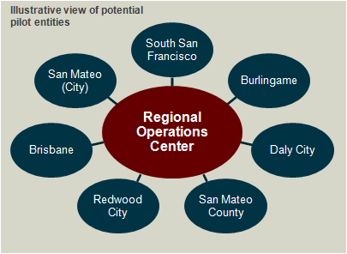
Example: Silicon Valley Network
Silicon Valley’s Regional Operations Center provides a blueprint for XJC success.
Situation
Silicon Valley jurisdictions had budget shortfalls, managers needed to make unpopular service cuts, and citizens reacted adversely to these cuts.
Challenge
While there was a lot of energy surrounding cross-jurisdiction collaboration in Silicon Valley, there has been little consensus on where to start or how to make it work.
Solution
A scalable Regional Operations Center with the authority, neutrality and funding to improve the delivery of civil services.
Start with a manageable number of stakeholders
Start with low-risk functions before tackling complex issues i.e. HR, IT, Finance & procurement or back office functions
Use existing decision-makers and structures more effectively
Control for different service expectations
Ensure a smooth transition
Outcome
New collaboration models will reduce costs while minimizing impact to citizens and employees. The impact of these collaborations could result in annual benefits of $220-520M for the Silicon Valley Network.
Notes:
our team aligned around the idea of a regional operations center. This path seemed the best way to start based on everything we heard.
And these are the reasons, at the lower left area of the chart around 7 oclock position for those early risers and adopters, we needed to come up with a manageable number of stakeholders and luck y number seven became that number. Those entities are named in the outer ring of the center model.
We also saw low risk functions as the way to start (ie. HR , IT, Finance, Procurement) areas that do not have a lot of jobs, do not face citizens, are scalable,)
We developed the Regional Operations Center as a JPA or Joint Powers Agreement which are mechanisms that city managers are familiar with and have experience.
We allowed for a difference in service levels as this seemed to be a factor in decision making.
And finally we envisioned a smooth transition by managing the change in a way that stakeholders see positive attributes in better service, etc.
But these small step is only the first step……we envision a far greater opportunity when this operations center is realized for the entire silicon valley.
Total budget for all silicon valley government entities is north of $14B and this slide shows the breakdown by type of entity and by type of service provided.
Of that $14B, we believe 36% of that total or $5B is possible as addressable under our regional operations center voyage.

Slide 15
Example: MN Local Government Information Systems Association (LOGIS)
Creating a sustainable model for local government collaboration.
Challenge
Facing budget shortfalls, heightened constituent expectations and rising technology costs, local government leaders needed a way to share ideas, risks and costs around technology infrastructure. Each member locality needed to receive state of the art technology services, at a lower cost, while providing more effective citizen services
Solution
LOGIS was formed (1972) under a Minnesota joint powers act to provide an organization through which its members could establish, operate, and maintain data processing facilities and management information systems for the use and benefit of members. LOGIS provides solutions for local governments across: Applications, Network Services, Internet Services, Implementation Services and IP Telephony.
Outcome
LOGIS, headquartered in Golden Valley, has an operating budget of $8 million and services 45 member localities comprising 2.1 million residents. LOGIS has delivered $73 million in savings and cost avoidance since its inception.
Notes:
our team aligned around the idea of a regional operations center. This path seemed the best way to start based on everything we heard.
And these are the reasons, at the lower left area of the chart around 7 oclock position for those early risers and adopters, we needed to come up with a manageable number of stakeholders and luck y number seven became that number. Those entities are named in the outer ring of the center model.
We also saw low risk functions as the way to start (ie. HR , IT, Finance, Procurement) areas that do not have a lot of jobs, do not face citizens, are scalable,)
We developed the Regional Operations Center as a JPA or Joint Powers Agreement which are mechanisms that city managers are familiar with and have experience.
We allowed for a difference in service levels as this seemed to be a factor in decision making.
And finally we envisioned a smooth transition by managing the change in a way that stakeholders see positive attributes in better service, etc.
But these small step is only the first step……we envision a far greater opportunity when this operations center is realized for the entire silicon valley.
Total budget for all silicon valley government entities is north of $14B and this slide shows the breakdown by type of entity and by type of service provided.
Of that $14B, we believe 36% of that total or $5B is possible as addressable under our regional operations center voyage.

Slide 16
Legislative Mandates For XJC Example: Michigan Executive Directive 2012-1
Government Technology Innovation: Executive Directive 2012-1 establishes Information, Communications and Technology (ITC) management responsibilities as well as an ITC Innovation Fund Investment Board within the Department of Technology, Management and Budget. The department received a $2.5 million appropriation for the fund. The $2.5 million innovation fund was approved by the state Legislature in Michigan’s 2012 budget.
All state Executive Branch agencies and departments and shared service projects involving local governments and other public service providers are eligible to receive loans from the fund. The investment fund board will oversee management of the fund, including the solicitation of projects, eligibility criteria, performance and accountability, contractual reporting, loan repayment and project termination.

Slide 17
Legislative Mandates For XJC Example Ohio Local Government Innovation Fund
Ohio Local Government Innovation Fund: House Bill 371 encourages local government innovation projects by allocating $45 million for collaboration and shared services amongst political subdivisions. Of the $45 million allocation, $36 million will be available for loans while $9 million will be designated for grants.
The Local Government Collaboration Council (LGIC) met in November 2011 to discuss the application process and the amount of money a collaborative project may receive. The fifteen member LGIC discussed how the $100,000 to $500,000 loan range could be allocated. Representative Ron Amstutz (R-Wooster) explained that a single entity seeking funding is eligible for $100,000 and each additional jurisdiction that signs on increases the total eligibility by $100,000 up to $500,000.

Slide 18
Legislative Mandates For XJC Example New Jersey Local Unit Sharing of Services
New Jersey Shared Services: Senate Bill 2794 would require New Jersey’s Local Unit Alignment, Reorganization, and Consolidation Commission (LUARCC) to study local government units (county government, municipal government, school districts) to determine where taxpayer dollars could be saved through sharing of services.
If the study shows that a savings can be realized through sharing that service in one or more local governments, the question of whether to do so or not would be put to a public referendum in all municipalities involved. If the towns involved fail to pass the proposal, they would be subject to losing state aid in the amount equal to what they would have saved had they shared the service. If one town approves it but another denies it, only the town that denied it would lose aid.

Slide 19
Minnesota Example Minnesota Accountable Government Innovation and Collaborate (MAGIC) Act
The MAGIC Act has two major components, each designed to address a specific barrier to innovation under the current state supervised-county administered model of service delivery.
1) Implement the Cooley Doctrine which would allow counties to do anything for the health, safety and general welfare of the public that is not prohibited or prescribed by state law. Currently Minnesota operates under the Dillon Rule which prohibits counties from doing anything unless it is explicitly authorized by state law and replacing it with the Cooley Doctrine
2) Authorizes counties to receive waivers from current rules by adhering to a strict process that includes the submission of detailed business plan with clear outcomes and performance measures, a mechanism for state input and a reporting component to allow for adequate legislative oversight of this new framework and a methodology for sharing the results of the experiments in innovation.
This legislation will create an environment where state and county employees focus their energy on outcomes rather than processes and where decisions are made by local communities to the extent possible. This represents an important shift in philosophy that will encourage state agencies to act as technical advisors to counties who are investing resources to explore new service delivery systems. At the same time, county boards and employees will be required to accept a heightened level of accountability in exchange for the freedom to innovate.

Slide 20
Minnesota Example S.F. No. 489, as introduced - 87th Legislative Session (2011-2012) [11-1740]
Minnesota School Districts Collaboration on Shared Services: S.F. 489 is a bill for an act relating to education finance; requiring the Department of Education to hire a consultant to work with districts to share services; creating a competition among school districts; creating an incentive for districts to share services; appropriating money.
Sec. 5. SHARED SERVICES COMPETITION.
School districts within each economic development region under Minnesota are encouraged to work together to share services to maximize the savings generated per adjusted average daily membership. For fiscal years 2012, 2013, and 2014, the school districts and charter schools in each economic development region with the most shared services savings in each year are eligible for a shared services savings grant under paragraph The commissioner shall award a shared services grant to the participating school districts and charter schools of the economic development region that generates the most savings per adjusted average daily membership, as reported according to section The shared services grants shall be equal per adjusted average daily membership among all participating school districts and charter schools, and may be up to $500 per adjusted average daily membership. The total grant per year may not exceed $5,000,000 each year.

Slide 21
What can we do in the future?
Key Questions:
How can Minnesota move from “program-centric” to “citizen-centric?”
What programs and operations could be made more efficient and/or effective via cross-jurisdiction collaboration? What services/functional areas should be targeted?
What incentives and levers does the legislature have to encourage cross-jurisdiction collaboration?
Example: Linking local government aid to increased collaboration.
Example: Make collaboration required versus optional.
Example: Innovation funds for cross-jurisdiction collaboration
Example: Encourage Joint Powers Agreements
At what level (legislature/county/local) should the decisions on enabling business models be made?

