Slide 1
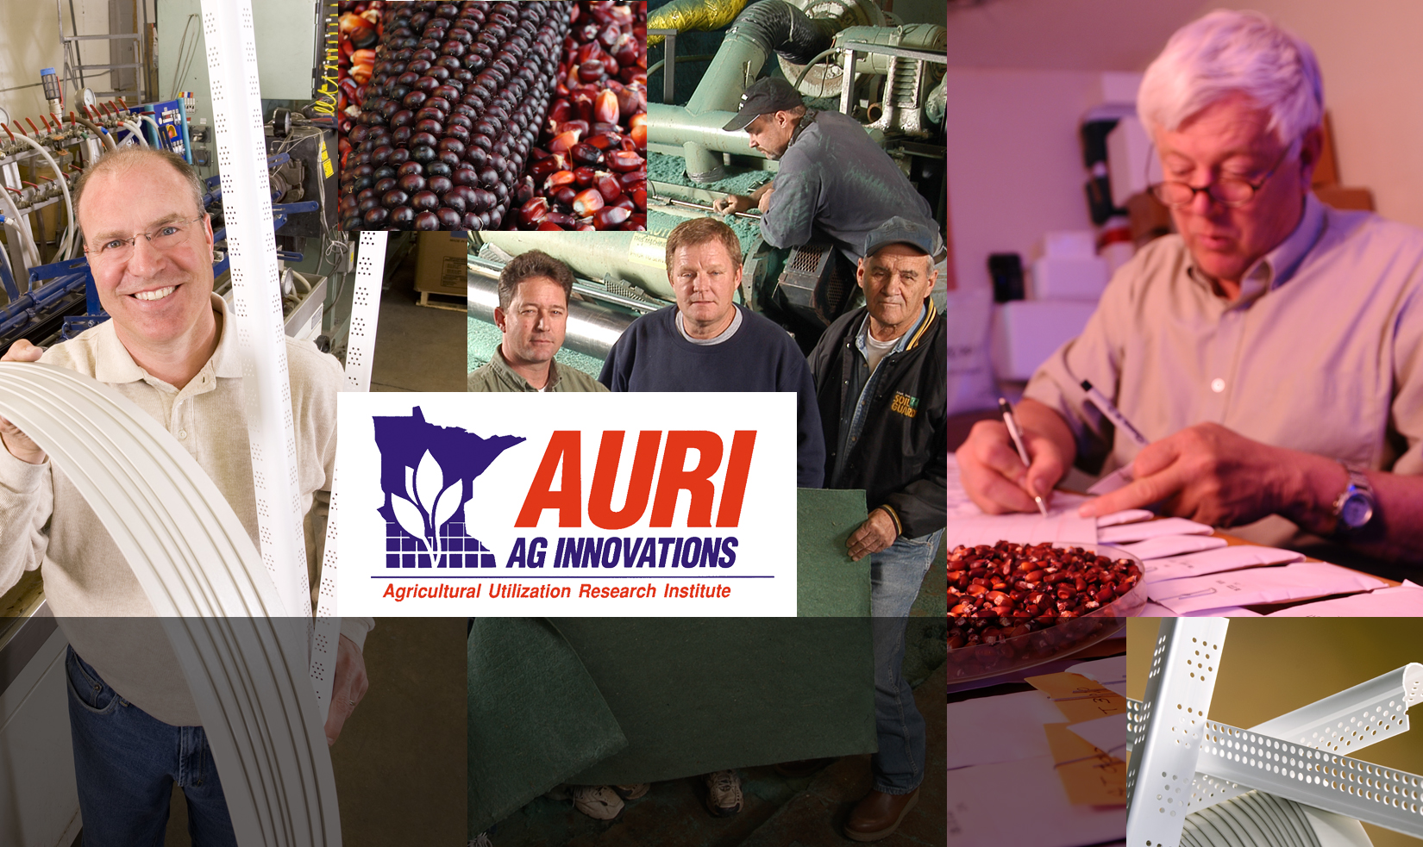
Perspectives on Growth: What we can learn from agricultural innovators

Slide 2

Who We Are
20+ years experience supporting small and mid- sized businesses in moving research and technology to commercialization
Our expertise is in adding value to agricultural commodities:
Food
Biobased Products
Renewable Energy
Coproduct Utilization
Notes:
During this time, we have learned a lot about what makes businesses competitive

Slide 3
Outcomes
In the last two years alone, AURI has:
Assisted in the development of more than 325 unique projects and initiatives
Brought 143 new or improved ag-based products to market
Helped bring more than $123 million in capital investment to Minnesota
Notes:
I only share these to demonstrate that we have experience helping businesses bring new products to market. My presentation today will focus on the lessons learned when working with these businesses. Of which, the most important presentation is (flip to new slide).

Slide 4
The Journey is as Important as the Destination
Each step in the development process increases understanding of product, market, and business opportunity – and reduces risk.
The more you know, the better decisions you make.
This deliberate process leads to businesses that:
Are more attractive to investors
Have a greater likelihood of market success
Achieve a sustained competitive position
In the end, this all means jobs.
Notes:
….the journey is as important as the destination. So what I’m going to talk to you about today is the development journey and how that is critical to creating jobs.

Slide 5
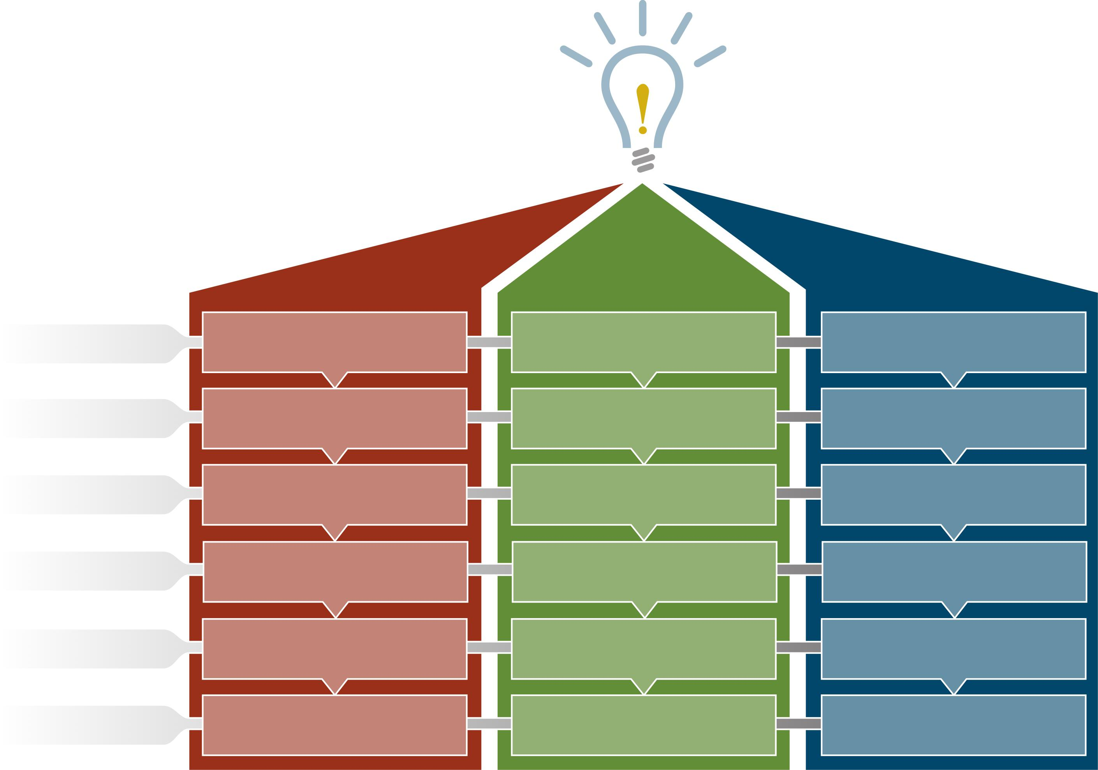
Development Journey: From Idea to Commercialization
Process is Important
PRODUCT
MARKET
BUSINESS
Investigation
Product Assessment
Market Needs Assessment
Business Assessment
Feasibility
Product Feasibility
Market Study
Economic Feasibility
Development
Product Prototype
Market Plan
Strategic Business Plan
Introduction
Pre-Production Prototype
Market Validation
Business Start-Up
Growth
Production
Sales & Distribution
Business Growth
Maturity
Production Support
Market Diversification
Business Maturity
Modified from SSTI’s TBED Resource Guide
Notes:
I recognize that this is a complicated slide, but I’m trying to show you that there’s a lot that goes into successfully bringing a product from idea to market. There are three components to a successful business—you need to ensure a good product that matches market needs that is supported by strong business operations. Each one of these components has a series of steps that leads to one another. Research, business plans, and access to capital.

Slide 6
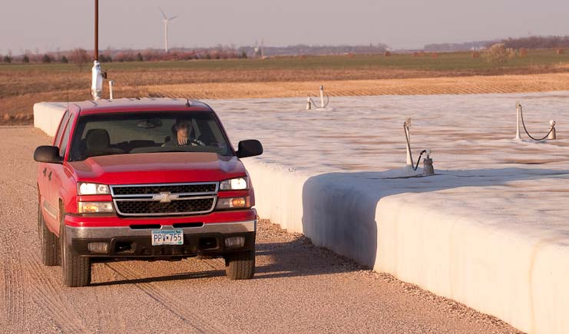
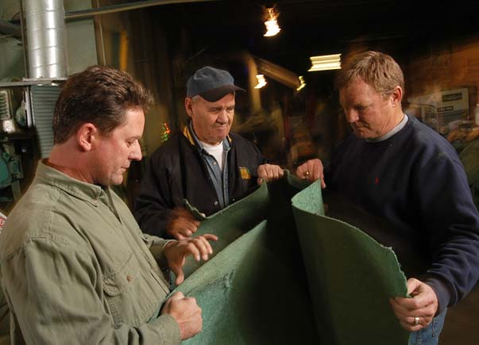

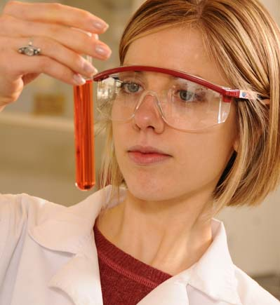
Capital Exists for Proven Innovations
Funding will be there if good ideas are vetted and proven.
95% of our clients that demonstrate appropriate product, market, and business readiness access the capital needed to move to commercialization.
Notes:
And we know that the development journey works because 95% of our clients that demonstrate appropriate product, market, and business readiness have access to the capital needed to move to commercialization.

Slide 7
Agriculture + Innovation = A Prosperous Minnesota

Slide 8
What can you do?
Encourage ALIGNMENT of programming across the state from research to development to commercialization.
When funding research, if appropriate, make sure there is a plan for dissemination or development, including collaboration with local organizations.
Look at your district – be proactive in supporting and providing venues for GENERATING IDEAS that build on the capacity and unique assets of your district.

