Slide 1

2010 – 2020 Occupations
What jobs will have the best future outlook!
November 2012
Suzan Reagan, Labor Economist

Slide 2

Labor Market Information
Job Descriptions
Education
Wages
Employment levels
Future Growth
Notes:
The Labor Market is like the Stock Market. In the stock market people buy, sale and trade stocks. In the Labor Market anyone with a job or looking for a job participates. Workers trade time, knowledge, skills and abilities for wages. LMI is anything that is related to work.

Slide 3
Agenda
1) NM Economic Situation
Industry
Recession Impact
Current Situation
What’s Next (2010-2020)
Occupations
Hot Jobs
Clusters
STEM & Healthcare
2) Sources & Tools
Career Solutions
LASER
CareerOnestop.org
Notes:
Agenda

Slide 4
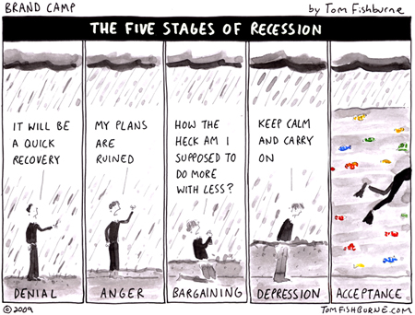
The Great Recession Ended July 2009?
New Mexico Total Non-farm Seasonally Adjusted Employment
September 2012: 794,300
September 2011: 805,200
Over -the-year change: -10,900
Notes:
The US economy stopped contracting June 2009 and showed an increase in July 2009. Employment will be slower to recover which is a characteristic that makes this recession different from other recent ones.

Slide 5
NM vs. US Employment
NM
US
In thousands
NM vs. US Employment from 1990 to Present
Total Non-Farm Employment Seasonally Adjusted
Notes:
You can see the dips the US took thru previous recessions…Because we have gov’t and energy jobs, NM did better until this one. Also note how deep this recession has been compared to the earlier ones. While the US now appears to be on the road to recovery NM has not yet show strong signs of recovery. Data can be found at http://laser.state.nm.us under CES.

Slide 6
NM Industries Change
To 1st Qtr 2012
562 Ag
3,398 Mining
-27 Utils.
-1,843 Const.
532 Manuf.
459 Whole.
1,111 Retail
955 Trans.
12 Info.
-368 Fin.
-116 RE
-945 Prof.
0 Mgmt.
-1,922 Admin.
-961 Ed.
2,223 Health
526 Arts
151 Accom.
111 Other
-1,670 PA
How Did New Mexico Handle the Recession?
Mining lost over 500
Construction shed about 16,000
Manufacturing lost another 8,000
Retail took a hit with 6,000
Admin & Waste Svs 5,000
Bright spot Health Care +12,000
Source: Quarterly Census of Employment and Wages NMDWS
Notes:
The reason health care is given so much focus is because they have significantly added jobs during this recession. Not all industries lost jobs at the same rate. Construction was the hardest hit.

Slide 7
NM Employment Industry Mix
Source: Projections unit 2010-2020, NM Dept. of Workforce Solutions
Notes:
Gov employment in Health and Ed. – Healthcare is the largest sector by employment. Small slices by employment Utilities, Real Estate & Agriculture, still have large monetary impact on the economy.

Slide 8

Current Employment Situation
The unemployment rate for:
September 2012 September 2011
The US is at 7.8 % 9.0 %
New Mexico 6.4 % 7.4 %
Albuquerque 6.6% 7.8%
Farmington 6.4% 7.4%
Las Cruces 6.7% 6.9%
Santa Fe 5.0% 6.0%
The bad news is…
Seasonally Adjusted
Notes:
Unemployed and actively seeking employment in the last month. A very narrow definition of economic hardship. We expect a spike in unemployment as employers begin advertise job openings and add more jobs again.

Slide 9
What about…
Part time but would work full time
Discouraged unemployed workers
Multiple job holders
Alternative Measures of Labor Underutilization U-6
NM 14.8%
US 15.0%
Third Quarter of 2011 through Third Quarter of 2012 Averages.
Unemployed
Part time for economic reasons
Multiple Jobs holders
Marginally attached workers
Bureau of Labor Statistics
4 QTR Moving Average
http://www.bls.gov/lau/stalt.htm
Notes:
http://www.bls.gov/lau/stalt.htm broader measure of “unemployment” that fits closer with perceptions of the difficult economy and the hardships experienced by workers.

Slide 10
Employment to Population Ratio
Source: Bureau of Labor Statistics Local Area Unemployment Statistics
Notes:
Late 90’ to the recession begins saw the highest ratio’s of employment. Now we’ve fallen back to levels seen during the 70’s. One difference now is that men and women’s participation rates remain about equal. http://www.bls.gov/lau/rdscnp16.htm

Slide 11
NM UI Continued Claims Duration
Based on UI Summary Data 1st Qtr 2012: Average Duration 20.3 weeks in 2011
Notes:
Prior to this recession duration of claims in the 52+ was a very small percentage. Workers who have been out of the workforce for big blocks of time have to overcome employers questions on work skills being current. http://www.workforcesecurity.doleta.gov/unemploy/content/data.asp for Average Duration by State.

Slide 12
US Unemployment Rates for Men and Women
Source: US Bureau of Labor Statistics, Current Population Survey
Notes:
For many years, men's unemployment rates were generally lower than women's both during and between recessions. However, since the early 1980s when labor force participation rates evened out between men and women, men's unemployment rates have been higher than women's during or immediately after recessions, and the rates for men and women have been quite similar in other periods. Higher unemployment among men was especially notable during and immediately after the recent recession.

Slide 13

New Mexico Unemployment Rate by Age
2011 annual averages
7.4%
Source: Census Geographic Profile of Employment and Unemployment
Notes:
During recessions youth tend to have higher unemployment rates and this one has not been an exception. Mom and Dad they really can’t find a job. Annual Average UR was 7.4% From pdf at http://www.bls.gov/lau/ptable14full2011.pdf or http://www.bls.gov/gps/tables.htm

Slide 14
New Mexico 2011 Unemployment Rate
Source: 2011 American Community Survey 1-Year Estimates, Table S2301 Employment Status
Notes:
Unemployment rates very by race in which minority groups tending to have higher unemployment.

Slide 15
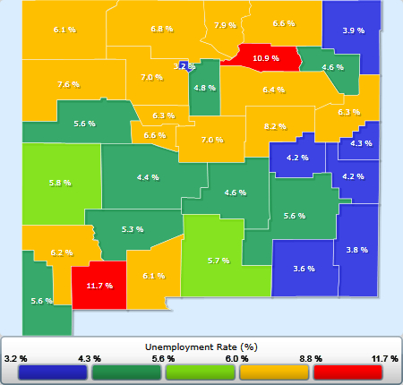
County Unemployment Rates September 2012
6.5
7.2
7.4
4.3
7.1
8.4
7.9
7.8
9.1
4.5
3.1
13.9
13.6
3.8
7.9
3.1
4.2
8.7
6.7
8.1
5.2
7.3
5.5
7.1
7.8
7.2
6.5
8.9
7.2
6.2
11.2
8.2
7.8
7.7
4.4
7.9
4.6
4.2
3.8
8.2
6.0
4.4
5.0
4.8
4.6
5.3
5.5
6.2
6.6
6.1
7.1
6.7
7.2
5.8
4.2
6.6
7.2
4.3
16.9
7.2
4.1
4.0
19.9
5.4
5.9
Not seasonally adjusted
Source: NMDWS LAUS unit in conjunction with US Bureau of Labor Statistics
Notes:
Source is mapping at http://laser.state.nm.us

Slide 16
What’s Next : Employment Projections 2010-2020
Future
From Wikipedia, the free encyclopedia
The future is the indefinite time period after the present. Its arrival is considered inevitable due to the existence of time and the laws of physics.
Notes:
Projections uses the existing long running trends to show what is expected if nothing changes.

Slide 17
National Trends – projected population by age
Source: Population Division, U.S. Census Bureau
Notes:
The demographic shift is 65 and over nationwide. Only marginal changes in 25-64 with little to no change in 18-24. According to the 2010 Census, there were 40.3 million people 65 and older on April 1, 2010, increasing by 5.3 million since the 2000 Census when this population numbered 35.0 million. The percentage of the population 65 and older also increased during the previous decade. In 2010, the older population represented 13.0 percent of the total population, an increase from 12.4 percent in 2000.

Slide 18
NM Population Projections by Age
Source: U.S.Census Bureau, Population Division, Interim State Population
Projections, 2005
Notes:
NM has an out-migration during the 25-44 working years but then it reverses to in-migration 45-64.

Slide 19
NM Employment Projections 2010-2020
Growth of 136,304
Total Change 15.9%
Annual Average Change 1.49%
Source: NMDWS ER&A Projections Unit

Slide 20
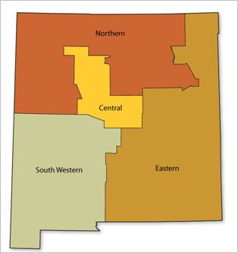
2010-2020 Projections Workforce Investment Areas
Annual
Average
Percent Change
1.40
1.46
1.50
1.43
Source: NMDWS ER&A Projections Unit
Notes:
The different regions in the state are expected to grow at different rates.

Slide 21
NM Job Recovery
Projected
991,600
Max Employment CES
April 2008 at 852,000
Min. Employment
August 2012 at 794,300
Notes:
We may have seen the bottom in jobs losses. When we do, we’ll be talking in terms of job recovery more so than job growth. The new term for this is growth recession.

Slide 22
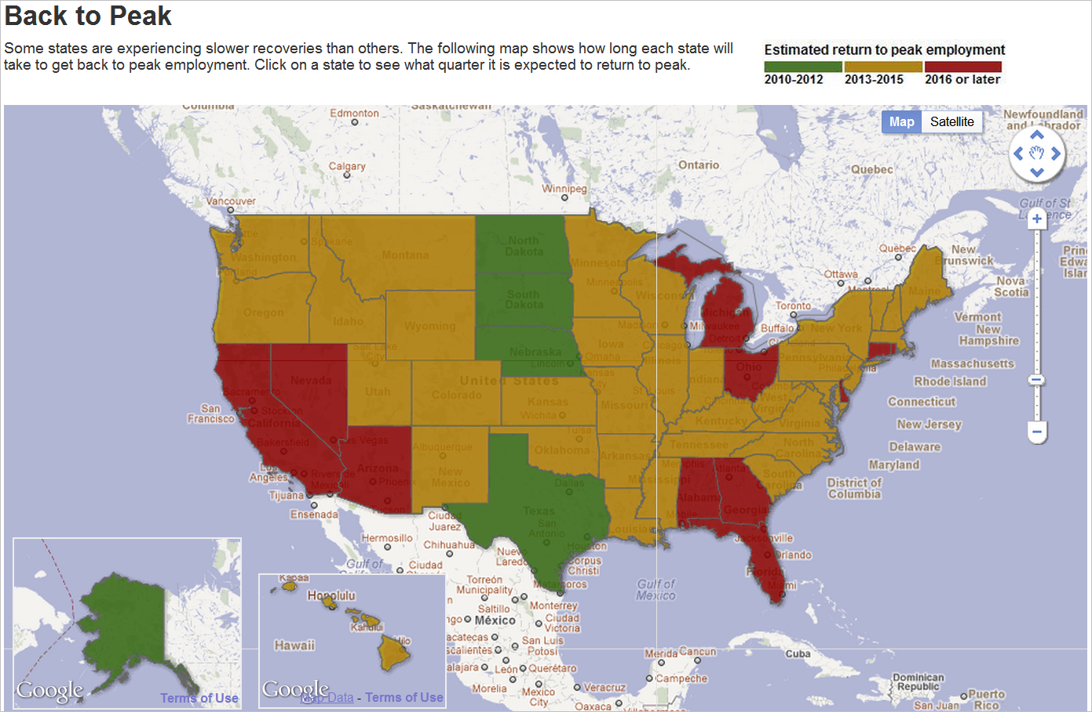
Casselman, Ben. “A State-by-State Look at Long Road to Jobs Recovery.” Wall Street Journal Blog, November 14, 2011
Notes:
http://blogs.wsj.com/economics/2011/11/14/a-state-by-state-look-at-long-road-to-jobs-recovery/tab/interactive/
Some states have already recovered and are above pre-recession employment. Other states are not expected to recover until well after 2016. New Mexico may recover a little earlier depending on Oil and Gas recovery and if Arizona lags effect areas in NM.

Slide 23
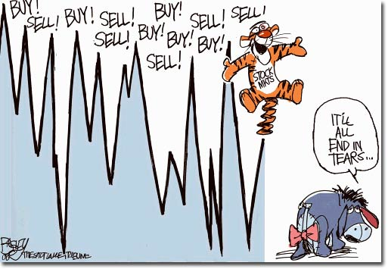
Tigger Slide
Notes:
Tigger Economics beats all the others

Slide 24

Occupations
Notes:
Given the industry data and the current economic situation how do we direct students and others on career choices?

Slide 25
O*NET / SOC 2010 Code Structure
Sample code : 15-1152.00 Title: Computer Network Support Specialists
Organized into Groups:
11- Management Occupations
13- Business & Financial Operations Occupations
15- Computer and Mathematical Occupations
17-Architecture and engineering Occupations
19- Life, Physical, and Social Science Occupations
21- Community and Social services Occupations
23- Legal Occupations
25- Education, Training, and Library Occupations
27- Arts, Design, Entertainment, Sports & Related
29- Healthcare Practitioners and Technical Occs.
31- Healthcare Support Occupations
33- Protective Service Occupations
35- Food Preparation & Serving Related Occs.
37- Building & Grounds Cleaning & Maintenance
39- Personal Care and Service Occupations
41- Sales and Related Occupations
43- Office &Administrative Support Wkrs
45- Farming, Fishing, and Forestry Occs.
47- Construction and Extraction Occs.
49- Installation, Maintenance, and Repair
51- Production Occupations
53- Transportation and Material Moving
55- Military Specific Occupations
Notes:
Occupations groups as only an economist would organize them. O*net is the coding system that determines how data is collected for occupations. O*net is based on Knowledge, Skills, Abilities and Tasks.

Slide 26
New Mexico Occupational Group
Source: 2010-2020 Estimated Employment Projections Unit NMDWS
Notes:
The order of the occupations did not change from 2010 despite the large losses in construction & mining. Education gains didn’t catch them up.
Note that Healthcare Practitioners & Healthcare support add together are close to the top.

Slide 27
Occupational Employment by Education Needed
Source: 2010-2020 Estimated Employment Projections Unit NMDWS
Notes:
Some college and above account for 29% of employment. Examples of occupations in High school or less are Retail Sales clerk, Cashiers, Food Preparation workers, Waiters & Waitresses, Personal and Home Care Aides, Janitors and Cleaners, Office Clerks etc. What is missing is work experience which would include apprenticeship occupations.

Slide 28

NM 10 Occupations with the Highest Employment
Occupation | 2010 Estimated Employment
Retail Salespersons | 29,637
Cashiers | 19,001
Personal and Home Care Aides | 17,778
Secretaries, Except Legal, Medical, and Executive | 17,486
Registered Nurses | 15,146
Waiters and Waitresses | 15,141
General and Operations Managers | 13,993
Bookkeeping, Accounting, & Auditing Clerks | 13,692
Combined Food Preparation & Serving Workers, Inc. Fast Food | 13,489
Janitors & Cleaners, Except Maids & Housekeeping Cleaners | 13,168
Nationally –
Retail Salespersons and Cashiers make up nearly 6 percent of total US Employment,
OES 2011.
Source: 2010-2020 Estimated Employment Projections Unit NMDWS
Notes:
More informative to look at detailed occupations. These are all entry level positions. Source NMDWS Projections unit.

Slide 29

NM Occupations, Most Annual Openings
Rank | Occupational | 2010-2020 Annual Average Job Openings | 2011 Entry Level Wage (OES)
1 | Retail Salespersons | 1,435 | $17,320
2 | Waiters and Waitresses | 1,114 | $17,260
3 | Cashiers | 1,112 | $17,330
4 | Personal and Home Care Aides | 1,083 | $17,290
5 | Combined Food Preparation & Serving Workers, Inc. Fast Food | 809 | $17,200
6 | Registered Nurses | 667 | $50,290
7 | Home Health Aides | 600 | $20,110
8 | Customer Service Representatives | 501 | $20,850
9 | Elementary School Teachers, Ex Special Education | 500 | $38,410
10 | Laborers & Freight, Stock, & Material Movers | 494 | $17,510
Source: 2010-2020 Estimated Employment Projections Unit NMDWS
Notes:
Most of these are entry level positions. Bright spots for wages are 7 and 11. Home Health Aides can be an entry level to healthcare jobs if paired with education.

Slide 30
Annual Average Openings
* Note:
Four groups with higher Openings due to growth
Source: 2010-2020 Estimated Employment Projections Unit NMDWS
Notes:
* Occupations that have higher number of openings due to growth instead of replacement rates.

Slide 31

Highest Growth Jobs in NM
Occupations | 2010-2020 Annual Percent Change
Home Health Aides | 4.8%
Personal and Home Care Aides | 4.3%
Coaches and Scouts | 3.9%
Helpers--Carpenters | 3.6%
Interpreters and Translators | 3.6%
Meeting and Convention Planners | 3.6%
Roustabouts, Oil and Gas | 3.4%
Diagnostic Medical Sonographers | 3.3%
Derrick Operators, Oil and Gas | 3.3%
Rotary Drill Operators, Oil and Gas | 3.2%
Veterinary Technologists and Technicians | 3.2%
Physical Therapist Assistants | 3.1%
Source: 2010-2020 Estimated Employment Projections Unit NMDWS
Notes:
Note the number of healthcare jobs on this list. Actuaries are small numbers.

Slide 32

NM Occupations – High Wage & Growth
Rank | Occupational Title | 2011 Annual Average Wage (OES) | 2010-20 Annual Job Growth
1 | Radio Mechanics | $46,290 | 5.1%
2 | Interpreters and Translators | $53,200 | 3.6%
3 | Meeting and Convention Planners | $49,500 | 3.6%
4 | Roustabouts, Oil and Gas | $34,150 | 3.4%
5 | Diagnostic Medical Sonographers | $67,240 | 3.3%
6 | Derrick Operators, Oil and Gas | $49,910 | 3.3%
7 | Rotary Drill Operators, Oil and Gas | $63,980 | 3.2%
8 | Philosophy and Religion Teachers, Postsecondary | $60,870 | 3.2%
9 | Physical Therapist Assistants | $37,730 | 3.1%
10 | Financial Examiners | $79,940 | 3.0%
Source: 2010-2020 Estimated Employment Projections & Occupational Employment Survey Units NMDWS
Notes:
Note Oil & Gas related and Healthcare fields.

Slide 33

Show me the money!
12 Highest paying jobs in New Mexico 2011 Occupation | Annual Median Wage (OES )
Psychiatrists | $180,740
Family and General Practitioners | $174,990
Pediatricians, General | $166,810
Dentists, General | $157,380
Dentists, All Other Specialists | $141,600
Health Specialties Teachers, Postsecondary | $134,610
Engineering Managers | $131,290
Pharmacists | $117,040
Air Traffic Controllers | $114,050
Engineers, All Other | $111,100
Materials Scientists | $111,090
Natural Sciences Managers | $106,360
Podiatrists | $104,210
Source: Occupational Employment Survey (OES) Unit NMDWS
Notes:
Family and General Practitioners are Doctors. All these occupations involve specialized training. Any surprises? Source is the Occupational Employment Survey (OES) New Mexico Department of Workforce Solutions found at laser.state.nm.us .

Slide 34

Lowest Paying Jobs in New Mexico
Occupation | 2011 Average Annual Wage (OES)
Baggage Porters and Bellhops | $18,580
Maids and Housekeeping Cleaners | $18,570
Graders and Sorters, Agricultural Products | $18,560
Umpires, Referees, and Other Sports Officials | $18,390
Farmworkers and Laborers, Crop, Nursery, and Greenhouse | $18,350
Food Preparation and Serving Related Workers, All Other | $18,310
Pressers, Textile, Garment, and Related Materials | $18,310
Counter Attendants, Cafeteria, Food Concession, and Coffee Shop | $18,300
Dishwashers | $18,270
Child Care Workers | $18,260
Source: Occupational Employment Survey (OES) Unit NMDWS
Notes:
One can argue that tipped occupations shouldn’t be on this list. I would argue that tipped occupations might not involve a 40 hour work week.

Slide 35

The Top 15 NM Occupations in Decline 2010-2020
Occupation Title | Annual Percent Change
Postal Service Clerks | -6.0%
Postal Service Mail Sorters, Processors, and Processing Machine Operators | -6.0%
Prepress Technicians and Workers | -3.6%
Postmasters and Mail Superintendents | -2.7%
Switchboard Operators, Including Answering Service | -2.7%
Desktop Publishers | -2.5%
Office Machine Operators, Except Computer | -1.9%
Jewelers and Precious Stone and Metal Workers | -1.7%
Camera Operators, Television, Video, and Motion Picture | -1.5%
Radio and Television Announcers | -1.4%
Pressers, Textile, Garment, and Related Materials | -1.4%
Motion Picture Projectionists | -1.3%
Gaming Change Persons and Booth Cashiers | -1.3%
Reporters and Correspondents | -1.3%
Floral Designers | -1.2%
Notes:
Note the declines in Postal workers is due to decrease in mail services, the internet has caused changes in the way business is conducted. Even while there are significant decreases job openings will still occur in these occupations. Source is Projections Unit NMDWS

Slide 36
Detailed job profile for nearly 800 occupations
Job Description +knowledge, skills, tasks, abilities
SOC and O*NET
Training Program Completers
Classification of Instructional Programs (CIP) crosswalk Many-to-Many
Typical Education Requirements
Wage Statistics by area and industry
Employment Projections
Employment by Industry
Area’s available:
Statewide,
4 MSA’s,
4 Workforce Investment Regions
Notes:
No occupation county data for wages or projections because of confidentiality.

Slide 37

Tools for LMI
Career Solutions : http://www.dws.state.nm.us/careersolutions/
LASER: http://laser.state.nm.us/
NM Workforce Connection: https://www.jobs.state.nm.us/
Green Jobs: http://www.greenjobs.state.nm.us
National http://careeronestop.org/
O*NET lookup http://www.onetonline.org/
O*NET Academy http://www.onetacademy.org/

Slide 38
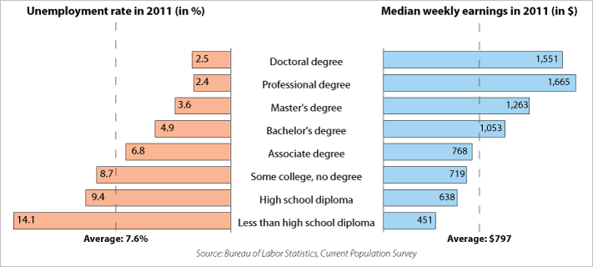
Education Pays
Notes:
Statistics that support why career exploration is so important to ones current and future financial security. http://www.bls.gov/emp/ep_chart_001.htm

Slide 39
Thank You!
Suzan Reagan
E-mail suzan.reagan@state.nm.us
Phone (505) 383-2731

