Slide 1
The Great Recession
2007-2009
The recovery has started, really.
March 2012
Suzan Reagan, Labor Economist

Slide 2

Labor Market Information
Job Descriptions
Education
Wages
Employment levels
Future Growth
Notes:
The Labor Market is like the Stock Market. In the stock market people buy, sale and trade stocks. In the Labor Market anyone with a job participates and trades time, skills and work for income. LMI is anything that is related to work.

Slide 3
Agenda
NM Economic Situation
Industry
Recession History/impact of
Current Situation
What’s Next
Occupations
Sources of Data
Career Solutions
LASER
Notes:
Agenda

Slide 4

The Great Recession
Started December 2007
Housing Peaked on 2006
High Oil and Gas prices early 2007
Financial Markets in August 2007
Notes:
One of the agreed upon indications of a recession is two or more consecutive quarters of GDP decline which occurred Dec. 2007. The primary

Slide 5

Housing
Notes:
This is why we lost over 11,000 jobs in construction. Last year we just went over 4000. No recovery in sight for new housing. http://research.stlouisfed.org/fred2/series/NMBPPRIV/downloaddata?rid=148&soid=19

Slide 6
Oil Rig
Notes:
State Revenue depends in part on oil & gas taxes. http://octane.nmt.edu/gotech/Rigcount/monthlyavg_rigcount.aspx?year=2012

Slide 7

Manufacturing
Values above 50
represent expansion.
.
Notes:
In the mid 70’s and 80’ high inflation and energy costs effected manufacturing. http://research.stlouisfed.org/fred2/data/NAPM.txt

Slide 8
US Retail Sales
Notes:
A combination of the financial market meltdown and consumer fear had a major impact on consumer spending. Consumer spending accounts for about 70 percent of U.S. gross domestic product. http://www.census.gov/retail/marts/www/download/text/adv44y72.txt

Slide 9
NM vs. US Employment
NM
US
In thousands
NM vs. US Employment from 1990 to Present
Total Non-Farm Employment Seasonally Adjusted
Notes:
You can see the dips the US took thru previous recessions…Because we have gov’t and energy jobs, NM did better until this one.

Slide 10

How BAD?
NM Total Non-Farm Employment Seasonally Adjusted:
Max September 2008: 852,900
Min January 2011: 795,700
Difference: -57,200
January 2008: 841,900
January 2012: 802,100
Difference: -39,800
Labor Market Supply and Demand!
Notes:
New Mexico lost about 57,000 jobs. We currently are doing better but still have a lot of ground to make up. This is the job supply and a consequence of increase demand with decreasing supply is for wages to decline.

Slide 11
NM Industries Change
How Has New Mexico Handled the Recession?
Mining lost over 500
Construction shed about 16,000
Manufacturing lost another 8,000
Retail took a hit with 6,000
Admin & Waste Svs 5,000
Bright spot Health Care +12,000
Source: Quarterly Census of Employment and Wages NM Dept. of Workforce Solutions
Notes:
The reason health care is given so much focus is because they have significantly added jobs during this recession.

Slide 12
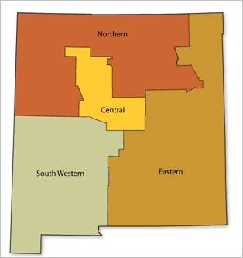
Central Area Industry Change
Source: Quarterly Census of Employment and Wages NM Dept. of Workforce Solutions
Notes:
Central area is very similar to the statewide. The industries with 0 didn’t change and/or had little employment to start with. *Some of the counties in this region had suppressed data for this industry

Slide 13
Eastern Area Industry Change
Source: Quarterly Census of Employment and Wages NM Dept. of Workforce Solutions
Notes:
Eastern Area is very different from statewide. Growth in Construction & Manufacturing is related to the uranium enrichment plant and other energy generation projects. *Some of the counties in this region had suppressed data for this industry

Slide 14
Northern Area Industry Change
Source: Quarterly Census of Employment and Wages NM Dept. of Workforce Solutions
Notes:
Northern area was especially hit hard by the recession. *Some of the counties in this region had suppressed data for this industry

Slide 15
Southwestern Area Industry Change
Source: Quarterly Census of Employment and Wages NM Dept. of Workforce Solutions
Notes:
Grants county had the mine re-open, Las Cruces continues to show some signs of growth during this recession. *Some of the counties in this region had suppressed data for this industry

Slide 16
NM Employment Industry Mix
Source: Projections unit 2009-2019, NM Dept. of Workforce Solutions
Notes:
Gov employment in Health and Ed. – Healthcare is the largest sector by employment. Small slices by employment Utilities, Real Estate & Agriculture, still have large monetary impact on the economy.

Slide 17
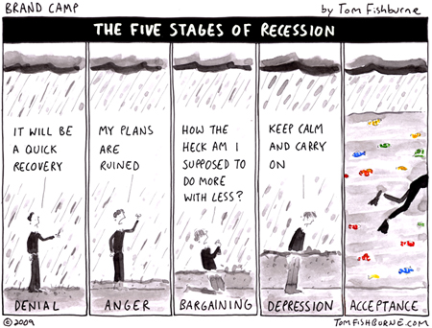
The Great Recession Ended July 2009?
Notes:
The US economy stopped contracting June 2009 and showed an increase in July 2009. Employment will be slower to recover which is a characteristic that makes this recession different from other recent ones.

Slide 18

Current Employment Situation
The unemployment rate for:
January 2012 January 2011
The US is at 8.3% 9.1%
New Mexico 7.0% 8.7%
Albuquerque 7.1% 9.0 %
Las Cruces 6.7% 8.6 %
Santa Fe 5.1% 7.3 %
Farmington 6.7% 9.4 %
The bad news is…
Seasonally Adjusted
Notes:
Unemployed and actively seeking employment in the last month. A very narrow definition of economic hardship. We expect a spike in unemployment as employers begin advertise job openings and add more jobs again.

Slide 19
What about…
Part time but would work full time
Discouraged unemployed workers
Multiple job holders
Alternative Measures of Labor Underutilization U-6
NM 14.8%
Fourth Quarter of 2010 through Third Quarter of 2011 Averages.
Unemployed
Part time for economic reasons
Multiple Jobs holders
Marginally attached workers
Bureau of Labor Statistics
4 QTR Moving Average
http://www.bls.gov/lau/stalt.htm
Notes:
http://www.bls.gov/lau/stalt.htm broader measure of “unemployment” that fits closer with perceptions of the difficult economy and the hardships experienced by workers.

Slide 20
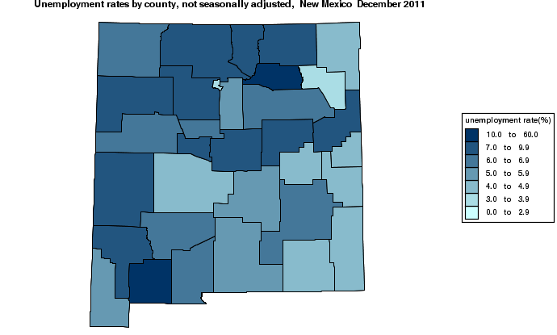
County Unemployment Rates
6.5
7.2
7.4
4.3
7.9
3.1
13.6
3.8
7.9
7.8
6.7
5.2
6.5
7.1
7.8
8.9
7.8
4.4
7.9
4.2
6.0
4.4
4.8
5.3
6.2
6.1
7.1
5.8
4.2
6.6
4.0
16.9
5.4
Notes:
Source is the Mapping tool at http://data.bls.gov/map/

Slide 21

NM UI Continued Claims Duration
Based on UI Summary Data 2nd Qtr 2011:
Average Duration 21.5 weeks in 2010
Notes:
Prior to this recession duration of claims in the 52+ was a very small percentage. Workers who have been out of the workforce for big blocks of time have to overcome employers questions on work skills being current.

Slide 22
US Unemployment Rates for Men and Women
Source: US Bureau of Labor Statistics, Current Population Survey
Notes:
For many years, men's unemployment rates were generally lower than women's both during and between recessions. However, since the early 1980s when labor force participation rates evened out between men and women, men's unemployment rates have been higher than women's during or immediately after recessions, and the rates for men and women have been quite similar in other periods. Higher unemployment among men was especially notable during and immediately after the recent recession.

Slide 23

New Mexico Unemployment Rate by Age
2011 annual averages
7.4%
Source: Census Geographic Profile of Employment and Unemployment
Notes:
During recessions youth tend to have higher unemployment rates and this one has not been an exception. Mom and Dad they really can’t find a job. Annual Average UR was 7.4%

Slide 24
New Mexico 2010 Unemployment Rate
Source: 2010 American Community Survey 1-Year Estimates
Notes:
Unemployment rates very by race in which minority groups tending to have higher unemployment.

Slide 25
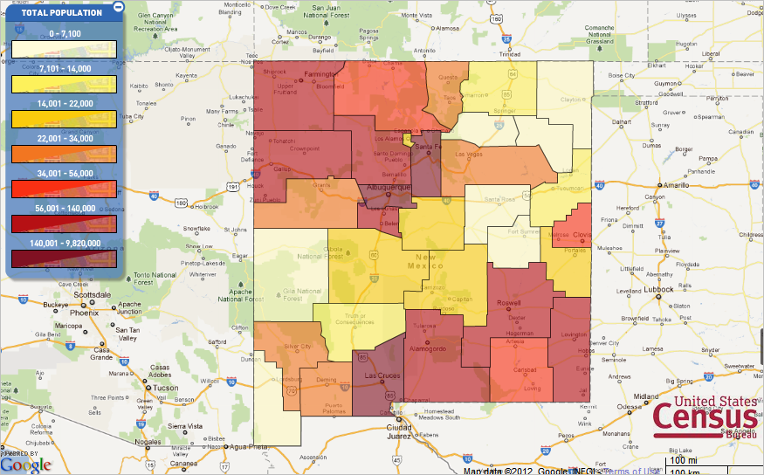
2010 Census Population by County
Notes:
From the US Census Mapping tool at http://2010.census.gov/2010census/popmap/ full release of data will happen May 4th and map will also show Race, Ethnicity, Age/Sex and Household data.

Slide 26
National Trends – projected population by age
Source: Population Division, U.S. Census Bureau
Notes:
The demographic shift is 65 and over nationwide. Only marginal changes in 25-64 with little to no change in 18-24. According to the 2010 Census, there were 40.3 million people 65 and older on April 1, 2010, increasing by 5.3 million since the 2000 Census when this population numbered 35.0 million. The percentage of the population 65 and older also increased during the previous decade. In 2010, the older population represented 13.0 percent of the total population, an increase from 12.4 percent in 2000.

Slide 27
NM Population Projections by Age
Source: U.S.Census Bureau, Population Division, Interim State Population
Projections, 2005
Notes:
NM has an out-migration during the 25-44 working years but then it reverses to in-migration 45-64.

Slide 28
NM Employment Projections
Annual Average Percent Change 0.97

Slide 29
NM Job Recovery
Projected
958,000
Max Employment
Sept. 2008
at 852,900
Minimum Employment January 2011 at 795,700
Notes:
We may have seen the bottom in jobs losses. When we do, we’ll be talking in terms of job recovery more so than job growth. The new term for this is growth recession. National based estimates are at 2014-2015 with some states lagging such as Michigan being as late as 2019.

Slide 30
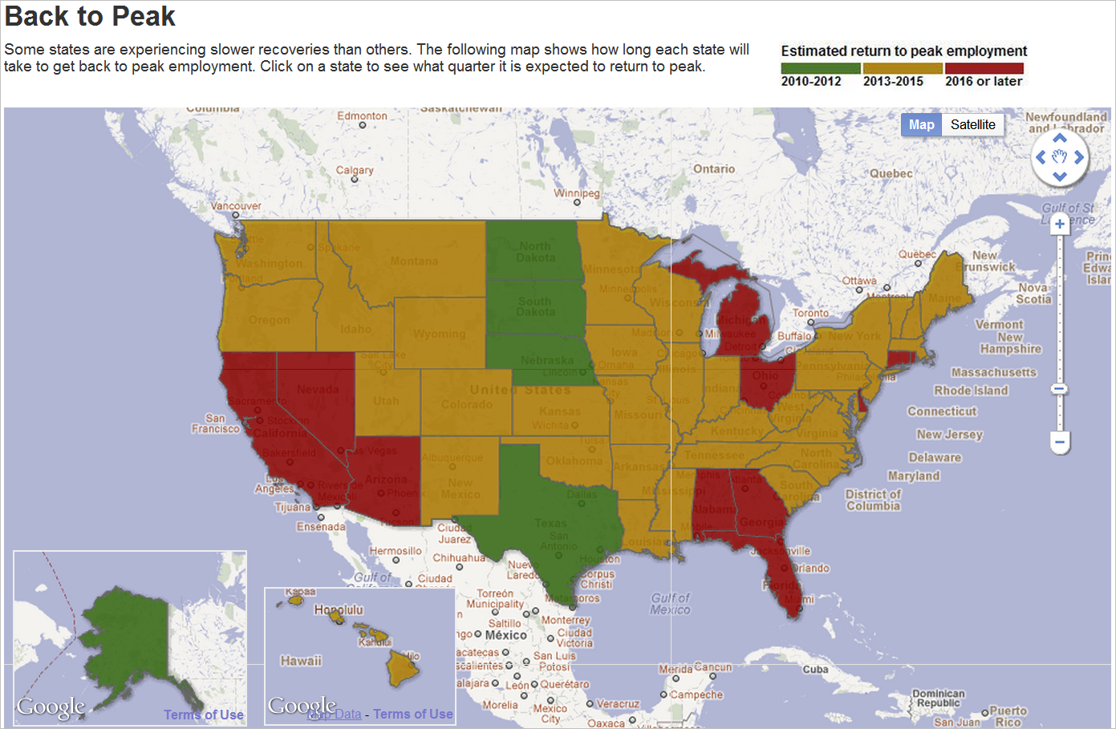
Casselman, Ben. “A State-by-State Look at Long Road to Jobs Recovery.” Wall Street Journal Blog, November 14, 2011
Notes:
http://blogs.wsj.com/economics/2011/11/14/a-state-by-state-look-at-long-road-to-jobs-recovery/tab/interactive/

Slide 31
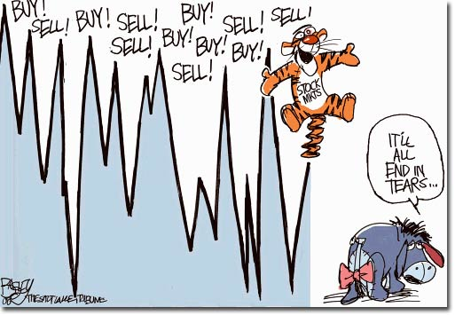
Tigger Slide
Notes:
Tigger Economics beats all the others

Slide 32

Occupations
Notes:
Given the industry data and the current economic situation how do we direct students and others on career choices?

Slide 33
O*NET / SOC 2010 Code Structure
Sample code : 15-1152.00 Title: Computer Network Support Specialists
Organized into Groups:
11- Management Occupations
13- Business & Financial Operations Occupations
15- Computer and Mathematical Occupations
17-Architecture and engineering Occupations
19- Life, Physical, and Social Science Occupations
21- Community and Social services Occupations
23- Legal Occupations
25- Education, Training, and Library Occupations
27- Arts, Design, Entertainment, Sports & Related
29- Healthcare Practitioners and Technical Occs.
31- Healthcare Support Occupations
33- Protective Service Occupations
35- Food Preparation & Serving Related Occs.
37- Building & Grounds Cleaning & Maintenance
39- Personal Care and Service Occupations
41- Sales and Related Occupations
43- Office &Administrative Support Wkrs
45- Farming, Fishing, and Forestry Occs.
47- Construction and Extraction Occs.
49- Installation, Maintenance, and Repair
51- Production Occupations
53- Transportation and Material Moving
55- Military Specific Occupations
Notes:
Occupations groups as only an economist would organize them. O*net is the coding system that determines how data is collected for occupations. O*net is based on Knowledge, Skills, Abilities and Tasks.

Slide 34
NM Occupational Category Employment 2009
Source: NM Department of Workforce Solutions Economic Research & Analysis Bureau
Notes:
The order of the occupations did not change from 2008 despite the large losses in construction & mining. Education gains didn’t catch them up.

Slide 35
NM Occupational Group Annual Average Percent Change 2009-2019
Notes:
Note declining occupations are Ag and Manuf. Healthcare jobs are in two of the areas of high growth. Construction should turn around and show modest increases.

Slide 36
Occupational Employment by Education Needed
Source: 2009-2019 Estimated Employment Projections Unit NMDWS
Notes:
Short-term on-the-job training occupations are Retail Sales clerk, Cashiers, Food Preparation workers, Waiters & Waitresses, Personal and Home Care Aides, Janitors and Cleaners, Office Clerks etc.

Slide 37

10 Occupations with the Highest Employment In New Mexico
Occupation | 2009 Estimated Employment
Retail Salespersons | 29,520
Cashiers | 20,684
Combined Food Preparation & Serving Workers, Including Fast Food | 17,194
Secretaries, Except Legal, Medical, and Executive | 17,162
Construction Laborer | 14,853
Waiters and Waitresses | 14,496
Personal and Home Care Aides | 14,441
General and Operations Managers | 14,048
Janitors and Cleaners, Except Maids & Housekeeping Cleaners | 13,873
Bookkeeping, Accounting, and Auditing Clerks | 13,692
Notes:
More informative to look at detailed occupations. These are all entry level positions.

Slide 38

NM Occupations, Most Annual Openings
Rank | Occupational | Annual Average Job Openings | 2009 Entry Level Wage (OES)
1 | Retail Salespersons | 1,167 | $16,746
2 | Cashiers | 1,120 | $16,117
3 | Waiters and Waitresses | 939 | $16,292
4 | Personal and Home Care Aides | 882 | $17,477
5 | Combined Food Preparation & Serving Workers, Including Fast Food | 851 | $16,252
6 | Customer Service Representatives | 682 | $21,289
7 | Registered Nurses | 539 | $48,863
8 | Home Health Aides | 524 | $17,548
9 | First-Line Supervisors/Managers of Retail Sales Workers | 411 | $21,169
10 | Stock Clerks & Order Fillers | 401 | $17,158
11 | Elementary School Teachers, Ex Special Education | 369 | $39,581
Notes:
Most of these are entry level positions. Bright spots for wages are 7 and 11. Home Health Aides can be an entry level to healthcare jobs if paired with education.

Slide 39
Highest Growth Jobs in NM
Occupations | 2009-2019 Annual Percent Change
Network Systems and Data Communications Analysts | 4.2%
Home Health Aides | 4.0%
Actuaries | 3.9%
Personal and Home Care Aides | 3.9%
Petroleum Engineers | 3.8%
Self-Enrichment Education Teachers | 3.4%
Medical Equipment Repairers | 3.4%
Pharmacy Technicians | 3.0%
Physical Therapist Aides | 2.8%
Compliance Officers, Except Agriculture, Construction, Health and Safety, and Transportation | 2.7%
Painting, Coating, and Decorating Workers | 2.7%
Medical Assistants | 2.6%
Notes:
Note the number of healthcare jobs on this list. Actuaries are small numbers.

Slide 40

NM Occupations – High Wage & Growth
Rank | Occupational Title | 2009 Annual Entry level Wage (OES) | 09-19 Annual Job Growth
1 | Network Systems & Data Communications Analysts | $40,681 | 4.2%
2 | Petroleum Engineers | $56,763 | 3.8%
3 | Medical Equipment Repairs | $24,841 | 3.1%
4 | Compliance Officers (Environmental, EEO Property, Regulatory) | $31,356 | 2.7%
5 | Radiation Therapists | $46,765 | 2.6%
6 | Physical Therapists | $41,922 | 2.6%
7 | Dental Hygienists | $27.51hrly | 2.6%
8 | Cardiovascular Technologists and Technicians | $31,671 | 2.5%
9 | Surgical Technologists | $25,607 | 2.5%
10 | Medical and Clinical Laboratory Technologists | $28,493 | 2.3%
11 | Computer Software Engineers | $52,435 | 2.2%
12 | Training and Development Specialists | $35,539 | 2.2%
13 | Detectives and Criminal Investigators | $42,114 | 2.1%
Notes:
Note healthcare and technology fields.

Slide 41

Show me the money!
12 Highest paying jobs in New Mexico Occupation | Annual Median Wage (OES )
Family and General Practitioners | $167,202
Dentists, General | $163,711
Obstetricians and Gynecologists | $163,216
Pediatricians, General | $161,955
Podiatrists | $131,556
Engineering Managers | $126,672
Actuaries | $123,353
Nuclear Engineers | $119,862
Law Teachers, Postsecondary | $117,219
Agricultural Sciences Teachers, Postsecondary | $113,687
Air Traffic Controllers | $108,423
Pharmacists | $104,506
Notes:
Family and General Practitioners are Doctors. All these occupations involve specialized training. Any surprises?

Slide 42

Lowest Paying Jobs in New Mexico
Occupation | 2009 Annual Median Wage (OES) | 2009 Hourly Median Wage (OES)
Ushers, Lobby Attendants, and Ticket Takers | $16,090 | $7.74
Textile Cutting Machine Setters, Operators, and Tenders | $16,222 | $7.80
Baggage Porters and Bellhops | $16,414 | $7.89
Combined Food Preparation and Serving Workers, Including Fast Food | $16,424 | $7.90
Cleaning, Washing, and Metal Pickling Equipment Operators and Tenders | $16,475 | $7.92
Costume Attendants | $16,495 | $7.93
Farmworkers and Laborers, Crop, Nursery, and Greenhouse | $16,606 | $7.98
Designers, All Other | $16,617 | $7.99
Waiters and Waitresses | $16,646 | $8.00
Notes:
One can argue that tipped occupations shouldn’t be on this list. I would argue that tipped occupations might not involve a 40 hour work week.

Slide 43

The Top 15 NM Occupations in Decline 2009-2019
Occupation Title | Annual Percent Change
Textile Cutting Machine Setters Optrs | -5.6%
Bindery Workers | -5.5%
Drilling & Boring Machine Tool Optrs , Metal & Plastic | -4.4%
Sewing Machine Operators | -4.4%
Milling & Planing Machine Optrs, Metal & Plastic | -4.3%
Aircraft Cargo Handling Supervisors | -4.3%
Dental Laboratory Technicians | -4.1%
Packaging & Filling Machine Operators | -3.4%
Job Printers | -3.4%
Semiconductor Processors | -3.4%
Jewelers Precious Stone & Metal Workers | -3.3%
Order Clerks | -3.2%
Postal Service Mail Sorters & Processing Machine Optrs | -3.1%
Photographic Processing Machine Optrs | -2.9%
Notes:
Most of these are declining because manufacturing continues to decline. Even Intel has retooled it’s manufacturing site to use less semiconductor processors

Slide 44
Detailed job profile for over 800 occupations
Job Description +knowledge, skills, tasks, abilities
SOC and O*NET
Training Program Completers
Classification of Instructional Programs (CIP) crosswalk Many-to-Many
Typical Education Requirements
Wage Statistics by area and industry
Employment Projections
Employment by Industry
Area’s available:
Statewide,
4 MSA’s,
4 Workforce Investment Regions
Notes:
No occupation county data for wages or projections because of confidentiality.

Slide 45

Tools for LMI
Career Solutions : http://www.dws.state.nm.us/careersolutions/
LASER: http://laser.state.nm.us/
NM Workforce Connection: https://www.jobs.state.nm.us/
Green Jobs: http://www.greenjobs.state.nm.us
National http://careeronestop.org/
O*NET lookup http://www.onetonline.org/
O*NET Academy http://www.onetacademy.org/

Slide 46
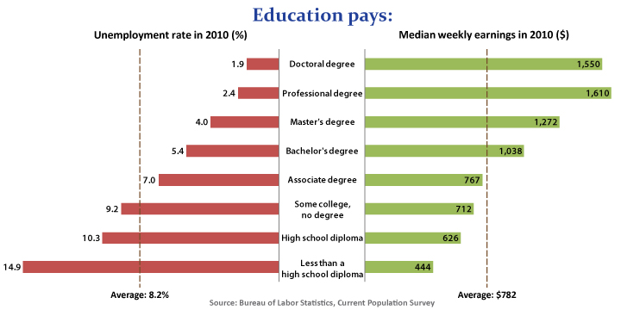
Education Pays
Notes:
Statistics that support why career exploration is so important to ones current and future financial security. http://www.bls.gov/emp/ep_chart_001.htm

Slide 47
Thank You!
Suzan Reagan
E-mail suzan.reagan@state.nm.us
Phone (505) 383-2731
Ashley Leach , Phone (505) 383-2737

