Slide 1
The Minnesota Geospatial Commons is Coming!
Mark Kotz, Chair Geospatial Commons Workgroup
Digital Cadastral Data Committee April 1, 2011

Slide 2
Why Do You Care?
MN: Much data, many services – more coming
No single web location to find or share
Especially Geo apps and web services
Opportunity!!!

Slide 3
What is the “Commons”?
A single place we all go to find and share geospatial resources

Slide 4
Why “Commons”
“Portal” = where you find. Belongs to some one else.
“Commons” = where you share. Belongs to all.

Slide 5
Who is Working on It?
Joint MnGeo-MetroGIS workgroup
MnGeo
DNR
Met Council
MnDOT
DEED
Scott County

Slide 6
What is the need? Feedback from:
Initial Workgroup
Federal
State
Regional
County
City
Non-profit
User/Producer Survey
Nearly 540 responses
Casual map users to GIS professional

Slide 7
Key Functions
Find
Evaluate
Share
Administer

Slide 8
Key Functions -
Find
Search
Structured interface
Spatial (e.g. bounding box)
Metadata
Google accessible
Catalog (viewable page)
Registry (back end database)

Slide 9
Key Functions -
Evaluate
Metadata viewer
Map viewer
Download data or connect to web services
User Reviews (quality, reliability, etc.)
Web service monitoring

Slide 10
Key Functions -
Share
Publish Metadata
Publish Data for download
Publish Services for consumption
Feeds (RSS & Twitter)

Slide 11
Key Functions -
Administer
User Account
Save searches
Notifications – registered user
Publish
Harvesting (producer & site admin)
Catalog maintenance
Security & User management
Governance

Slide 12
Interface Focus Group
Keep it “really simple like Google”
Quickly get to Find function
Specific query options & results items

Slide 13
6 Query/Filter Items
Query/Filter items that would be valuable
Spatial extent (Could draw a box and/or pick list)
Constrain metadata search (e.g. just title & abstract)
Type of resource
Publisher (could be a pick list)
Date (as range, or by currency, e.g. “within last month”)
ISO theme category
*Note when filtered, it should be obvious to user what elements are in play

Slide 14
8 Quick Results Items
Results elements that would be valuable
Title
Abstract
Type of resource
Browse graphic
Link to full metadata
Link to download dataset or to web service (“add to map” as one option)
Source/Publisher of resource
Last updated date

Slide 15
Interface Thoughts
Find
Evaluate
Share
Administer
Home
Share
Account
Find

Slide 16
Test Implementation
MnGeo hosting
ArcGIS GeoPortal Extension v9.3
Implementing out-of-box functions
Evaluating customization needs

Slide 17
Test Site
Test Bed MN Geospatial Commons

Slide 18
Issues
Searching by keywords needs refining
Not so friendly to MGMG
Metadata for web services needed
Customization work needed

Slide 19
Timeline – Next Steps
Work completed on test implementation
Recommending ESRI product for production portal
Awaiting feedback from project sponsors
Project plan for production Commons
Development of additional functions
Hosting & Staffing
Budget
Timing? Depends on approval & budgets

Slide 20
Final Points
Strong executive commitment for test
Driven by data producers
Solid business needs
Highly talented workgroup
Executive commitment for production?
Next budget cycle????
www.mngeo.state.mn.us/workgroup/commons

Slide 21
Thank You!
Active Workgroup Members
Chris Cialek, MnGeo
Jim Dickerson, MnGeo
Jessica Fendos, DEED
Josh Gumm, Scott County
John Harrison, Mn/DOT
Mark Kotz, Met. Council (Chair)
Susanne Maeder, MnGeo
Chris Pouliot, DNR
Nancy Rader, MnGeo
Hal Watson, DNR
Paul Weinberger, Mn/DOT
Mark Kotz
MN Geospatial Commons Workgroup
GIS Database Administrator
Metropolitan Council
mark.kotz@metc.state.mn.us

Slide 22
Demo of Test Site

Slide 23
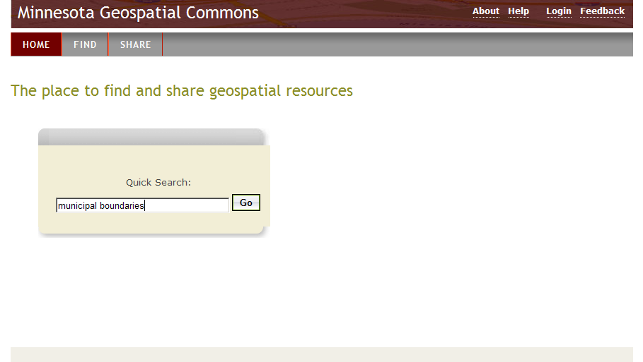

Slide 24
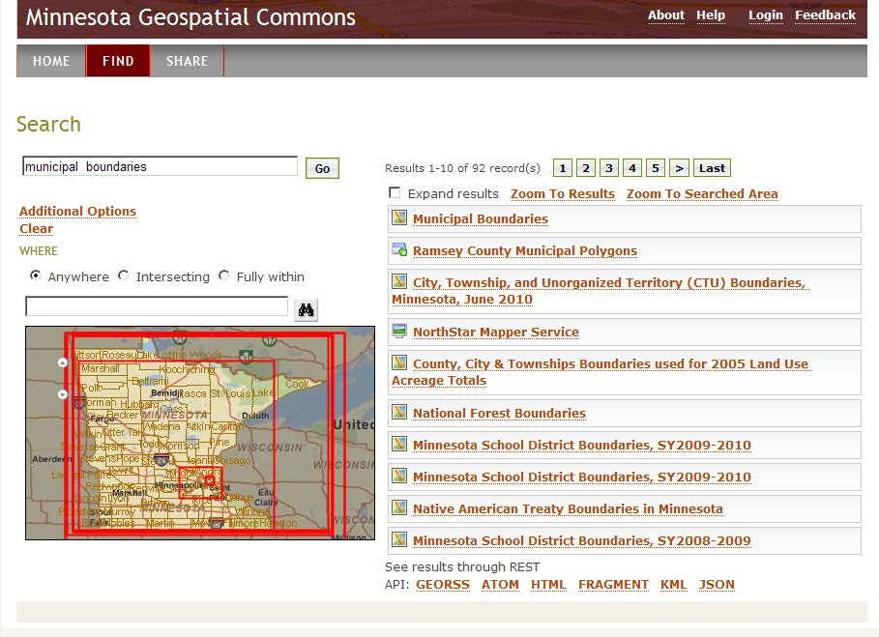

Slide 25
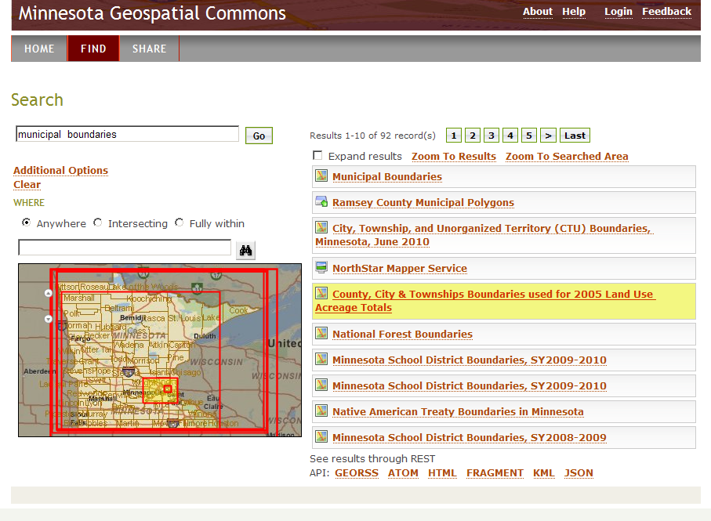

Slide 26
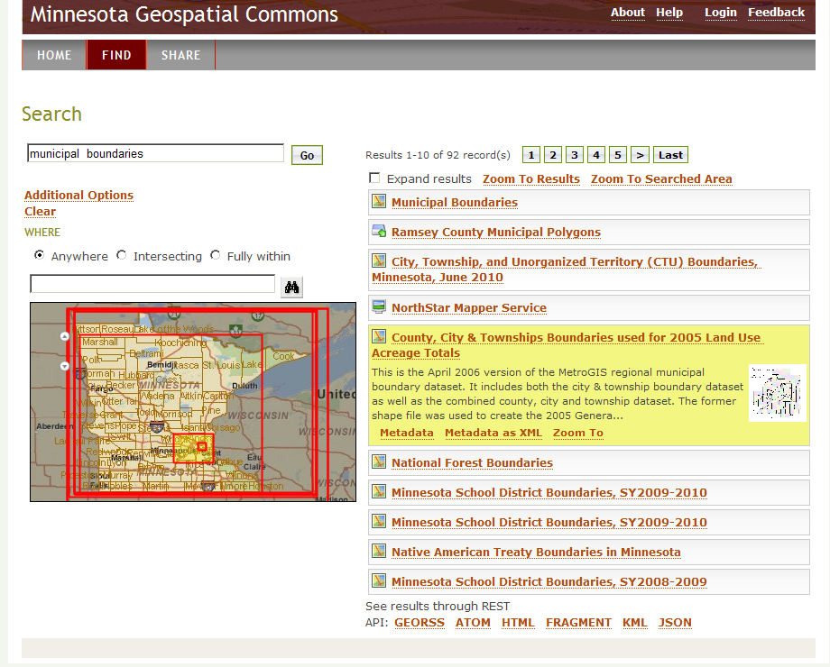

Slide 27
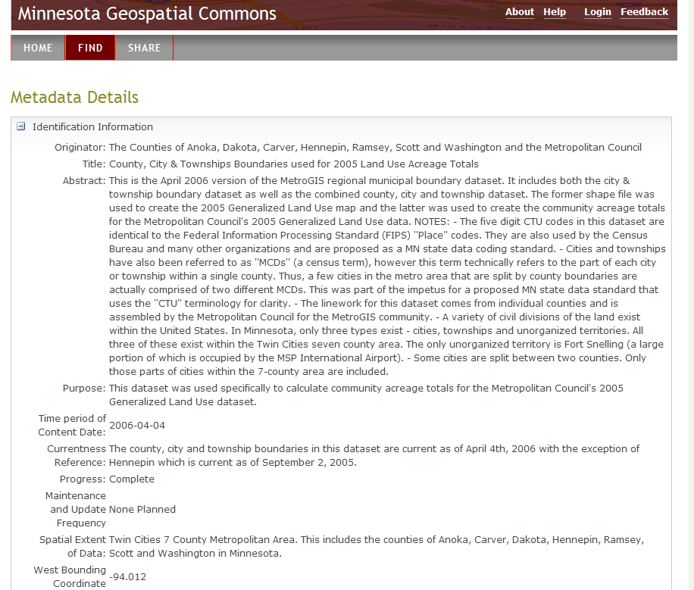

Slide 28
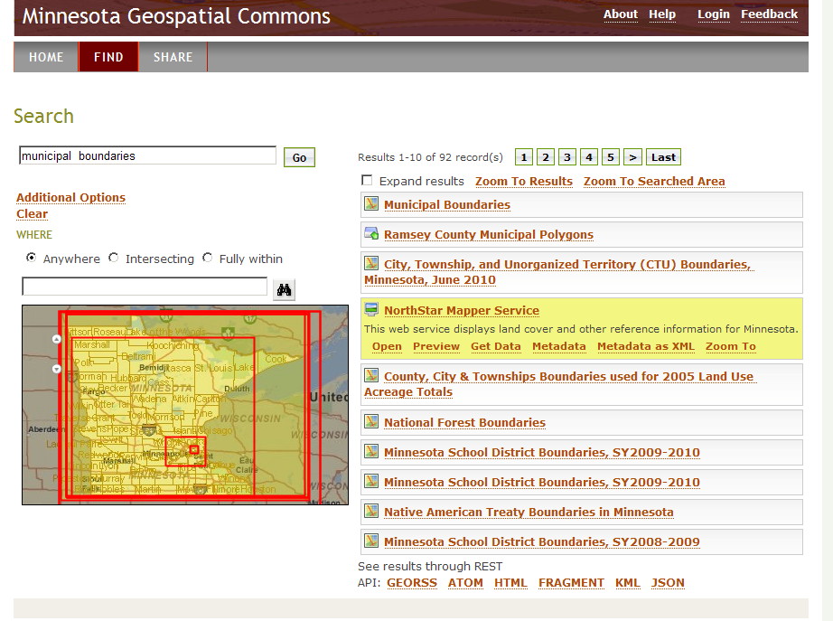

Slide 29
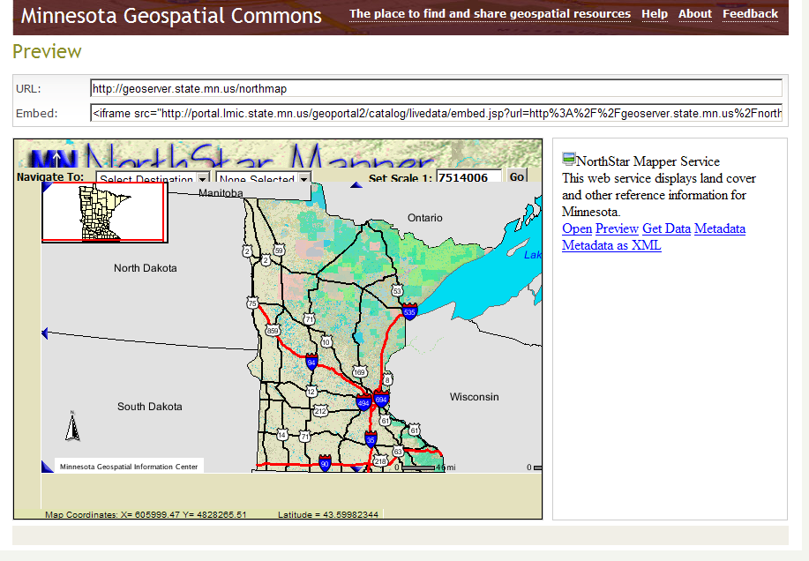

Slide 30
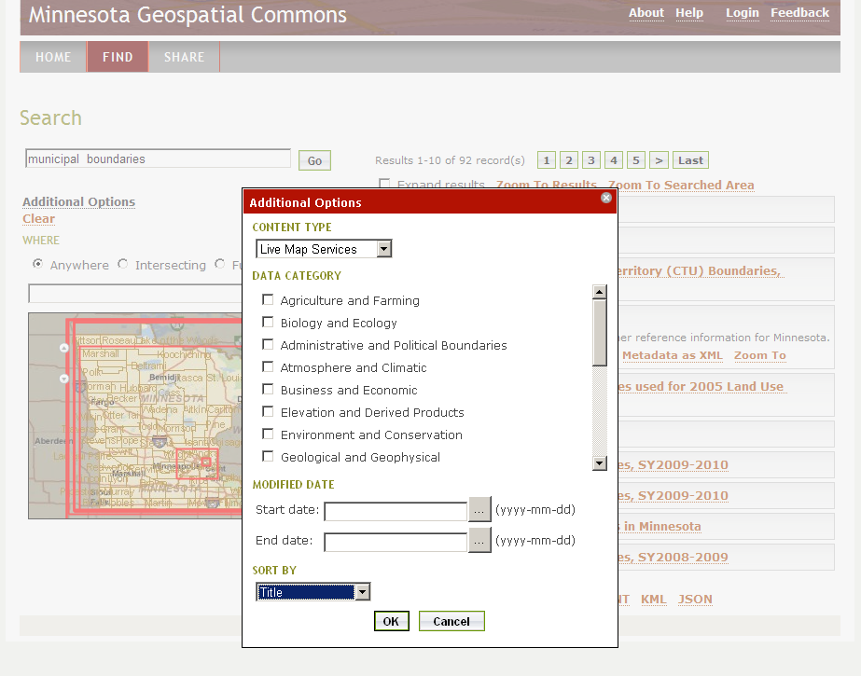

Slide 31
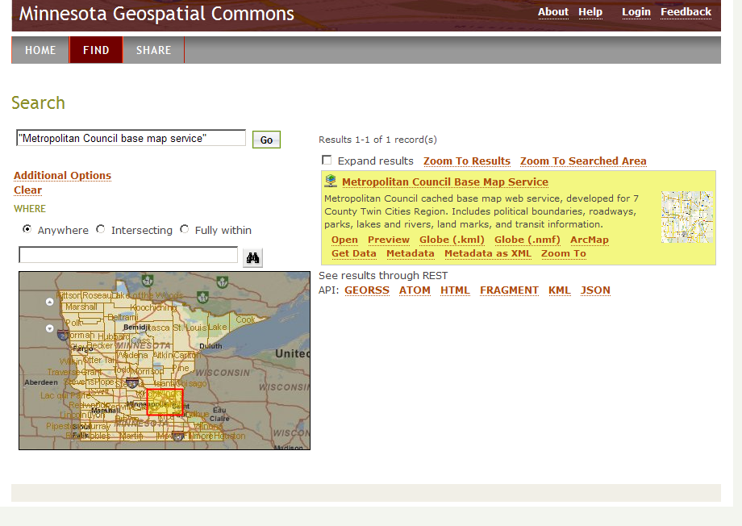

Slide 32
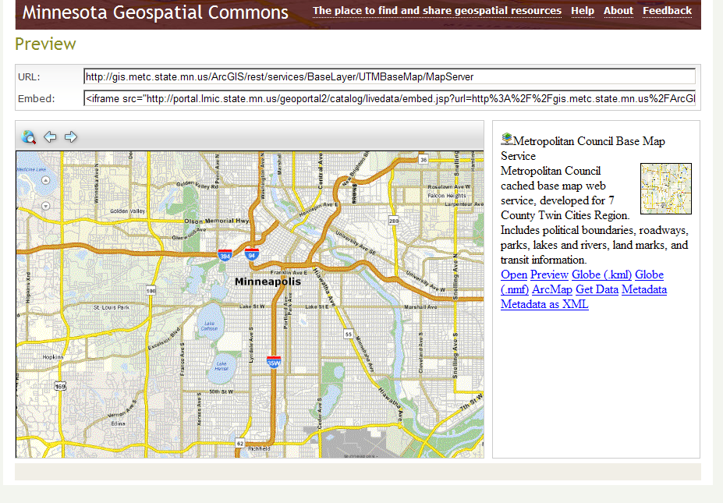

Slide 33
