Slide 1

Minneapolis Saint Paul Regional Economic Development Partnership

Slide 2
MISSION
Accelerate job growth and capital investment in the Greater MSP Region
Notes:
Need to highlight or emphasize the work “recognized”.

Slide 3
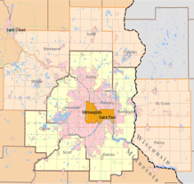

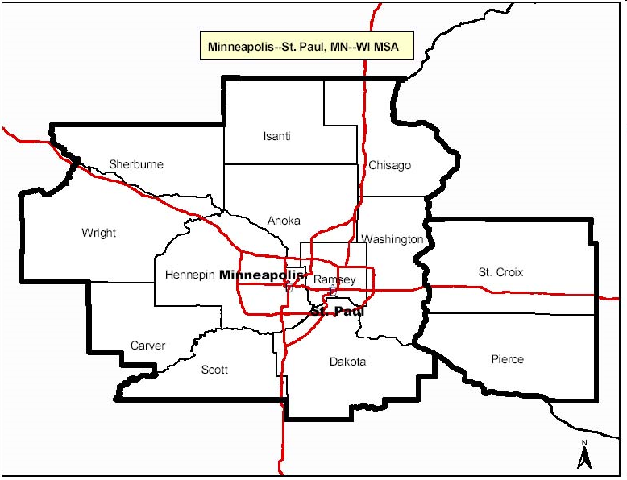


OUR REGION
13 county MSA
$200 billion in GMP
44th largest global economy
More than 3 million residents
3
Notes:
BENCHMARKING VS. COMPARABLE REGIONS
1 Rankings of the 200 largest metro areas based on cost of doing business, educational attainment, income growth, job growth, net migration, cost of living, culture and leisure, and colleges. Decline driven by rising cost of doing business (fell from 103rd to 172nd), crime rate (47th to 89th) and low job growth (fell from 116th to 130th)
2 Ranking of the 200 largest metro areas based on job growth, wages/salaries growth, relative high tech GDP, and high tech GDP location quotient (measure of high-tech concentration). Decline driven by low job growth (fell from 89th to 123rd) and low wage growth (fell from 51st to 149th)
SOURCE: Forbes; Milken

Slide 4





REGIONAL ASSETS OF STRENGTH
Financial advisory
Banking
Insurance
Bio tech
Healthcare providers
Healthcare payers and IT
Medical devices
Financial Services
& Insurance
Health & Life Sciences
R&D centers
Software/ IT
Advanced manufacturing
Energy/ renewables
Corporate headquarters
Creative services
Professional services
Data centers
Innovation & Technology
Headquarters & Business Services
Food processors
Food production
Food & Agribusiness
Agrichemicals
Seed production

Slide 5
ELEVATOR SPEECH
History of prosperity
Large and diverse private sector
Talented workforce
Culture of research and development

Slide 6
KEEPING COMPETITIVE
Cost of doing business
Human capital and infrastructure
Economic development toolkit

Slide 7
GOAL
A total increase of 100,000 jobs in
100,000 New Jobs
25% Margin
of Excellence
22,700 Total New Jobs
margin of excellence
2012
2013
2016

Slide 8
PROSPER
The Momentum is Building

Slide 9
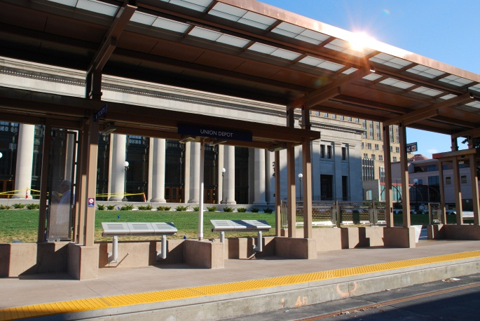
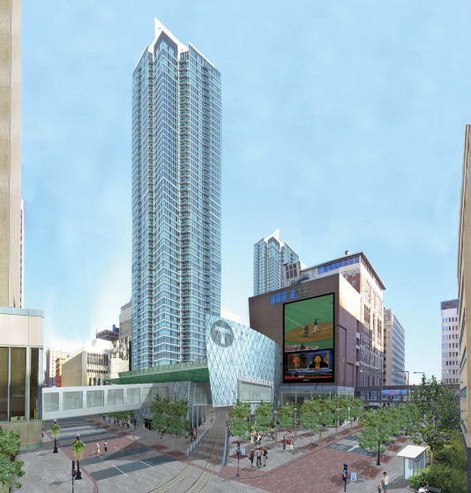

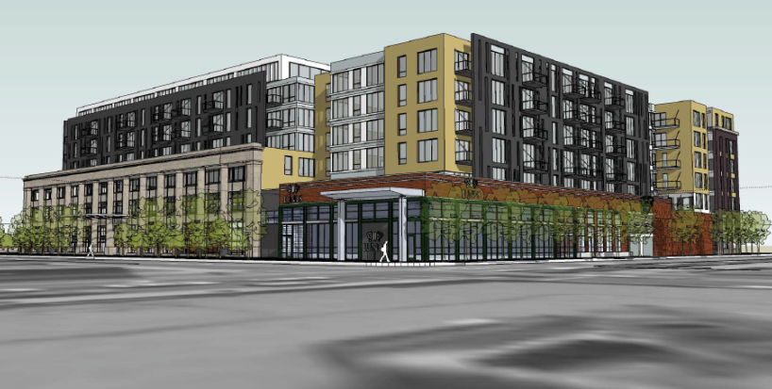
PRIVATE & PUBLIC INVESTMENT
$8 Billion

Slide 10
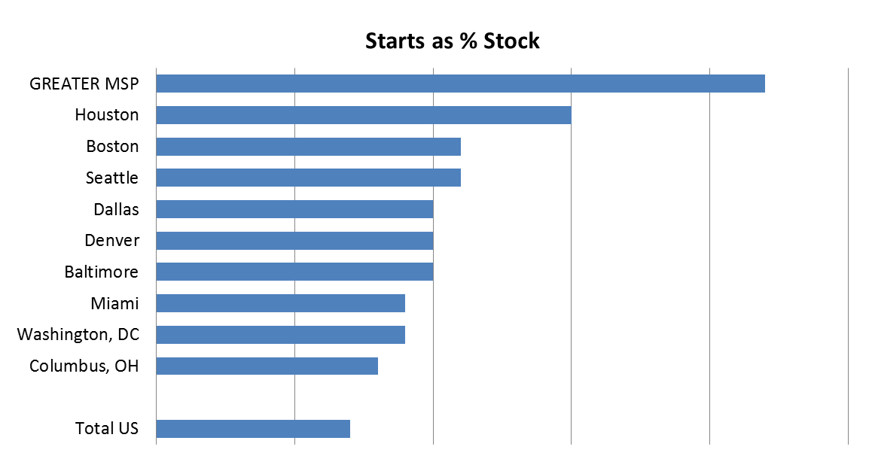
LEADING THE U.S. IN CONSTRUCTION STARTS
0%
.5%
1.0%
1.5%
2.0%
2.5%
Source: McGraw-Hill, and Citi Research, 9/21/12

Slide 11
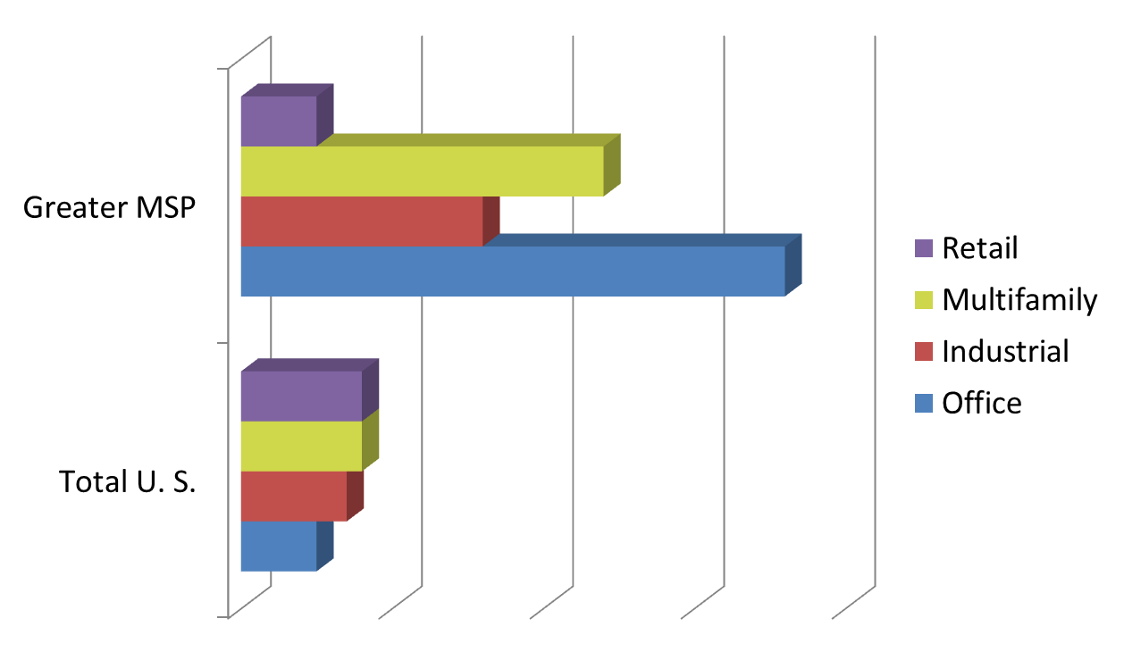
LEADS IN MOST TYPES OF STARTS
0%
1.0%
2.0%
3.0%
4.0%
Source: McGraw-Hill, and Citi Research, 9/21/12

Slide 12

MSP EXPORT INITIATIVE

Slide 13
REGIONAL MOMENTUM IS BUILDING
Great regional cooperation
Capital Investment is up
On track to add 100,000 jobs by 2016
The region must make century decisions to ensure we continue to Prosper.

