Slide 1
OneMinnesota
January 25, 2012
Carolyn Parnell
OET Commissioner and State CIO

Slide 2
IT Consolidation
The largest state government reorganization in decades
Current model: State IT employees working in more than 70 separate agencies, each with its own organizational culture and technology solutions
To: One organization with common policies and standards
Legislative requirements
One centralized IT organization
One centralized IT budget
One Statewide project portfolio
Statewide IT efficiencies

Slide 3
IT Consolidation Planning and Implementation
Four Phases:
HR and finance foundation – 7/11 – 9/11
Agency and IT centralization planning – 10/11 – 1/12
Enterprise strategic planning and governance – 11/1 – 4/12
Service optimization – 4/12 and beyond

Slide 4
Enterprise Consolidation Program
Projects & Deliverables
Agency Centralization
Central Org Planning
Enterprise Human Resources
Finance
Service Level Agreements
State IT Governance
Strategic Planning
Agency Planning Toolkit
Updated Org Structure
Common Hiring Processes
Key Financial Strategies
SLA framework for FY13 SLAs
Defined Structure
Defined Planning Goals and Outcomes
Agency Centralization Plans
Key Leadership Positions Filled
Common Management Plan
Common Chart of Accounts
Formation of Tech Advisory Committee
Planning Process & Schedule
Enterprise Comp / Classification Strategy
Asset Inventory
FY13 SLAs
Launch of Governance Bodies
Utility Service
Migration Plans
Internal Leadership / Governance
Change Management Plan
MNGeo Transfer Plan
Consolidated Procurement Strategy
Agency CIOs Roles & Reporting
“Maturity Report” – best practices validation
Enterprise Seniority Strategy
Strategic and Tactical Enterprise Plan(s)
New Employee Processes & Procedures
Legislative Report
CIO Hiring Process
Enterprise Financial Policies
Agency IT Management Standards & Templates
Staffing Plan for OET HR
Clarification on Key Administrative & Legal Issues
Interagency Transfer Process
ITC Program Mgmt Plan
Utility Service
Migrations
Roles for Agency/OET HR
Employee Satisfaction Metrics
Enterprise HR Policies

Slide 5
IT Consolidation Benefits
Savings to enable reinvestment in IT solutions that increase productivity
Legislative / Executive Branch partnership on wise investment decisions on IT solutions
More responsive, convenient government
More productive, agile workforce
Reduced operational complexity
Next generation technologies

Slide 6
IT Consolidation Benefits
Advantageous contracting, economies of scale
Shared services
Nimble resource deployment to adjust to changing needs
Data center efficiencies – improved security, reduced energy consumption, streamlined management
Better approach for disaster recovery and improved business continuity

Slide 7
What will State IT look like?
Agency Centralization: All agency IT will have a common definition of services, common functional constructs for management and accounting, common employee policies and management discipline designed to improve services and minimize costs
Central Organization Planning: The central organization will be prepared to manage its increased role and responsibilities through careful planning and resource management
Enterprise Human Resources: Standard enterprise employee policies and a redefined internal HR function will facilitate a smooth transition from a virtual organization to an integrated one
Finance: There will be a single view into state IT spending that leads to better decisions and economies of scale, through standard accounting and financial planning procedures
Service Level Agreements: Agency IT services – both local and centralized – will be managed through standard service level agreements
State IT Governance: The State CIO will manage her mandated duties through appropriate governance that includes both business input and operational management
Strategic Planning: State IT will operate through strategies and tactics that stem from the construct of a five-year vision for how information technology serves the business of the State

Slide 8
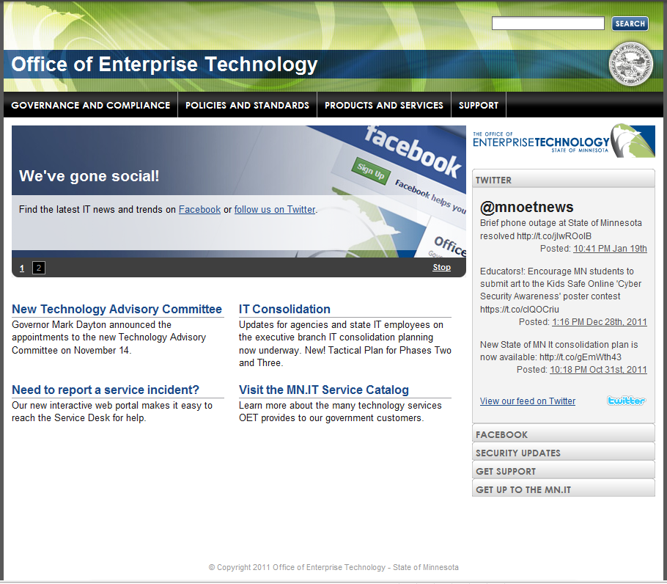
Thank you!
More information:
www.mn.gov/oet

