Slide 1

Conducting A
Home Risk Evaluation

Slide 2
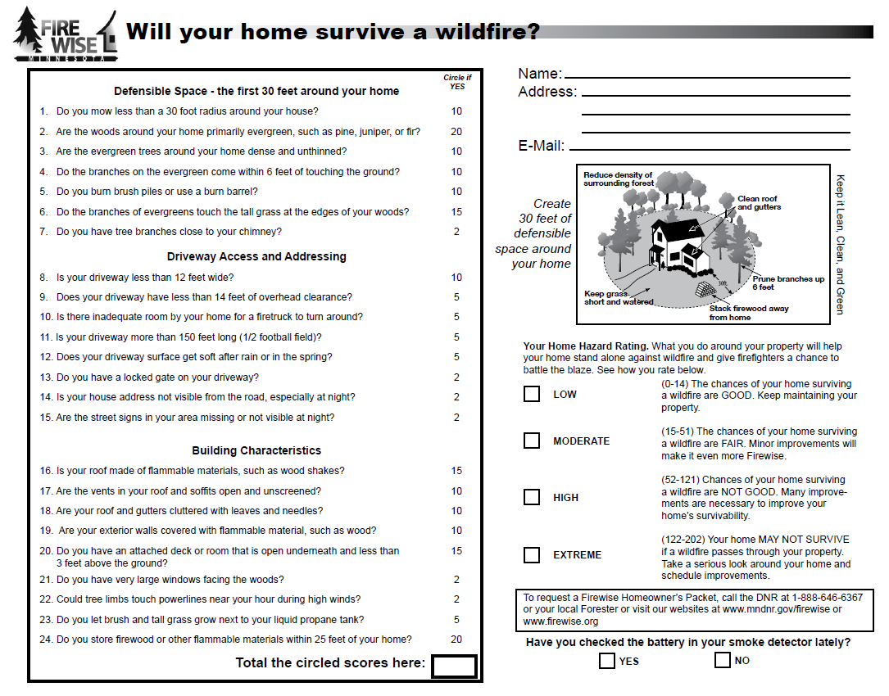
3 Major Factors You Will Be Considering

Slide 3

Fill In The Contact Information
12345 Forest Road
Firewise City, MN 55555
someone@somewhere.com
Optional: if the homeowner wants more information from the local Forestry office or Fire Dept., they can send a copy of the form in with a request for further assistance.

Slide 4
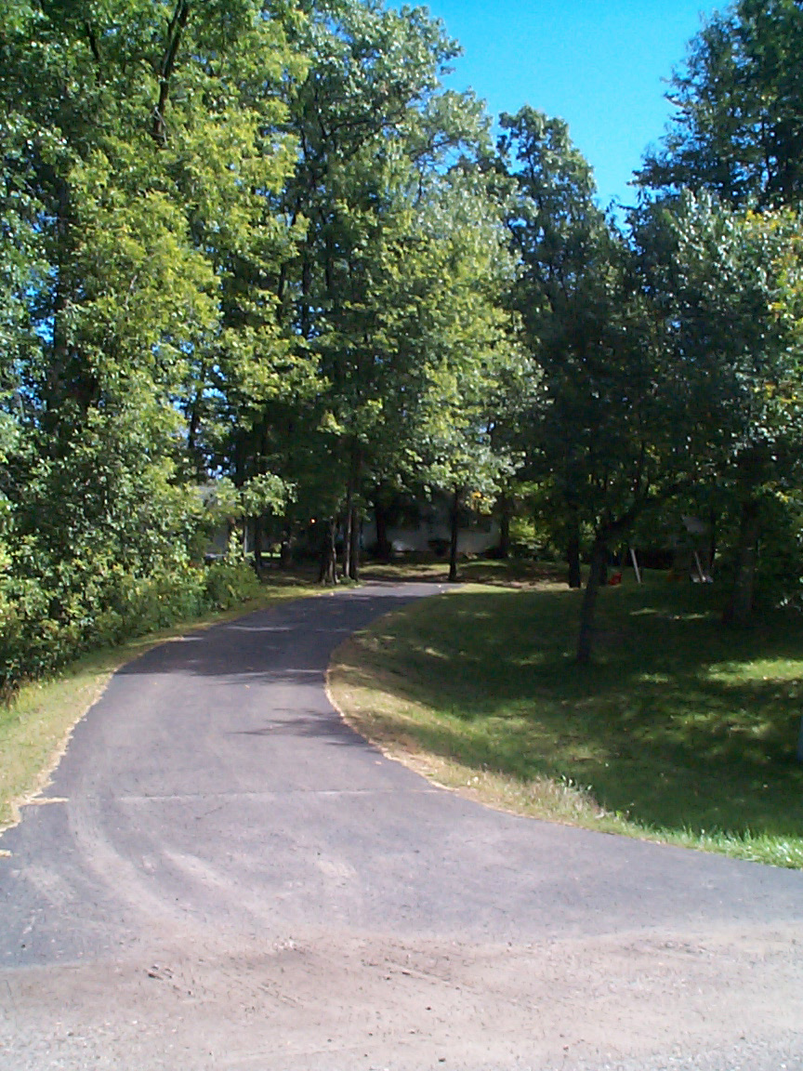
Greeting The Homeowner
Introduce yourself and explain about the Evaluation.
Ask permission to assess the home site and invite homeowner to join you.
Fill out form.
Leave form and literature bag with the plan.

Slide 5
If The Homeowner Says No or Is Not Home
If the homeowner says no, thank them and leave the information in the packet with the Stewardship Plan.
If the homeowner is not home, do assessment from the street. Leave the form, literature bag and special note that states the assessment was completed from the street with the completed plan package.

Slide 6
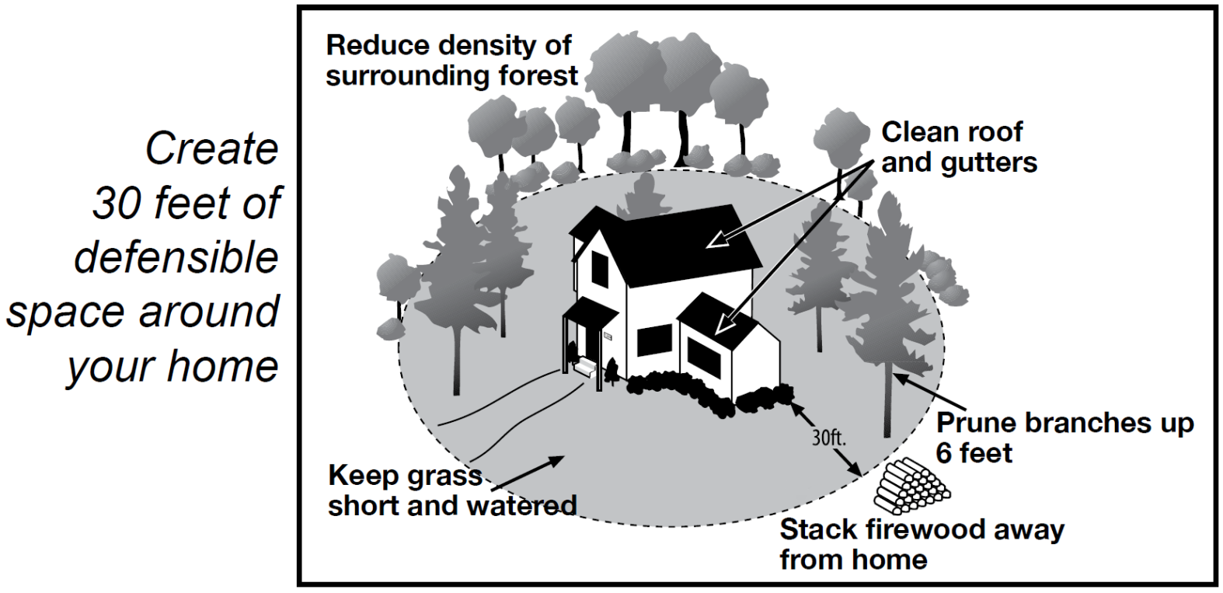
When completing the survey, concentrate on the area within 30 feet of buildings.

Slide 7
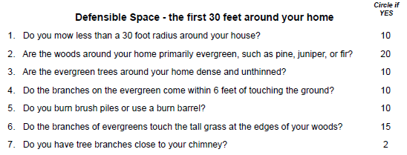
Fill Defensible Space Information
If the factor is present, circle the score.

Slide 8
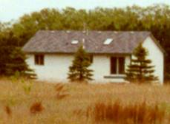
1. 30’ of mowed lawn…

Slide 9
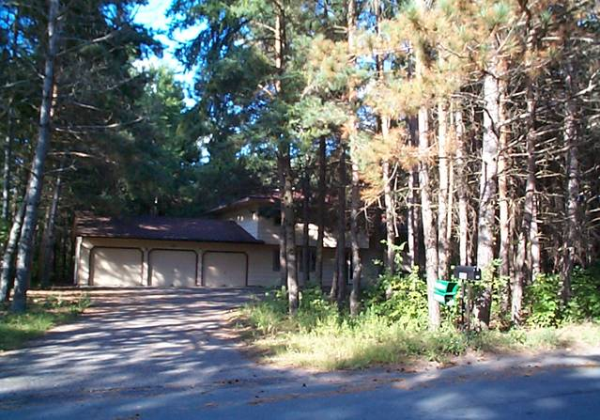
2. What are the dominant trees?
This home has evergreens within 30 feet of the house.

Slide 10


3. If there are evergreens present, are their crowns touching?
YES
NO

Slide 11
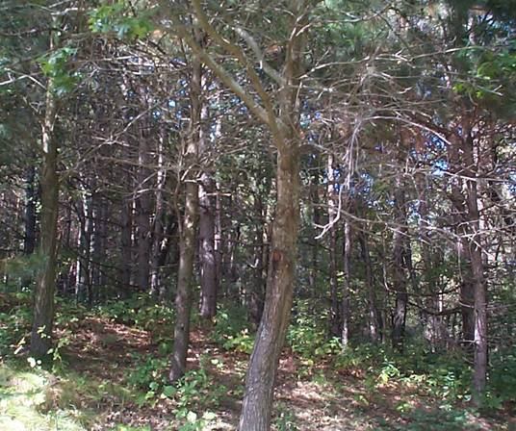
4. Are there ladder fuels present?
Here ground vegetation touches the lower branches of the trees.

Slide 12
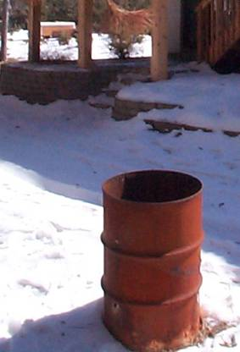
5. Is there outdoor burning practiced on the property?
Look for burning barrels, fire pits or other signs of burning.

Slide 13
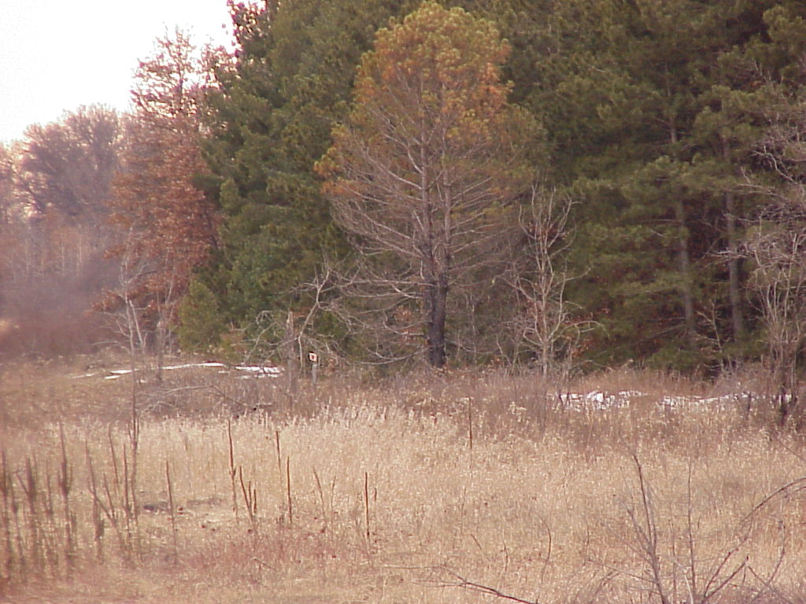
6. Tall grass ... or heavy shrubs

Slide 14
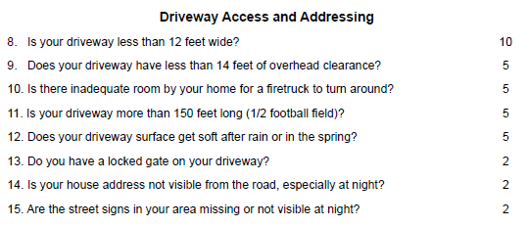
Fill Access Information
If the factor is present, circle the score.

Slide 15
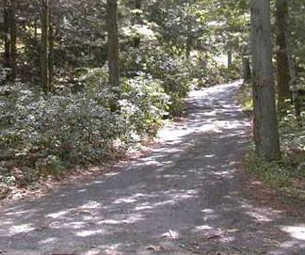

8 and 9. Is the driveway too narrow or clearance too low for emergency vehicles?

Slide 16

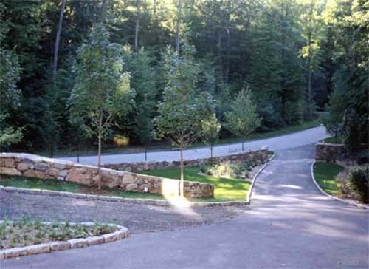
10 & 11. Is the driveway over 150 feet long, and if so, does it have an adequate turnaround?

Slide 17
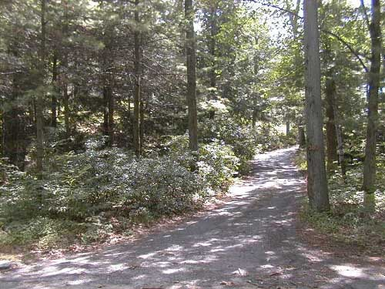
12. Is the driveway rutted?

Slide 18
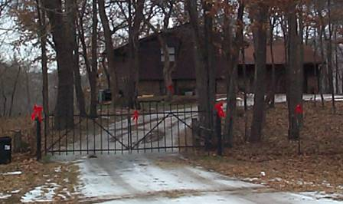
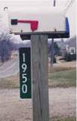

14. Is the address visible from the road?
13. Is the driveway gated?

Slide 19

15. Look for street signs.

Slide 20
Building Characteristics
16-24
Rate the most vulnerable structure
or part of the main structure
within the 30 foot defensible space.

Slide 21
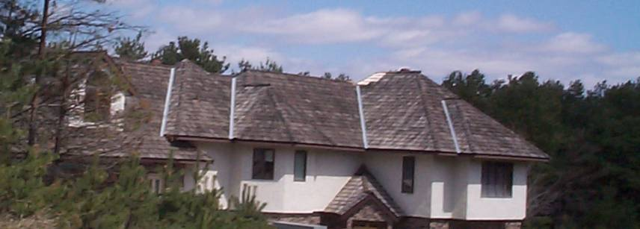
16. Does the building have a wood roof?

Slide 22
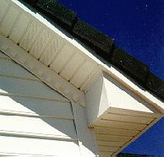
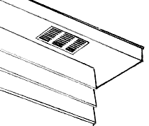
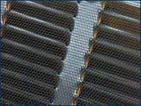
17. Are the vents in the soffits enclosed?
Remember to look at outbuildings too.

Slide 23
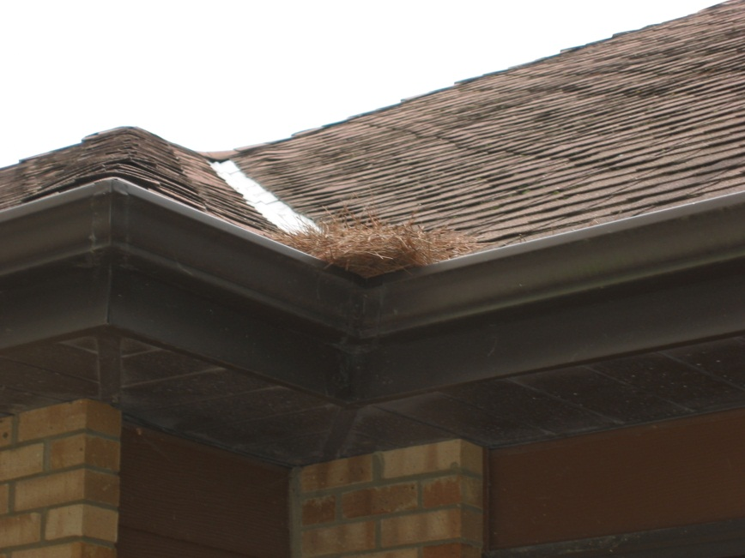
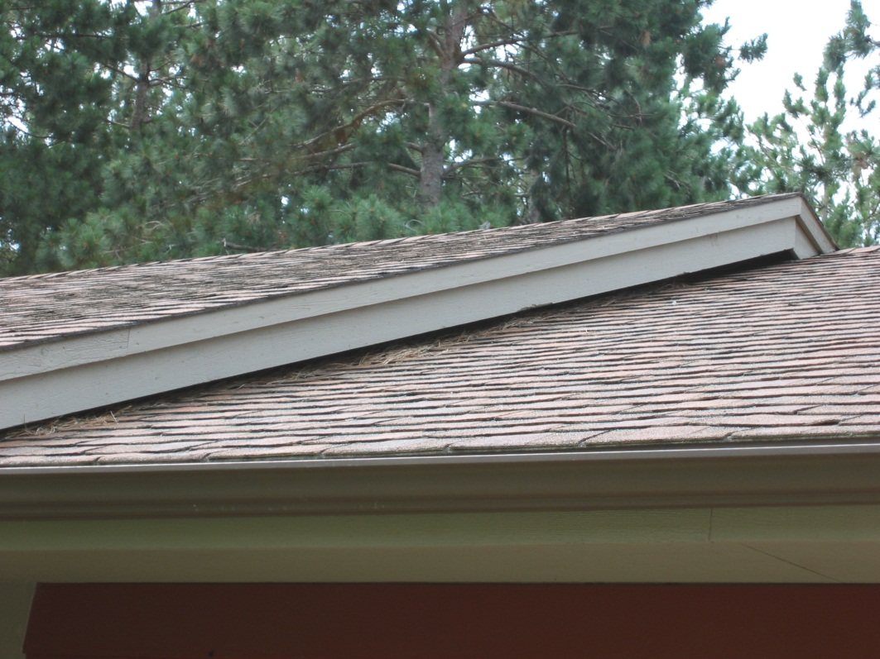
18. Are the roof and gutters clean?

Slide 24
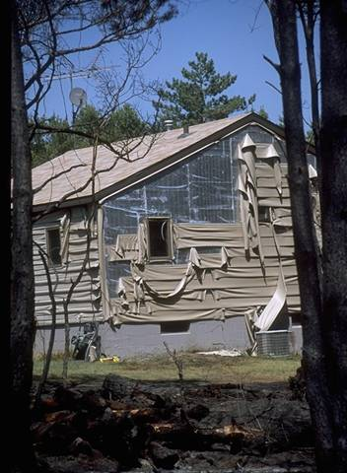
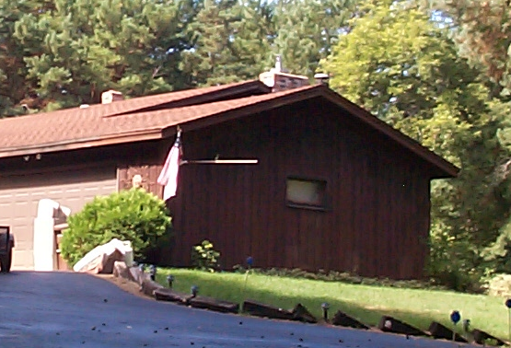
19. Does the home have vinyl or wood siding?

Slide 25
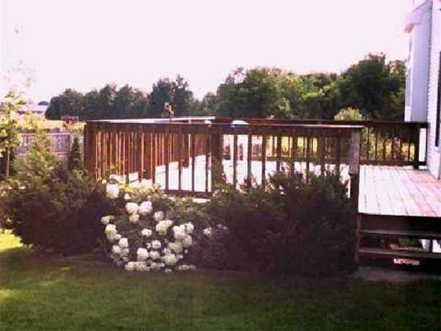
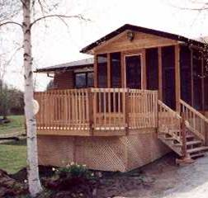
20. Is there is an unskirted wood deck attached to a wood or vinyl sided building?

Slide 26
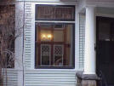
21. Are there any picture windows?

Slide 27
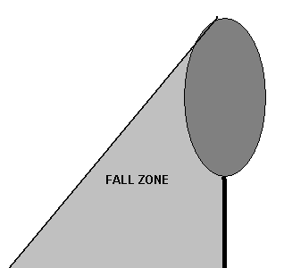
22. Are there power lines on the property that are within the “fall zone” of trees?
Could they hamper a fire truck’s access to the back of the home?

Slide 28
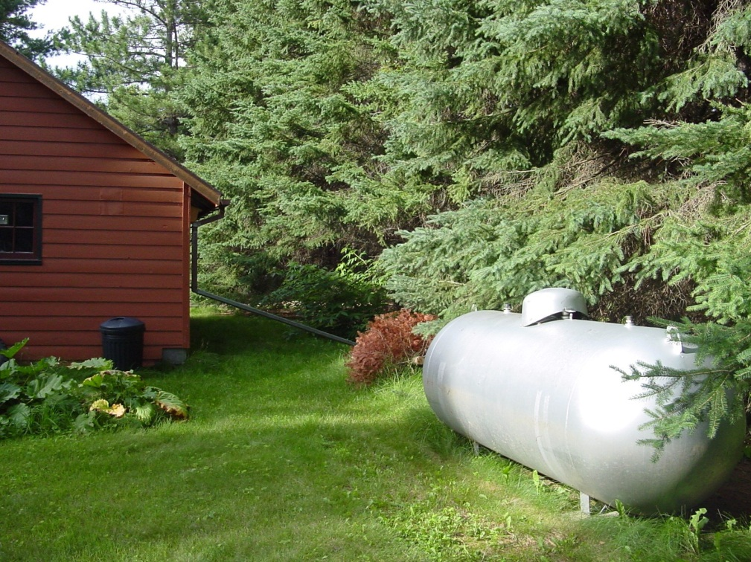
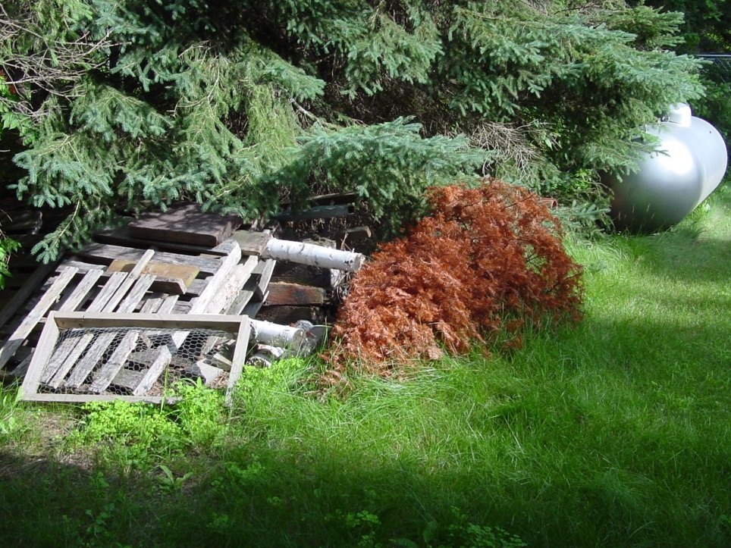
23. Is the propane tank clear?

Slide 29
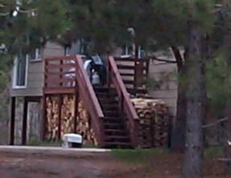
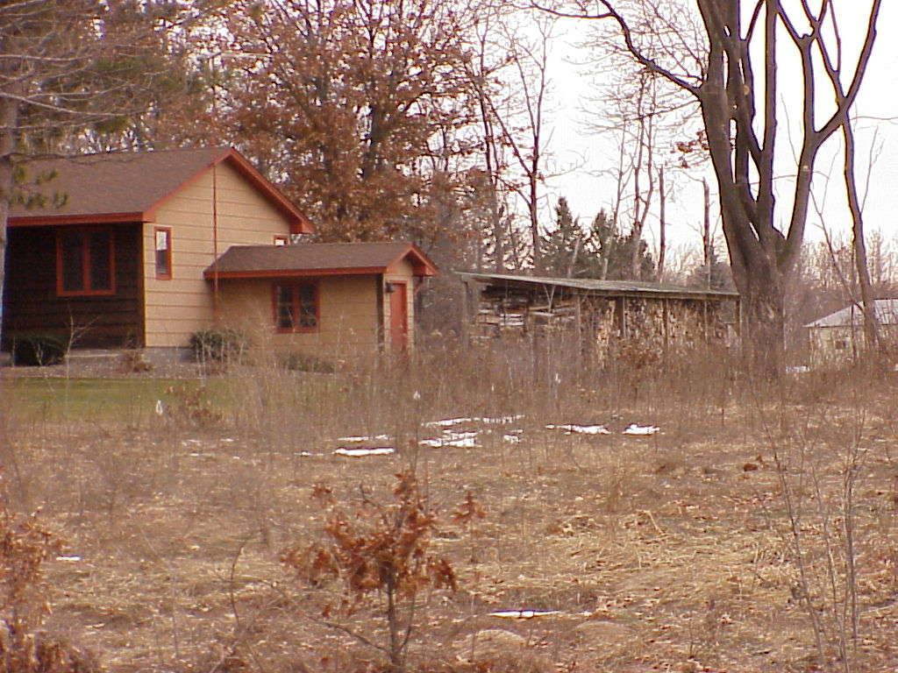
24. Is firewood stored near the home?

Slide 30
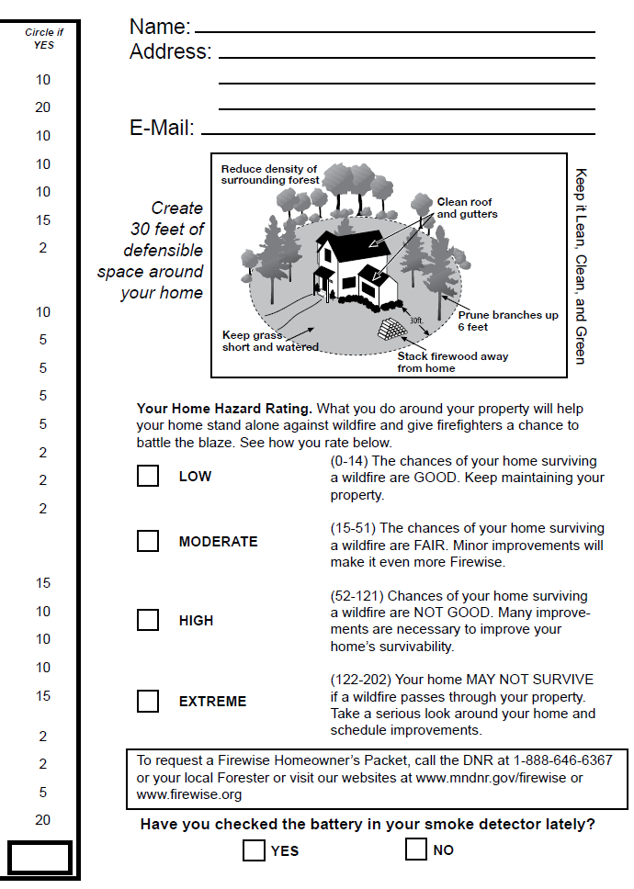

Calculate The Risk
Don’t forget to ask
them about the
smoke detector.
68

Slide 31
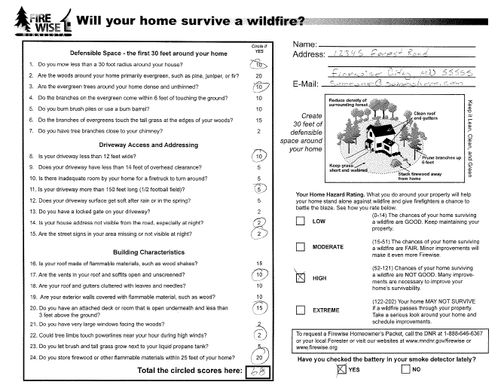
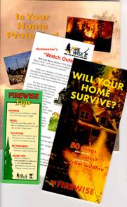
Leave With The Homeowner and give addt’l contact info if requested.
If the homeowner is not there, leave form and literature with the plan.

Slide 32
Questions?

