Slide 1

Fuzzy Cognitive Map for Depression in Seniors
Math 800 Final Presentation
Sara Namazi
November 30, 2011

Slide 2
Outline:
Fuzzy Cognitive Map(FCM) for Deviance Model
Scenarios on Deviance FCM
Introduction to Depression
Depression Significance
Risk Factors to Depression
FCM for Contributing Factors to Depression
Limitation & Future Work

Slide 3
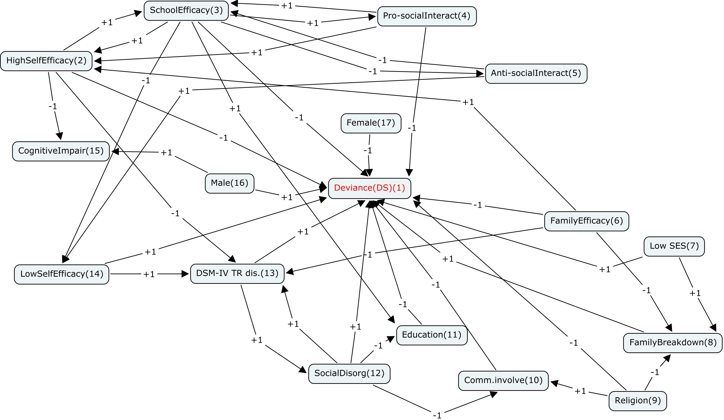
Fuzzy Cognitive Map(FCM) for Deviance Model

Slide 4
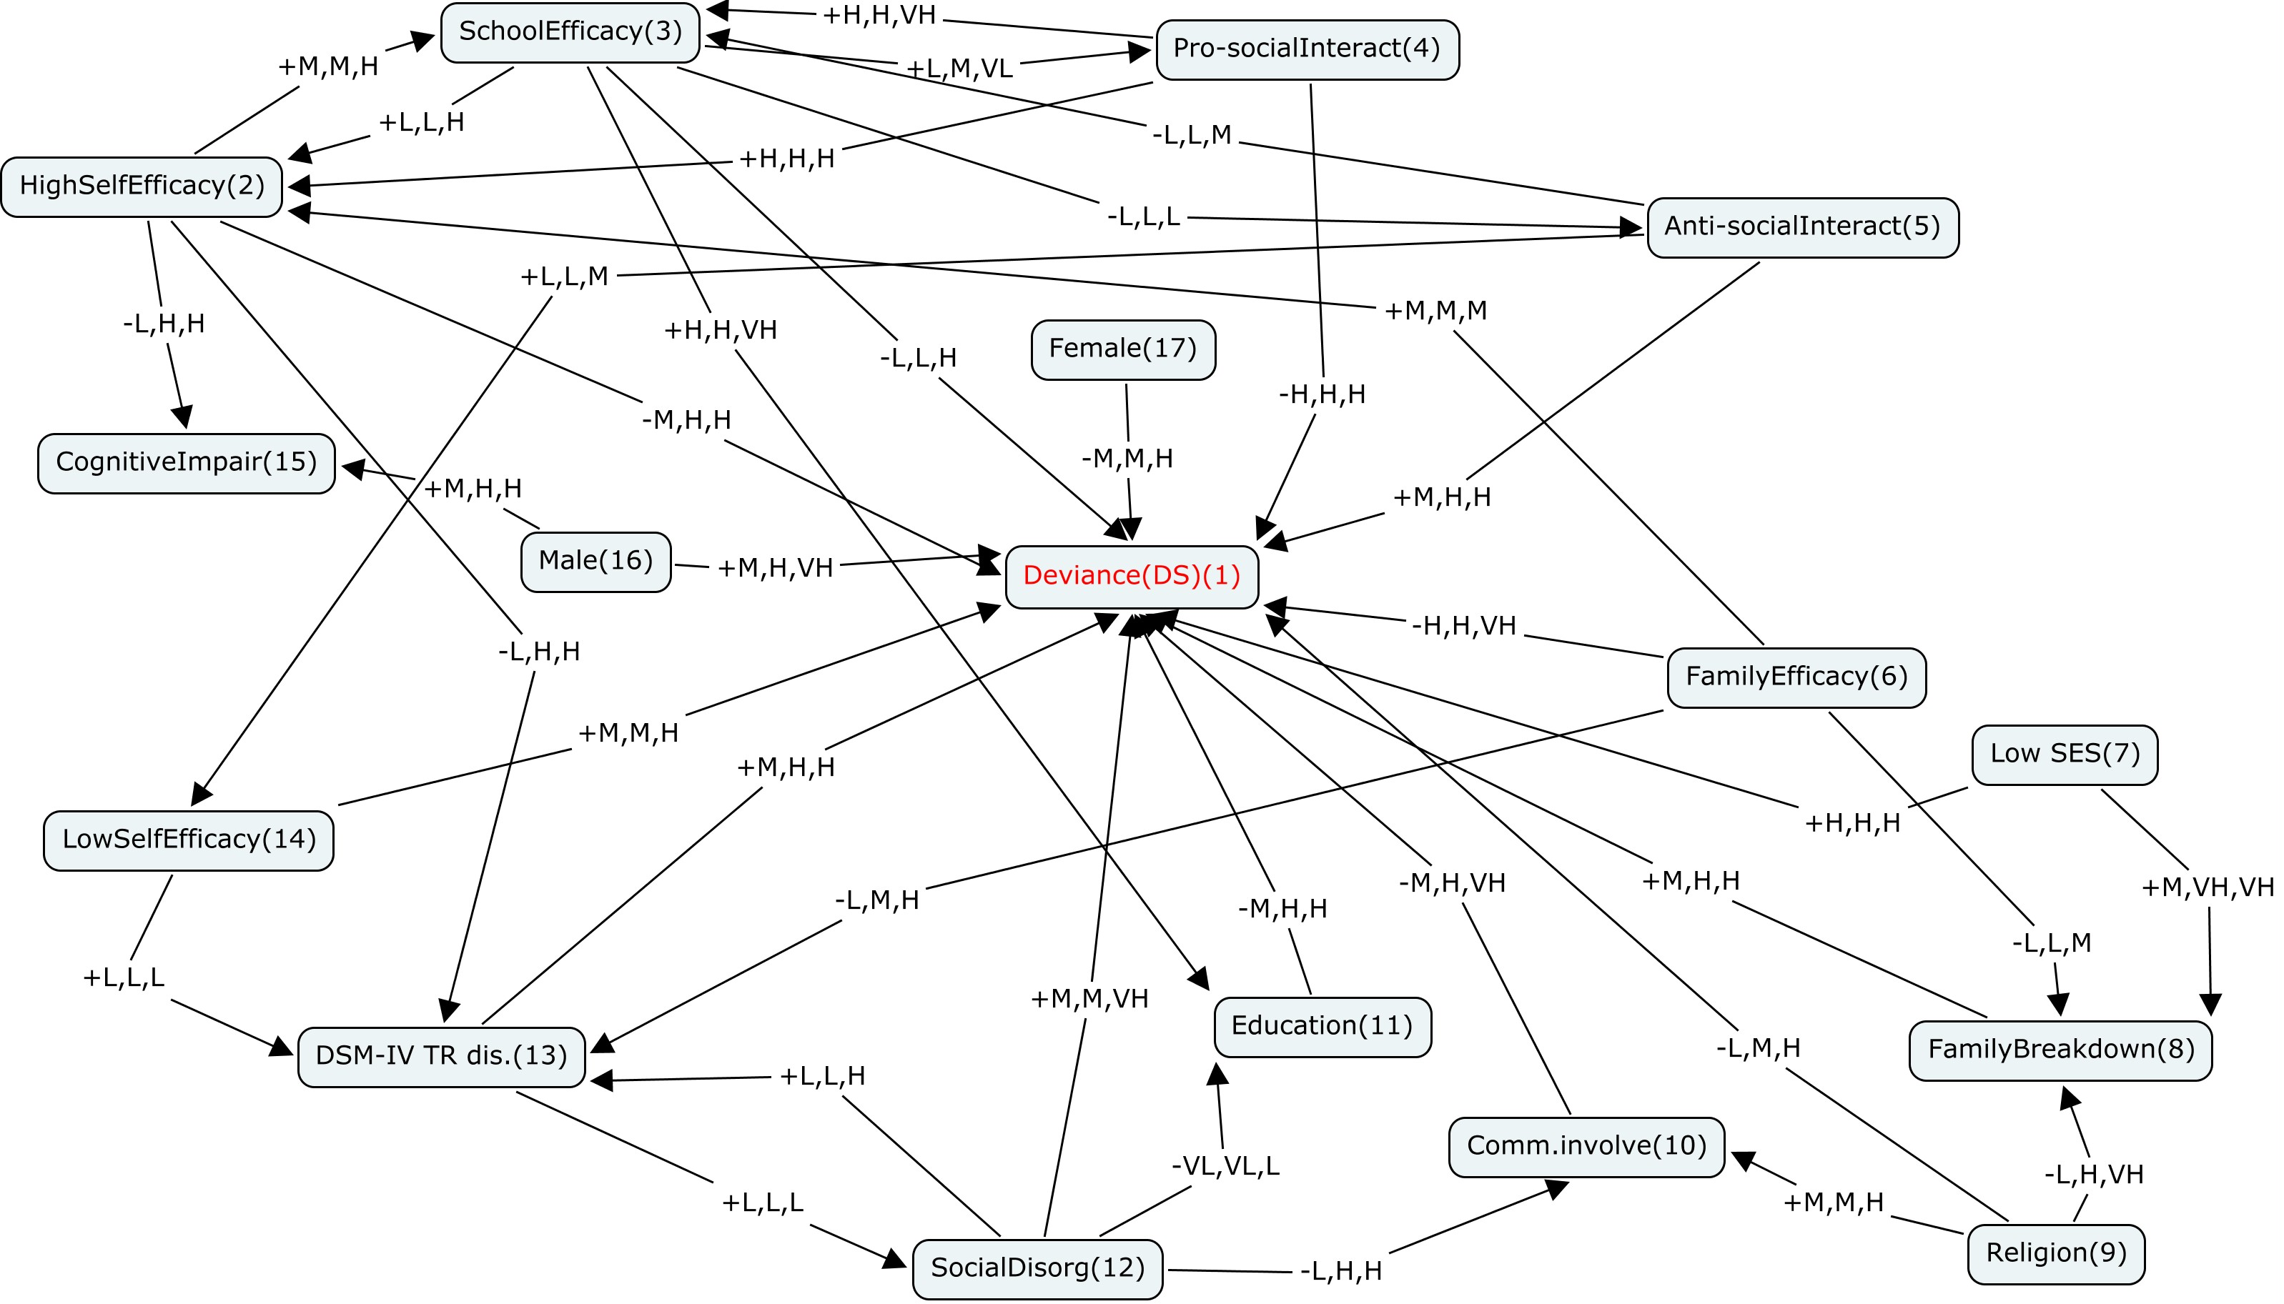
Fuzzy Cognitive Map(FCM) for Deviance Model

Slide 5
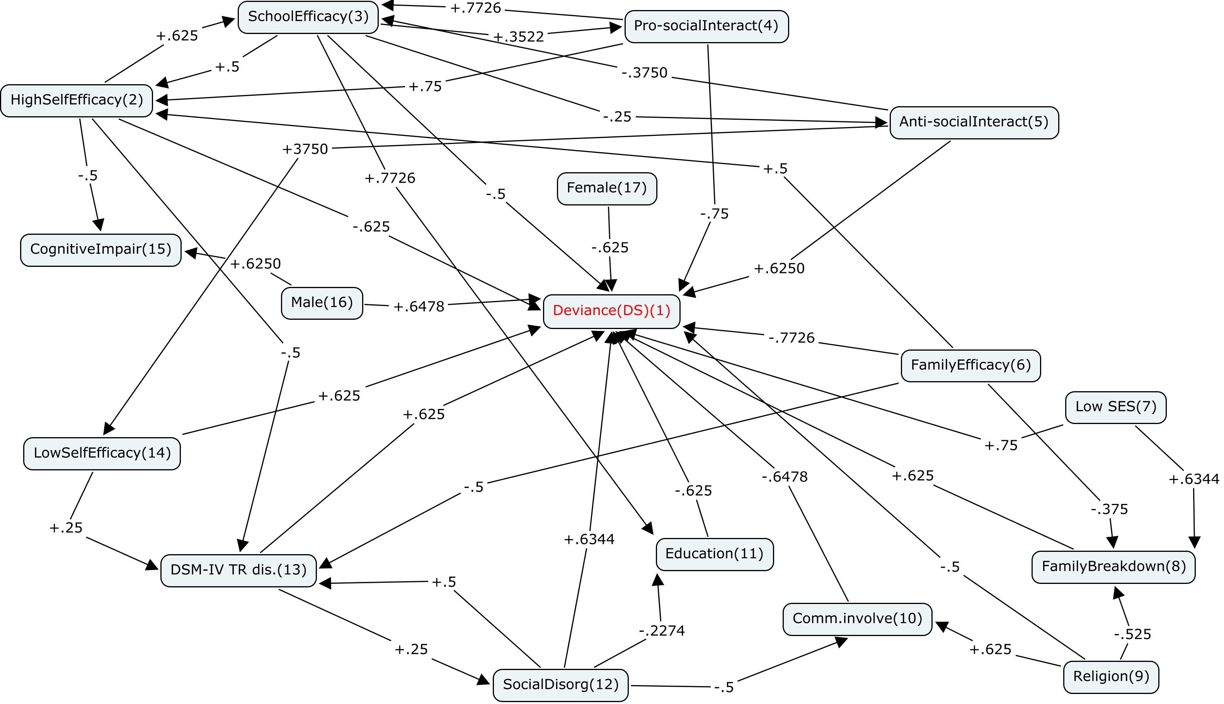
Fuzzy Cognitive Map(FCM) for Deviance Model

Slide 6
Scenarios on Deviance FCM
Case1:
Inputs are:
School Efficacy
High Self Efficacy
Family Efficacy
Education

Slide 7
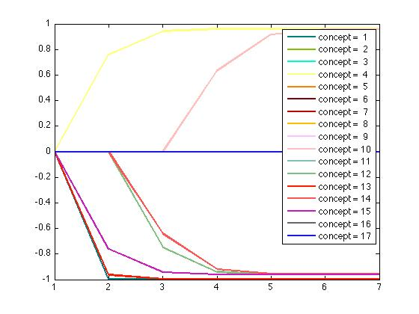
Case1: outputs

Slide 8
Scenarios on Deviance FCM
Case2:
Inputs are:
Family Breakdown
Social Disorganization

Slide 9
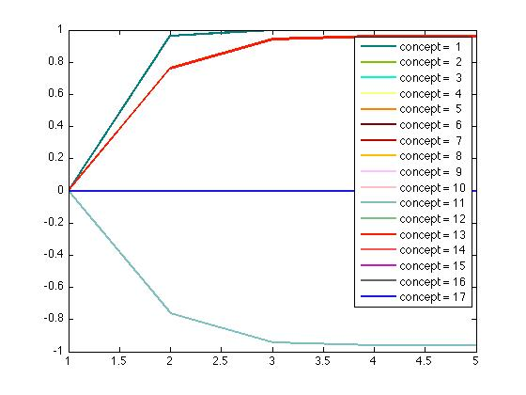
Case2: outputs

Slide 10
Scenarios on Deviance FCM
Case3:
Inputs are:
Here all concepts are ON other than Education, Social Disorganization, Female, Male, and Cognitive Impairment.

Slide 11
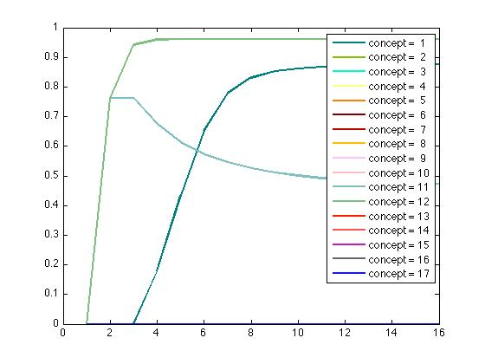
Case3: outputs

Slide 12
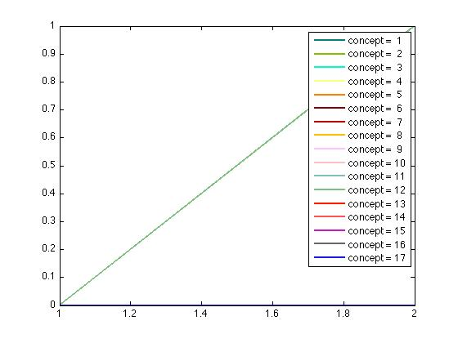
Case3: outputs

Slide 13
Introduction to Depression
Depression is mood disorder.
The key attributes are loss of hope and courage and lack of interest in and enjoyment from everyday life.
Person with depression may experience sadness, tearfulness, feeling of worthlessness or guilt, difficulty concentrating and making decisions, changes in appetite and energy levels, physical restlessness or retardation, and sleep problems.

Slide 14
Depression Significance
Depression is one of the most common emotional disorder among people in different ages.
14% of US citizens will experience major depression during their life span.
The rate of major depressive disorder goes up sharply by moving from general population of seniors to those with acute or chronic illness.
Depression has more important implication in seniors because of its strong association with physical illness and impaired function, cognitive decline, reduction of overall quality of life, and mortality.

Slide 15
Depression Significance
Depression increases illness symptoms and make suffering worse.
It damage cognitive function and may place persons at risk of dementia.
It is believed that the rates of late-life depression will rise as the current cohort of middle aged adults – the Baby Boomers – move into their later years.
Baby Boomer: the post-world war II generation, with the birth years roughly between 1946- 1966

Slide 16
Is Late-Life Depression Same as Early or Midlife Syndromes?
The unique presentation of depression among some elders regarding to the complexity of symptoms characteristic of the disorder.
The linkage between depression and cognitive decline.
Result of studies of the neuroanatomical characteristics of late-life depression versus early depression.

Slide 17
Late-life Depression Symptomatology
Some elders may experience significant symptomatology, but in absence of sadness and discouragement which are counted as the core of depression identification in early ages.
It is a recognized syndrome among seniors without sadness, but with hopelessness, helplessness, and anhedonia.
Anxiety which often co-occur with depression and made a differentiate diagnoses challenging, is more likely between elders.
By aging some diseases may trigger depression as well as some medications used for treatment.

Slide 18
Risk Factors to Depression
Biological Risk Factors
Medical and Clinical Risk Factors
Psychosocial Risk Factors

Slide 19
Biological Risk Factors
Aging
Genetic factors
Cerebrovascular Factors
Endocrine Function
Abnormalities of hypothalamic–pituitary–adrenal (HPA) axis activity is linked with depression dispose.
Changes in sleep patterns in terms of normal aging, and sex hormones also associated with HPA and may result in depression in elders.

Slide 20
Cerebrovascular Factors
Brain structure changes and function related to vascular pathologies are strongly linked with late-onset major depressive disorder.
The most obvious and most heavily studied one is, stroke.

Slide 21
Medical and Clinical Risk Factors
The relationship of specific medical conditions with depression.
Cardiac disease
Diabetes, Cancer, Stroke, Parkinson.
Overall medical burden and depression.
Seniors with greater number of health problems and more serious medical condition, are at significantly higher risk of depression regardless of the specific medical illness.

Slide 22
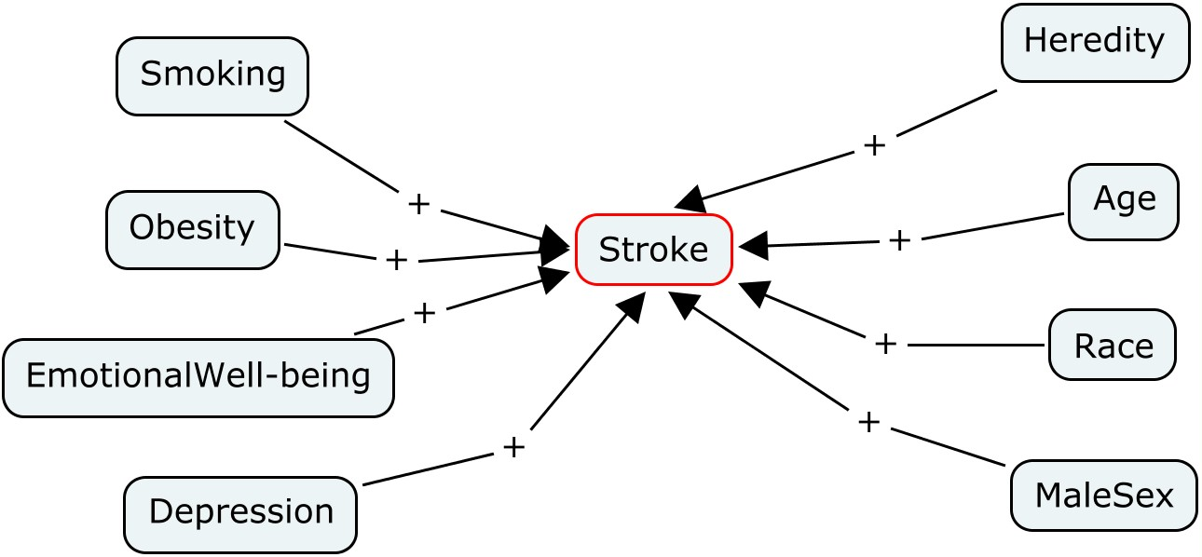
Stroke
Stroke is the third most common cause of death and a leading cause of long term disability among elders.

Slide 23
Psychosocial Risk Factors
Major and minor stressors
Death of a spouse or other loved one
retirement
Lack of cognitive and behavioral coping skills
Inadequate social resources for managing the situation
Social isolation and loneliness are strong and consistent predictors of depression

Slide 24
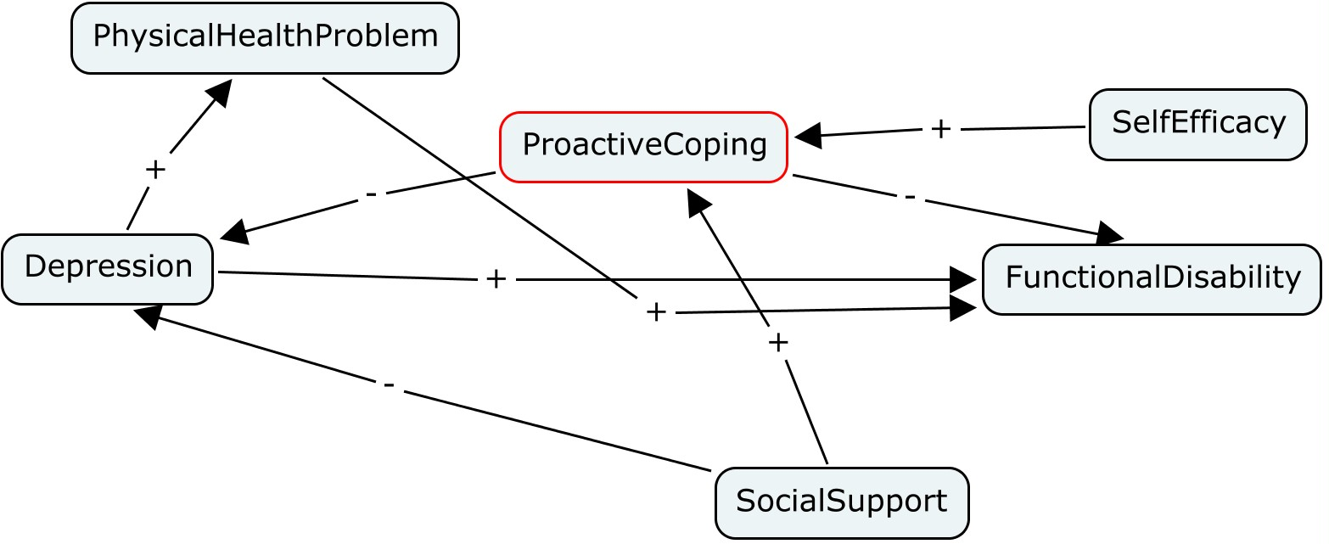
FCM of Coping

Slide 25
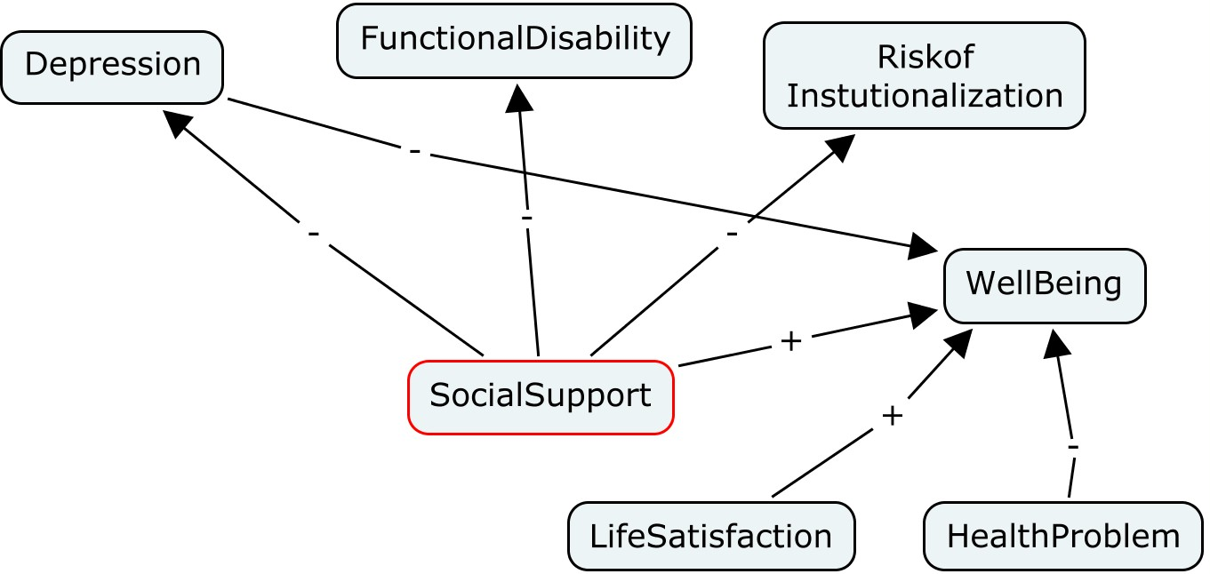
FCM of Social Support

Slide 26
Religious
Higher level of religious involvement may result in:
Lower level of functional disability
Lower prevalence of hypertension
Better recovery after cardiac disease
Lower mortality

Slide 27
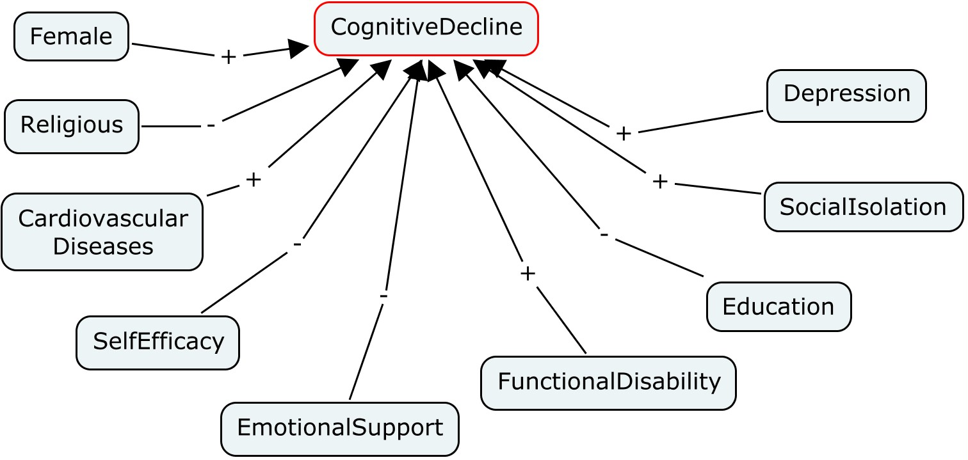
FCM of Cognitive Decline

Slide 28
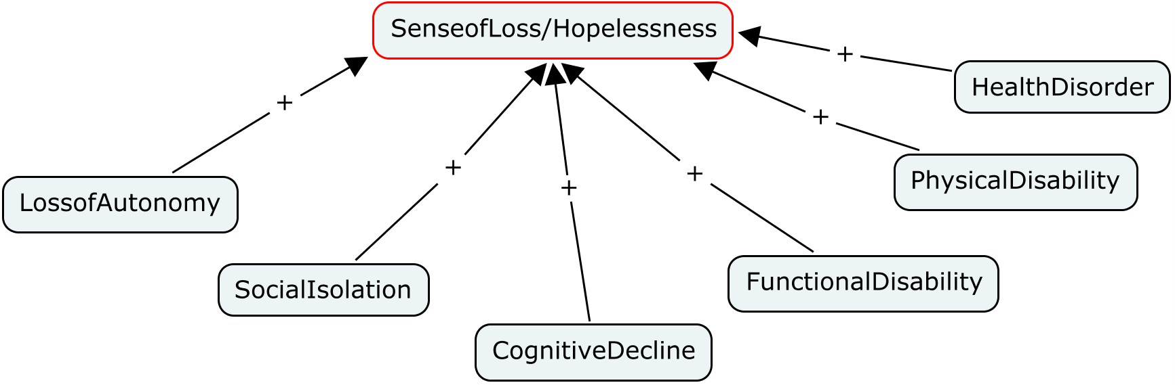
FCM of Sense of Loss

Slide 29
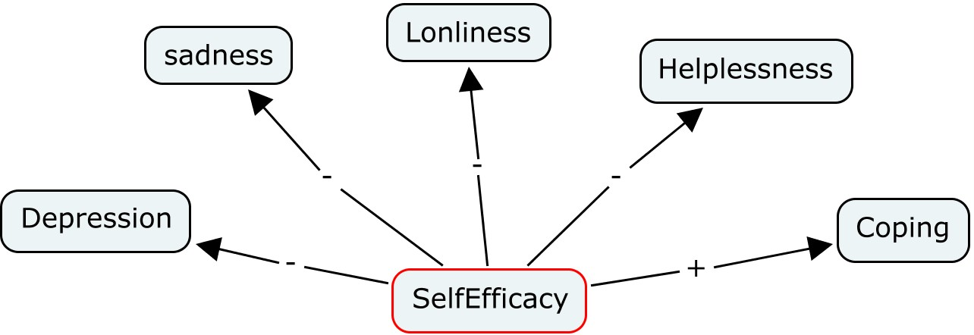
FCM of SelfEfficacy

Slide 30
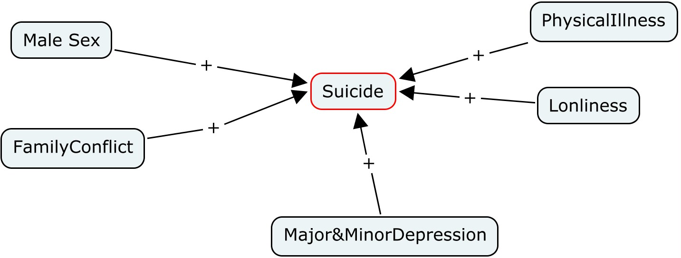
FCM of Suicide

Slide 31
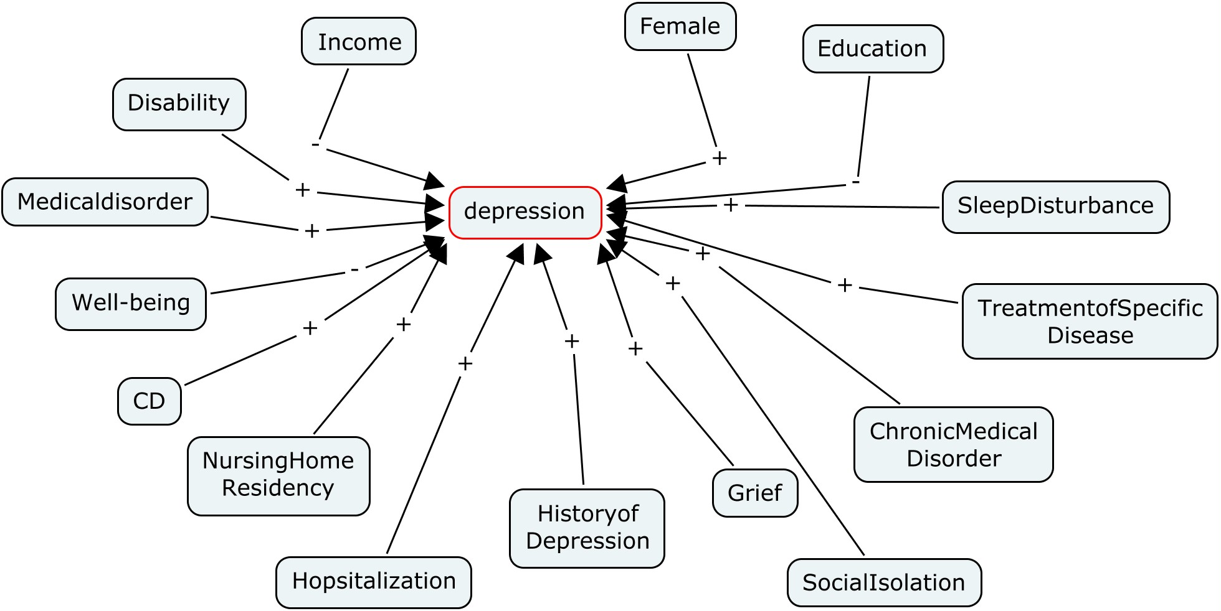
Partial FCM of Depression

Slide 32
Why Seniors?
Report of statistical profile of people aged 65 and over, shows that the number of seniors in Canada jumped from 2.4 million to 4.2 million between 1981 and 2005.
The expected increase between 2006 and 2026, is from 4.3 million to 9.8 million.

Slide 33
Limitation and Future Work
Depression can be seen as a very complex and dynamic model, which using just statistics and software to demonstrate its complexity does not seem enough.
All data used mostly related to past.
Scales for measuring each concept are predetermined, which regarding nowadays cultural, technological changes seems somehow not fully sufficient.
In most cases, examined samples are from community-dwelling seniors, but the rate of depression seems higher between LTC residents.

Slide 34
Thank you.

