Slide 1

Thompson Rivers University
Operating Budget
2010– 2011
Senate Presentation
April 2010

Slide 2
Budget Committee of Senate BCOS
Regular monthly meetings
Regular capital construction updates
Presentations from
Faculty of Arts
Ancillary Services
Institutional Planning and Analysis (IPA) – Space Utilization
Information Technology Services including a presentation on Project Sage
Advancement – fundraising update

Slide 3
Sub-committees of BCOS:
Scholarship and Bursary Funding
Budget Review of New Programs and Courses
BCOS Communications and Profile Enhancement
Strategic Plan Funding
Credit Card Payment Review

Slide 4
Budget Challenges for 2010 and Beyond
Enrolments – how to offset the declining student numbers within our region
Reliance on International Enrolment growth to balance the budget
Reduction in the Annual Capital Allowance Grant (cyclical maintenance)
ALMD FTE model based on three years; funding is provided on a year-to-year basis
Funding of new programs and other initiatives
Law School start-up and setting the initial tuition fee
Collective Agreements expired March 31, 2010
Realignment of Faculties and Schools - effective April 1st 2010
Environmental legislation and carbon penalties – effective 2010
Lack of funding for non-salary inflation and progression through the salary grids
Uncertain economic times leads to uncertain provincial budgets

Slide 5
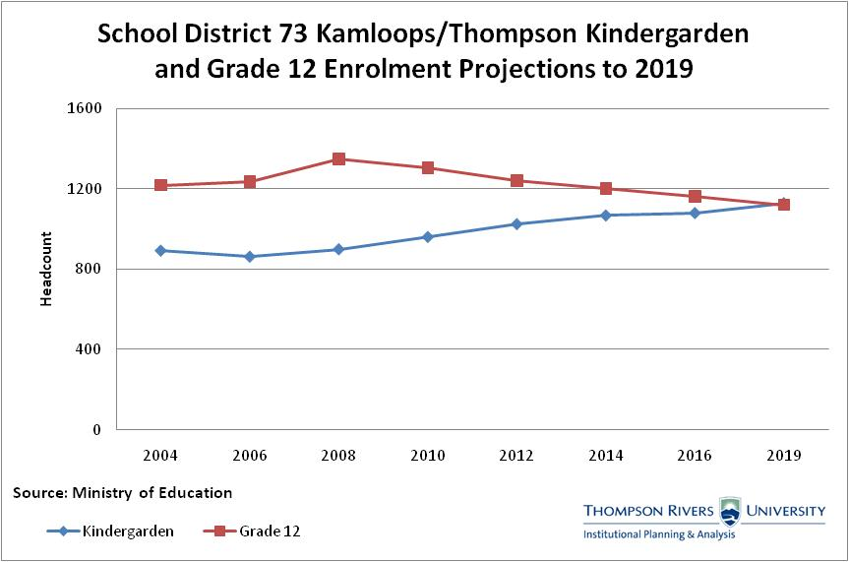

Slide 6
Academic Course Registrant Enrolment Trends % Change 2004-05 to 2009-10

Slide 11
International enrolments School of Nursing:
2009-10 - 35
2008-09 - 42
2007-08 - 48
2006-07 - 67
2005-06 - 54

Slide 12
International enrolments School of Education:
2009-10 - 106
2008-09 - 110
2007-08 - 94
2006-07 - 122
2005-06 - 105
International enrolments School of Social Work:
2009-10 - 30
2008-09 - 20
2007-08 - 8
2006-07 - 17
2005-06 - 5

Slide 14
Revenue
Government Grants
Macro grant information received, no detailed budget letter to date
Total ALMD grant is $64.7 M
Annual Capital Allowance grant of $655K
No funding for any salary increases
No additional funding for non-salary inflation
Preliminary Industry Training Authority (ITA) grant is $5.0 M
ITA funding is contingent on achieving minimum enrolments for each program
Tuition Fees
Includes a 2% increase
Based on a 3 year rolling enrolment average for Face-to-Face, OL and TRU World is based on the latest projections

Slide 15
Expenditures
Based on current levels of staffing – 2009/10.
Includes progression through the scales
Includes a “reserve” for non-wage impacted benefits (dental, extended health etc), carbon taxes, promotion (faculty) and third party contracted services

Slide 16
Outstanding Issues
General Letter of Expectations (ITA and ALMD)
August 2010
Collective Agreements for all employee groups

Slide 17
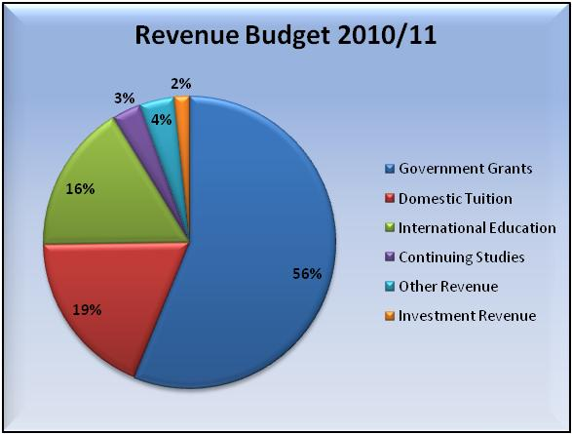
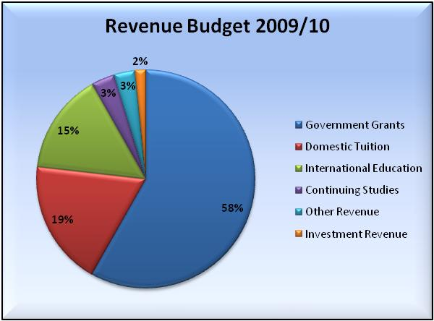
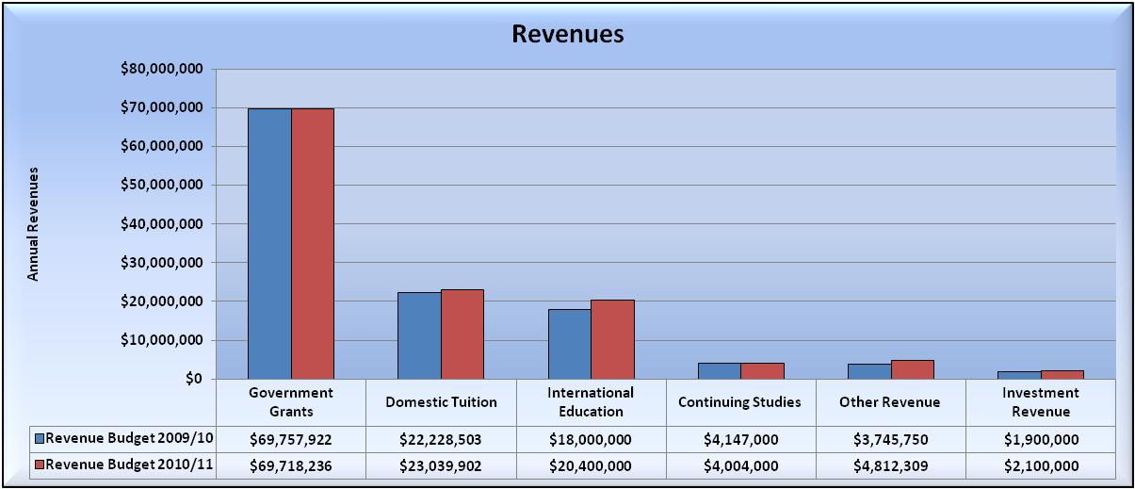
Draft Operating Fund Revenues (Total)

Slide 18
Draft Operating Fund Expenditures (Total)

Slide 19
Draft Operating Fund Budget of Revenues and Expenditures for the 2009/2010 Fiscal Year

Slide 20
Thompson Rivers University - Open Learning Draft Operating Budget 2009-10 Fiscal Year

Slide 21
Thompson Rivers University - TRU World Draft Operating Budget 2009-10 Fiscal Year

Slide 22
Draft Base Operating Fund – Expenditures by Division (F2F) 2010-11 Fiscal Year

Slide 23
Thompson Rivers University Operating Funds (Excluding Professional Development Funds) Divisional Projected Results as per Q3 Forecast April 1st 2009 to March 31, 2010

Slide 24
Thompson Rivers University Operating Funds (Excluding Professional Development Funds) Divisional Projected Results as per Q3 Forecast April 1st 2009 to March 31, 2010

Slide 25
Thompson Rivers University
Capital Projects Update
2010 – 2011

Slide 26
Capital Funding Sources
Major Capital – Ministry Funded ($5M -……)
Minor Capital – Ministry Funded ($300k - $5M)
Annual Capital Allowance – this funding has been reduced for 2010/11. These funds are used for cyclical maintenance (buildings, boilers, roof, grounds, etc.), infrastructure (public works - roads, sidewalks, sewer water, and electronic), renovations ($25K to $1.5M), capital reserves, planning for major capital, etc.
Self–Financed – separate revenue stream or reserves

Slide 27
Capital Projects Completed in 2009-10 and/or currently under construction
House of Learning
Old Main Building Code Upgrades
Gathering Places
Kamloops and Williams Lake
TRU Access Road and Hillside Drive Extension
Partnership with City of Kamloops
Signalization of McGill Road
At Eastgate

Slide 28
House of Learning
$32 million total project – LEED gold standard
Construction – commenced 2009/10
Occupancy – targeted for Fall 2010
Web site - http://www.tru.ca/houseoflearning.html

Slide 29
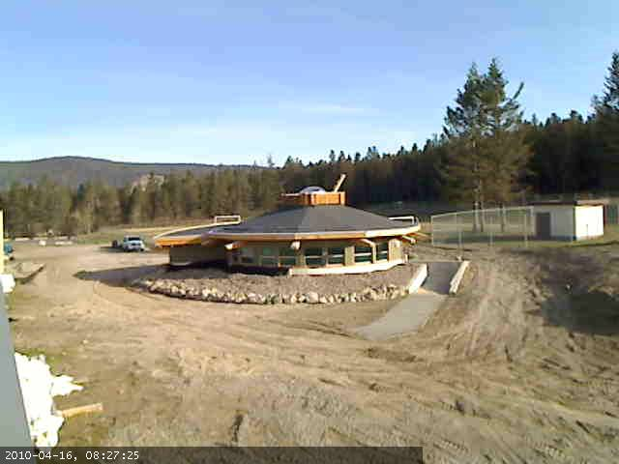
Williams Lake Gathering Place April 16, 2010

Slide 30
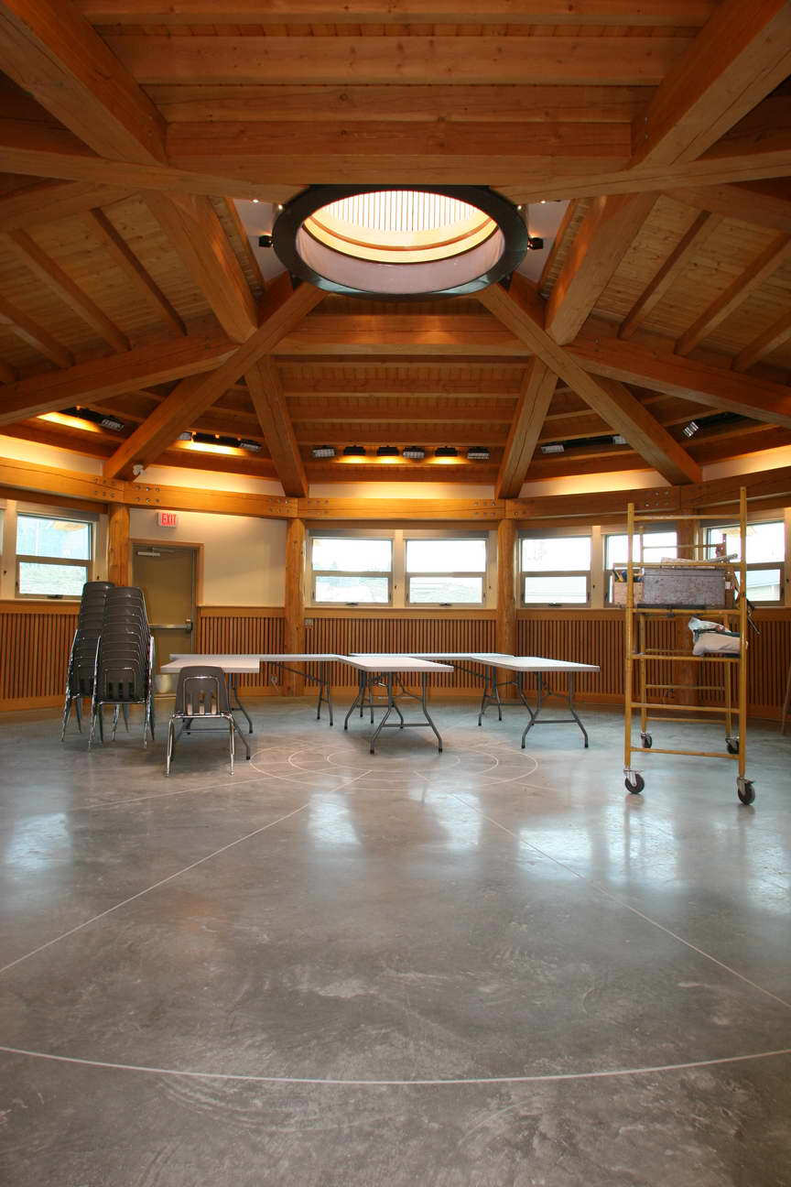

Slide 31
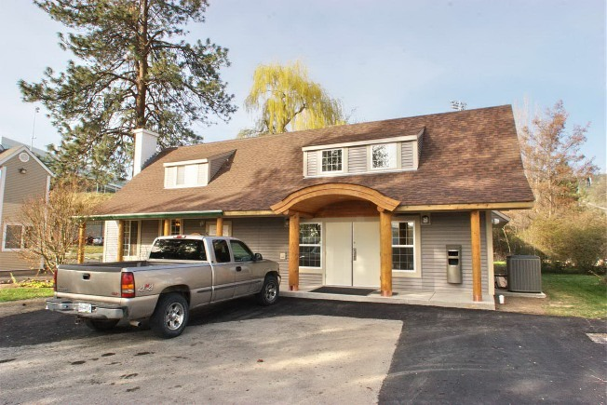
Kamloops - Gathering Place April 16, 2010

Slide 32
Capital Projects Under Consideration (All must be self financed or developer financed)
Third Floor Old Main
Third Floor Campus Activity Center
University Village

Slide 33
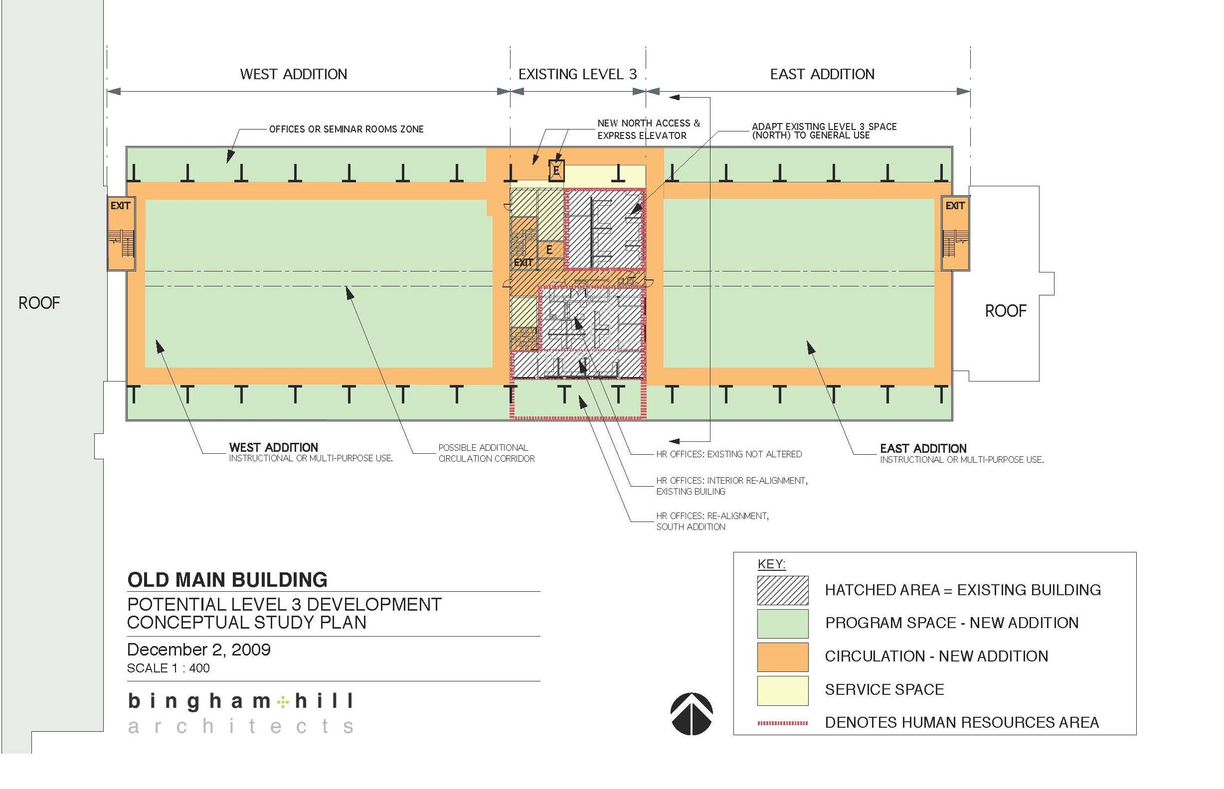
Third Floor Old Main

Slide 34
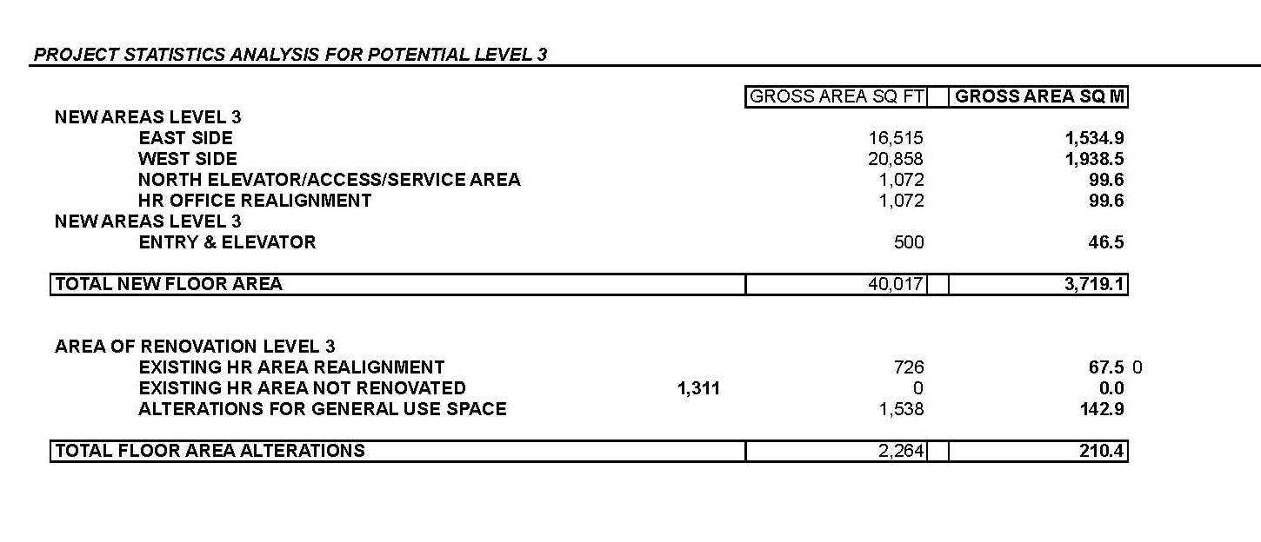


Slide 35
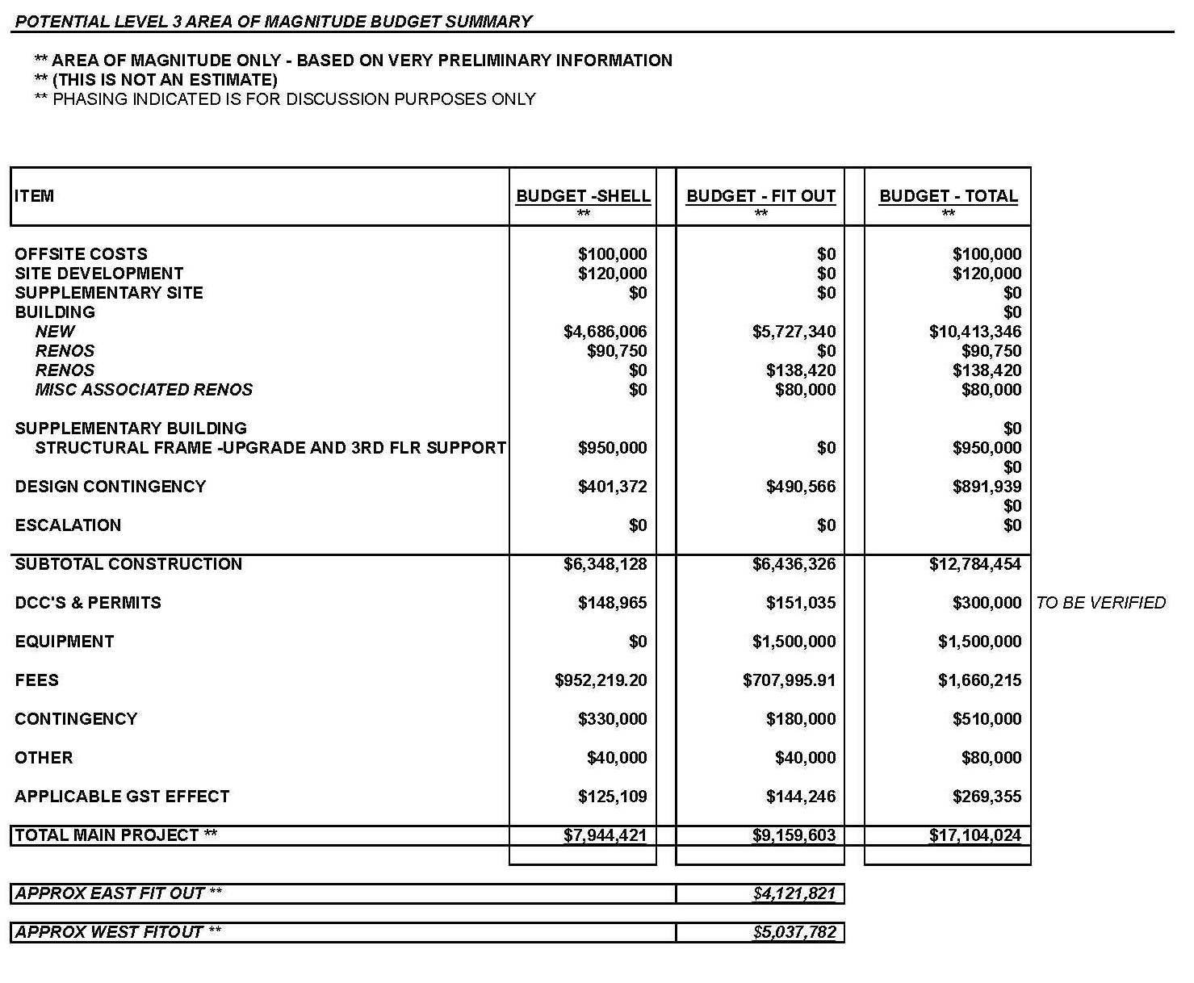

Slide 36
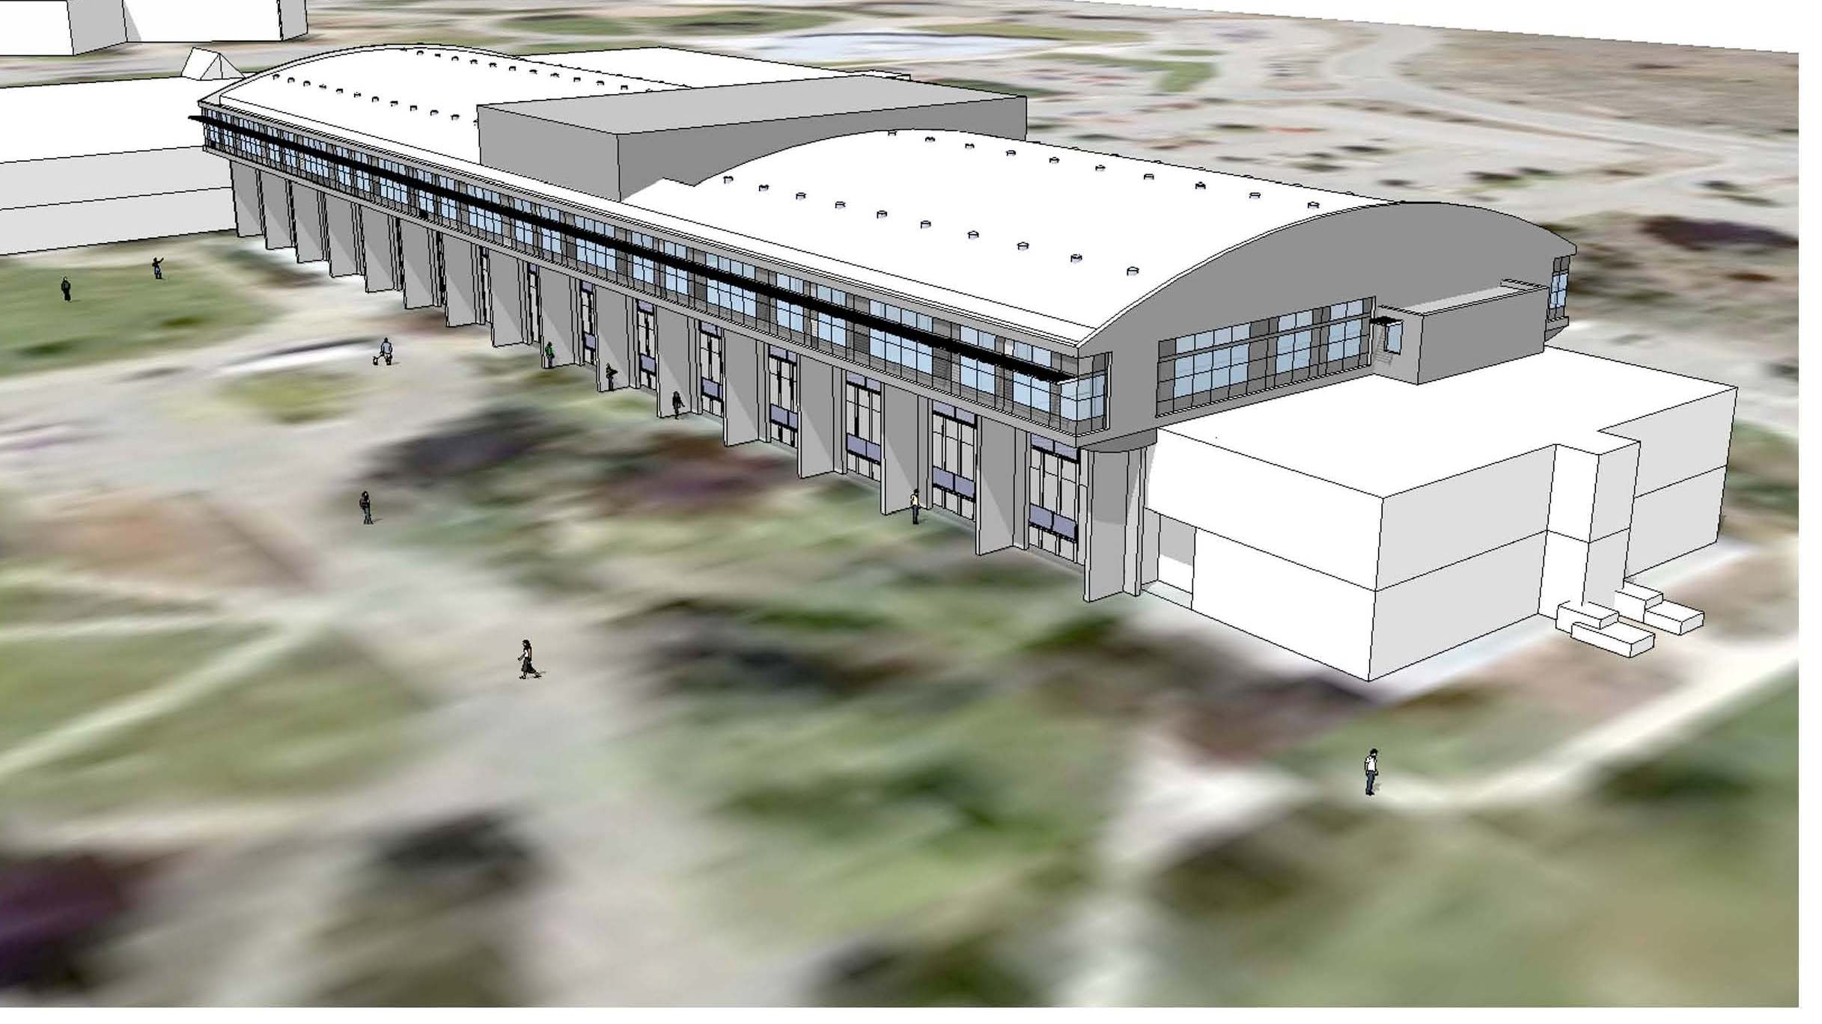

Slide 37
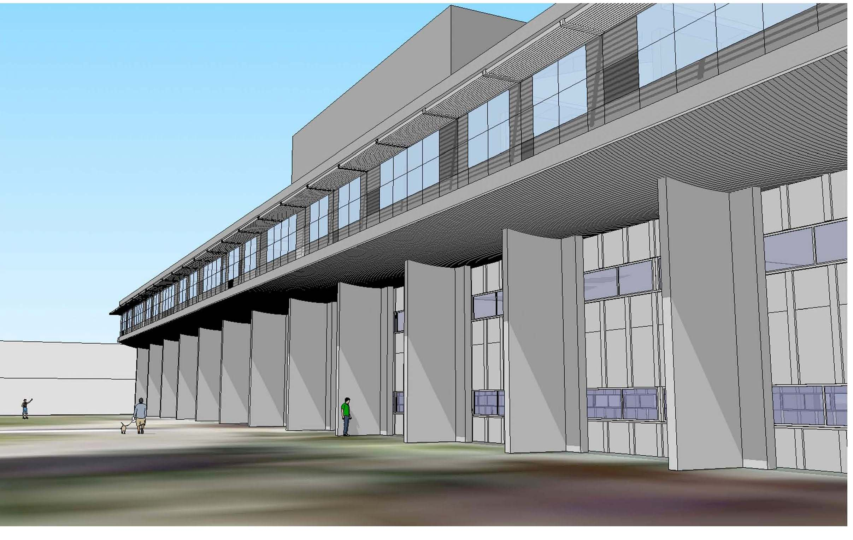

Slide 38
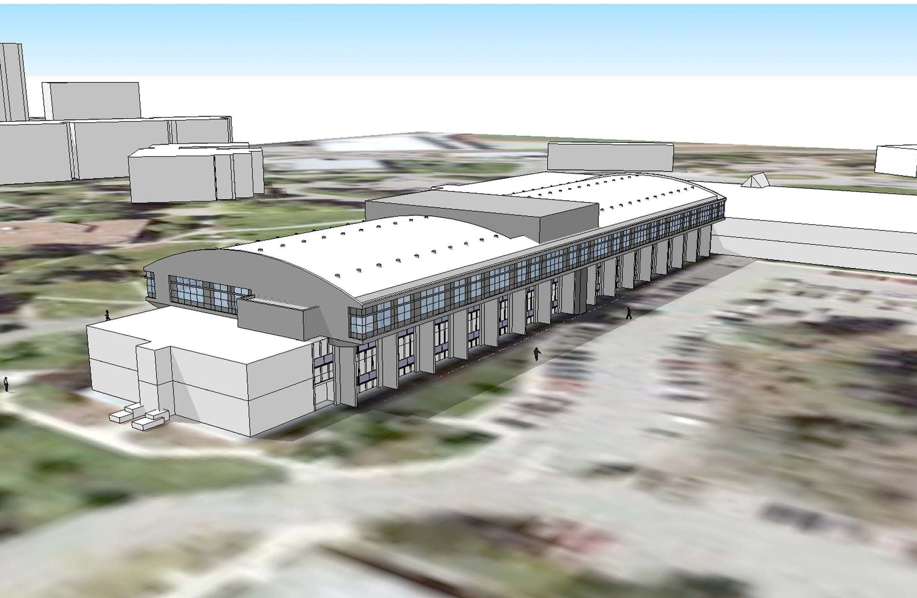

Slide 39
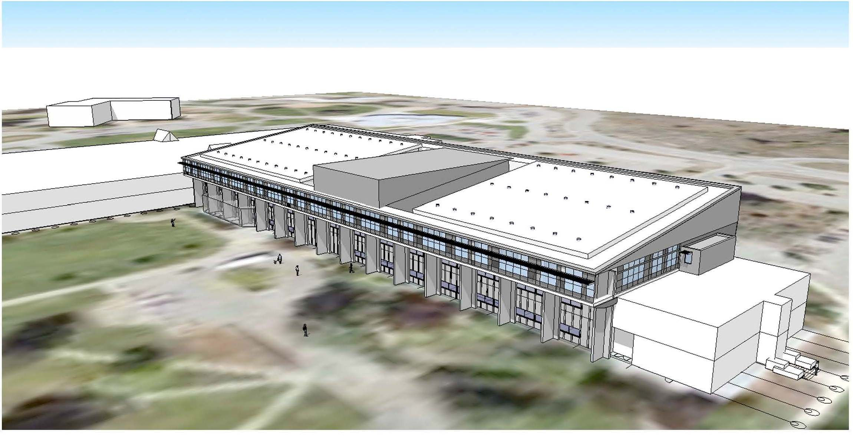

Slide 40
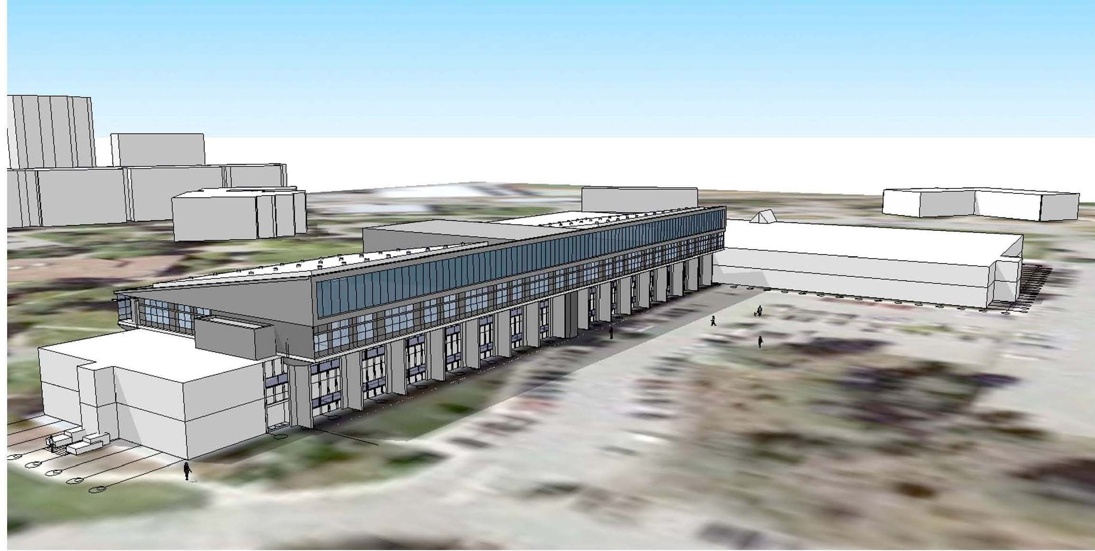

Slide 41
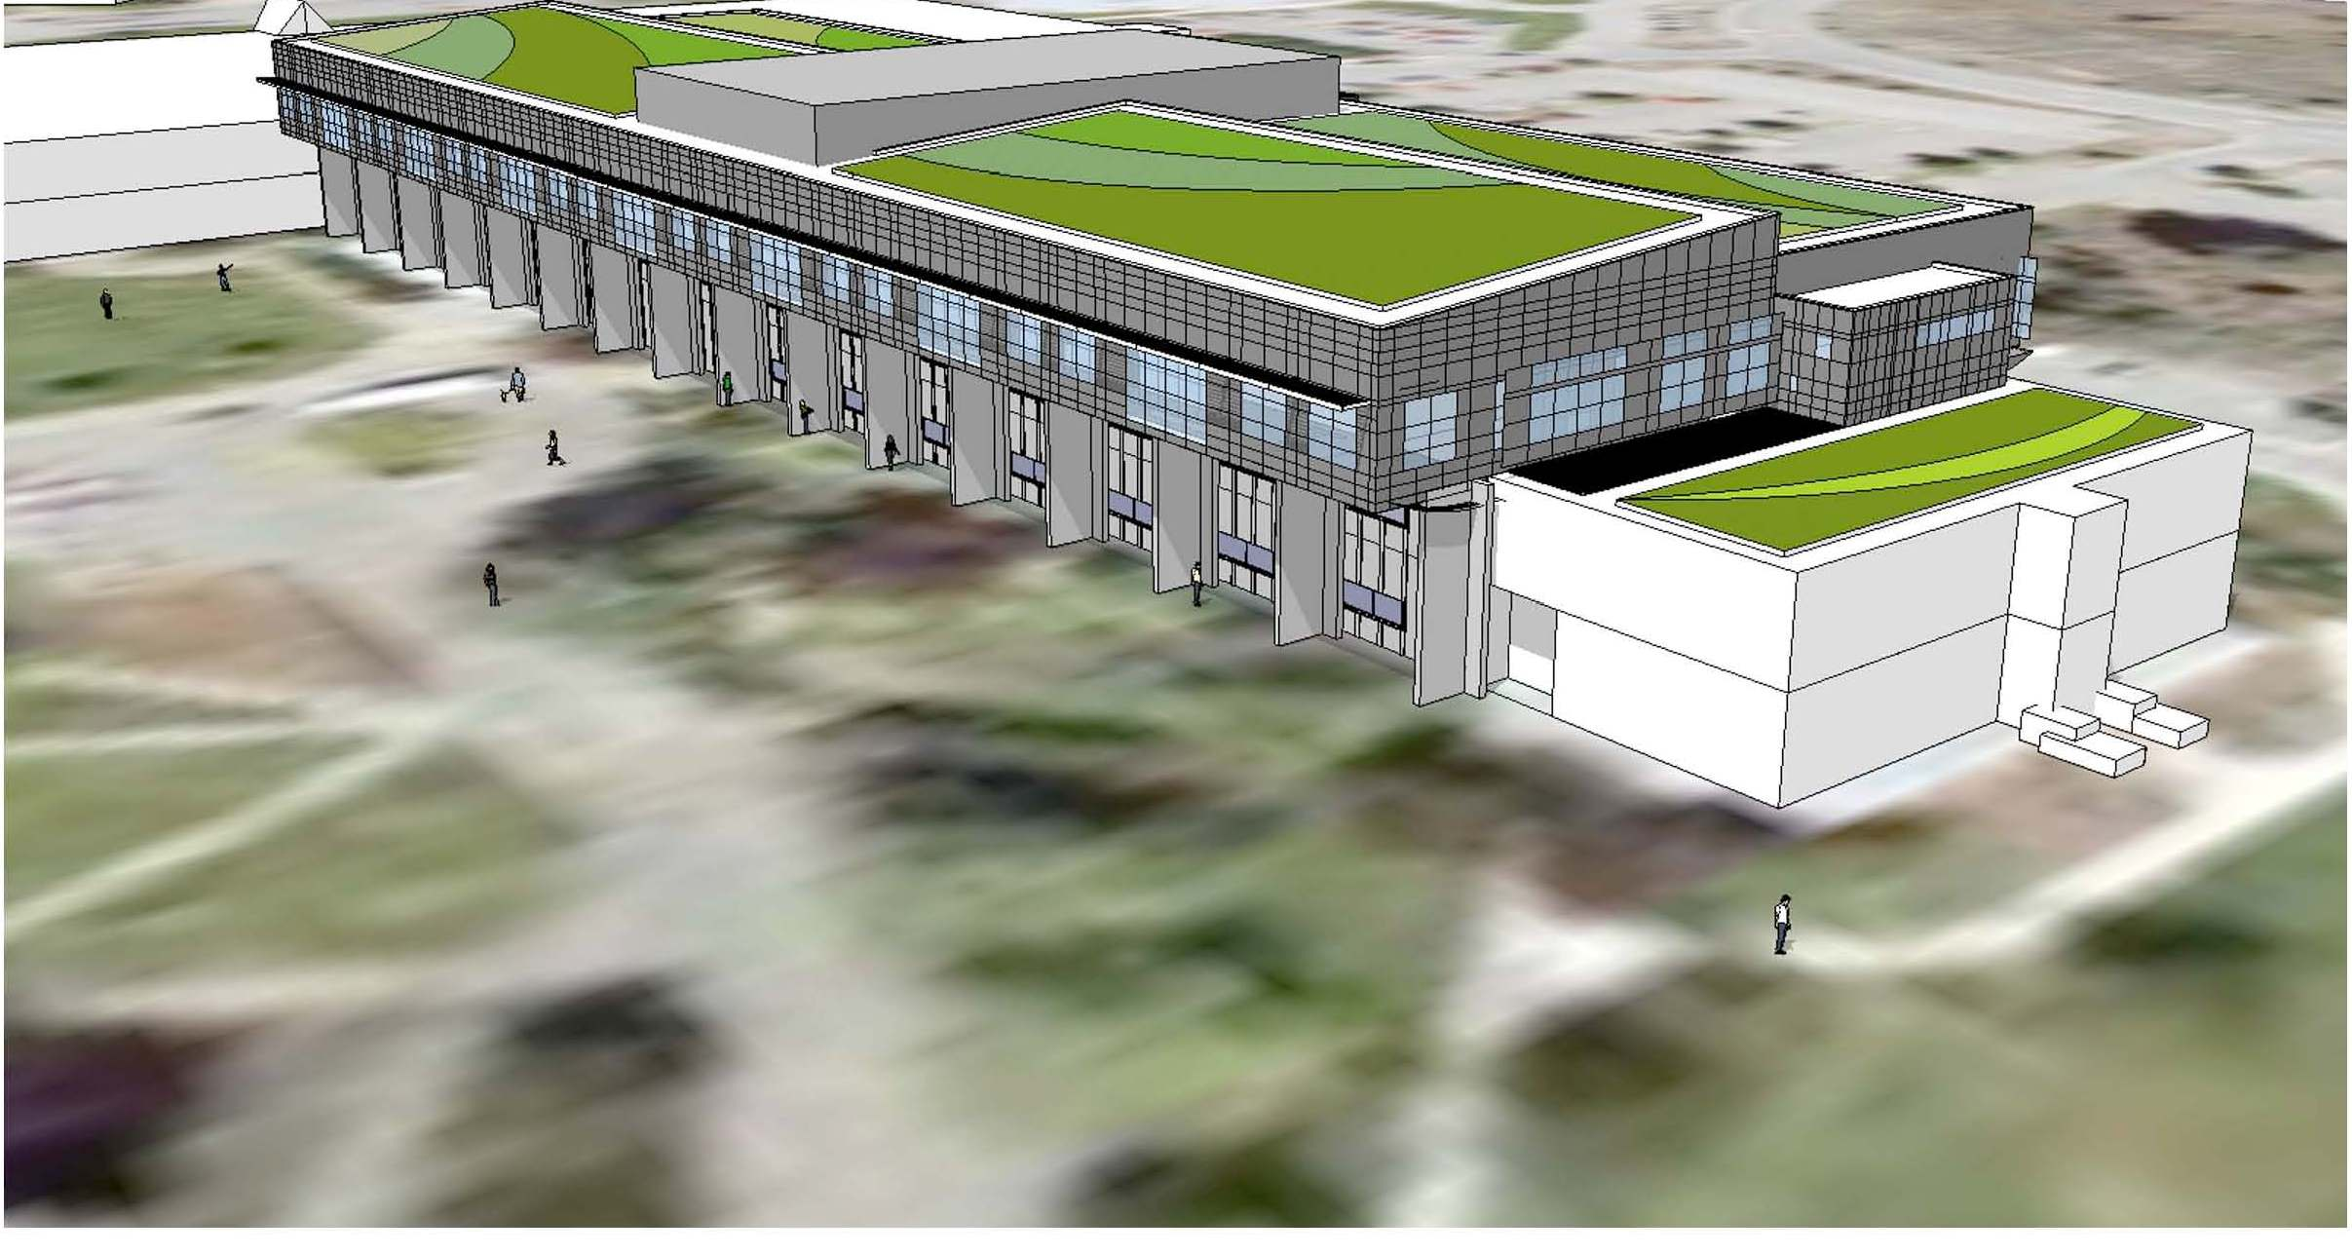

Slide 42
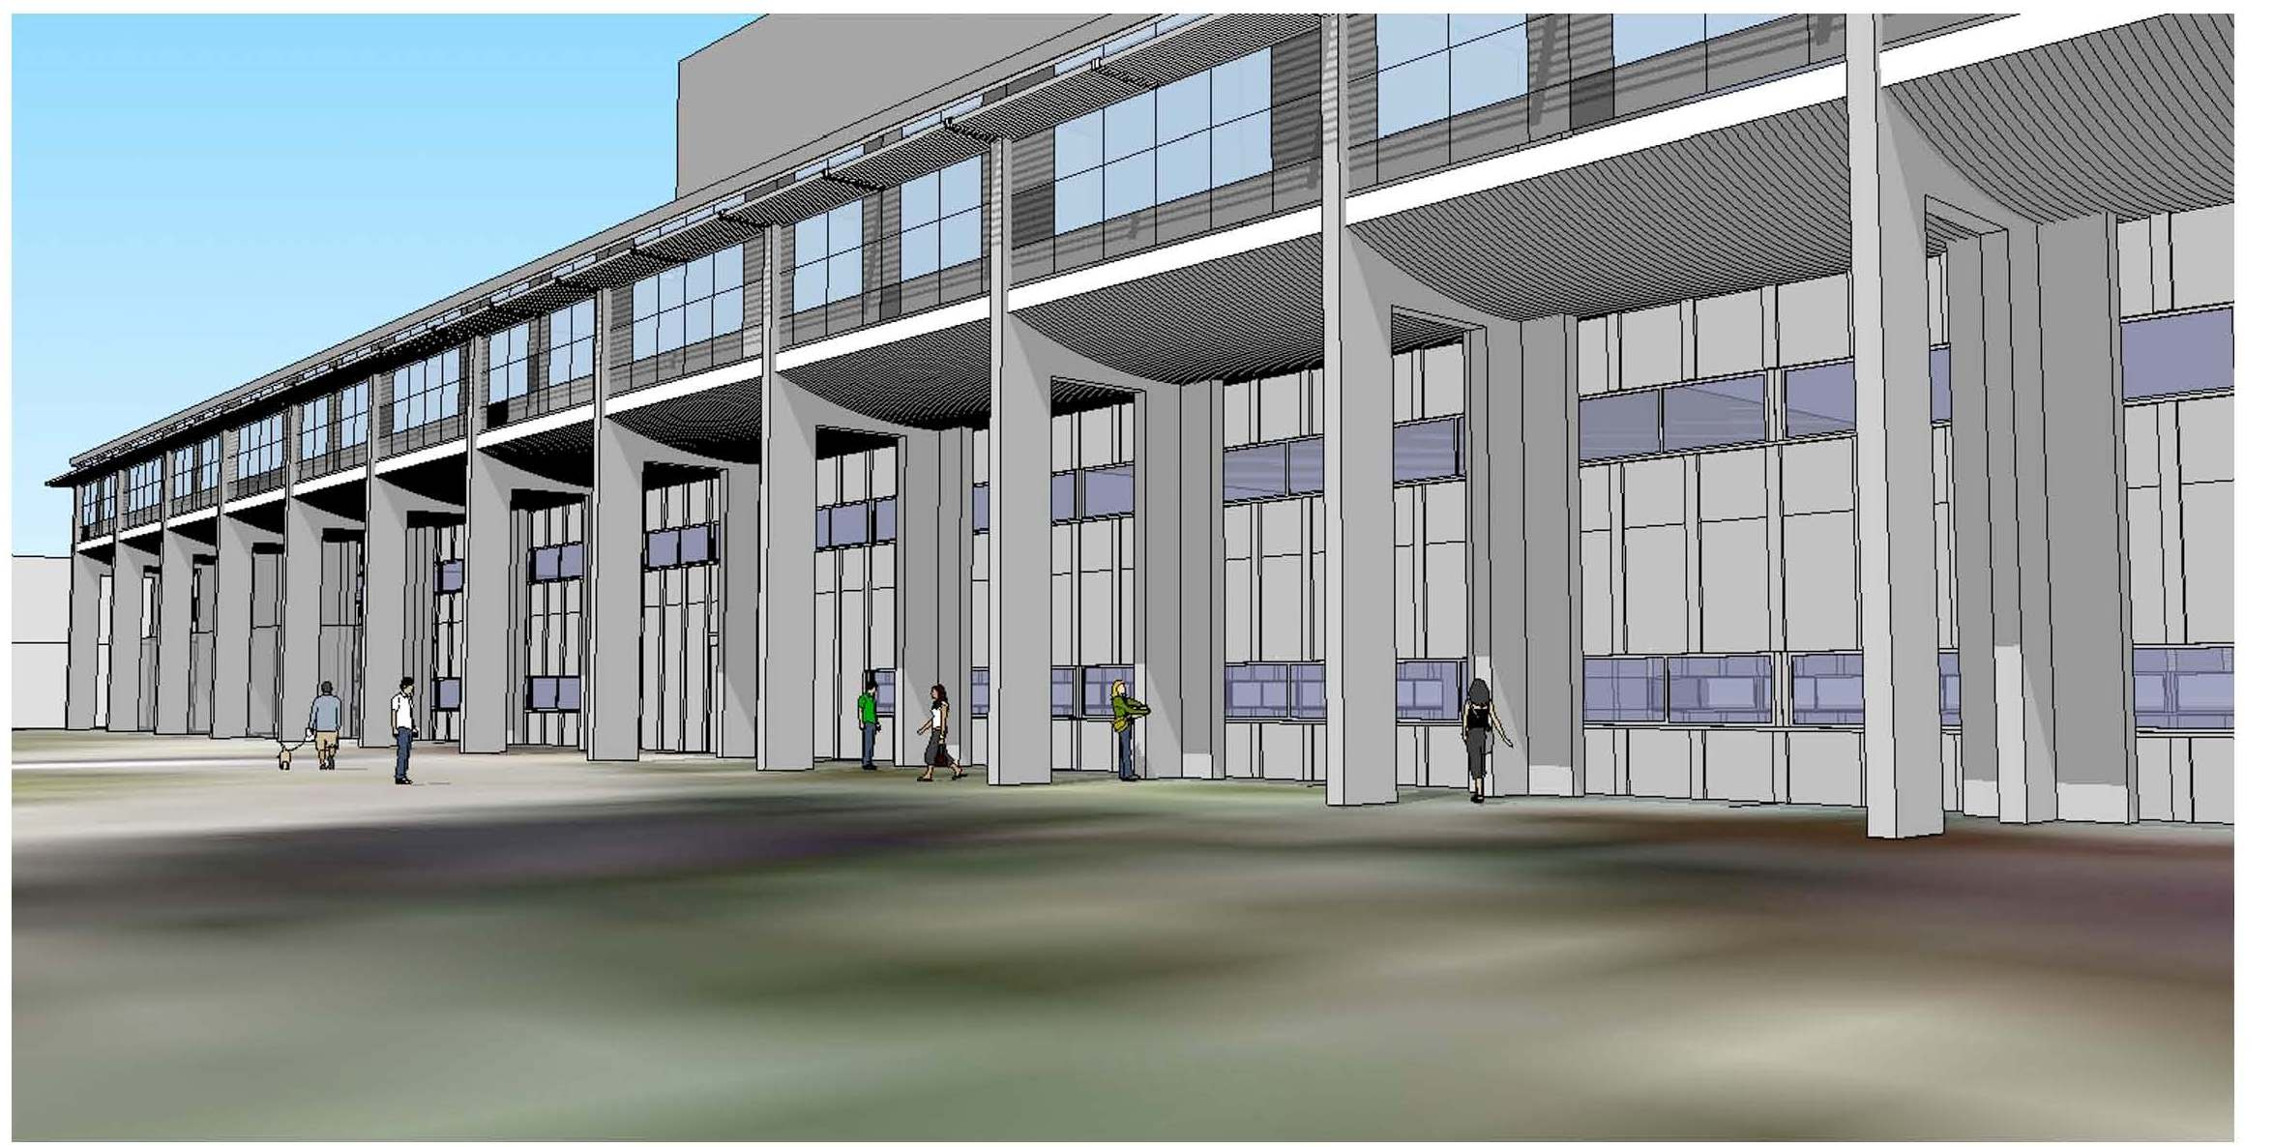

Slide 43
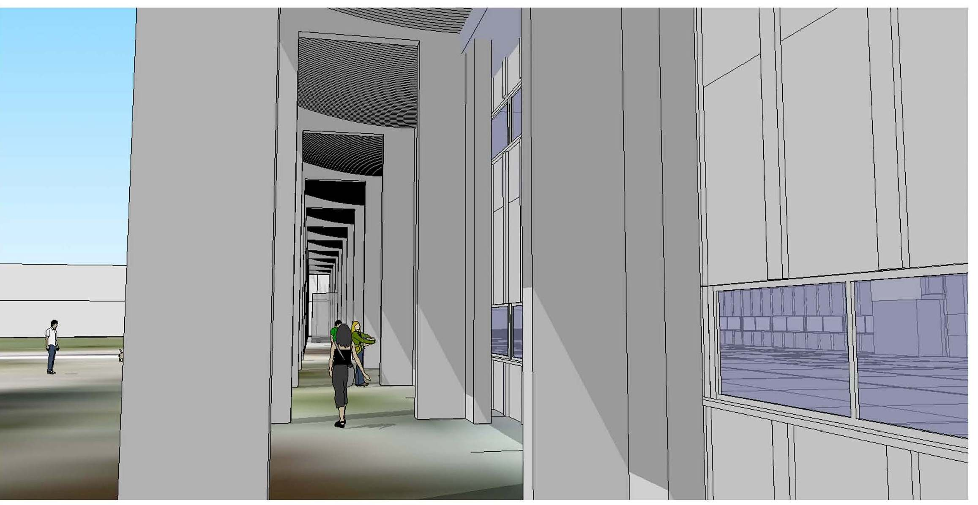

Slide 44
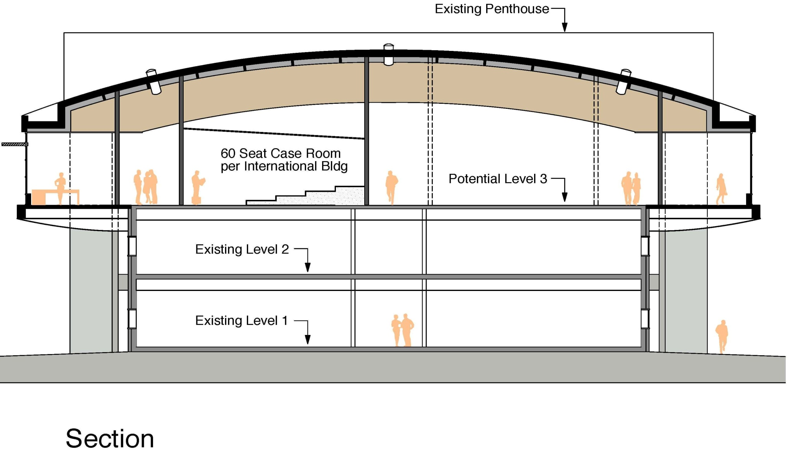

Slide 45
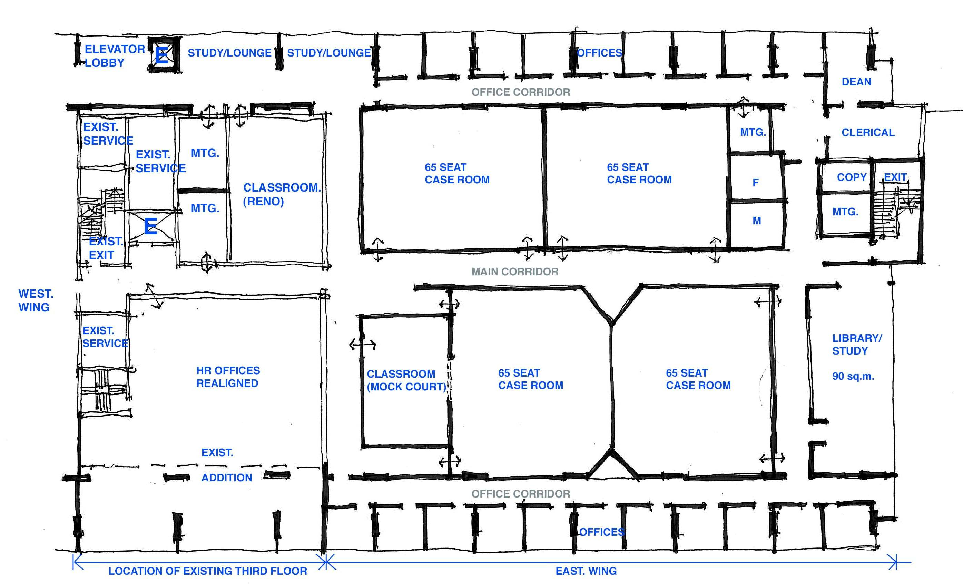

Slide 46
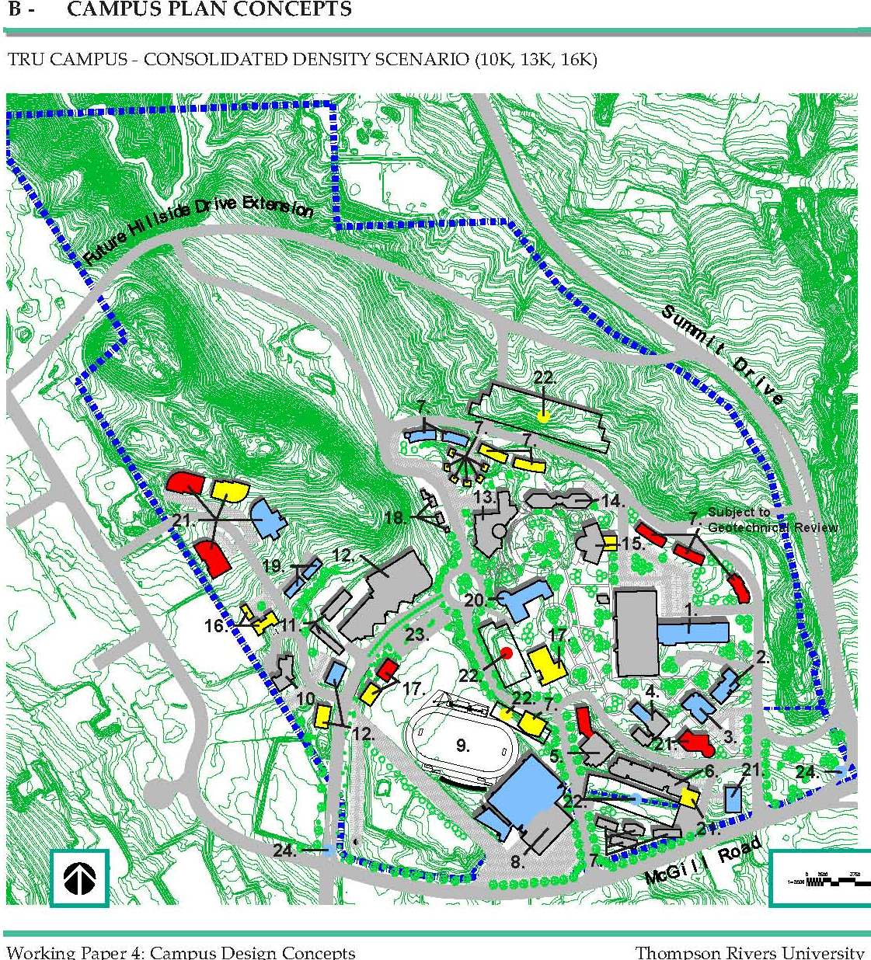

Slide 47
