Slide 1
Topological Data Analysis
MATH 800
Fall 2011

Slide 2
Topological Data Analysis (TDA)
An ε-chain is a finite sequence of points x₁, ..., x_{n} such that |x_{i} – x_{i+1} | < ε for all i=1,…,n-1
x and y are ε-connected if there is an ε-chain joining them.
A ε-connected set is a set that any two points can be linked by an ε-chain.
A ε-connected component is a maximal ε-connected subset.

Slide 3
Topological Data Analysis (TDA)
An ε-chain is a finite sequence of points x₁, ..., x_{n} such that |x_{i} – x_{i+1} | < ε for all i=1,…,n-1
x and y are ε-connected if there is an ε-chain joining them.
A ε-connected set is a set that any two points can be linked by an ε-chain.
A ε-connected component is a maximal ε-connected subset.
ε

Slide 4
Topological Data Analysis (TDA)
C_{ε} = the number of ε-connected components
D_{ε} = the maximum distance of the points in ε-connected components
I_{ε} = the number of component consisting of a single point (isolated points)
ε

Slide 5
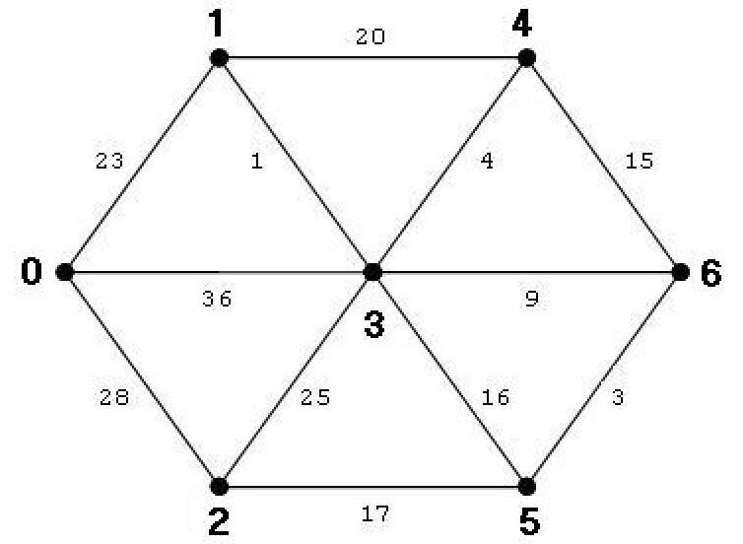
Minimal Spanning Tree (MST)
MST is the tree of minimum total branch length that spans the data.
To construct the MST (Prim's algorithm)
Start with any point and its nearest neighbor,
Add the closest point
Repeat until all points are in the tree

Slide 6
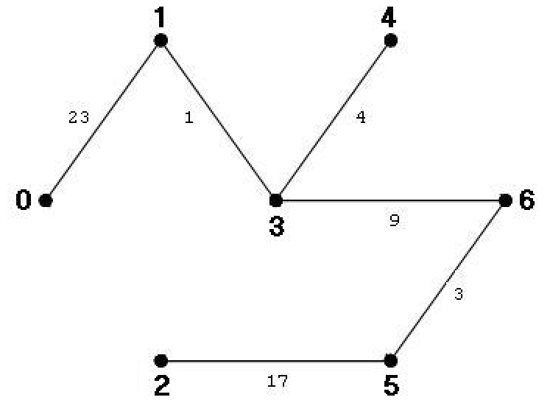
Minimal Spanning Tree (MST)
MST is the tree of minimum total branch length that spans the data.
To construct the MST (Prim's algorithm)
Start with any point and its nearest neighbor,
Add the closest point
Repeat until all points are in the tree

Slide 7
Minimal Spanning Tree (MST)
MST is the tree of minimum total branch length that spans the data.
To construct the MST (Prim's algorithm)
Start with any point and its nearest neighbor,
Add the closest point
Repeat until all points are in the tree
ε = 6

Slide 8
Topological Data Analysis (TDA)

Slide 9
Topological Data Analysis (TDA)

Slide 10
Topological Data Analysis (TDA)

Slide 11
Topological Data Analysis (TDA)

Slide 12
Applications of TDA
Cluster analysis: is the task of assigning a set of objects into groups so that the objects in the same cluster are more similar to each other than to those in other clusters.
connected components
Outlier: is an observation that is numerically distant from the rest of the data.
Noise: is an unwanted value in a data
isolated points

Slide 13
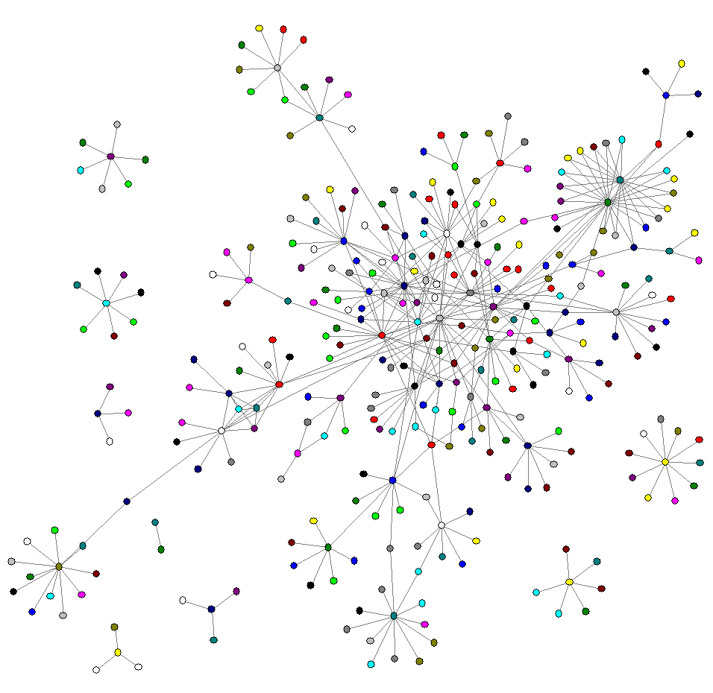

Slide 14
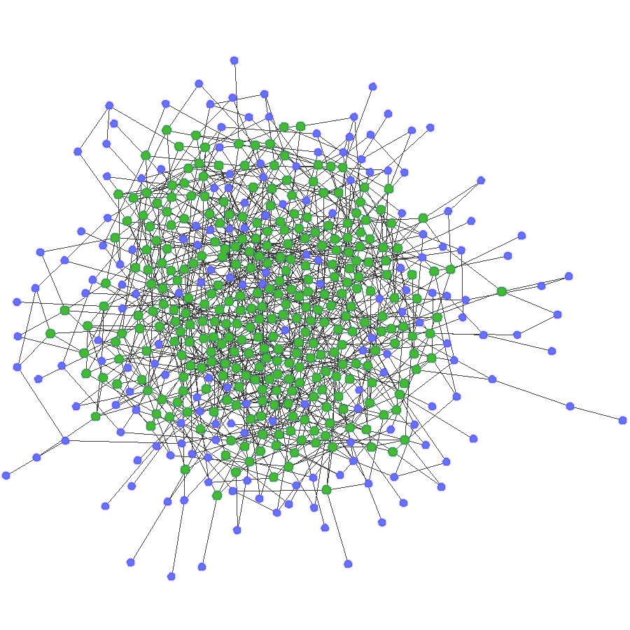

Slide 15
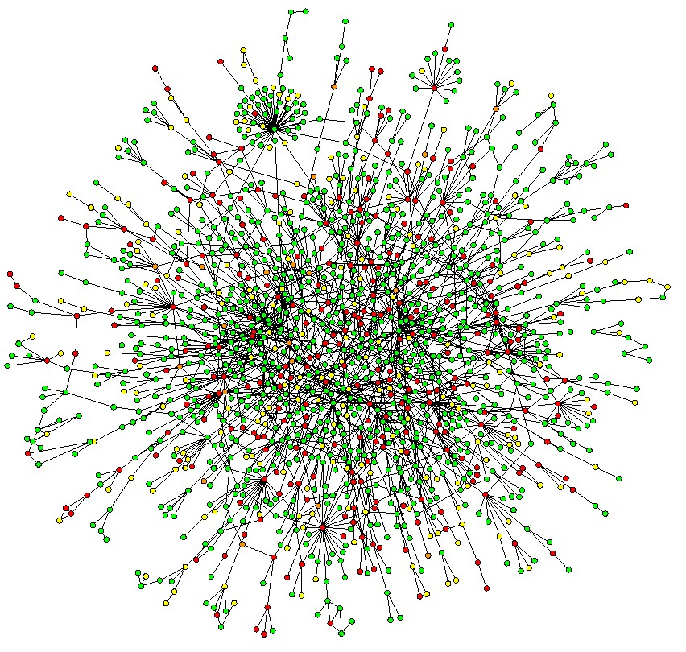

Slide 16
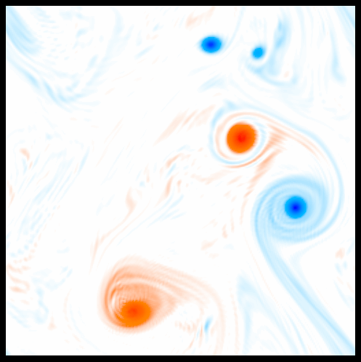

Slide 17
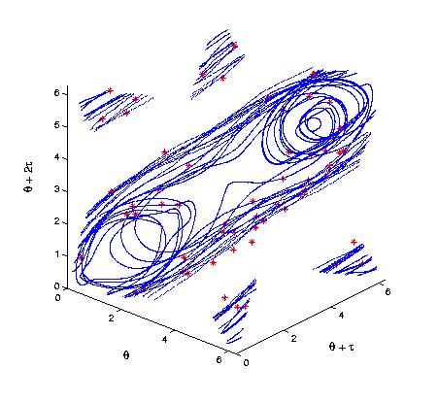

Slide 19
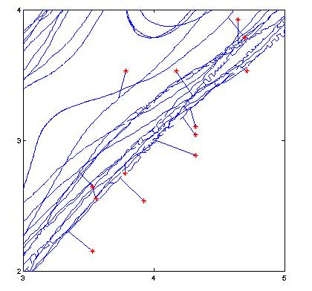

Slide 23
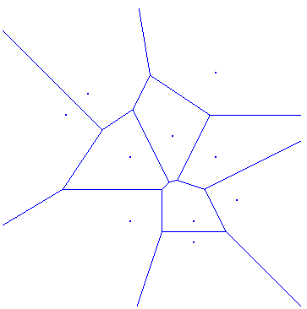
C

Slide 28
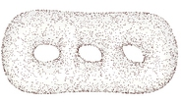
Geometry of Data
Consider 10⁶ points and each point is a string of 100 numbers.
Is it one piece or more?
Is there a tunnel? Or a void?
Point clouds in 100-D Euclidean space.

Slide 29
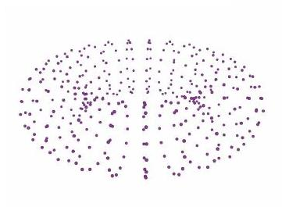
Point Cloud

Slide 30
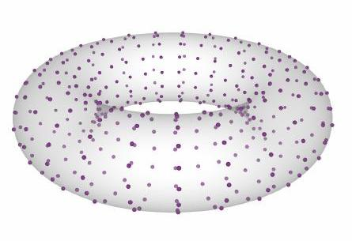
Point Cloud

Slide 31
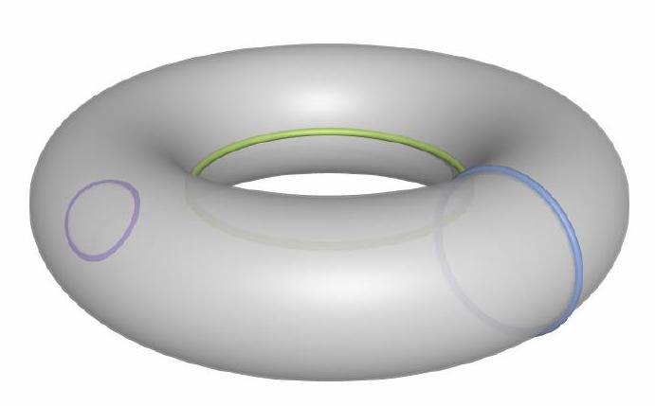
Point Cloud

Slide 32
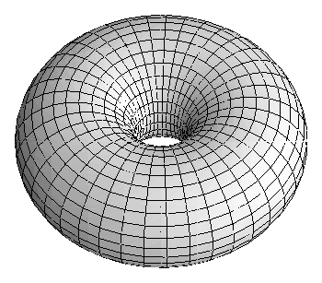
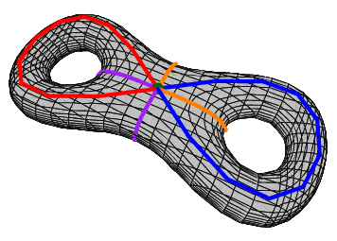
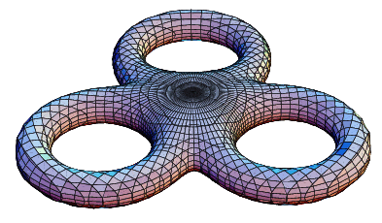
Point Cloud

Slide 33
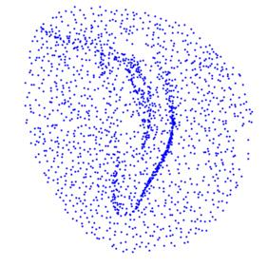
Point Cloud

Slide 34
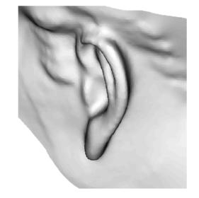
Point Cloud

Slide 35
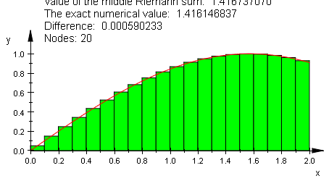

Slide 36
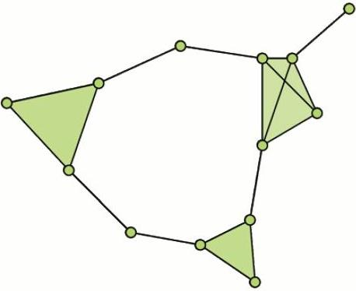
Triangulation

Slide 37
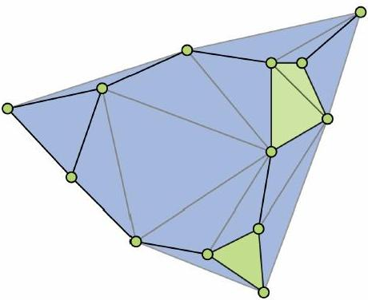
Triangulation

Slide 38
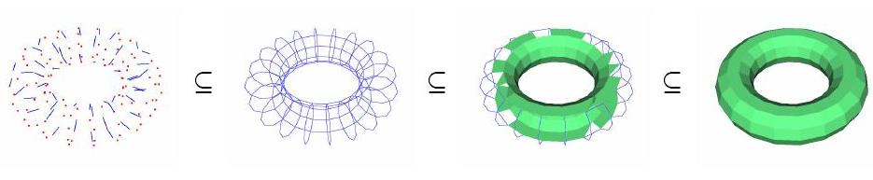
Triangulation

Slide 39
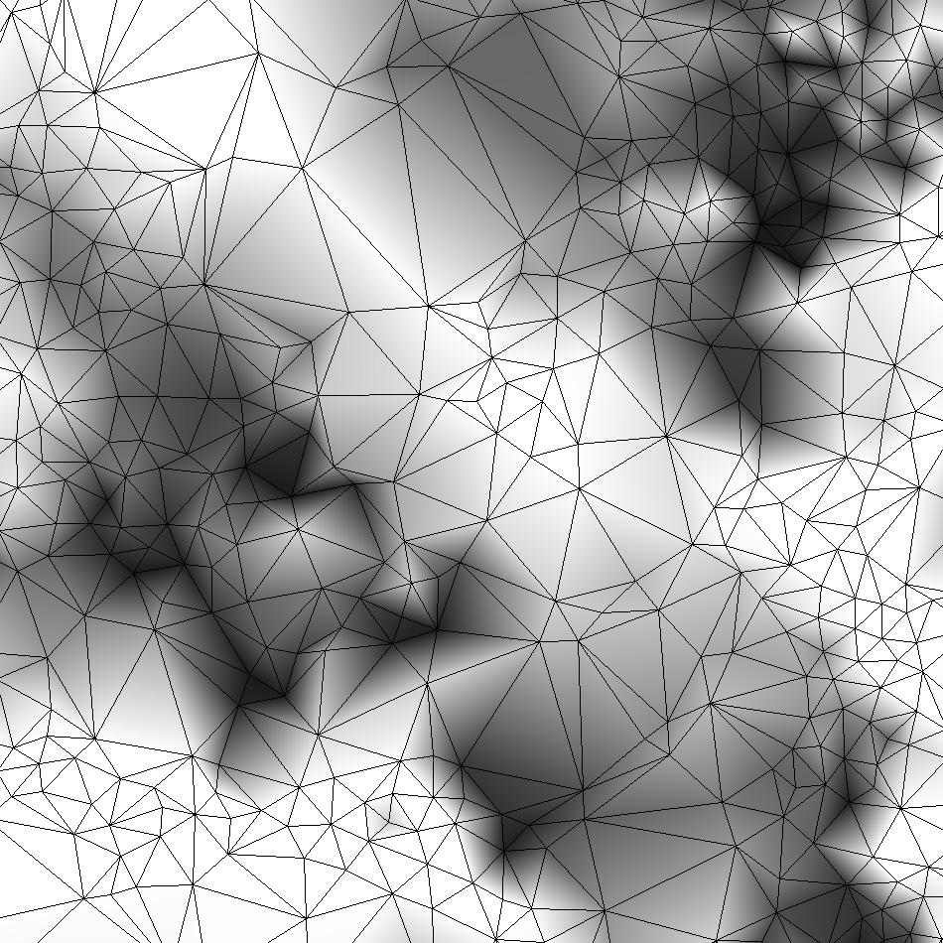
Triangulation

Slide 40
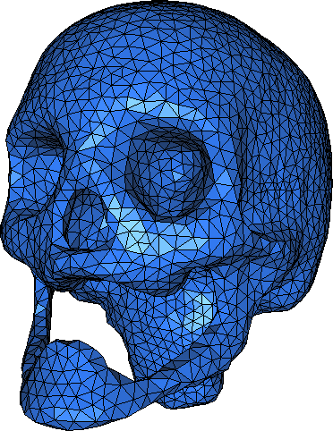
Triangulation

Slide 41
Point Cloud

Slide 42

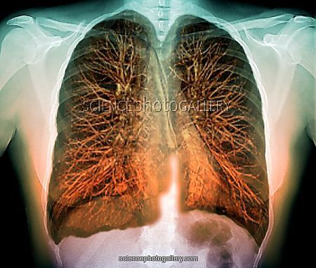
MRI

Slide 43
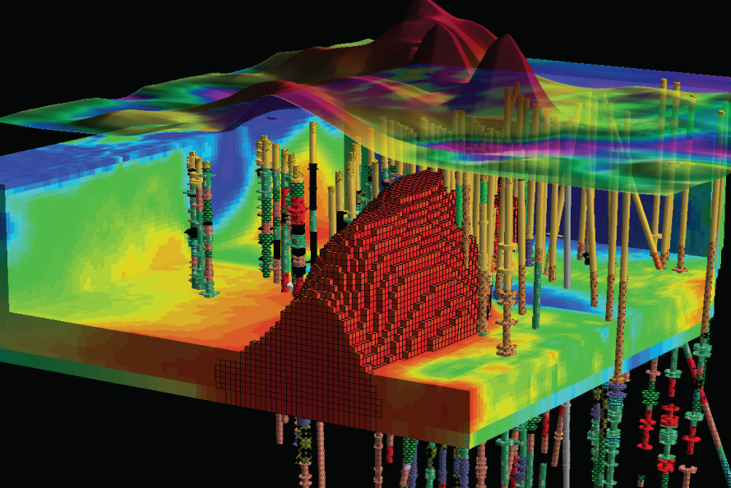
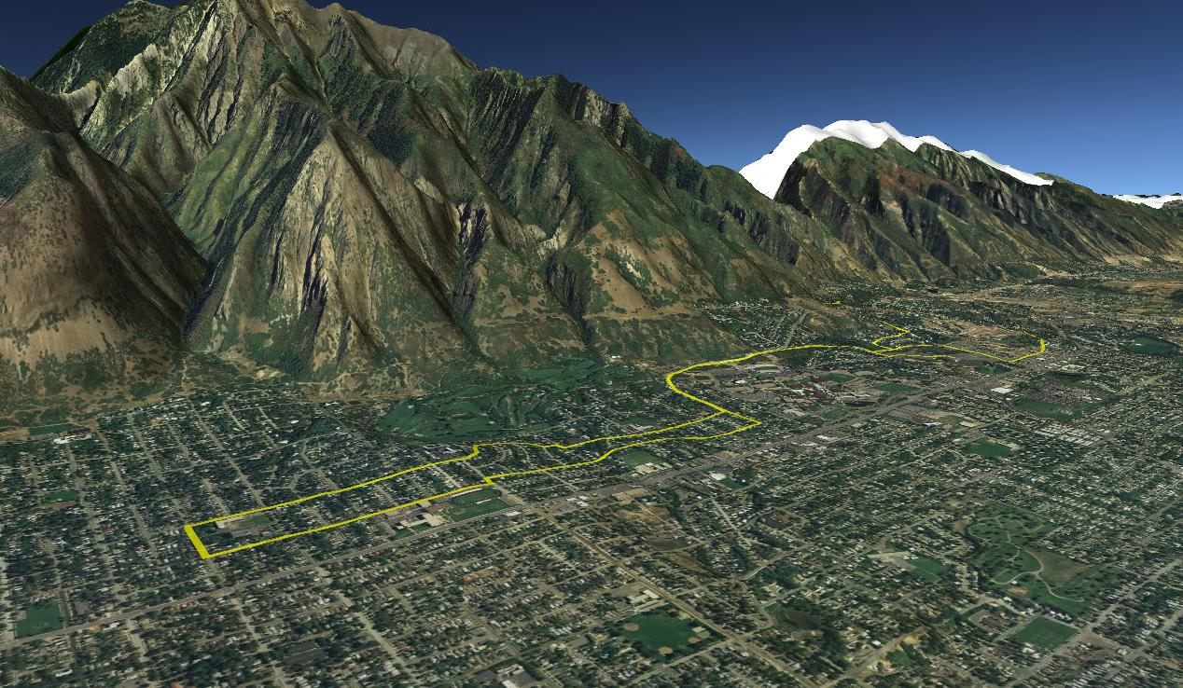
GIS – Elevation Model

Slide 44
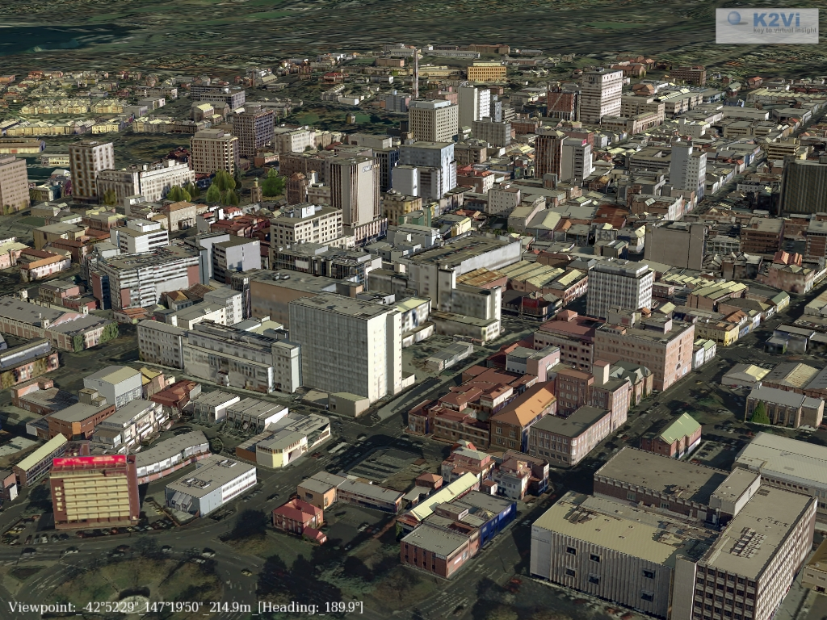
GIS – Urban Environment

