Slide 1
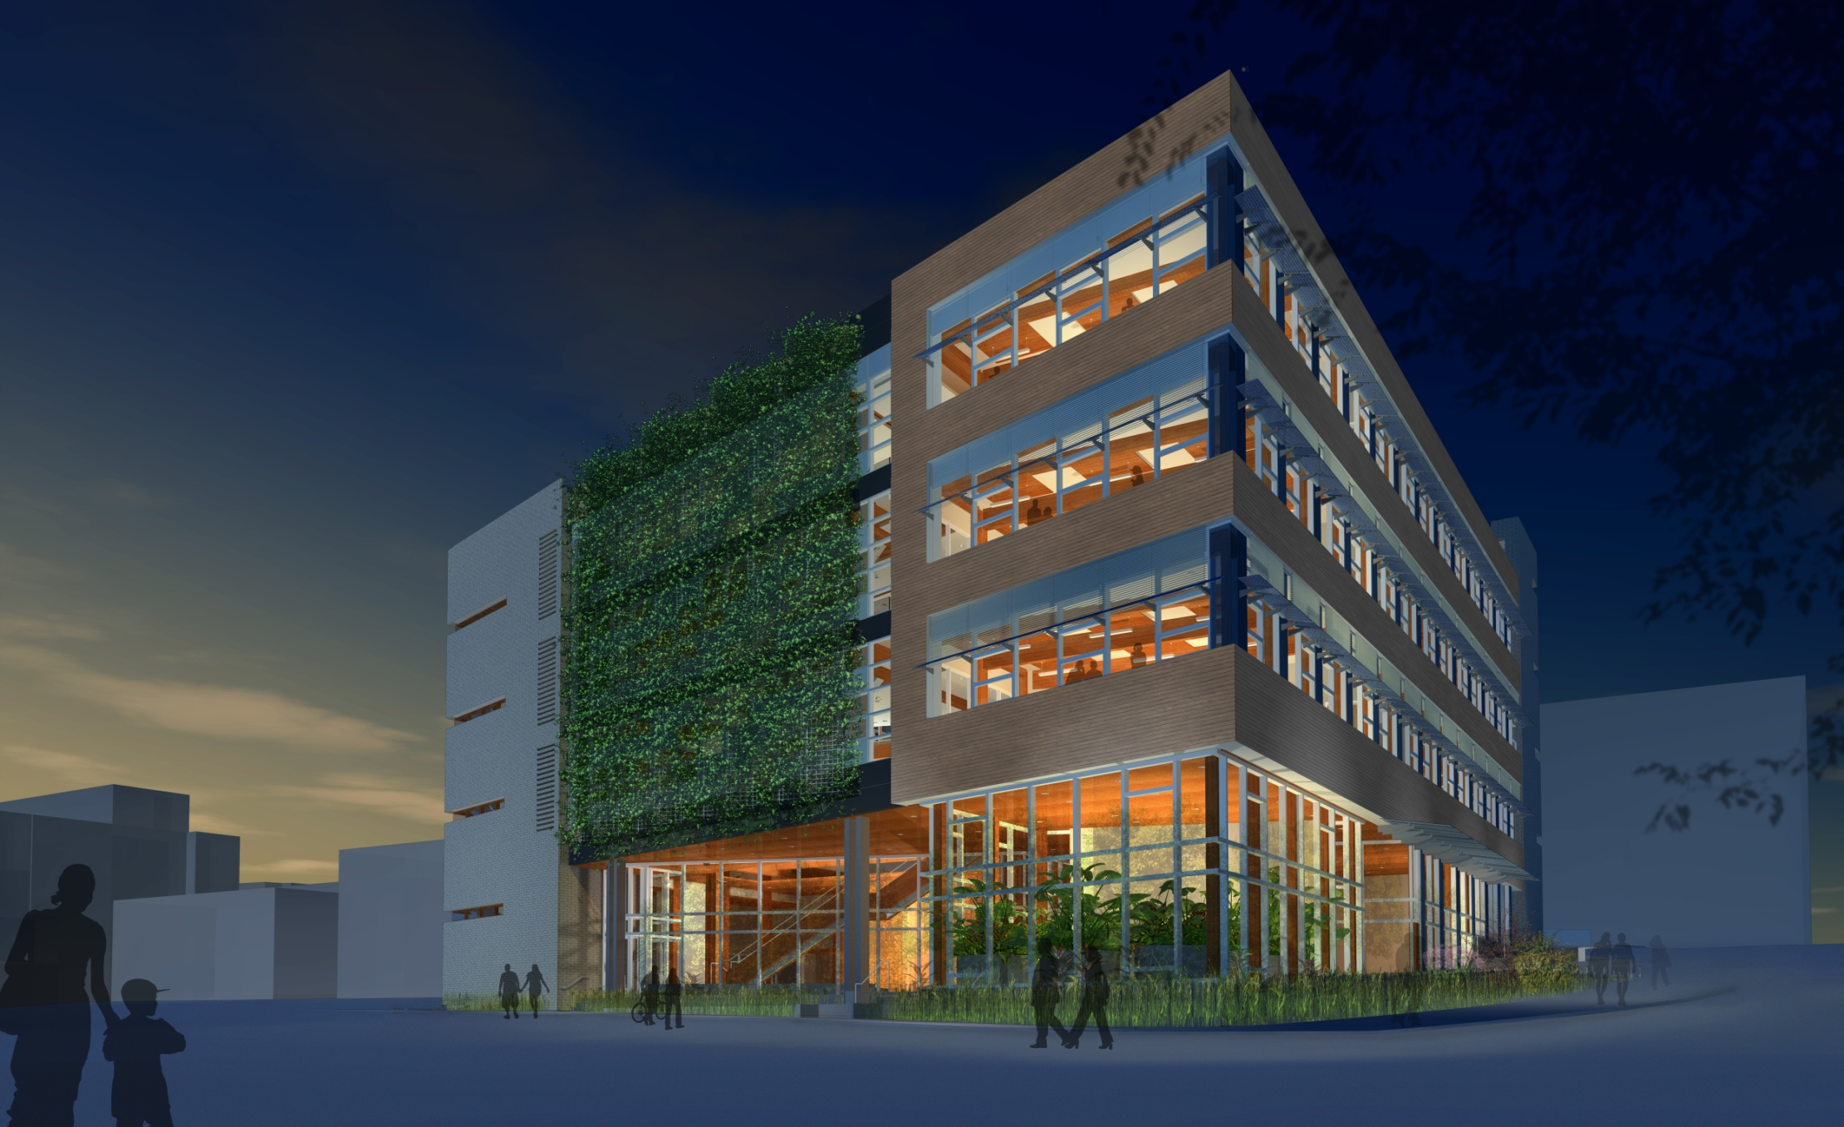
Centre for Interactive Research on Sustainability
“Accelerating Sustainability”

Slide 2
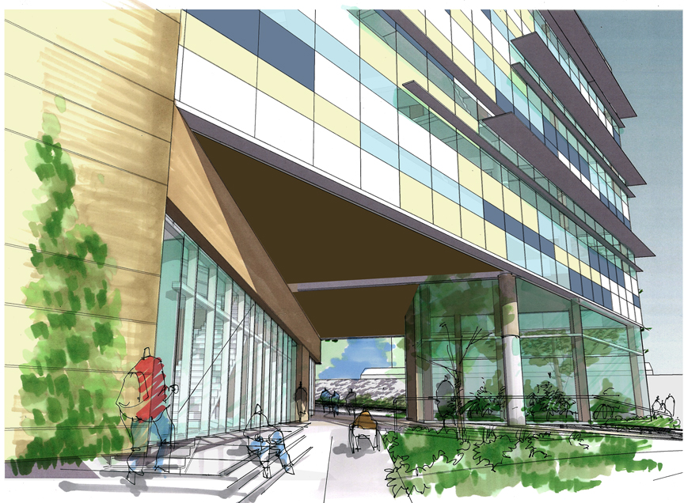
The CIRS Opportunity
To help make Canada a world leader in three interconnected fields of applied sustainability:
Part 1 - building design and operations
Part 2 - visualization, simulation and community engagement
Part 3 - partnerships and strategies of regional implementation

Slide 3
A Regenerative Building Process
All water from the sky
All liquid waste treatment from the ground & sun
All heating and cooling from the ground/neighbours/sun
All light (when avail.) from the sun
Much electricity from the sun
Most ventilation from the wind
Wood building
Continuous research:
technical performance of building systems
behavioural interface of building & inhabitants
net positive on water
net positive on energy and GHG emissions
net positive on structural carbon
A building that restores the environment around it
Notes:
The CIRS building will live within its biophysical means, and make its biophysical and human environment better than if it was not built. We will continuously study the environmental performance of building systems and human health, happiness and productivity in the building, with a goal of continuous improvement over time. Building inhabitants will be asked to sign a Sustainability Charter, committing them to work towards the sustainability goals of CIRS, in return for more control over their workspace and building operations and very high air quality.

Slide 4
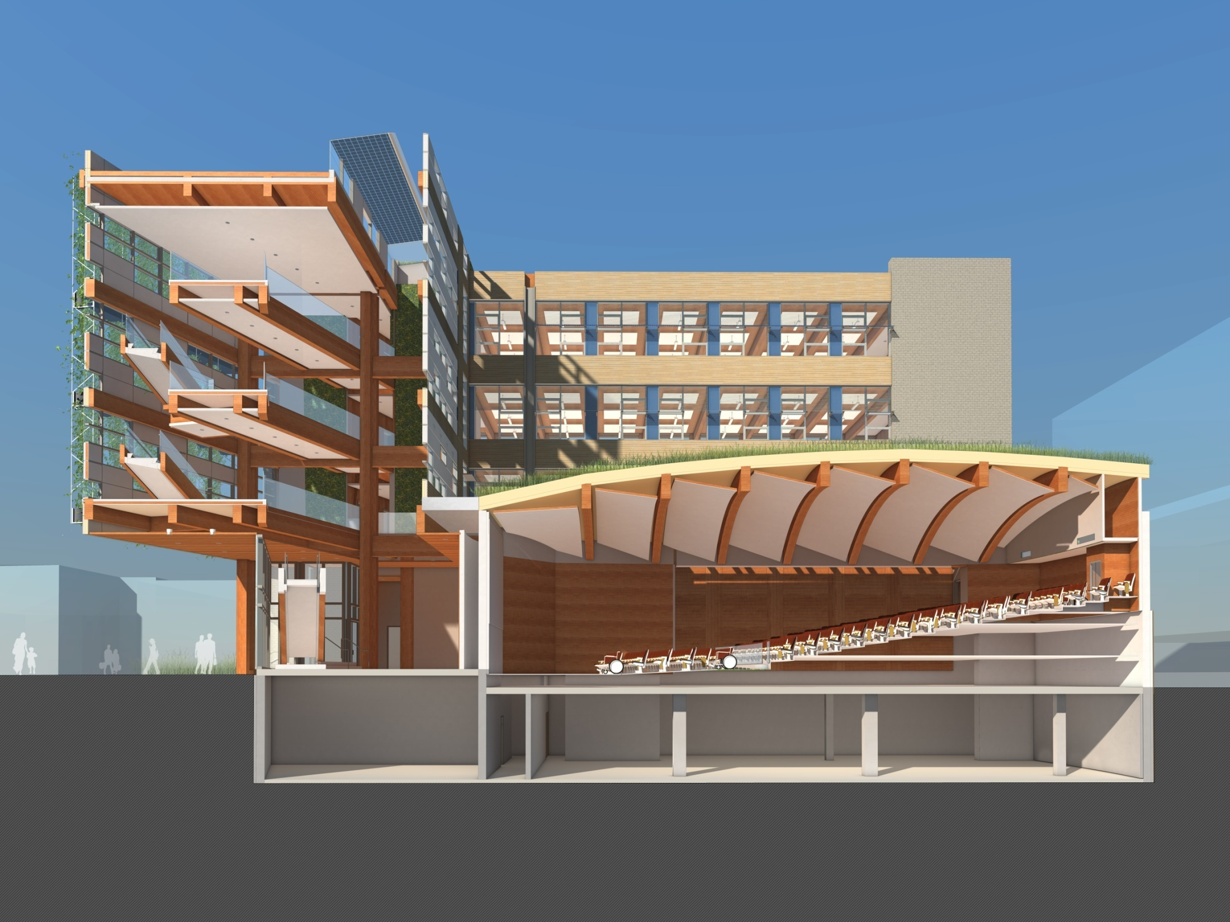

Slide 5
Life Cycle Cost of CIRS

Slide 6
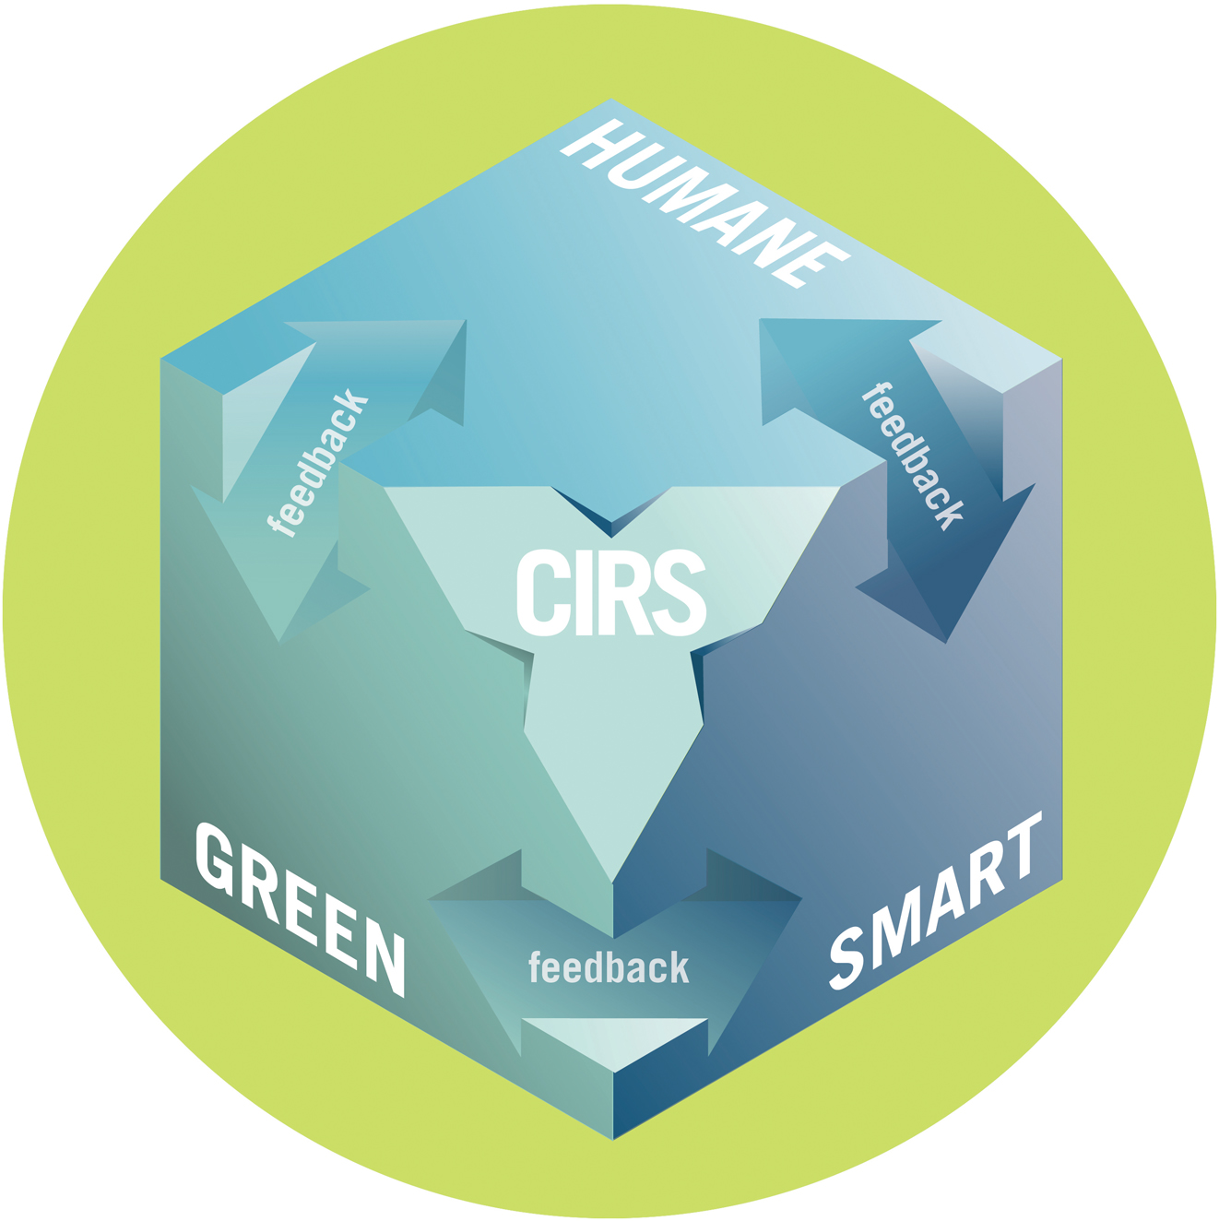
The CIRS Building Concept
Improving the Local and Global Environment

Slide 7
The CIRS Building Concept
Improving the Human Environment

Slide 8
The CIRS Building Concept
Cost-effective and Adaptive

Slide 9
The CIRS Building Concept

Slide 10
Engaging the Community
60 seat theatre with interactive touch pads in the seat arms
4m X 12m curved screen immersion environment at the front
Fly audience through the landscape of the future, showing effects on the ground as they make policy decisions
Plus displays, interactive exhibits and public art, web experiences of building, etc.
Notes:
UBC is a world leader in designing and implementing interactive participatory processes of community engagement. We will build on these techniques and take them to a new level of engagement on issues ranging from climate change and urban futures to building operations.

Slide 11
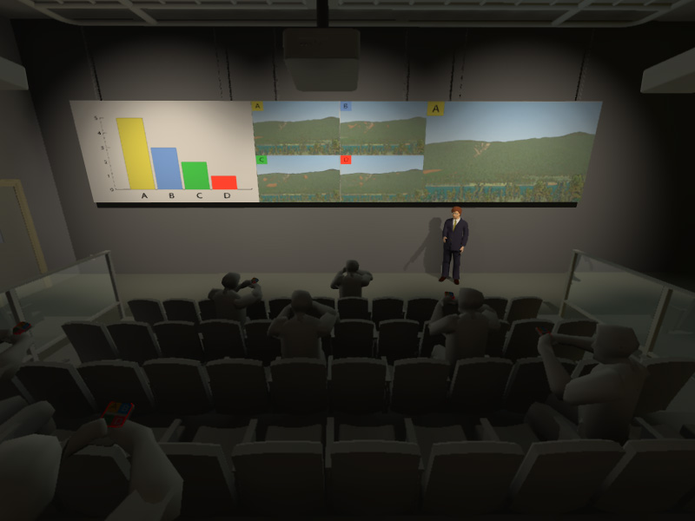
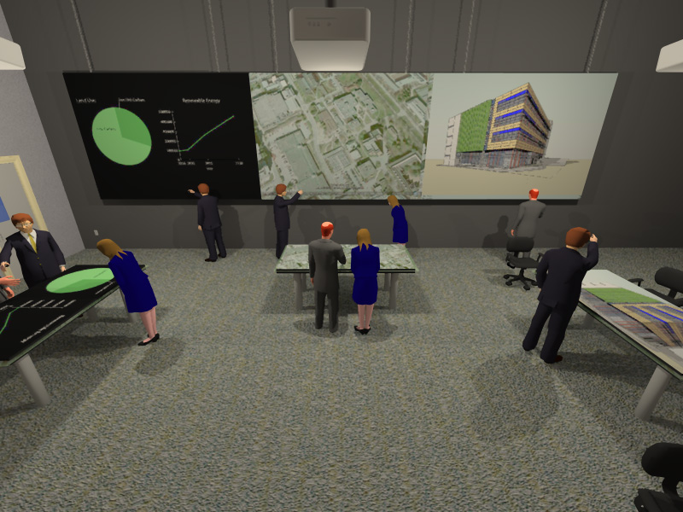
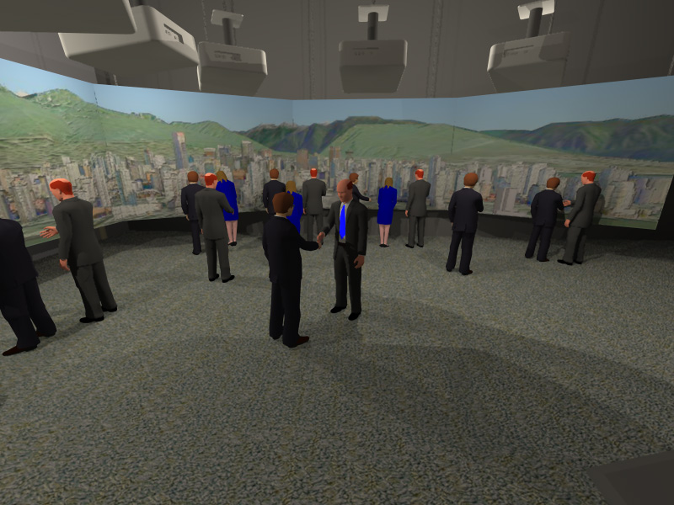
Immersion
Exploration
Collaboration

Slide 12
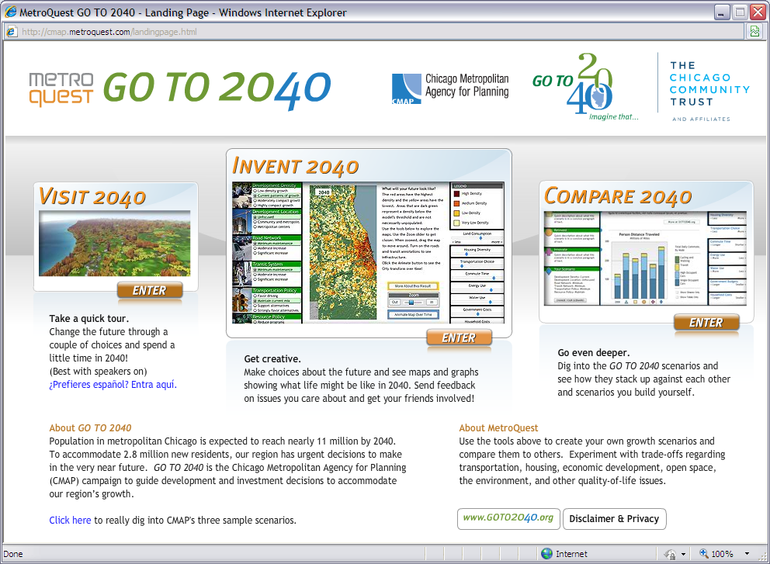
Chicago Metroquest

Slide 13
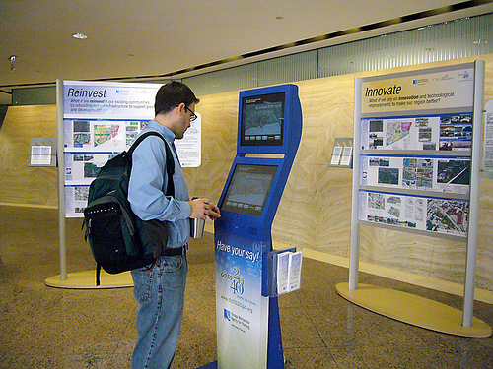
Metroquest kiosk Sears Tower, Chicago, 2009

Slide 14
Showcasing Sustainable Development in BC
Identify handful of areas of comparative advantage in SD in BC
Create new forms of partnership to make them happen on the ground in this region: create Showcase
Use this as springboard for penetrating global market in SD technology and services

Slide 15

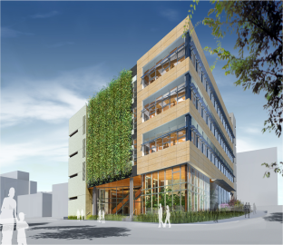
The Sustainability Mosaic
New forms of partnership
controls
Honeywell
data mgmt
SGI
urban
design
ICSC
utility
Corix
solar
Xantrex
offsets
DSF
simulation
Envision
finance
Vancity
envelope
Visionwall
energy
policy
NRCan
DSM
BC Hydro
IT
Telus
fuel cells
FCC
codes
Vancouver
interiors
Haworth
standards
GVRD
industrial
ecology
NRC
Notes:
The Sustainability Mosaic illustrates our approach to creating new forms of partnership aimed at commercialization and market transformation with regard to sustainability technologies and services (click through animation):
List of companies, NGOs and government agencies we are working with
Each has a different comparative advantage in sustainability
CIRS is the grout
That creates the mosaic of sustainability
We plan to use these partnerships and the existence of the CIRS showcase as an sustainability incubator and a springboard for penetrating global market in SD technology and services
We are already getting evidence that this approach has significant positive implications. Our partners are excited and eager to work with us. This is already reflecting well on UBC.

Slide 16
UBC Sustainability Academic Strategy
Exploring and Exemplifying Sustainability
UBC’s Sustainability Academic Strategy
October 17, 2009
Presented to UBC Executive in August 2009
Additional Public Comment in September 2009
Final Submission in October, 2009
UBC Vancouver’s Steam Heating System (top) and UBC Okanagan’s Geothermal Field (bottom): Treating both UBC’s campuses as integrated energy, water and waste systems offers an unparalleled opportunity to link teaching and learning, research and partnerships, and operational activities through the Sustainability Academic Strategy

Slide 17
UBC Sustainability Academic Strategy
Campus as Living Lab
Agent of Change
Teaching/
Learning
Research/
Partnerships
Operations/ Admin
Explore
&
Exemplify
4. Further On Beyond Zebra

Slide 18
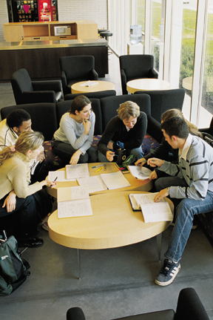
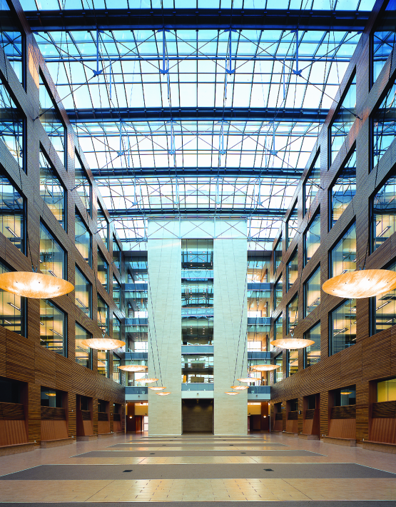
SAS Table of Contents
Vision
Teaching & Learning
- 3 recommendations
Research & Service
- 4 recommendations
Operations & Administration
- 5 recommendations
Implementation
- 3 recommendations

Slide 19
UBC (Vancouver) Sustainability Initiative
Media Release Jan. 27, 2010
“UBC President Stephen Toope has announced the creation of a new sustainability strategic management initiative that will begin to take shape immediately.”

Slide 20

UBC Vancouver Sustainability Initiative
Student Advisory
Council
Steering
Committee
BC Sustainability
Council
University
Sustainability
Initiative
RPO
CSO
APO
Research & Partnerships
Operations/
Admin
Academic Programs

Slide 21
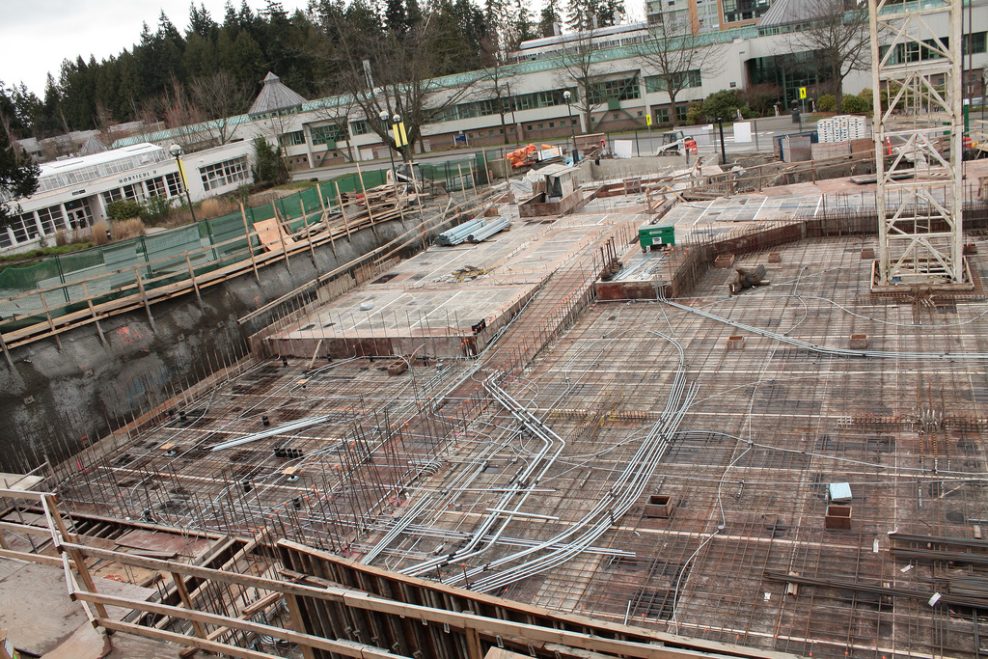
CIRS Site, Feb 27, 2010

