Slide 1



Notes:
Presentation for: Healthy Communities Community Development /Community Economic Development Program Red River Community College

Slide 2
Outline
Intro
What is a CIS?
Peg’s background
How is Peg different from other CISs
Demo
Next steps
Questions

Slide 3
Intro
What is a community indicator
What is a community indicator system?
Notes:
What is a community indicator:
measurements that provide information about past and current trends within a community. They show the connectedness between social, environmental, and economic factors that affect a community’s well-being. Community indicators provide information on the overall direction of a community, providing data on where it is improving, declining and/or staying the same.
“Community indicators are bits of information that, when combined, generate a picture of what is happening in a local system. They provide insight into the overall direction of a community: whether it is improving, declining, or staying the same, or is some mix of all three . . . Indicators are gauges for a community, like the Dow Jones Industrial Average: just as the Dow indicates the direction of the whole stock market by tracking a small selection of stocks, indicators represent a whole community through a few factors, often selected by way of a community visioning process.” (Rhonda Phillips, Community Indicators, The American Planning Association, 2003, page 2.)
What is a community indicator system? Identify and track indicators that speak to a community’s well-being; that relate to the economic, environmental, cultural, social and other priorities and issues that matter most to a community’s members. The system collects, analyzes and interprets data for each indicator, making the information fully available to members of the community.

Slide 4
Intro
Why is this important to Winnipeg?
Knowing that investments are making a difference
Open data, and evidence-based decision-making
A way to see where we have strengths and where we need to work together to make improvements

Slide 5
Intro
Governance
Pilot structure
Going forward

Slide 6
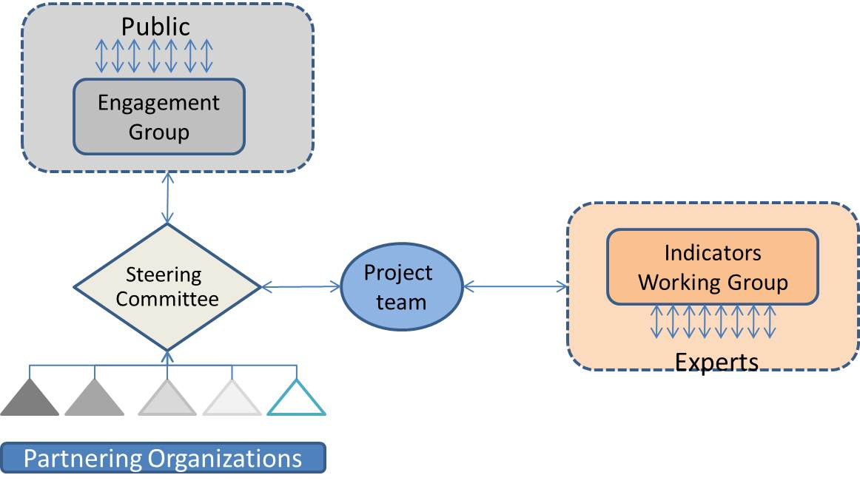
Governance model: Pilot
Notes:
Also speaks to the community engagement process:
Project Team – United Way & IISD – also spearheaded the project
Steering Committee – provided oversight and overall guidance, to ensure that Peg stayed credible and balanced
Engagement Group – a testing ground for Peg policy, approaches and next steps
Indicators Working Group – organizations and individuals with expertise and/or experience in the theme being explored. Their role is to develop a list of potential indicators and to assist in narrowing the list to a reasonable and achievable list of indicators.

Slide 7
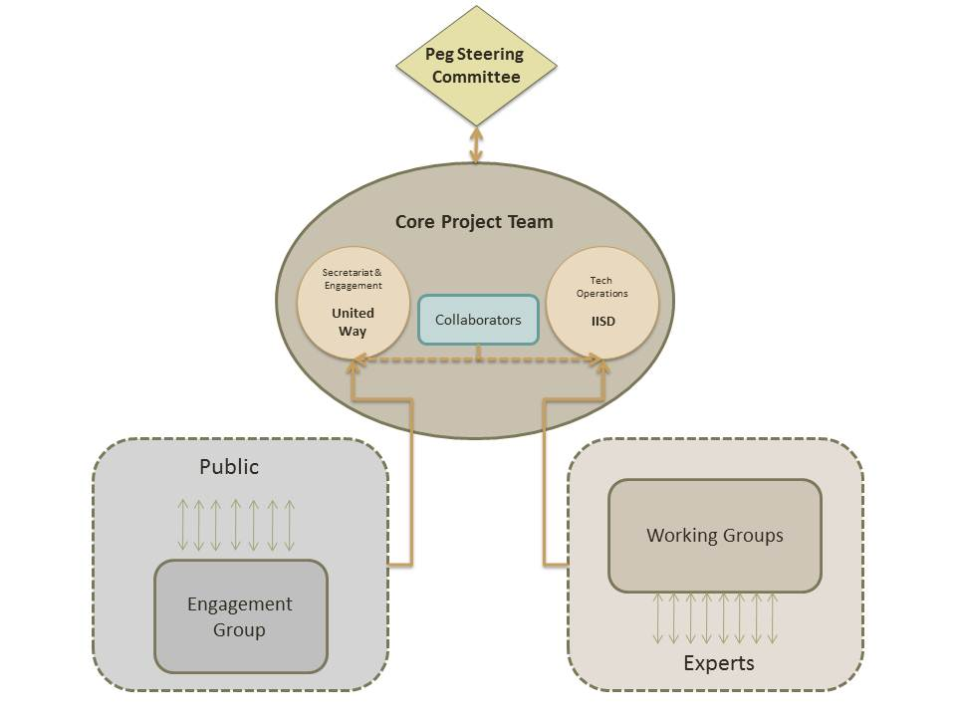
Governance model: Moving forward
Notes:
Peg Steering Committee – similar to a Board – oversight, accountability
Core Project Team – United Way & IISD are collaborators. United Way takes primary responsibility for the Secretariat and Engagement roles and IISD takes primary responsibility for Technological Operations
The Engagement Group will continue to be a testing ground for Peg policy, approaches and next steps
Working Groups – Indicator WG, Stories WG, and Communications WG

Slide 8
Well-being
Domains
Culture
Economy
Environment
Social
Themes
Indicators
Crosscutting
issues
Notes:
With the assistance of the various groups and with research into other CIS, looked at what we could learn, what we wanted to replicate.
Identified Winnipeg’s priority domains, and 8 themes.
Identified a crosscutting issue

Slide 9
How is Peg different?
Crosscutting Issues
Stories
Technology

Slide 10
How is Peg Different
Crosscutting Issue
A crosscutting issue is an issue or concern whose indicators impact on several theme areas. Peg has identified poverty as a crosscutting issue, and has developed indicators that speak to the complexity of the issue. The poverty indicators touch on the following themes: basic needs, education and learning, health, and social vitality.
Notes:
This is new to the Winnipeg system. It is a way of bringing indicators together, of showing how, together, they reflect on an issue. They are also a way of bringing the community together to explore indicators on a topic where there’s shared energy. For us, in developing Peg, there was a significant amount of energy and interest in poverty, and so that became the focus of the earliest indicators in the pilot.
Strengths –Shared energy about a shared concern, mobilizes the community
Challenge – Keeping the focus on wellness

Slide 11

How is Peg different?
Stories
inspire and empower others to take action
help improve general understanding of an issue
illustrate the impacts of an action to serve as a tool for sharing best practices and celebrating success
help establish why, how and who is affecting change in a given indicator
Notes:
Methods of story collection:
Semi-structured interviews
Sharing circles
Storytellers approached in this pilot represent:
people living in poverty or people whohave lived in poverty
everyday people, service providers or experts helping to make a difference with respect to poverty
We’ll be working to enhance the function of stories and develop a working group that will inform how they’ll be gathered, used.

Slide 12

Questions of Clarification

Slide 13
How is Peg different?
Crosscutting issues
Stories
Technology
Semantic analysis—capacity for the system to be able to derive meaning from the stories.
Ability of the system to connect themes, indicators, stories

Slide 14
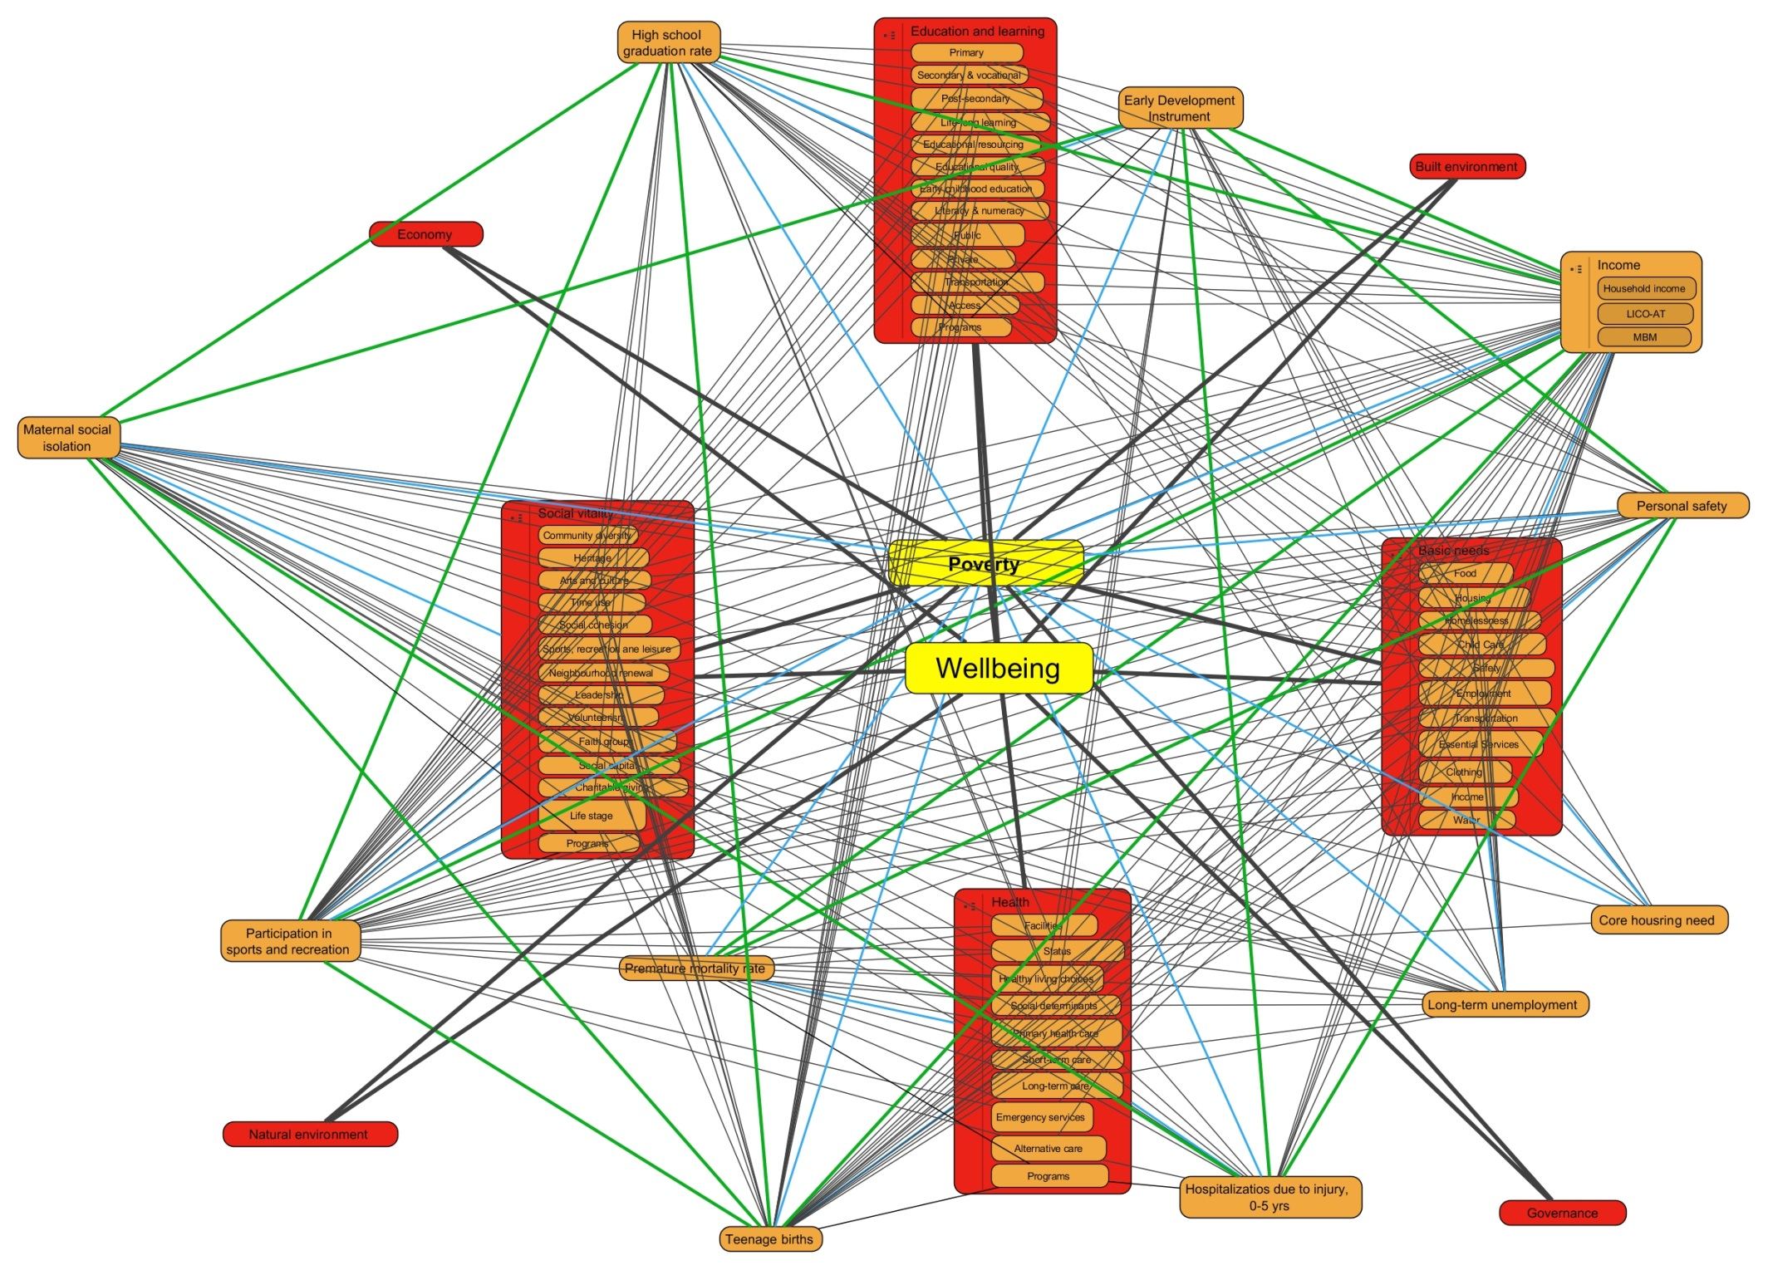
Notes:
Underlying connections. This does not include stories.

Slide 15
Unemployment & disability
Household income
LICO-AT
Long-term unemployment
Premature Mortality Rate (PMR)
MBM
Basic needs
Teen birth rate
Personal safety
Health
Hospitalizations due
to injuries in years 0-5
Core housing need
Poverty
Maternal social isolation
Participation in sports/recreation
EDI
Education and learning
Social vitality
High school graduation rate
Notes:
The way it is visualized is more like this. Several indicators belong to multiple themes. All indicators are related to poverty.

Slide 16
DEMO www.mypeg.ca

Slide 17
Questions of Clarification

Slide 18
Going Forward
Taking action
Benchmarks
Embrace an indicator
Community compacts
Notes:
When we think of where Peg is going and how it will impact the city, we look to other CIS to see how they are being used. One of the key sites that is well developed is the Truckee Meadows, Nevada site. Here are some of the ways a CIS can be used to enhance the community and its wellbeing.

Slide 19
Going Forward: Benchmarks
Use the system to determine benchmarks and whether we’re improving or not
Use the system to strategically plan, set performance goals, determine whether actions need to change

Slide 20

Going Forward: Embrace an Indicator
A way for individuals and small groups to contribute to the city’s well-being
1. Choose an indicator(s) 2. Make a plan 3. Log your progress and track your outcomes 4. Celebrate your success

Slide 21
Going Forward: Community Compacts
Grew out of the adopt-an-indicator system
Brings together unlikely groups through collaboration, outreach and community compacts. Community Compacts are formal, voluntary agreements between the CIS and one or more organizations, individuals, businesses and/or local government that work together to measurably improve performance on targeted indicators.
Notes:
Truckee Meadows Tomorrow (TMT) brings together unlikely groups through collaboration, outreach and community compacts. Quality of Life Compacts are formal, voluntary agreements between TMT and one or more organizations, individuals, businesses, and/or local governmental entities that work together to measurably improve performance on targeted quality of life indicators.
Criteria used when TMT plans a compact include that it will:
* Be of general community benefit * Have a high probability of success * Be visible, tangible and measurable * Have a defined timeline for measurable success and reporting * Provide opportunities for individual and group involvement * Provide for stewardship following the compact agreement

Slide 22
Going Forward: Community Compacts
Completed Compacts:
Natural environment
Open space
Parental involvement
Community-wide indicators
Voter turnout
Quality of life

Slide 23
Going Forward: Community Compacts
Example: Quality-of-Life Compact
Air quality – 90% alternative new fuels
Energy conservation – 21% energy + 14% $
Waste reduction – 20% recycling rate
Water conservation/quality – 10-15% usage
Mentor new compacts

Slide 24
Going Forward: Next Steps
All theme areas completed over 3 years
Key performance indicators for Peg
Super-users
Enhanced website
Further community engagement

Slide 25

Questions / Discussion

