Slide 1

Highlights ‘11-’12
Elisabeth Kosters – CCCESD meeting
October 25, 2012

Slide 2


IGC2020 Bid
Bid was presented at the IGC in Brisbane
Bid committee chaired by CFES past president Bill Mercer.
Bid Committee representative of CFES constituency
Generous support from Canadian Geological Foundation, NRCan, Tourism Vancouver.
The only competitor, India, won
Evaluation carried out → Report to CFES Council.
CFES Council will decide whether to attempt bid for IGC2024.

Slide 3
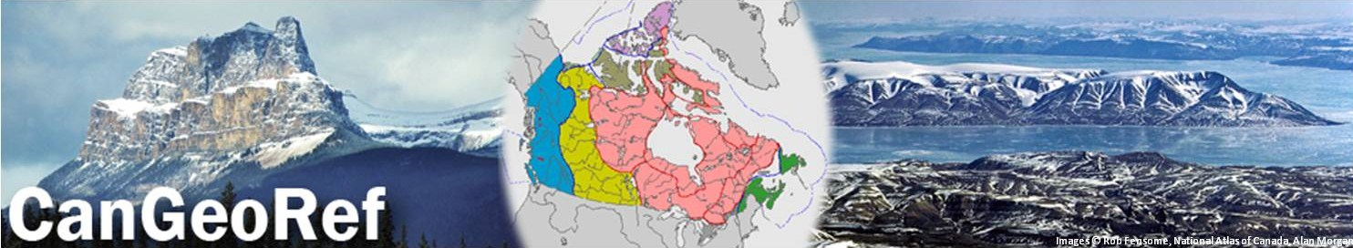
CanGeoRef launched September 2011, currently ca. 210,000 references. BC updated last week, NL close. Details: www.geoscience.ca/cangeoref - narrated ppt!
Marketing tour (EK) concentrated on Provincial Geological Survey Open Houses:
NS, NB, ON, MB (Fall ‘11)
Roundup (Jan. ‘12)
Calgary (April ‘12)
Sales below expectations so far
evaluation year 1 (with AGI)
explore marketing through EBSCO / ProQuest (in progress)

Slide 4
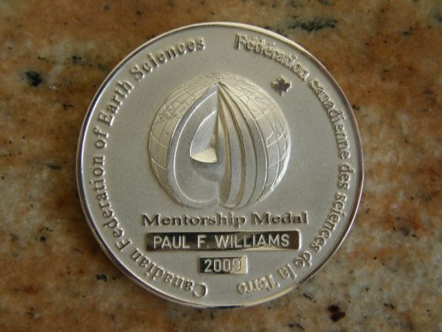
For Canadian geoscientists & the public
Mentorship Medal
Otto van Breemen, 4th mentorship medal
Nominate someone! www.geoscience.ca/awards
Outreach:
Careers website: videos uploaded
“Four Billion Years and Counting”: nearing completion
Geoparks
Committee continues to work with 5 communities that have expressed interest. Long, involved process, requires local funding, community support. Economic drivers crucial

Slide 5
National and International linkages
AGI
CFES became AGI International Associate
Presence at AGI Council meeting through CFES-AGI Liaison: Brian Pratt (U Sask) and John Hogg (MGM Energy, Calgary)
PAGSE
New representative: Chris Burn (Carleton, Geography)
SMCC
Continue to provide feedback for journalists seeking geoscience experts: building roster at SMCC

Slide 6


The View from Canada: Graduation, Retention, and Job Market Needs in the Earth Sciences AGI-CFES joint session at AGU, 2011
immediate reason for session: Earth Science degree program retention rates in the US appear to be much lower than in Canada
Rob Raeside, Elisabeth Kosters
with help from
Dave Eaton (AGU) and Greg Dipple (4IPGC)

Slide 7
Conclusions Comparing the US and Canada
Similar:
Degree requirements
Gender balance
Different:
course-based field training vs. summer field camp
Job entry qualifications
Retention rates
Anticipated shortages in Canada will cause economic havoc without recruitment of new Canadians

Slide 8
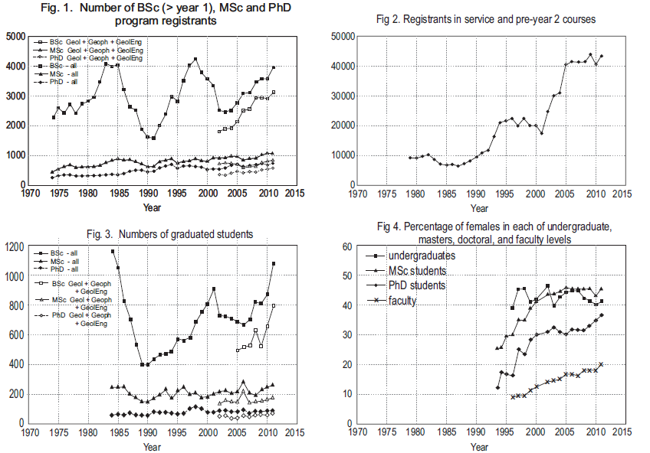
Why recruitment of new Canadians?
Retention >85%
Girl gain and/or boy loss?

Slide 9
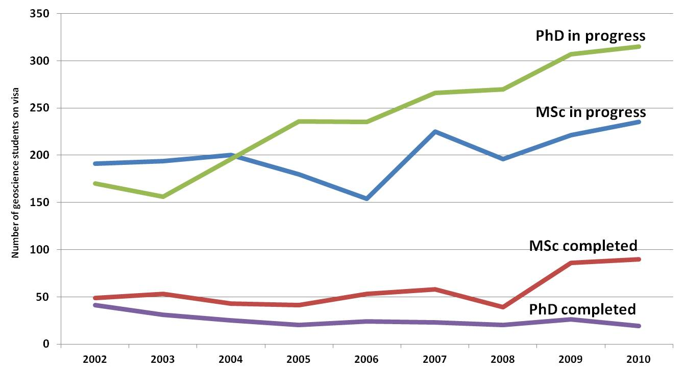
Students on visa, CCCESD participating departments

Slide 10
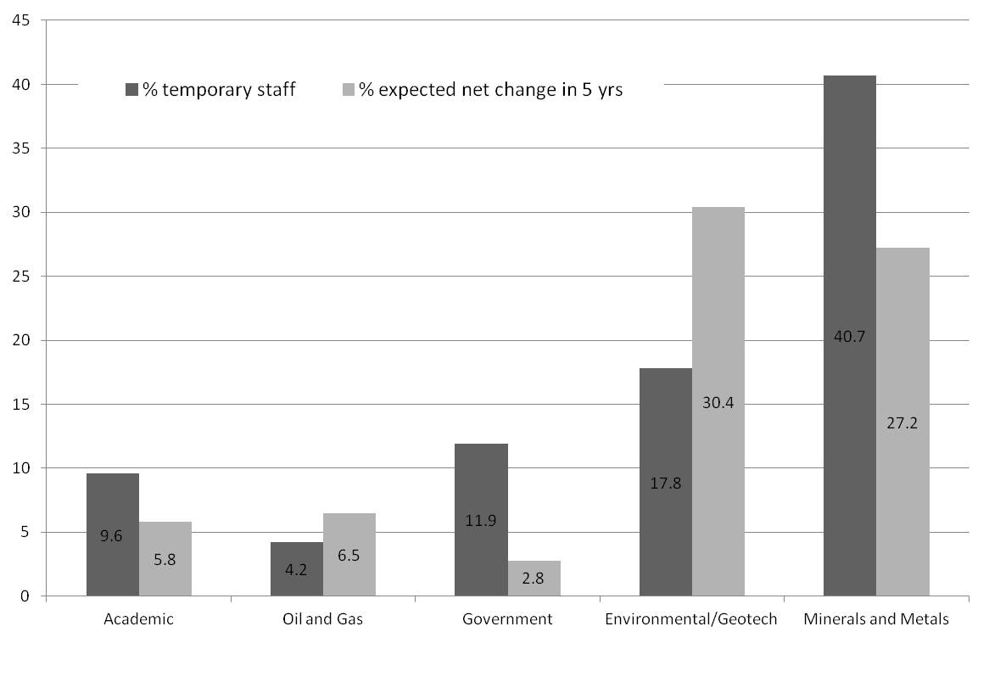
CFES industry survey ‘07-’08
% temporary staff
% expected change in personnel in 5 years
New Canadians occupy 20% of Canadian workforce, but only 7% of mining workforce
Academia
Oil and Gas
Govʹt
Env - Geotech
Minerals
7% aboriginals

Slide 11
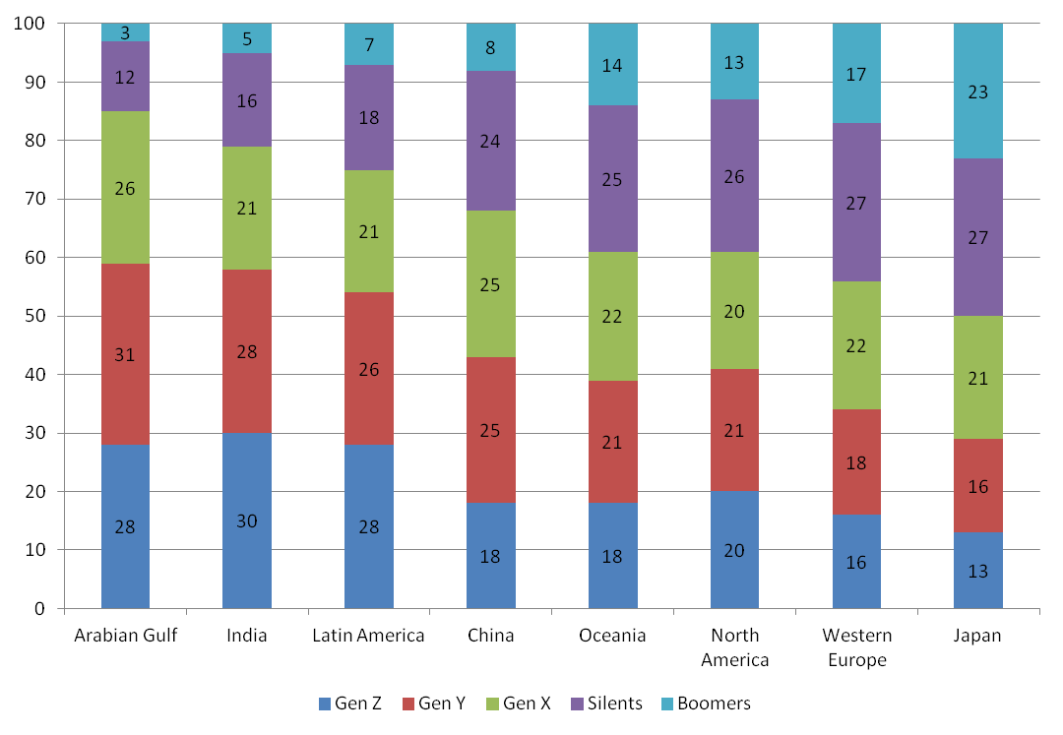
Gen X, Y, Z – the future
born
`46-`61
`61-`79
`80-`95
`95-ʹ10
McCrindle, 2009

Slide 12
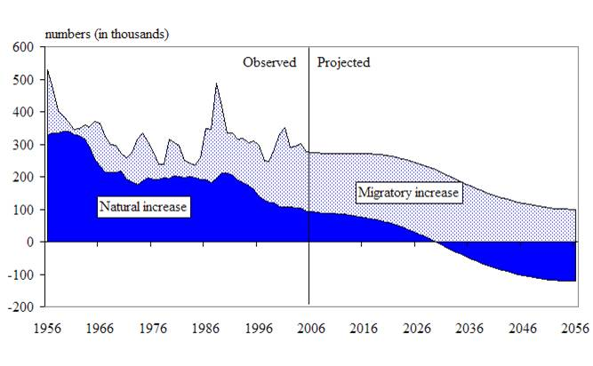
projected increase in Canadian population
Statistics Canada 2006

Slide 13
Recommendation
The Canadian geoscience community should embark on developing a nationally coordinated strategy to increase recruitment from non-traditional talent pools into earth sciences

