Slide 1
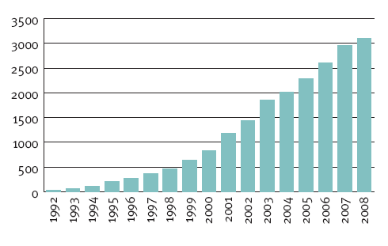
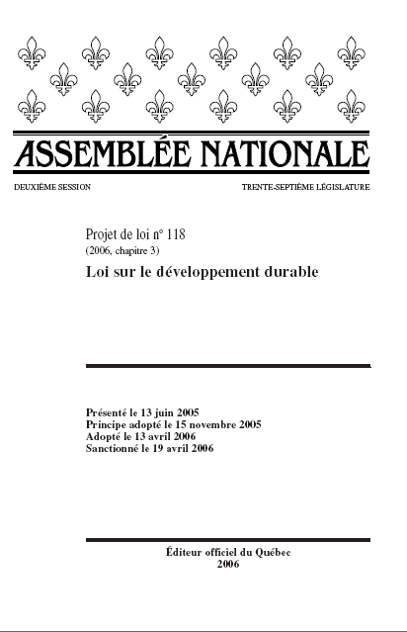
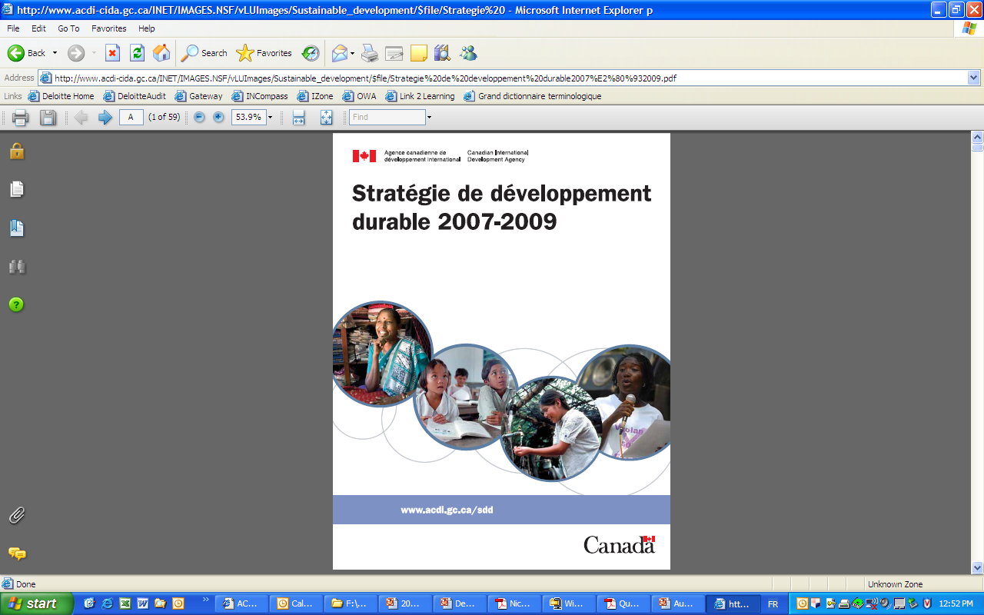
Sustainability information disclosure
Sustainability information disclosure in various ways: sustainability report, MD&A, annual report, website, product sale sheets, etc.
Over 3100 sustainability reports have been published worldwide in 2008
Global Sustainability Report output per year
Disclosure requirements for public departments:
Source : CorporateRegister.com, The CR Reporting Awards 2008, Global Winners & Reporting Trends, 2009, QC SD law , CIDA website

Slide 2
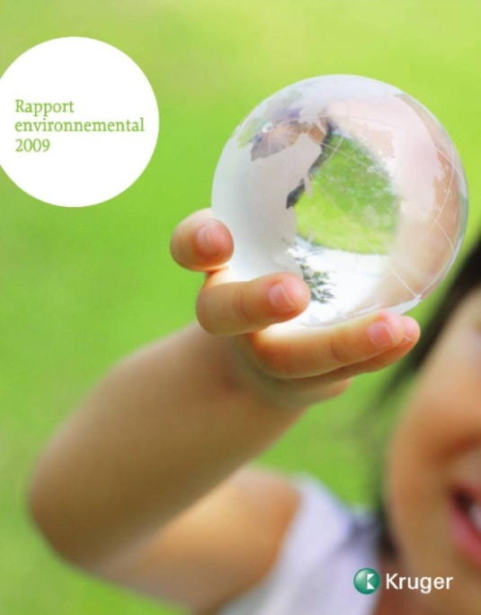

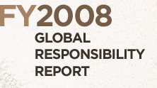







Sustainability reporting How to meet various stakeholders’ expectations?
Stakeholders (readers)
Organizations’ sustainability reports
Expectations
Shareholders / investors
Accessible
Suppliers / clients
Customizable
Story – common thread
Employees
Relevance - materiality
Media & NGOs
Comparability (use standards)
Governments
Interactive
Consumers / general public
Accountability

Slide 3
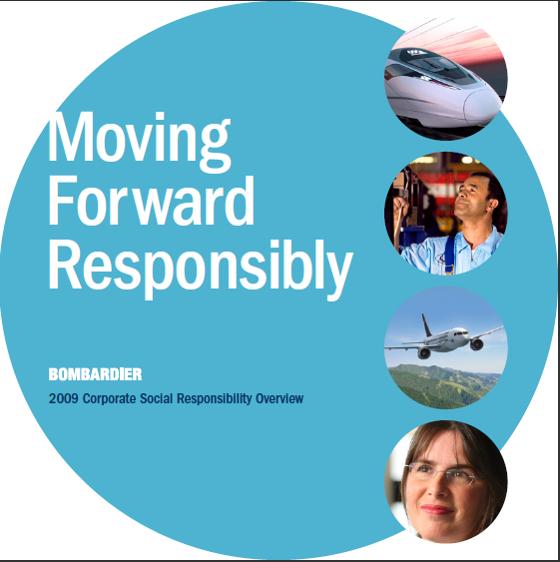

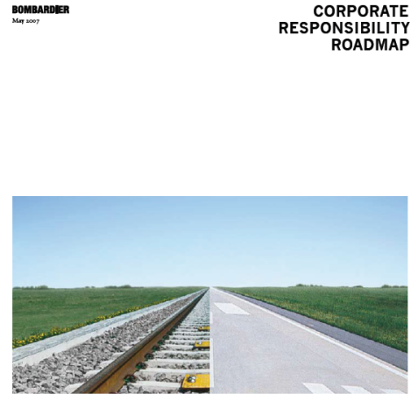
Case study - Bombardier
2007 2008 2009

Slide 4
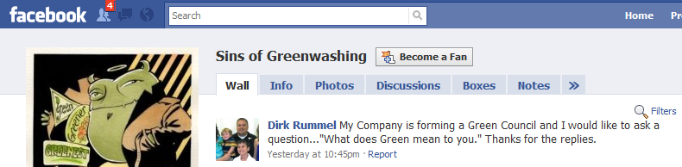
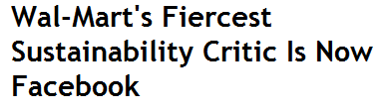
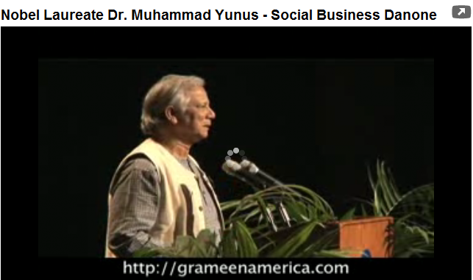





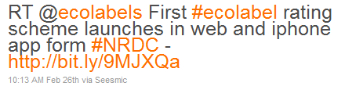
Social media and sustainability
Blogs
Notes:
Use of social and viral marketing for CR communications:
Utilizing social communication tools to exponentially propagate a message or campaign via grassroots user networks (e.g., Facebook group, twitter)
Makes it easier for companies and stakeholders to engage in meaningful dialogue
e.g., The Friends of David Suzuki Facebook Group automatically updates the entire friends network of a new joiner; these friends then also have the option to join the discussion
Makes it easier to track and report their impacts on the environment and society more broadly, e.g., company wiki page
Makes it simpler for companies to collaborate with each other, with NGOs, government agencies, stakeholders and larger communities to solve problems

